Slide 1
Training: Microsoft Monitoring
Instrument Application with Azure Monitor Application Insights
Troubleshooting Using Microsoft Azure Portal
Instrument Solutions for Monitoring and Logging
Monitor Resources with Azure Monitor
Monitoring Microsoft Azure skill path
Query Azure Monitor Data with the Kusto Query Language
AZ-204: Developing Solutions for Microsoft Azure : Optimize and Monitor

Slide 2
Pluralsight Training: Google Monitoring
Logging, Monitoring and Observability in Google Cloud
Managing Logs, Errors and Application Performance Using Google Stackdriver
Managing Cloud Resources Using Google Stackdriver

Slide 3
Learning Materials: Microsoft
Microsoft Learning
Application Insights
Azure Monitor Alerts
Azure Dashboards
Azure Log Analytics
Kusto Query Language
Azure Insights Application Map
Azure Service Health
Application Insights availability
Azure Monitor VM insights
Azure Autoscaling
Microsoft Learning
Azure Monitor OpenTelemetry
Application Insights Profiler
Application Insights Smart detection
Application Insights AutoInstrumentation
Application Insights Funnels
Application Insights User Flows
Azure Workbooks
Application Insights Sampling
Azure Monitor Change Analysis

Slide 4
Learning Materials: Google
Introducing Stackdriver APM and Stackdriver Profiler
Cloud Trace (former Stackdriver Trace)
Cloud Logging API
Cloud Stackdriver Debugger
Stackdriver Profiler
Stackdriver Logging API

Slide 5
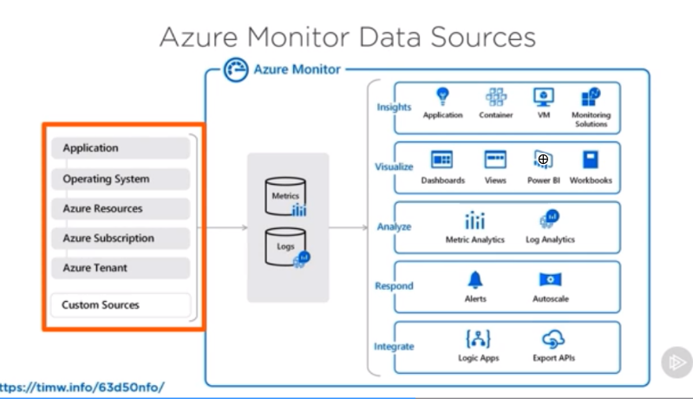
Big Picture

Slide 6
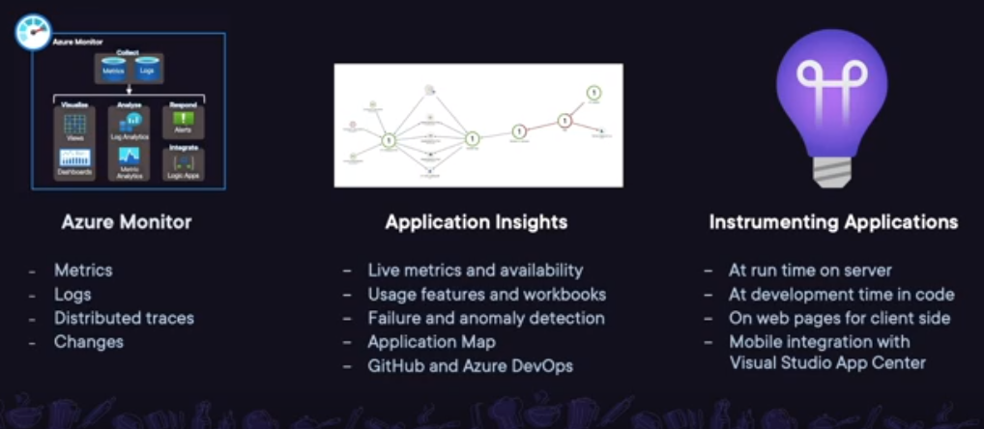
Big Picture

Slide 7
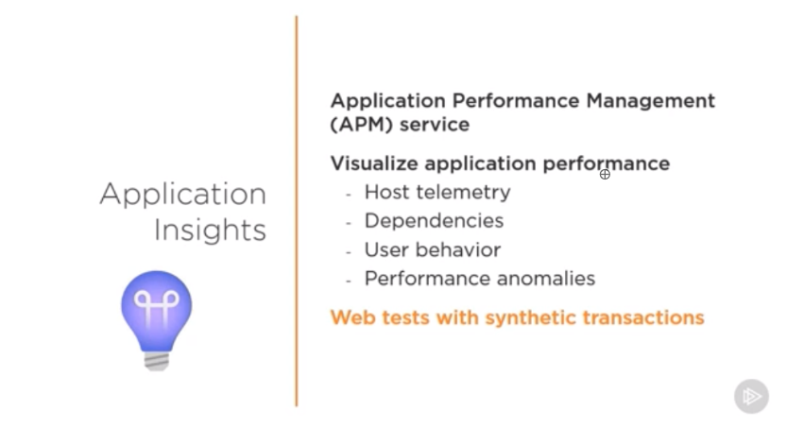
Application Insights

Slide 8
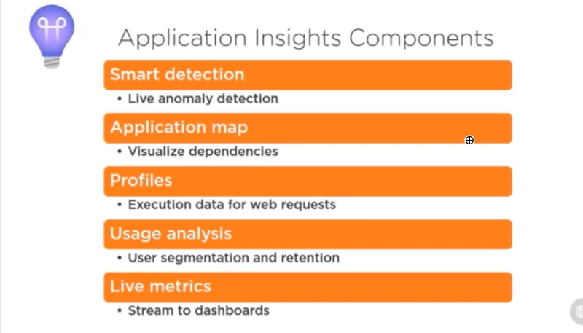
Application Insights Components

Slide 9
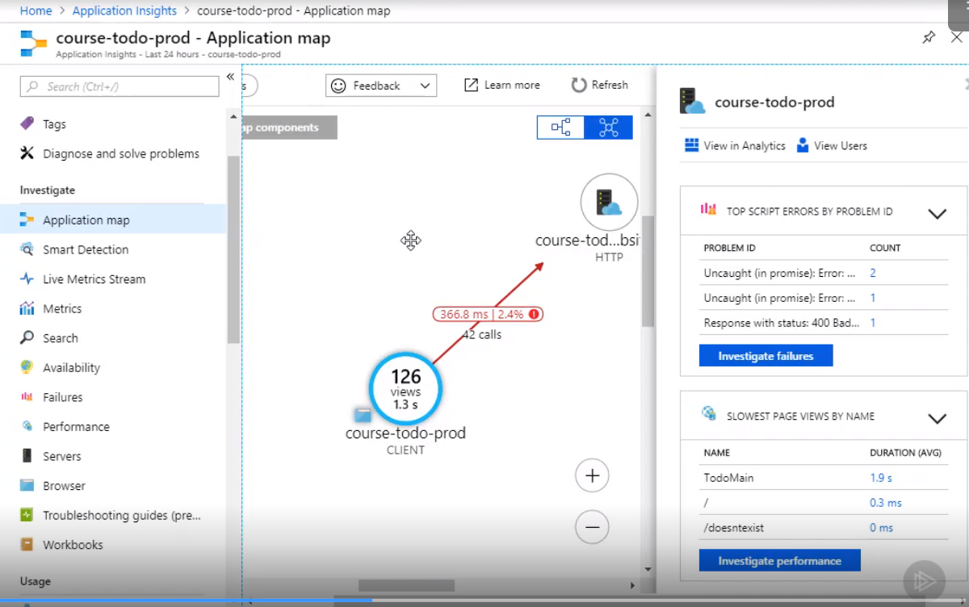
Application Map

Slide 10
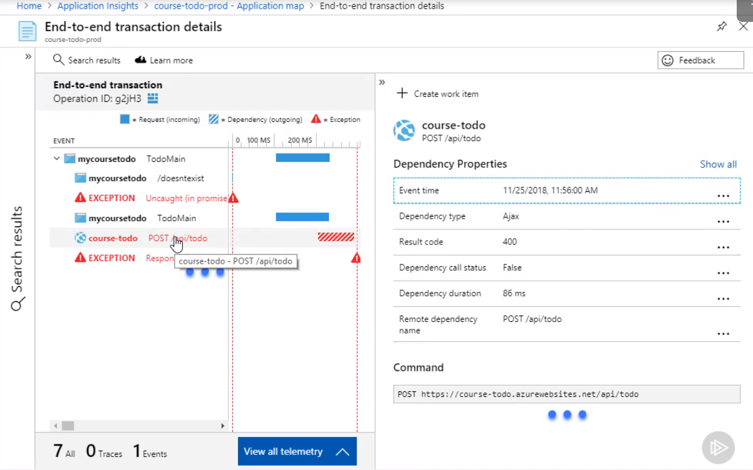
Transactions

Slide 11
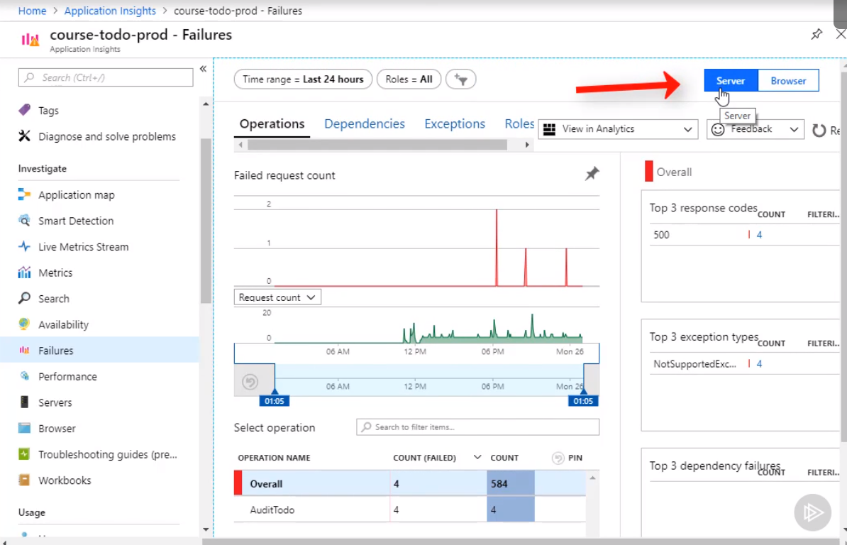
Distributed Tracing

Slide 12
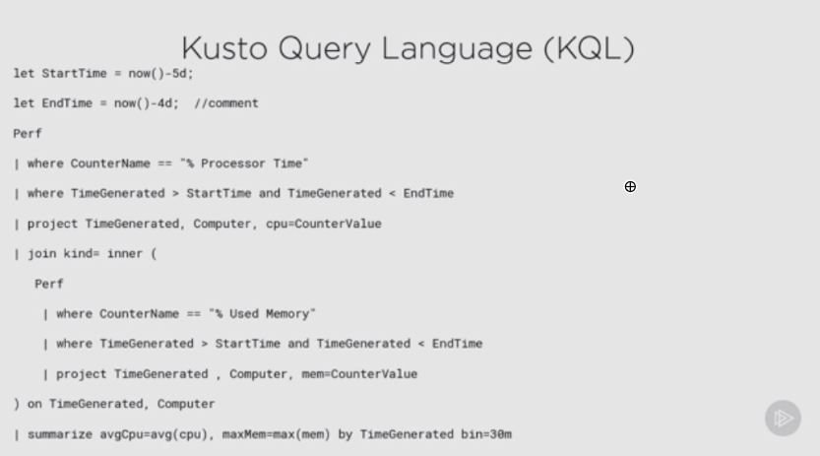
Querying with KQL

Slide 13
Querying with KQL
Kusto Query Language: Getting Started
Kusto Query Language: Beginning Operators
Kusto Query Language: Scalar Operators
Query Azure Monitor Data with the Kusto Query Language
Azure Data Explorer - Advanced KQL

Slide 14
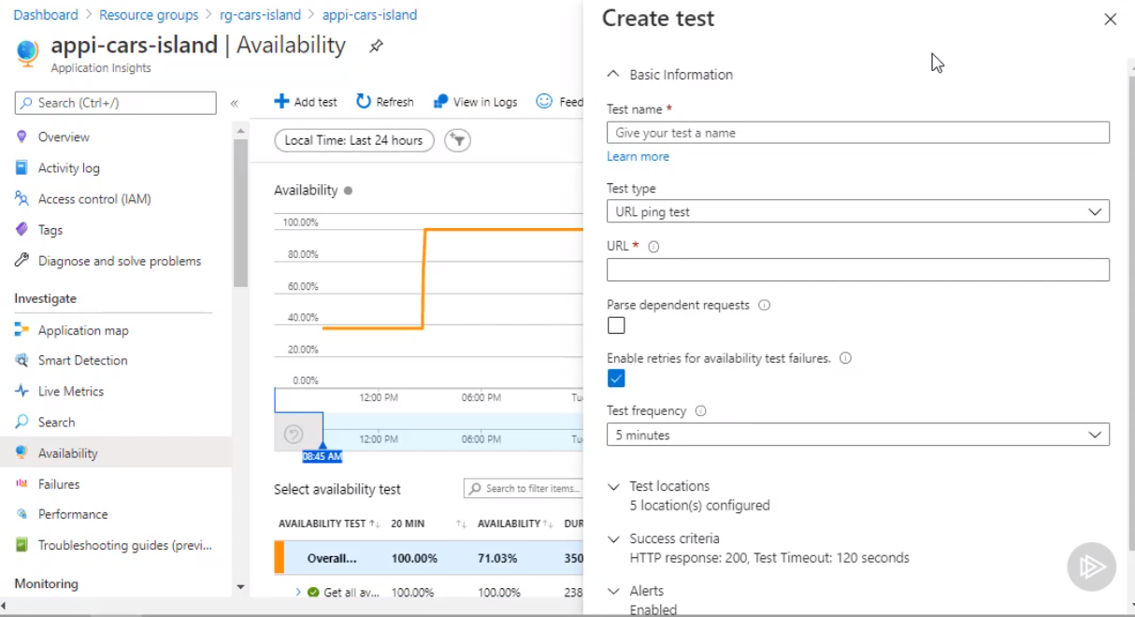
URL HTTP Ping and Multi Step Web App Availability Tests

Slide 15
Azure Shell Integration
Microsoft Azure Resource Providers Namespaces available by default in Azure CLI, Powershell and Cloud Shell (a Linux container with Microsoft Core PowerShell installed available in the browser) in PowerShell and bash mode:
Microsoft.Insights
Microsoft.KeyVault
Microsoft.Web
Microsoft.Storage

Slide 16
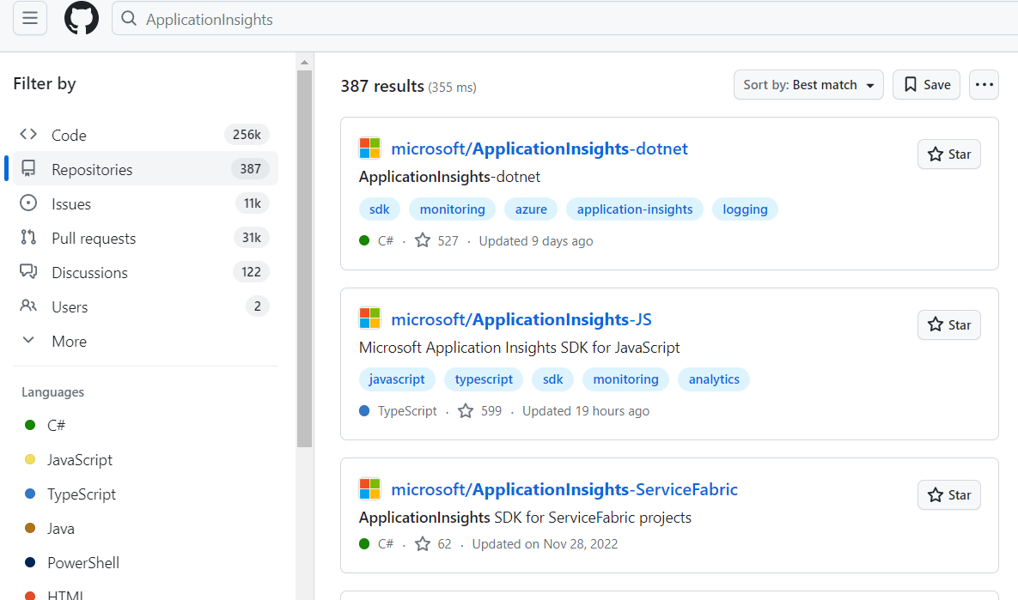
Public Github Projects

Slide 17
Public Github Projects - Azure
Publicly Released SDKs (Server, Client and Mobile), Utilities, Frameworks:
ApplicationInsights-dotnet
ApplicationInsights-JS
ApplicationInsights-Java
ApplicationInsights-node.js
ApplicationInsights-aspnetcore
ApplicationInsights-PHP
ApplicationInsights-Python
ApplicationInsights-Ruby
ApplicationInsights-Go
applicationinsights-angularplugin-js
applicationinsights-react-js
Applicationinsights-react-native
owner:microsoft ApplicationInsights = 40+ projects
ApplicationInsights = 340 projects
ApplicationInsights-iOS
ApplicationIn sights-Android
ApplicationInsights-Xamarin
opentelemetry-azure-monitor-js
ApplicationInsights-Kubernetes
ApplicationInsights-Docker

Slide 18
Public Github Projects - GCP
GoogleCloudPlatform repository:
snapshot-debugger
gke-tracing-demo
cloud-trace-java-instrumentation
healthcare-data-harmonization
cloud-logging-data-source-plugin
opentelemetry-operations-collector
Stackdriver-errors-js
stackdriver-metrics-export
search through 1.5k project titles, not very effective
cloud-profiler-python
cloud-profiler-java
cloud-trace-java
cloud-debug-java
cloud-debug-python
google-cloud-dotnet-debugger
opentelemetry-operations-python
opentelemetry-operations-js
opentelemetry-operations-go

Slide 19
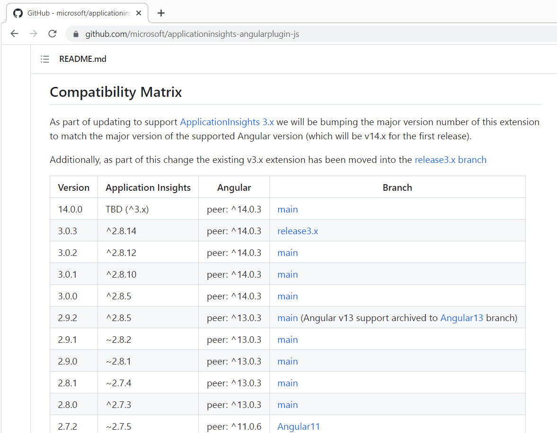
Releases and Compatibility

Slide 20
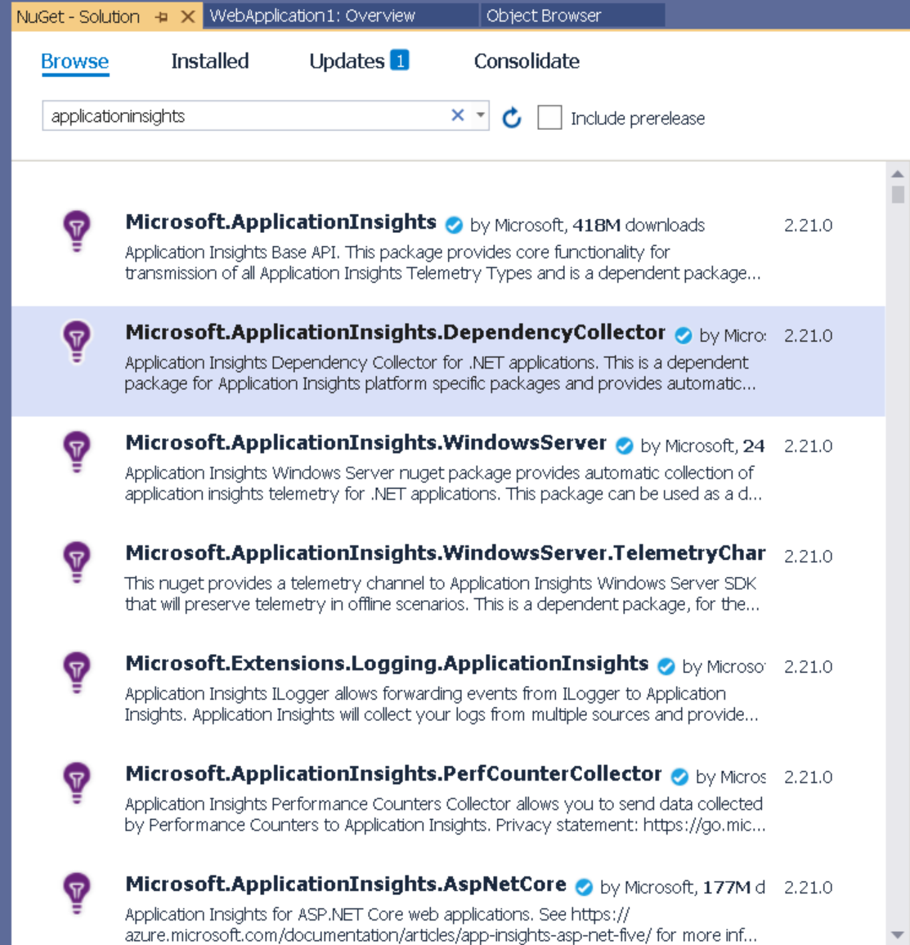
Visual Studio IDE

Slide 21







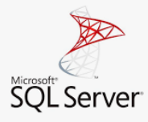
Non Cloud Products
Visual Studio Code
Android Studio
Visual Studio
Nuget
Firebase
Xamarin
Google Big Table
SQL Server

