Slide 1
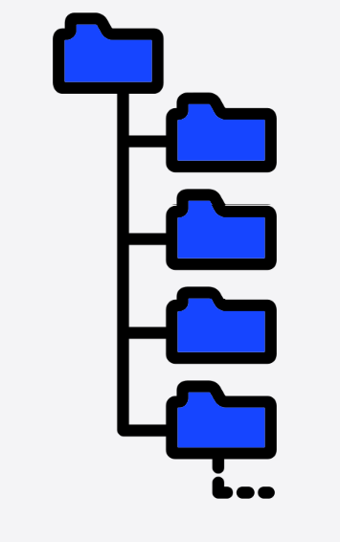

Timing
Config server
Config server
Config server
DB server

Slide 2

Timing
Config server
Cache server
DB server

Slide 3
Timing
Config server
Cache server
DB server
Config server
Cache server
DB server

Slide 4

Timing
Cache server
Cache server
DB server
Cache server
DB server

