Slide 1

A · FOUNDATIONS
M01
Platform Orientation & First App

Slide 2

M01 · PLATFORM ORIENTATION & FIRST APP
The 2 a.m. pet problem
A named server, patched and prayed over
It wedges; a human logs in
Restart by hand, hope it holds
Every box is unique and mourned
There has to be a better model
CONFIDENTIAL
1
Notes:
Open with the pain everyone recognizes. The old way to run the claims portal was a server somebody named and hand-nursed; when it broke at 2 a.m., a person fixed it. That server is a "pet." Set up the contrast the whole module pays off: what if the platform kept the app alive instead of you?

Slide 3

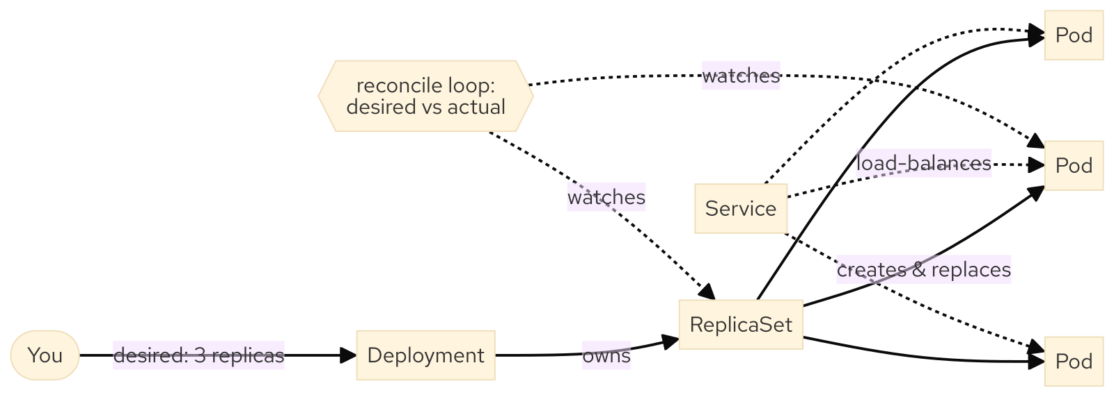
M01 · PLATFORM ORIENTATION & FIRST APP
Desired state — the one idea
You declare what you want
A control loop enforces it, forever
Pods run; Deployments own them
Services give a stable address
You stop operating Pods by hand
CONFIDENTIAL
2
Notes:
This is the concept the entire workshop rests on. You do not run Pods directly — you declare desired state on a Deployment ("three replicas of this image"), and the reconcile loop continuously makes actual match desired. Introduce the three objects at consumer depth: Pod (disposable unit), Deployment (desired state), Service (stable front door).

Slide 4
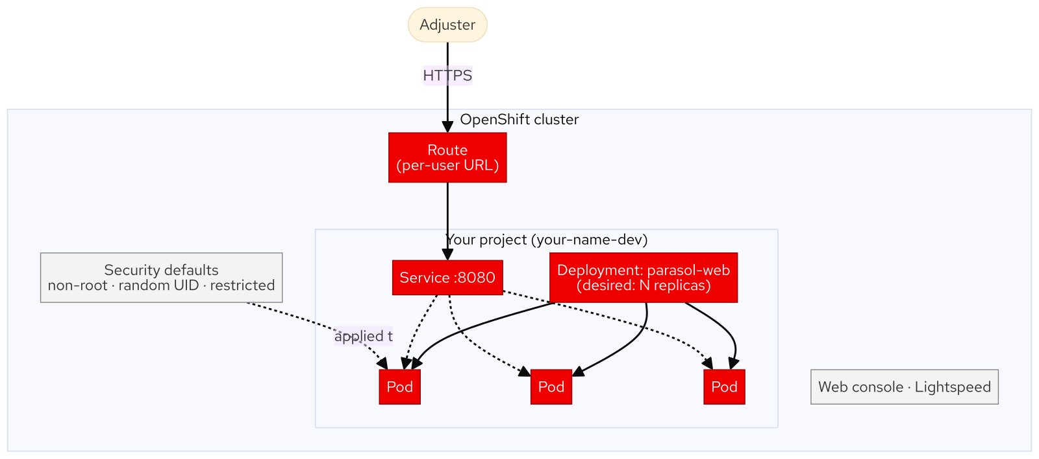
M01 · PLATFORM ORIENTATION & FIRST APP
What OpenShift adds over Kubernetes
Web console, Topology, developer catalog
Routes: a real URL, built in
Secure by default: non-root, random UID
Build to run to operate, one platform
Kubernetes is the engine; OpenShift the car
CONFIDENTIAL
3
Notes:
Kubernetes gives the object model and the reconcile loop. OpenShift adds what an organization needs on day one: the console and catalog, Routes for ingress without a load-balancer ticket, containers hardened automatically (non-root, random high UID, dropped capabilities), and an integrated build-run-operate workflow. Every lab step uses a Kubernetes primitive plus an OpenShift convenience.

Slide 5
M01 · PLATFORM ORIENTATION & FIRST APP
Self-healing, live
Three replicas, three worker nodes
Kill one Pod on purpose
ReplicaSet: SuccessfulCreate, in seconds
Service never stopped serving
Cattle, not pets
CONFIDENTIAL
4
Notes:
The signature moment. With three replicas spread across nodes, deleting a Pod is a routine event, not an incident: actual drops below desired, the ReplicaSet emits SuccessfulCreate, a replacement schedules, and the Service keeps routing to survivors the whole time. No human, no page, no downtime. This is desired state defending itself.

Slide 6
M01 · PLATFORM ORIENTATION & FIRST APP
What you'll do
Tour the unified console and terminal
Deploy the claims portal from an image
Scale to three; kill a Pod
Publish it with a Route
Ask Lightspeed why Pods restart
CONFIDENTIAL
5
Notes:
Set expectations for the hands-on. Attendees deploy Parasol's claims portal from a prebuilt image, scale it, watch self-healing, expose it at a URL, read logs and events, do the whole thing again in six oc commands, and finish by asking OpenShift Lightspeed a real operational question. Everything happens in their own project; nobody can affect anyone else.

Slide 7
M01 · PLATFORM ORIENTATION & FIRST APP
Map to your org — and when not
Which deploys are self-service vs ticket?
What dies when a VM dies?
Name three pets you still nurse
Don't run a database as a naive Deployment
A VM is sometimes still right
CONFIDENTIAL
6
Notes:
Land the transfer to their world and stay honest. Discussion prompts: what is self-service versus ticket-and-wait today; how long to recover a real service if its box vanished; where are your genuine pets. Then the credibility close — self-healing disposable workloads are the default, not always: stateful data, legacy appliances, and licensed VMs have their place, covered in later modules. Choosing is the skill.

Slide 8
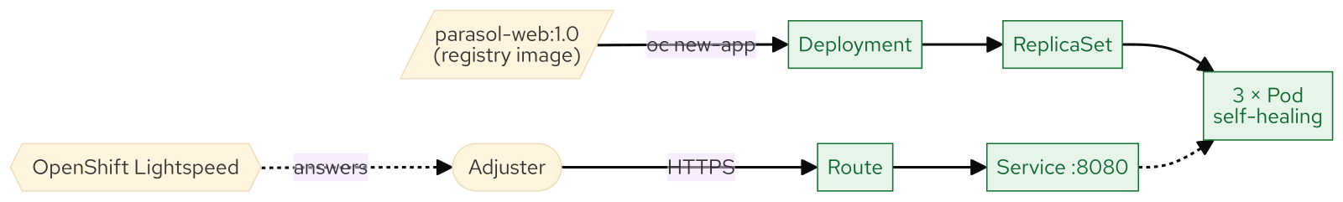
M01 · PLATFORM ORIENTATION & FIRST APP
What you built
CONFIDENTIAL
7
Notes:
Concept diagram: What you built.

