Slide 1

A · FOUNDATIONS
M02
Ways to Build & Deliver Apps

Slide 2

M02 · WAYS TO BUILD & DELIVER APPS
Here is some source code
The dev team hands you a Git repo
No image, no Dockerfile anywhere
It has to run on the platform
You could hand-write a build
Or let the platform do it
CONFIDENTIAL
1
Notes:
Open with the situation the module solves. Parasol's development team hands you the claims service as source code — a Quarkus repo in Git, no container image. In the first module you ran a prebuilt image; now you have to produce one. Set up the question the whole module answers: what is the right way to turn source into a running app, and why does OpenShift offer several?

Slide 3

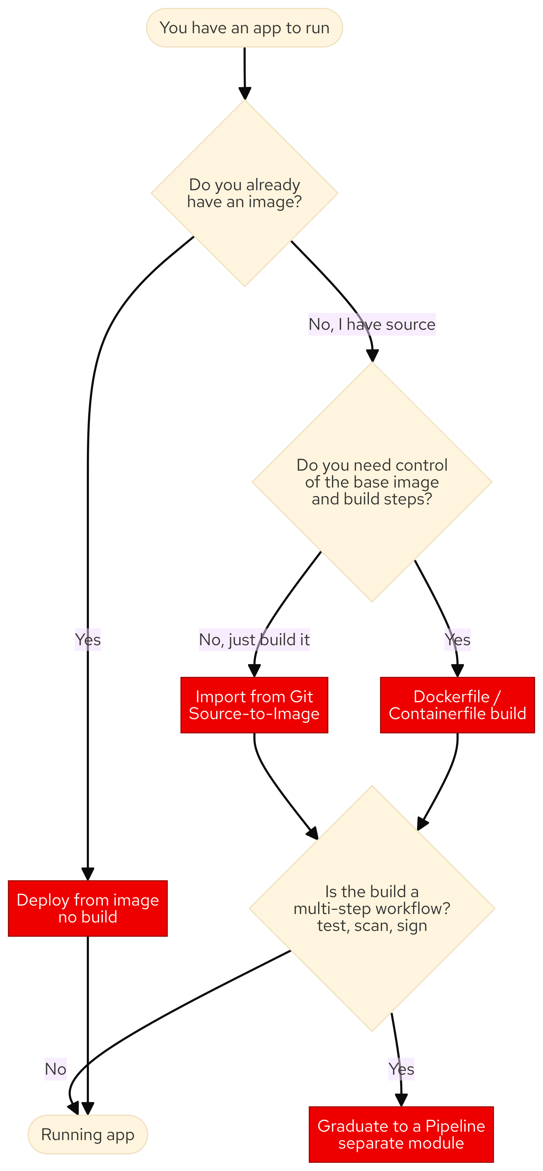
M02 · WAYS TO BUILD & DELIVER APPS
The build spectrum — four on-ramps
Deploy from image: no build
Import from Git: Source-to-Image
Dockerfile / Containerfile: full control
Pipeline: when build is a workflow
Match the on-ramp to the app
CONFIDENTIAL
2
Notes:
There is no single right way, because apps arrive in different shapes. Four on-ramps, from least to most control: deploy a prebuilt image (no build); import from Git and let Source-to-Image build it (no Dockerfile); build from a Dockerfile/Containerfile when you need control of the base image; graduate to a pipeline when the build is really test-scan-sign-deploy. The skill is choosing, not memorizing one path.

Slide 4
M02 · WAYS TO BUILD & DELIVER APPS
Source-to-Image — the paved road
Your source plus a builder image
Platform builds the image for you
No Dockerfile to write or patch
Works for Java, Node.js, Python
The right default for most services
CONFIDENTIAL
3
Notes:
S2I is the fast default. You supply source and pick a language builder image (the workshop's Java 21 builder for the claims service); the platform runs the build inside it and pushes a runnable image. You write zero Dockerfiles for the common case. The same on-ramp handles the polyglot notifications service in Node.js — one workflow, many languages. Reach past S2I only when you have a reason.

Slide 5
M02 · WAYS TO BUILD & DELIVER APPS
Where your image comes from
Every container starts from a base image
UBI: trusted, maintained, redistributable
registry.access: anonymous UBI pull
registry.redhat.io: authenticated, credentialed
Provenance is a security question
CONFIDENTIAL
4
Notes:
Where a base image comes from is the foundation of everything you ship and the first thing security asks. Red Hat's answer is the Universal Base Image — trusted, patched, freely redistributable — and the language builders are built on it. The two registries prove the point: registry.access hands out UBI anonymously; the fuller registry.redhat.io needs the cluster's pull secret. Starting from trusted content is how you answer "where did this come from?" before an auditor does. Also note: containers run as a random non-root UID, so images use a numeric USER and group-writable paths.

Slide 6
M02 · WAYS TO BUILD & DELIVER APPS
The catalog is the front door
One place: templates, samples, services
Curated by the platform team
Deploy a database without a ticket
Bad defaults are curated out
Someone chose what you see
CONFIDENTIAL
5
Notes:
Builder images, templates, and operator-backed services are surfaced in one place — the developer catalog, reached from +Add. It is where a developer answers "what can I deploy here?" without filing a ticket. It is curated: in the lab you deploy PostgreSQL from a Parasol template that exists because the stock templates ship an end-of-life engine on a deprecated workload type. Notice that someone chose the tiles in front of you — catalog governance is a later module.

Slide 7
M02 · WAYS TO BUILD & DELIVER APPS
What you'll do
Import claims from Git with S2I
Build the same app from its Containerfile
Import notifications — Node.js polyglot
Deploy PostgreSQL from the catalog
Wire it up; watch the app go live
CONFIDENTIAL
6
Notes:
Set expectations for the hands-on. Attendees build the claims service two ways (S2I and Dockerfile) and compare the BuildConfigs, import the notifications service in Node.js with the same S2I on-ramp, deploy a PostgreSQL database from the Parasol catalog, and wire the claims service to it — turning a crash-looping Pod into a running, database-backed API. Everything builds from their own Gitea fork, in their own project.

Slide 8
M02 · WAYS TO BUILD & DELIVER APPS
Map to your org — and when not
Count your Dockerfiles; how many needed?
Where do your base images come from?
Who curates your paved road?
Dockerfile only when you need control
Ephemeral DB is not production
CONFIDENTIAL
7
Notes:
Land the transfer and stay honest. Prompts: how many Dockerfiles do your teams maintain versus need; can you trace a production image to its base; is there a curated paved road or does every team reinvent it. The credibility close — S2I is the default, but the Dockerfile strategy earns its keep when you must pin a base image; a lone BuildConfig is not a pipeline; and the ephemeral database you deployed is deliberately not production. Choosing the right on-ramp is the skill.

Slide 9
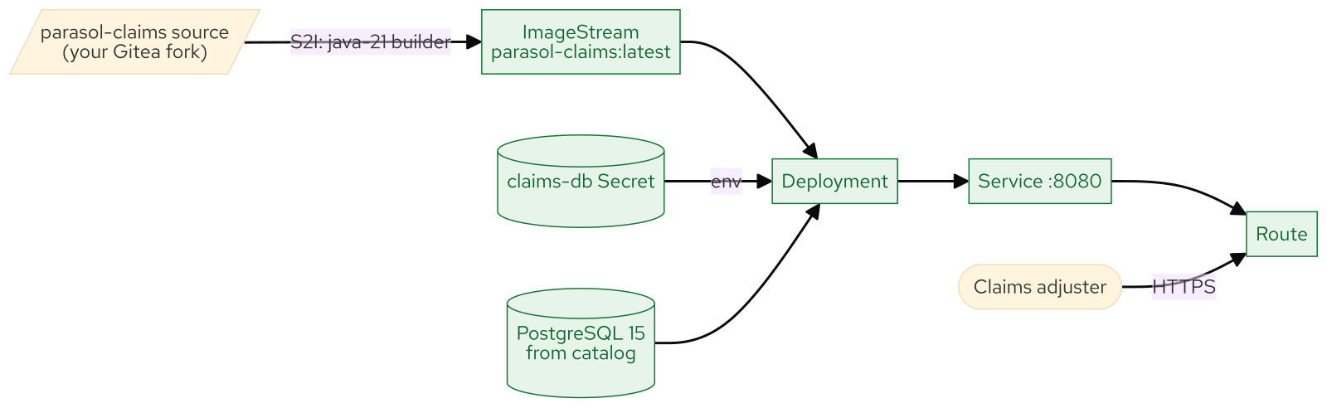
M02 · WAYS TO BUILD & DELIVER APPS
What you built
CONFIDENTIAL
8
Notes:
Concept diagram: What you built.

