Slide 1

A · FOUNDATIONS
M03
Dev Spaces & the Inner Loop

Slide 2

M03 · DEV SPACES & THE INNER LOOP
Day one, without the laptop marathon
New hire, first day on claims
The old way: install JDK, Maven, DB
Hours to days, and it rots
What if it were a link?
Productive today, not next week
CONFIDENTIAL
1
Notes:
Open with the pain everyone recognizes. Onboarding a developer usually means a checklist of local installs that takes hours to days and drifts out of sync with production. Set up the contrast the module pays off: a correct, running, database-connected environment from a single link. This is the "oh — that's it?" promise the lab delivers.

Slide 3

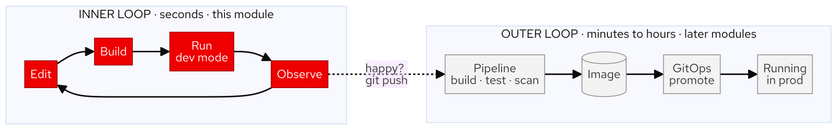
M03 · DEV SPACES & THE INNER LOOP
Two loops, two clocks
Inner loop: edit, run, observe — seconds
Outer loop: commit, pipeline, deploy — minutes
This module makes the inner loop fast
The push at the end starts the outer loop
The platform optimizes each differently
CONFIDENTIAL
2
Notes:
The core mental model. The inner loop is the seconds-scale edit-run-observe cycle you do dozens of times an hour; the outer loop is the minutes-to-hours build-test-deploy cycle about safety and repeatability. Dev Spaces is about making the inner loop fast without a laptop. The rest of the workshop is the outer loop, and it begins the moment they git push.

Slide 4
M03 · DEV SPACES & THE INNER LOOP
Why the IDE belongs in the cluster
Onboarding: a link, not a checklist
No more "works on my machine"
Code and data stay under cluster RBAC
The environment is reviewed like code
One perimeter, not a laptop fleet
CONFIDENTIAL
3
Notes:
Three problems laptops create, each solved by moving the inner loop into the cluster. Onboarding collapses to a click. Toolchain drift disappears because everyone — and the pipeline — uses the same pinned image. Governance gets one perimeter: code and data never leave the cluster onto a laptop that can be lost. Land that these are business costs, not developer conveniences.

Slide 5
M03 · DEV SPACES & THE INNER LOOP
The devfile — your workspace as code
One file in the repo defines the workspace
Components: the containers (JDK 21 + Maven)
Commands: named tasks, discoverable
Endpoints: ports the gateway publishes
Change the toolchain = a pull request
CONFIDENTIAL
4
Notes:
The devfile (devfile.yaml, schema 2.2.0) is the contract that makes a workspace reproducible for everyone. Introduce its three parts at consumer depth — components (containers), commands (named tasks), endpoints (published ports). The punchline: "upgrade everyone to JDK 21" is a one-line diff the pipeline and every developer inherit together, not a laptop-by-laptop chase. In the lab they edit this file to add a Valkey cache.

Slide 6
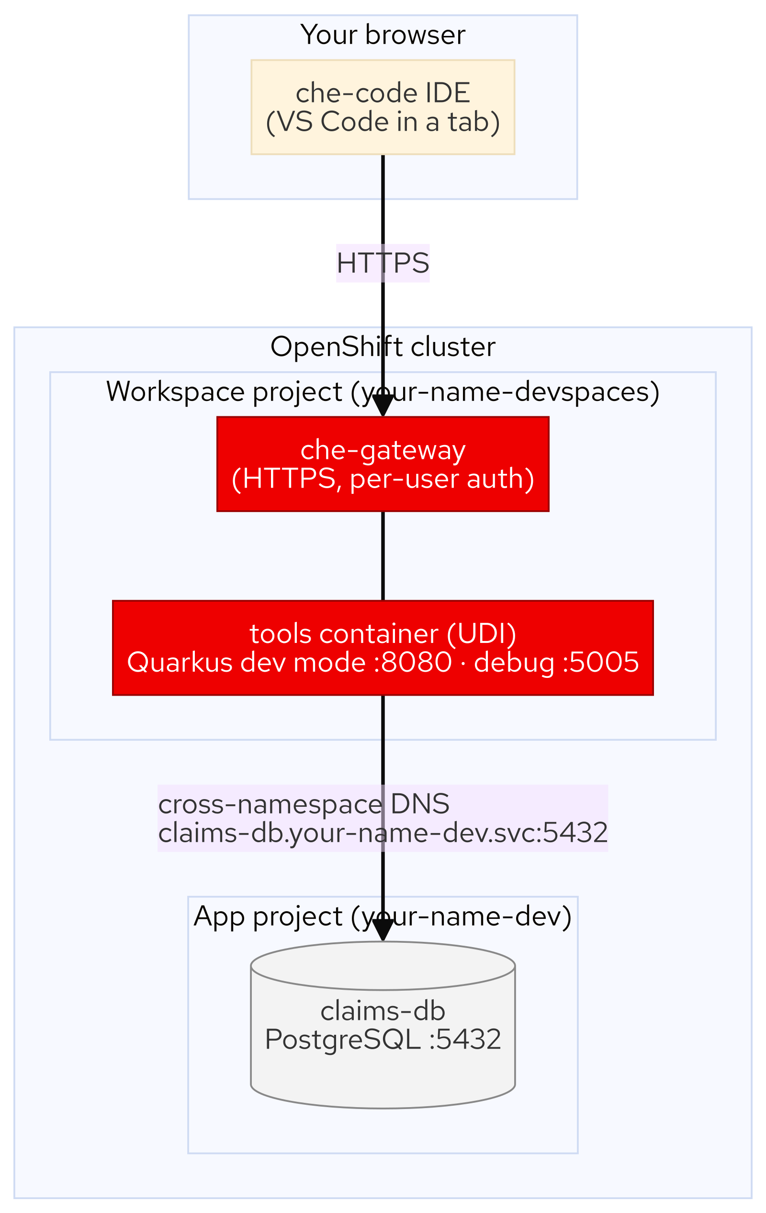
M03 · DEV SPACES & THE INNER LOOP
The workspace talks to real services
Workspace runs in your-name-devspaces
Database runs in your-name-dev
They meet by ordinary service DNS
Dev mode hot-reloads against the real DB
Debug port 5005 opens automatically
CONFIDENTIAL
5
Notes:
The workspace is a first-class citizen of the cluster network. Dev mode runs in the workspace project and reaches the real claims-db in the app project by cross-namespace DNS — exactly how one microservice finds another. Hot reload lands changes in ~2 seconds against real data, and a Java debug port opens automatically so you can step through a live request. This is what "fast inner loop, real services" means.

Slide 7
M03 · DEV SPACES & THE INNER LOOP
What you'll do
Open the claims service from a link
Run dev mode against the real database
Change an endpoint; watch it hot-reload
Add a Valkey cache to the devfile
Push, debug, port-forward, and ship a container
CONFIDENTIAL
6
Notes:
Set expectations for the hands-on. Attendees open a one-click workspace, wire dev mode to the in-cluster database (a deliberate break-and-fix), change a live endpoint with hot reload, extend the devfile with a Valkey sidecar and restart from it, push to their fork, attach a debugger to a running request, and finally reach past the workspace — port-forward the internal database and ship their pushed change as a running Deployment (the bridge to the outer loop). Everything is in their own projects.

Slide 8
M03 · DEV SPACES & THE INNER LOOP
Map to your org — and when not
Measure your real onboarding-to-first-PR time
Count the laptop fleet, and its drift
Not for air-gapped or local-hardware work
Heavy native toolchains may still be local
A workspace is for dev, not production
CONFIDENTIAL
7
Notes:
Land the transfer to their world and stay honest. Discussion prompts: how long from laptop-handover to first merged PR; what the laptop fleet costs in money and drift; where "works on my machine" still bites. Then the credibility close — in-cluster workspaces are a strong default for server-side work but wrong for air-gapped/offline, local-hardware-dependent, or very heavy native toolchains, and a workspace is a dev environment, not a place to run production.

Slide 9
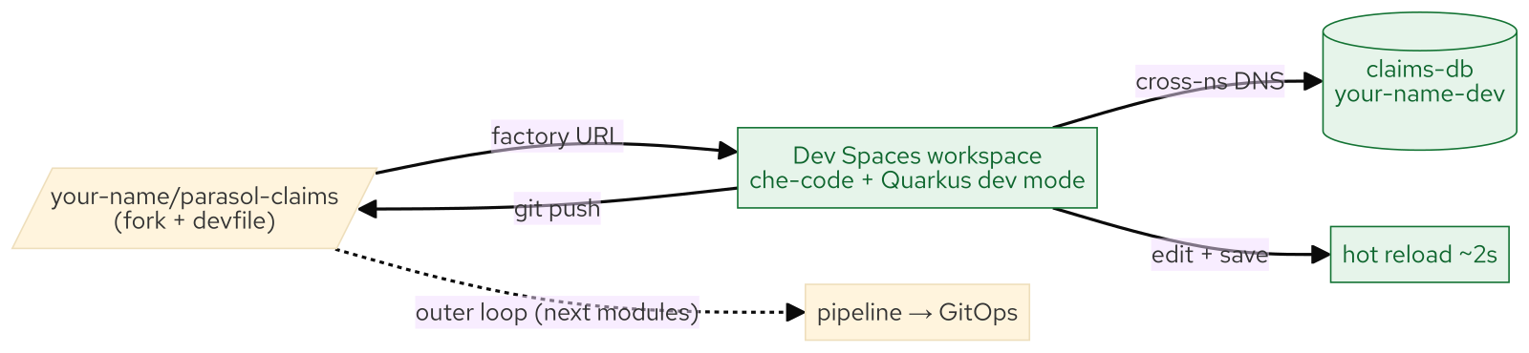
M03 · DEV SPACES & THE INNER LOOP
What you built
CONFIDENTIAL
8
Notes:
Concept diagram: What you built.

