Slide 1

A · FOUNDATIONS
M05
Storage & Stateful Apps

Slide 2

M05 · STORAGE & STATEFUL APPS
The database that was a time bomb
Parasol's claims DB ran all week
Its data lived in an emptyDir
One Pod restart wipes everything
Routine churn, total data loss
Persistence is the missing piece
CONFIDENTIAL
1
Notes:
Open with the stakes. The claims database has been running fine, but its storage is an emptyDir — a volume that belongs to the Pod and dies with it. The first node drain, upgrade, or crash destroys every claim. This is not an edge case; Pod churn is normal. The module is the difference between storage that dies with a Pod and storage that outlives it, and running databases on the platform honestly.

Slide 3

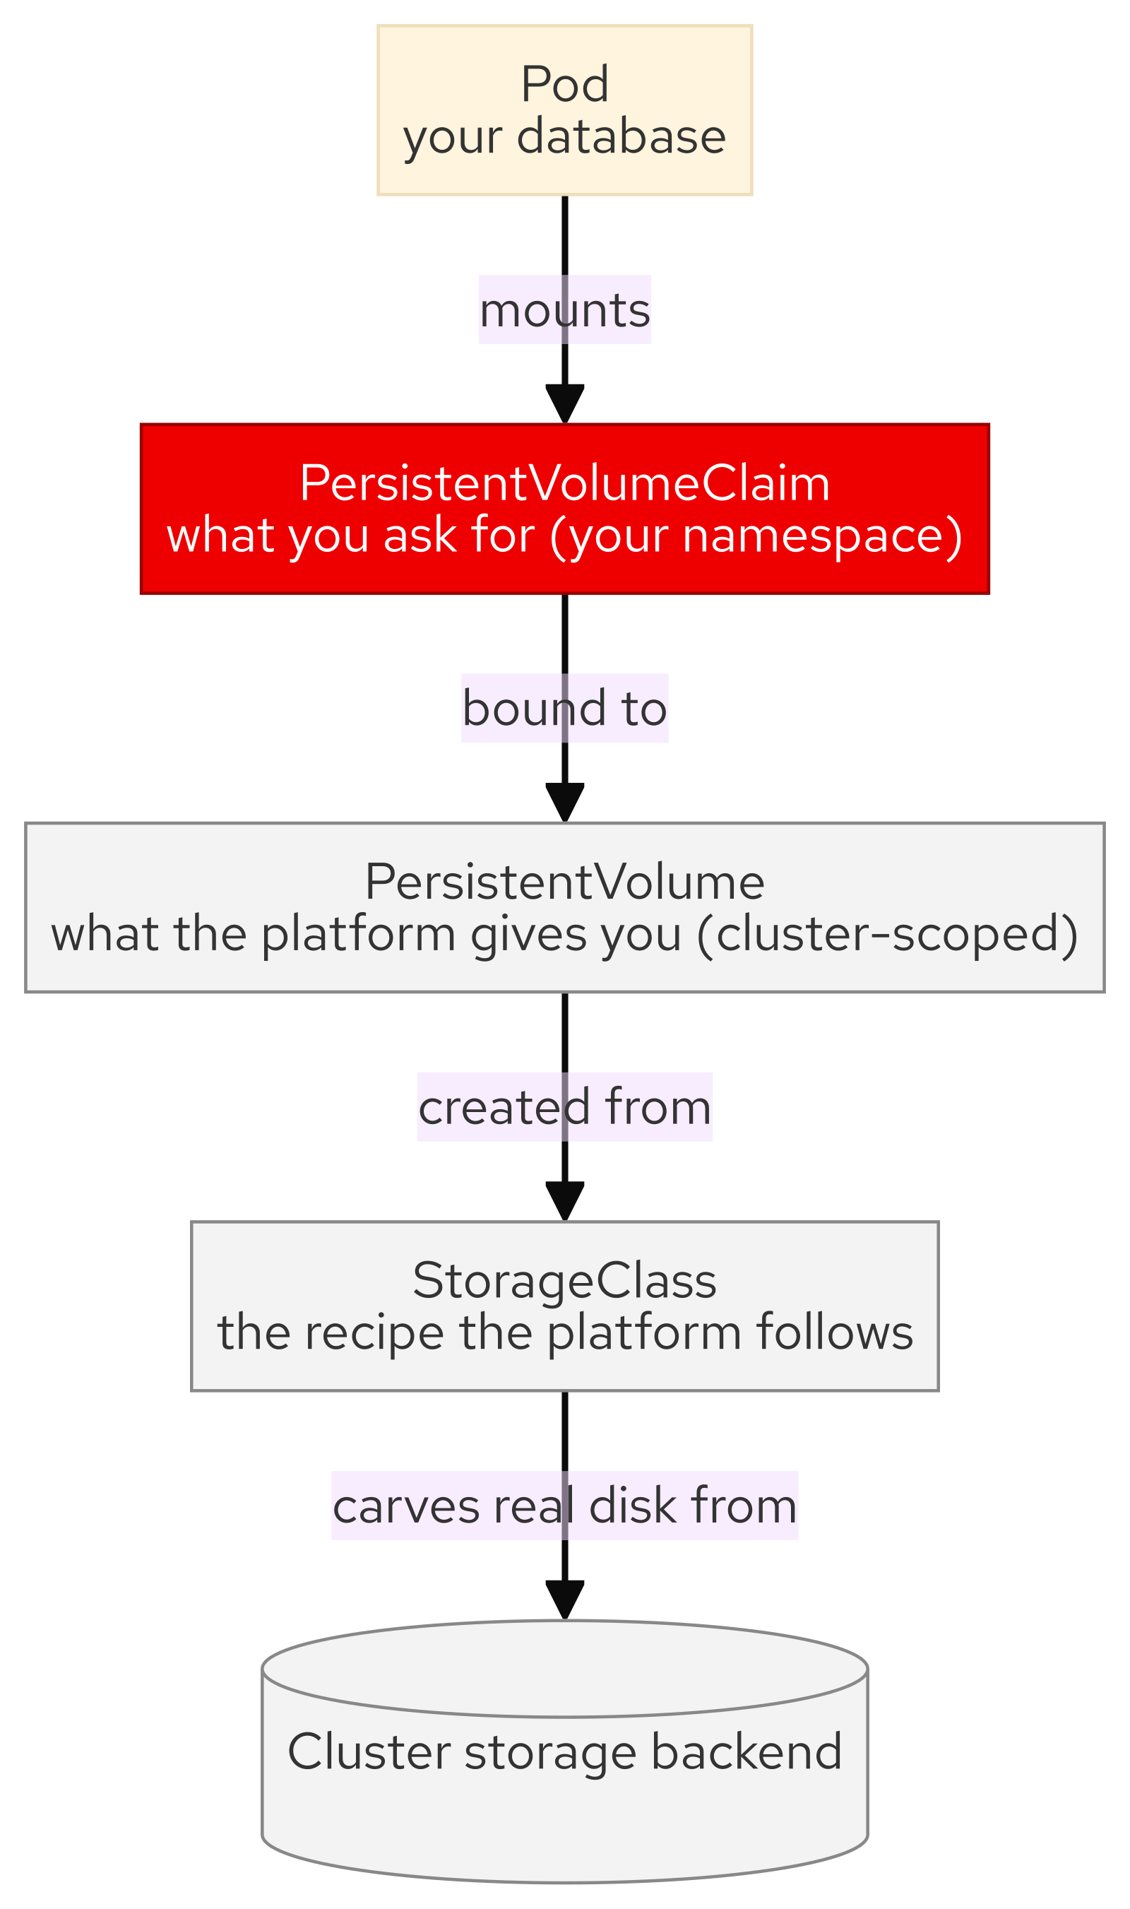
M05 · STORAGE & STATEFUL APPS
The storage abstraction chain
PVC: what your app asks for
PV: what the platform provisioned
StorageClass: the recipe it followed
Dynamic provisioning: request becomes disk
You write PVCs, never disks
CONFIDENTIAL
2
Notes:
The three objects and why the separation is the whole idea. A PersistentVolumeClaim is a request in your namespace ("2Gi, ReadWriteOnce"). A PersistentVolume is the actual storage the platform provisioned. A StorageClass is the rules it followed — provisioner, access modes, expansion, reclaim. Dynamic provisioning makes it a one-liner: submit a PVC and a matching PV is created and bound on demand. App teams ask; the platform provisions.

Slide 4
M05 · STORAGE & STATEFUL APPS
Ephemeral vs persistent is a property of
the volume
emptyDir: lives and dies with the Pod
PVC: outlives the Pod, cluster-managed
Same app, same DB, different volume
Change the volume, change the outcome
WaitForFirstConsumer: Pending is not broken
CONFIDENTIAL
3
Notes:
The core beat, and the one attendees feel in the lab. The same database Pod loses or keeps its data based only on what its data volume is — swap emptyDir for a PVC and a Pod restart stops being catastrophic. Also pre-empt the number-one confusion: a new PVC on a WaitForFirstConsumer class sits Pending until a Pod uses it, on purpose, so the disk lands near the Pod. Pending with no consumer is waiting, not failing.

Slide 5
M05 · STORAGE & STATEFUL APPS
Access modes — don't assume
RWO: one node writes at a time
RWX: many nodes write at once
ROX: many read-only mounts
Not every backend offers RWX
Read your StorageClasses, don't guess
CONFIDENTIAL
4
Notes:
Access modes, taught against reality instead of a single-cloud mental model. RWO (single-writer, right for a database) is universal; RWX (shared multi-writer files) exists on some backends and not others; ROX is niche. The rule: do not assume RWX exists — an app that quietly relies on shared volumes fails to schedule where the backend is block-only. On this cluster the default class is RWO and a separate file class offers RWX; you confirm which by reading the StorageClasses. RWX is the right tool for genuinely shared files (a scaled image registry, a shared content directory) and only a problem when it stands in for a database or an object store.

Slide 6
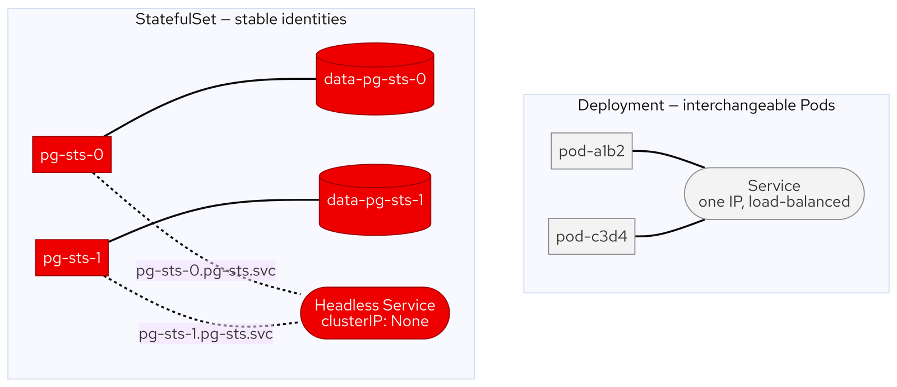
M05 · STORAGE & STATEFUL APPS
StatefulSet
identity and storage travel together
Stable names: pg-sts-0, pg-sts-1
Headless Service: per-Pod DNS
volumeClaimTemplate: one PVC per Pod
Ordered lifecycle, partitioned updates
Not automatically a replicated database
CONFIDENTIAL
5
Notes:
When identity matters, a Deployment's interchangeable Pods are wrong. A StatefulSet gives ordinal names that persist across restarts, a headless Service so each Pod has its own stable DNS name, and a volumeClaimTemplate so each Pod gets its own PVC — identity and storage stay bound together. Updates can be staged with a partition (canary one ordinal, then finish). Be honest: two replicas of PostgreSQL are two independent instances, not an HA database — real replication is an Operator's job. The StatefulSet is the plumbing.

Slide 7
M05 · STORAGE & STATEFUL APPS
What you'll do
Seed claims, then lose them (emptyDir)
Add a PVC; watch them survive
Walk PVC → PV → StorageClass
Run a StatefulSet: identity, DNS, per-Pod volumes
Partitioned update, init container, online resize
CONFIDENTIAL
6
Notes:
Set expectations for the hands-on. Attendees seed real claims, watch a Pod restart destroy them, swap the emptyDir for a PVC (a deliberate break-and-fix on the oc set volume command), and watch the same restart leave the data intact. Then they inspect the storage chain and access modes, run a two-replica PostgreSQL StatefulSet, stage a partitioned update to one member, migrate a schema with an init container, and grow a volume online — all in their own project.

Slide 8
M05 · STORAGE & STATEFUL APPS
Map to your org — and when not
Which of your "databases" are actually ephemeral?
Who owns backup and failover?
Run databases with an Operator (not a bare StatefulSet)
RWX: for shared files, not a DB substitute
Not every workload needs persistence
CONFIDENTIAL
7
Notes:
Land the transfer and stay honest. Discussion prompts: which dev/test datastores are secretly ephemeral; who restores your in-cluster data and when they last tested it; whether your StorageClass is a clean self-service contract. Then the credibility close — production databases run on the platform through Operators (EDB/CloudNativePG, CockroachDB, MongoDB, Couchbase) that own backup, failover, and upgrades, ideally in their own project; a bare StatefulSet is only the plumbing, and a managed service is the hands-off alternative. RWX is the right tool for genuinely shared files but a poor stand-in for a datastore or object store; and caches belong on emptyDir. Backup is its own capability (OADP, a later module).

Slide 9
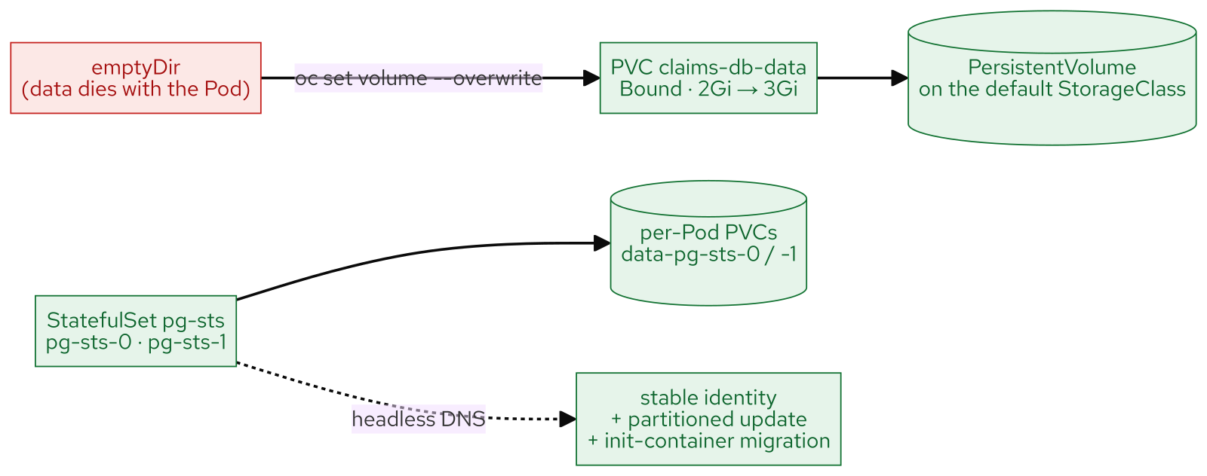
M05 · STORAGE & STATEFUL APPS
What you built
CONFIDENTIAL
8
Notes:
Concept diagram: What you built.

