Slide 1

A · FOUNDATIONS
M06
Jobs, Batch & Queued Workloads

Slide 2

M06 · JOBS, BATCH & QUEUED WORKLOADS
The overnight run that can take down the
cluster
Parasol runs API in milliseconds
And batch overnight: statements, fraud, rollups
Batch has quietly grown huge
One team's month-end starves everyone
Nothing arbitrates between jobs
CONFIDENTIAL
1
Notes:
Open with the stakes and the two speeds. Parasol answers customers in milliseconds through its API, but the real weight is the overnight batch tier — statements, fraud scoring, actuarial rollups over every open claim. That work has grown until a single team's month-end run can crowd every other job off the cluster, because plain Jobs have no arbitration: every job the scheduler can place, it runs. The module is about running batch well — Jobs and CronJobs for the work, and admission control so no team's batch starves the rest.

Slide 3

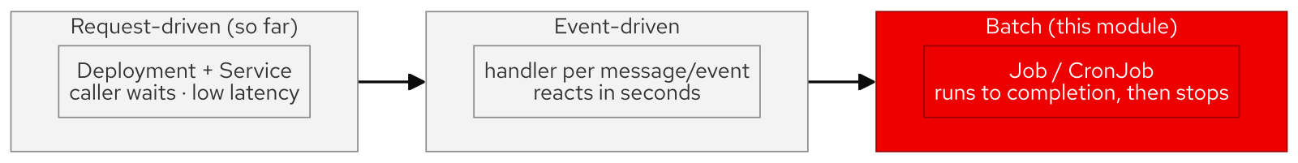
M06 · JOBS, BATCH & QUEUED WORKLOADS
The async spectrum — request, event, batch
Request-driven: caller waits, low latency
Event-driven: reacts per message, seconds
Batch: bounded work, runs then stops
You care it finishes, not its latency
The Job is the batch-tier object
CONFIDENTIAL
2
Notes:
Place batch on the spectrum so people pick the right tool. Request-driven work has a caller holding a socket — a Deployment behind a Service, measured in latency. Event-driven work reacts to a message or webhook within seconds. Batch is different in kind: a bounded body of work runs to completion and stops — "process all 40,000 claims" — and nobody waits on a connection; you care that it finishes, correctly, within a window. OpenShift's object for that end of the spectrum is the Job.

Slide 4
M06 · JOBS, BATCH & QUEUED WORKLOADS
The Job controller
runs to completion, then stops
completions + parallelism: how many, how parallel
backoffLimit: retries, then gives up
Indexed Job: shard by $JOB_COMPLETION_INDEX
CronJob: schedule, no-overlap, suspend
Pod template is immutable — batch lives in Git
CONFIDENTIAL
3
Notes:
The vocabulary that makes the rest legible. A Job runs Pods until a set number succeed, then stops — the opposite of a Deployment. `completions` and `parallelism` set how much and how parallel (6 completions, 3 at a time = two waves). `backoffLimit` retries a failure, with exponential backoff, then marks the Job failed. An Indexed Job hands each Pod a fixed index to shard a dataset with no coordinator. A CronJob wraps a Job on a schedule, with `concurrencyPolicy` to prevent overlap and `suspend` to pause. And a Job's Pod template is immutable — you delete and recreate, which is the platform telling you batch belongs in Git.

Slide 5
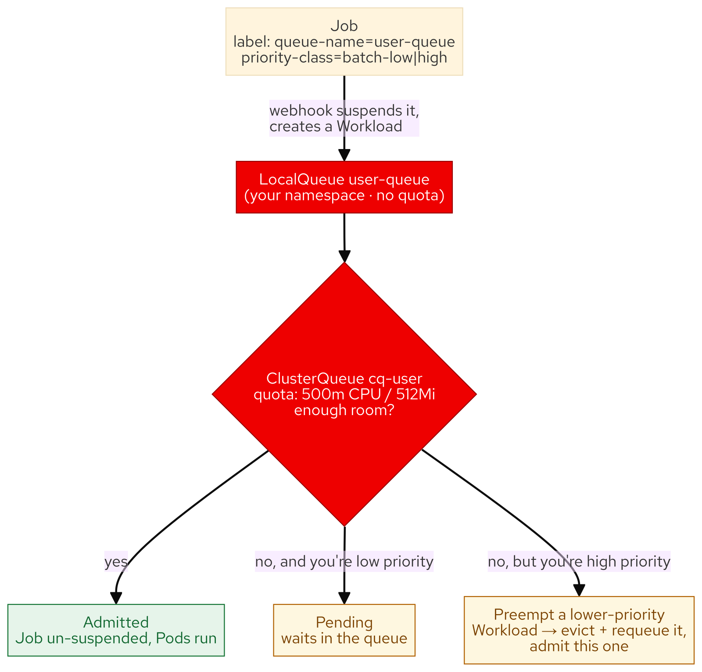
M06 · JOBS, BATCH & QUEUED WORKLOADS
Admission control with Kueue
ClusterQueue holds the quota
LocalQueue: your project's pointer in
Label a Job: queue-name → it's managed
Full queue: admit some, hold the rest
Higher priority preempts — evict + requeue
CONFIDENTIAL
4
Notes:
The heart of the module. Plain Jobs have no arbitration; Red Hat build of Kueue adds an admission layer above the Job controller. A ClusterQueue holds the quota (each attendee gets their own, so nobody starves anyone else); a LocalQueue is the namespaced pointer into it; a Job opts in with a `queue-name` label and Kueue holds it suspended until there is room. When the queue is full, some jobs are admitted and the rest wait — and a higher-priority job can preempt a running lower-priority one, evicting it back into the queue. You watch exactly this: five jobs, two admitted, three pending; one urgent job preempts a running one.

Slide 6
M06 · JOBS, BATCH & QUEUED WORKLOADS
AI batch is just batch
Inference/eval job reads, calls model, stops
Same queue-name label, same Workload
Admitted and preempted identically
GPU quotas: the same machinery
Adopt the control plane before the crunch
CONFIDENTIAL
5
Notes:
The payoff, and the line SAs remember. A batch-inference or model-evaluation job is an ordinary Job — it reads input, calls a model, writes output, stops. It carries the same `queue-name` label, becomes the same Workload, and is admitted, queued, and preempted by the same ClusterQueue as the statement run. That is why the industry is standardizing GPU scheduling on this exact machinery: a ClusterQueue can hold `nvidia.com/gpu` quota, and a high-priority eval job can preempt a low-priority training run. Everything learned on tiny CPU jobs is the control plane that governs AI batch at scale.

Slide 7
M06 · JOBS, BATCH & QUEUED WORKLOADS
What you'll do
Run a monthly-statement Job in waves
Break it, read the backoff, fix it
Shard the dataset with an Indexed Job
Schedule with a CronJob, then suspend
Watch Kueue admit, queue, and preempt — then AI batch
CONFIDENTIAL
6
Notes:
Set expectations for the hands-on, all in your own `{user}-batch` project. You run a monthly-statement Job over a seeded dataset and watch it complete in parallel waves; you break a Job on purpose and read its backoff, its `BackoffLimitExceeded`, and the immutability refusal; you shard the dataset with an Indexed Job; you schedule it with a CronJob and suspend it. Then the core: submit five jobs into a tiny Kueue quota and watch two admitted, three queued, then one high-priority job preempt a running one. Finish by running a fraud-scoring inference Job through the very same queue.

Slide 8
M06 · JOBS, BATCH & QUEUED WORKLOADS
Map to your org — and when not
Who owns the batch quota?
Which CronJobs can you name the owner of?
Where's your first GPU-contention fight?
Don't Kueue a three-job team
Don't cron what should be event-driven
CONFIDENTIAL
7
Notes:
Land the transfer and stay honest. Discussion prompts: who in your org decides how much of the cluster the batch tier may use and how teams share it; whether you can name the owner and concurrency policy of one production CronJob; where your first GPU-contention fight will happen and whether you would rather design that queue now or during the crunch. Then the credibility close on restraint: admission control earns its keep only under real contention — a three-job team on a cluster with headroom just needs a ResourceQuota; a CronJob polling every minute for an event is a queue-shaped problem wearing a schedule; and match the object to the lifecycle (runs forever → Deployment, runs once → Job).

Slide 9
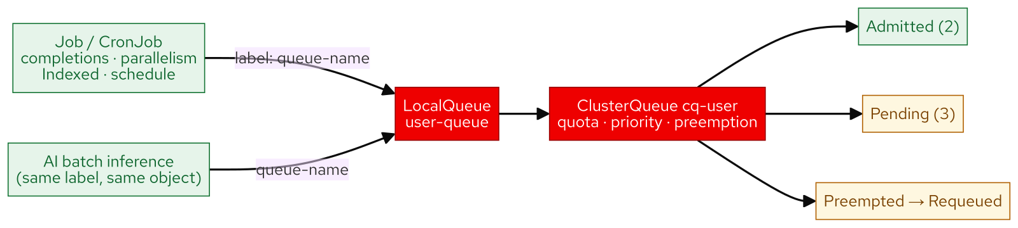
M06 · JOBS, BATCH & QUEUED WORKLOADS
What you built
CONFIDENTIAL
8
Notes:
Concept diagram: What you built.

