Slide 1

B · DELIVERY & TRUST
M07
Pipelines Fundamentals & Task Libraries

Slide 2

M07 · PIPELINES FUNDAMENTALS & TASK LIBRARIES
The build that lives in someone's shell
history
Parasol ships claims by hand today
Every engineer builds it slightly differently
No shared record of how, no gate
"How do we ship this?" → a stale wiki page
A pipeline makes it reviewed and repeatable
CONFIDENTIAL
1
Notes:
Open with the pain everyone recognizes. Parasol's claims service builds and deploys with commands people type by hand — which is fine for one person learning, and a liability for a team. There's no shared, current answer to "how is this service built and tested?"; it lives in shell history and a wiki page that went stale months ago, and nothing gates a broken change on its way out. The module turns that manual sequence into a pipeline — a versioned, repeatable build-test-deploy that any Git push can run — and starts the company task library that keeps every team's pipeline consistent.

Slide 3
M07 · PIPELINES FUNDAMENTALS & TASK LIBRARIES
Anatomy — Task, Pipeline, PipelineRun
Task: one reusable unit of work
Pipeline: an ordered graph of Tasks (the recipe)
PipelineRun: one execution (recipe meets reality)
Reusable via params, workspaces, results
Params in, files shared, facts out
CONFIDENTIAL
2
Notes:
Give people the vocabulary before anything else. A Task is a single reusable unit — clone, test, build, deploy. A Pipeline is an ordered graph of Tasks; it runs nothing itself, it's the recipe. A PipelineRun is one execution — you hand it parameter values and a workspace and it creates the Pods. What makes a Task reusable instead of a copy-pasted script is three typed connection points: parameters (typed inputs like the Git URL and image tag), workspaces (shared storage, usually a PVC, so one Task hands files to the next), and results (small typed outputs — a computed size, a verdict — that let later steps and humans act on a fact). The claims pipeline is exactly this: five Tasks, one workspace, four params, two results.

Slide 4
M07 · PIPELINES FUNDAMENTALS & TASK LIBRARIES
Three reuse layers
wired by the cluster resolver
Catalog Tasks: shipped, ~40, you never maintain
Org library: your platform team curates
App pipeline: the one thing that's yours
resolver: cluster — reference, don't copy
ClusterTask is gone (1.17); resolver replaced it
CONFIDENTIAL
3
Notes:
The best Task is one you didn't write. OpenShift Pipelines organizes reuse into three layers and your app pipeline pulls from all three: shipped catalog Tasks in the openshift-pipelines namespace (git-clone, buildah, openshift-client — you reference, never maintain); a curated organization library your platform team standardizes on, published once into a shared namespace so every team uses the same blessed version; and your app's own pipeline, which composes the other two. The wiring is the cluster resolver — instead of copying a Task's YAML you write a reference ("the Task named X in namespace Y") and Tekton resolves it at run time. Note for the field: the old ClusterTask kind was removed in Pipelines 1.17; the cluster resolver is its supported, better replacement.

Slide 5
M07 · PIPELINES FUNDAMENTALS & TASK LIBRARIES
Why curate a library — the Java 17 vs 21 gap
OpenShift ships a maven Task — use it, right?
It's pinned to Java 17, no image parameter
This app is Java 21 → "release 21 not supported"
Fix once: curate maven-jdk21 into the library
Every pipeline references it — that's the leverage
CONFIDENTIAL
4
Notes:
This is the slide that answers the skeptic — "if OpenShift ships forty Tasks, why maintain our own?" The claims pipeline needs to run Maven, and OpenShift ships a maven Task, so the obvious move is to use it. Except the shipped Task pins its build step to a Java 17 runner image and exposes no parameter to change it — and this app is Java 21, so it fails immediately with "release version 21 not supported." You can't pass a parameter because there's no parameter to pass. The choice is to fork and maintain a patched copy in every Java 21 pipeline, or curate one correct Task once — maven-jdk21 — that every team references by resolver. That single concrete gap is the entire argument for an organization library, and it's the platform team's leverage: fix a Task once, everyone inherits the fix.

Slide 6
M07 · PIPELINES FUNDAMENTALS & TASK LIBRARIES
Pipelines-as-Code
the pipeline lives with the code
.tekton/ file lives in the app's own repo
A Git push fires the pipeline — no button
Webhook → PaC controller → PipelineRun
Versioned, diffed, rolled back like code
Every push built the same way
CONFIDENTIAL
5
Notes:
A pipeline someone has to remember to run will drift from the code it builds. Pipelines-as-Code closes that gap: the PipelineRun definition lives in a .tekton/ directory inside the application's own Git repository, and a push fires it. Two pieces make it work, and attendees set up both in the lab — a webhook on the repo that POSTs to the PaC controller on every push, and a Repository custom resource that PaC matches to the incoming webhook by URL. The payoff is that the build is versioned with the app: the .tekton file is reviewed, diffed, and rolled back like any other code, and every push — yours or a teammate's — is built the same way, with no one remembering to press a button. This is the on-ramp everything later attaches to.

Slide 7
M07 · PIPELINES FUNDAMENTALS & TASK LIBRARIES
Pipelines produce data, not just images
A Task can publish results (typed facts)
image-size-report: 391 MB, within 500 MB budget
Results surface at the run level
Later steps can branch on them; humans audit
Next module: sign, attest, scan — same idea
CONFIDENTIAL
6
Notes:
A pipeline's obvious output is an image, but a Task can also publish results — small, typed facts about what it did. Parasol's curated image-size-report Task inspects the freshly built image, computes its pull size, and checks it against a budget, then publishes three results; the pipeline surfaces two at the run level, so a describe shows image-size-mb 391 and image-within-budget true for the claims image. That's a small idea with large consequences: once a pipeline emits data, later steps can branch on it — fail a build whose image blew its budget, block a deploy on a failed scan — and humans can audit it. The next module builds entirely on this: signing, attestation, and vulnerability gates are all "a Task produced a fact, and a later step enforced it."

Slide 8
M07 · PIPELINES FUNDAMENTALS & TASK LIBRARIES
What you'll do
Run the build-test-deploy pipeline; read its anatomy
Explore the task library; find the Java 17/21 gap
Break a test — watch the pipeline refuse the build
Wire Pipelines-as-Code; push to green
Read the image-size result the pipeline published
CONFIDENTIAL
7
Notes:
Set expectations for the hands-on, all in your own {user}-cicd project. You run the seeded build-test-deploy pipeline and read how it's wired — params, workspaces, results, and five Tasks all pulled in by cluster resolver — then explore the two curated Tasks and see, concretely, why the shipped maven Task can't build this app. Then the memorable beat: you flip a one-line toggle in your fork that breaks a business-rule test, run the pipeline, and watch it go red at the test with the build skipped — a failing test stops a bad build. You revert to green, then wire Pipelines-as-Code so a Git push builds, tests, and deploys on its own. Expect the first run to take a while (Maven downloads its world twice); use the wait to explore the library.

Slide 9
M07 · PIPELINES FUNDAMENTALS & TASK LIBRARIES
Map to your org — and when not
Where does "how we build this" actually live?
What's your library's first Task (your Java 17/21 gap)?
Which test do you wish had gated a past incident?
Don't pipeline a one-off; don't build one monolith
Don't treat a CI-namespace deploy as production
CONFIDENTIAL
8
Notes:
Land the transfer and stay honest. Discussion prompts: where the real build of one of your services lives today — a reviewed pipeline, or a wiki and shell history; what the equivalent of the Java 17/21 gap is on your platform (a required scanner, a company base image, a standard deploy step every team solves differently) — that's your library's first Task; and the one test you wish had gated a past incident, and whether it was actually in the pipeline as a gate. Then the credibility close on restraint: a pipeline earns its keep through repetition, so don't build one for a throwaway; split a pipeline the moment it's hard to read rather than growing a monolith; reuse before you author; and never treat the module's CI-namespace deploy as promotion to production — building a trustworthy image is CI's job, and reconciling it into environments is GitOps' job (next up).

Slide 10
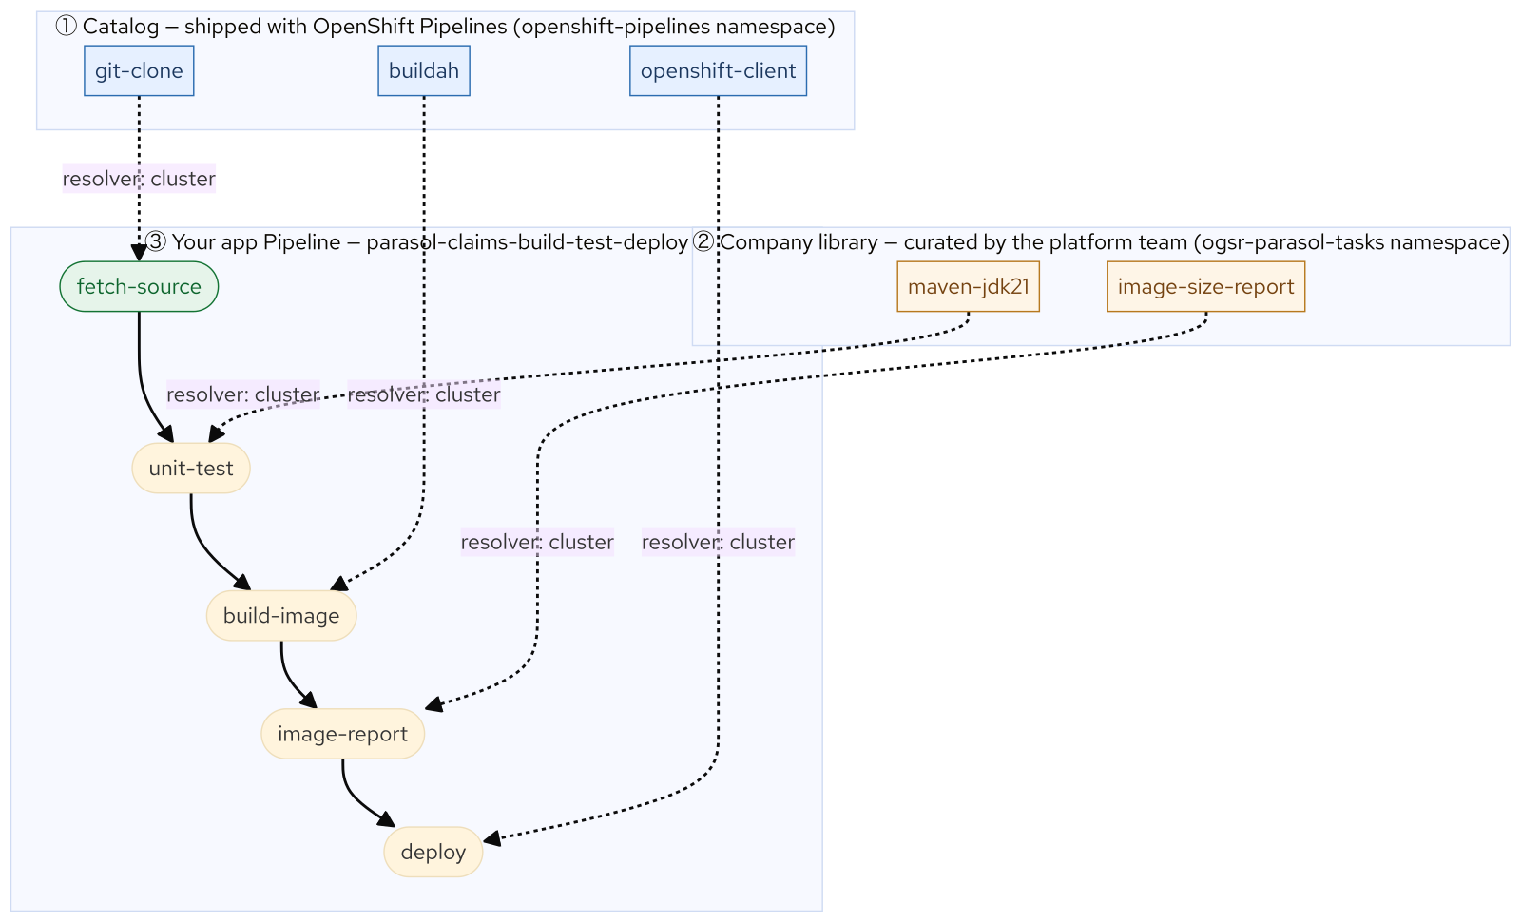
M07 · PIPELINES FUNDAMENTALS & TASK LIBRARIES
Anatomy and layers
CONFIDENTIAL
9
Notes:
Concept diagram: Anatomy and layers.

Slide 11
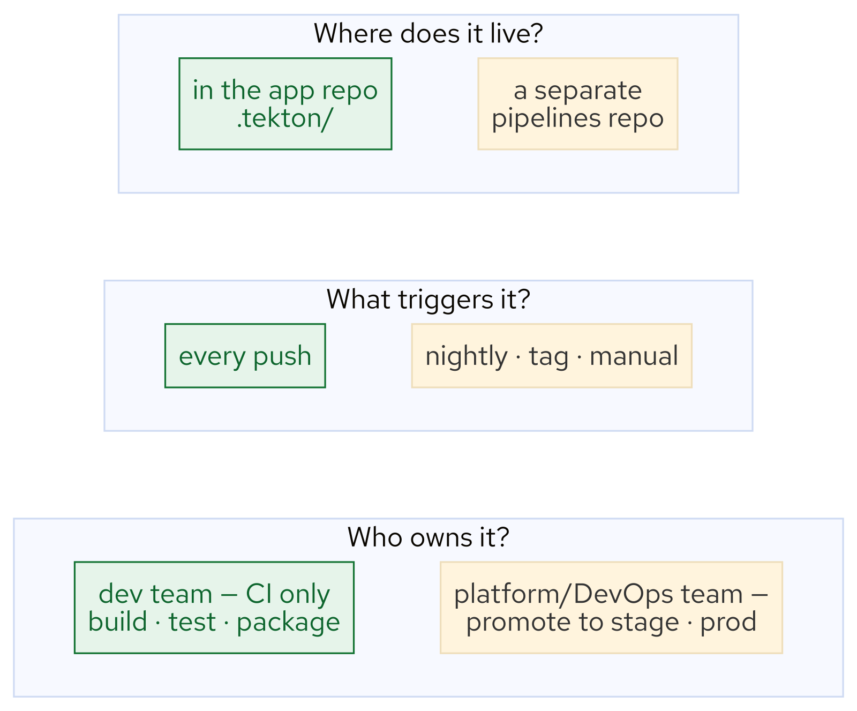
M07 · PIPELINES FUNDAMENTALS & TASK LIBRARIES
Pipeline choices
CONFIDENTIAL
10
Notes:
Concept diagram: Pipeline choices.

Slide 12
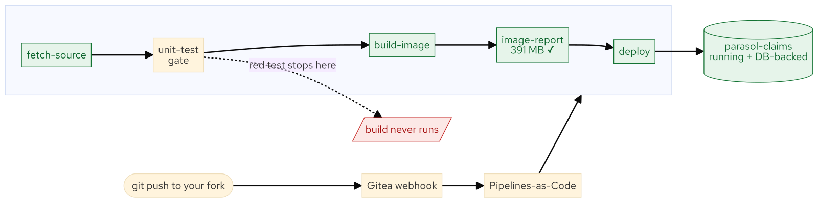
M07 · PIPELINES FUNDAMENTALS & TASK LIBRARIES
What you built
CONFIDENTIAL
11
Notes:
Concept diagram: What you built.

