Slide 1

B · DELIVERY & TRUST
M11
GitOps at Scale & Progressive Delivery

Slide 2

M11 · GITOPS AT SCALE & PROGRESSIVE DELIVERY
Thirty-six Applications nobody wants to
write
Claims is GitOps-managed — one Application per env
A dozen services × three envs = 36 Applications
Every one a near-copy that drifts
And prod takes new builds all-at-once
Scale and safety both break here
CONFIDENTIAL
1
Notes:
Open with the two pains this module fixes. Parasol's claims service is GitOps-managed in dev and stage, but as two hand-made Argo CD Applications. That is fine for one service; count it at real scale — a dozen services, three environments each — and it is thirty-six near-identical Applications a human has to author and keep consistent, and they drift. The second pain is delivery: pushing a new build straight to all of production at 100% bets the whole environment on it working. This module generates the fleet from one object and makes a production deploy safe to automate.

Slide 3
M11 · GITOPS AT SCALE & PROGRESSIVE DELIVERY
One ApplicationSet generates the fleet
Describe the Application once, as a template
A generator produces the parameters
One Application per environment, stamped out
Generators: list, git (folders), cluster, matrix
Take a position: folders, not branches
CONFIDENTIAL
2
Notes:
An ApplicationSet removes the toil. You describe the Application once as a template and hand it a generator — a source of truth for "what set of things should exist." A list generator enumerates environments inline; a git generator discovers them from folders; a cluster generator makes one per registered cluster; matrix/merge combine them. Parameters in, Applications out. Take a position on layout: folders, not branches — one main branch with overlays/dev, overlays/stage, overlays/prod side by side, so "what's different about prod" is the difference between folders, not a diff between drifting branches. And environments can differ in kind: dev/stage are plain Deployments, prod is a Rollout — one ApplicationSet still covers all three.

Slide 4
M11 · GITOPS AT SCALE & PROGRESSIVE DELIVERY
Order matters — sync waves and hooks
Some objects must be ready before others
Migration: after the DB, before the app
Sync waves order the apply (0, 1, 2…)
A Sync hook slots in a one-shot Job
DB (0) → migration (1) → app (2)
CONFIDENTIAL
3
Notes:
Applying a folder all at once is usually fine — Kubernetes retries. It is not fine when order matters: a schema migration must run after the database accepts connections and before the app boots against it. Argo CD gives you two tools. Sync waves: an integer annotation groups resources; Argo applies all of wave 0, waits for health, then wave 1, then wave 2. Resource hooks: a Sync hook runs as part of the sync rather than as steady state — the idiomatic way to slot in a one-shot Job. Production uses exactly this: database at wave 0, the migration Job as a Sync hook at wave 1, the app Rollout at wave 2 — so the app is never created against a schema that isn't ready, unattended, every time.

Slide 5
M11 · GITOPS AT SCALE & PROGRESSIVE DELIVERY
Progressive delivery — earn the traffic
Don't bet all of prod on one deploy
Route a small slice to the new version
Canary: 25% → pause → 50% → analysis → 100%
Analysis probes real health, gates promotion
Pod-ratio here; request-% needs a traffic router
CONFIDENTIAL
4
Notes:
GitOps gets the new manifests into prod; it does not tell you whether the new version is healthy under real conditions. Rolling to all pods at once bets the environment on the answer being yes. Progressive delivery refuses the bet: route a small slice to the new version, watch it, widen only as it proves itself, and revert automatically if it fails. Argo Rollouts is the controller — a drop-in for a Deployment whose strategy describes the shift. The canary steps: 25% to the canary, a pause to bake, 50%, then an automated analysis step probes the canary's real readiness, and only on success does it take 100%. Be honest about the mechanism: traffic splits by pod ratio (1 of 4 pods at 25%), which needs no extra infrastructure; exact request percentages or header routing need a traffic router — a Route plugin or a mesh.

Slide 6
M11 · GITOPS AT SCALE & PROGRESSIVE DELIVERY
The bad release that rolls itself back
Ship a build whose analysis will fail
Canary reaches 50%, analysis reports Failed
Rollout aborts — automatically
Stable version never left production (200 throughout)
Read the AnalysisRun like an incident
CONFIDENTIAL
5
Notes:
This is the beat that makes the toil worth it. In the lab you force an analysis failure — a deterministic stand-in for a canary whose real metrics spiked — and ship. The canary reaches the analysis step, the analysis reports Failed, and the Rollout aborts and rolls back to the stable version on its own: no human noticed, decided, and acted under pressure. And production never went down — the stable pods served every request through the entire failed rollout; the route answered 200 the whole time. Then you read the failed AnalysisRun the way you'd read an incident review, except the rollback already happened. That is the whole promise: a production deploy that is safe to automate because a bad one reverts itself before anyone sees it.

Slide 7
M11 · GITOPS AT SCALE & PROGRESSIVE DELIVERY
Canary or blue-green — pick the shape
Canary: gradual slice, analysis-gated, small extra capacity
Blue-green: two full copies, instant cutover, manual gate
Canary limits blast radius, measures mid-rollout
Blue-green: clean switch after a preview pre-flight
Mesh / serverless shift traffic other ways (other modules)
CONFIDENTIAL
6
Notes:
Canary is one progressive-delivery strategy; blue-green is the other, and the same controller serves both. Canary shifts gradually and gates on analysis mid-rollout, costing a small extra slice. Blue-green runs two full versions side by side — blue live behind an active service, green new behind a preview service — and cuts over all at once when you promote, with a manual gate and double capacity for the window. Reach for canary to limit blast radius when you can measure health during the rollout; reach for blue-green for a clean instant switch after a full pre-flight on a preview URL. And Rollouts is only the deployment-controller way to shift traffic — a service mesh shifts by routing rules, serverless by revision tags; both are their own modules. Rule of thumb: Rollouts when delivery is driven by the deployment and gated by metrics.

Slide 8
M11 · GITOPS AT SCALE & PROGRESSIVE DELIVERY
Map to your org — and when not
Onboarding a service = one line, not N files
Release risk: from "hope" to "measured"
Migration ordering: structural, not tribal
Don't canary changes analysis can't judge
Blue-green costs double capacity; pod-ratio ≠ exact %
CONFIDENTIAL
7
Notes:
Land the transfer and stay honest. In your org: how many deployment definitions are quietly drifting because each environment is a hand-maintained copy rather than generated from one source? When a bad release last reached prod, how did you find out, and how much of recovery was a human noticing? Is your "run the migration in the right place" rule structural or a runbook step someone can skip? Then the credibility close on restraint: don't canary a change whose failure is slow or downstream — a short readiness analysis will pass a subtle data bug; gate those on tests and manual promotion. Don't reach for pod-ratio when you need exact or header-based traffic — that needs a traffic router. Don't auto-promote before your analysis has earned trust. And blue-green's clean cutover costs a full second copy — pick the strategy your capacity affords.

Slide 9
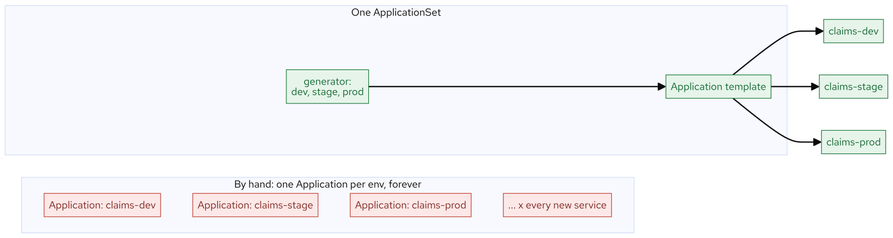
M11 · GITOPS AT SCALE & PROGRESSIVE DELIVERY
Appset
CONFIDENTIAL
8
Notes:
Concept diagram: Appset.

Slide 10
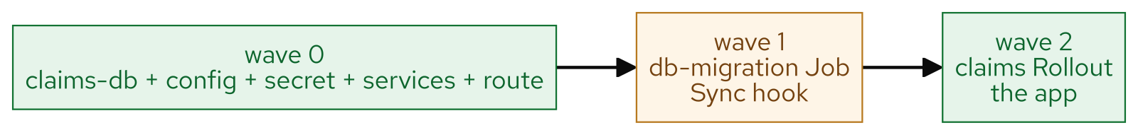
M11 · GITOPS AT SCALE & PROGRESSIVE DELIVERY
Sync waves
CONFIDENTIAL
9
Notes:
Concept diagram: Sync waves.

Slide 11
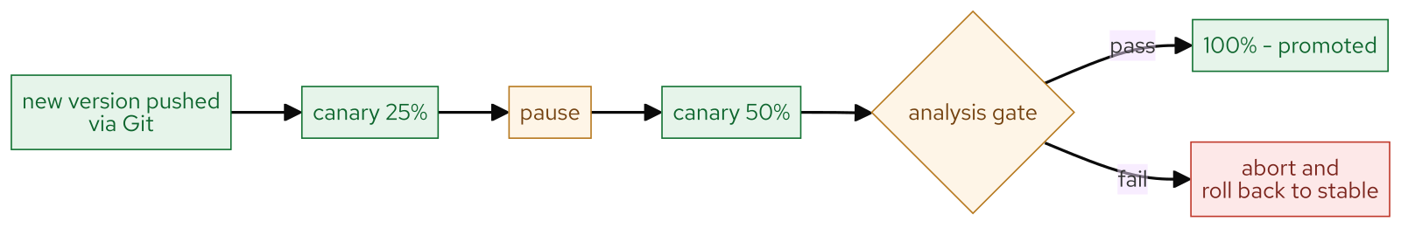
M11 · GITOPS AT SCALE & PROGRESSIVE DELIVERY
Canary analysis
CONFIDENTIAL
10
Notes:
Concept diagram: Canary analysis.

Slide 12
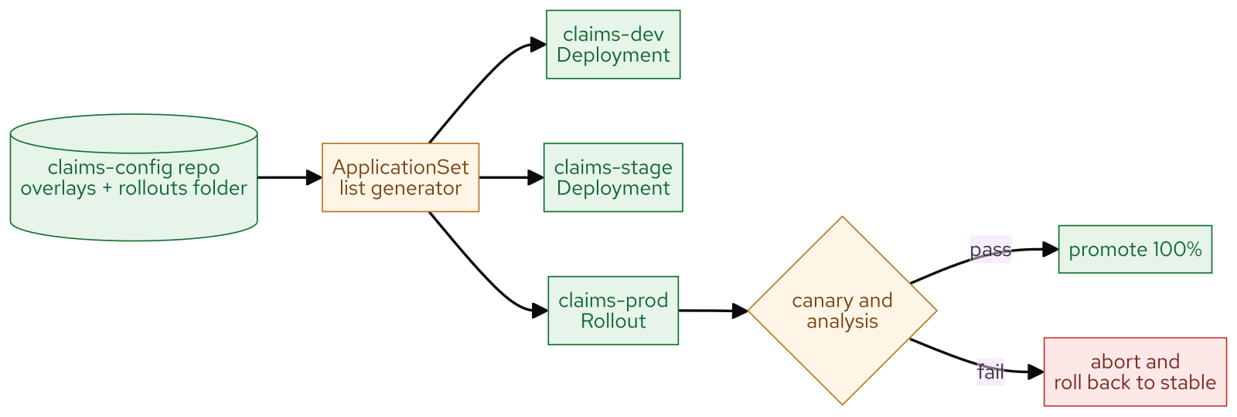
M11 · GITOPS AT SCALE & PROGRESSIVE DELIVERY
What you built
CONFIDENTIAL
11
Notes:
Concept diagram: What you built.

