Slide 1

B · DELIVERY & TRUST
M12
Developer Hub & Golden Paths

Slide 2

M12 · DEVELOPER HUB & GOLDEN PATHS
Ten tools before the first line of code
New engineer, day one, needs a service
Build, pipeline, GitOps, probes, metrics, tracing
Each is another tool to learn
Standards live in a wiki — and drift
The platform is powerful; nobody finds the on-ramp
CONFIDENTIAL
1
Notes:
Open with the pain this module resolves. By now the workshop has assembled a real platform — trusted builds, pipelines, supply-chain security, GitOps, progressive delivery. Every one of those is a capability, and every one is another tool, repo layout, and convention a developer must learn before they are productive. The tenth engineer to create a service reverse-engineers how the last nine did it, or copies a repo that was already subtly wrong. Standards that live in a wiki drift: the probe gets forgotten, the base image goes stale. The problem is not the tools; it is the cognitive load and the missing on-ramp. This module is the on-ramp.

Slide 3
M12 · DEVELOPER HUB & GOLDEN PATHS
The catalog
the org's map, not a spreadsheet
Components: the things you build and run
APIs: the contracts they provide and consume
Systems: groups of components that work together
Groups: the teams that own them
Sourced from files next to the code
CONFIDENTIAL
2
Notes:
The first thing a developer portal — Red Hat Developer Hub, Red Hat's build of Backstage — gives you is a software catalog: a live inventory modelled as typed entities. A Component is a service or website; an API is a contract it provides or consumes; a System groups components that work together; a Group is the team that owns them. Because the relationships are typed, the catalog is a map, not a spreadsheet: it renders who owns the claims service, which System it belongs to, which API it provides, who consumes that API. And each entity's source of truth is a small catalog-info.yaml in the service's own repo — described as code, reviewed in pull requests, as current as the last commit. When you onboard someone, you point them at the catalog, not a diagram three reorgs out of date.

Slide 4
M12 · DEVELOPER HUB & GOLDEN PATHS
The golden path — a paved road, not a cage
A Software Template: a form plus steps
Fill a couple of fields, get a service
Probes, metrics, tracing, trusted image — pre-wired
Plain, standard code in your own repo
The right thing is the easy thing
CONFIDENTIAL
3
Notes:
A catalog tells you what exists; a golden path is how you create something new, correctly, without learning the whole platform first. Concretely it is a Software Template: a form plus steps. The developer names a service, and the template scaffolds a complete, standards-compliant service — source with health, metrics, and tracing already wired; a trusted UBI base image; a build recipe; a catalog entry; a workspace. The phrase that matters is paved road, not cage: a cage forces one way and punishes deviation; a paved road makes the right thing the easy thing while leaving you free to drive off it with a reason. The scaffolded service is plain, editable code in your own repo — you own it the moment it is created. The template gave you a correct starting line and got out of the way.

Slide 5
M12 · DEVELOPER HUB & GOLDEN PATHS
One button = modules 2 through 10
Every earlier module's decision, encoded once
Trusted base image, probes, GitOps-ready layout
New engineer inherits them, does not re-derive
Compliance is the default at creation, not an audit
Improve the template once, every future service gains
CONFIDENTIAL
4
Notes:
This is why the golden path is the payoff of the whole delivery-and-trust block. Everything you did by hand across the earlier modules — choosing a trusted base image, wiring probes and metrics, describing the app for GitOps, laying out the repo — is a decision the platform team makes once and encodes in the template. The new engineer does not re-derive those decisions; they inherit them. And notice when compliance happens: without a golden path, a service is created some ad-hoc way and audited later — someone finds the missing probe and files a ticket. With one, the service starts already carrying probes, a trusted image, and an owner, so compliance is the default state at creation. Auditing shifts from find-and-fix-the-drift to confirm-the-road-was-used. And the leverage compounds: improve the template once and every service created after inherits it.

Slide 6
M12 · DEVELOPER HUB & GOLDEN PATHS
What you'll do
Tour the catalog: find claims, its owner, its API
Scaffold a new service from the golden path
Inspect the paved road — nothing hand-written
Build and run it in your namespace
Watch health and metrics answer, unconfigured
CONFIDENTIAL
5
Notes:
In the lab you are the new Parasol engineer. First you tour the software catalog and read what it knows about the claims service — owner, System, the API it provides — all from files next to the code. Then you run the New Parasol microservice template: a short form scaffolds a complete Quarkus Java 21 service into your own Git organization, publishes the repo, and registers it in the catalog, where it appears immediately as part of the parasol-insurance System. You inspect the paved road — probes, metrics, tracing, a trusted UBI9 image, a build recipe, a workspace, none of it hand-written — then build its image in-cluster and run it, watching the health and metrics endpoints answer observability you never set up. And you break it on purpose: run the template twice with the same name and read the honest failure.

Slide 7
M12 · DEVELOPER HUB & GOLDEN PATHS
Map to your org — and when not
How does a new service get created today?
Who owns this, and what depends on it?
Standards enforced by construction, or by audit?
Do not stand up a portal you will not feed
A paved road, not a cage; not every workflow
CONFIDENTIAL
6
Notes:
Land the transfer and stay honest. In your org: how does a new service actually get created, and who has to be in the room — is it scaffolded from a template the platform team owns, or copied from an existing repo and fixed up later? When someone asks who owns a service and what depends on it, is that a query against a live map or an archaeology project? And which of your standards are enforced by construction versus found missing in an audit? Then the credibility close on restraint. Do not stand up a portal you will not feed — a catalog nobody maintains rots into the stale wiki it replaced, now with more to run. Do not let golden paths sprawl into the copy-and-drift problem one level up. Do not turn the paved road into a cage teams route around. And do not platform-engineer every workflow — templatize the common path, leave the genuine one-offs alone. The portal is production software; it earns its cost when cognitive load is the real problem, not before.

Slide 8
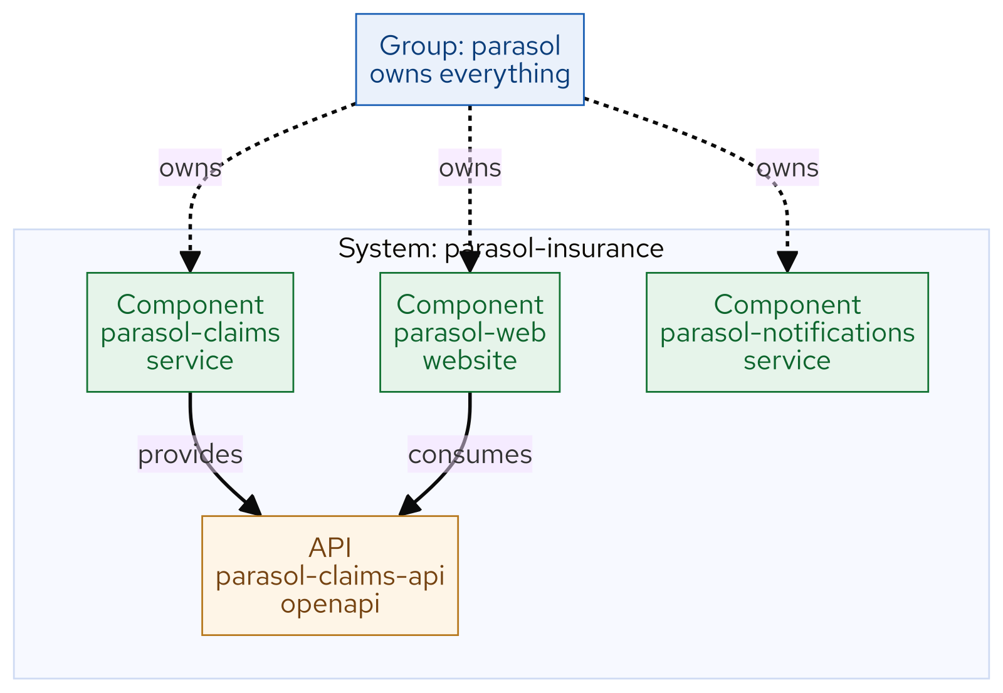
M12 · DEVELOPER HUB & GOLDEN PATHS
Catalog model
CONFIDENTIAL
7
Notes:
Concept diagram: Catalog model.

Slide 9
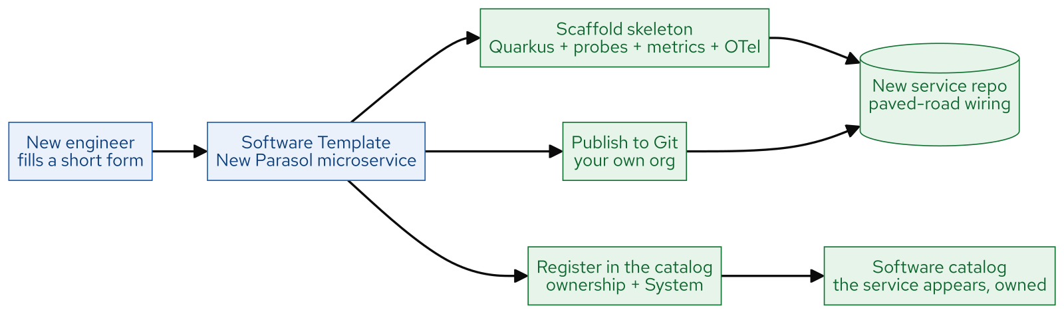
M12 · DEVELOPER HUB & GOLDEN PATHS
Golden path flow
CONFIDENTIAL
8
Notes:
Concept diagram: Golden path flow.

Slide 10
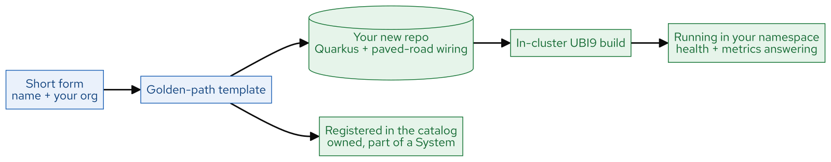
M12 · DEVELOPER HUB & GOLDEN PATHS
What you built
CONFIDENTIAL
9
Notes:
Concept diagram: What you built.

