Slide 1

C · PLATFORM & TENANCY
M16
Networking for Dev & DevOps

Slide 2

M16 · NETWORKING FOR DEV & DEVOPS
From a flat network to a controlled one
Parasol's claims app: web → API → database
Default network is flat and open
Any pod can reach any pod, any port
Nothing is reachable from outside — yet
The network is a control plane you configure
CONFIDENTIAL
1
Notes:
Open on the concrete situation. Parasol's claims application is three tiers — a web front end, a claims API, and a Postgres database — sitting on a flat, open network where any pod can reach any other on any port, and nothing is reachable from outside at all. The whole module is how OpenShift turns that network into a control plane: you choose exactly what becomes public (north-south) and you let only the right pods talk to each other (east-west). Same cluster, same app — but by the end the database answers only the API, the front end is the only door in, and none of it is a firewall appliance.

Slide 3

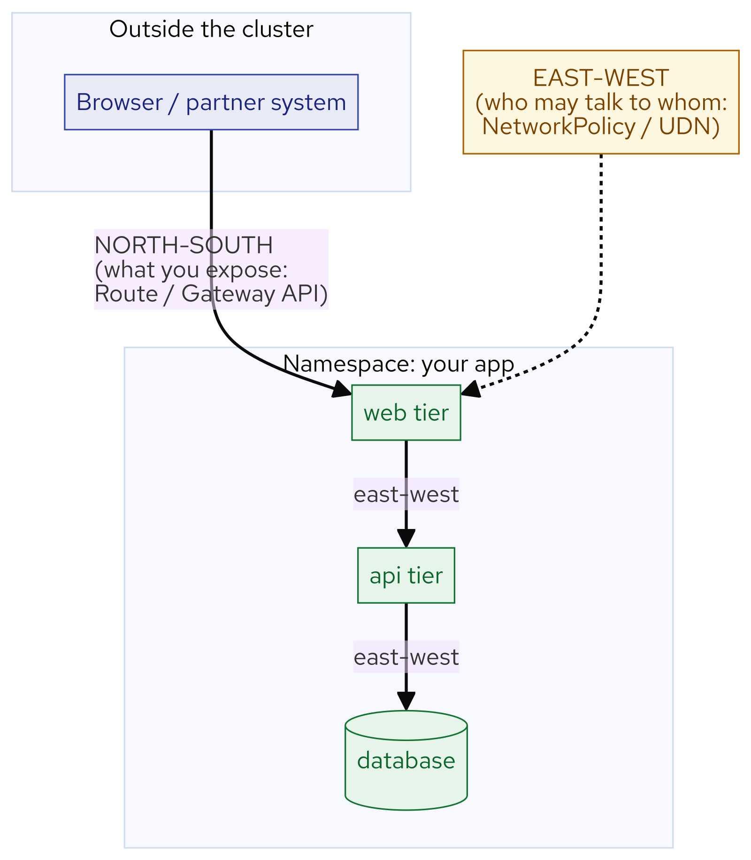
M16 · NETWORKING FOR DEV & DEVOPS
Two directions of traffic
North-south: crossing the cluster boundary
Controlled by what you EXPOSE (Route / Gateway)
East-west: pod-to-pod inside the cluster
Controlled by who may TALK (NetworkPolicy / UDN)
Every tool is one direction or the other
CONFIDENTIAL
2
Notes:
Every conversation runs in one of two directions, and OpenShift gives you a different tool for each. North-south is traffic crossing the cluster boundary — a browser reaching your front end — and you control it by choosing what to expose; most workloads should never be reachable from outside. East-west is traffic between pods inside the cluster — web calling API, API querying database — and by default it's wide open, so you control it by writing policy or giving a namespace its own network. Knowing which direction you need is half the battle: north-south is a Route or Gateway, east-west is a NetworkPolicy or UDN.

Slide 4
M16 · NETWORKING FOR DEV & DEVOPS
A mental model of the network
Service: stable name + virtual IP
Endpoints: the actual pod IPs (via label selector)
Data plane (OVN-K): programs every node, enforces policy
Route: tells the router to accept outside traffic
The #1 bug: a selector that matches no pods
CONFIDENTIAL
3
Notes:
You don't need OVN-Kubernetes internals — you need one chain. A Service is a stable name and virtual IP for a set of pods; behind it are endpoints, the real pod IPs kept in step with a label selector; the data plane programs every node so a packet reaches a healthy endpoint, and that's where NetworkPolicy is enforced — as flow rules, not a sidecar; and a Route tells the ingress router to accept outside traffic for a hostname. The single most common "networking bug" in the field isn't a firewall — it's a Service whose selector matches no pods: the Service is green, DNS resolves, and every connection fails. Attendees break exactly that on purpose in the lab.

Slide 5
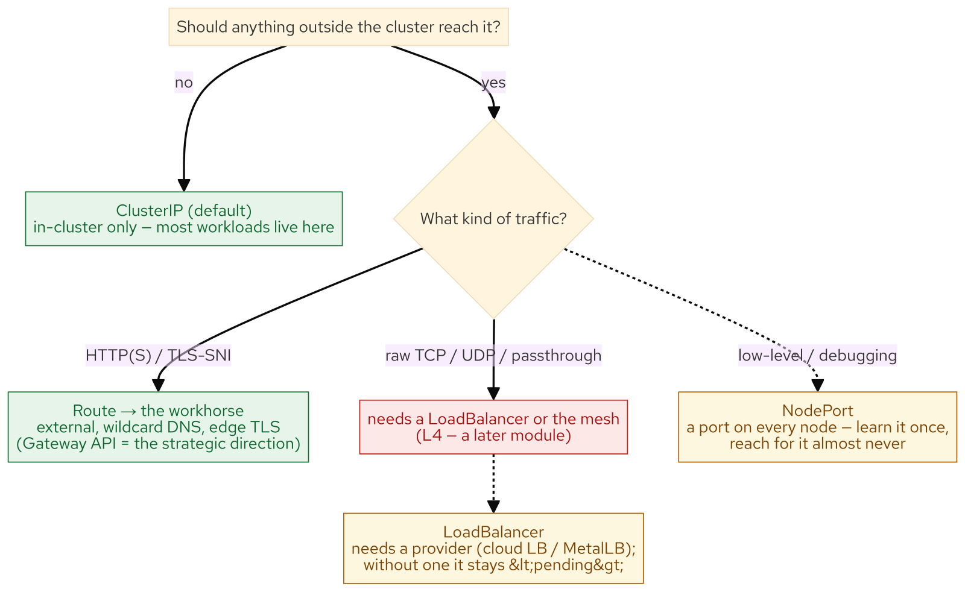
M16 · NETWORKING FOR DEV & DEVOPS
North-south — the exposure decision tree
ClusterIP (default) — in-cluster only, most workloads
NodePort — a port on every node, learn once
LoadBalancer — needs a provider, else <pending>
Route — the workhorse: external, wildcard DNS, edge TLS
Gateway API — the strategic direction (GA)
CONFIDENTIAL
4
Notes:
There's a decision tree for "make this reachable," and each rung exists for a reason — stop at the first that fits. ClusterIP is the default and where most workloads stay. NodePort opens the same port on every node — understand it once, reach for it almost never. LoadBalancer asks the platform for an external IP, which only appears if a provider answers — on this bare-metal cluster with no provider it hangs at <pending>, which is the lesson: LoadBalancer is a promise the platform has to be able to keep. Route is the deterministic path — wildcard DNS, edge TLS, no provider — and it's what you actually run. The Gateway API (GatewayClass → Gateway → HTTPRoute, weighted splits) is the portable successor and the strategic direction, GA on OpenShift.

Slide 6
M16 · NETWORKING FOR DEV & DEVOPS
The honest L4 boundary
Routes + today's Gateway API: HTTP(S)/SNI-centric
Route by hostname/path; TLS by SNI
No raw TCP / UDP / TLS-passthrough
That's the service mesh's job (a later module)
Know the boundary — don't fight the Route
CONFIDENTIAL
5
Notes:
A credibility slide. Routes and today's OpenShift Gateway API are HTTP(S)/SNI-centric — they route by hostname and path and terminate or pass TLS by SNI. They do not expose raw TCP, UDP, or TLS-passthrough for arbitrary protocols; on this cluster the experimental TCPRoute/TLSRoute/UDPRoute APIs are deliberately not installed. When you need L4 ingress — a database port, a custom protocol, gRPC with passthrough — that's the service mesh, covered in the advanced module. Knowing this boundary keeps teams from fighting a Route to do something it was never designed for.

Slide 7
M16 · NETWORKING FOR DEV & DEVOPS
East-west
default-deny, then precise allows
Default is allow-all between pods
Step 1: default-deny the namespace
Step 2: re-open only the flows the app needs
db only from api; api only from web
The gotcha: default-deny eats DNS too
CONFIDENTIAL
6
Notes:
Inside the cluster the default is allow-all, so a three-tier app's database will happily accept a connection from anything. The pattern to fix it is always the same: apply a default-deny so nothing may talk, then re-open only the flows the app genuinely needs — the database accepts 5432 only from the API, the API accepts 8080 only from the web tier. It's per-pod and per-port, expressed as labels, enforced in the data plane, and the allows become the documentation of what may talk to what. One trap everyone hits: default-deny on egress also blocks DNS, so pods stop resolving names and the app looks broken for the wrong reason — the fix is a deliberate DNS egress allow that names the CoreDNS pods' actual port, not the Service's 53.

Slide 8
M16 · NETWORKING FOR DEV & DEVOPS
UserDefinedNetwork
isolation without policy
Primary UDN: a namespace's OWN pod network
Native isolation — no NetworkPolicy at all
Layer 2 segment (e.g. 10.20.0.0/16 on ovn-udn1)
Must exist BEFORE the namespace's first pod
UDN for whole-namespace; netpol for selective flows
CONFIDENTIAL
7
Notes:
Sometimes you want a whole namespace isolated and you want it for free. A Primary UserDefinedNetwork gives its namespace its own pod network — a separate Layer 2 segment — so its pods are isolated from every other namespace natively, with no NetworkPolicy at all. It's GA on OpenShift. The trade-off is a hard rule: a Primary UDN must exist before the namespace's first pod (you can't convert a populated namespace), so it's the platform team's decision at creation time — exactly how the workshop's partner namespace was built. Reach for a UDN when isolation is a property of the whole namespace; reach for NetworkPolicy when you need selective flows within or across namespaces. The service mesh is the third layer on top, adding workload identity — a later module.

Slide 9
M16 · NETWORKING FOR DEV & DEVOPS
What you'll do — and map to your org
Trace a packet; break a selector and fix it
Expose the front end with an edge Route
default-deny → precise allows → prove isolation
Meet a namespace isolated natively by a UDN
If a debug pod landed in prod, what could it reach?
CONFIDENTIAL
8
Notes:
Set expectations for the hands-on, all in the attendee's own claims-app namespace, then land the transfer. You trace a packet and break a Service selector to feel the #1 bug; expose the front end with an edge Route and see NodePort and LoadBalancer honestly (the latter stuck at <pending>); apply default-deny, watch the app and DNS break, re-open only what's needed, and prove a debug pod is now blocked from the database while the API still gets through; then meet a partner namespace isolated natively by a UDN with zero policy. Take the questions back: if someone deployed a debug pod in your most sensitive namespace right now, what could it reach — and could you produce, from policy alone, the list of flows your app is actually allowed? And stay honest about restraint: don't hand-write netpols where a UDN fits, don't fight a Route to do L4, don't reach for LoadBalancer when a Route will do, and never default-deny without the DNS allow.

Slide 10
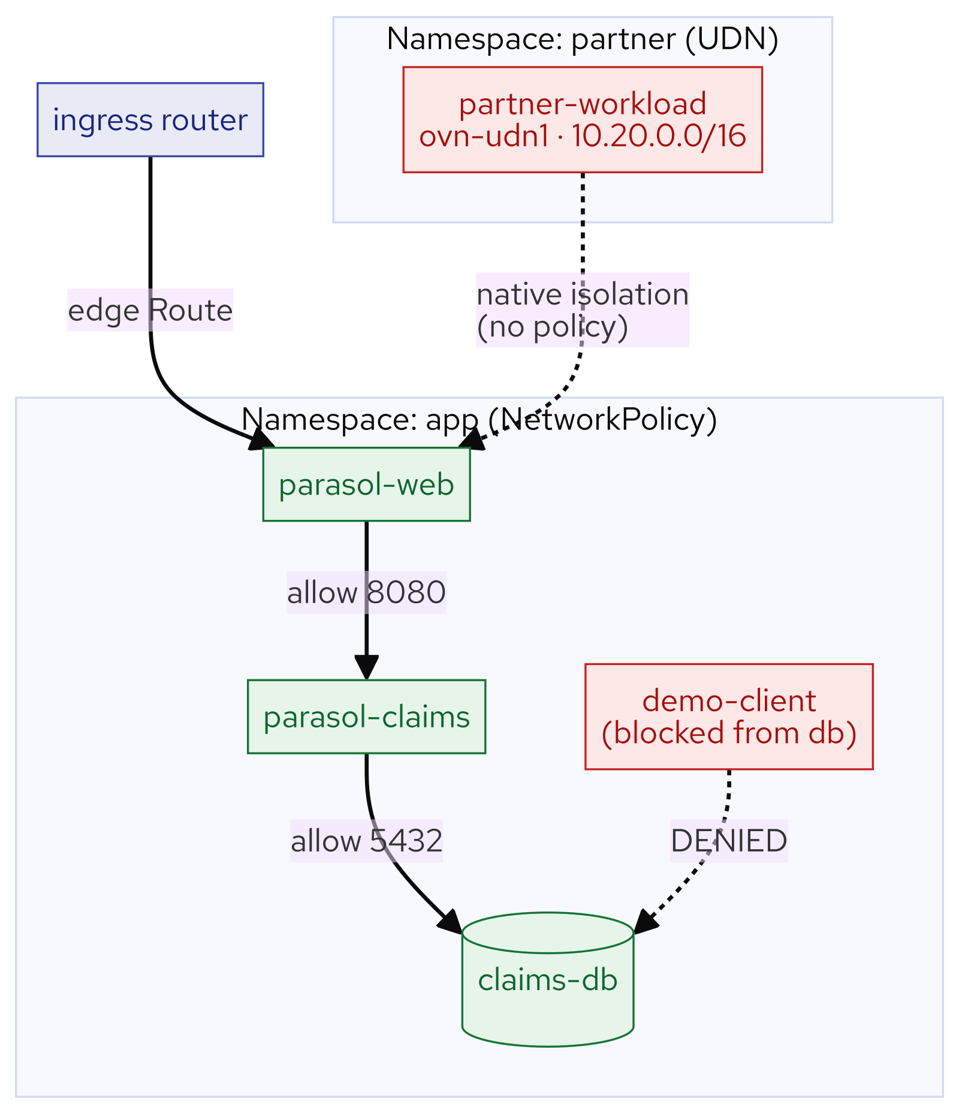
M16 · NETWORKING FOR DEV & DEVOPS
What you built
CONFIDENTIAL
9
Notes:
Concept diagram: What you built.

Slide 11
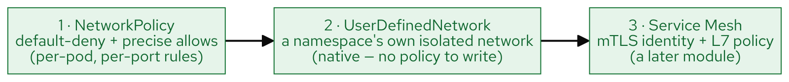
M16 · NETWORKING FOR DEV & DEVOPS
Network policy layers
CONFIDENTIAL
10
Notes:
Concept diagram: Network policy layers.

