Slide 1

C · PLATFORM & TENANCY
M17
Deployment Targets & Scheduling

Slide 2

M17 · DEPLOYMENT TARGETS & SCHEDULING
From scheduled-wherever to placed-on-purpose
Parasol's claims API lands wherever it fits
A batch job fights the API for the same CPUs
A routine rollout drops customer requests
None of it is a bigger cluster — it's control
Placement is a decision, not a lottery
CONFIDENTIAL
1
Notes:
Open on the concrete pain. Parasol's claims API lands wherever the scheduler happens to drop it, a monthly-statement batch job elbows the live API off the same CPUs, and a routine rollout quietly drops a handful of customer requests every time it runs. This module is how you take control: where each pod lands, how replicas spread so one dead node can't take the service down, which workloads get dedicated capacity, and how a deploy finishes without a customer noticing. Same app, same cluster — but by the end the API is spread across the cluster, the batch job runs on its own nodes, and a rollout keeps serving throughout. The one idea under all of it: placement is a decision you make, not a lottery you accept.

Slide 3

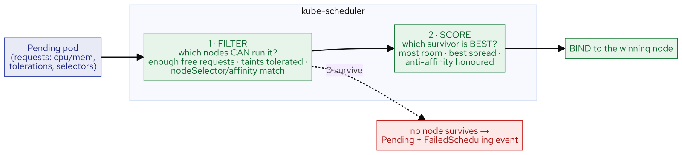
M17 · DEPLOYMENT TARGETS & SCHEDULING
The scheduler in one mental model
Every pod: FILTER then SCORE, then bind
Filter: which nodes CAN run it (requests, taints, selectors)
Score: which survivor is BEST (room, spread)
No survivor → Pending + FailedScheduling event
The currency is REQUESTS, not usage
CONFIDENTIAL
2
Notes:
You don't need the scheduler's internals — you need one two-step pipeline that runs for every pod. Filter throws out every node that can't run it: not enough unreserved CPU or memory measured by the pod's requests, a taint it doesn't tolerate, a nodeSelector or affinity that doesn't match. Score ranks the survivors — most room, best spread, anti-affinity satisfied — and binds to the winner. If no node survives, the pod stays Pending and the scheduler writes a FailedScheduling event that names the reason node by node — reading that event is the whole skill. The currency in the filter is requests, not usage and not limits: a pod that requests 200m is placed as if it always uses 200m; a pod that requests nothing can be packed onto a full node. Requests also set QoS (Guaranteed/Burstable/BestEffort), which decides eviction order.

Slide 4
M17 · DEPLOYMENT TARGETS & SCHEDULING
Direct pods — who seeks, who repels
Affinity / nodeSelector: the POD seeks (attract)
Taint: the NODE repels
Toleration: only PERMITS — it does not attract
Dedicated pool needs taint + toleration + selector
podAntiAffinity: never two replicas on one node
CONFIDENTIAL
3
Notes:
There are two families of placement control, and confusing them is the most common scheduling mistake there is. Affinity is the pod reaching toward a node — nodeSelector is the blunt form, nodeAffinity adds required/preferred, podAntiAffinity points at other pods ("never two of me on a node") to spread replicas. A taint is the node pushing pods away: NoSchedule means nothing lands unless it tolerates the taint. Here's the trap that catches everyone: a toleration only permits, it does not attract. A pod that tolerates the batch taint may land on the batch node, but the scheduler is just as happy to put it anywhere else. To actually pin a workload to a dedicated pool you need all three: a taint (keep others off), a toleration (be allowed on), and a nodeSelector (be sent there). Add the selector alone and the pod goes Pending on the untolerated taint.

Slide 5
M17 · DEPLOYMENT TARGETS & SCHEDULING
Spread across failure domains
Anti-affinity: blunt "no two on a node"
topologySpreadConstraints: EVEN spread across a domain
Domain = any node label (hostname, zone, region)
maxSkew = how uneven you'll tolerate
DoNotSchedule (hard) vs ScheduleAnyway (soft)
CONFIDENTIAL
4
Notes:
Anti-affinity is a blunt "no two on one node." topologySpreadConstraints is the precise version: keep replicas evenly spread across a domain, where the domain is any node label — hostname (spread across nodes), a zone label (spread across failure zones), a region. maxSkew is how uneven you'll tolerate — maxSkew 1 means no domain holds more than one pod above the least-loaded. whenUnsatisfiable is the teeth: DoNotSchedule makes the spread a hard requirement (a breaking pod stays Pending); ScheduleAnyway makes it a strong preference (spread if you can, never block a deploy). The honest note for this workshop: real zones need real failure domains a single bare-metal cluster doesn't have — hostname spread is the always-true story, and where you see a zone label it was synthesized on the workshop nodes. On a cloud you'd point at the provider's real topology.kubernetes.io/zone.

Slide 6
M17 · DEPLOYMENT TARGETS & SCHEDULING
Dedicated pools — the trio in practice
Platform taints a pool: keep everything off
Your workload tolerates it: allowed on
Your workload selects it: sent there
Miss the selector → Pending (untolerated taint)
GPU / batch / licensed-software pools work this way
CONFIDENTIAL
5
Notes:
This is where the who-seeks/who-repels idea becomes a recipe. A platform team taints a pool of nodes (NoSchedule) so ordinary pods stay off — a GPU box, a node licensed for a commercial database, a batch pool. To run YOUR workload there, it needs a toleration (permission past the taint) and a nodeSelector or affinity (direction to the pool). In the lab you feel the failure mode directly: add the selector alone and the batch worker goes Pending with "untolerated taint" — the selector sent it to the pool node but the taint repels it. Add the toleration and it snaps onto the pool. Selector to send it, toleration to permit it — you need both. This is exactly how expensive or special hardware earns its keep: the taint keeps freeloaders off, the toleration-plus-selector puts the right workload on.

Slide 7
M17 · DEPLOYMENT TARGETS & SCHEDULING
Zero-downtime — capacity AND data
maxUnavailable: 0 — surge before retire, capacity flat
Recreate — for single-writers (deliberate gap)
The real trap: a pod that *rebuilds shared state on boot*
Fix: schema-management=none + seed once at deploy + raise the CPU limit
A PDB makes a node drain wait its turn
CONFIDENTIAL
6
Notes:
A Deployment doesn't just run pods, it replaces them — and how it replaces them has a consequence. RollingUpdate with maxUnavailable 0 is the load-bearing capacity setting: it surges a new pod to Ready before retiring an old one, so ready-pod count never dips (you watch it hold flat through a roll). Recreate is correct for a single-writer database — a deliberate gap so two copies never run at once. But capacity is only half the story. Parasol's claims API shares one PostgreSQL, and the image boots Hibernate with drop-and-create — so every pod boot drops and reseeds the shared database. During a rolling update the new pod wipes the tables out from under the old pods still serving, and a claim filed since the last deploy is silently gone. maxUnavailable 0 did its job — three ready pods throughout — and the data still vanished, because the disruption is in the data plane at startup, not the connection plane at shutdown; no preStop or SIGTERM handling touches it. The fix stops pods rebuilding shared state on boot: schema-management=none, seed the database once at deploy (a Flyway/Liquibase Job), and raise the CPU limit so the cold-start is quick. In the lab you prove it deterministically — plant a value, restart one pod, watch it revert to the seed — then fix it and watch the value survive. Finally a PodDisruptionBudget protects voluntary disruptions: a node drain must respect minAvailable, so it waits its turn instead of taking your last replica — and minAvailable equal to the replica count deadlocks the drain.

Slide 8
M17 · DEPLOYMENT TARGETS & SCHEDULING
How platform teams shape the cluster
DaemonSets: one pod per node (the node-agent pattern)
The CNI, monitoring, machine-config ARE DaemonSets
Native sidecar (GA): init container, restartPolicy Always
MachineSets: the object that builds the pools
You read these; creating a pool is cluster-wide
CONFIDENTIAL
7
Notes:
The pools and agents you work around are built with the same primitives you just learned. DaemonSets run one pod per node — the node-agent pattern — and the cluster's own plumbing is built this way: the CNI (ovnkube-node), the monitoring node-exporter, the machine-config daemon are all DaemonSets, one on every node. Some target only a subset of nodes using the very nodeSelector-plus-tolerations you learned — a control-plane-only agent, for instance. A native sidecar is an init container with restartPolicy Always: it starts first and keeps running alongside your app for the pod's whole life — GA on OpenShift, the pattern a mesh proxy or log shipper uses; know it exists. MachineSets are the declarative "how many nodes of this shape" object: on a cloud a platform team scales one to grow a pool, labels and taints its nodes, and a MachineAutoscaler sizes it to demand — that's how the batch pool you pinned onto was made. You read all this via a read-only role; creating and tainting a pool is the instructor's segment because it's cluster-wide.

Slide 9
M17 · DEPLOYMENT TARGETS & SCHEDULING
What you'll do — and map to your org
Read placement; force replicas apart; read a refusal
Spread across nodes (and, with one knob, zones)
Pin the batch worker onto a dedicated pool
Roll under load with capacity held flat; add a PDB
If that node died now — replica elsewhere, guaranteed?
CONFIDENTIAL
8
Notes:
Set expectations for the hands-on, all in the attendee's own claims-app namespace, then land the transfer. You read how the scheduler placed the pods and confirm it against a Scheduled event; force the API replicas apart with required anti-affinity and read the FailedScheduling event when the scheduler can't oblige; spread them evenly with topologySpreadConstraints across nodes, and with one changed key across zones; pin the batch worker onto a dedicated pool the honest way — feeling the Pending a nodeSelector alone earns, then fixing it with the toleration; make a rollout zero-downtime where the Deployment can (maxUnavailable 0 holding capacity flat) and protect it with a PodDisruptionBudget that blocks an eviction rather than breach its floor. Take the questions back: if the node under your busiest service died right now, is a replica already running elsewhere — guaranteed, or just probably? Is your expensive hardware running the workload you bought it for and nothing else? And do your deploys drop requests — does anyone even know?

Slide 10
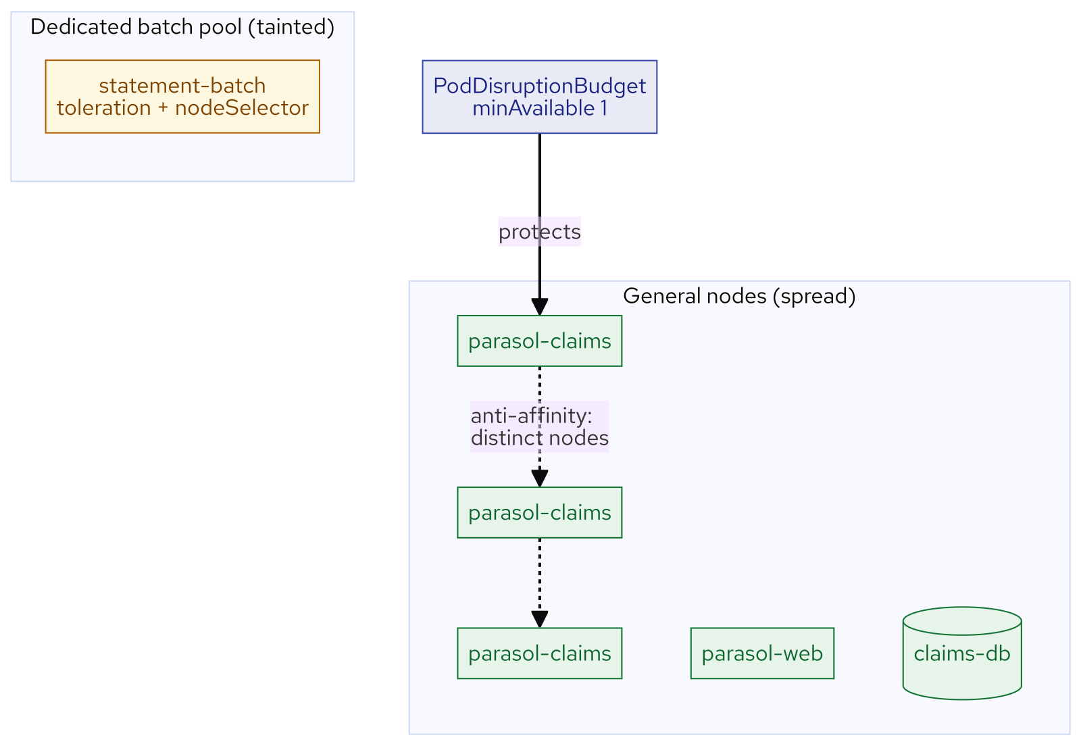
M17 · DEPLOYMENT TARGETS & SCHEDULING
What you built
CONFIDENTIAL
9
Notes:
Concept diagram: What you built.

Slide 11
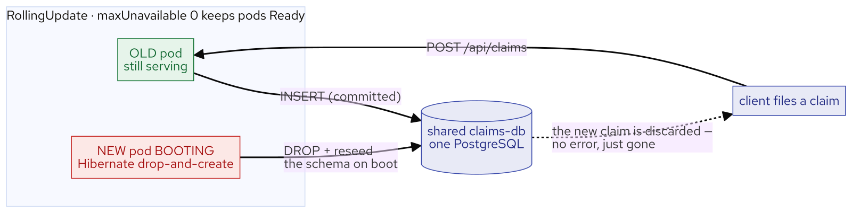
M17 · DEPLOYMENT TARGETS & SCHEDULING
Reseed on boot
CONFIDENTIAL
10
Notes:
Concept diagram: Reseed on boot.

