Slide 1

D · ADVANCED ELECTIVES
M22
Resilience, Multi-Cluster & DR

Slide 2

M22 · RESILIENCE, MULTI-CLUSTER & DR
Resilience keeps a site up
failover keeps the service up
Parasol's claims service survives a pod crash and a node drain — replicas, PDB, spread, HPA (Platform Orientation/Observability/Deployment Targets & Scheduling)
That does NOTHING when a WHOLE SITE goes down — a data center, a cluster, a region
The resilience LADDER: pod → node → zone → SITE → region
In-site resilience owns the bottom rungs; cross-site FAILOVER owns the site rung
This module: fail over to another site automatically (mesh), connect real sites (RHSI), and the DR net underneath (OADP + GitOps, concept)
CONFIDENTIAL
1
Notes:
Open on the distinction, because it's the whole module. Parasol's claims service is genuinely resilient in one site — three replicas, a PodDisruptionBudget, topology spread across nodes, an autoscaler. That reflex, built in Platform Orientation, Observability, and Deployment Targets & Scheduling, absorbs the common failures: a pod crashes and the Deployment replaces it; a node is drained and the PDB paces the eviction so a quorum stays up. But "we have three replicas" does nothing the moment the failure is a whole SITE going dark — a data center loses power, the cluster fails, the region has an outage — because every one of those replicas was IN the site that just died. Think of it as a ladder: pod, node, zone, site, region. The bottom three rungs are in-site resilience, and you already own them. The site rung — a whole site lost — is what this module is about: surviving it means failing OVER to another site, and doing it automatically so the client never notices. Above that, a lost region is where the platform's DR tooling comes in. Resilience and failover are different disciplines; this module is the failover half, built on top of the resilience you already have — with the platform's backup-and-GitOps DR net underneath as the safety layer.

Slide 3
M22 · RESILIENCE, MULTI-CLUSTER & DR
Design a service to survive
in-site resiliency
Before a service can fail OVER, it has to be resilient WHERE it lives
Multiple replicas → losing one pod is a non-event (the Deployment replaces it)
PodDisruptionBudget → a quorum stays up through a node drain (evict one at a time)
topologySpreadConstraints + anti-affinity → replicas on DIFFERENT nodes
HorizontalPodAutoscaler → holds the floor, bursts under load — the lab proves it with a pod kill
CONFIDENTIAL
2
Notes:
Before a service can fail over to another site, it has to be resilient where it lives — the site rung sits ON TOP of these, it doesn't replace them. Parasol's claims service runs the Observability and Deployment Targets & Scheduling primitives, made concrete. Multiple replicas — three here — so losing one pod is a non-event; the Deployment notices and replaces it in seconds. A PodDisruptionBudget that keeps a quorum, two of three, available during any voluntary disruption, so a node drain evicts at most one replica at a time and paces the rest. topologySpreadConstraints plus anti-affinity so the replicas land on different nodes, and one node loss can't take them all. And a HorizontalPodAutoscaler that holds the replica floor and bursts under load. In the lab the attendee proves this by KILLING a pod and watching the service never dip — two replicas keep serving, a replacement appears in about six seconds. That's the baseline. It's also exactly what these primitives CANNOT do — survive the loss of the whole site — which is the next slide.

Slide 4
M22 · RESILIENCE, MULTI-CLUSTER & DR
Cross-site failover with Service Mesh
the centerpiece
Two sites — A (primary) and B (secondary) — behind ONE stable endpoint (a mesh ingress gateway)
ServiceEntry: one logical claims host, two endpoints (site A, site B) tagged with localities
DestinationRule: locality-aware LB (prefer the primary) + outlier detection (eject a failing site)
VirtualService on the gateway: routes the endpoint to the host, with RETRIES so failover is seamless
Three small resources, ZERO application code — the client never changes its address
CONFIDENTIAL
3
Notes:
Here's the centerpiece. Picture Parasol running its claims service in two sites — A the primary, B a warm secondary — and a client calling it through ONE stable address, an ingress gateway, that must keep working even if site A disappears. The mesh gives you exactly that with three small resources. A ServiceEntry declares one logical claims host whose two endpoints are site A and site B, each tagged with its LOCALITY. A DestinationRule turns on locality-aware load balancing — prefer the local, primary site — and outlier detection, which ejects a site whose requests start failing. And a VirtualService on the gateway routes the stable endpoint to that host, with RETRIES so a request that hits the just-failed site is transparently retried onto the healthy one. Because the gateway is co-located with site A's locality, traffic prefers A — site A is priority zero, site B is the failover. That's primary/backup, not active-active. Three resources, zero application code, and the client never changes its address. The next slide is what happens when you pull the plug on site A.

Slide 5
M22 · RESILIENCE, MULTI-CLUSTER & DR
Fail an entire site
the client never notices
The disaster: scale site A to ZERO — the entire primary site is gone (a power cut, a bad deploy, a lost cluster)
The client is hitting the stable endpoint once a second, logging which site served it
Within ~4 s the log flips `SITE=A` → `SITE=B` — and EVERY line is still `HTTP 200`
No client change, no dropped request — outlier detection ejected A, retries flipped it to B
Recover site A → traffic RETURNS to the primary automatically. Failover AND failback
CONFIDENTIAL
4
Notes:
This is the beat that makes cross-site failover real instead of a slide. A client is calling the claims service through the stable endpoint once a second, logging which site answered — steadily site A, the primary. Then the disaster: scale site A to ZERO. Not a pod, not a node — the ENTIRE primary site is gone, the bluntest possible simulation of a power cut, a bad deploy, a lost cluster. Keep your eyes on the client log. Within about four seconds the site marker flips from A to B — and here's the whole point — EVERY line is still HTTP 200. Not a single dropped request. The client never changed its address; the mesh detected site A's requests failing, ejected it with outlier detection, and retried the in-flight requests onto site B. That's automatic cross-site failover. And recovery is just as automatic: bring site A back, and once the mesh trusts it again — about thirty seconds, the ejection expiring — traffic RETURNS to the primary. Failover AND failback, both automatic, both invisible to the client. Measured live: the marker flipped across roughly ninety continuous requests with zero errors. If site A were a real data center and site B a real second cluster, this is exactly how you survive losing one.

Slide 6
M22 · RESILIENCE, MULTI-CLUSTER & DR
Connect the sites
RHSI Virtual Application Network [ADD-ON]
Failover assumes the two sites can REACH each other — free on one cluster, hard across real DCs
Old answer: a VPN or a flattened network (heavy, security-owned, cross-boundary-hostile)
RHSI / Skupper v2 builds a Virtual Application Network — mutual-TLS L7, links SPECIFIC services
Site → expose with a Connector → consume with a Listener → link via AccessGrant→AccessToken
The app is UNCHANGED: it reads a remote site's service through a LOCAL name; same CRs link two clusters
CONFIDENTIAL
5
Notes:
The failover you just saw assumes the two sites can reach each other. On one cluster that's free. When they're two real data centers, two clusters, or a cluster and a partner's environment, the old answer is a VPN or a flattened network — heavyweight, security-team-owned, often impossible across organizational boundaries. Red Hat Service Interconnect, built on Skupper version 2, is the modern answer. It creates a Virtual Application Network: a dedicated mutual-TLS Layer-7 overlay that links just the specific services that need it, over a single outbound connection, with no VPN and no shared subnet. Each site becomes a Site; you expose a service on one site with a Connector, consume it on another with a Listener bound to the same routing key, and link the sites by issuing an AccessGrant and redeeming it with an AccessToken. The elegant part: the application is completely unchanged — it reads a LOCAL address that only exists because the VAN provides it, and traffic is carried, encrypted, to the remote site's real service. In the lab, a client in one data center reads the OTHER data center's claims service — SITE=B — through a local name. And keep the distinction clear: the mesh is your in-cluster traffic-policy and FAILOVER layer; RHSI is your cross-site CONNECTIVITY fabric. A real multi-region Parasol uses both — RHSI to connect the regions, the mesh to fail over within them. This whole section is a flagged, skippable add-on; RHSI is a separate subscription and nothing in the graded core depends on it.

Slide 7
M22 · RESILIENCE, MULTI-CLUSTER & DR
Mesh vs RHSI + the platform's DR safety net
(OADP + GitOps)
MESH = in-cluster traffic policy + cross-site FAILOVER (your job) · RHSI = cross-site CONNECTIVITY fabric (your job)
Underneath: the platform's DR NET for catastrophes even failover can't cover
OADP (OpenShift API for Data Protection): backup/restore of objects AND persistent-volume DATA — a platform op
GitOps re-materialization (GitOps at Scale): declare the platform in Git → Argo rebuilds it anywhere in minutes
The honest split: the platform HAS YOUR BACK for DR; YOUR job is to design for resiliency + failover
CONFIDENTIAL
6
Notes:
Two things to separate, then one thing underneath. First, mesh versus RHSI — they're complementary, not competing. The service mesh governs in-cluster traffic — routing, mutual TLS, and the primary/backup failover you just built. RHSI is a cross-site fabric that stitches separate clusters or data centers into one network so services can find each other at all. Both are the APP TEAM's job: design for resilience, wire up failover, connect your sites. Underneath sits the PLATFORM's job — the DR safety net for the catastrophes even failover can't cover: a corrupted database, a fat-fingered delete, a whole cluster or region lost. OADP — OpenShift API for Data Protection, the supported packaging of Velero — backs up and restores an application's Kubernetes objects AND its persistent-volume data to an object store; when data is destroyed, OADP brings the DATA back, not just the empty objects. And GitOps re-materialization — from GitOps at Scale — is the multiplier: if your whole platform is declared in Git and reconciled by Argo CD, standing it back up on a new cluster is a convergence, not a runbook. The honest division of labor: the platform HAS YOUR BACK for DR — OADP restores the data, GitOps rebuilds the platform, ACM automates both across a fleet — but that net only helps if YOUR app is designed to use it: resilient in-site, and able to fail over when a site goes down. That's the part this module's lab makes yours.

Slide 8
M22 · RESILIENCE, MULTI-CLUSTER & DR
Decision guide + map to your org
Pod/node/zone loss → replicas + PDB + spread (Observability/Deployment Targets & Scheduling), NOT a second site
A whole site/cluster lost → mesh cross-site FAILOVER, NOT more replicas in the same site
Connect real sites/DCs with no flat network → RHSI [ADD-ON], NOT a VPN
Destroyed/corrupt DATA → OADP restore · stand a platform up elsewhere → GitOps + OADP (GitOps at Scale)
Map to your org: do you fail over AUTOMATICALLY? which rung does each measure absorb? where's the app/platform line?
CONFIDENTIAL
7
Notes:
Close on the decision and the transfer. Match the mechanism to the failure: a pod, node, or zone loss is replicas plus a PodDisruptionBudget plus spread — from Observability and Deployment Targets & Scheduling — not a second site; the loss of a whole site or cluster is mesh cross-site failover, not more replicas in the site that died; connecting real sites or data centers with no flat network is RHSI, an add-on, not a VPN; destroyed or corrupt DATA is an OADP restore; and standing a platform back up elsewhere is a GitOps re-materialization from GitOps at Scale plus OADP for the data. Then take the questions back to your org. Do you fail over to your second site AUTOMATICALLY, or is it a 3-a.m. runbook — because a warm site nobody has ever cut over to is a hope, not a capability, and the "scale the site to zero and watch the client keep working" drill is exactly the game-day to run. Which rung does each of your resilience measures actually absorb — is there anything for the SITE rung, or does "we have replicas" quietly stand in for a failover story you don't have? And where's the line between the app team's job and the platform's — do teams own in-site resilience and failover while the platform owns backup, restore, and re-materialization, or do they blur it and either over-rely on an untested backup or hand-roll DR the platform already provides? The honest core: resilience keeps a site up, failover keeps the service up, and the platform's net catches what neither can.

Slide 9
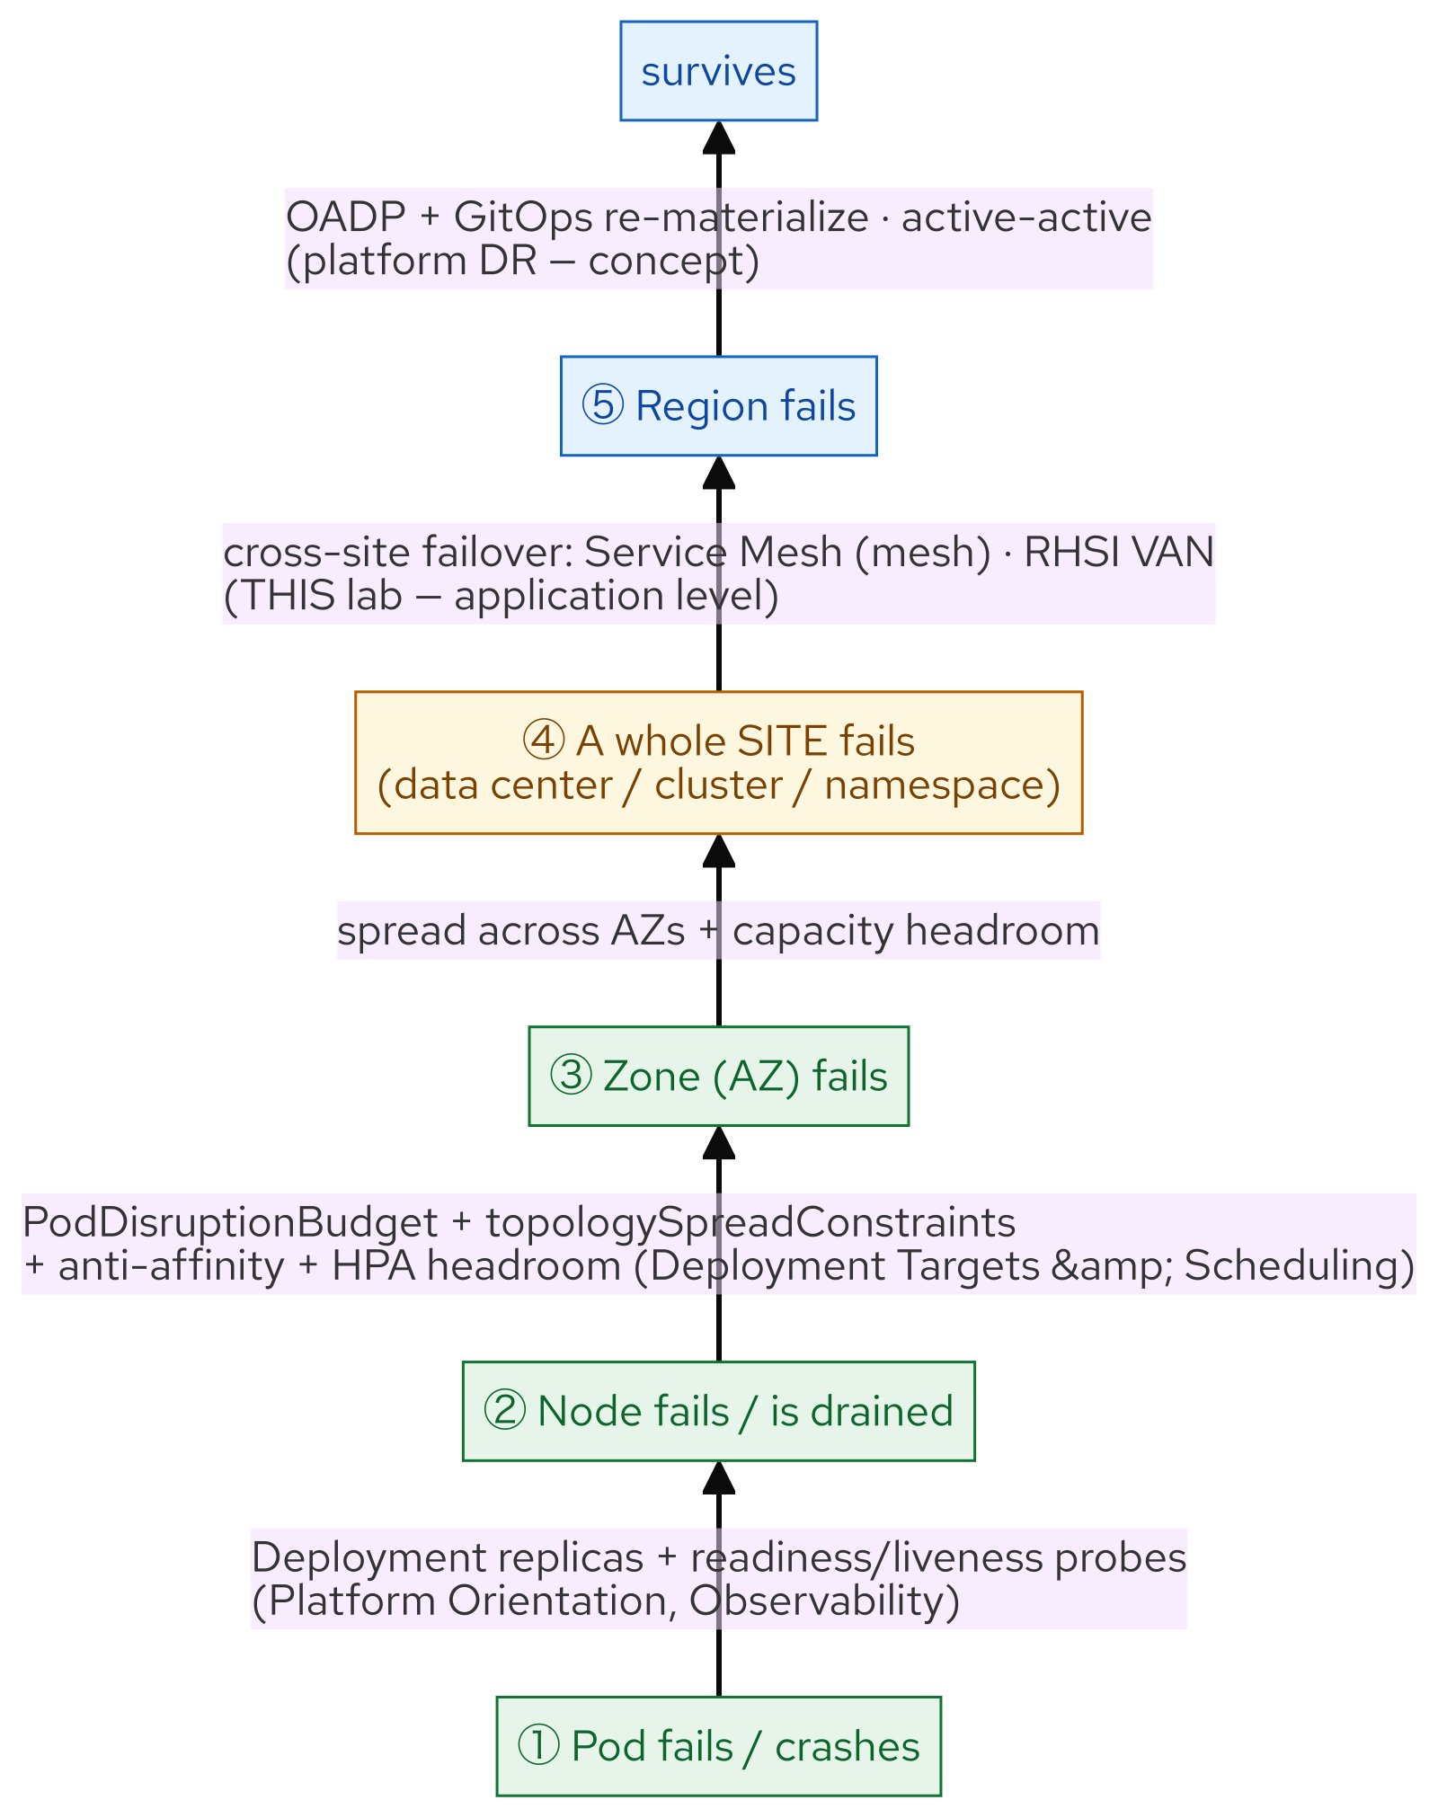
M22 · RESILIENCE, MULTI-CLUSTER & DR
Resilience ladder
CONFIDENTIAL
8
Notes:
Concept diagram: Resilience ladder.

Slide 10
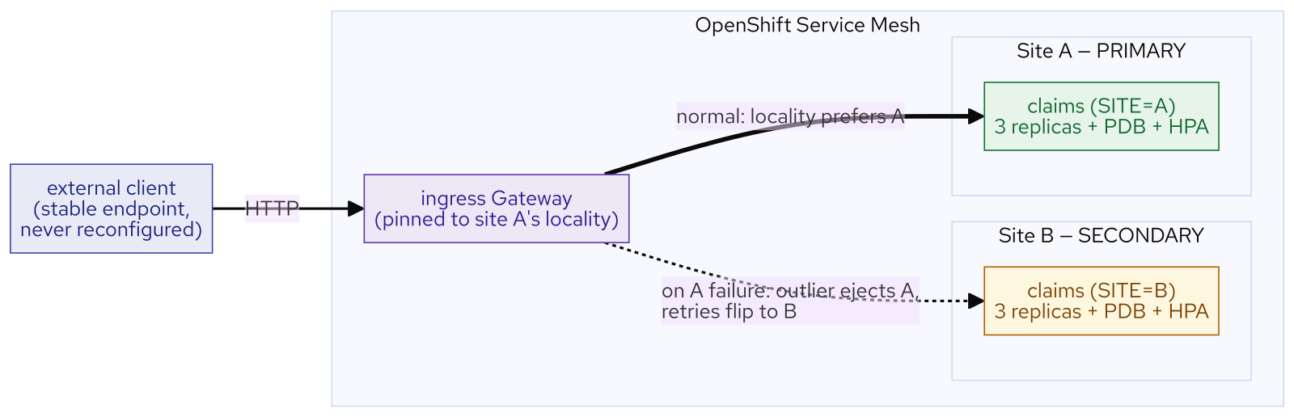
M22 · RESILIENCE, MULTI-CLUSTER & DR
Mesh failover
CONFIDENTIAL
9
Notes:
Concept diagram: Mesh failover.

Slide 11
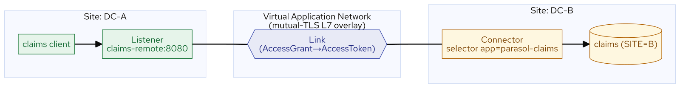
M22 · RESILIENCE, MULTI-CLUSTER & DR
Rhsi van
CONFIDENTIAL
10
Notes:
Concept diagram: Rhsi van.

Slide 12
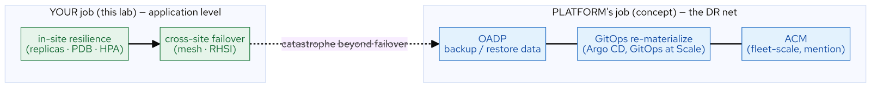
M22 · RESILIENCE, MULTI-CLUSTER & DR
Dr safety net
CONFIDENTIAL
11
Notes:
Concept diagram: Dr safety net.

Slide 13
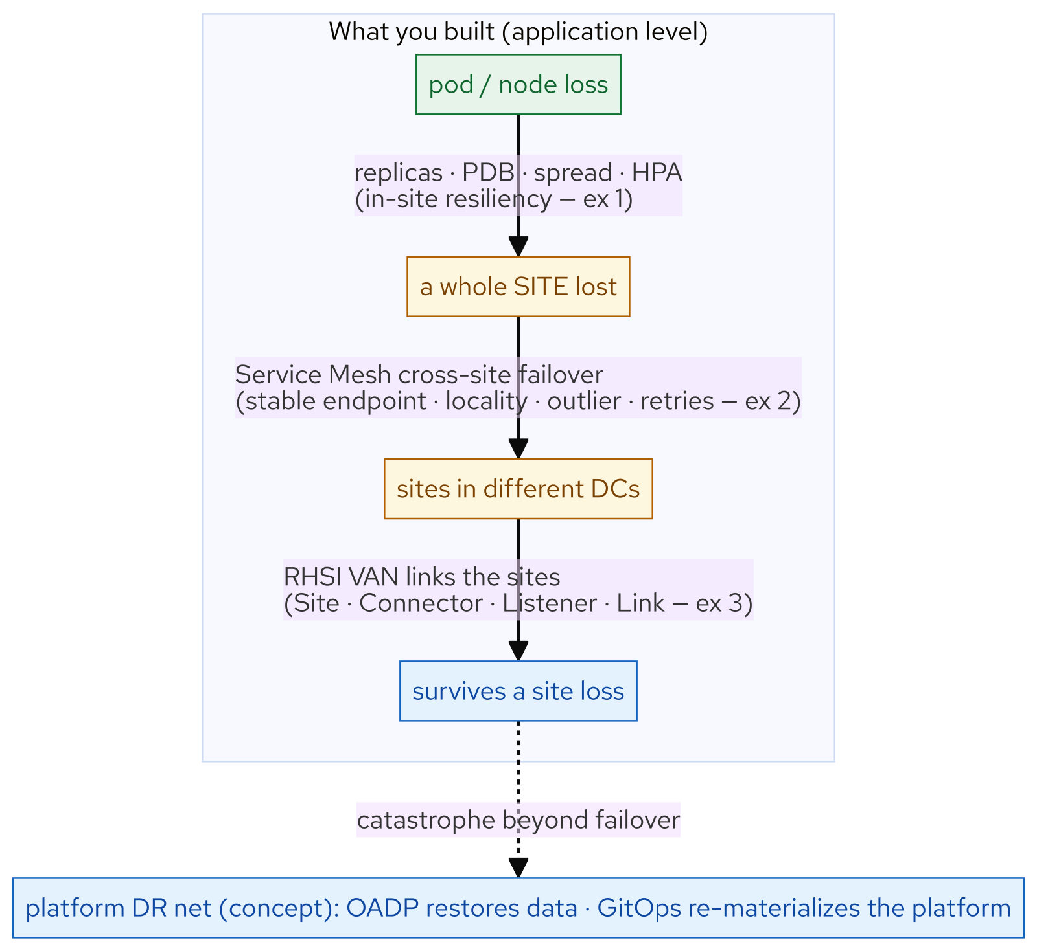
M22 · RESILIENCE, MULTI-CLUSTER & DR
What you built
CONFIDENTIAL
12
Notes:
Concept diagram: What you built.

