Slide 1

Week 13: Data Science Healthcare Final Presentation
Name: Serhat Uğur
E-mail: ugur.serhat@outlook.com
Country: Turkey
University: Anadolu University
Specialization: Data Science
GitHub Repo Link: https://github.com/serhatugur/data-science-internship

Slide 2
Agenda
Problem Description
Business Understanding
Data Understanding
Exploratory Data Analysis
Proposed Modeling Technique
Model Selection and Building

Slide 3
Problem Description
One of the challenges for all pharmaceutical companies is to understand the persistence of drugs as per the physician's prescription. To solve this problem, ABC Pharma Company approached an analytics company to automate the identification process.

Slide 4
Business Understanding
“Persistency_Flag” is the main target variable. This variable contains whether the patient is persistent or not. My main objective is to automate the process to find out if the patient will be persistent or not.

Slide 5
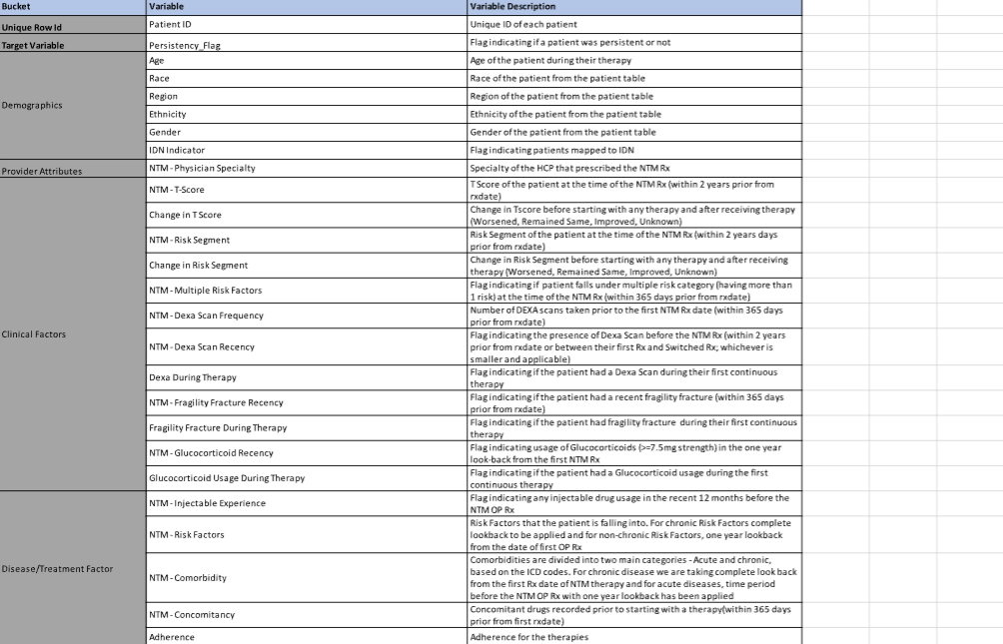
Data Understanding
The original dataset contains 3424 rows and 69 columns. Most of the columns have an object datatype.

Slide 6
EXPLORATORY DATA ANALYSIS

Slide 7
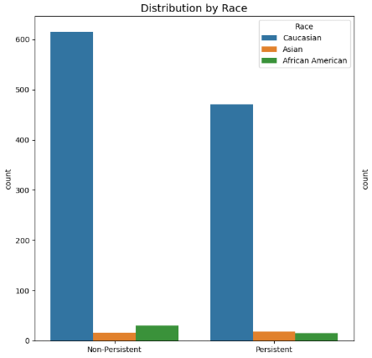
Distribution by Race
Caucasian is the most common race in the study.

Slide 8
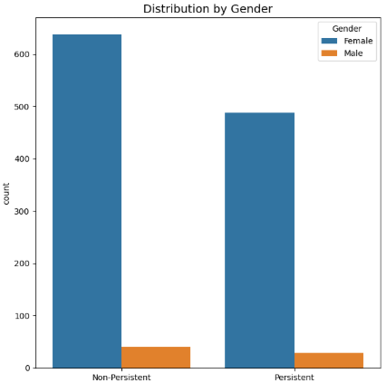
Distribution by Gender
In both groups, females number much more than the number of men.

Slide 9
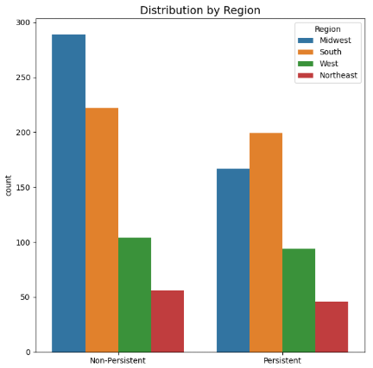
Distribution by Region
In both groups, the Midwest and South regions have more patients than the other regions.

Slide 10
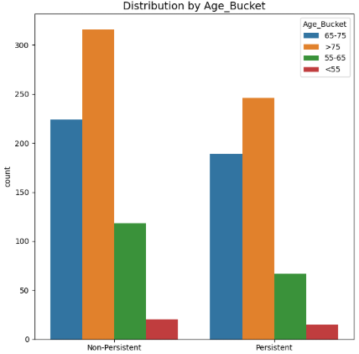
Distribution by Age
In both groups, 65+ age patients count higher than the others.

Slide 11
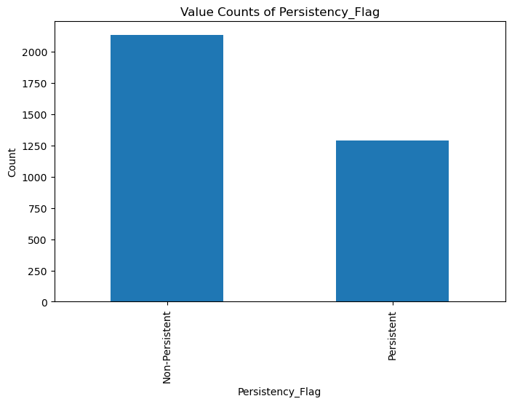
Non-persistent vs. Persistent
There are more non-persistent patients than the persistent group.

Slide 12
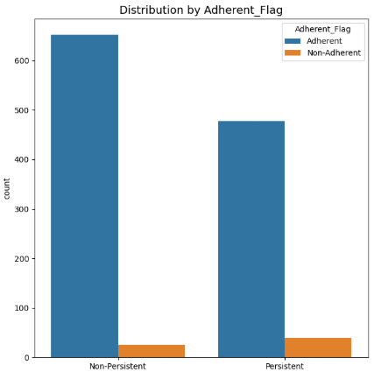
Distribution by Adherent_Flag
Most of the patients are following their medical advice.

Slide 13
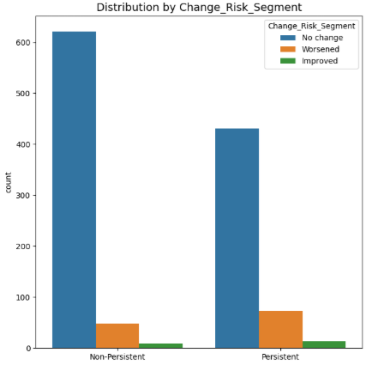
Distribution by Change_Risk_Segment
Mostly, there are no big risk changes for both groups. However, persistent groups’ risks tend to be higher compared to non-persistent patients.

Slide 14
Proposed Modeling Technique
The main goal of this analysis is to predict the persistence of patients as accurately as possible and provide actionable recommendations for improvement. The following steps outline the approach taken and the proposed next steps:
Model Development and Validation
This project will implement several machine learning models, such as logistic regression, random forest, and gradient boosting, to find reliable predictions.
Model Evaluation
Key performance metrics such as accuracy, precision, recall, F1-score, and AUC-ROC will be used for model comparisons. The most effective model will be chosen by balancing predictive power and interpretability.

Slide 15
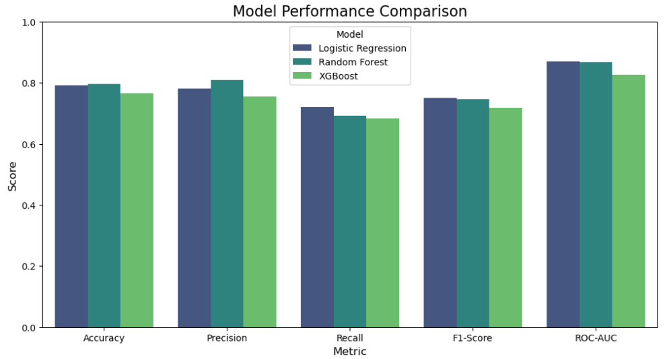
Model Selection and Building
For this project, I used logistic regression, random forest, and XGBoost. However, after doing cross-validation, we can choose logistic regression for our project.

Slide 16
Thank You for Your Time.

