Slide 1

Exploratory Data Analysis
G2M Insight for Cab Investment Firm
Serhat Uğur
10/15/2024

Slide 2
Introduction
XYZ is a private firm in US. Due to remarkable growth in the Cab Industry in last few years and multiple key players in the market, it is planning for an investment in Cab industry and as per their Go-to-Market(G2M) strategy they want to understand the market before taking final decision.

Slide 3
Approach
I looked at the data to make sure there weren’t any repeated sections and checked that everything was unique. I fixed one of the categories so the information was in the right format. Then, I combined all the data and explored it to see what insights I could find. Finally, I did five different tests to check some ideas and assumptions.

Slide 4
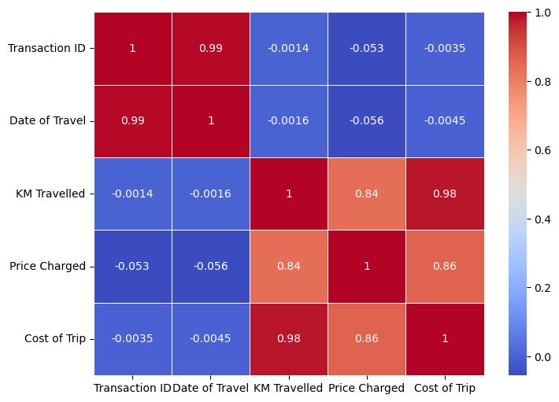
Correlation
When the correlation value is close to 1, it means there is a strong relationship between the two variables. If the value is close to -1, it shows a strong negative relationship, meaning when one goes up, the other goes down. A value near 0 indicates little to no relationship between them.
Strong Relationships
KM Travelled-Price Charged
KM Travelled-Cost of Trip

Slide 5
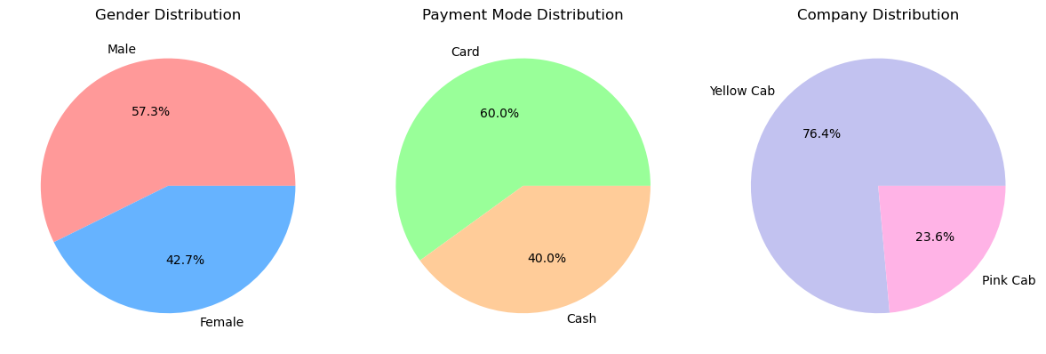
Overall Company Distribution

Slide 6
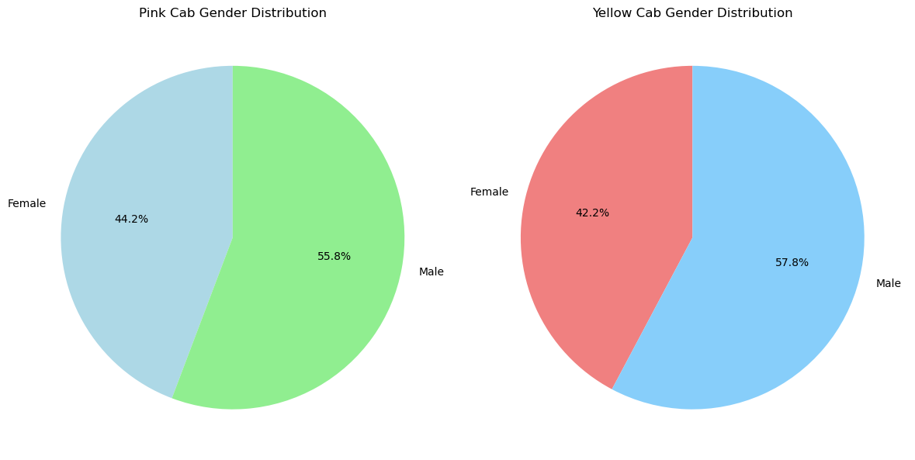
Gender Distribution for Two Different Company Types

Slide 7
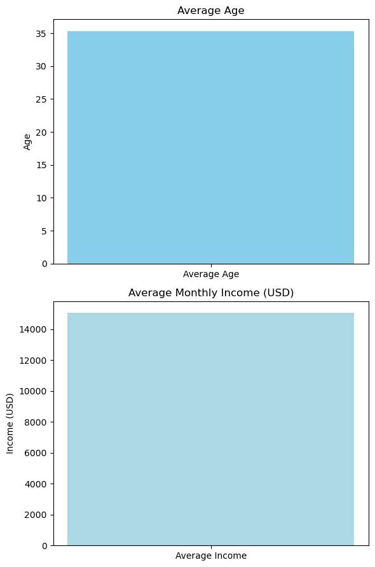
Average Age and Monthly Income ($)
The average age is: 35.34 years The average income is: $15048.82 USD/Month

Slide 8
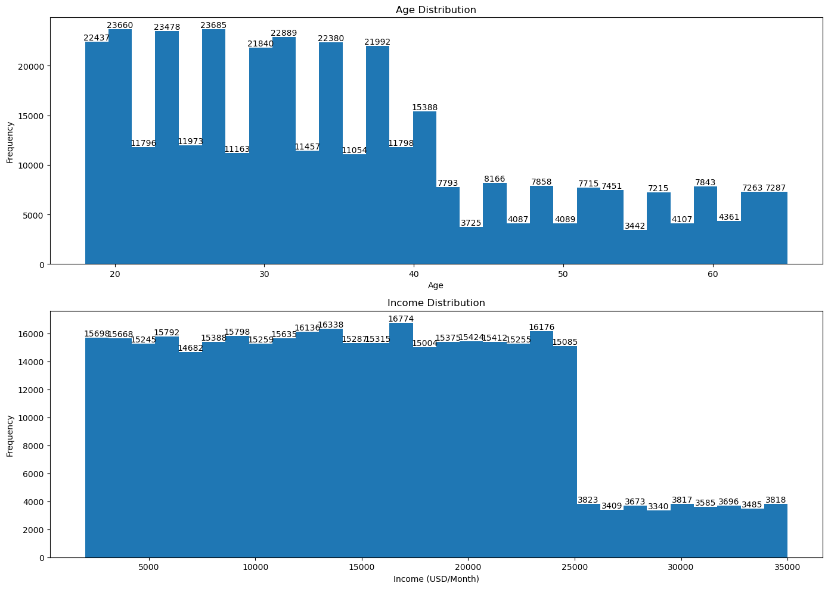
Age and Income Distribution

Slide 9
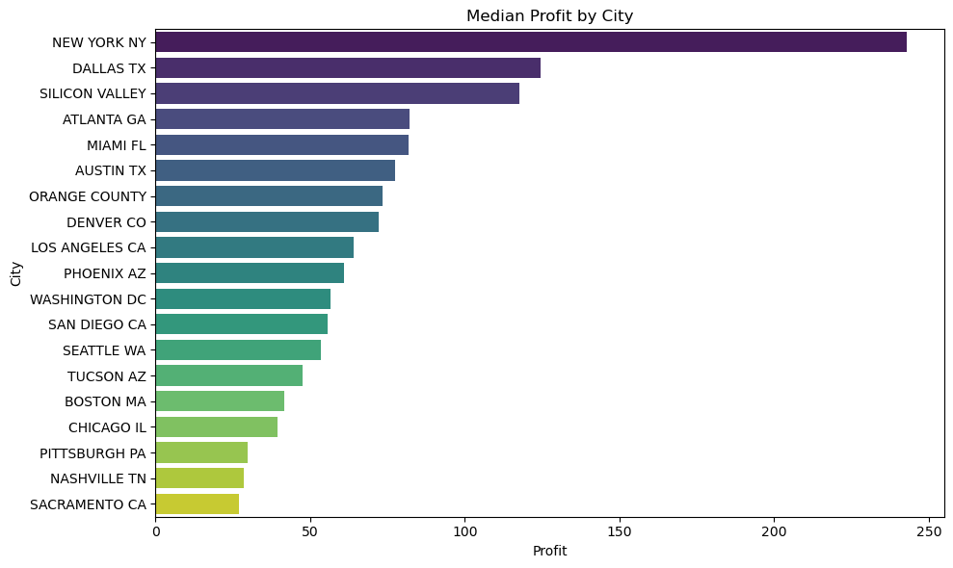
Median Profit by City

Slide 10
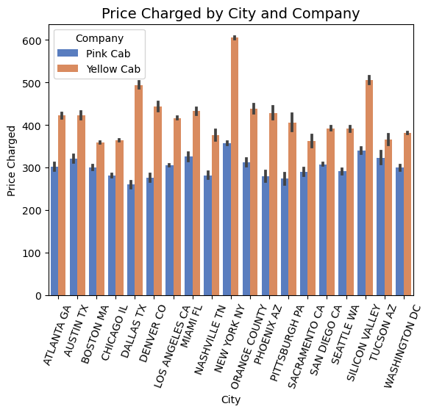
Price Charged by City and Company
Overall, yellow cab's price charge is higher than pink cab in every city.

Slide 11
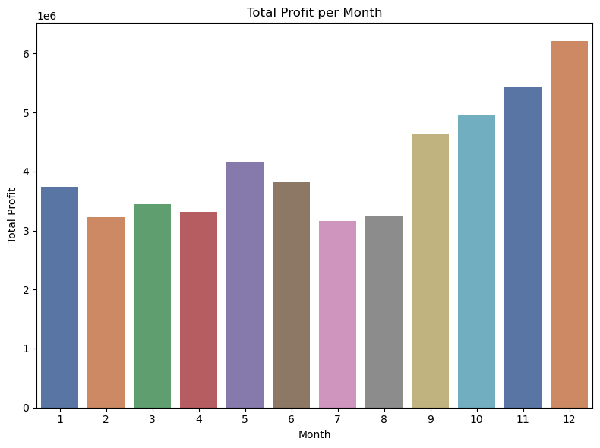
Total Profit per Month
The graph displays total profit from January to December.

Slide 12
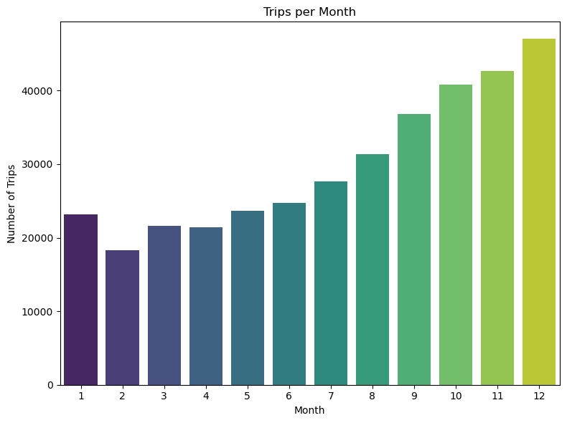
Trips per Month
The graph shows the number of trips from January to December.

Slide 13
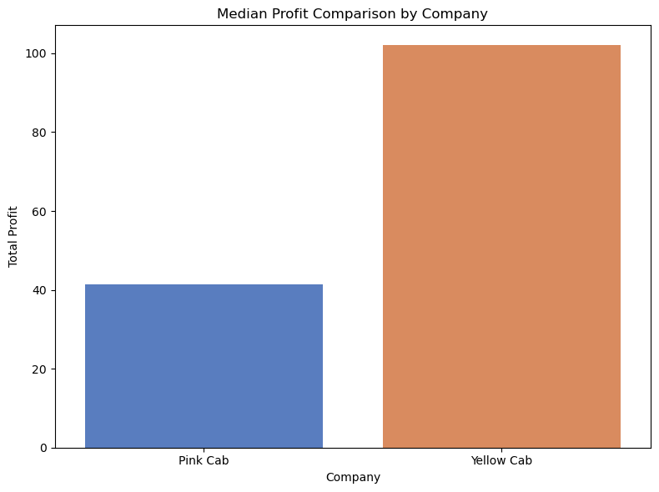
Median Profit Comparison by Company
Pink Cab has a lower median profit than yellow Cab.

Slide 14
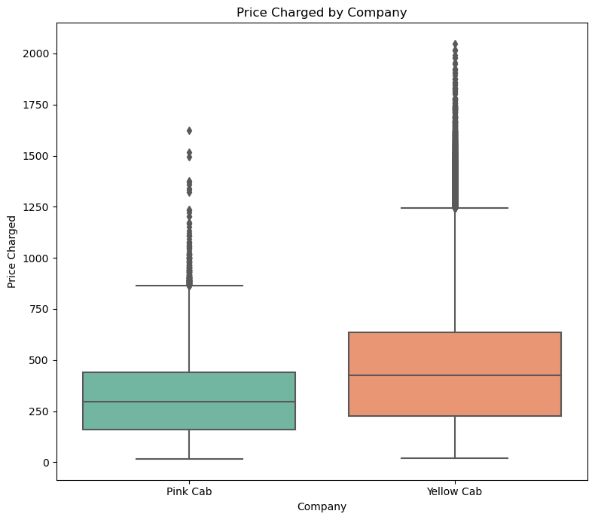
Price Charged by Company
Overall, yellow cabs charge more than pink cabs.

Slide 15
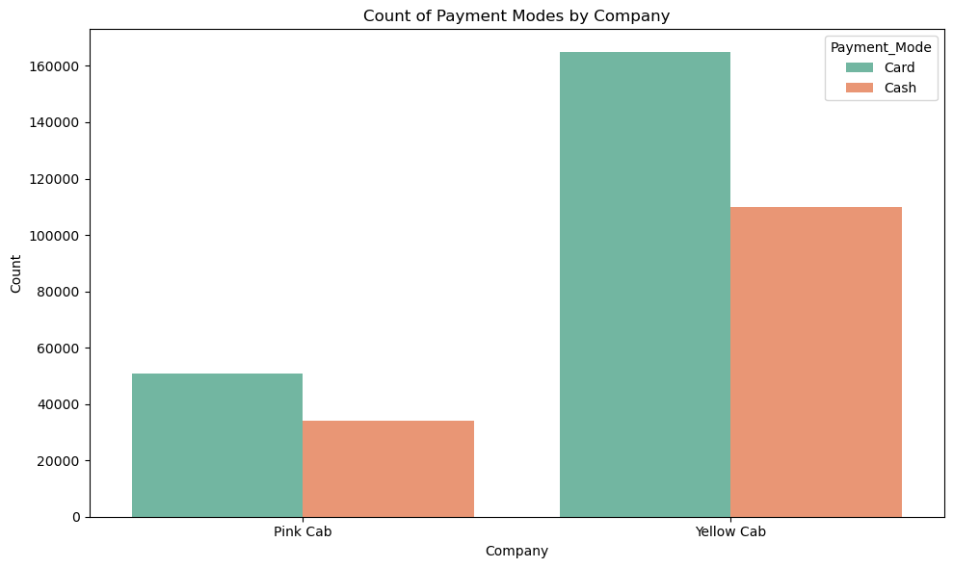
Count of Payment Modes by Company
People mostly prefer card rather than cash payment in both cab types.

Slide 16
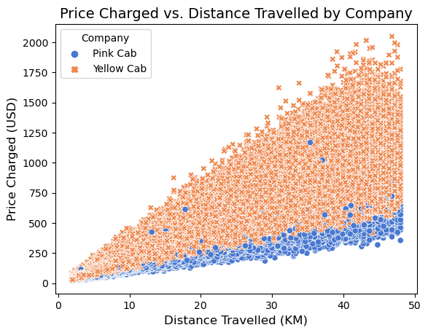
Price Charged vs. Distance Travelled by Company
As the distance increases, the price increases too.
Yellow cab has a wider range than pink cab.

Slide 17
Hypothesis Test Results
1) There is a significant relationship between KM traveled and cost of trip
2) There is no significant difference in the average cost of the trip between payment modes.
3) There is a significant difference in profit across different age groups.
4) There is a significant difference in the average price charged between genders.
5) There is a significant difference in the average price charged between high-income and low-income customers.

Slide 18
Summary and Recommendation
Yellow Cab generates more profit compared to pink Cab.
Yellow Cab usage rate is higher than pink Cab (76.4%–23.6%).
Yellow Cab also serves a broader range of customers compared to Pink Cab.
People generally tend to pay by card rather than cash.
Recommendation: We should consider investing in Yellow Cab rather than Pink Cab.

Slide 19
Thank you for your time.

