Slide 1

BIBLIOPHAGE APP
SE 307 Concepts of Object-Oriented
Assoc Prof.Dr Yuriy MISHCHENKO
Lutfu Melih Buğra Oğuzer

Slide 2

Nowadays there is no application that can respond to the requests of readers. Most of the existing applications are very inadequate
My aim is to develop a software for book-lovers

Slide 3

What is BIBLIOPHAGE ?
This software is to meet all the needs of reading people.
Here are some of the features of the application
Available
-Book management system
-Wish list
-Multiplatform with login system
Soon
-Borrower Reminder
-Rate and Comment System
-Quotes Area

Slide 4
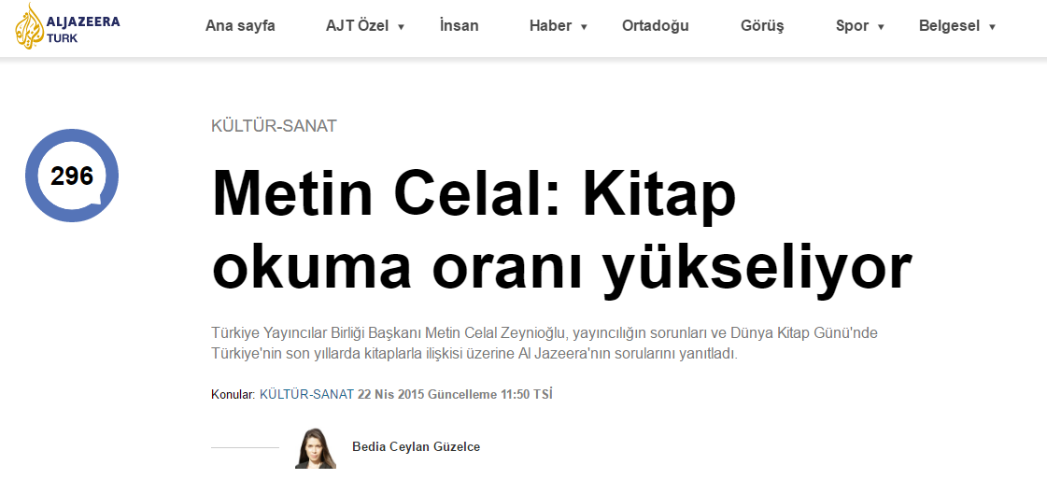
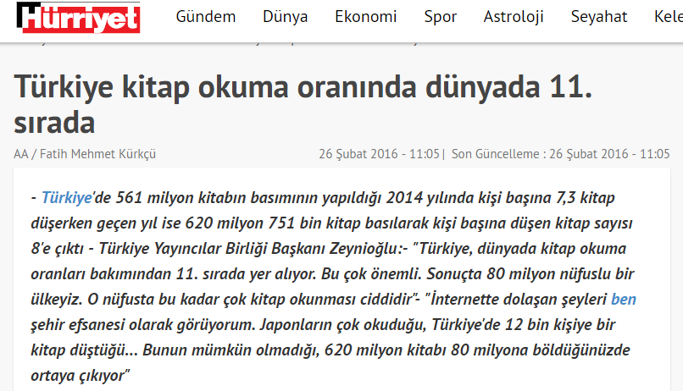
Why do I believe in this project?
Interestingly, the rate of reading rises in Turkey

Slide 5
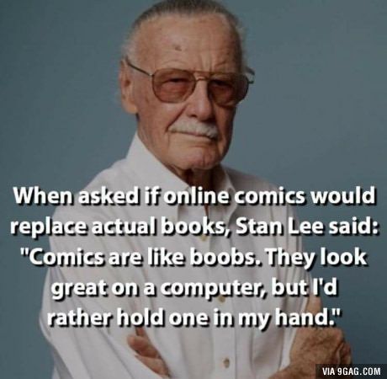
E-bookings are widespread, but some people always want physical products

Slide 6
Use Case

Slide 7
Statement of Work
This application was made for people who liked to read books.Some basic features are currently available.
-Login or Sign-up process
-Book Management System
-Wish List
From a user’s perspective,Firstly user must create a account for use this application.So every move the user makes will be exclusive to his account.Receiving mail,username and password from the user during sign-up. To log in, the user must type the user name and password.After the user log-in, user can add a book with ISBN,Title,Author,Page,Genre,Languange,Publisher infomations. The user can list their books offline at any time,the user delete books in the own library or change the book's information. The user can add a wish-list book at any time and the book that the user added can be deleted.

Slide 8
Functional Requirements
System should provide sign up and sign in facilities.
System must able to store added books
System should be able to list books
System shall display detailed book description consisting of name,title,author name,page,genre,language,publisher
System should provide delete books
System must able to store added wish in list

Slide 9
Non-Functional Requirements
System shall respond to click within 1 second
User information should be protected with a encryption algorithm
System must be user-friendly
System must be legal Intellectual property rights must be protected

Slide 10
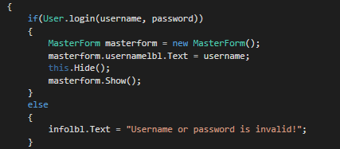
Before Class Diagram
I usually use bool as return in methods. I could move in different directions depending on the status of "true" and "false.Also mostly methods's type is static. The reason for this is that there is a lot of interaction between the two classes.

Slide 11
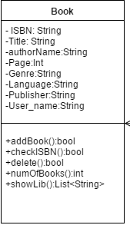
Book Class
This class is one of the focus points of the software.The already done application is mostly around books.Most of the important methods are structured under this class
Attributes
String title: Title of the book
String authorName; : Author Name of the book
Int page : Page Number of the book
String genre; Genre of the book
String lang : Language of the book
String publisher: Publisher Name of the book
String username; b

Slide 12
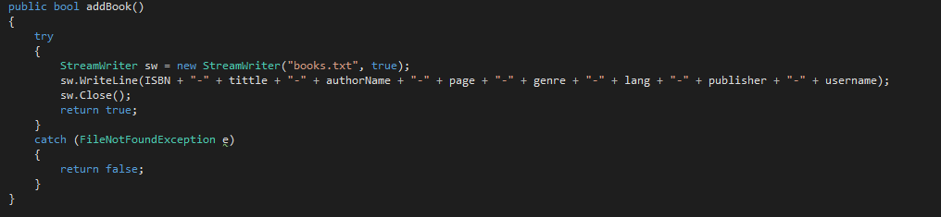
Code Implementation
Addbook()
This function retrieves book information from the user.After this process it writes this information to the file.also,function have “FileNotFoundException” exception

Slide 13
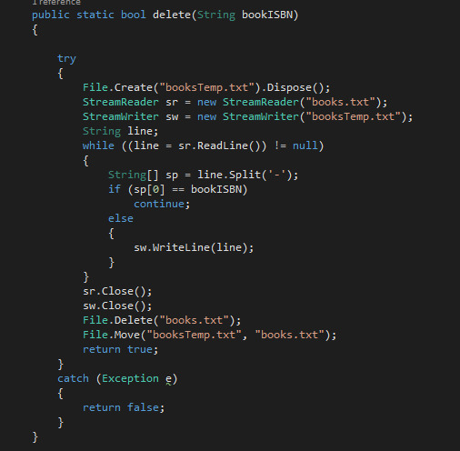
Deletebook();
This section deletes the books in the library.Additionly,bookISBN used as control during deletion.If BookISBN matches the isbn(sp[0]) at the list, the system will skip writing that line.So that book is not written on the list

Slide 14

Other Methods
checkisbn():This function provides control.For example,If a book is available and is trying to add the same book,system will notice it
numOfBooks():Function that counts the number of books
ShowLib(): This function takes book information and creates a list.I can show gui books with this list

Slide 15
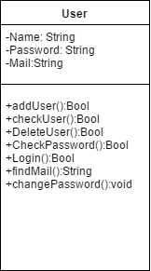
User Class
This class mostly deals with login processes. At the same time, most control methods are here
Attributes
String name; User's name
String password; User's password
String mail; User's mail

Slide 16
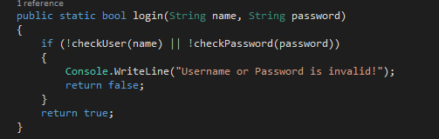
Code Implementation
login(): This method checks the username and password when logging in

Slide 17
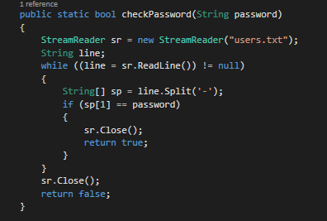
CheckPassword()
This function is controlling the password,of course we can control username too

Slide 18
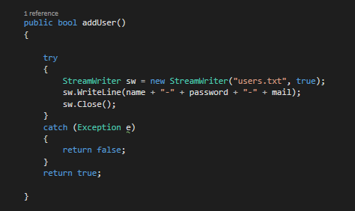
Other Methods
addUser(); This method creates new users
changepassword() This method change user’s password
findmail() This method found user’s mail
checkuser() This method control user name in data
deleteuser() This method delete user in database

Slide 19
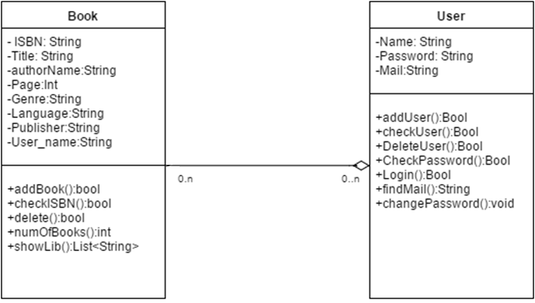
I could do the current program with these two classes.Of course gui available,Especially the wish-list part is working via gui.Most of my methods are static.The main reason for this is that there is a lot of interaction between classes and of course I did not want to create a lot of objects

Slide 20
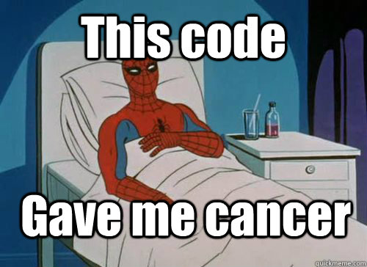
Where did I get cancer?
Of course there were a few problems I could not solve for a long time.The most difficult of these..

Slide 21
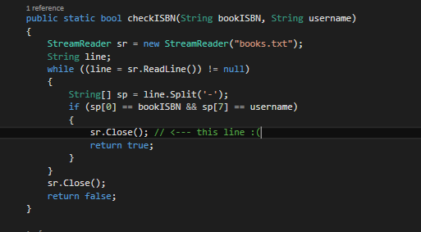
I was always take a file error in this area when i was programming.The program sometimes worked, sometimes did not.After 1 hour i found error. When code pass if condition, The system file is not closed because there is no Close() method in that range

Slide 22
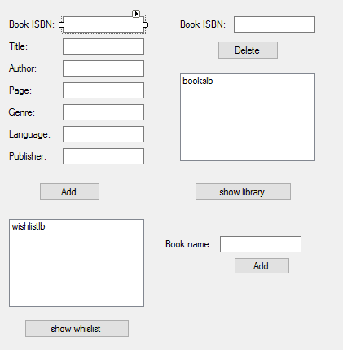
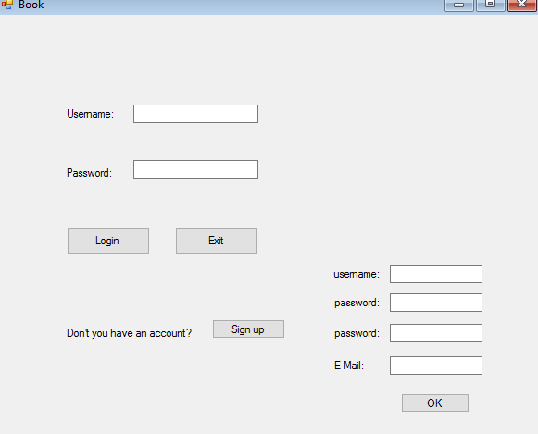
Example Ugly Gui Simples

Slide 23
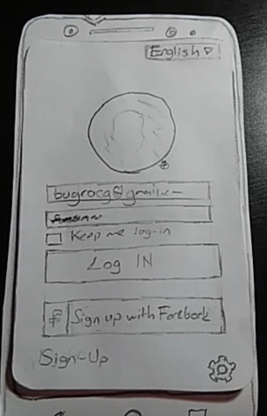
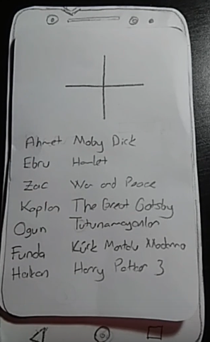
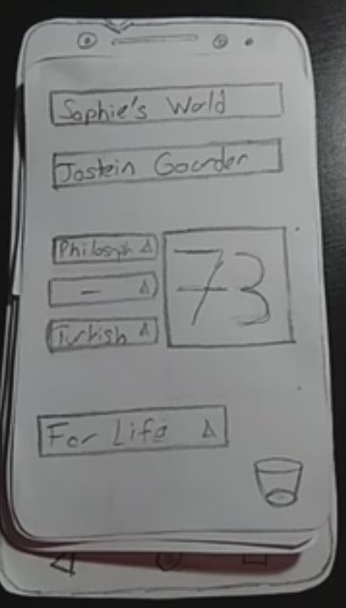
Future?

