Slide 1
DATA SCIENCE & MACHINE LEARNING CAPSTONE
Reproducible Wildfire Exposure Screening for Residential Location Selection in Mainland Portugal
Historical screening plus a validated annual comparative-exposure model—not a property-level safety forecast.
Serhii Diadechko
6 August 2026
Notes:
This capstone now has two clearly separated outputs. First, the historical screening summarises observed 2016–2025 fire recurrence for broad location comparison. Second, a fixed nine-feature hurdle model was evaluated on untouched predictor years 2022–2024, then refit through observed 2025 outcomes to publish a target-free 2026 comparative estimate. Neither output is a property-level safety forecast or purchase recommendation.
Key takeaway: the project moved from exploratory modelling to a governed annual model cycle while retaining historical recurrence as an interpretable reference.
[Sources]
- README.md
- reports/validation/final_temporal_test_2022_2024.md
- reports/validation/model_final_decision.md
- reports/validation/operational_forecast_2026_validation.md
- reports/validation/historical_exposure_screening_and_icnf_comparison.md

Slide 2
Historical evidence compares broad areas—not properties
MAINLAND PORTUGAL
How can historical wildfire evidence help compare candidate residential areas in mainland Portugal?
89,112
validated grid cells
The decision is national comparative shortlisting: apply one transparent method before investing time in detailed municipal, site, and property checks.
1 km
sole analytical cell resolution
Scope boundary: historical comparative screening only—no property-level safety guarantee or purchase decision.
02
Notes:
I frame the project around an early-stage buyer decision. Before comparing individual houses, a buyer may need to compare broad candidate areas across mainland Portugal using one consistent evidence base. The analytical unit is a 1 km cell, and the final screening layer includes 89,112 mainland cells. The tool gives every candidate area the same historical-recurrence definition and the same official comparison reference.
Key takeaway for the assessor: this is a national comparative screening problem, not a building-level safety classification.
Methodological nuance: the 2 km measure used later is an outward context around each 1 km cell; it is not a second analytical grid.
Likely assessor question and answer
Why not label lower-exposure cells as safe? Because the evidence excludes property construction, immediate vegetation, access, suppression, ignition likelihood, and future weather.
[Sources]
- README.md
- reports/validation/historical_exposure_screening_and_icnf_comparison.md
- reports/validation/spatial_output_registry.md

Slide 3
National coverage makes the method consistent
and supports honest temporal validation
NATIONAL FIRST
Consistent
One method across the full range of mainland wildfire conditions
The same definitions and processing rules apply across mainland Portugal.
Representative
The screening spans the country's broad range of historical wildfire conditions.
Testable
89,112 cells and 15 labelled predictor years supported strict temporal evaluation before a fixed nine-feature model was refit through 2025 outcomes.
Separated training, validation, and final-test years support an honest temporal evaluation.
Reusable
The result is one inspectable national GeoPackage and QGIS presentation layer.
National screening does not replace municipal or property-level assessment.
03
Notes:
All mainland Portugal was analysed because the buyer's first comparison can be national: compare broad candidate areas, then investigate shortlisted places locally. The canonical grid has 89,112 cells. Model development uses 15 labelled predictor years from 2010 through 2024, with outcomes through 2025, while the historical screening GeoPackage stores one geometry per cell.
Key takeaway: national coverage is a consistent decision framework, not a claim of property-level precision.
[Sources]
- README.md
- reports/validation/national_panel_2015_2024_validation.md
- reports/validation/final_temporal_test_2022_2024.md
- reports/validation/spatial_output_registry.md

Slide 4
One workflow keeps three evidence roles distinct
1
2
3
4
5
6
ICNF burned areas
Canonical grid
Historical bands
Frozen ML evaluation
Official comparison
Present outputs
Observed history
2016–2025
1 km cells;
2 km context
0–1 / 2–3 /
4–10 years
2010–19 fit
2020–21 validate
2022–24 test
2020–2030
structural hazard
GeoPackage • QGIS
Figures • reports
Nine-feature model context
CLC land cover • Copernicus DEM terrain • ERA5-Land JJAS climate • strictly prior fire history
The official ICNF structural-hazard layer is neither the regression target nor an accuracy benchmark.
04
Notes:
The workflow keeps three analytical roles distinct. ICNF annual burned areas provide strictly prior fire history and next-year outcomes. The model uses nine governed land-cover, terrain, climate, and history features under a temporal protocol. Separately, observed 2016–2025 recurrence is presented as historical screening and the official ICNF structural-hazard map is an independent comparison reference.
Key takeaway: model estimates, observed historical screening, and official structural hazard have different meanings and are never substituted for one another.
[Sources]
- docs/data_dictionary.md
- reports/validation/final_temporal_test_2022_2024.md
- reports/validation/historical_exposure_screening_and_icnf_comparison.md
- docs/operational_forecast_cycle.md

Slide 5
Zero-heavy outcomes make low error deceptively easy
Exact zeros dominate the target
Three complementary questions
A regression that stays near zero can achieve a low average error while failing to rank many fire-affected cells near the top.
MAE
How large is the average absolute error?
RMSE
How strongly are larger errors penalised?
0
exact zero is a valid outcome
Capture@20%
How many positive-target cells appear in the top-ranked fifth?
Comparative estimates require error, calibration, and ranking evidence.
05
Notes:
The target is zero-heavy. An always-zero reference can produce deceptively low average error while offering no useful ranking. The project therefore reports MAE and RMSE, positive-target errors, mean predicted versus observed share, and Capture@20% as a ranking diagnostic. Capture@20% is not a buyer threshold.
On the frozen final temporal test, the nine-feature hurdle improved all-row MAE and Capture@20% versus the historical-recurrence baseline, while RMSE was essentially unchanged and positive-target error was slightly worse.
[Sources]
- reports/validation/national_panel_model_readiness_eda.md
- reports/validation/final_temporal_test_2022_2024.md
- docs/success_criteria.md

Slide 6
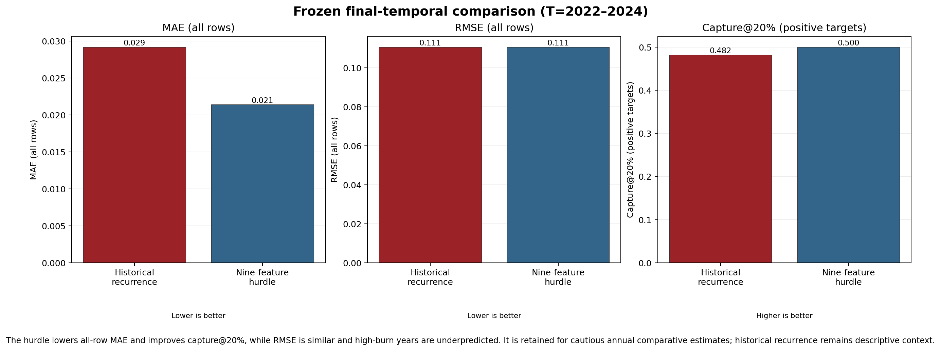
Nine-feature hurdle: lower MAE, better ranking
On T=2022–2024, the hurdle reduced MAE and improved Capture@20% versus recurrence, while RMSE remained similar and the high-burn T=2024 outcome was underpredicted.
06
Notes:
The figure compares the frozen historical-recurrence baseline with the frozen nine-feature hurdle on untouched predictor years T=2022–2024. Overall MAE improved from 0.0292 to 0.0214 and Capture@20% improved from 48.2% to 50.0%. RMSE was essentially unchanged at about 0.111. The model underpredicted the unusually high observed mean in T=2024, so annual estimates must be interpreted cautiously.
Key takeaway: the hurdle adds useful comparative variation, but it is not a probability or property-level prediction.
[Sources]
- reports/figures/validation_baseline_vs_tested_models.png
- data/processed/extended_model_selection_2010_2021/final_temporal_test_metrics.json
- reports/validation/final_temporal_test_2022_2024.md
- reports/validation/model_final_decision.md

Slide 7
From buyer request to comparative location shortlist
1
Buyer request
2
Reproducible lookup
3
Appropriate next step
Compare broad candidate areas before detailed property checks.
Read observed historical exposure and the complementary official class consistently.
Prioritise local due diligence according to the evidence—not an automatic accept or reject.
Fictional example — not a property recommendation
Candidate area
Historical exposure
Official structural hazard
Appropriate next step
Area A
Lower
Moderate
Prioritise detailed local checks
Area B
Moderate
High
Investigate prevention and access conditions
Area C
Higher
Very High
Require deeper specialist and local due diligence
The final classes summarise observed historical evidence consistently across the country. They support comparative shortlisting, not a property-level prediction or purchase decision.
07
Notes:
I use this fictional example to show the intended decision workflow without inventing analytical results. A buyer first identifies broad candidate areas. The same 1 km screening grid is then used to read the historical-exposure band calculated from observed 2016–2025 ICNF records in a 2 km context, alongside the independent official structural-hazard class. The result guides the depth and priority of local investigation rather than producing an automatic decision.
Key takeaway for the assessor: lower, moderate, and higher are comparative evidence categories, not property recommendations.
Methodological nuance: MAE and RMSE concern the unselected regressions. The final classes are calculated directly from observed historical recurrence, so their interpretation does not depend on model error.
Likely assessor question and answer
Why show fictional areas? They demonstrate an appropriate use process while avoiding unsupported rankings or claims about real locations.
[Sources]
- reports/validation/historical_exposure_screening_and_icnf_comparison.md
- qgis/README.md
- Fictional buyer example created for explanation; no analytical values are implied.

Slide 8
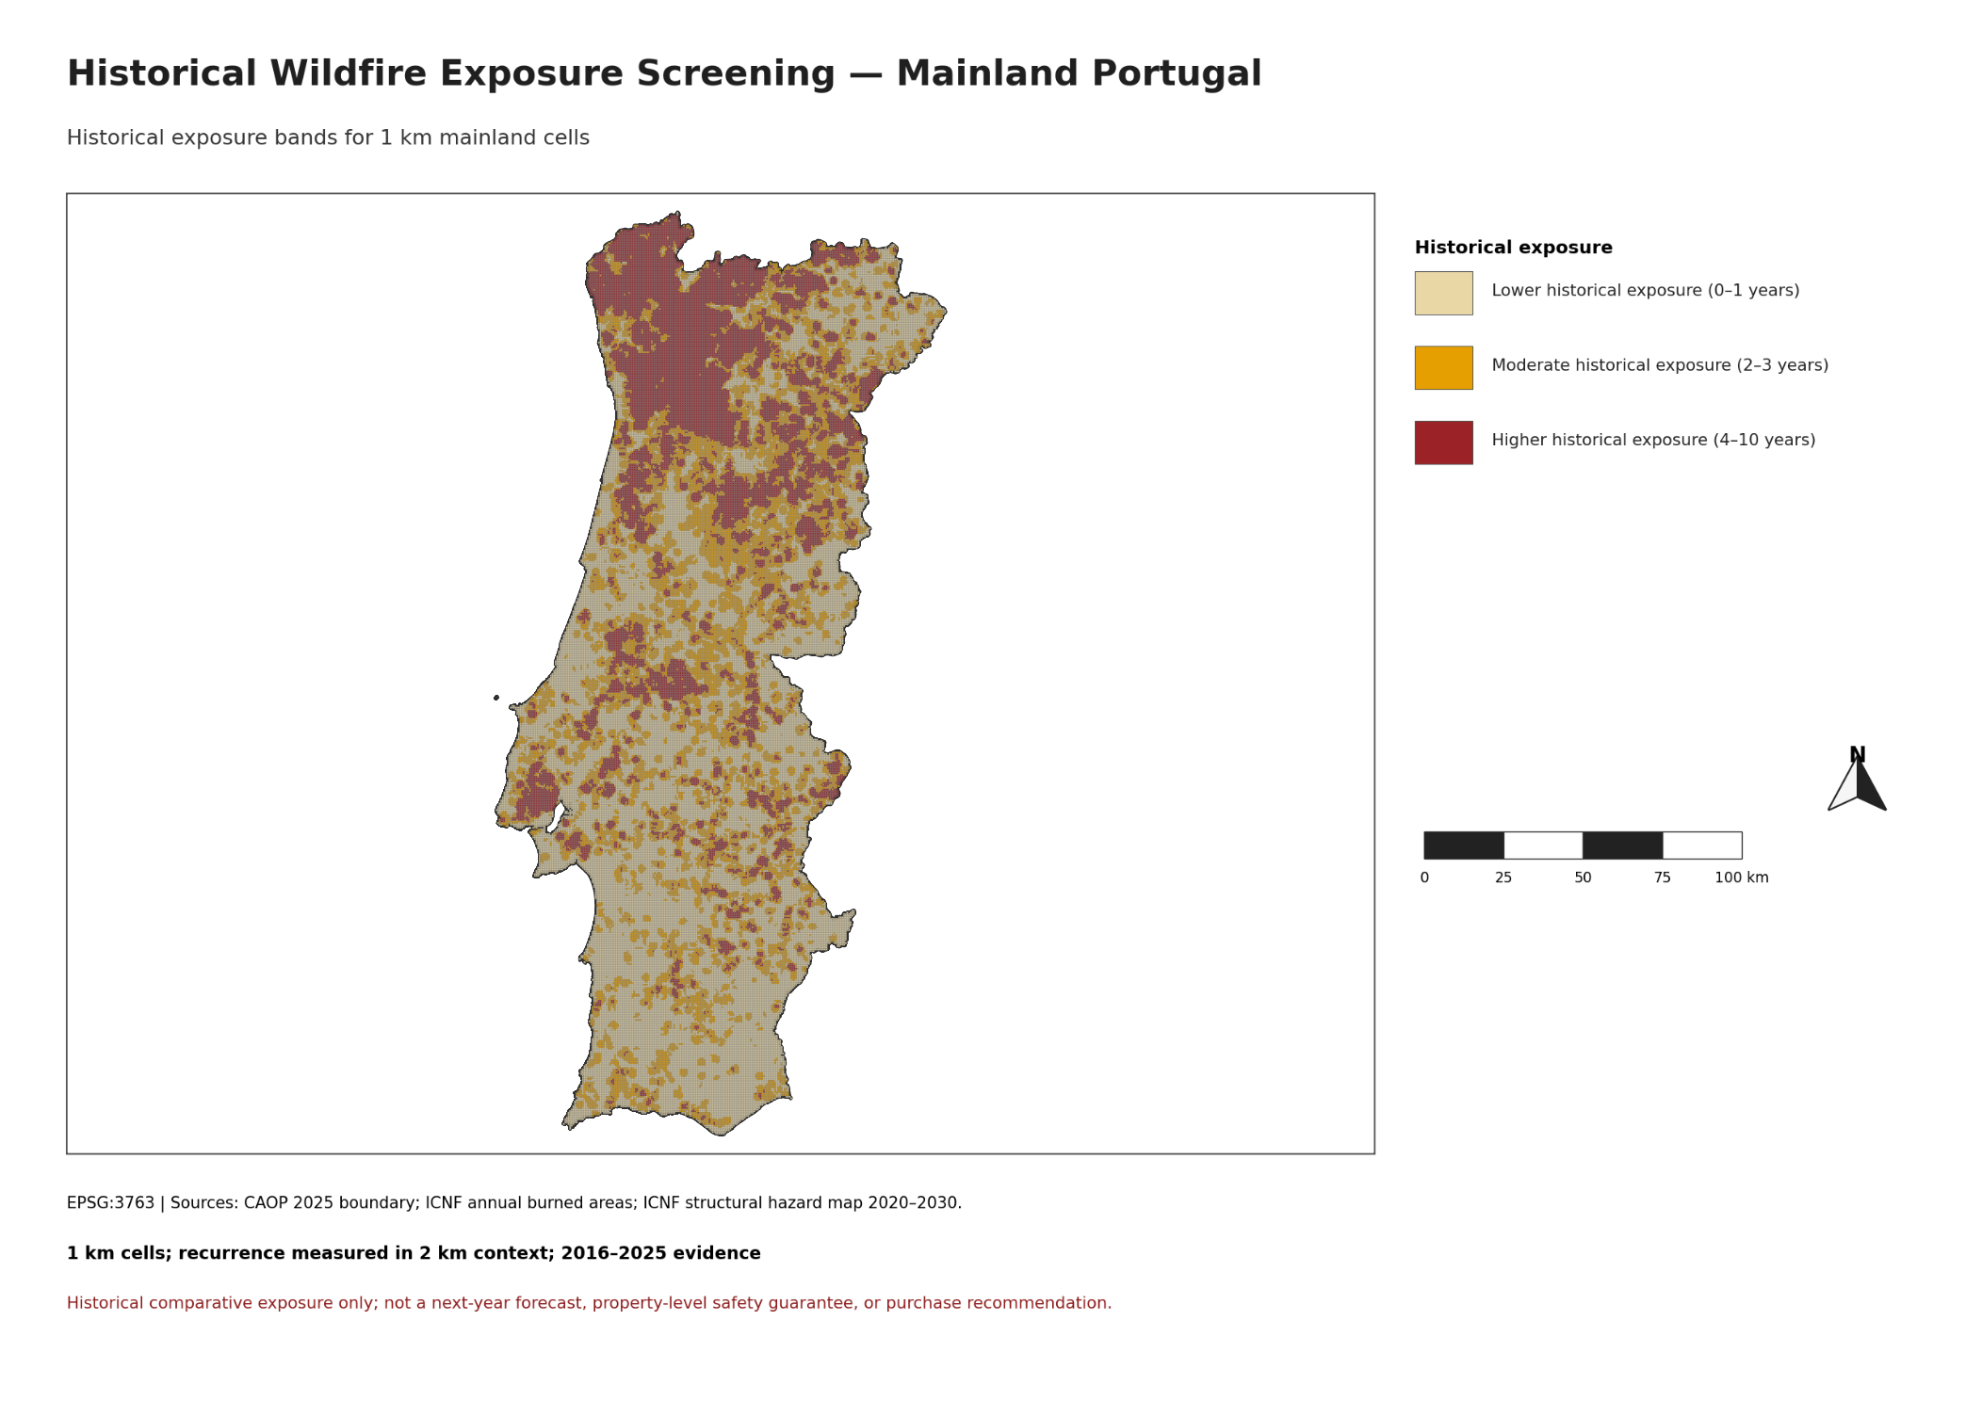
Observed recurrence defines the final screening bands
OBSERVED 2016–2025 EVIDENCE
Lower
0–1 observed fire years
Moderate
2–3 observed fire years
Higher
4–10 observed fire years
1 km mainland grid cells with fire recurrence measured in a 2 km context.
Lower historical exposure does not mean safe.
08
Notes:
This is the final historical-exposure screening map. For each canonical 1 km mainland cell, I count the distinct years from 2016 through 2025 in which its mainland-masked 2 km context intersected the dissolved annual ICNF burned-area geometry. The observed national recurrence distribution produced transparent bands: lower for zero to one fire years, moderate for two to three, and higher for four to ten.
Key takeaway for the assessor: the map is a direct, reproducible summary of observed recurrence across all 89,112 cells.
Methodological nuance: overlapping polygons within an annual ICNF layer were dissolved before intersection, preventing double counting. The 2 km context is a screening parameter; the mapped analytical geometry remains the 1 km cell.
Likely assessor question and answer
Does lower mean safe? No. It means fewer observed fire years in this evidence window and context, not zero future risk.
[Sources]
- reports/figures/historical_wildfire_exposure_screening_mainland_portugal.png
- reports/validation/historical_exposure_screening_and_icnf_comparison.md
- ICNF annual burned-area cartography, 2016–2025

Slide 9
Most cells fall in lower or moderate historical exposure
74.70%
of mainland cells are in the lower or moderate historical-exposure bands
Lower 41.12%
Moderate 33.57%
Higher 25.30%
Lower
Moderate
Higher
36,645 cells
29,919 cells
22,548 cells
41.12%
33.57%
25.30%
Complete national grid: 89,112 cells. Distribution is descriptive—not predictive performance or map accuracy.
09
Notes:
The national distribution is 36,645 lower-exposure cells, 29,919 moderate cells, and 22,548 higher cells. These correspond to 41.12%, 33.57%, and 25.30% of the 89,112-cell mainland grid. The classification therefore preserves meaningful variation rather than assigning nearly every location to one category.
Key takeaway for the assessor: the historical bands provide a complete, interpretable national distribution for comparative screening.
Methodological nuance: the thresholds are empirical recurrence tertiles at one and three years, translated into integer ranges. These shares describe the observed 2016–2025 recurrence classification; they are not predictive performance, class accuracy, or the prevalence of future fire.
Likely assessor question and answer
Were these thresholds tuned to a model? No. They were derived transparently from the national observed recurrence distribution after the predictive gate was closed.
[Sources]
- reports/figures/historical_exposure_screening_summary_table.png
- reports/tables/historical_exposure_band_summary.csv
- reports/validation/historical_exposure_screening_and_icnf_comparison.md

Slide 10
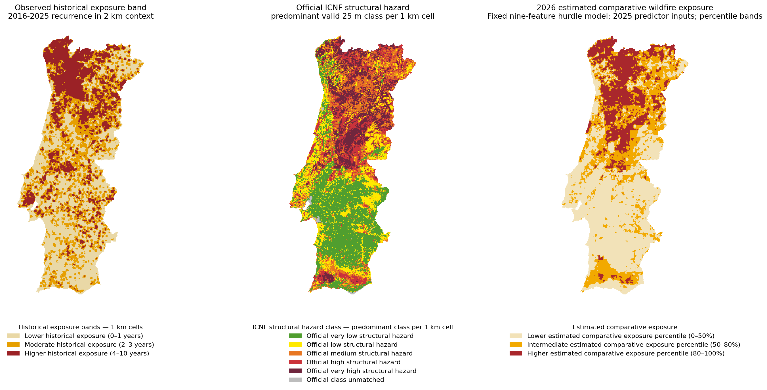
Three maps answer different questions
Observed history, official structure and the 2026 estimate are complementary
10
Notes:
The three maps use the same 89,112 mainland 1 km grid cells but answer different questions.
The left map summarizes observed ICNF fire recurrence during 2016-2025, measured in a 2 km outward context around each 1 km cell. The centre map shows the official ICNF structural wildfire-hazard classification for 2020-2030, summarized from the 25 m raster to each 1 km cell by predominant valid class. The right map is separate: it applies the fixed nine-feature hurdle model to validated 2025 predictor inputs and groups the stored continuous 2026 comparative estimate into presentation percentiles.
These views are complementary, not interchangeable. The historical and official maps are descriptive evidence under different methods. The 2026 layer is a target-free model estimate; there is no observed 2026 outcome yet, so it has no 2026 error score. None is a property-level safety guarantee or purchase recommendation.
[Sources]
- data/processed/spatial_outputs/historical_residential_wildfire_exposure_screening.gpkg
- data/processed/spatial_outputs/estimated_comparative_wildfire_exposure_2026.gpkg
- reports/validation/historical_exposure_screening_and_icnf_comparison.md
- reports/validation/operational_forecast_2026_validation.md
- src/historical_screening_reporting.py

Slide 11
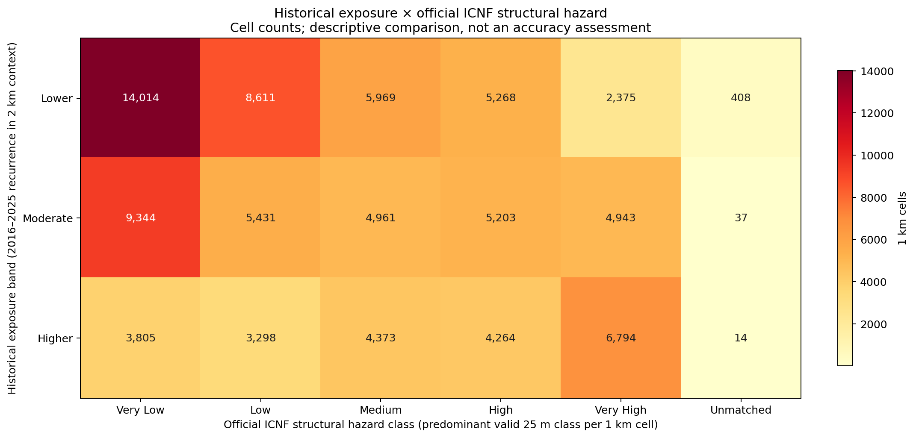
Correspondence is informative—not an accuracy score
43.59%
broad correspondence across matched cells
6,794
Higher × Very High
14,014
Lower × Very Low
3,805
Higher × Very Low
2,375
Lower × Very High
Descriptive correspondence only—not ICNF-map accuracy or model accuracy.
11
Notes:
The cross-tab quantifies how the two classifications relate at the shared 1 km comparison resolution. Higher historical exposure coincides with very high official hazard in 6,794 cells, while lower exposure coincides with very low official hazard in 14,014 cells. There are also informative disagreements: 3,805 cells combine higher historical exposure with very low official hazard, and 2,375 combine lower historical exposure with very high official hazard. Broad grouped levels coincide in 43.59% of matched cells.
Key takeaway for the assessor: correspondence and disagreement are both expected because the layers measure different concepts.
Methodological nuance: 43.59% is descriptive correspondence after grouping official classes; it is not a model-accuracy or official-map-accuracy statistic.
Likely assessor question and answer
Which map should override the other? Neither. They are complementary evidence and discrepancies should trigger deeper official and local investigation.
[Sources]
- reports/figures/historical_exposure_by_icnf_structural_hazard_crosstab.png
- reports/tables/historical_exposure_band_by_icnf_hazard_class.csv
- reports/validation/historical_exposure_screening_and_icnf_comparison.md

Slide 12
Two complementary outputs, explicit limits
EVIDENCE-TO-USE CONTRACT
CONCLUSION
1
Historical recurrence remains the transparent reference and a separate observed-history screening layer.
Validated ICNF
evidence
2016–2025
1 km cells
recurrence in
2 km context
Lower / moderate / higher
historical exposure
2
The frozen nine-feature hurdle improved final-test MAE and ranking, with similar RMSE and cautious high-burn calibration.
Use: broad location comparison and shortlisting; compare separately with official ICNF structural hazard.
3
The result combines an inspectable historical GIS layer with a reproducible annual comparative-estimate workflow.
Not a property-level safety guarantee, wildfire-risk probability, insurance estimate, or purchase recommendation.
ACTUAL DELIVERABLES
Python project + numbered notebooks • validated screening GeoPackage • portable QGIS project • figures, tables and validation reports • final PowerPoint presentation
Interactive layer: qgis/wildfire_exposure_screening_portugal.qgz
12
Notes:
The project retains two complementary products. Historical recurrence is a directly interpretable observed-evidence screening layer. The frozen nine-feature hurdle was evaluated on untouched 2022–2024 predictor years, refit through observed 2025 outcomes, and used to publish a target-free 2026 comparative estimate. Its high-burn calibration limitation is explicit.
Appropriate use is broad 1 km location comparison followed by local due diligence. Neither product is a safety guarantee, probability, insurance estimate, or purchase recommendation.
[Sources]
- reports/validation/model_final_decision.md
- reports/validation/operational_forecast_2026_validation.md
- reports/validation/spatial_output_registry.md
- qgis/wildfire_exposure_screening_portugal.qgz
- README.md

Slide 13
Likely assessor questions
Why all mainland Portugal?
Was the project successful?
The buyer's first comparison is national; local property checks follow after shortlisting.
Yes: it produced validated historical screening and a tested annual comparative-estimate workflow with explicit limits.
What was the hypothesis and result?
Why is the classification still useful?
The frozen nine-feature hurdle improved MAE and ranking versus recurrence, but not RMSE, on the final temporal test.
It directly summarizes observed 2016–2025 recurrence for consistent broad-location comparison.
Were the features sufficient?
Why retain recurrence if it is not prediction?
Nine governed features supported a useful comparative model; calibration remains weak for unusually high-burn years.
It remains an interpretable observed-history reference, separate from the model's annual estimate.
Central conclusion: retain both products—historical screening for context and the fixed hurdle for cautious annual comparison.
13
Notes:
Why all mainland Portugal? The buyer's first comparison can be national, followed by local property checks.
What was tested? A frozen historical-recurrence baseline and a nine-feature hurdle model under separated fit, validation, and final-test years.
What was the result? On T=2022–2024, the hurdle improved MAE from 0.0292 to 0.0214 and Capture@20% from 48.2% to 50.0%; RMSE remained about 0.111 and the high-burn T=2024 outcome was underpredicted.
Was the project successful? Yes as a reproducible, governed comparative-exposure project. The 2026 target-free model estimate and the 2016–2025 historical screening are separate products with explicit limitations.
Why keep recurrence? It is transparent observed evidence and a useful reference, not a next-year model output.
[Sources]
- reports/validation/final_temporal_test_2022_2024.md
- reports/validation/model_final_decision.md
- reports/validation/operational_forecast_2026_validation.md
- reports/validation/historical_exposure_screening_and_icnf_comparison.md

