Slide 1
DATA SCIENCE & MACHINE LEARNING CAPSTONE
Reproducible Wildfire Exposure Screening for Residential Location Selection in Mainland Portugal
A reproducible historical screening tool, not a property-level wildfire forecast.
Serhii Diadechko
5 August 2026
Notes:
I will present a capstone that began as a next-year wildfire-exposure modelling experiment and ended with a deliberately more cautious result. I tested whether a national set of land-cover, terrain, climate, and fire-history predictors could outperform a transparent historical-recurrence reference. The tested regressions did not pass the predefined validation gate, so I did not advance them to final testing or publish a predictive layer. Instead, the project delivers a reproducible historical screening for broad location comparison across mainland Portugal.
Key takeaway for the assessor: the value of the project is both the validated GIS deliverable and the evidence-based decision not to overclaim predictive performance.
Methodological nuance: the final exposure bands come directly from observed ICNF burned-area history; they are not Random Forest or Tweedie outputs.
[Sources]
- README.md
- reports/validation/train_validation_model_selection.md
- reports/validation/historical_exposure_screening_and_icnf_comparison.md
- docs/Capstone_Kickoff_Workbook_Serhii_Diadechko.docx

Slide 2
Historical evidence compares broad areas—not properties
MAINLAND PORTUGAL
How can historical wildfire evidence help compare candidate residential areas in mainland Portugal?
89,112
validated grid cells
The decision is national comparative shortlisting: apply one transparent method before investing time in detailed municipal, site, and property checks.
1 km
sole analytical cell resolution
Scope boundary: historical comparative screening only—no property-level safety guarantee or purchase decision.
02
Notes:
I frame the project around an early-stage buyer decision. Before comparing individual houses, a buyer may need to compare broad candidate areas across mainland Portugal using one consistent evidence base. The analytical unit is a 1 km cell, and the final screening layer includes 89,112 mainland cells. The tool gives every candidate area the same historical-recurrence definition and the same official comparison reference.
Key takeaway for the assessor: this is a national comparative screening problem, not a building-level safety classification.
Methodological nuance: the 2 km measure used later is an outward context around each 1 km cell; it is not a second analytical grid.
Likely assessor question and answer
Why not label lower-exposure cells as safe? Because the evidence excludes property construction, immediate vegetation, access, suppression, ignition likelihood, and future weather.
[Sources]
- README.md
- reports/validation/historical_exposure_screening_and_icnf_comparison.md
- reports/validation/spatial_output_registry.md

Slide 3
National coverage makes the method consistent
and supports honest temporal validation
NATIONAL FIRST
Consistent
One method across the full range of mainland wildfire conditions
The same definitions and processing rules apply across mainland Portugal.
Representative
The screening spans the country's broad range of historical wildfire conditions.
Testable
89,112 cells × 10 observation years supplied enough records for a strict temporal ML experiment without narrowing the buyer's national decision.
Temporal train and validation periods support an honest predictive experiment.
Reusable
The result is one inspectable national GeoPackage and QGIS presentation layer.
National screening does not replace municipal or property-level assessment.
03
Notes:
I analysed all mainland Portugal because the buyer's first choice can be national: compare broad candidate areas, then investigate shortlisted places locally. A national grid applies the same definitions to the north, centre, interior, coast, and south rather than changing methods by region. It also supplied enough cell-year records to test next-year regression models under a strict temporal split.
Key takeaway for the assessor: national coverage is a decision-design choice and a reproducibility advantage, not an attempt to claim property-level precision.
Methodological nuance: the national analytical panel contains repeated cell-year records for modelling, while the final screening GeoPackage contains one geometry per canonical cell.
Likely assessor question and answer
Why not begin with one region? A regional scope would not answer the buyer's initial national comparison and would reduce the range of conditions available for temporal validation.
[Sources]
- README.md
- reports/validation/national_panel_2015_2024_validation.md
- reports/validation/spatial_output_registry.md

Slide 4
One workflow keeps three evidence roles distinct
1
2
3
4
5
6
ICNF burned areas
Canonical grid
Historical bands
ML experiment
Official comparison
Present outputs
Observed history
2016–2025
1 km cells;
2 km context
0–1 / 2–3 /
4–10 years
2015–19 train
2020–21 validate
2020–2030
structural hazard
GeoPackage • QGIS
Figures • reports
Attempted regression context
CLC land cover • Copernicus DEM terrain • ERA5-Land JJAS climate • strictly prior fire history
The official ICNF structural-hazard layer is neither the regression target nor an accuracy benchmark.
04
Notes:
I designed the workflow so that each analytical role remains explicit. Annual ICNF burned-area records supply observed historical recurrence and next-year model outcomes. The canonical 1 km grid provides the analytical unit, while selected contextual measures use an outward 2 km buffer. The model experiment adds governed land cover, terrain, climate, and strictly prior fire history. Separately, the official ICNF structural-hazard map is summarized to the same cells for descriptive comparison.
Key takeaway for the assessor: observed history, attempted prediction, and official structural hazard are separate evidence layers with different meanings.
Methodological nuance: all modelling features obey temporal rules; the final historical bands use the latest complete observed 2016–2025 window directly and do not depend on model output.
Likely assessor question and answer
Was official hazard used to train or validate the model? No. It is an independent comparison reference only.
[Sources]
- docs/data_dictionary.md
- reports/validation/canonical_full_scope_readiness.md
- reports/validation/train_validation_model_selection.md
- reports/validation/historical_exposure_screening_and_icnf_comparison.md

Slide 5
Zero-heavy outcomes make low error deceptively easy
Exact zeros dominate the target
Three complementary questions
A regression that stays near zero can achieve a low average error while failing to rank many fire-affected cells near the top.
MAE
How large is the average absolute error?
RMSE
How strongly are larger errors penalised?
0
exact zero is a valid outcome
Capture@20%
How many positive-target cells appear in the top-ranked fifth?
Useful comparative prioritisation needs error and ranking evidence.
05
Notes:
The modelling challenge is the target distribution. Many cell-years have exactly zero burned share, so an always-zero reference can look strong on average error even though it provides no useful prioritisation. That is why I evaluated MAE and RMSE over all rows, positive-target error separately, and Capture@20%, which asks how many fire-affected rows appear in the highest-ranked fifth.
Key takeaway for the assessor: low error alone is insufficient when the practical question includes prioritising where observed fire outcomes occur.
Methodological nuance: Capture@20% is a ranking diagnostic for the attempted regression models. It is not an accuracy score for the final historical bands.
Likely assessor question and answer
Why not accept the zero reference because it has the lowest MAE? It predicts no meaningful variation and captures only 11.38% of positive targets in the top-ranked fifth.
[Sources]
- reports/validation/national_panel_model_readiness_eda.md
- reports/validation/train_validation_model_selection.md
- docs/success_criteria.md

Slide 6
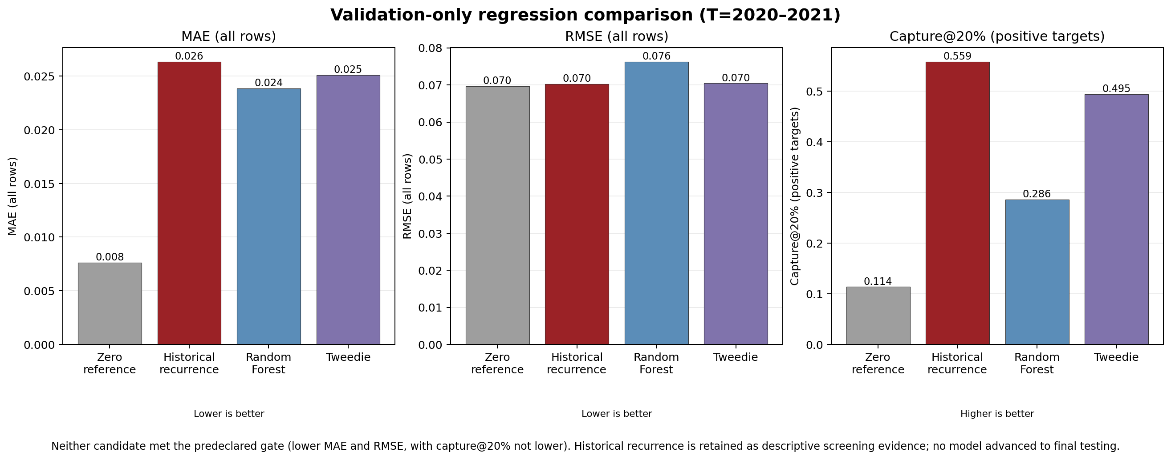
Validation rejected both predictive candidates
The ML models were not selected for prediction; observed historical recurrence was retained as the final, directly interpretable screening classification.
06
Notes:
This chart shows the validation-only evidence for the zero reference, the historical-fire baseline, Random Forest, and Tweedie. Historical recurrence captured 55.88% of positive-target rows in the top-ranked 20%, compared with 49.46% for Tweedie and 28.62% for Random Forest. Random Forest reduced MAE but worsened RMSE and ranking; Tweedie also failed the requirement for lower RMSE and non-inferior capture. Neither candidate passed the predefined gate, so no model advanced to final testing.
Key takeaway for the assessor: I closed the predictive gate rather than selecting a model on one favourable metric.
Methodological nuance: MAE and RMSE apply to the attempted regression outputs. Historical recurrence was retained as descriptive evidence, not re-labelled as a predictive model.
Likely assessor question and answer
What was the acceptance rule? At least 2% lower validation MAE and RMSE than the historical baseline, with Capture@20% no lower.
[Sources]
- reports/figures/validation_baseline_vs_tested_models.png
- reports/validation/train_validation_model_selection.md
- reports/validation/train_validation_model_selection.json

Slide 7
From buyer request to comparative location shortlist
1
Buyer request
2
Reproducible lookup
3
Appropriate next step
Compare broad candidate areas before detailed property checks.
Read observed historical exposure and the complementary official class consistently.
Prioritise local due diligence according to the evidence—not an automatic accept or reject.
Fictional example — not a property recommendation
Candidate area
Historical exposure
Official structural hazard
Appropriate next step
Area A
Lower
Moderate
Prioritise detailed local checks
Area B
Moderate
High
Investigate prevention and access conditions
Area C
Higher
Very High
Require deeper specialist and local due diligence
The final classes summarise observed historical evidence consistently across the country. They support comparative shortlisting, not a property-level prediction or purchase decision.
07
Notes:
I use this fictional example to show the intended decision workflow without inventing analytical results. A buyer first identifies broad candidate areas. The same 1 km screening grid is then used to read the historical-exposure band calculated from observed 2016–2025 ICNF records in a 2 km context, alongside the independent official structural-hazard class. The result guides the depth and priority of local investigation rather than producing an automatic decision.
Key takeaway for the assessor: lower, moderate, and higher are comparative evidence categories, not property recommendations.
Methodological nuance: MAE and RMSE concern the unselected regressions. The final classes are calculated directly from observed historical recurrence, so their interpretation does not depend on model error.
Likely assessor question and answer
Why show fictional areas? They demonstrate an appropriate use process while avoiding unsupported rankings or claims about real locations.
[Sources]
- reports/validation/historical_exposure_screening_and_icnf_comparison.md
- qgis/README.md
- Fictional buyer example created for explanation; no analytical values are implied.

Slide 8
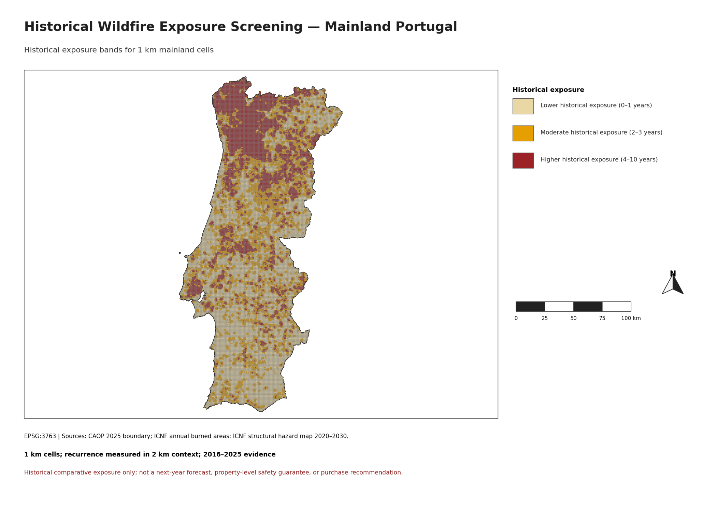
Observed recurrence defines the final screening bands
OBSERVED 2016–2025 EVIDENCE
Lower
0–1 observed fire years
Moderate
2–3 observed fire years
Higher
4–10 observed fire years
1 km mainland grid cells with fire recurrence measured in a 2 km context.
Lower historical exposure does not mean safe.
08
Notes:
This is the final historical-exposure screening map. For each canonical 1 km mainland cell, I count the distinct years from 2016 through 2025 in which its mainland-masked 2 km context intersected the dissolved annual ICNF burned-area geometry. The observed national recurrence distribution produced transparent bands: lower for zero to one fire years, moderate for two to three, and higher for four to ten.
Key takeaway for the assessor: the map is a direct, reproducible summary of observed recurrence across all 89,112 cells.
Methodological nuance: overlapping polygons within an annual ICNF layer were dissolved before intersection, preventing double counting. The 2 km context is a screening parameter; the mapped analytical geometry remains the 1 km cell.
Likely assessor question and answer
Does lower mean safe? No. It means fewer observed fire years in this evidence window and context, not zero future risk.
[Sources]
- reports/figures/historical_wildfire_exposure_screening_mainland_portugal.png
- reports/validation/historical_exposure_screening_and_icnf_comparison.md
- ICNF annual burned-area cartography, 2016–2025

Slide 9
Most cells fall in lower or moderate historical exposure
74.70%
of mainland cells are in the lower or moderate historical-exposure bands
Lower 41.12%
Moderate 33.57%
Higher 25.30%
Lower
Moderate
Higher
36,645 cells
29,919 cells
22,548 cells
41.12%
33.57%
25.30%
Complete national grid: 89,112 cells. Distribution is descriptive—not predictive performance or map accuracy.
09
Notes:
The national distribution is 36,645 lower-exposure cells, 29,919 moderate cells, and 22,548 higher cells. These correspond to 41.12%, 33.57%, and 25.30% of the 89,112-cell mainland grid. The classification therefore preserves meaningful variation rather than assigning nearly every location to one category.
Key takeaway for the assessor: the historical bands provide a complete, interpretable national distribution for comparative screening.
Methodological nuance: the thresholds are empirical recurrence tertiles at one and three years, translated into integer ranges. These shares describe the observed 2016–2025 recurrence classification; they are not predictive performance, class accuracy, or the prevalence of future fire.
Likely assessor question and answer
Were these thresholds tuned to a model? No. They were derived transparently from the national observed recurrence distribution after the predictive gate was closed.
[Sources]
- reports/figures/historical_exposure_screening_summary_table.png
- reports/tables/historical_exposure_band_summary.csv
- reports/validation/historical_exposure_screening_and_icnf_comparison.md

Slide 10
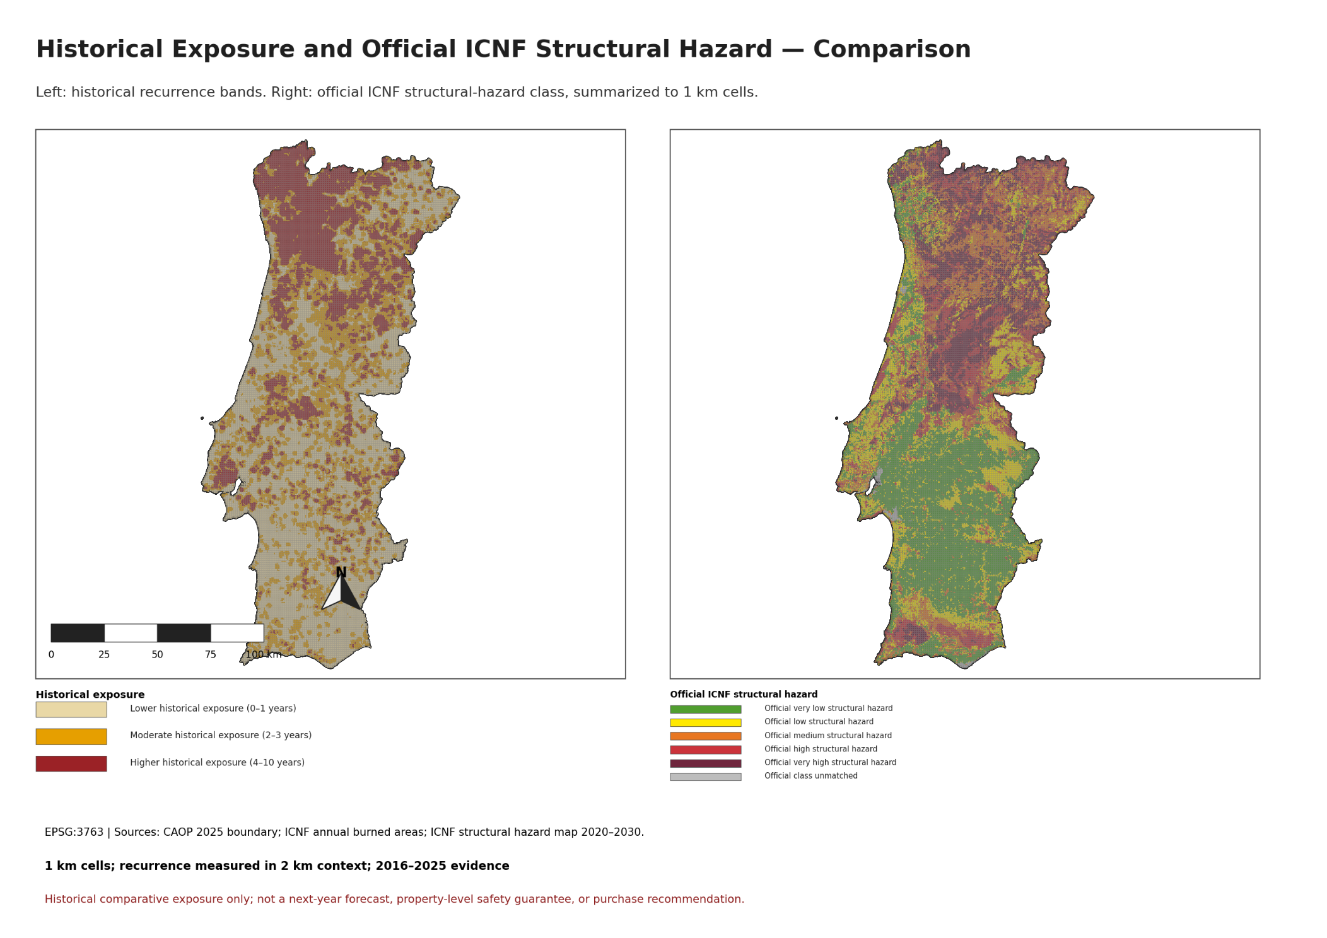
The two maps answer different questions
Observed recurrence and official structural propensity are complementary
10
Notes:
The left map asks how frequently each cell's context was affected in the observed 2016–2025 burned-area record. The right map shows the official ICNF structural wildfire-hazard classification for 2020–2030. The official source begins as a 25 m raster and is summarized to each 1 km cell using the predominant valid class. These layers measure related but different concepts: recent observed recurrence versus structural propensity under the official methodology.
Key takeaway for the assessor: this is not prediction versus real fire data, and neither layer is used as an accuracy benchmark for the other.
Methodological nuance: exact modal ties in the official raster select the higher class; cells without valid official pixels remain unmatched rather than being assigned a low class.
Likely assessor question and answer
Why compare them? Agreement and disagreement reveal where recent observed recurrence aligns—or does not align—with the independent structural assessment, guiding further investigation.
[Sources]
- reports/figures/historical_exposure_and_official_icnf_structural_hazard_comparison.png
- reports/validation/historical_exposure_screening_and_icnf_comparison.md
- ICNF SRUP structural wildfire hazard map 2020–2030

Slide 11
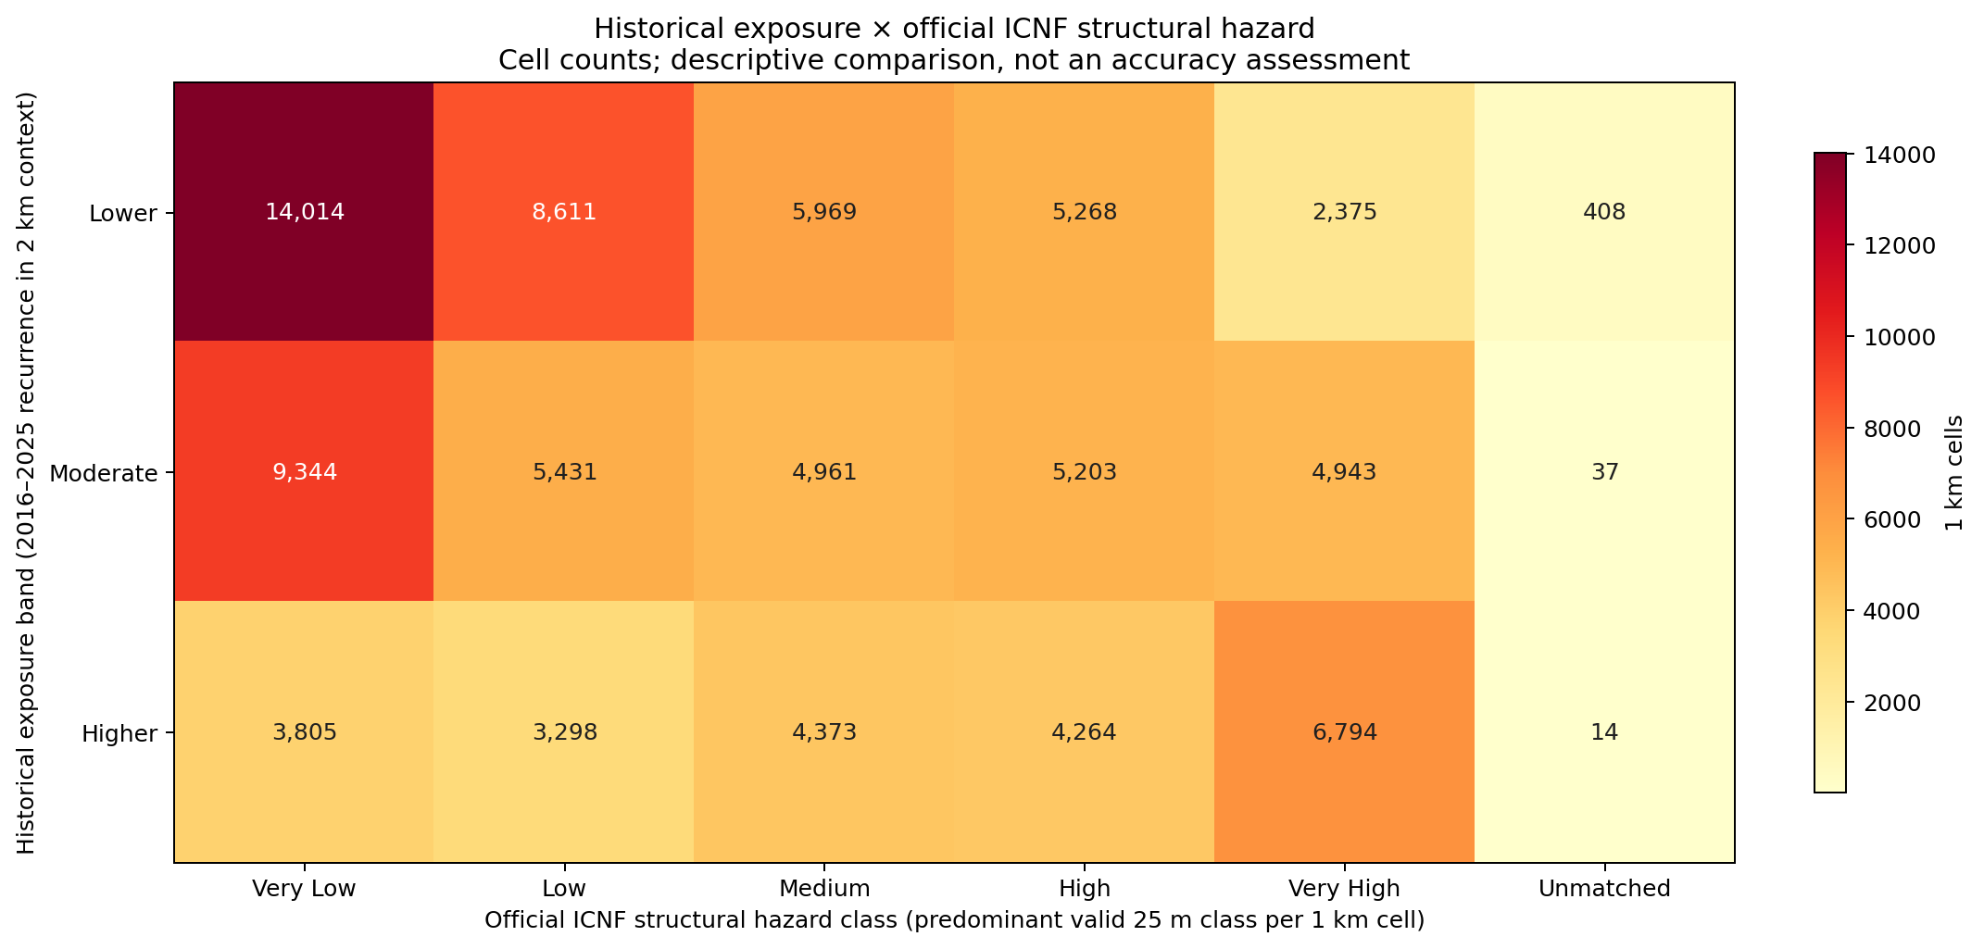
Correspondence is informative—not an accuracy score
43.59%
broad correspondence across matched cells
6,794
Higher × Very High
14,014
Lower × Very Low
3,805
Higher × Very Low
2,375
Lower × Very High
Descriptive correspondence only—not ICNF-map accuracy or model accuracy.
11
Notes:
The cross-tab quantifies how the two classifications relate at the shared 1 km comparison resolution. Higher historical exposure coincides with very high official hazard in 6,794 cells, while lower exposure coincides with very low official hazard in 14,014 cells. There are also informative disagreements: 3,805 cells combine higher historical exposure with very low official hazard, and 2,375 combine lower historical exposure with very high official hazard. Broad grouped levels coincide in 43.59% of matched cells.
Key takeaway for the assessor: correspondence and disagreement are both expected because the layers measure different concepts.
Methodological nuance: 43.59% is descriptive correspondence after grouping official classes; it is not a model-accuracy or official-map-accuracy statistic.
Likely assessor question and answer
Which map should override the other? Neither. They are complementary evidence and discrepancies should trigger deeper official and local investigation.
[Sources]
- reports/figures/historical_exposure_by_icnf_structural_hazard_crosstab.png
- reports/tables/historical_exposure_band_by_icnf_hazard_class.csv
- reports/validation/historical_exposure_screening_and_icnf_comparison.md

Slide 12
The project delivers screening with explicit limits
EVIDENCE-TO-USE CONTRACT
CONCLUSION
1
Historical recurrence was the strongest validated evidence for comparative screening.
Validated ICNF
evidence
2016–2025
1 km cells
recurrence in
2 km context
Lower / moderate / higher
historical exposure
2
Random Forest and Tweedie were not selected because they did not improve sufficiently on validation.
Use: broad location comparison and shortlisting; compare separately with official ICNF structural hazard.
3
The result is a reproducible, inspectable national GIS screening workflow.
Not a next-year forecast, property-level safety guarantee, wildfire-risk probability, or purchase recommendation.
ACTUAL DELIVERABLES
Python project + numbered notebooks • validated screening GeoPackage • portable QGIS project • figures, tables and validation reports • final PowerPoint presentation
Interactive layer: qgis/wildfire_exposure_screening_portugal.qgz
12
Notes:
I close with the evidence-led project decision. Historical recurrence was the strongest validated evidence for comparative screening. The tested regressions were not selected because neither met the predefined combination of MAE, RMSE, and ranking evidence. The project therefore delivers a reproducible national screening layer, a portable QGIS project that presents the same validated GeoPackage, and a complete set of figures, tables, reports, notebooks, and this presentation.
Key takeaway for the assessor: the project succeeded as a rigorous and inspectable GIS screening workflow, while explicitly not succeeding as an accepted next-year predictive model.
Methodological nuance: appropriate use is broad location comparison and follow-up due diligence. The outputs exclude building vulnerability, ignition likelihood, evacuation access, suppression conditions, and damage assessment.
Likely assessor question and answer
Was the project successful? Yes against its evidence-based workflow criteria, but not as a next-year prediction project—and that limitation is explicit.
[Sources]
- reports/figures/historical_exposure_screening_decision_limitations.png
- reports/validation/spatial_output_registry.md
- reports/validation/qgis_presentation_project_validation.md
- qgis/wildfire_exposure_screening_portugal.qgz
- README.md

Slide 13
Likely assessor questions
Why all mainland Portugal?
Was the project successful?
The buyer's first comparison is national; local property checks follow after shortlisting.
Yes as a reproducible GIS screening workflow; no as an accepted next-year prediction project.
What was the hypothesis and result?
Why is the classification still useful?
The seven-feature regressions did not beat the historical-recurrence reference sufficiently on validation.
It directly summarizes observed 2016–2025 recurrence for consistent broad-location comparison.
Were the features sufficient?
Why retain recurrence if it is not prediction?
They were appropriate for an initial reproducible experiment, but insufficient for an accepted next-year model.
It was the strongest validated comparative evidence and remains transparently interpretable.
Central conclusion: no predictive model was selected; the final deliverable is historical comparative screening.
13
Notes:
Why analyse all mainland Portugal rather than one region?
The buyer's initial decision is national: first compare broad candidate areas, then investigate shortlisted places locally. A national 1 km grid applies one consistent method across the full range of Portuguese wildfire conditions and provides enough observations for an honest temporal ML experiment. The result is a national screening layer, not a replacement for local property-level assessment.
What was the hypothesis, and what was the result?
The hypothesis was that land cover, terrain, climate-related context, and historical-fire information could improve next-year wildfire prioritisation compared with a transparent historical-recurrence reference. The hypothesis was not supported: Random Forest and Tweedie did not pass the predefined validation gate, with Capture@20% of 28.62% and 49.46%, compared with 55.88% for historical recurrence. No predictive model was selected.
Were the features chosen correctly, and were they sufficient?
The features were appropriate for an initial reproducible national experiment: historical recurrence, land-cover context, terrain, and climate-related context. However, validation showed they were not sufficient—at this resolution and with this modelling design—to justify a reliable next-year predictive model. Future work needs additional temporally valid information such as ignition sources, fuel condition, wind extremes, access, suppression context, and property vulnerability.
Was the project successful?
Yes, according to its evidence-based success criteria. It delivered a reproducible national GIS workflow, evaluated predictive models honestly, avoided publishing an insufficient predictive model, and produced an interpretable historical-exposure screening with an independent official ICNF comparison. It was not successful as a next-year prediction project, and that is stated clearly.
If the ML models did not perform sufficiently well, why can the final classification still support a buyer?
Because the final classification is not the output of the unselected ML models. It is a transparent summary of observed fire recurrence from 2016–2025. The project tested whether ML could add a reliable next-year predictive layer; it could not, so that claim was not made. The historical classes still provide reproducible evidence for comparing broad locations and deciding where further local investigation is most justified.
Why retain historical recurrence if it is not a prediction?
Historical recurrence was retained because it was the strongest validated evidence for comparative prioritisation. It identifies areas repeatedly affected in the 2016–2025 record, but is presented strictly as historical exposure, not as the probability of fire next year.
Key takeaway for the assessor: the conclusions follow the validation evidence and the final classification remains conceptually separate from the rejected regressions.
[Sources]
- reports/validation/train_validation_model_selection.md
- reports/validation/historical_exposure_screening_and_icnf_comparison.md
- reports/validation/spatial_output_registry.md
- docs/success_criteria.md

