Slide 1
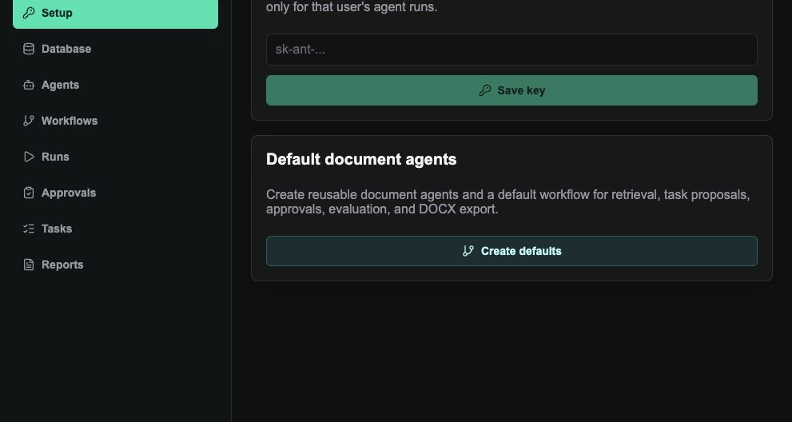
BACHELOR'S QUALIFICATION WORK
Creating a Service-Oriented Architecture for
Scalable Use of Language Models
in Commercial Solutions
ModelWeave: deployed document-grounded agent platform
with database, workflows, approvals, tasks, and DOCX reports
Student
Serhii Sotskyi, group AB221
Supervisor
Vira Oleksandrivna Hrishyna
National University "Odesa Polytechnic" | Odesa, 2026
Real deployed web app
Synthetic data only
DOCX outputs
Defense duration target: under 15 minutes
Production demo is linked at the end
ModelWeave | Service-oriented architecture for scalable LLM use
Topic
1
Notes:
Timing: about 1 minute.
Good afternoon. My name is Serhii Sotskyi, group AB221. The topic of my bachelor's qualification work is "Creating a Service-Oriented Architecture for Scalable Use of Language Models in Commercial Solutions."
In this work I do not study language models only as isolated chatbots. I study how they can be included in a real software architecture that has users, documents, data storage, agent workflows, approval gates, audit events, and final business deliverables.
The practical result of the work is called ModelWeave. It is a deployed full-stack web application that demonstrates document-grounded agents, a searchable database, editable workflows, approval gates, durable tasks, and DOCX reports. The system uses only synthetic academic data, so it is not connected to any real company information. At the end of the presentation I will show the production link and the demo path.

Slide 2
GOAL AND TASKS
Build a scalable LLM architecture, not a single chatbot
1
Theory
Goal
Review LLMs, RAG, vector search, SOA, and multi-agent systems.
Design and evaluate a service-oriented architecture for scalable use of language models in commercial workflows.
2
Requirements
Define functional and non-functional needs for a document-agent platform.
3
Mathematics
Formalize retrieval, embeddings, workflow graphs, approvals, and evaluation.
Case study: ModelWeave, a document-grounded agent platform with RAG, reusable agents, workflows, approvals, audit events, tasks, and DOCX reports.
Implementation
4
Build the full-stack application using Next.js, FastAPI, Supabase, Qdrant, and Anthropic.
5
Validation
Run synthetic document workflows and verify reports, events, citations, approvals, and tasks.
ModelWeave | Service-oriented architecture for scalable LLM use
Goal and tasks
2
Notes:
Timing: about 1.5 minutes.
The goal of the work is to design, formalize, implement, deploy, and evaluate a service-oriented architecture that allows language models to be used in a scalable commercial workflow.
The main idea is that a commercial LLM system should not be only one prompt or one chat window. The model should be one component inside a controlled workflow.
To reach this goal, I completed five main tasks.
First, I reviewed the theoretical basis: large language models, retrieval-augmented generation, vector search, service-oriented architecture, and multi-agent systems.
Second, I defined requirements for a document-grounded agent platform: document database, agents, workflows, runs, approvals, tasks, and reports.
Third, I built the mathematical model. It formalizes the document corpus, chunking, embeddings, cosine similarity, top-k retrieval, workflow graphs, approval state transitions, and quality evaluation.
Fourth, I implemented the full-stack prototype with Next.js, FastAPI, Supabase, Qdrant, and Anthropic API.
Fifth, I validated the system using synthetic document workflows, test outputs, screenshots, citations, approval records, tasks, and generated DOCX reports.

Slide 3
RELEVANCE
Commercial LLM adoption fails when model output is not connected to workflow control
A chatbot can answer
A commercial system must control
Respond to a prompt without persistent business state
Users, documents, model keys, permissions, and storage
Summarize text without proving every operational decision
Retrieval, citations, agents, approvals, and audit events
Draft recommendations but not safely execute team workflows
Typed workflow nodes that turn outputs into proposed actions
Give fluent output while hiding retrieval, risk, and audit context
Exported deliverables that can be reviewed outside the app
Model
Data
Agents
Approvals
Reports
ModelWeave connects these parts into one controlled workflow.
ModelWeave | Service-oriented architecture for scalable LLM use
Relevance
3
Notes:
Timing: about 1.5 minutes.
The relevance of the topic comes from the difference between a language model demonstration and a commercial software system.
A chatbot can answer a user prompt, summarize text, or produce recommendations. However, this is not enough for business use. In a company workflow, the system must know who the user is, what documents belong to that user, which data can be used, which actions are only recommendations, and which actions change business objects.
There are also quality and safety problems. A model can produce fluent text, but the system still needs evidence, citations, risk checks, and an audit trail. Without these controls, it is difficult to explain why a decision was made or whether the output is grounded in the available documents.
That is why the thesis focuses on architecture. ModelWeave connects model execution with data, agents, approvals, and reports. In this architecture, the language model is useful because it is placed inside a workflow that controls context, state, and final deliverables.

Slide 4
METHODS AND COMPARISON
The prototype combines retrieval, agent workflows, and governance controls
SOA
RAG
Embeddings
Vector search
Multi-agent graph
Approval gates
BYOK
Approach
Workflow control
Grounding
Mutation safety
Fit for thesis
Generic chatbot
Conversation only
Weak or implicit
None
Low
Simple RAG report tool
Report generation
Document citations
Limited
Medium
Generic agent builder
Flexible automation
Depends on setup
Often optional
Medium
ModelWeave
Typed document workflow
RAG citations
Mandatory approvals
High
Key idea: language model calls become controlled services inside a workflow, not isolated answers.
ModelWeave | Service-oriented architecture for scalable LLM use
Methods
4
Notes:
Timing: about 1.7 minutes.
Several methods were used together in the work.
The first method is service-oriented architecture. The application is separated into frontend, backend API, authentication, relational database, vector database, model provider, and deployment infrastructure.
The second method is retrieval-augmented generation. Documents are parsed into chunks, converted into embeddings, stored for semantic search, and retrieved as evidence for agents.
The third method is a multi-agent workflow graph. Instead of one general assistant, configurable agents take narrower roles such as document reviewer, task planner, QA agent, and report writer.
The fourth method is approval-gated automation. Agents can propose actions, but persistent changes require human approval.
Compared with a generic chatbot, ModelWeave has stronger workflow control. Compared with a simple RAG report tool, it can create proposed tasks and approvals, not only reports. Compared with a generic agent builder, it is grounded in a clear service-oriented architecture with database, workflow, run history, approval, and document export services. This is why it fits the thesis topic better.

Slide 5
MATHEMATICAL MODEL I
RAG turns documents into vectors, then ranks evidence before generation
Document corpus
D = {d1, d2, ..., dn}; di = {ci,1, ci,2, ..., ci,mi}; φ(cj) = ej ∈ Rᵈ
Documents are parsed, chunked, embedded, and stored as searchable vectors.
Similarity
Top-k retrieval
sim(q, cj) = (vq · ej) / (||vq|| ||ej||)
Rk(q) = arg top-k cj∈C sim(q, cj)
Cosine similarity ranks text chunks by semantic closeness to the query.
Only the most relevant chunks are injected into the agent context.
RAG generation
Retrieval metrics
P(y|q,Rk,a)=Πt P(yt | y<t,q,Rk,a)
Precision@k = |Rel(q) ∩ Rk(q)| / k
The answer depends on the question, retrieved evidence, and agent role.
Citation coverage is a practical MVP proxy for retrieval quality.
Embedding dimension d
Retrieval depth k
Chunk size b
Evidence citations
Agent role a
ModelWeave | Service-oriented architecture for scalable LLM use
Math: RAG
5
Notes:
Timing: about 1.2 minutes.
Because my speciality is Applied Mathematics, I included a formal model of the system, not only implementation details.
The first part is the RAG model. User documents form a corpus D. Each document is split into chunks, and each chunk is transformed into a vector in a d-dimensional space.
When the user asks a question or runs a workflow, the query is also embedded. The system compares the query vector with document chunk vectors using cosine similarity.
The retrieval step selects the top-k chunks. In the prototype k is usually eight: enough evidence for citations, but still practical for model calls.
Generation is modeled as conditional probability. The output depends on the query, retrieved chunks, and agent role.
This slide is important because it shows that RAG in the project is not just a feature. It is a mathematical pipeline from documents to vectors, from vectors to ranked evidence, and from evidence to generated output.

Slide 6
MATHEMATICAL MODEL II
Agent workflows are typed graphs with state, approvals, cost, and quality scores
Workflow graph
G = (V, E, τ, σ)
τ(v) ∈ {retrieve, agent, create_task, approval, evaluate, export_docx}
σt(v) ∈ {waiting, running, completed, approval_required, failed}
Retrieve
Agent
Create task
Approval
Evaluate
DOCX
Approval constraint
Quality score
Token cost
mutate(x) ⇒ approval(x)=approved
S=(wcC+waA+wrR+wmM)/(wc+wa+wr+wm)
Cost=Σj(pinTin,j+poutTout,j)
Applied-math value
The formulas connect product behavior to measurable parameters: corpus size |C|, vector dimension d, retrieval depth k, agent count |Vagent|, pending approvals, latency, and run quality.
ModelWeave | Service-oriented architecture for scalable LLM use
Math: workflow
6
Notes:
Timing: about 1.2 minutes.
The second mathematical part describes workflow execution.
A workflow is represented as a typed directed graph G. V is the set of nodes, E is the set of edges, tau gives the type of each node, and sigma gives the execution state of each node over time.
The node types in the MVP are retrieve, agent, create task, approval, evaluate, and export DOCX. Node state can be waiting, running, completed, approval required, or failed. This is what the UI visualizes in the live run screen.
The approval formula says that a persistent mutation is allowed only when there is an approved human decision.
The quality formula combines citation coverage, actionability, risk control, and completeness into one normalized score.
The cost formula estimates model cost from input and output tokens. It explains why agent count, retrieval depth, and context length matter.
Together, these formulas connect the software architecture to measurable variables: corpus size, embedding dimension, retrieval depth, number of agents, approval load, latency, and quality score.

Slide 7
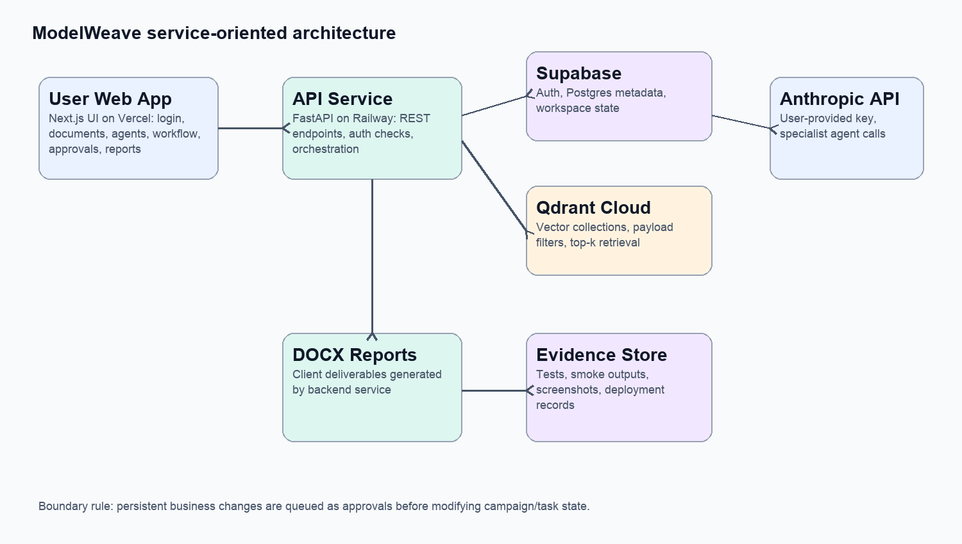
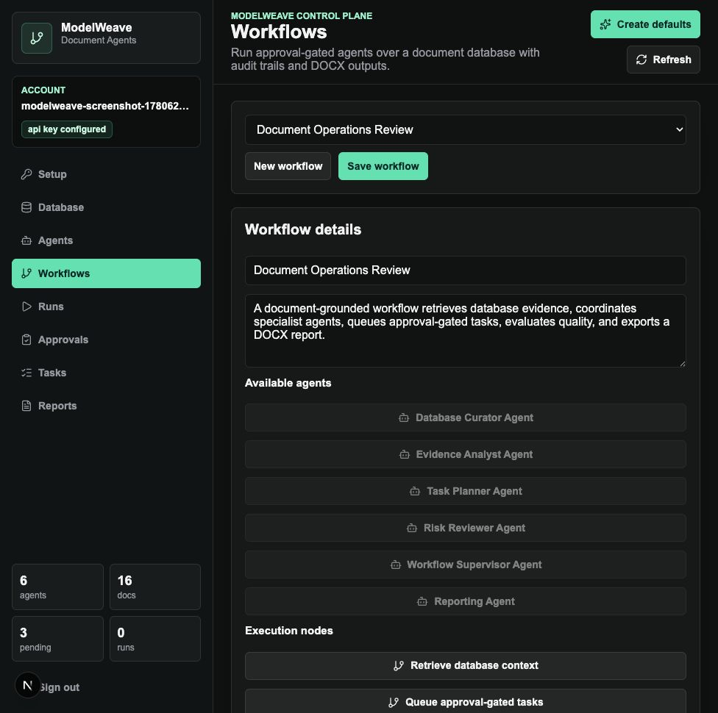
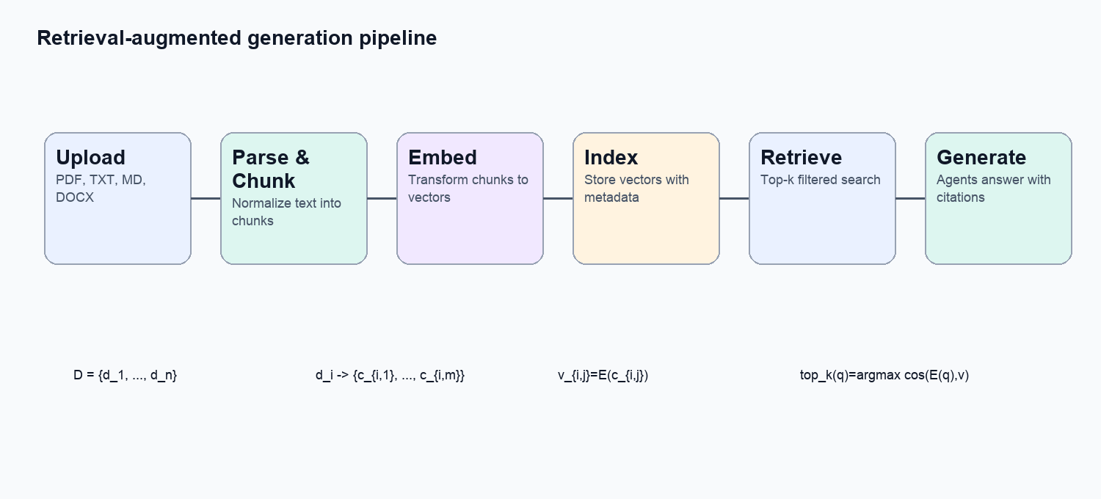
STRUCTURAL SCHEME OF THE SOFTWARE ALGORITHM
Documents become retrievable context; agents turn context into approval-gated tasks and reports
Auth
Documents
Chunks
Vectors
Retrieve
Agents
Approve
DOCX
Main execution path
ModelWeave | Service-oriented architecture for scalable LLM use
Algorithm scheme
7
Notes:
Timing: about 2.1 minutes.
This slide shows the structural scheme of the software algorithm.
The process begins with authentication. A user registers or signs in through Supabase Auth. After that, the user can add their own Anthropic API key. This is the bring-your-own-key approach, so each user controls their own model access.
Next, the user uploads documents or loads the synthetic corpus. The backend parses PDF, TXT, Markdown, and DOCX, then splits documents into chunks.
Each chunk is converted into an embedding vector. Vectors are stored in Qdrant, while users, documents, agents, workflows, runs, tasks, approvals, and events are stored in Supabase Postgres.
When the user starts a workflow, the system embeds the query and retrieves the top-k most similar chunks. These chunks become grounding context for the agents.
The workflow itself is a graph of typed nodes: retrieve, agent, create task, approval, evaluate, and export DOCX.
The safety rule is that agents can draft recommendations, but persistent changes go through approval. Rejected actions remain in the audit trail without changing final state.
At the end, the system evaluates the run and exports a DOCX report. This shows a complete workflow from documents to actions and deliverables.

Slide 8
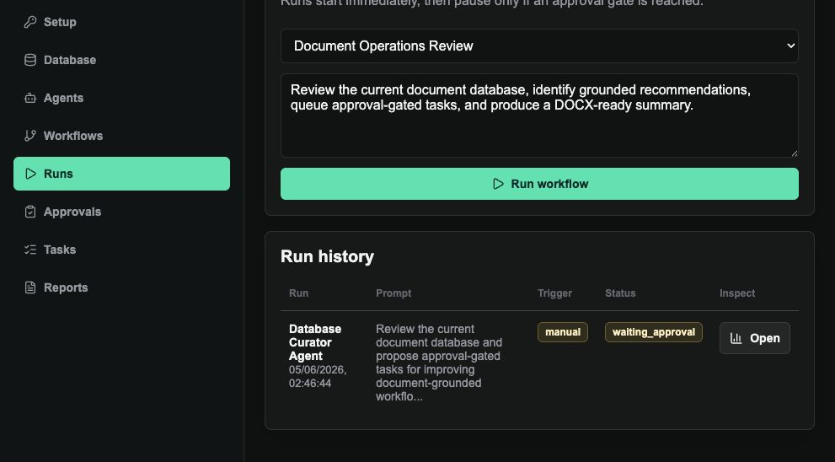
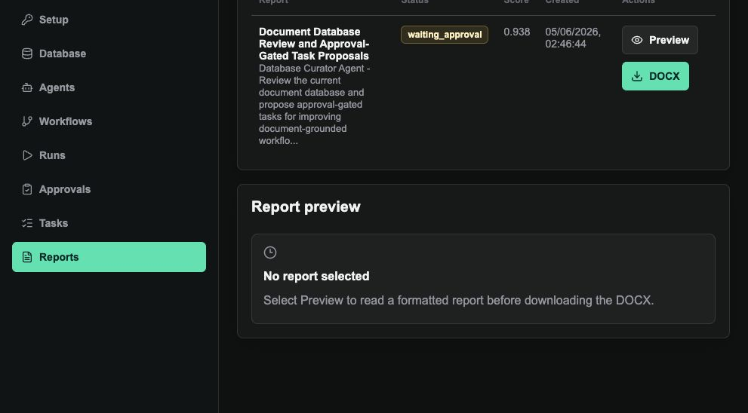
RESULTS
The thesis result is a deployed, tested full-stack prototype
16
8
21+
3+
0
1.0
synthetic documents seeded
citations in clean agent run
recorded run events in QA
approval records created
raw Markdown markers in DOCX
run evaluation score
Production frontend: https://modelweave-two.vercel.app
Backend: https://api-production-e70a9.up.railway.app
Repository: GitHub public
ModelWeave | Service-oriented architecture for scalable LLM use
Results
8
Notes:
Timing: about 2 minutes.
The result of the work is a deployed and tested full-stack prototype.
The production frontend is available at modelweave-two.vercel.app. The backend health endpoint is deployed on Railway, and the repository is public on GitHub. This means the result is not only a local prototype. It can be opened as a web application.
The validation used synthetic data only. The test corpus includes sixteen fictional academic documents. In the clean agent run, the system produced eight citations, which confirms that the generated output was connected to retrieved evidence.
The UX polish smoke test recorded forty-six run events. This is important because the workflow is traceable: we can see which nodes and agents were executed. The same test created four approval records, which shows that proposed actions are routed through the human approval queue.
The DOCX export was also checked. The generated report contained no raw Markdown markers, so the output is suitable as a client-facing document rather than just raw model text.
The screenshots on this slide show two important parts of the interface: the Runs screen and the Reports screen. Together, they demonstrate that the system can run workflows, inspect results, and export deliverables.

Slide 9
CONCLUSIONS
ModelWeave proves that LLM capabilities can be organized as a managed commercial workflow
SOA is the backbone
RAG grounds the output
Agents represent roles
Separate services make the system deployable, testable, and easier to scale.
Documents are chunked, embedded, retrieved, and cited before agents produce recommendations.
Document reviewer, curator, task planner, QA, and report writer agents cooperate.
Approvals reduce risk
The prototype is practical
Persistent business changes are proposed first and applied only after human approval.
The result is a deployed web app with authentication, BYOK, uploads, workflows, audit events, and DOCX reports.
Future work: durable workflow queue, external connectors, richer evaluation, and organization-level permissions.
ModelWeave | Service-oriented architecture for scalable LLM use
Conclusions
9
Notes:
Timing: about 1.5 minutes.
The main conclusion is that scalable commercial use of language models requires architecture, not only prompt engineering.
First, service-oriented architecture is the backbone of the system. By separating the frontend, backend, database, vector store, model provider, and deployment services, the application becomes easier to deploy, test, and extend.
Second, retrieval-augmented generation is necessary for grounding. The system does not rely only on the model's internal knowledge. It retrieves relevant document chunks and uses them as evidence for agent outputs.
Third, agents are useful when they represent focused work roles. In ModelWeave, document reviewer, database curator, task planner, QA, and report writer agents can cooperate inside one workflow.
Fourth, approval gates reduce operational risk. Business changes are proposed first and only applied after human approval. This is important for commercial systems where automatic changes can have consequences.
Fifth, the prototype is practical. It includes authentication, bring-your-own-key model access, document uploads, workflows, audit events, approvals, evaluations, and DOCX exports.
Future work could include a durable workflow queue, richer scheduling, external connectors, stronger retrieval benchmarks, richer evaluation methods, and organization-level permissions.

Slide 10

DEMO LINK
Open the deployed ModelWeave prototype and run a document-agent workflow
Demo path
1
Sign in
Register or confirm the user session through Supabase Auth.
2
Add model key
Save the user's own Anthropic API key for agent execution.
3
Load corpus
Seed the synthetic academic document set.
4
Run workflow
Run the default Document Operations Review workflow.
https://modelweave-two.vercel.app
5
Review output
Inspect timeline, citations, approvals, tasks, evaluation, and DOCX report.
Backend: https://api-production-e70a9.up.railway.app
Repository: https://github.com/serhiiSotskyi/multi-agent-knowledge-platform
ModelWeave | Service-oriented architecture for scalable LLM use
Demo
10
Notes:
Timing: about 1 minute.
This is the demo link for the deployed prototype. The current production frontend is modelweave-two.vercel.app. The QR code opens the same address.
The recommended demo path is short. First, sign in or register. Second, add the user's Anthropic API key, because the system uses a bring-your-own-key model. Third, load the synthetic academic corpus. Fourth, run the default Document Operations Review workflow. Fifth, review the output: the execution timeline, citations, approval queue, created tasks, evaluation score, and DOCX report.
If there is enough time and internet access, I can open the application and show this workflow directly. If not, the link and QR code provide a safe way to access the demo after the presentation.
This completes the presentation. Thank you for your attention.

