Slide 1
OLYMPIC
HOLIDAYS
PAID SEARCH
PERFORMANCE
£382,746
Q1 2026 Performance Review
Revenue
215.8
January – March 2026
Purchases
£338
CPA
Prepared by Summon Digital

Slide 2
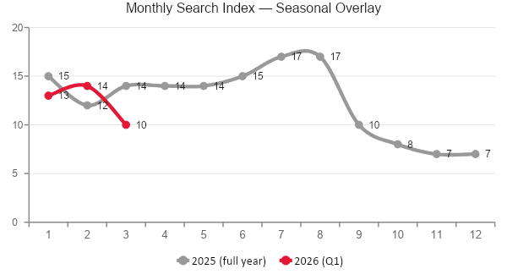
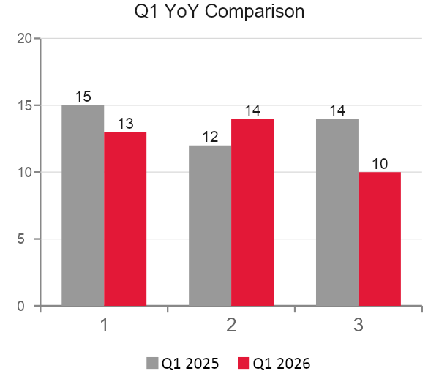
Olympic Holidays Trends
Brand search interest · GB · YoY comparison
Jan 2026
Feb 2026
Mar 2026
13
vs 15
-13%
14
vs 12
+17%
10
vs 14
-29%
Jan 2026 (13) is below Jan 2025 (15), aligned with the broader YoY revenue decline seen in paid search.
Feb 2026 (14) is the only Q1 month to outperform the prior year, recovering above Feb 2025 (12).
Mar 2026 (10) is the weakest Q1 month in both years and fell -29% vs Mar 2025 (14), mirroring the CPA pressure in the same period.
Brand search peaked at 17 in Jul–Aug 2025; the Q1 2026 range of 10–14 sits at the lower end of the annual cycle.

Slide 3
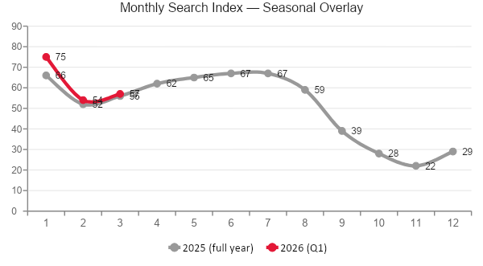
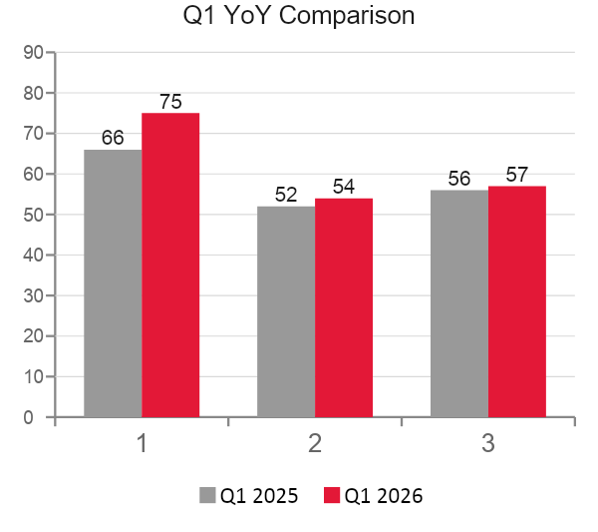
Holidays to Greece Trends
Category search interest · GB · YoY comparison
Jan 2026
Feb 2026
Mar 2026
75
vs 66
+14%
54
vs 52
+4%
57
vs 56
+2%
Jan 2026 (75) is the highest index in the entire dataset — up +14% on Jan 2025 (66), signalling strong early-year intent.
Feb 2026 (54) and Mar 2026 (57) both edge above their prior-year equivalents, making Q1 2026 a consistently stronger period for Greece search demand.
All three Q1 2026 months outperform Q1 2025, which contrasts with the Olympic Holidays brand trend and highlights category-level demand growth despite paid search revenue decline.

Slide 4
Executive Summary
Olympic Holidays | Q1 2026
REVENUE
PURCHASES
CPA
COST
AOV
COST/ATC
£382,746
215.8
£338
£72,932
£1,774
£31
Q1 2026
Q1 2026
Cost per purchase
Total spend
Avg order value
Cost per add-to-cart
-49.3% YoY
-43.5% YoY
+29.6% YoY
-26.9% YoY
-10.2% YoY
+102.6% YoY
Key Highlights
Q1 2026 delivered £382,746 revenue from 215.8 purchases on £72,932 spend.
Quarter efficiency closed at £338 CPA, £31 cost per ATC, and £1,774 AOV.
Jan 2026 was the strongest revenue month, while Jan 2026 recorded the most efficient CPA.
Versus Q1 2025, revenue moved -49.3%, cost moved -26.9%, and purchases moved -43.5%.

Slide 5
Auction Insights
Competitor landscape
Domain | Imp. Share | Overlap Rate | Pos. Above | Top of Page | Abs. Top | Outranking
jet2holidays.com | 55.8% | 50.0% | 80.3% | 93.8% | 41.9% | 3.1%
tui.co.uk | 55.0% | 49.4% | 77.6% | 91.0% | 32.2% | 3.2%
loveholidays.com | 53.2% | 39.4% | 67.2% | 85.8% | 24.4% | 3.8%
easyjet.com | 32.1% | 21.8% | 63.5% | 89.5% | 24.6% | 4.5%
booking.com | 19.9% | 16.2% | 66.1% | 89.0% | 21.1% | 4.6%
thomascook.com | 15.1% | 9.5% | 53.0% | 65.7% | 7.6% | 4.9%
you (Olympic) | n/a | n/a | n/a | 78.2% | 18.1% | n/a
teletextholidays.co.uk | n/a | 4.1% | 53.8% | 55.6% | 11.4% | 5.1%
onthebeach.co.uk | n/a | 6.1% | 51.5% | 81.9% | 10.0% | 5.0%
airbnb.co.uk | n/a | 6.8% | 52.0% | 82.4% | 14.4% | 5.0%
firstchoice.co.uk | n/a | 7.0% | 45.0% | 52.7% | 3.0% | 5.0%
jet2holidays.com had the highest impression share at 55.8% and highest overlap rate at 50.0%.
jet2holidays.com had the highest position-above rate at 80.3% and absolute top-of-page rate at 41.9%.
Average top-of-page pressure across competitors was 78.7%.
teletextholidays.co.uk had the highest outranking share at 5.1%.
Our own impression share value was unavailable; competitor pressure is read from surrounding auction metrics.

Slide 6
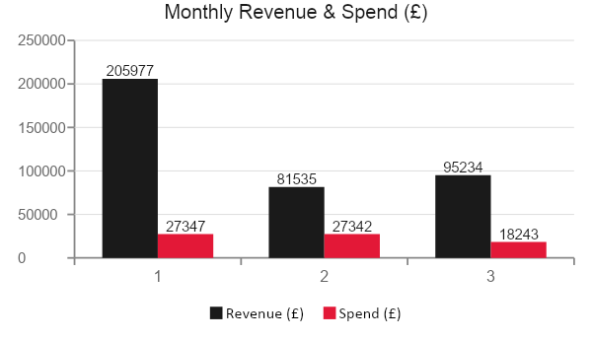
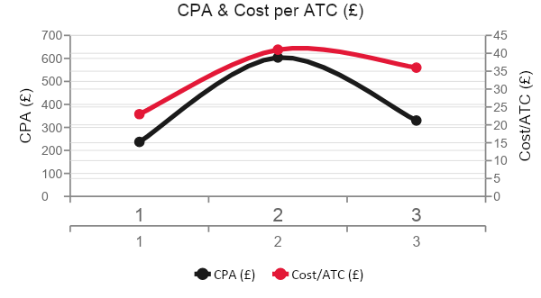
Overall Performance
Olympic Holidays | Q1 2026
Month | Revenue | Spend | Purchases | CPA | Cost/ATC
Jan 2026 | £205,977 | £27,347 | 115.3 | £237 | £23
Feb 2026 | £81,535 | £27,342 | 45.3 | £604 | £41
Mar 2026 | £95,234 | £18,243 | 55.2 | £330 | £36
Revenue moved -53.8% from Jan 2026 (£205,977) to Mar 2026 (£95,234). Jan figure is derived from the quarter total minus Feb and Mar.
Spend moved -33.3% over the same period (£27,347 → £18,243), while purchases fell -52.2% (115.3 → 55.2).
CPA moved from £237 in Jan to a Feb peak of £604, recovering to £330 in Mar. Quarter average CPA was £338.
Add-to-cart volume reached 2,353.5, with quarter cost per ATC at £31.

Slide 7
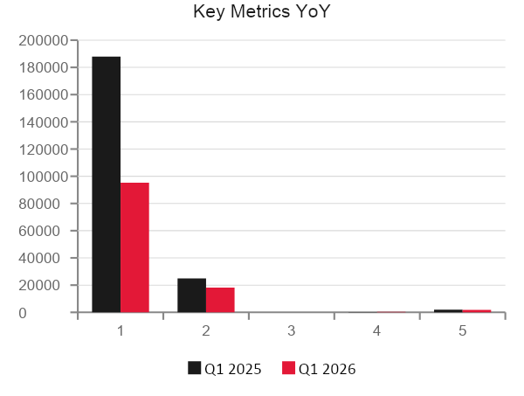
YoY Matched-Month Comparison
Matched months versus prior-year quarter
⚠ Partial coverage: 1 of 3 months matched. YoY changes reflect January only, not the full quarter.
Metric | Q1 2025 | Q1 2026 | Change
Revenue | £187,875 | £95,234 | -49.3%
Cost | £24,941 | £18,243 | -26.9%
Purchases | 97.7 | 55.2 | -43.5%
Add to Cart | 1398.3 | 504.9 | -63.9%
CPA | £255 | £331 | +29.6%
Cost per ATC | £18 | £36 | +102.6%
AOV | £1,922 | £1,726 | -10.2%
The comparison covers 1 of 3 month(s) in the quarter.
Revenue was -49.3% versus Q1 2025; spend was -26.9% and purchases were -43.5% on matched months.
CPA moved +29.6%, cost per ATC moved +102.6%, and AOV moved -10.2%.

Slide 8
End of Period
Latest months
Feb 2026
Change
Feb→Mar
Mar 2026 ← Latest
Revenue
£81,535
+16.8%
Revenue
£95,234
Spend
£27,342
-33.3%
Spend
£18,243
Purchases
45.3
+21.9%
Purchases
55.2
CPA
£604
-45.2%
CPA
£331
Cost/ATC
£41
-12.2%
Cost/ATC
£36
Mar 2026 revenue was £95,234 versus £81,535 in Feb 2026.
Spend moved from £27,342 to £18,243, while purchases moved from 45.3 to 55.2.
CPA improved from £604 to £331.
Cost per ATC moved from £41 to £36.

Slide 9
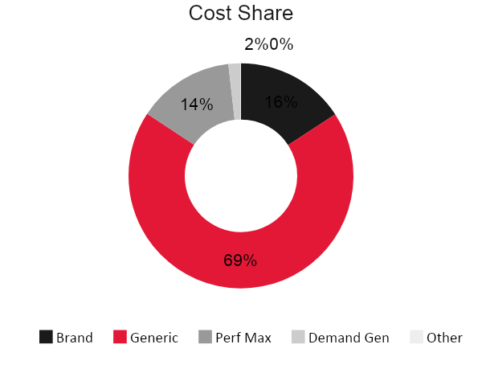
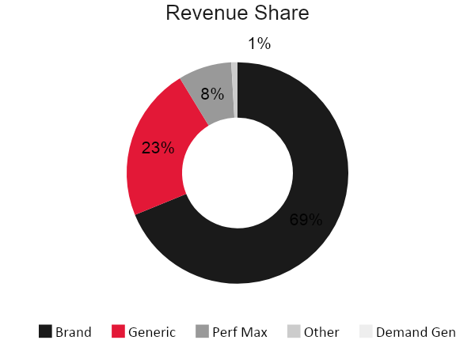
Channel Performance
Cost and revenue share
Channel | Revenue | Cost | Purchases | Add to Cart | CPA | Cost/ATC | AOV | Cost % | Rev %
Brand | £263,193 | £11,531 | 148.4 | 1338.1 | £78 | £9 | £1,773 | 15.8% | 68.8%
Generic | £86,135 | £49,952 | 49.0 | 755.5 | £1,020 | £66 | £1,759 | 68.5% | 22.5%
Performance Max | £29,841 | £10,173 | 16.6 | 209.3 | £614 | £49 | £1,800 | 13.9% | 7.8%
Other | £3,577 | £0 | 1.8 | 24.2 | £0 | £0 | £1,955 | 0.0% | 0.9%
Demand Gen | £0 | £1,276 | 0.0 | 26.3 | — | £49 | — | 1.7% | 0.0%
Brand drove the largest revenue share at 68.8% with £78 CPA.
Generic carried the highest cost share at 68.5% of spend.
Generic was the least efficient campaign type on quarter CPA at £1,020.
Brand delivered 68.8% of revenue, while Generic accounted for 68.5% of spend.

Slide 10
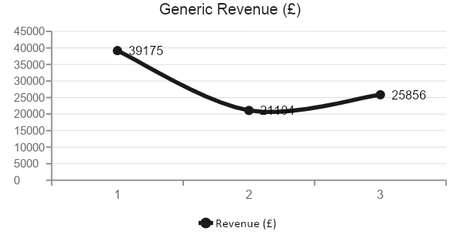
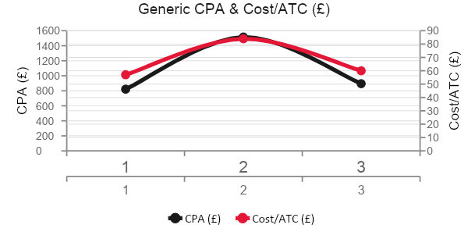
Generic Performance
Olympic Holidays | Q1 2026
Month | Revenue | Cost | Purchases | Add to Cart | CPA | Cost/ATC | AOV
Jan 2026 | £39,175 | £19,264 | 23.5 | 337.0 | £821 | £57 | £1,670
Feb 2026 | £21,104 | £19,195 | 12.7 | 228.5 | £1,516 | £84 | £1,667
Mar 2026 | £25,856 | £11,493 | 12.8 | 190.0 | £895 | £60 | £2,013
Generic delivered £86,135 revenue from £49,952 spend at £1,020 CPA.
Jan 2026 was the strongest generic revenue month in the quarter.
From Jan 2026 to Mar 2026, generic revenue moved -34.0% and CPA moved +9.0%.
Generic add-to-cart volume totalled 755.5, with £66 cost per ATC and £1,759 AOV.

Slide 11
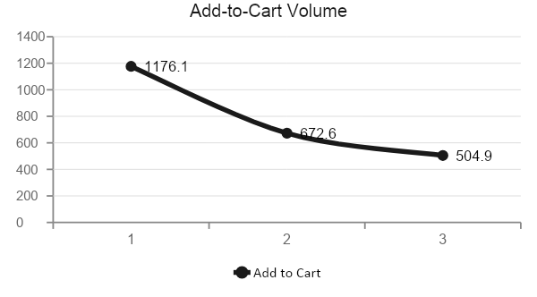
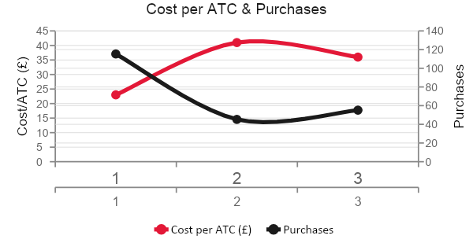
ATC Analysis
Add to cart and cost per ATC
Month | Add to Cart | Cost per ATC | Purchases
Jan 2026 | 1176.1 | £23 | 115.3
Feb 2026 | 672.6 | £41 | 45.3
Mar 2026 | 504.9 | £36 | 55.2
TOTAL ATC
COST PER ATC
2,353.5
£31
Q1 2026 volume
Quarter average
Add-to-cart volume moved -57.1% from Jan 2026 to Mar 2026.
Cost per ATC moved +55.4% across the same period.
The quarter delivered 2353.5 total add-to-cart actions from £72,932 spend.
Purchases totalled 215.8, providing the downstream conversion context for ATC performance.

