Slide 1
Wendy Wu Tours | Quarterly PPC Performance Report
Q1 2026 (Jan - Mar 2026) | Summon Digital

Slide 2
Performance

Slide 3
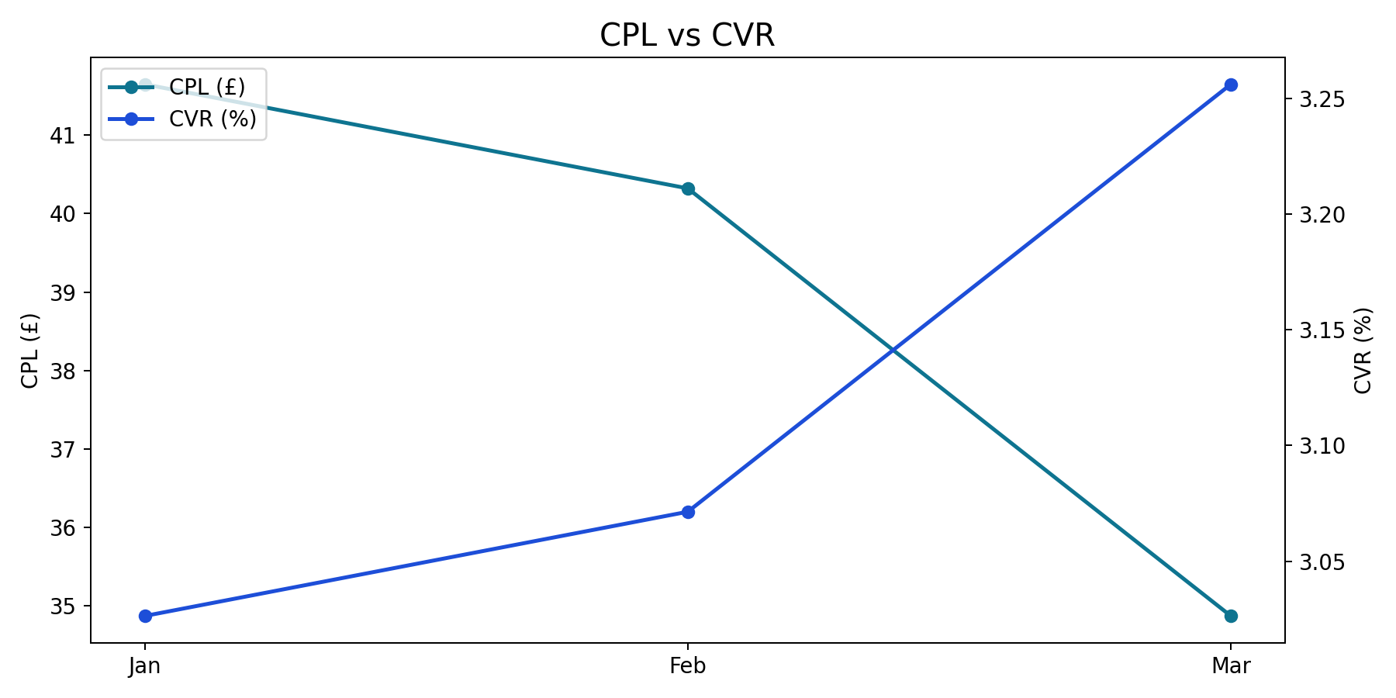
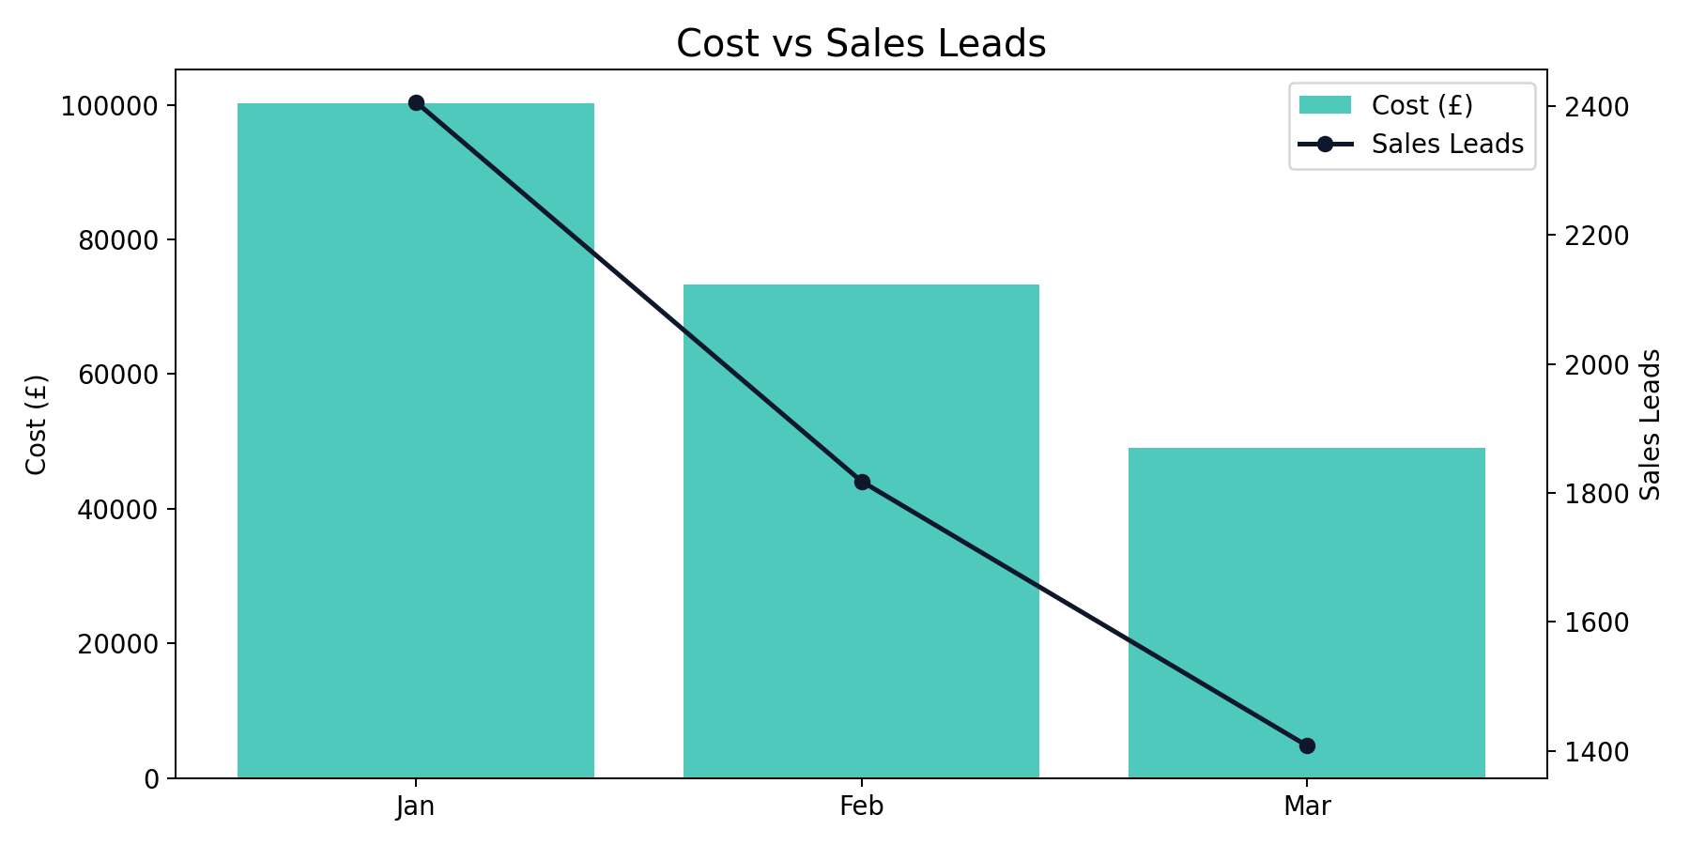
Overall Performance Trend
Q1 2026 (Jan - Mar 2026)
Best efficiency was in Mar (£34.87 CPL), while Jan was highest at £41.65.
Quarter total: 5,632 leads from £222,611.31 spend at a blended CPL of £39.53.
YoY vs same quarter last year: leads +59.82% and spend +48.39%.
Brand generated the highest share of leads (59.9%).

Slide 4
Overall Quarter Summary
Q1 2026 (Jan - Mar 2026)
Month | Impressions | Clicks | CTR | CPC | Cost | Sales Leads | CPL | CVR
Jan | 4,733,048 | 79,502 | 1.68% | £1.26 | £100,208.74 | 2,406 | £41.65 | 3.03%
Feb | 4,790,487 | 59,192 | 1.24% | £1.24 | £73,305.47 | 1,818 | £40.32 | 3.07%
Mar | 2,625,597 | 43,243 | 1.65% | £1.14 | £49,097.11 | 1,408 | £34.87 | 3.26%
Total | 12,149,132 | 181,937 | 1.50% | £1.22 | £222,611.31 | 5,632 | £39.53 | 3.10%
Overall generated 5,632 leads from £222,611.31 with a quarter CPL of £39.53.
Best efficiency was in Mar (£34.87 CPL), while Jan was highest at £41.65.
YoY vs same quarter last year: leads +59.82%, spend +48.39%.

Slide 5
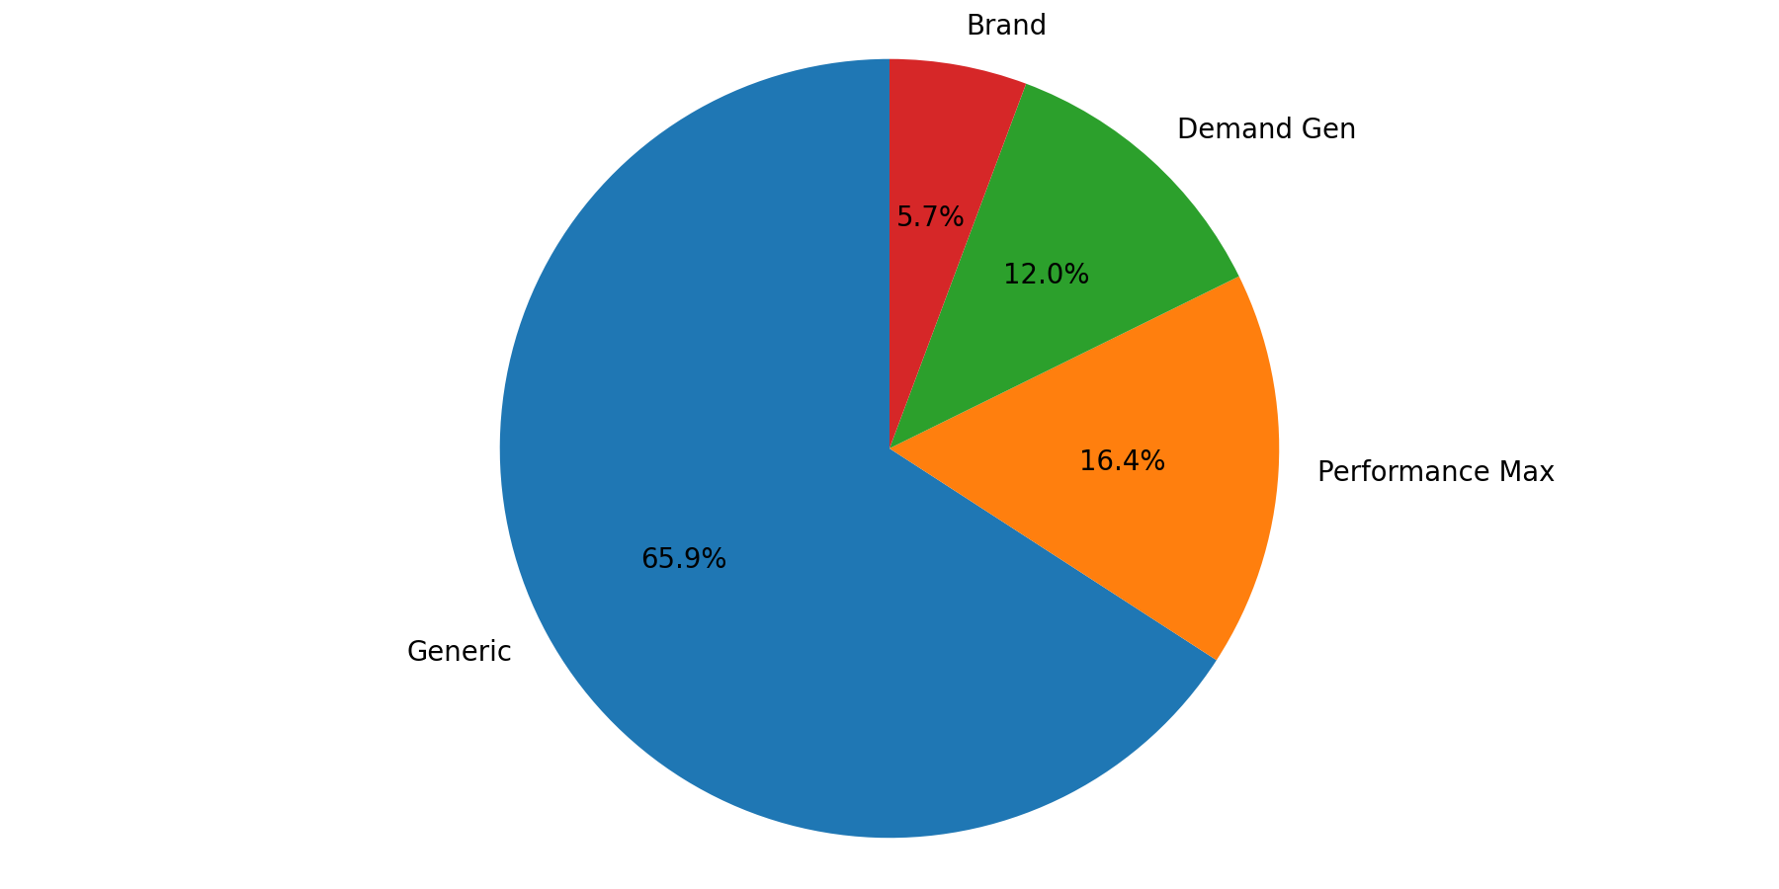
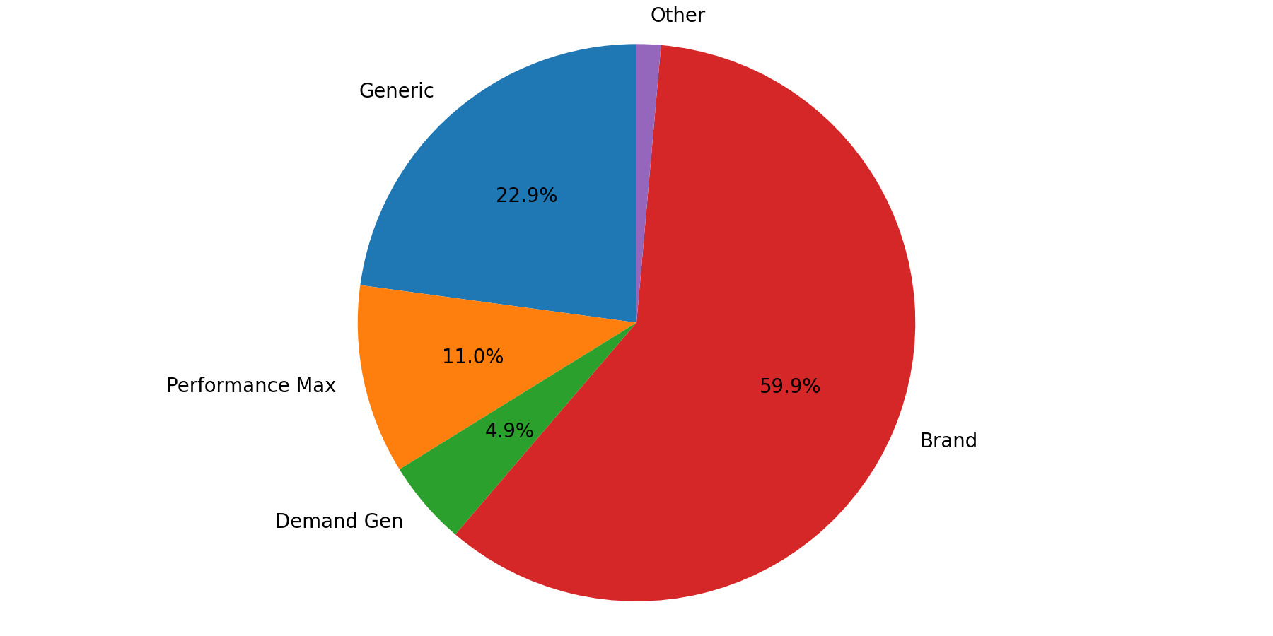
Campaign Type Mix
Q1 2026 (Jan - Mar 2026)
Generic represented the largest share of spend (65.9%).
Brand delivered the largest share of leads (59.9%).
Spend and lead mix are concentrated in different campaign types, indicating different efficiency profiles.

Slide 6
Brand Summary
Q1 2026 (Jan - Mar 2026)
Month | Impressions | Clicks | CTR | CPC | Cost | Sales Leads | CPL | CVR
Jan | 29,361 | 15,291 | 52.08% | £0.38 | £5,737.22 | 1,430 | £4.01 | 9.35%
Feb | 22,554 | 11,520 | 51.08% | £0.29 | £3,384.96 | 1,015 | £3.33 | 8.81%
Mar | 19,379 | 9,574 | 49.40% | £0.37 | £3,567.80 | 926 | £3.85 | 9.67%
Total | 71,294 | 36,385 | 51.04% | £0.35 | £12,689.98 | 3,371 | £3.76 | 9.26%
Brand generated 3,371 leads from £12,689.98 with a quarter CPL of £3.76.
Best efficiency was in Feb (£3.33 CPL), while Jan was highest at £4.01.
YoY vs same quarter last year: leads +390.68%, spend +46.72%.

Slide 7
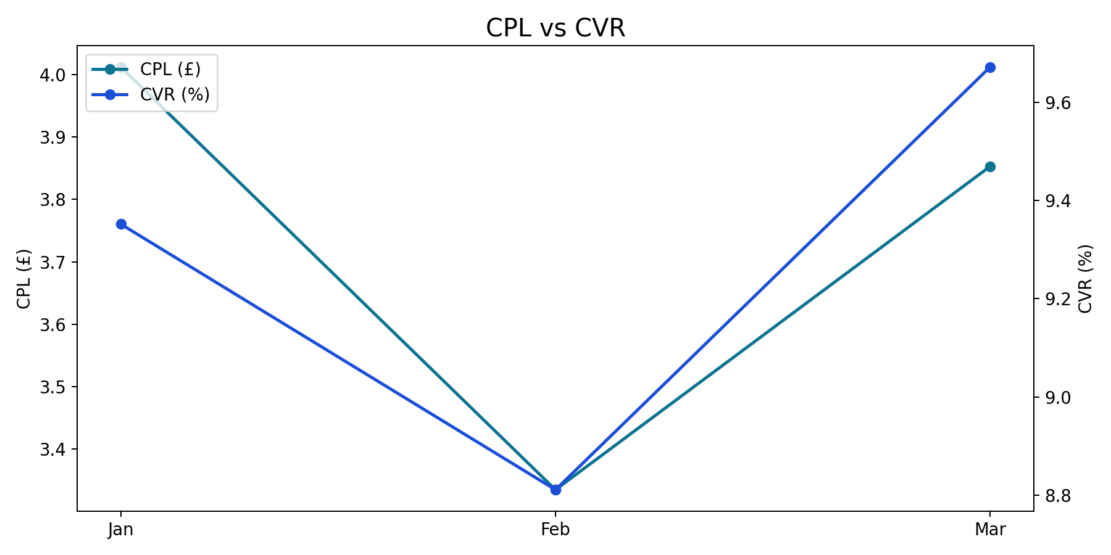
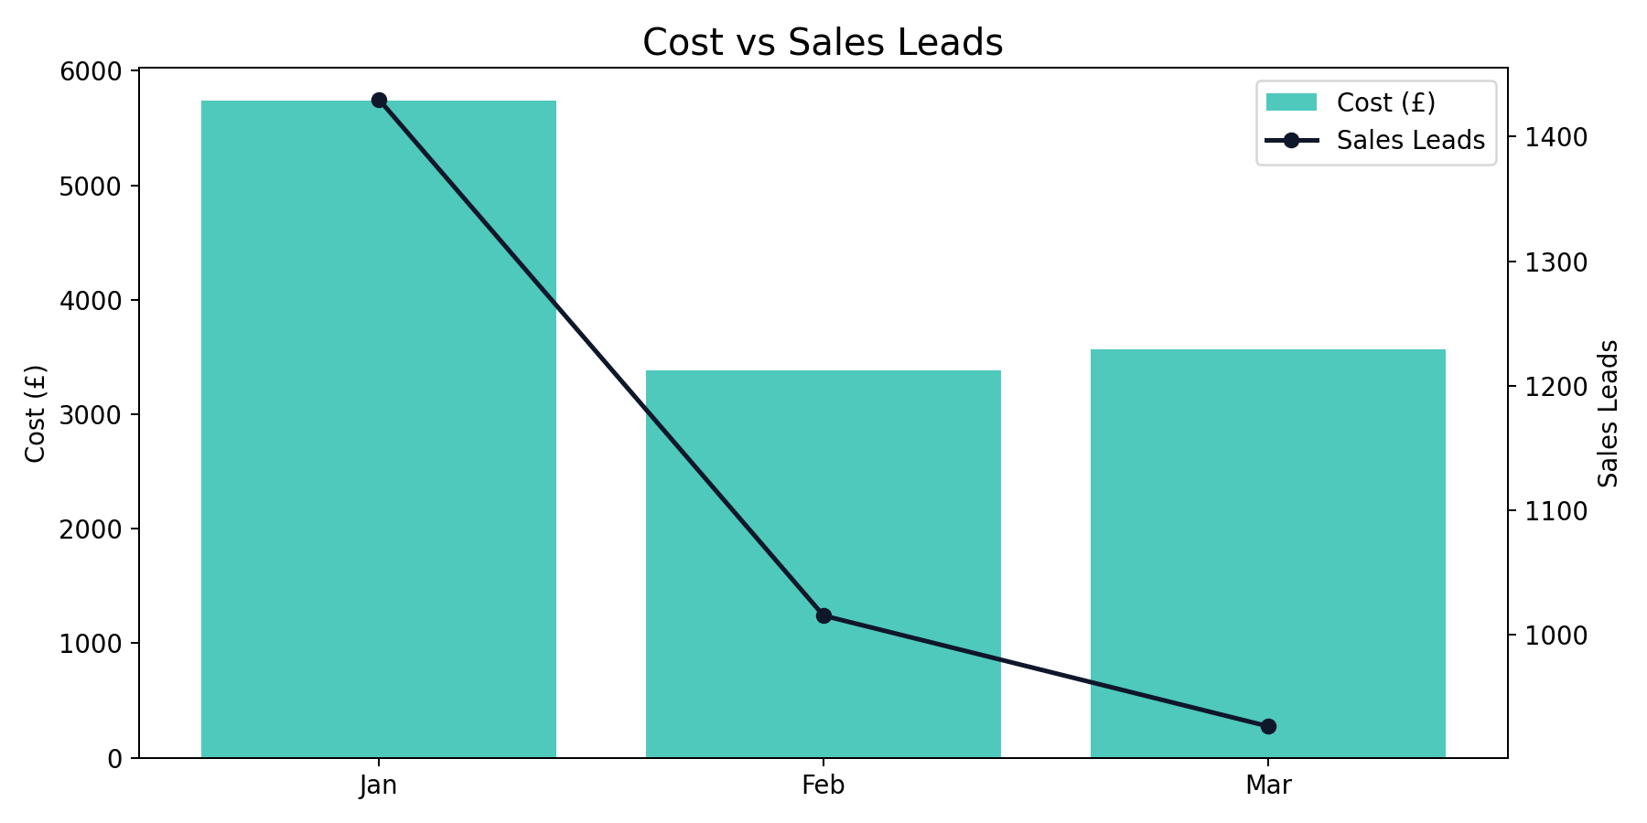
Brand Monthly Trend
Q1 2026 (Jan - Mar 2026)
Brand generated 3,371 leads from £12,689.98 with a quarter CPL of £3.76.
Best efficiency was in Feb (£3.33 CPL), while Jan was highest at £4.01.
YoY vs same quarter last year: leads +390.68%, spend +46.72%.

Slide 8
Generic Summary
Q1 2026 (Jan - Mar 2026)
Month | Impressions | Clicks | CTR | CPC | Cost | Sales Leads | CPL | CVR
Jan | 404,712 | 22,167 | 5.48% | £2.97 | £65,788.14 | 524 | £125.55 | 2.36%
Feb | 354,493 | 19,784 | 5.58% | £2.40 | £47,474.65 | 478 | £99.32 | 2.42%
Mar | 429,822 | 16,157 | 3.76% | £2.06 | £33,328.58 | 285 | £116.94 | 1.76%
Total | 1,189,027 | 58,108 | 4.89% | £2.52 | £146,591.38 | 1,287 | £113.90 | 2.21%
Generic generated 1,287 leads from £146,591.38 with a quarter CPL of £113.90.
Best efficiency was in Feb (£99.32 CPL), while Jan was highest at £125.55.
YoY vs same quarter last year: leads +13.79%, spend +24.70%.

Slide 9
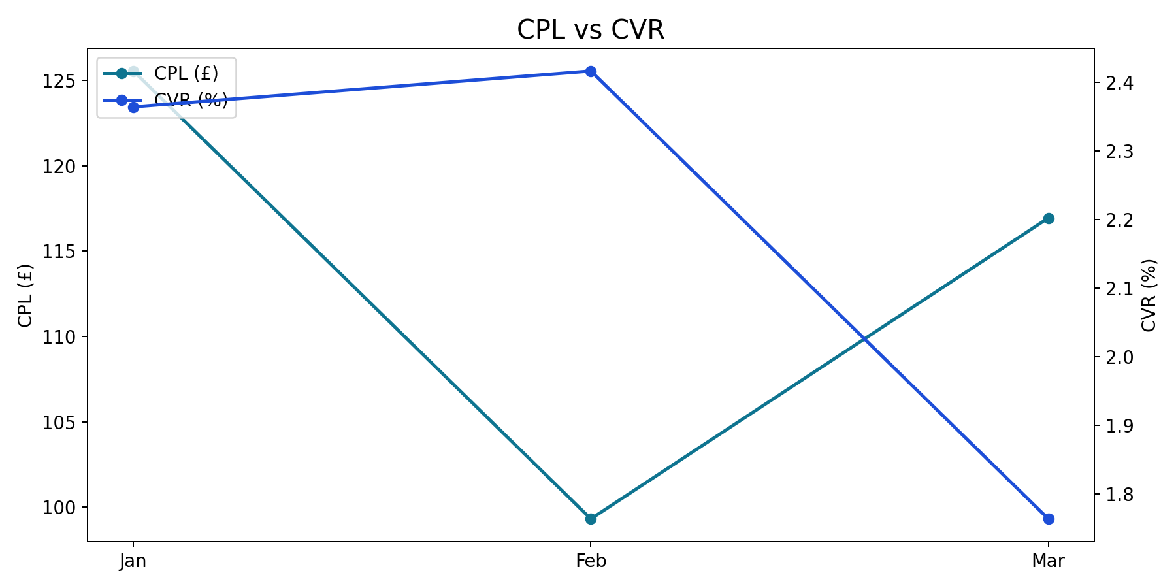
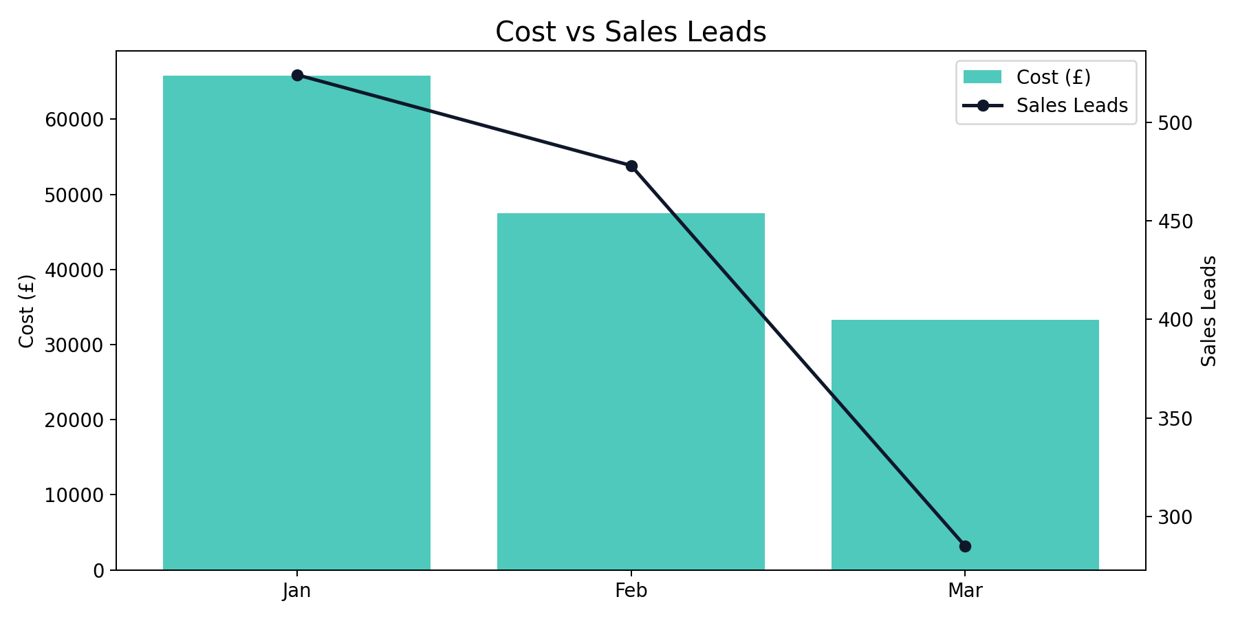
Generic Monthly Trend
Q1 2026 (Jan - Mar 2026)
Generic generated 1,287 leads from £146,591.38 with a quarter CPL of £113.90.
Best efficiency was in Feb (£99.32 CPL), while Jan was highest at £125.55.
YoY vs same quarter last year: leads +13.79%, spend +24.70%.

Slide 10
Performance Max Summary
Q1 2026 (Jan - Mar 2026)
Month | Impressions | Clicks | CTR | CPC | Cost | Sales Leads | CPL | CVR
Jan | 1,525,966 | 17,022 | 1.12% | £0.89 | £15,223.55 | 271 | £56.18 | 1.59%
Feb | 2,813,840 | 16,230 | 0.58% | £0.82 | £13,350.29 | 210 | £63.57 | 1.29%
Mar | 1,125,512 | 9,916 | 0.88% | £0.81 | £8,010.41 | 137 | £58.47 | 1.38%
Total | 5,465,318 | 43,168 | 0.79% | £0.85 | £36,584.24 | 618 | £59.20 | 1.43%
Performance Max generated 618 leads from £36,584.24 with a quarter CPL of £59.20.
Best efficiency was in Jan (£56.18 CPL), while Feb was highest at £63.57.
YoY vs same quarter last year: leads -57.61%, spend +66.32%.

Slide 11
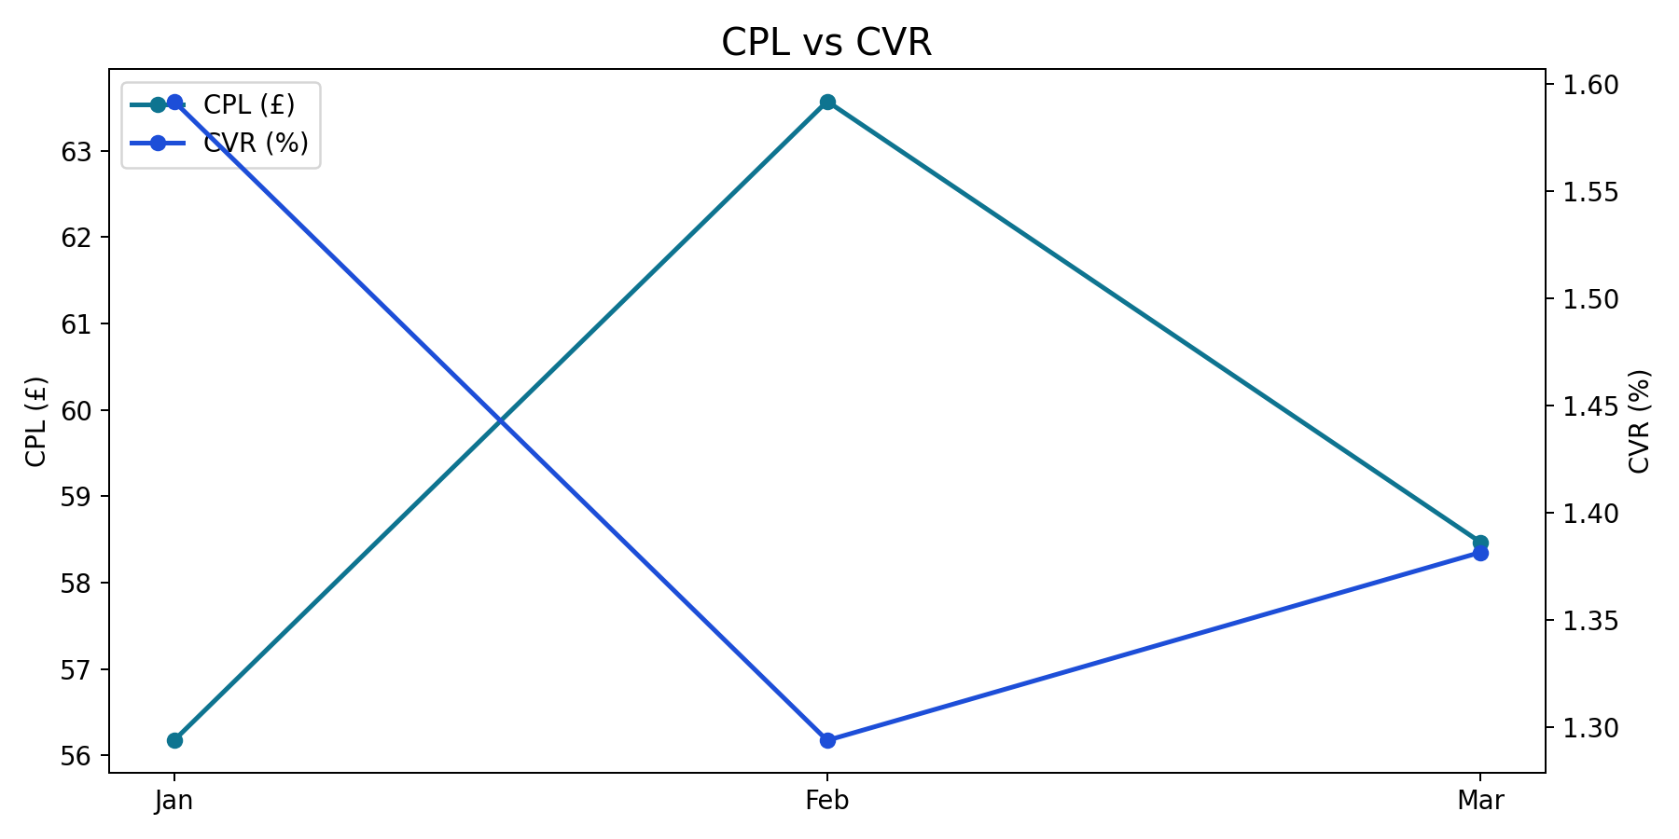
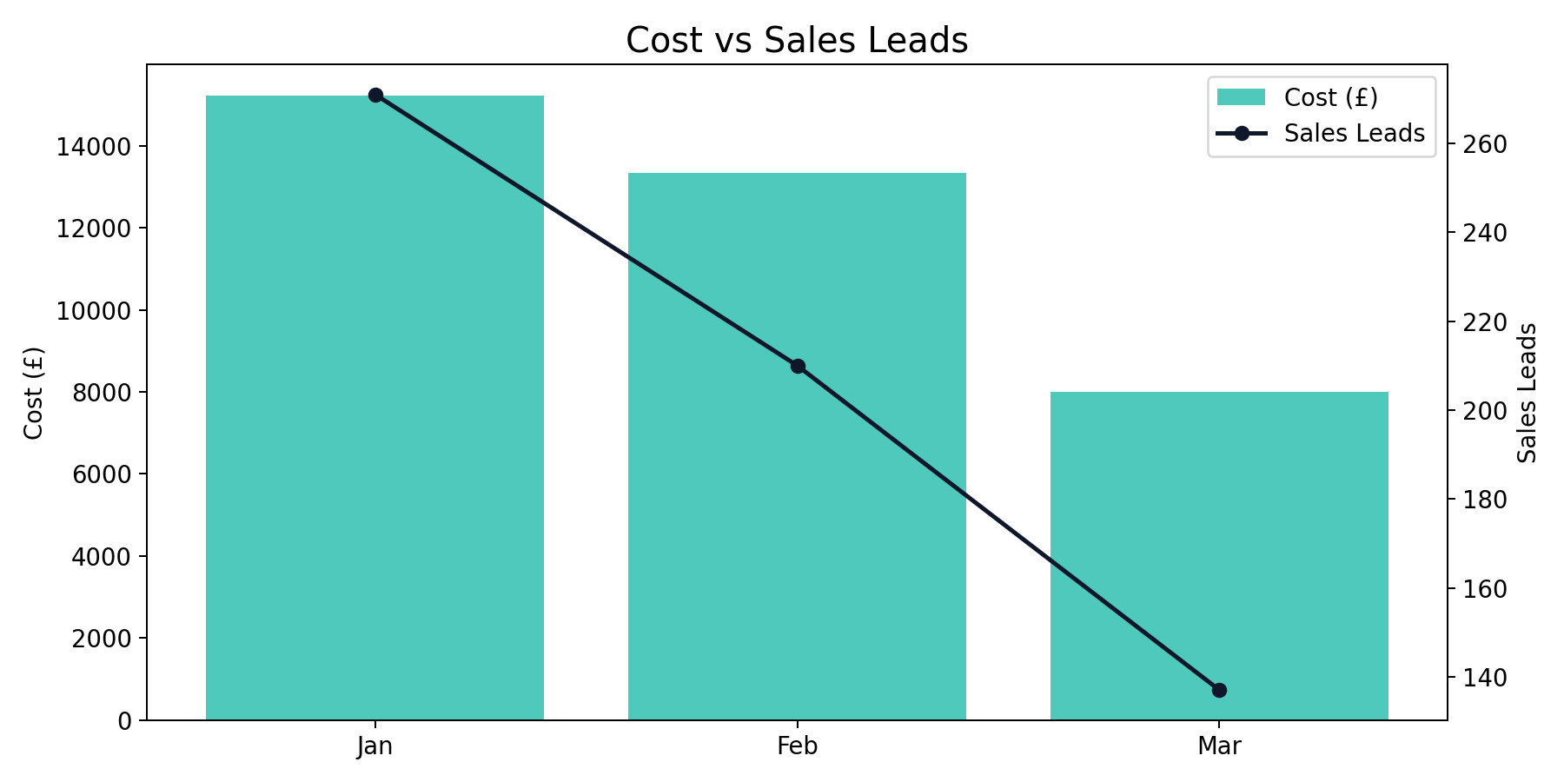
Performance Max Monthly Trend
Q1 2026 (Jan - Mar 2026)
Performance Max generated 618 leads from £36,584.24 with a quarter CPL of £59.20.
Best efficiency was in Jan (£56.18 CPL), while Feb was highest at £63.57.
YoY vs same quarter last year: leads -57.61%, spend +66.32%.

Slide 12
Demand Gen Summary
Q1 2026 (Jan - Mar 2026)
Month | Impressions | Clicks | CTR | CPC | Cost | Sales Leads | CPL | CVR
Jan | 2,773,009 | 25,022 | 0.90% | £0.54 | £13,459.83 | 147 | £91.56 | 0.59%
Feb | 1,599,600 | 11,658 | 0.73% | £0.78 | £9,095.57 | 92 | £98.86 | 0.79%
Mar | 1,050,884 | 7,596 | 0.72% | £0.55 | £4,190.32 | 38 | £110.27 | 0.50%
Total | 5,423,493 | 44,276 | 0.82% | £0.60 | £26,745.71 | 277 | £96.55 | 0.63%
Demand Gen generated 277 leads from £26,745.71 with a quarter CPL of £96.55.
Best efficiency was in Jan (£91.56 CPL), while Mar was highest at £110.27.
YoY vs same quarter last year: leads +793.55%, spend +1368.05%.

Slide 13
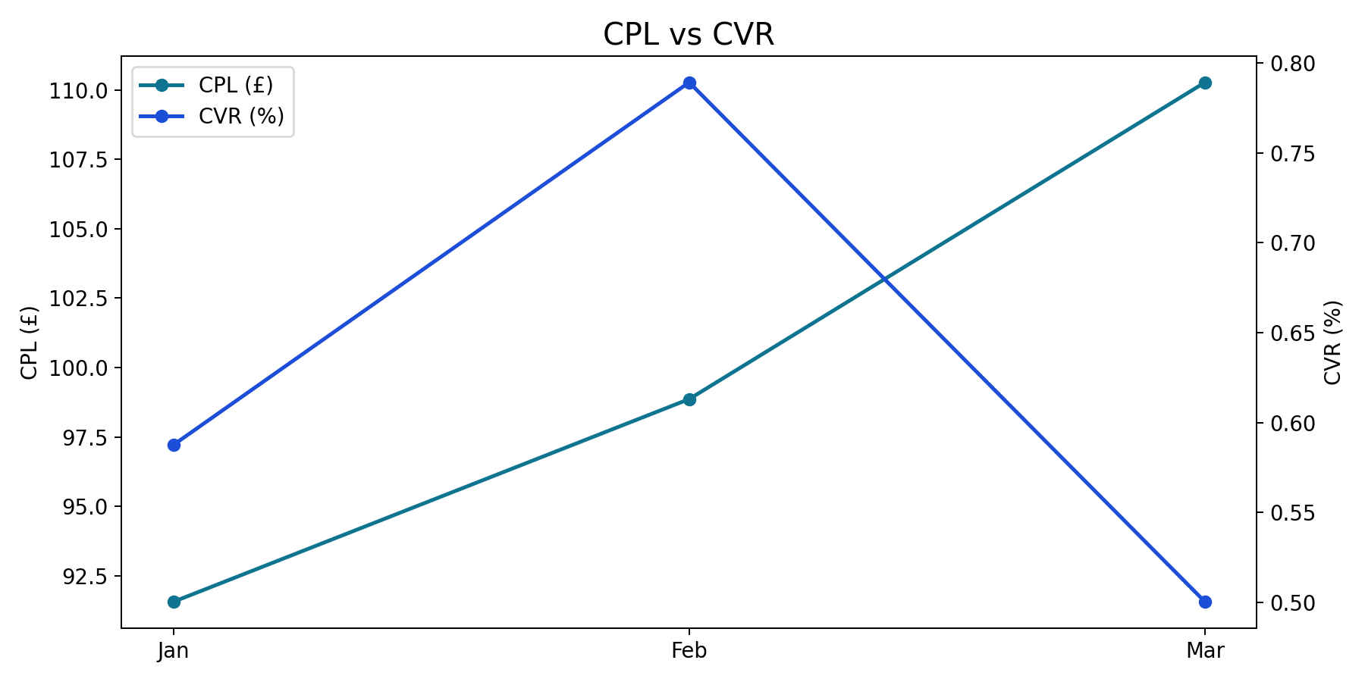
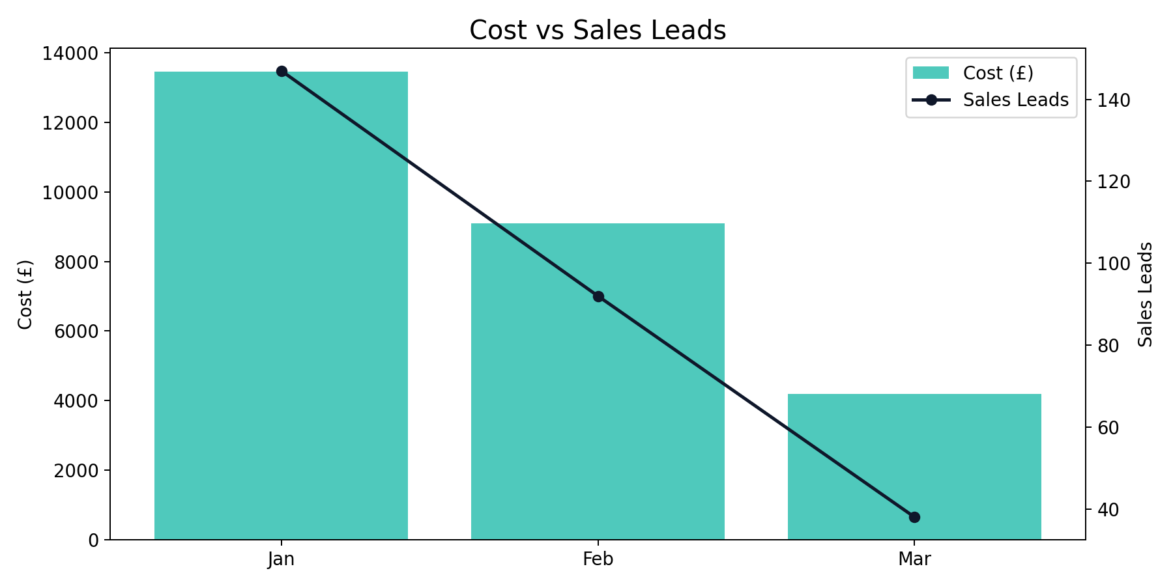
Demand Gen Monthly Trend
Q1 2026 (Jan - Mar 2026)
Demand Gen generated 277 leads from £26,745.71 with a quarter CPL of £96.55.
Best efficiency was in Jan (£91.56 CPL), while Mar was highest at £110.27.
YoY vs same quarter last year: leads +793.55%, spend +1368.05%.

Slide 14
Other Summary
Q1 2026 (Jan - Mar 2026)
Month | Impressions | Clicks | CTR | CPC | Cost | Sales Leads | CPL | CVR
Jan | 0 | 0 | n/a | n/a | £0.00 | 34 | £0.00 | n/a
Feb | 0 | 0 | n/a | n/a | £0.00 | 23 | £0.00 | n/a
Mar | 0 | 0 | n/a | n/a | £0.00 | 22 | £0.00 | n/a
Total | 0 | 0 | n/a | n/a | £0.00 | 79 | £0.00 | n/a
Other generated 79 leads from £0.00 with a quarter CPL of £0.00.
Active months in this quarter subset were Jan, Feb, Mar.
YoY comparison is unavailable due to missing or zero baseline in prior year data.

Slide 15
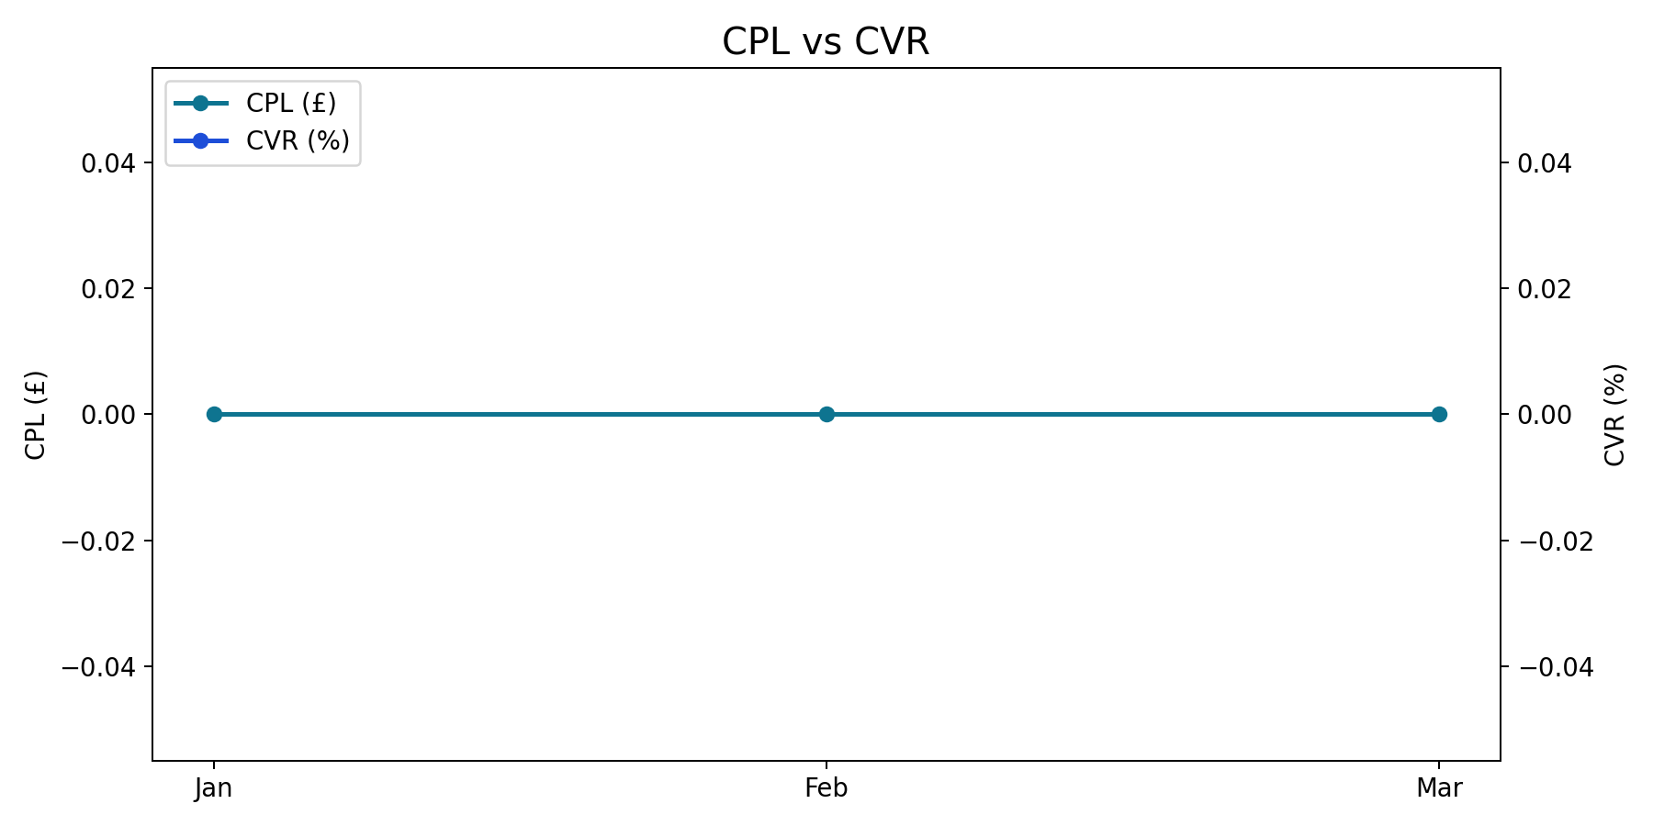
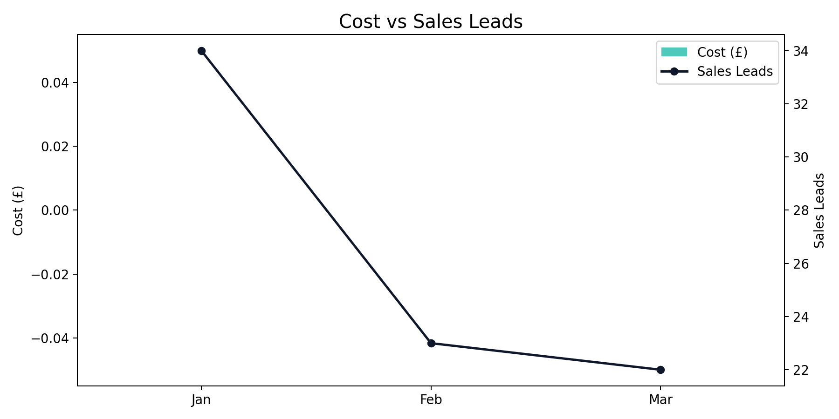
Other Monthly Trend
Q1 2026 (Jan - Mar 2026)
Other generated 79 leads from £0.00 with a quarter CPL of £0.00.
Active months in this quarter subset were Jan, Feb, Mar.
YoY comparison is unavailable due to missing or zero baseline in prior year data.

Slide 16
China Summary + YoY
Q1 2026 (Jan - Mar 2026)
Month | Impressions | Clicks | CTR | CPC | Cost | Sales Leads | CPL | CVR
Jan | 1,872,295 | 22,617 | 1.21% | £1.56 | £35,382.89 | 299 | £118.34 | 1.32%
Feb | 701,195 | 11,892 | 1.70% | £1.61 | £19,195.21 | 276 | £69.55 | 2.32%
Mar | 1,069,902 | 12,959 | 1.21% | £1.48 | £19,127.63 | 196 | £97.59 | 1.51%
Total | 3,643,392 | 47,468 | 1.30% | £1.55 | £73,705.74 | 771 | £95.60 | 1.62%
China generated 771 leads from £73,705.74 with a quarter CPL of £95.60.
Best efficiency was in Feb (£69.55 CPL), while Jan was highest at £118.34.
YoY vs same quarter last year: leads -5.05%, spend +155.66%.

Slide 17
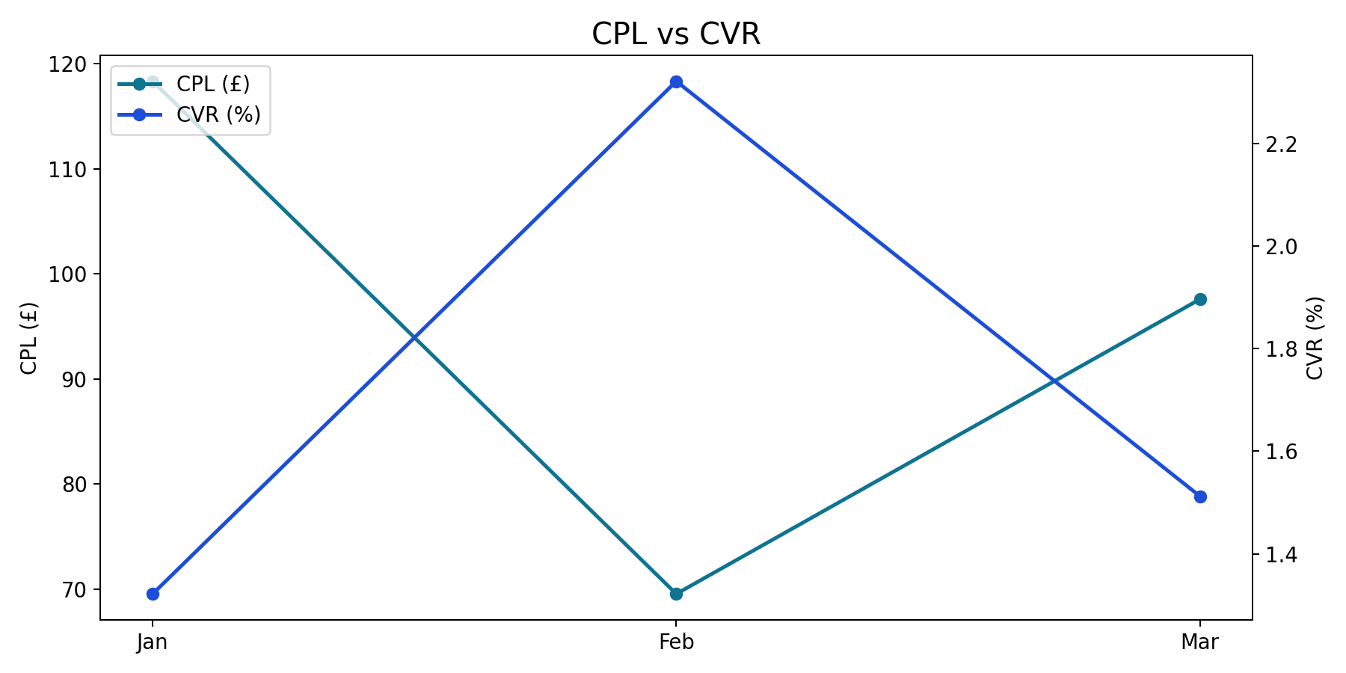
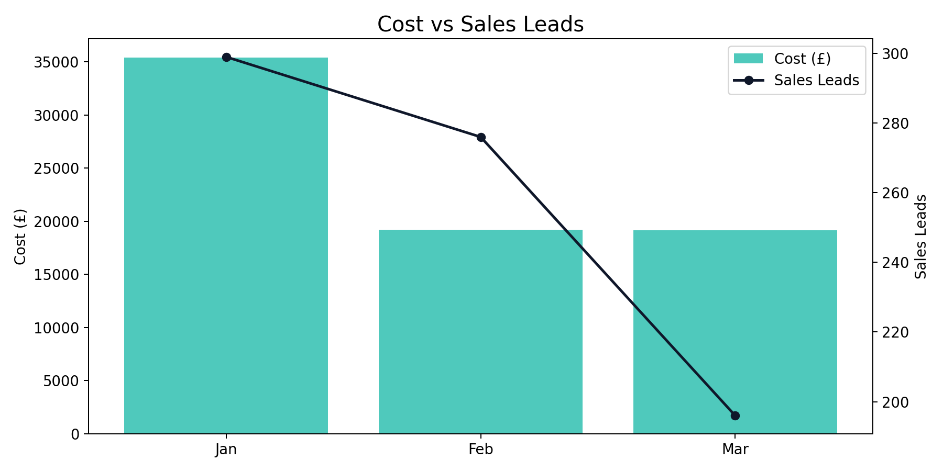
China Monthly Trend
Q1 2026 (Jan - Mar 2026)
China generated 771 leads from £73,705.74 with a quarter CPL of £95.60.
Best efficiency was in Feb (£69.55 CPL), while Jan was highest at £118.34.
YoY vs same quarter last year: leads -5.05%, spend +155.66%.

Slide 18
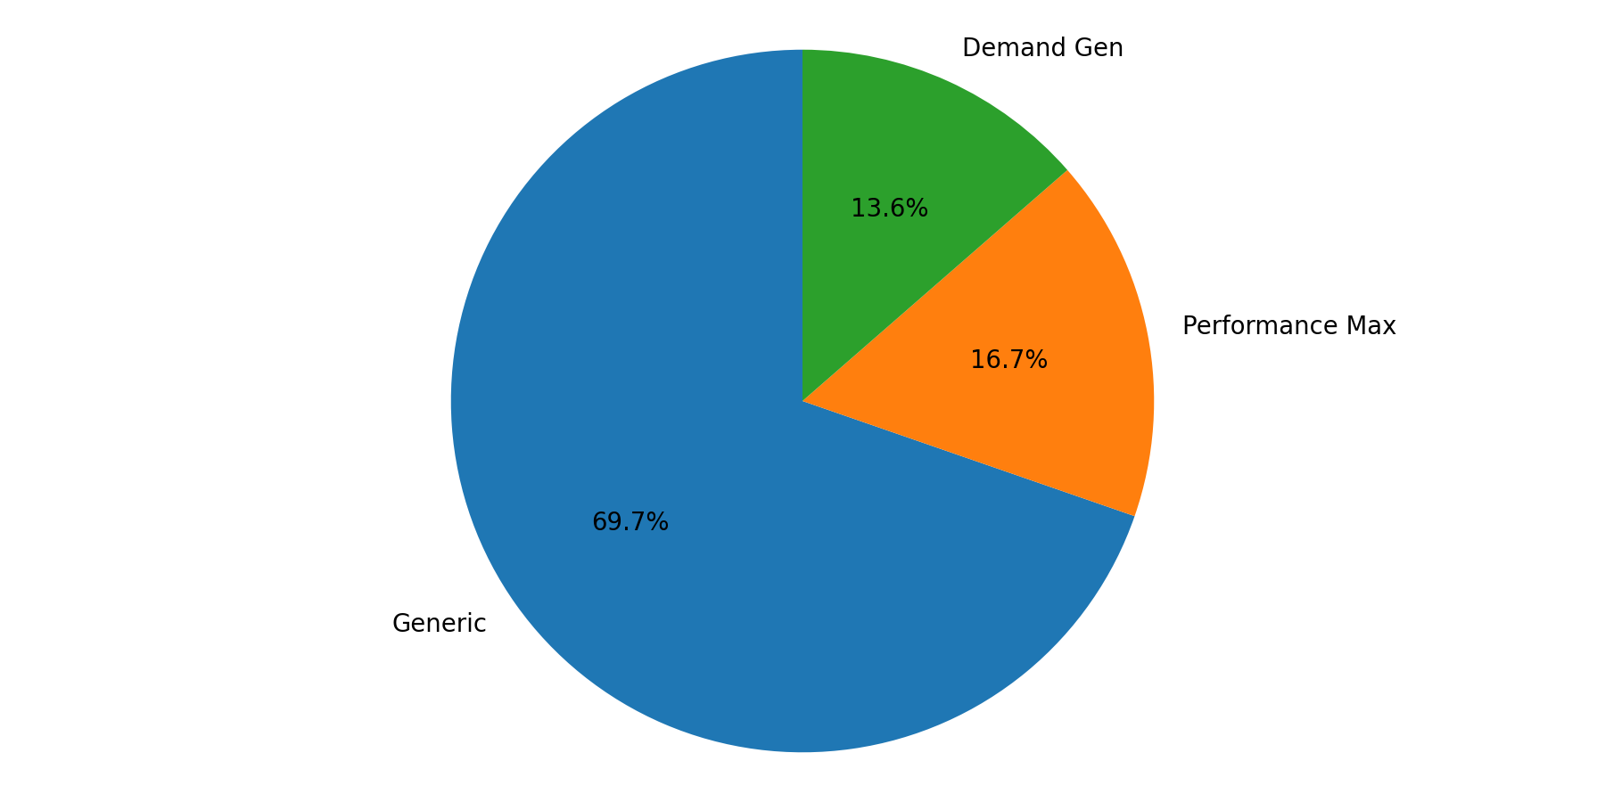
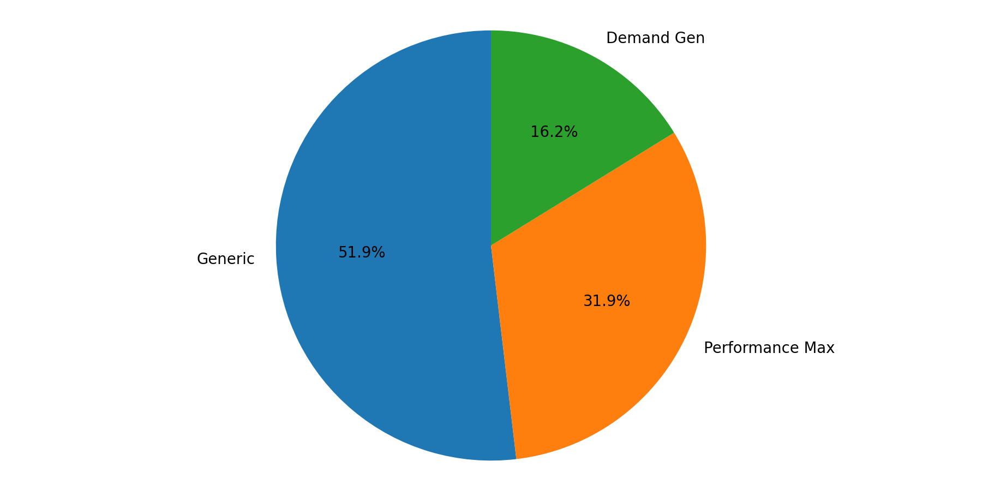
China Campaign Mix
Q1 2026 (Jan - Mar 2026)
Generic represented the largest share of spend (69.7%).
Generic delivered the largest share of leads (51.9%).

Slide 19
Japan Summary + YoY
Q1 2026 (Jan - Mar 2026)
Month | Impressions | Clicks | CTR | CPC | Cost | Sales Leads | CPL | CVR
Jan | 1,375,199 | 21,412 | 1.56% | £1.50 | £32,104.77 | 352 | £91.21 | 1.64%
Feb | 1,222,264 | 12,209 | 1.00% | £1.58 | £19,285.56 | 201 | £95.95 | 1.65%
Mar | 594,709 | 7,425 | 1.25% | £1.35 | £9,994.90 | 121 | £82.60 | 1.63%
Total | 3,192,172 | 41,046 | 1.29% | £1.50 | £61,385.22 | 674 | £91.08 | 1.64%
Japan generated 674 leads from £61,385.22 with a quarter CPL of £91.08.
Best efficiency was in Mar (£82.60 CPL), while Feb was highest at £95.95.
YoY vs same quarter last year: leads -10.85%, spend +18.27%.

Slide 20
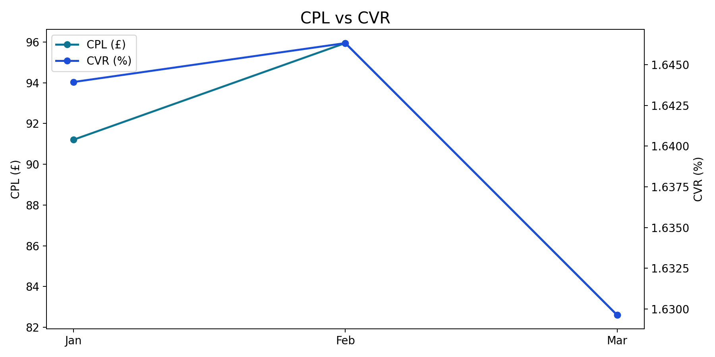
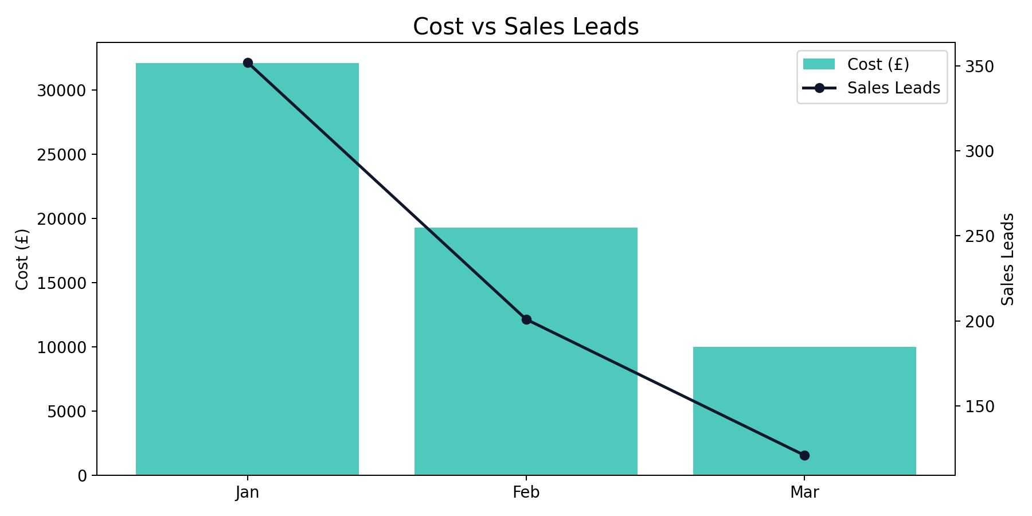
Japan Monthly Trend
Q1 2026 (Jan - Mar 2026)
Japan generated 674 leads from £61,385.22 with a quarter CPL of £91.08.
Best efficiency was in Mar (£82.60 CPL), while Feb was highest at £95.95.
YoY vs same quarter last year: leads -10.85%, spend +18.27%.

Slide 21
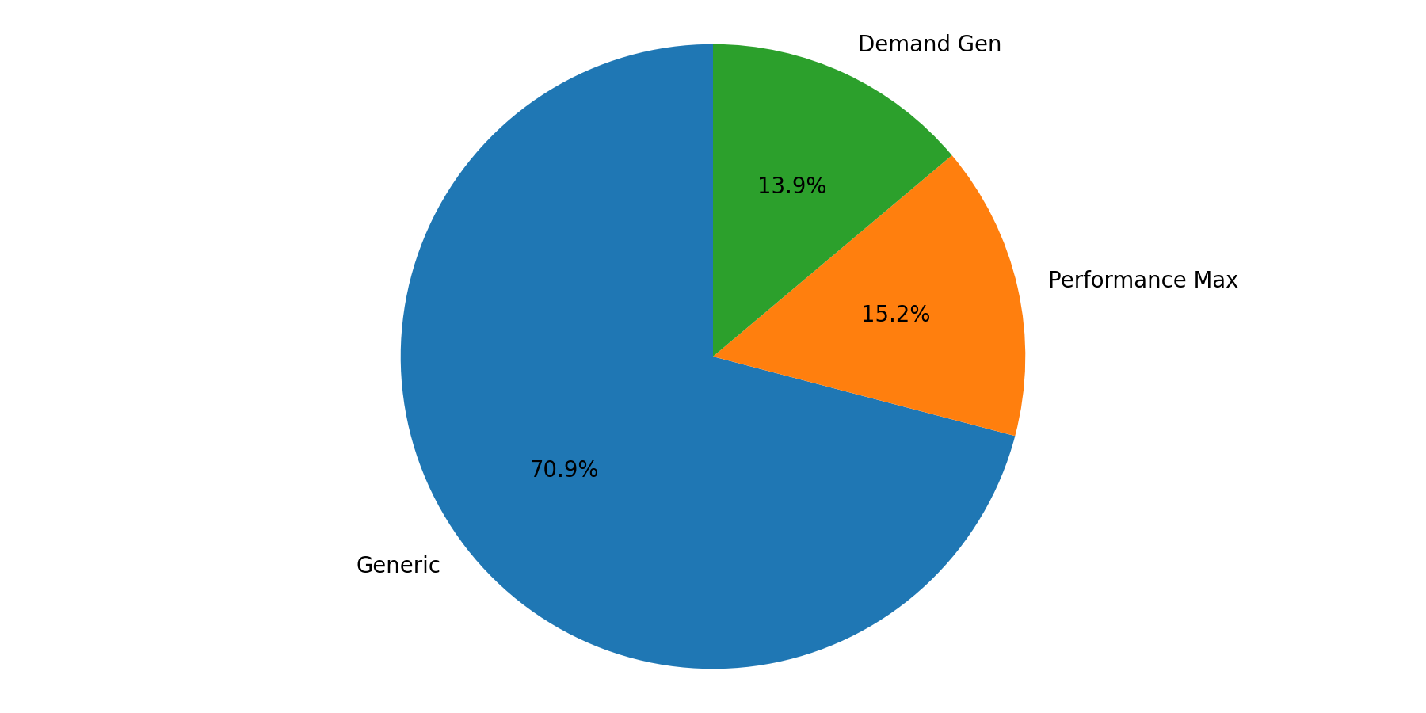
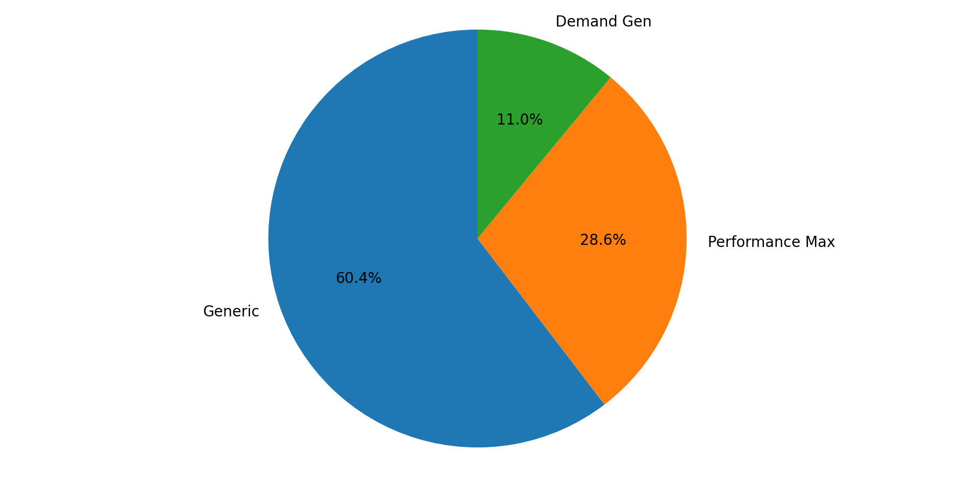
Japan Campaign Mix
Q1 2026 (Jan - Mar 2026)
Generic represented the largest share of spend (70.9%).
Generic delivered the largest share of leads (60.4%).

Slide 22
SE Asia Summary + YoY
Q1 2026 (Jan - Mar 2026)
Month | Impressions | Clicks | CTR | CPC | Cost | Sales Leads | CPL | CVR
Jan | 775,452 | 10,117 | 1.30% | £1.27 | £12,799.91 | 119 | £107.56 | 1.18%
Feb | 971,734 | 8,383 | 0.86% | £1.17 | £9,847.36 | 99 | £99.47 | 1.18%
Mar | 237,896 | 3,782 | 1.59% | £1.45 | £5,470.85 | 53 | £103.22 | 1.40%
Total | 1,985,082 | 22,282 | 1.12% | £1.26 | £28,118.12 | 271 | £103.76 | 1.22%
SE Asia generated 271 leads from £28,118.12 with a quarter CPL of £103.76.
Best efficiency was in Feb (£99.47 CPL), while Jan was highest at £107.56.
YoY vs same quarter last year: leads -33.58%, spend +12.15%.

Slide 23
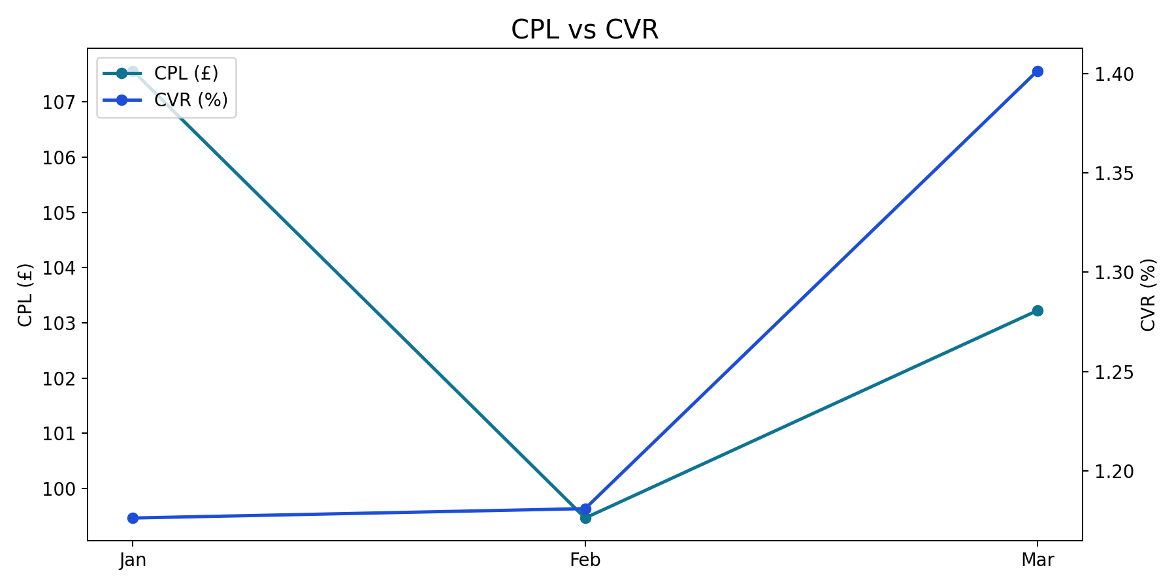
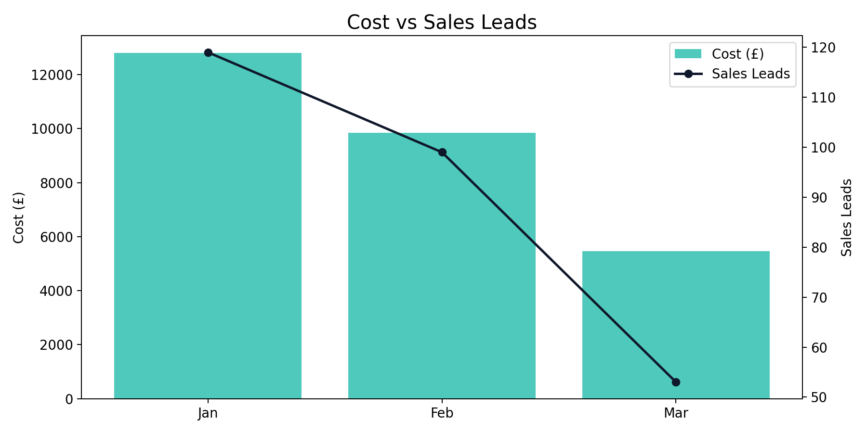
SE Asia Monthly Trend
Q1 2026 (Jan - Mar 2026)
SE Asia generated 271 leads from £28,118.12 with a quarter CPL of £103.76.
Best efficiency was in Feb (£99.47 CPL), while Jan was highest at £107.56.
YoY vs same quarter last year: leads -33.58%, spend +12.15%.

Slide 24
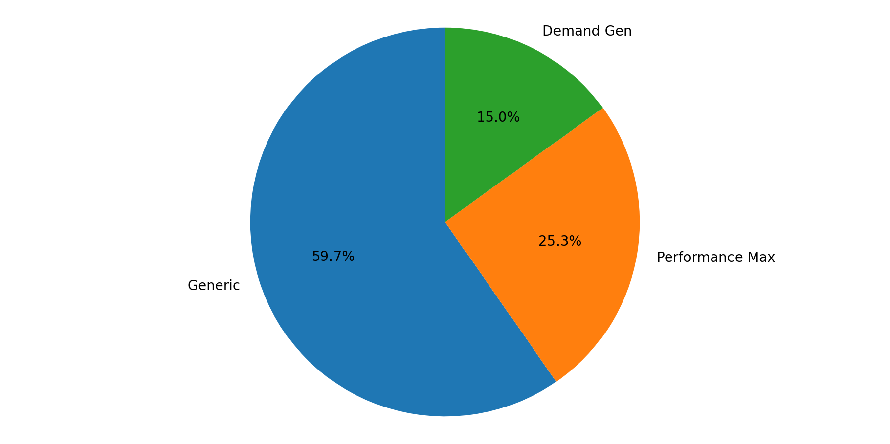

SE Asia Campaign Mix
Q1 2026 (Jan - Mar 2026)
Generic represented the largest share of spend (59.7%).
Generic delivered the largest share of leads (52.0%).

Slide 25
India Summary + YoY
Q1 2026 (Jan - Mar 2026)
Month | Impressions | Clicks | CTR | CPC | Cost | Sales Leads | CPL | CVR
Jan | 451,624 | 5,177 | 1.15% | £1.45 | £7,524.19 | 99 | £76.00 | 1.91%
Feb | 1,357,405 | 6,958 | 0.51% | £1.42 | £9,908.31 | 85 | £116.57 | 1.22%
Mar | 187,767 | 2,968 | 1.58% | £1.82 | £5,388.04 | 41 | £131.42 | 1.38%
Total | 1,996,796 | 15,103 | 0.76% | £1.51 | £22,820.53 | 225 | £101.42 | 1.49%
India generated 225 leads from £22,820.53 with a quarter CPL of £101.42.
Best efficiency was in Jan (£76.00 CPL), while Mar was highest at £131.42.
YoY vs same quarter last year: leads -42.31%, spend +17.52%.

Slide 26
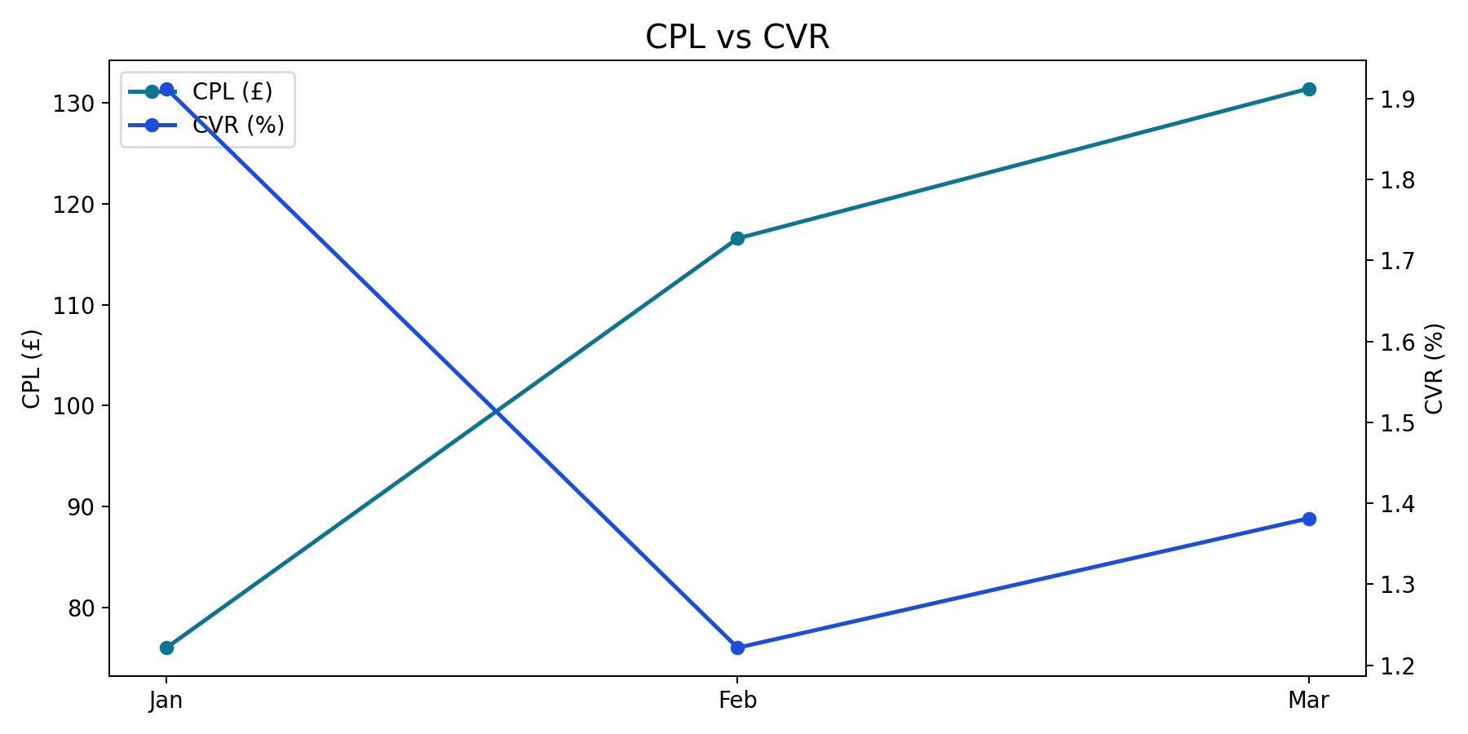
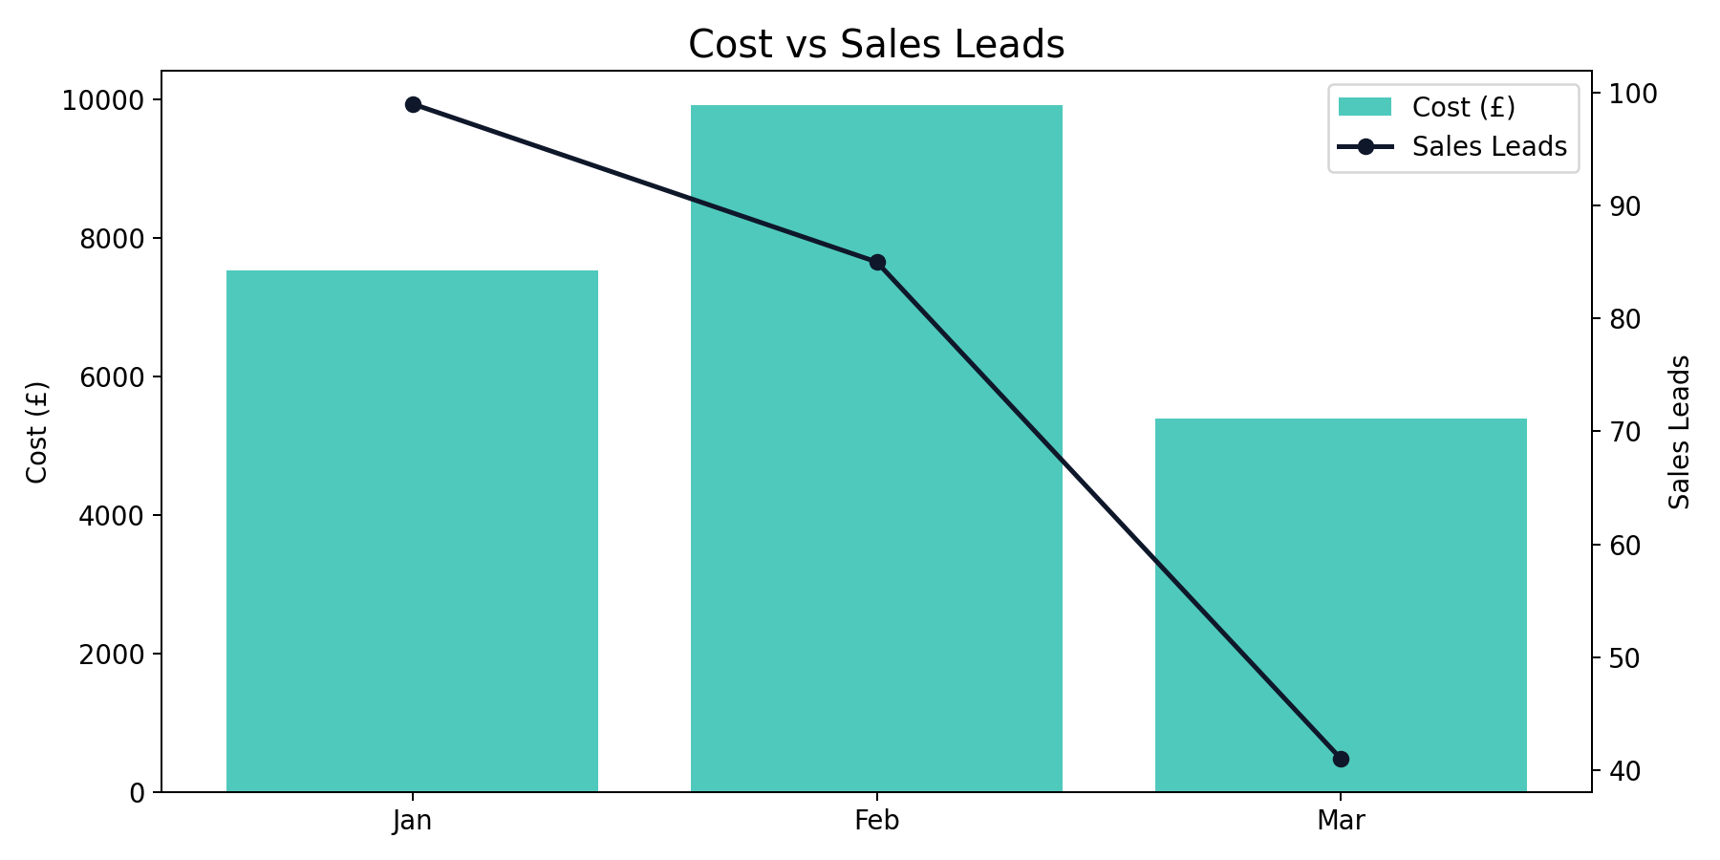
India Monthly Trend
Q1 2026 (Jan - Mar 2026)
India generated 225 leads from £22,820.53 with a quarter CPL of £101.42.
Best efficiency was in Jan (£76.00 CPL), while Mar was highest at £131.42.
YoY vs same quarter last year: leads -42.31%, spend +17.52%.

Slide 27
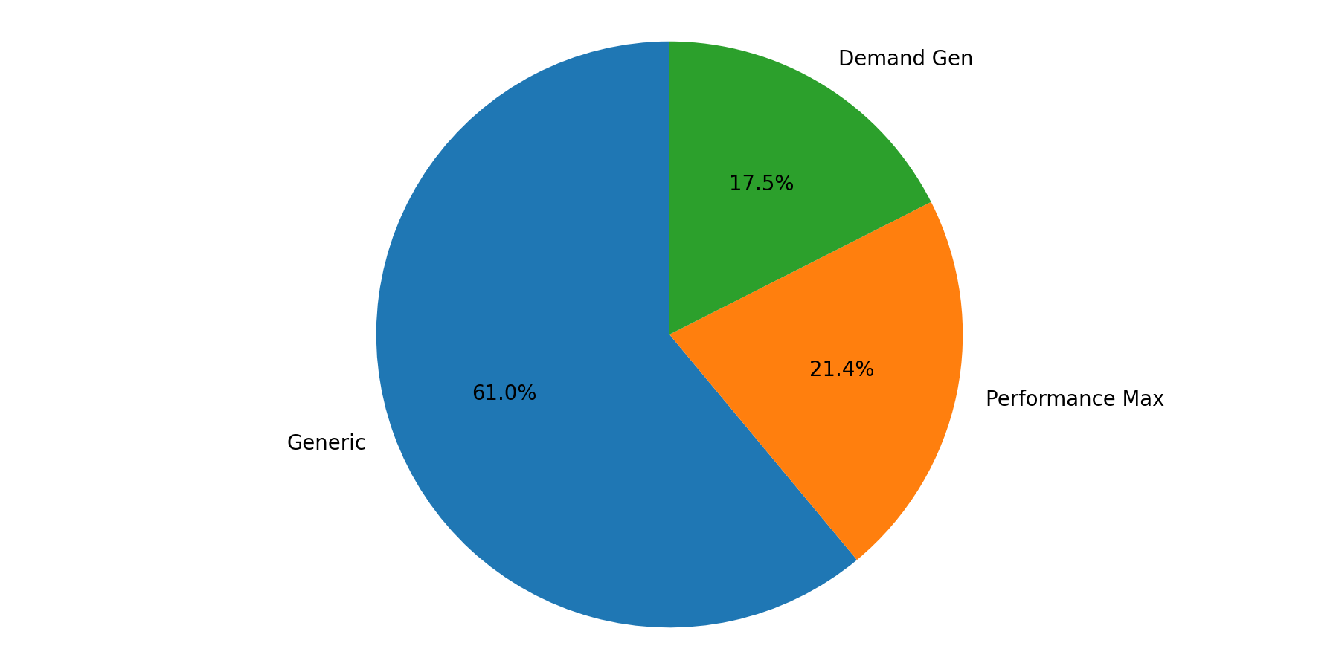
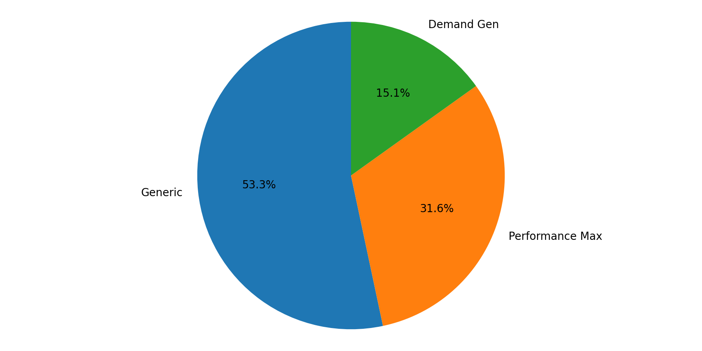
India Campaign Mix
Q1 2026 (Jan - Mar 2026)
Generic represented the largest share of spend (61.0%).
Generic delivered the largest share of leads (53.3%).

Slide 28
Other Summary + YoY
Q1 2026 (Jan - Mar 2026)
Month | Impressions | Clicks | CTR | CPC | Cost | Sales Leads | CPL | CVR
Jan | 258,478 | 20,179 | 7.81% | £0.61 | £12,396.98 | 1,537 | £8.07 | 7.62%
Feb | 537,889 | 19,750 | 3.67% | £0.76 | £15,069.02 | 1,157 | £13.02 | 5.86%
Mar | 535,323 | 16,109 | 3.01% | £0.57 | £9,115.70 | 997 | £9.14 | 6.19%
Total | 1,331,690 | 56,038 | 4.21% | £0.65 | £36,581.70 | 3,691 | £9.91 | 6.59%
Other generated 3,691 leads from £36,581.70 with a quarter CPL of £9.91.
Best efficiency was in Jan (£8.07 CPL), while Feb was highest at £13.02.
YoY vs same quarter last year: leads +218.74%, spend +47.51%.

Slide 29
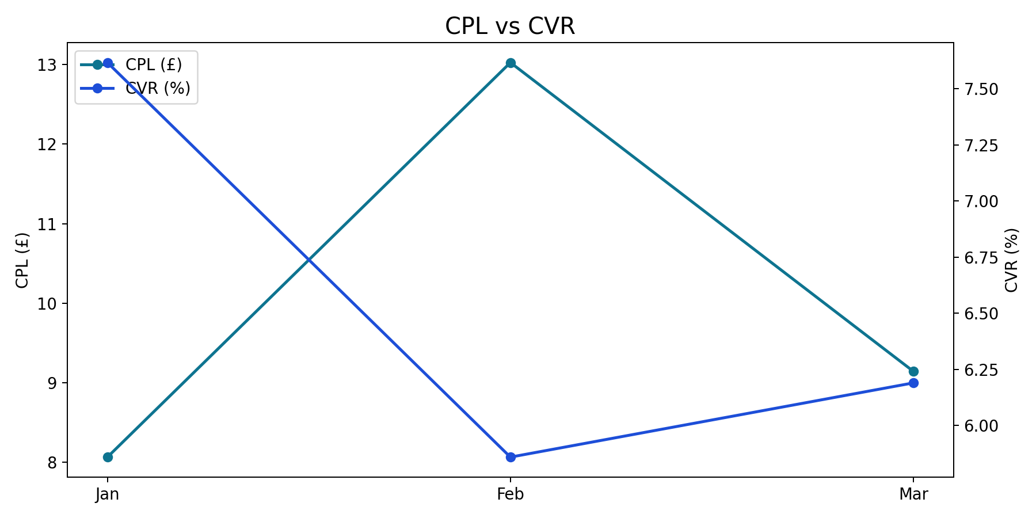
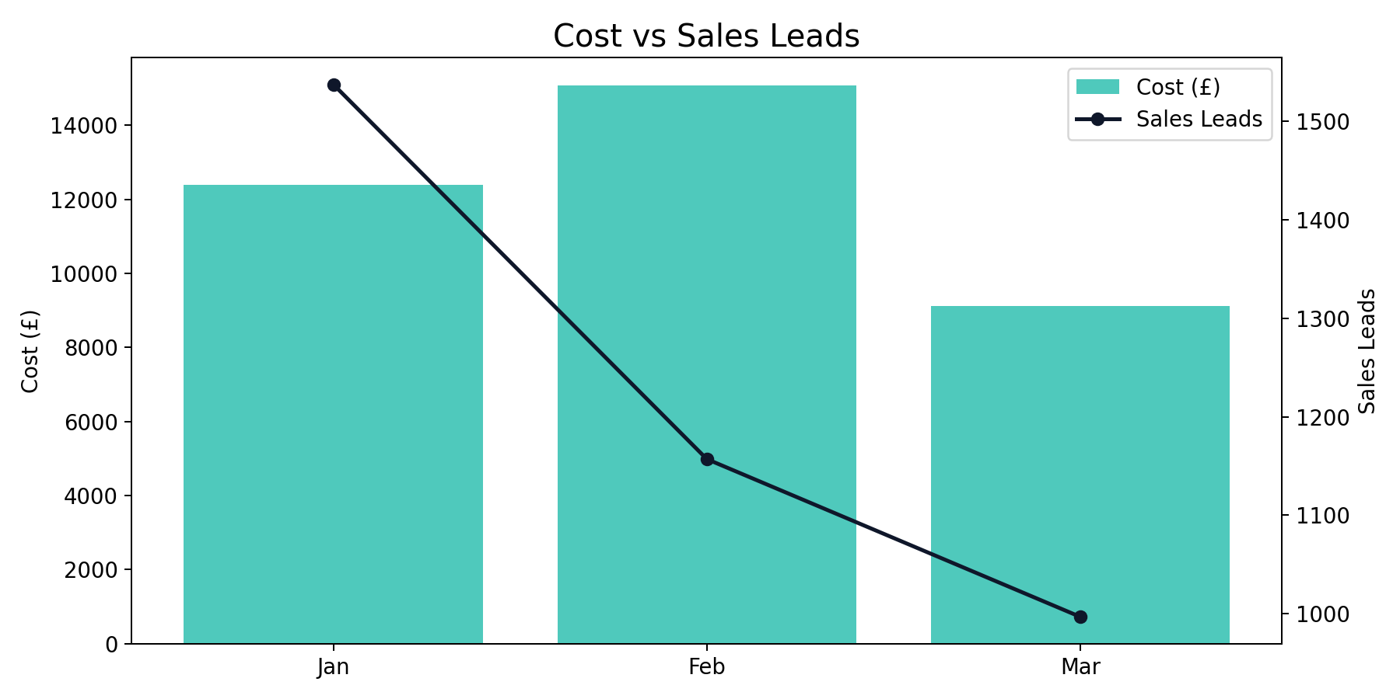
Other Monthly Trend
Q1 2026 (Jan - Mar 2026)
Other generated 3,691 leads from £36,581.70 with a quarter CPL of £9.91.
Best efficiency was in Jan (£8.07 CPL), while Feb was highest at £13.02.
YoY vs same quarter last year: leads +218.74%, spend +47.51%.

Slide 30
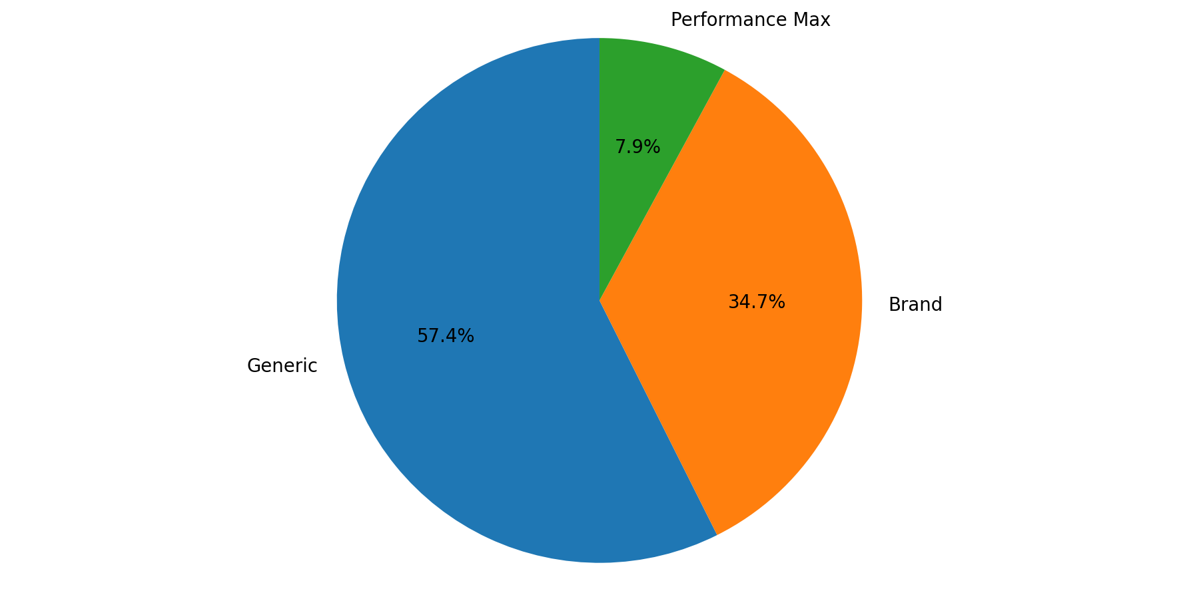
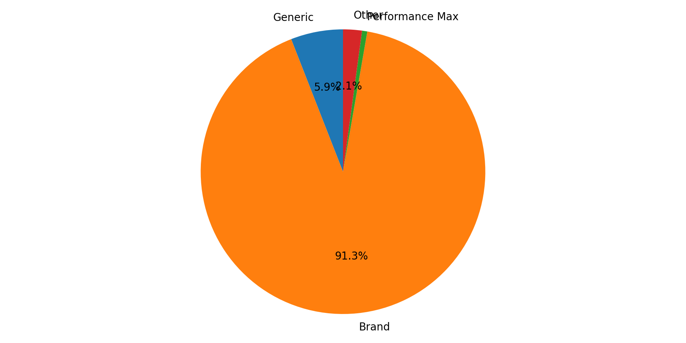
Other Campaign Mix
Q1 2026 (Jan - Mar 2026)
Generic represented the largest share of spend (57.4%).
Brand delivered the largest share of leads (91.3%).
Spend and lead mix are concentrated in different campaign types, indicating different efficiency profiles.

Slide 31
Google Trends

Slide 32
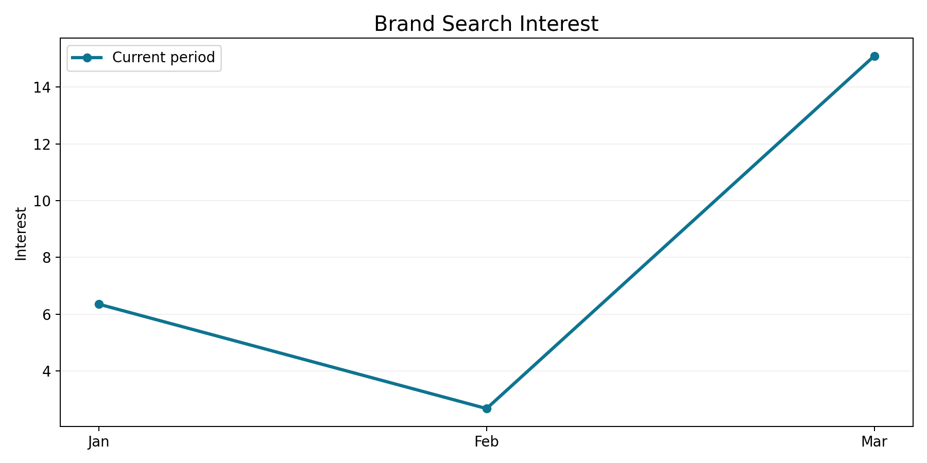
Wendy Wu Tours Terms Are Growing
Q1 2026 (Jan - Mar 2026)
Brand trend data is available for the current period, but a prior-year baseline is not available.
Peak interest in the quarter fell in Mar.
The broader trend pattern looks seasonal / spiky.
Source: Google Trends

Slide 33
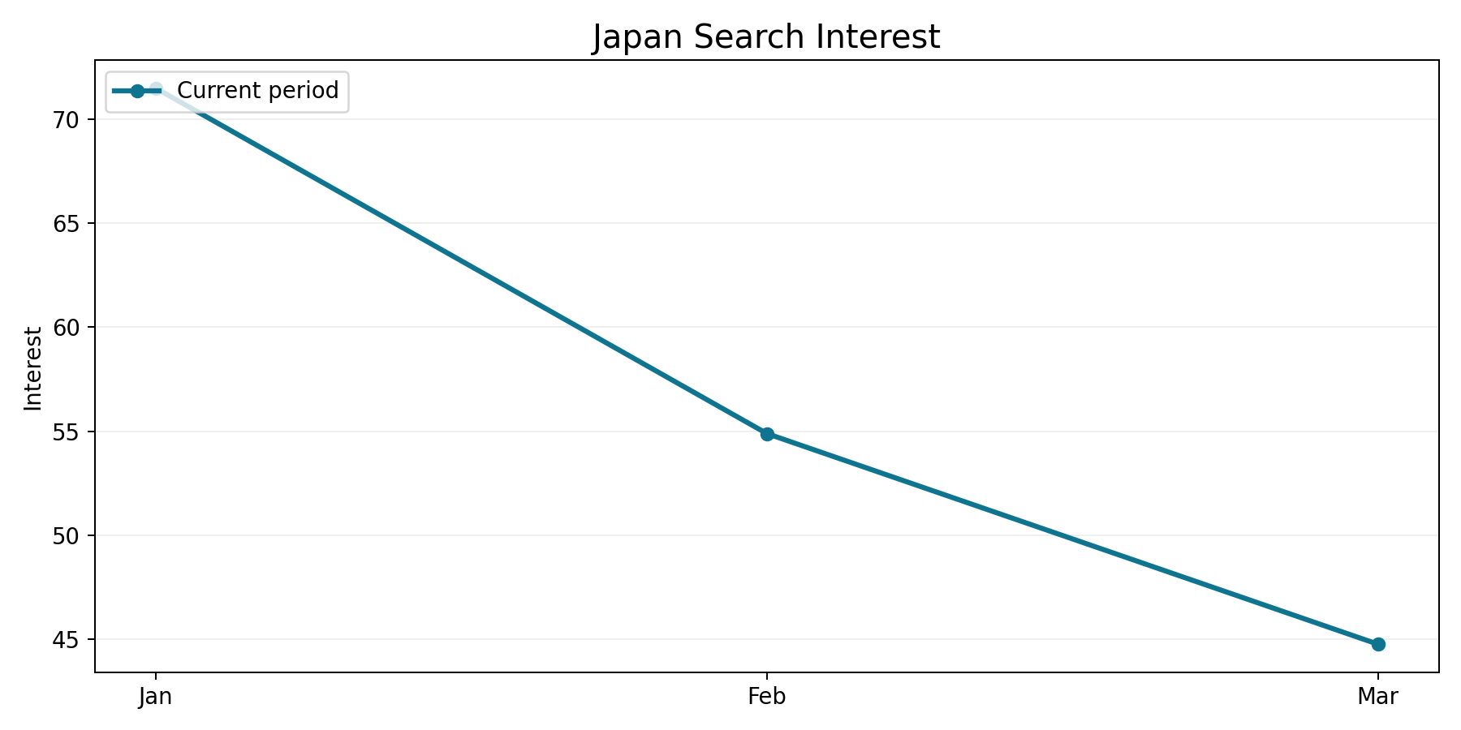
Japan Demand Trend
Q1 2026 (Jan - Mar 2026)
Japan trend data is available for the current period, but a prior-year baseline is not available.
Peak interest in the quarter fell in Jan.
The broader trend pattern looks decreasing.
Source: Google Trends

Slide 34
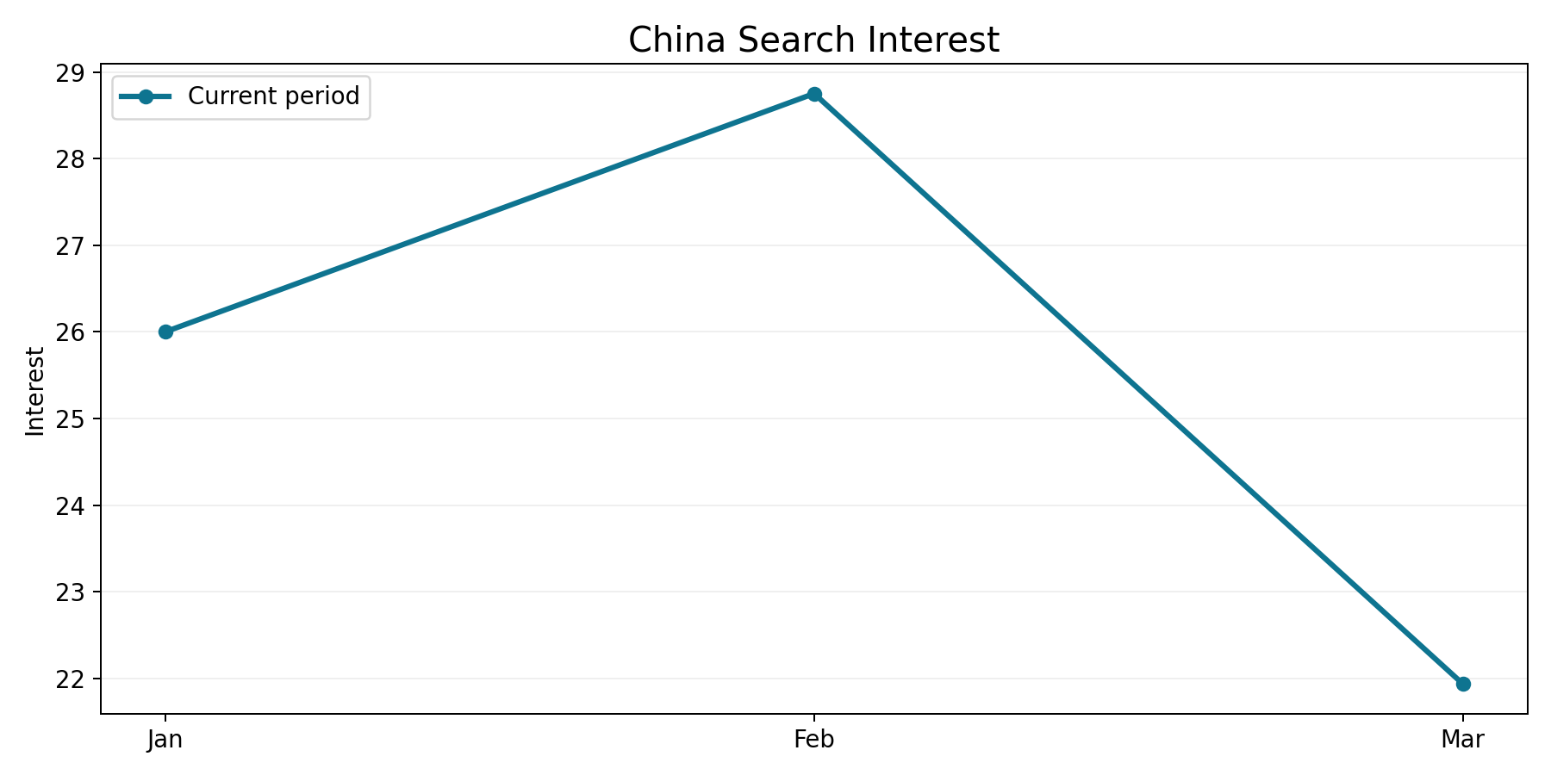
China Demand Trend
Q1 2026 (Jan - Mar 2026)
China trend data is available for the current period, but a prior-year baseline is not available.
Peak interest in the quarter fell in Feb.
The broader trend pattern looks decreasing.
Source: Google Trends

Slide 35
Auction Insights

Slide 36
Brand coverage is very strong
Q1 2026 (Jan - Mar 2026)
Domain | Impression Share | Overlap Rate | Position Above Rate | Top of Page Rate | Absolute Top Rate | Outranking Share
tui.co.uk | n/a | 3.6% | 57.0% | 73.8% | 21.3% | 18.7%
gadventures.com | n/a | 5.1% | 42.6% | 70.2% | 21.6% | 18.6%
travelbag.co.uk | n/a | 9.3% | 65.0% | 74.8% | 19.7% | 17.9%
exoticca.com | n/a | 9.4% | 45.5% | 73.6% | 19.0% | 18.3%
loveholidays.com | n/a | 4.3% | 57.1% | 80.2% | 20.6% | 18.6%
greatrail.com | n/a | 7.7% | 52.9% | 75.4% | 24.4% | 18.3%
getyourguide.com | n/a | 2.0% | 52.1% | 81.5% | 31.8% | 18.9%
rivieratravel.co.uk | n/a | 12.2% | 48.2% | 63.0% | 17.1% | 17.9%
audleytravel.com, distantjourneys.co.uk and intrepidtravel.com are the closest competitors based on overlap rate.
audleytravel.com, you and distantjourneys.co.uk are strongest on impression share among competitors in the file.
getyourguide.com, tui.co.uk and gadventures.com show the strongest outranking presence where that metric is available.
Source: Google Ads Auction Insights

Slide 37
Recommendations

Slide 38
Recommendations / Next Steps
Q1 2026 (Jan - Mar 2026)
Scale efficiency: Increase budget in the campaign types that are already delivering lead growth without a CPL penalty.
Budget allocation: Protect investment in Brand for scale while testing incremental budget into Other where efficiency is strongest.
Competitive defence: Monitor overlap from audleytravel.com, distantjourneys.co.uk and protect impression share on the most valuable queries.

