Slide 1
Wendy Wu Tours
5,682
Quarterly PPC Performance Report
Total Leads
Q1 2026 (Jan – Mar 2026)
£224K
Total Spend
Prepared by Summon
£39.46
Blended CPL
3.10%
CVR

Slide 2
Google Trends
Wendy Wu Tours | Q1 2026 | Summon

Slide 3

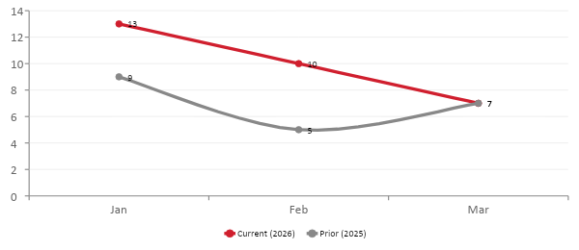
Wendy Wu Tours Terms Are Growing
Q1 2026 (Jan – Mar 2026)
Source: Google Trends
Brand demand has increased year on year, with search volume occuring in January and then tailing off.
March interest is now in line with last year
This year has show reduction MoM, whereads last year saw a March uplift from February
This March we are starting to see the impact of the Iran conflict
Q1 2026 | Summon Digital | Confidential

Slide 4
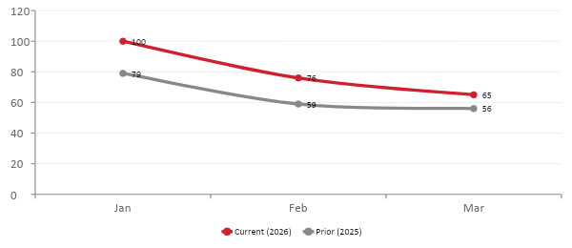
Japan Demand Trend
Q1 2026 (Jan – Mar 2026)
Source: Google Trends
Japan demand has increased year on year and is following a very similar pattern to last year, wich slightly nore of a MoM reduction from February to March
Q1 2026 | Summon Digital | Confidential

Slide 5
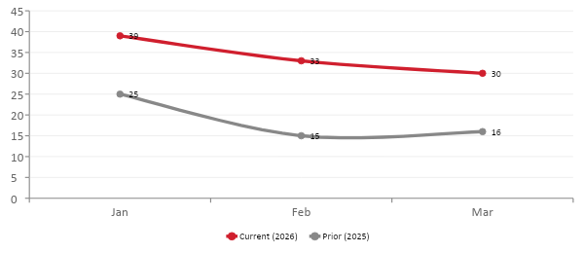
China Demand Trend
Q1 2026 (Jan – Mar 2026)
Source: Google Trends
China shows the same story with reducing MoM search volume compared to last year where March was lightly higher than Feb.
Overall however, search demand is still higher YoY
Q1 2026 | Summon Digital | Confidential

Slide 6
Performance
Wendy Wu Tours | Q1 2026 | Summon

Slide 7
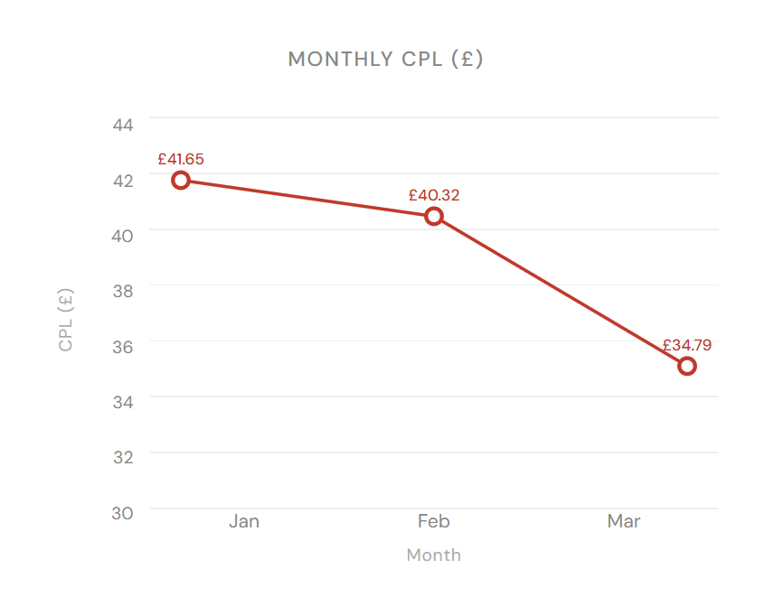
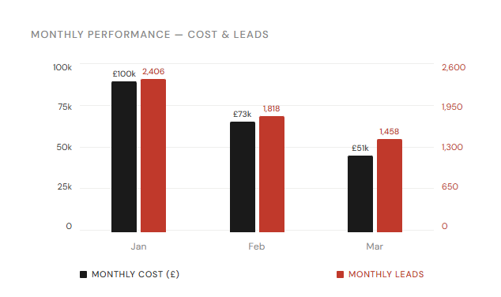
Overall Performance Trend
Q1 2026 (Jan – Mar 2026)
5,682
£224,233
£39.46
3.10%
183,460
1.50%
Leads
Spend
CPL
CVR
Clicks
CTR
YoY: +61.24%
YoY: +49.47%
YoY: -7.3%
YoY: +6.81%
YoY: +50%
YoY: +46%
Overall a strong quarter for the account with 61% increase in leads.
Even within increased spend CPL has come in at 7% lower YoY
Large improvement in Clicks and CTR YoY suggesting improved efficiency of ads at converting searches to visitors
CVR also improved YoY
CPL efficiency improved as the quarter progressed - as budget lowered so did bids leading to fewer conversions but also lower CPLs
The quarterly was only marginally impacted by market conditions at the end of March
Q1 2026 | Summon Digital | Confidential

Slide 8
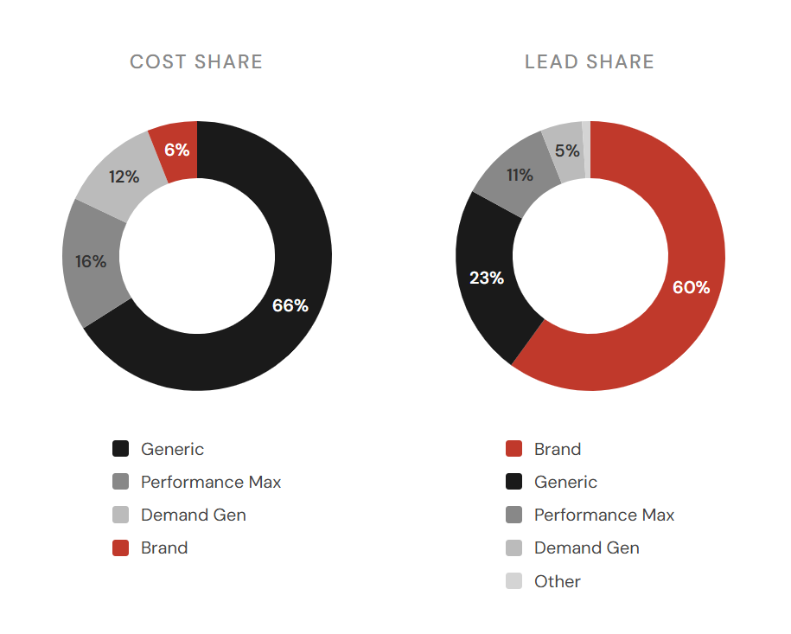
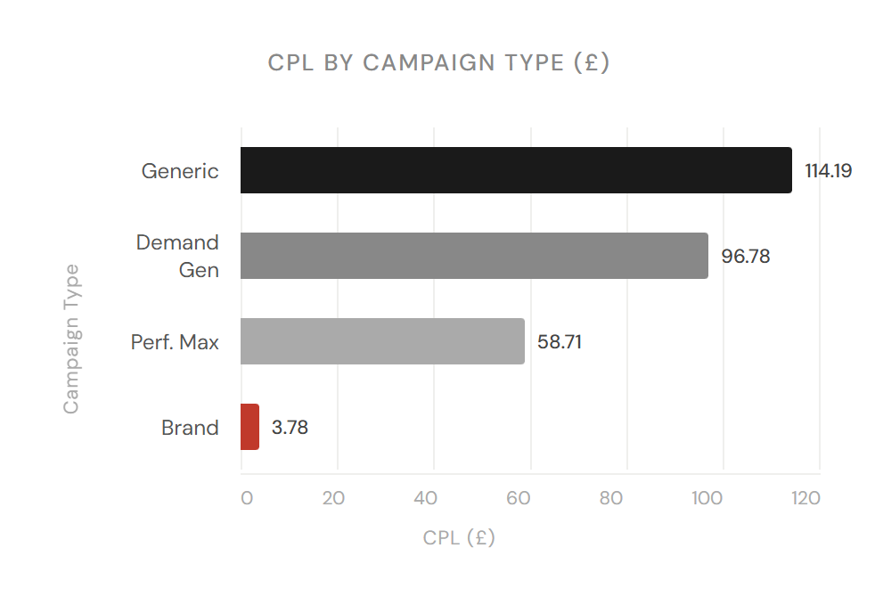
Campaign Type Mix
Q1 2026 (Jan – Mar 2026)
As you would expect Brand delivered the highest across the account, but performance was positive across all campaign types
The majority of budget was invested in Generic campaigns, and these campaigns saw CPLs of £144 this quarter
Generics is the main prospecting channel so CPL is the highest but performing well, both Demand Gen and PMax can feature brand or remarketing, so is not necessarily all purely new prospects
Performance Max produced leads at the lowest CPL, but the second highest investment. There may be scope to increase investment here, depending on YoY sales lead performance
Q1 2026 | Summon Digital | Confidential

Slide 9
Brand Summary
Q1 2026 (Jan – Mar 2026)
3,406
£12,861
£3.78
9.27%
36,760
50.87%
Leads
Spend
Blended CPL
CVR
Clicks
CTR
YoY: +395.78%
YoY: +48.70%
YoY: -70%
YoY: +17%
YoY: +321%
YoY: -2%
Month | Impressions | Clicks | CTR | CPC | Cost | Sales Leads | CPL | CVR
Jan | 29,361 | 15,291 | 52.08% | £0.38 | £5,737.22 | 1,430 | £4.01 | 9.35%
Feb | 22,554 | 11,520 | 51.08% | £0.29 | £3,384.96 | 1,015 | £3.33 | 8.81%
Mar | 20,353 | 9,949 | 48.88% | £0.38 | £3,739.10 | 961 | £3.89 | 9.66%
Total | 72,268 | 36,760 | 50.87% | £0.35 | £12,861.28 | 3,406 | £3.78 | 9.27%
Brand generated 3,406 leads from £12,861.28 with a quarter CPL of £3.78. A very strong improvement in efficiency
Brand campaigns have seen the biggest growth of all channels YoY, although the real success is return far outstripping the level of increased investment
This is in part due to higher investment in this channel, and also brand searches that could have been attributed to PMax last year, now being attributed to our brand specific campaigns
Protecting brand terms remains an important tactic in light of increased competition on brand terms as a result of competitors using AI Max and Performance Max campaigns more.
Some of the overall success of the quarter lands in brand, so a large part of the brand success is assisted by the increased Generics activity as well as PMax and DGen
Q1 2026 | Summon Digital | Confidential

Slide 10
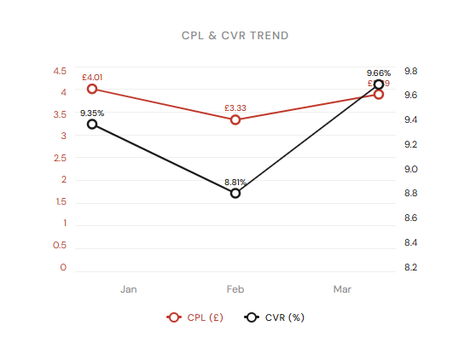
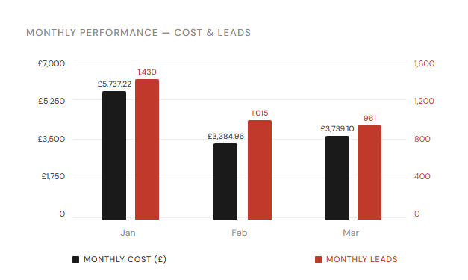
Brand Monthly Trend
Q1 2026 (Jan – Mar 2026)
Q1 2026 | Summon Digital | Confidential

Slide 11
Generic Summary
Q1 2026 (Jan – Mar 2026)
1,294
£147,756
£114.19
2.20%
58,685
4.86%
Leads
Spend
CPL
CVR
Clicks
CTR
YoY: +14.41%
YoY: +25.69%
YoY: +9.86%
YoY: -8.60%
YoY: +25.18%
YoY: +47.57%
Month | Impressions | Clicks | CTR | CPC | Cost | Sales Leads | CPL | CVR
Jan | 404,712 | 22,167 | 5.48% | £2.97 | £65,788.14 | 524 | £125.55 | 2.36%
Feb | 354,493 | 19,784 | 5.58% | £2.40 | £47,474.65 | 478 | £99.32 | 2.42%
Mar | 448,963 | 16,734 | 3.73% | £2.06 | £34,492.96 | 292 | £118.13 | 1.74%
Total | 1,208,168 | 58,685 | 4.86% | £2.52 | £147,755.75 | 1,294 | £114.19 | 2.20%
Overall we have seen a YoY increase in leads from our Generic campaigns
As we push investment, it is expected that we may not see the exact level of return in leads, however CPL remains strong. March performance had an impact on the numbers as we started to see reducing performance
CTR has improved by 45% - this will be in part due to greater visibility in better positions, plus we have been running ad copy tests throughout the quarter, so this is a very good indication that our tests have improved performance here.
Q1 2026 | Summon Digital | Confidential

Slide 12
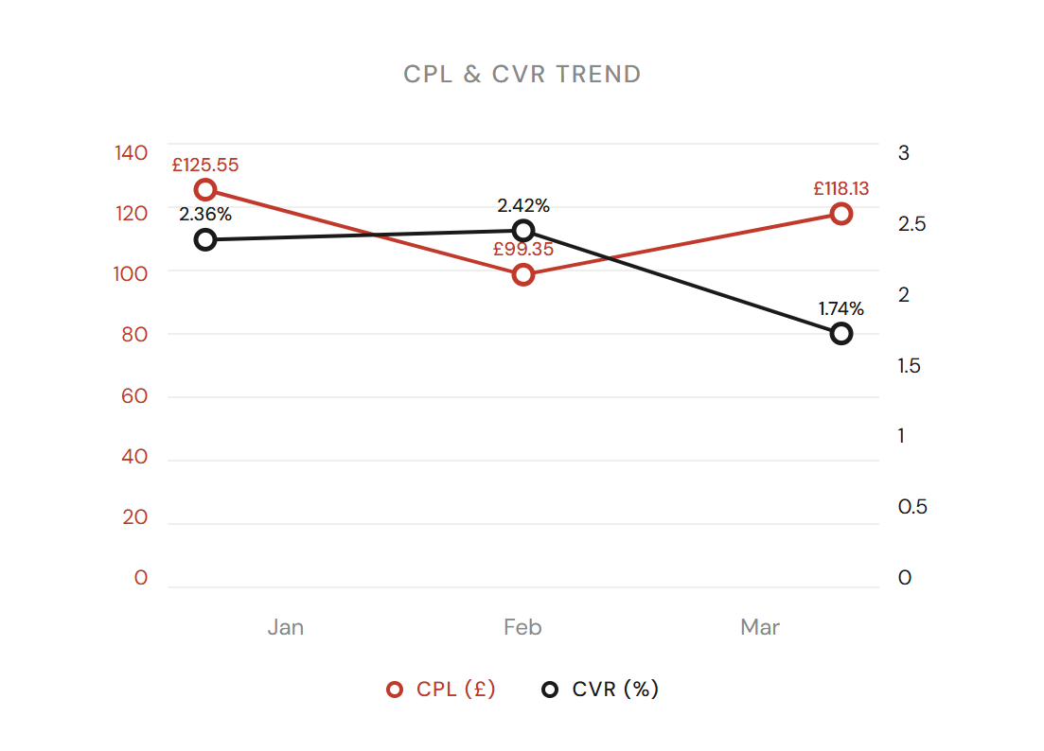
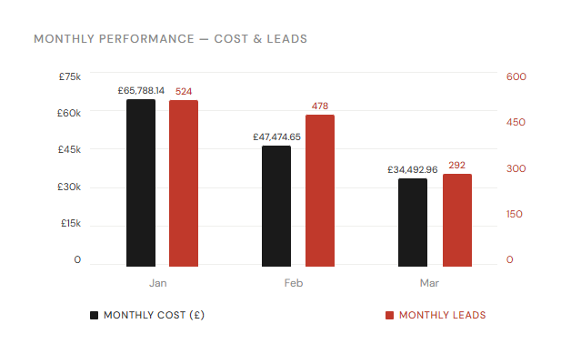
Generic Monthly Trend
Q1 2026 (Jan – Mar 2026)
Q1 2026 | Summon Digital | Confidential

Slide 13
Performance Max Summary
Q1 2026 (Jan – Mar 2026)
627
£36,809
£58.71
1.44%
43,599
0.79%
Leads
Spend
Blended CPL
CVR
Clicks
CTR
YoY:-57.00%
YoY: +67.34%
YoY: +289.14%
YoY: -45.91%
YoY: -20.50%
YoY: +34.26%
Month | Impressions | Clicks | CTR | CPC | Cost | Sales Leads | CPL | CVR
Jan | 1,525,966 | 17,022 | 1.12% | £0.89 | £15,223.55 | 271 | £56.18 | 1.59%
Feb | 2,813,840 | 16,230 | 0.58% | £0.82 | £13,350.29 | 210 | £63.57 | 1.29%
Mar | 1,153,267 | 10,347 | 0.90% | £0.80 | £8,234.92 | 146 | £56.40 | 1.41%
Total | 5,493,073 | 43,599 | 0.79% | £0.84 | £36,808.75 | 627 | £58.71 | 1.44%
PMax has shifted significantly this quarter compared to 2025, however it is being used in a different way with extensive brand exclusions
This has results in more realistic CPLs, not masked by branded conversions
PMax is now being used in a much more efficient way - as a way to generate demand across the full funnel from awareness to purchase, and also as a way of investigating new keyword possibilities that can be used to inform high intent search campaigns
Although CVR has reduced YoY, 1.44% for a Pmax campaign that includes display etc is very healthy
Improvements in CTR also suggest a movement away from display and more budget being spent on search, this acts as a discovery tool where we find new terms and add these to search campaigns, so it’s a valuable part of our overall approach
The cleaner structure allows us to push investment more confidently, in the knowledge that the numbers are not inflated
Q1 2026 | Summon Digital | Confidential

Slide 14
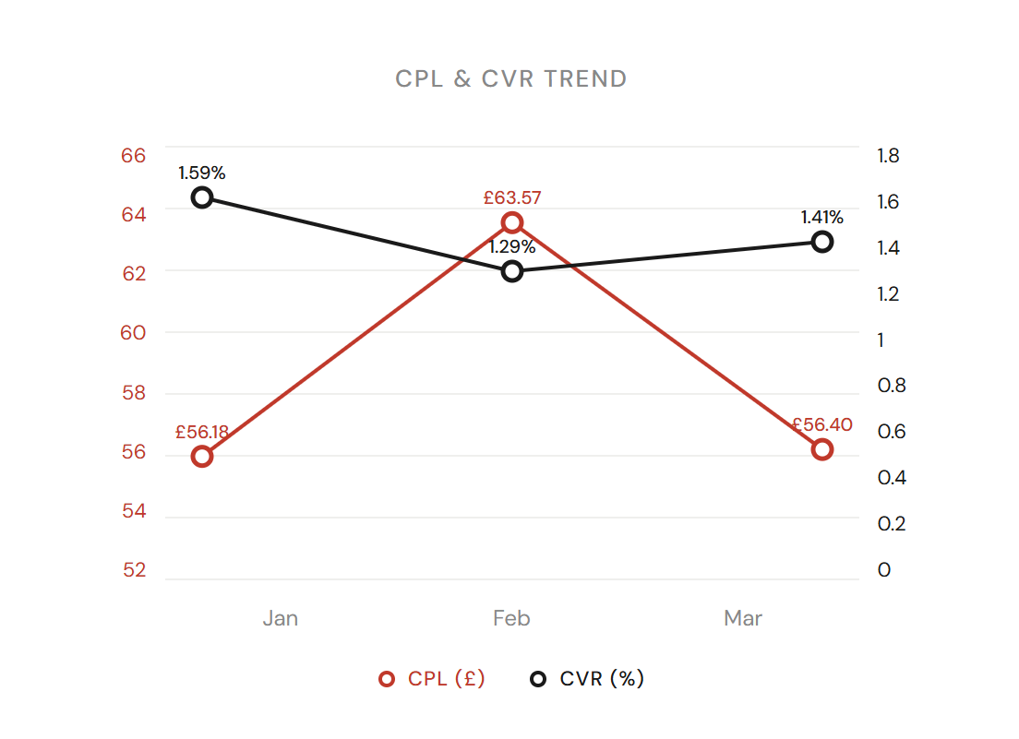
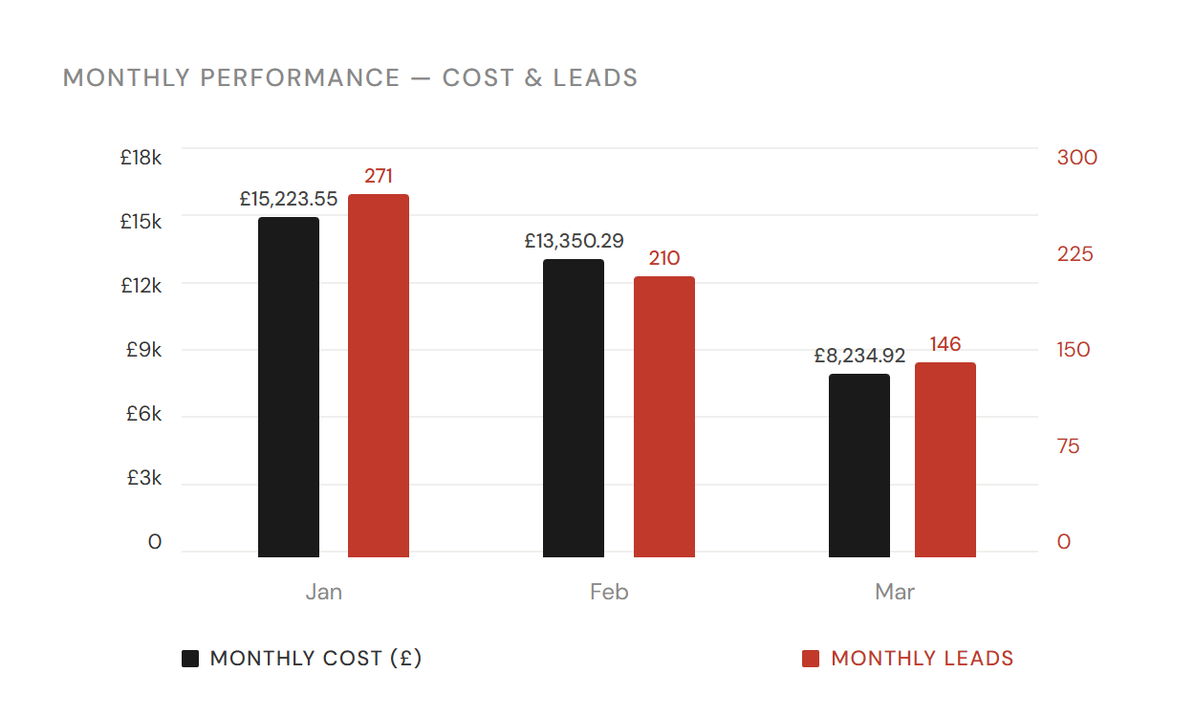
Performance Max Monthly Trend
Q1 2026 (Jan – Mar 2026)
Q1 2026 | Summon Digital | Confidential

Slide 15
Demand Gen Summary
Q1 2026 (Jan – Mar 2026)
277
£26,807
£96.78
0.62%
44,416
0.82%
Leads
Spend
Blended CPL
CVR
Clicks
CTR
YoY: +793.55%
YoY: +1371.44%
YoY: +64.67%
YoY: +123.21%
YoY: +300.32%
YoY: -17.87%
Month | Impressions | Clicks | CTR | CPC | Cost | Sales Leads | CPL | CVR
Jan | 2,773,009 | 25,022 | 0.90% | £0.54 | £13,459.83 | 147 | £91.56 | 0.59%
Feb | 1,599,600 | 11,658 | 0.73% | £0.78 | £9,095.57 | 92 | £98.86 | 0.79%
Mar | 1,060,399 | 7,736 | 0.73% | £0.55 | £4,251.99 | 38 | £111.89 | 0.49%
Total | 5,433,008 | 44,416 | 0.82% | £0.60 | £26,807.39 | 277 | £96.78 | 0.62%
Demand Gen investment was low last year with only and India campaign running from mid February. Its expansion has been a real success story
Although DGen is not always best measured by how well it generates leads, our campaigns have produced a good number at a very acceptable CPL.
Degen is currently live for core destinations only and is set to approximately 10% of destination spend.
This give us good MOF and awareness coverage, as well as contributing directly to leads
There may be potential to make better use of DGen, particularly with high quality video content. This is something we would like to expand
Q1 2026 | Summon Digital | Confidential

Slide 16
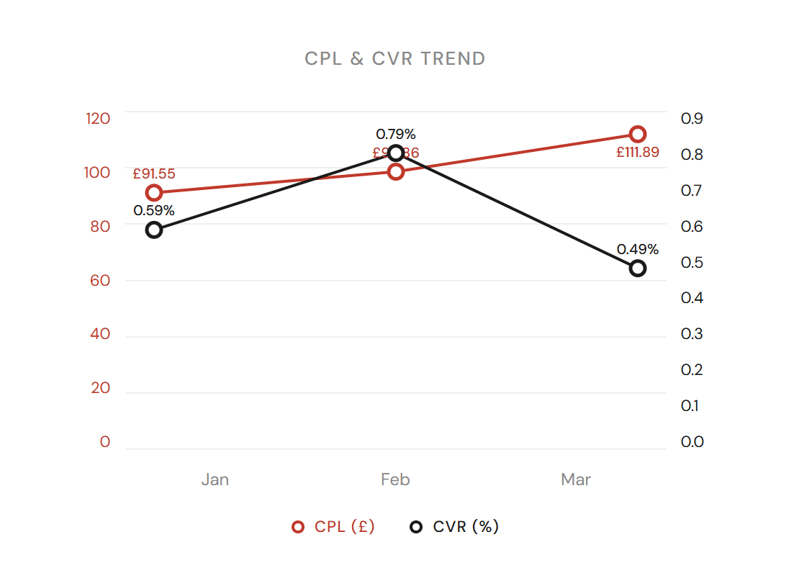
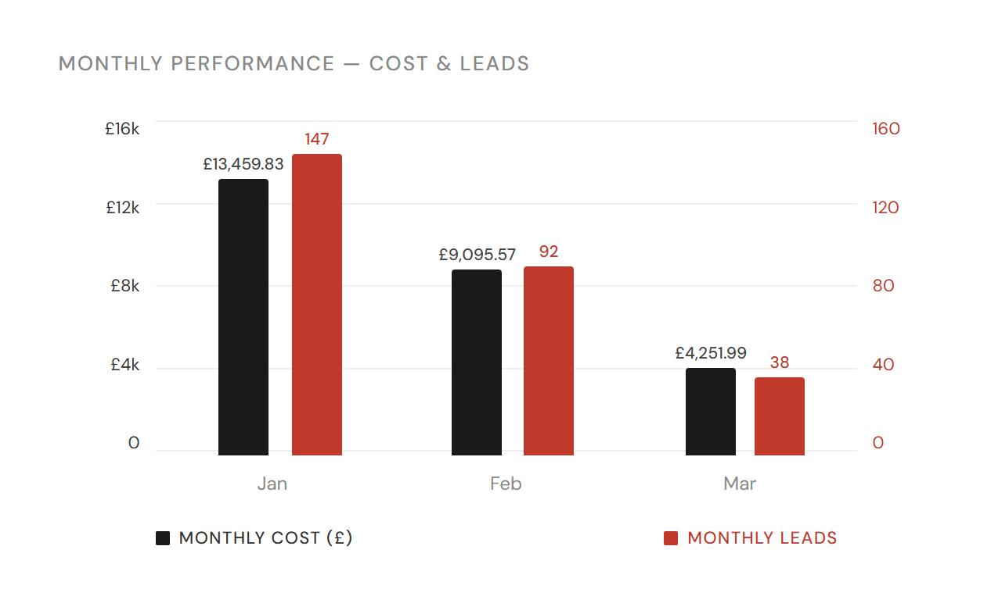
Demand Gen Monthly Trend
Q1 2026 (Jan – Mar 2026)
Q1 2026 | Summon Digital | Confidential

Slide 17
Destinations
Wendy Wu Tours | Q1 2026 | Summon

Slide 18
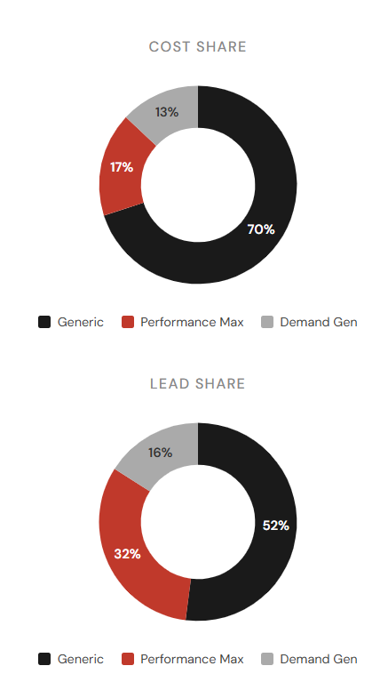
China Summary + YoY
Q1 2026 (Jan – Mar 2026)
780
£74,541
£95.56
1.63%
47,910
1.31%
Leads
Spend
CPL
CVR
Clicks
CTR
YoY: -3.94%
YoY: +158.56%
YoY: +169.17%
YoY: -39.61%
YoY: +59.06%
YoY: +100.21%
Campaign Type | Cost | Sales Leads | Cost Share | Lead Share | CPL
Generic | £52,047.86 (169%) | 404 (+161%) | 69.82% | 51.79% | £128.83
Performance Max | £12,448.77 (+31%) | 251 (-62%) | 16.70% | 32.18% | £49.60
Demand Gen | £10,043.90 | 125 | 13.47% | 16.03% | £80.35
China has seen increased investment this quarter, which has led to higher traffic
Ad copy tests and increased bids have led to higher CTRs
Leads overall look to be slightly down YoY, but this is affected by the PMax reduction mentioned earlier
Generics tell a different story with leads +161% YoY
AI Max has been tested and implemented this quarter and while this needs some heavy negative keyword controls does appear to be beneficial
Whilst the numbers here present a high spend uplift and lead levels maintained, this activity has been successful due to the reported quality of those leads coming through to the business, so it makes sense to continue on that basis.
Q1 2026 | Summon Digital | Confidential

Slide 19
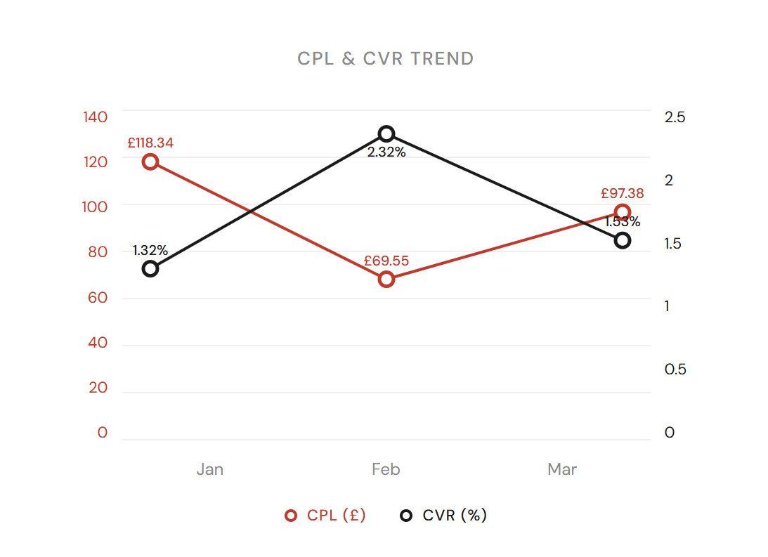
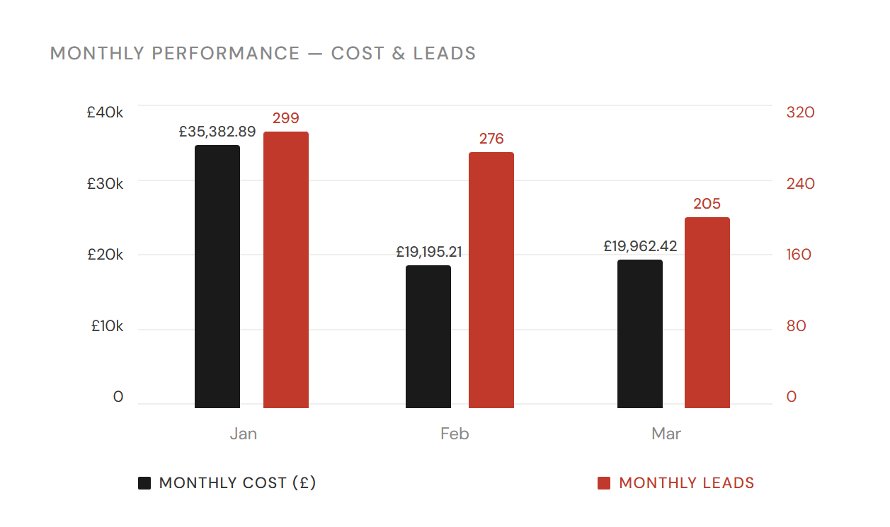
China Monthly Trend
Q1 2026 (Jan – Mar 2026)
Q1 2026 | Summon Digital | Confidential

Slide 20
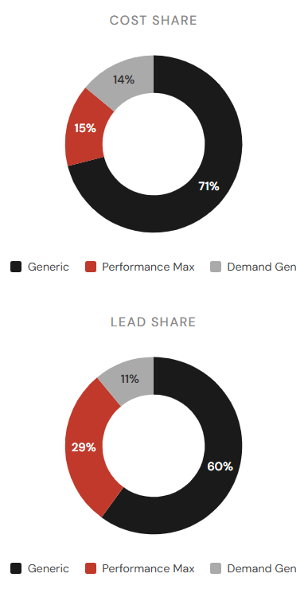
Japan Summary + YoY
Q1 2026 (Jan – Mar 2026)
676
£61,553
£91.06
1.64%
41,337
1.29%
Leads
Spend
CPL
CVR
Clicks
CTR
YoY: -10.58%
YoY: +18.59%
YoY: +32.63%
YoY: -47.42%
YoY: +70.07%
YoY: -65.99%
Campaign Type | Cost | Sales Leads | Cost Share | Lead Share | CPL
Generic | £43,624.59 (+26%) | 407 (-14%) | 70.87% | 60.21% | £107.19
Performance Max | £9,404.54 (+159%) | 195 (-13%) | 15.28% | 28.85% | £48.23
Demand Gen | £8,524.15 | 74 | 13.85% | 10.95% | £115.19
Other | £0.00 | 0 | 0.00% | 0.00% | n/a
Smaller YoY increase in spend for Japan has led to increased traffic, but overall decrease in leads
This decrease in leads is seen in both Generic and PMax, with new leads coming from DGen
Low investment in PMax last year - it is now inline with other core destinations
While CVR over all is -47%, this is driven by PMax and Generic CVR is only -8% in comparison
AI Max has been a feature in the Japan campaigns for longer - while this is likely increasing traffic we will thoroughly review this setting to ensure efficiency.
CRV reduction in March most evident for the Japan campaigns
Q1 2026 | Summon Digital | Confidential

Slide 21
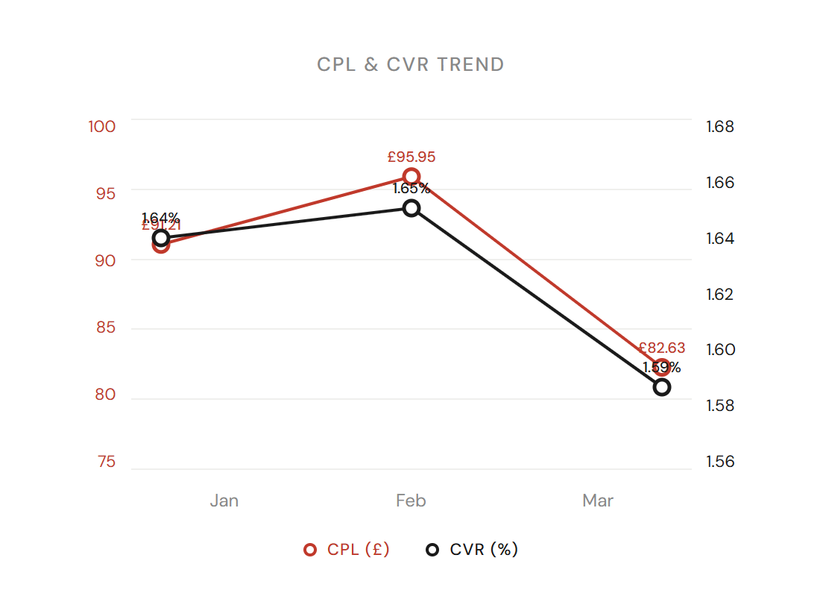
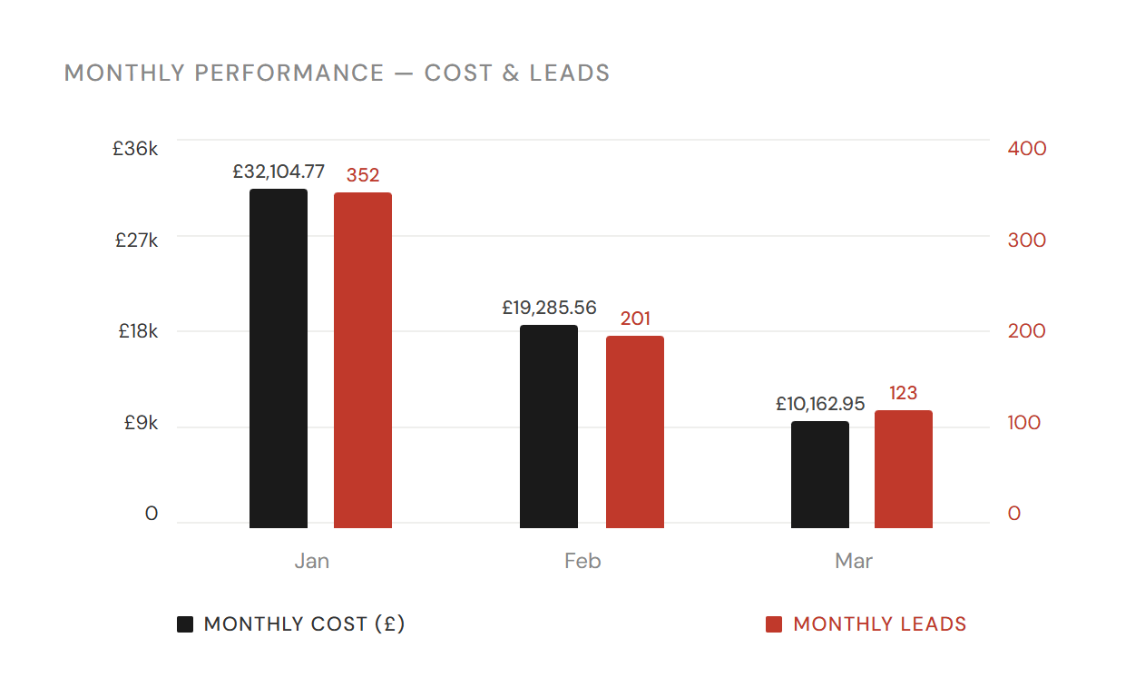
Japan Monthly Trend
Q1 2026 (Jan – Mar 2026)
Q1 2026 | Summon Digital | Confidential

Slide 22

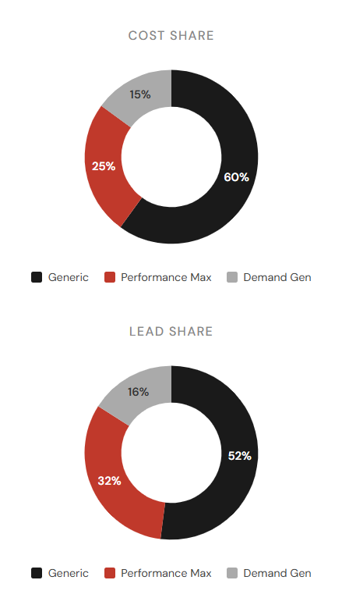
SE Asia Summary + YoY
Q1 2026 (Jan – Mar 2026)
274
£28,191
£102.89
1.23%
22,351
1.12%
Leads
Spend
CPL
CVR
Clicks
CTR
YoY: -32.84%
YoY: +12.44%
YoY: +67.43%
YoY: -64.67%
YoY: +90.11%
YoY: -61.12%
Campaign Type | Cost | Sales Leads | Cost Share | Lead Share | CPL
Generic | £16,831.90 (-26%) | 142 (-26%) | 59.71% | 51.82% | £118.53
Performance Max | £7,127.70 (+198%) | 88 (-59%) | 25.28% | 32.12% | £81.00
Demand Gen | £4,231.48 | 44 | 15.01% | 16.06% | £96.17
Overall reduction in leads, mostly driven by PMax.
Generic leads have decreased inline with lower spend. CVR from Generic campaign has remained the same YoY
Although PMax is generating leads at lower CPL, there is potential here for adjusting budget splits to favour Generic more heavily for these destinations
SE Asia is one destination that has bucked the trend of lower CVR in March, actually seeing an increase MoM
Q1 2026 | Summon Digital | Confidential

Slide 23
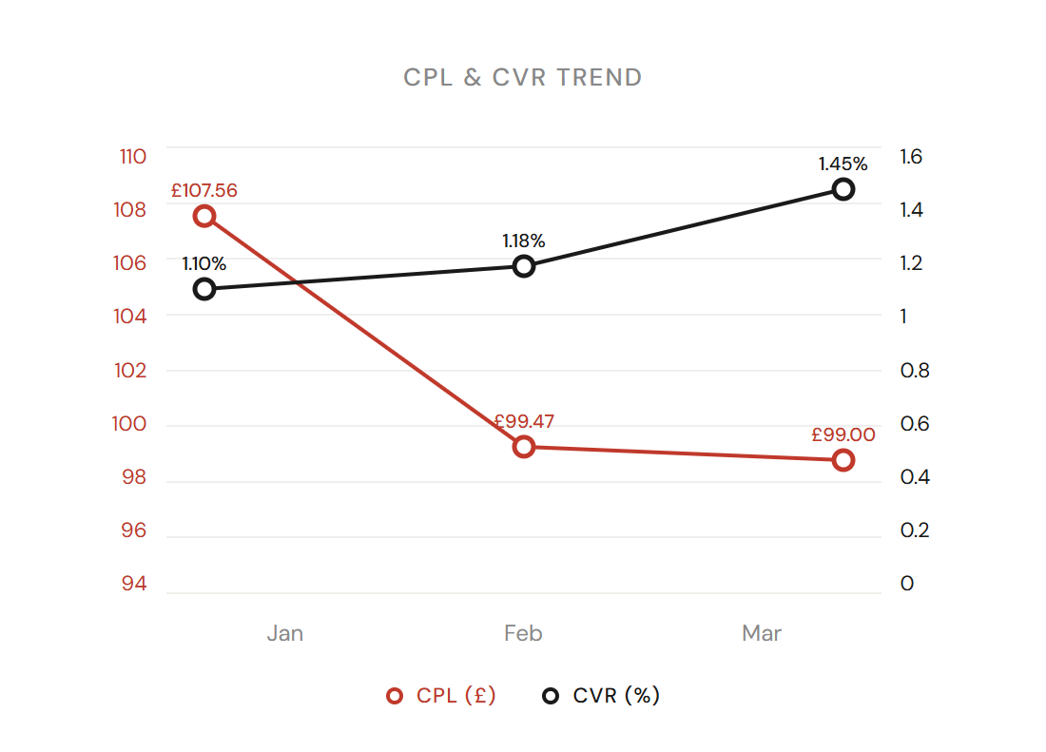
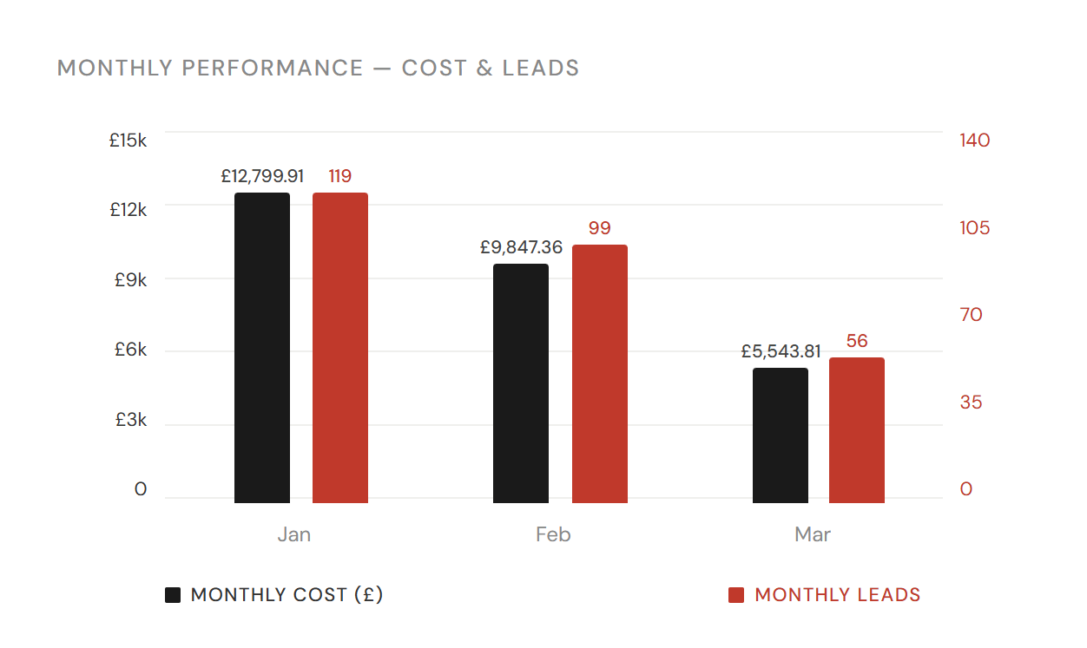
SE Asia Monthly Trend
Q1 2026 (Jan – Mar 2026)
Q1 2026 | Summon Digital | Confidential

Slide 24
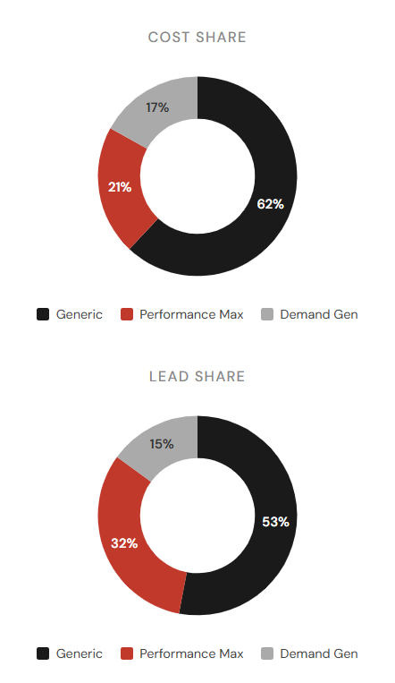
India Summary + YoY
Q1 2026 (Jan – Mar 2026)
225
£22,922
£101.88
1.48%
15,154
0.76%
Leads
Spend
Blended CPL
CVR
Clicks
CTR
YoY: -42.31%
YoY: +18.04%
ToY: +104.61%
YoY: +38.14%
YoY: -58.24%
YoY: +19.37%
Campaign Type | Cost | Sales Leads | Cost Share | Lead Share | CPL
Generic | £14,021.32 (+26%) | 120 (+114%) | 61.17% | 53.33% | £116.84
Performance Max | £4,893.30 (-25%) | 71 (-77%) | 21.35% | 31.56% | £68.92
Demand Gen | £4,007.86 (+12%) | 34 (+10%) | 17.48% | 15.11% | £117.88
India Generic campaigns are the standout performer YoY with more than double the amount of leads from a 25% increase in budget
CVR have improved by 38% as a result of Generic performance
Less investment in PMax this quarter has led to fewer clicks, but higher CTRs and CVR for this destination.
Budget split between the campaign types can be adjusted further to funnel more spend to better performing Generic campaigns
Q1 2026 | Summon Digital | Confidential

Slide 25
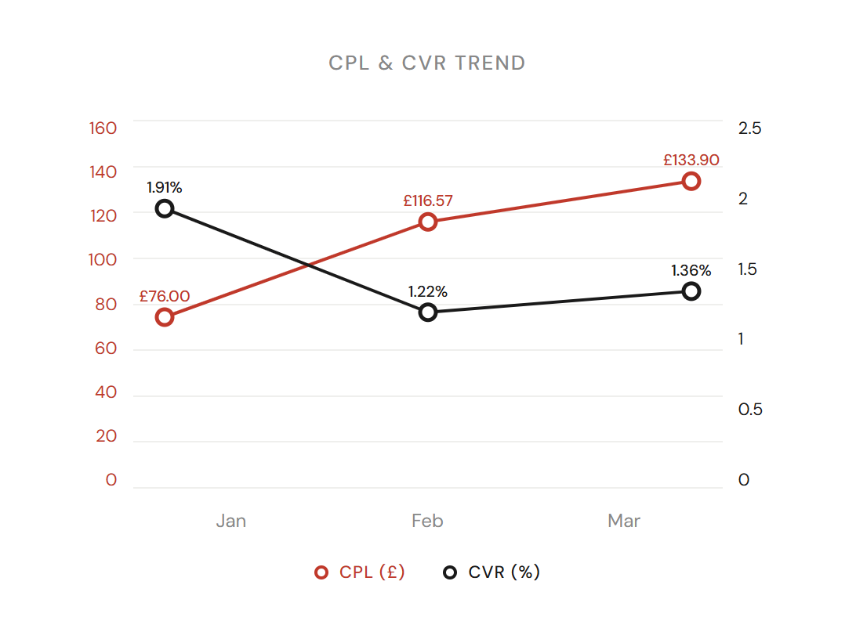
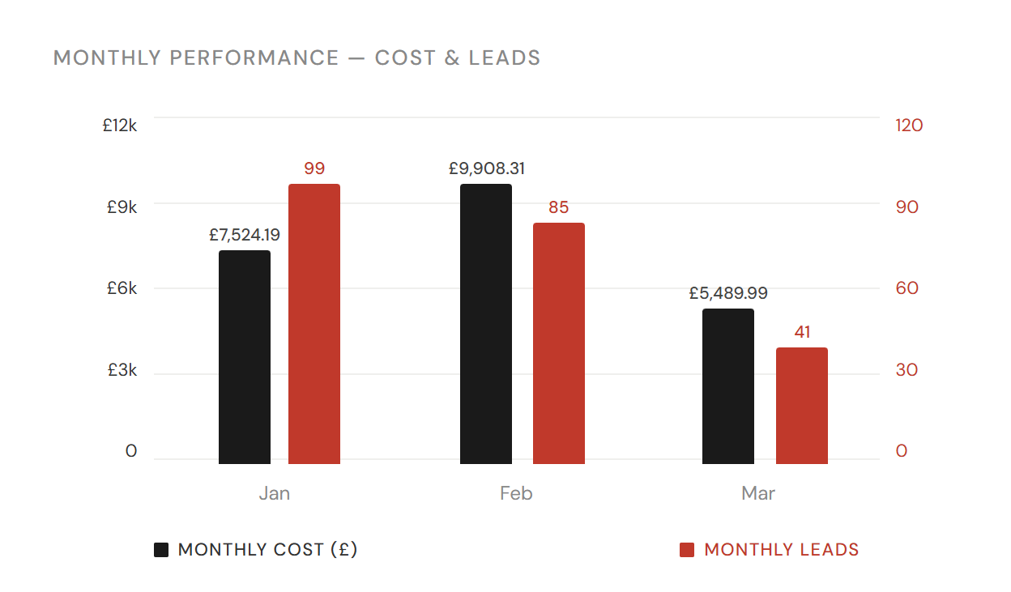
India Monthly Trend
Q1 2026 (Jan – Mar 2026)
Q1 2026 | Summon Digital | Confidential

Slide 26
Other (Destination) Summary + YoY
Q1 2026 (Jan – Mar 2026)
321
£24,165
£75.28
6.57%
56,708
4.20%
Leads
Spend
Blended CPL
CVR
Clicks
CTR
YoY: -32%
YoY: +50%
YoY: +120%
YoY: -65%
YoY: +93%
YoY: -33%
Month | Impressions | Clicks | CTR | CPC | Cost | Leads | CPL | CVR
Jan | 229,117 | 4,888 | 2.13% | £1.36 | £6,659.76 | 107 | £62.24 | 2.19%
Feb | 515,335 | 8,230 | 1.60% | £1.42 | £11,684.06 | 142 | £82.28 | 1.73%
Mar | 533,645 | 6,830 | 1.28% | £0.85 | £5,820.69 | 72 | £80.84 | 1.05%
Leads from Other campaigns have decreased YoY
There may be some discrepancy in the data with campaigns that are attributed to other, so this may not be a direct comparison
The mix of campaigns in this category is likely to have changed
These are all Generic campaigns however, so the CPL of £75 is lower than most core destinations.
Q1 2026 | Summon Digital | Confidential

Slide 27
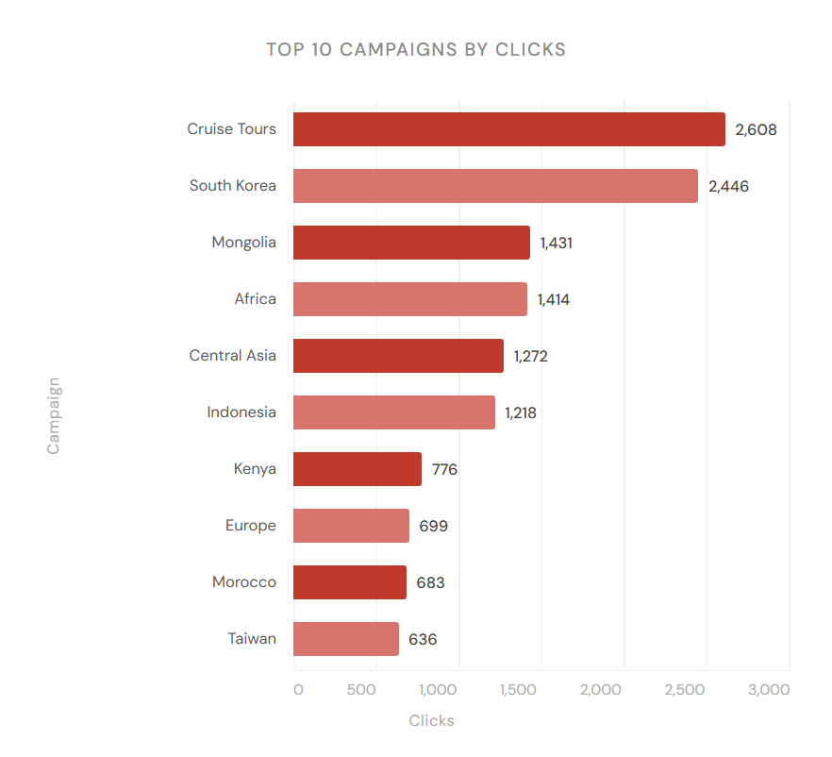
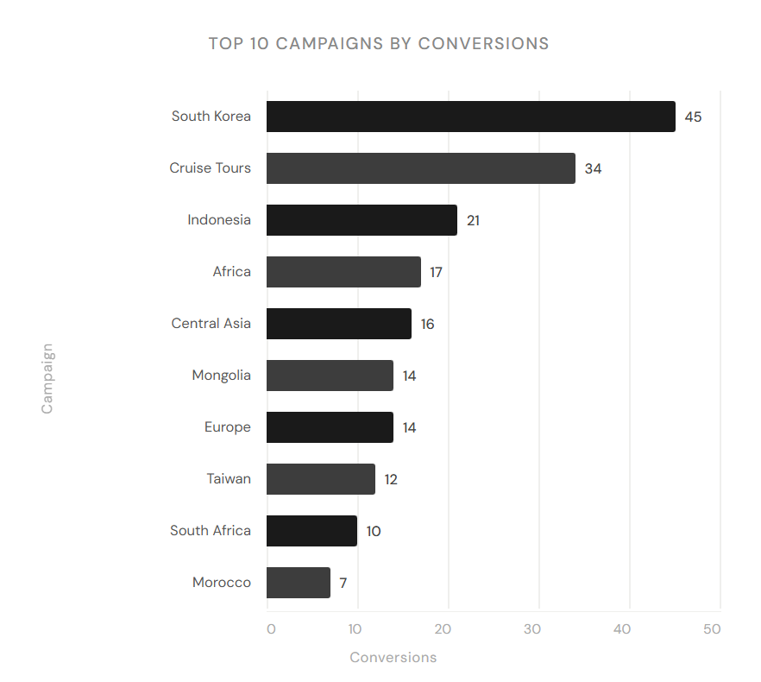
Other (Destination) Top 10 campaigns
Q1 2026 (Jan – Mar 2026)
Q1 2026 | Summon Digital | Confidential

Slide 28
Auction Insights
Wendy Wu Tours | Q1 2026 | Summon

Slide 29
Non-Brand Auction Insights
Q1 2026 (Jan – Mar 2026)
Domain | Imp. Share | Overlap Rate | Pos. Above | Top of Page | Abs. Top | Outranking
audleytravel.com | 26.6% | 42.0% | 63.6% | 75.6% | 38.0% | 8.7%
distantjourneys.co.uk | 20.1% | 37.7% | 64.8% | 75.8% | 36.3% | 9.0%
you | 11.9% | n/a | n/a | 71.5% | 16.0% | n/a
rivieratravel.co.uk | 11.2% | 18.3% | 48.1% | 61.0% | 18.6% | 10.9%
exoticca.com | 10.7% | 22.9% | 50.5% | 73.4% | 19.3% | 10.5%
travelbag.co.uk | n/a | 7.0% | 48.4% | 69.0% | 17.5% | 11.5%
holidayarchitects.co.uk | n/a | 6.1% | 48.9% | 66.9% | 14.7% | 11.6%
iglucruise.com | n/a | 11.2% | 58.0% | 73.8% | 34.0% | 11.1%
Source: Google Ads Auction Insights
Overall impression share for this quarter remains strong, we are in auctions with other highly relevant competitors.
Audley & Distant Journeys are our main competitors this quarter
We are likely comparing against significantly higher budgets, you can see that we still have a fairly modest impression share, however that is impacted by our selecting targeting of age and terms within that grouping
You can see that when we do appear our top of page is strong, but not too aggressively in absolute top to maximise our efficiency across the account
Q1 2026 | Summon Digital | Confidential

Slide 30
Testing
Wendy Wu Tours | Q1 2026 | Summon

Slide 31
China AI Max 80% Test
Q1 2026 (Jan – Mar 2026)
Arm | Impr. | Clicks | CTR | Avg. CPC | Cost | Conversions | Cost / conv. | Conv. rate | Conv. value
Control (at 20% traffic split) | 3,506 | 530 | 15.12% | £3.36 | £1,779.22 | 17.78 | £100.08 | 3.35% | 20,962.00
Treatment (at 80% traffic split) | 37,766 | 3,622 | 9.59% | £2.37 | £8,583.20 | 114 | £75.29 | 3.15% | 31,651.80
Difference | +34,260 | +3,092 | -5.53% | -£0.99 | +£6,803.98 | +96.23 | -£24.79 | -0.21% | +10,689.80
Difference (%) | 1.693 | 70.80% | -36.60% | -29.40% | 20.60% | 60.30% | -24.80% | -6.20% | -62.30%
80% confid... | [+160.2%, +178.4%] Stat. significant | [+56.8%, +84.9%] Stat. significant | [-40.9%, -32.2%] Stat. significant | [-33.3%, -25.5%] Stat. significant | [+9.4%, +31.8%] Stat. significant | Not enough data | Not enough data | Not enough data | Not enough data
AI Max test for China was a continuation of the positive 50/50 test that was run in September November 2025.
This 80/20 test continued to show that AI Max resulted in a 24% reduction in CPA and 29% reduction in CPC.
AI Max has now been added to the China campaign as campaign wide setting and we are continuing to monitor search terms and expand negative keyword lists.
To ensure control over ad copy and messaging text customisation and final URL expansion has been turned off.
Next steps are to continue to monitor the performance of AI Max generated traffic to ensure that search terms do not become too broad and are still converting at a good CPA.
Q1 2026 | Summon Digital | Confidential

Slide 32
China AI Max 80% Test
Core destinations ad copy test - China
Q1 2026 (Jan – Mar 2026)
Metric | New Copy Test | Delta vs Control |  | Control · Spring Sale | Winner | Notes
Impressions | 8,760 | +63% |  | 5,373 | New Copy | New copy captured significantly more auction volume
Clicks | 1,114 | +112% |  | 526 | New Copy | 2x more clicks — higher CTR driving volume
CTR | 12.72% | +2.93pp |  | 9.79% | New Copy | Strongest signal for new copy; product-specific H1 working
Avg. CPC | £2.23 | +78% |  | £1.25 | Control | Control nearly half the CPC, key efficiency advantage
Conversions | 30.00 | +165% |  | 11.33 | New Copy | ~3x more conversions; partly a function of higher spend
CPA | £82.97 | +43% |  | £57.88 | Control | Control £25.09 cheaper per conv. - CPC differential is the cause
Conv. rate | 2.69% | +0.54pp |  | 2.15% | New Copy | Marginal gap - both ads convert at comparable rates on-site
Spend | £2,489 | 4.6x |  | £656 | N/A | Unequal split — limits statistical confidence of this test
Ad strength | Good | — |  | Poor | New Copy | Control strength low due to H1/H2 pins for offer messaging
New copy CTR of 12.72% is the standout result. Product-specific headline copy ("China Tour Packages", escorted tours, prices from £2,690pp) is qualifying intent more effectively and driving 2x the click volume
Control CPA of £57.88 vs £82.97 for new copy 30% more cost-efficient per conversion. CPC of £1.25 vs £2.23 is the primary driver; the control is acquiring clicks at nearly half the cost.
CVR Gap is narrow. 2.69% new copy vs 2.15% control. The higher CPA for new copy is almost entirely a CPC problem, not a landing page or offer problem. Both ads convert at comparable rates once a user lands on site.
Next Step - Keep both ads active and force an equal spend split for a further 3–4 weeks. The new copy has a meaningful CTR advantage worth preserving. If after equal-spend running the new copy CPA does not close to within ~10% of the control, revert to the control as primary and use the new copy headlines as RSA asset variants only rather than a standalone ad.
Q1 2026 | Summon Digital | Confidential

Slide 33
Other Updates
Wendy Wu Tours | Q1 2026 | Summon

Slide 34
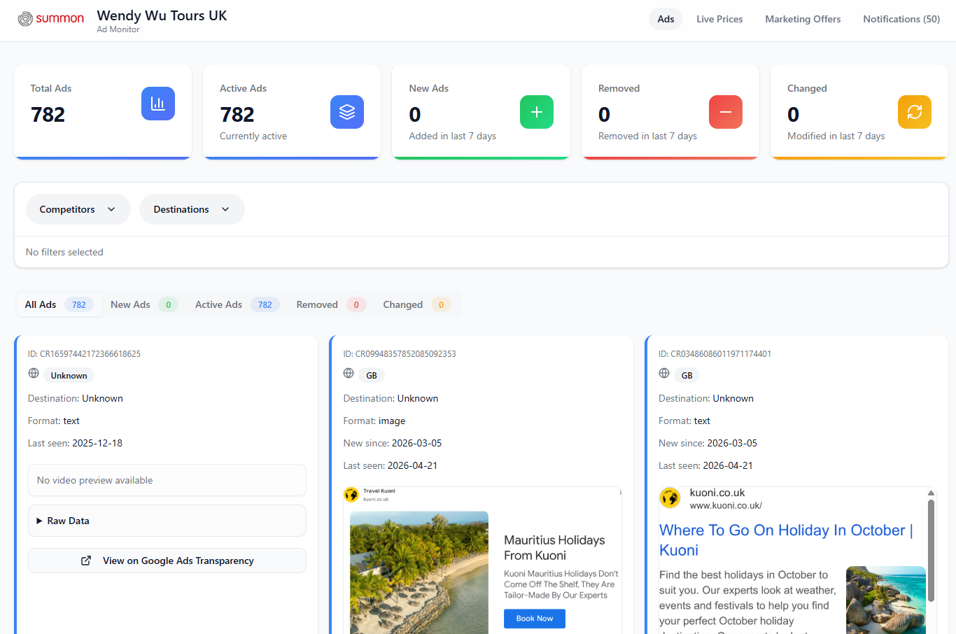
China AI Max 80% Test
Ad Monitor Now Live
Tracking competitor changes in real time
In a fast moving competitor landscape, we wanted to provide an easy solution to monitor competitor offers
So we created the Ad Monitor tool
The platform currently includes separate views for:
Ads monitoring
Live prices / offers
Marketing offers
Notification
This is used by us internally. but we hope it will also prove a useful resources for the business too
https://wwt-uk-monitor.vercel.app/
Q1 2026 | Summon Digital | Confidential

Slide 35
Next Steps
Wendy Wu Tours | Q1 2026 | Summon

Slide 36
Next Steps for Q2
Q1 2026 (Jan – Mar 2026)
Continue ad copy test
GTM audit and tracking
Ad copy tests so far are inconclusive, so adjustments will be made to the tests and this will run for another month. Upon completion of this test we can roll out the learnings to all campaigns.
Make updates to GTM set up to ensure accurate tracking and set up and test native tracking for purchases and form fills in Google Ads. Accurate data continues to be the most important factor in ensuring Google’s bidding algorithm works efficently
New landing page test
AI Max Development
Once above ad copy test is concluded, set up experiment to test Holidays vs Tours landing pages.
Continue to monitor the performance of AI Max generated traffic to ensure that search terms do not become too broad and are still converting at a good CPA. Consider turning off this setting if this is not proven.
Q1 2026 | Summon Digital | Confidential

Slide 37
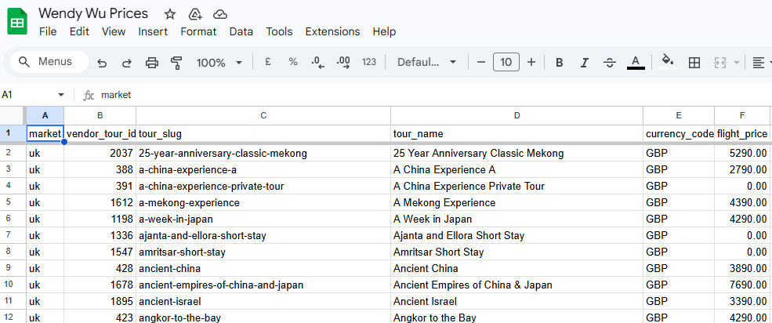
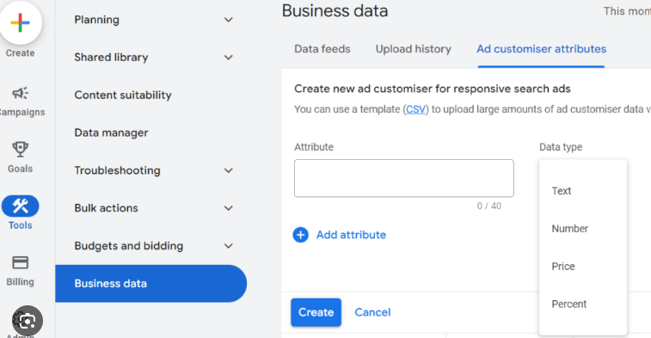
Next Steps for Q2
Q1 2026 (Jan – Mar 2026)
Live price inclusion in ads
Using data from the API we can begin to use Price Customisers in our ads to ensure up-to-date pricing is maintained without having to make manual changes.
Q1 2026 | Summon Digital | Confidential

Slide 38
Thank You
Wendy Wu Tours | Q1 2026 PPC Report
Prepared by Summon
Q1 2026 | Summon Digital | Confidential

