Slide 1
Wendy Wu Tours | Quarterly PPC Performance Report
Q4 2025 (Oct - Dec 2025) | Summon Digital

Slide 2
Performance

Slide 3
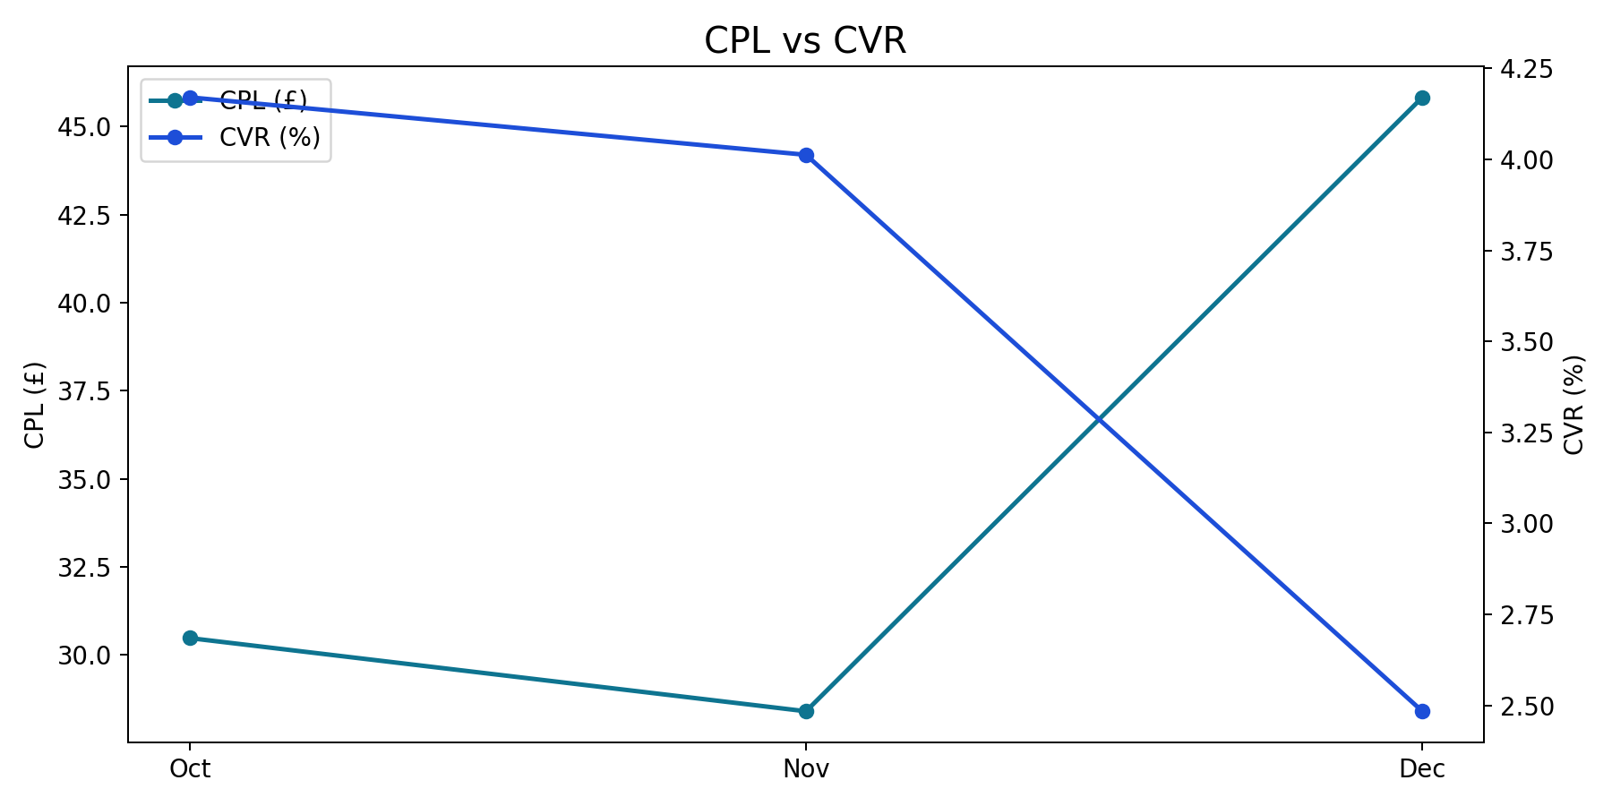
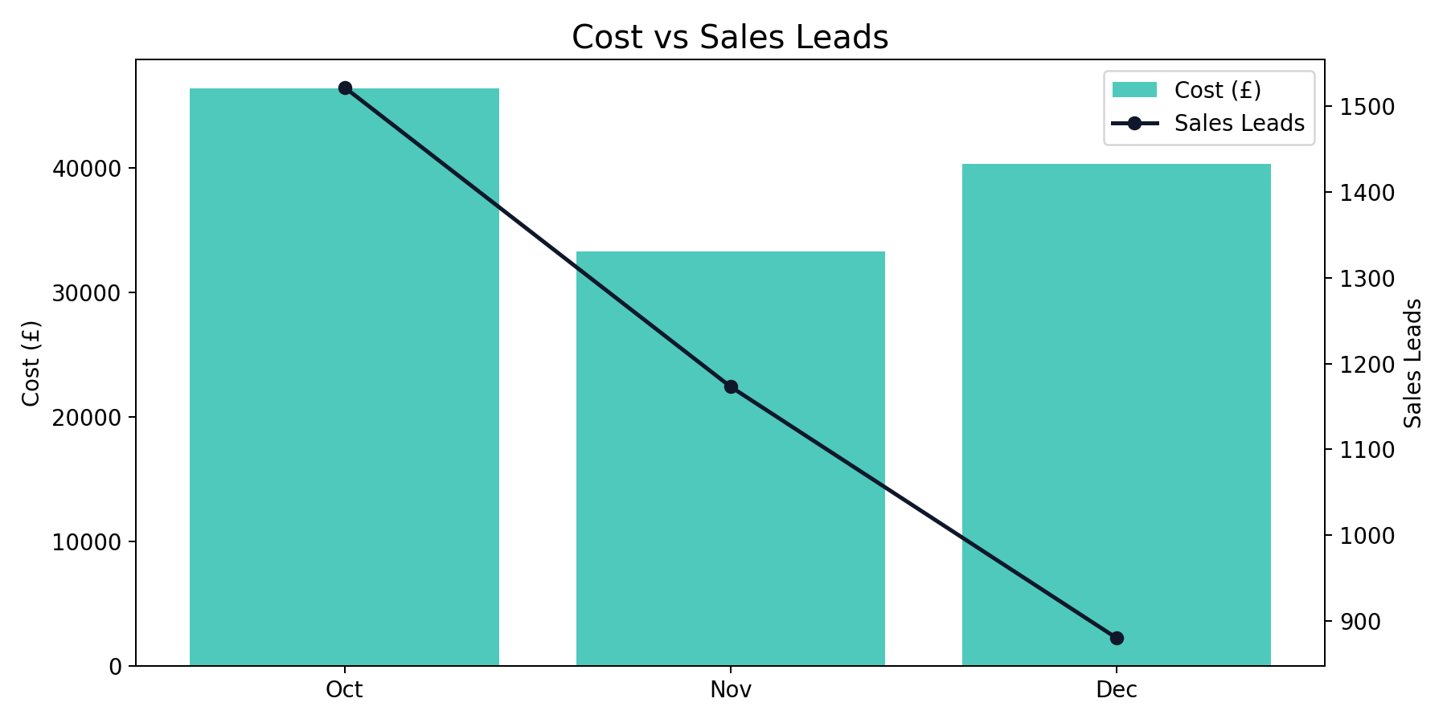
Overall Performance Trend
Q4 2025 (Oct - Dec 2025)
Nov delivered the lowest CPL of the quarter (£28.40), while Oct had the highest CVR (4.17%).
Quarter total: 3,575 leads from £120,047.00 spend at a blended CPL of £33.58.
YoY vs same quarter last year: leads +42.37% and spend +17.27%.
Brand generated the highest share of leads (45.9%).

Slide 4
Overall Quarter Summary
Q4 2025 (Oct - Dec 2025)
Month | Impressions | Clicks | CTR | CPC | Cost | Sales Leads | CPL | CVR
Oct | 1,225,562 | 36,494 | 2.98% | £1.27 | £46,394.79 | 1,522 | £30.48 | 4.17%
Nov | 1,219,769 | 29,233 | 2.40% | £1.14 | £33,318.85 | 1,173 | £28.40 | 4.01%
Dec | 1,457,076 | 35,434 | 2.43% | £1.14 | £40,333.36 | 880 | £45.83 | 2.48%
Total | 3,902,407 | 101,161 | 2.59% | £1.19 | £120,047.00 | 3,575 | £33.58 | 3.53%
Overall generated 3,575 leads from £120,047.00 with a quarter CPL of £33.58.
Best efficiency was in Nov (£28.40 CPL), while Dec was highest at £45.83.
YoY vs same quarter last year: leads +42.37%, spend +17.27%.

Slide 5
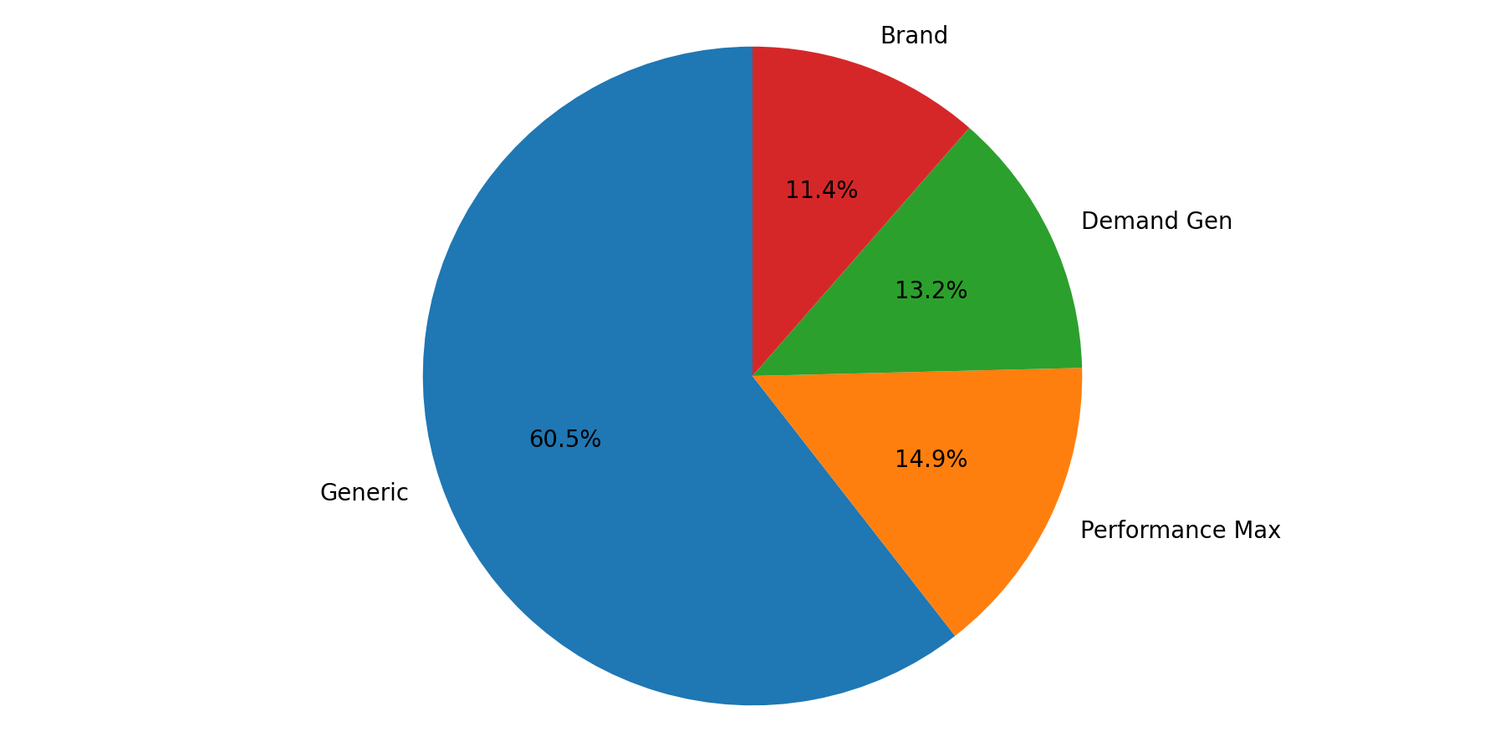
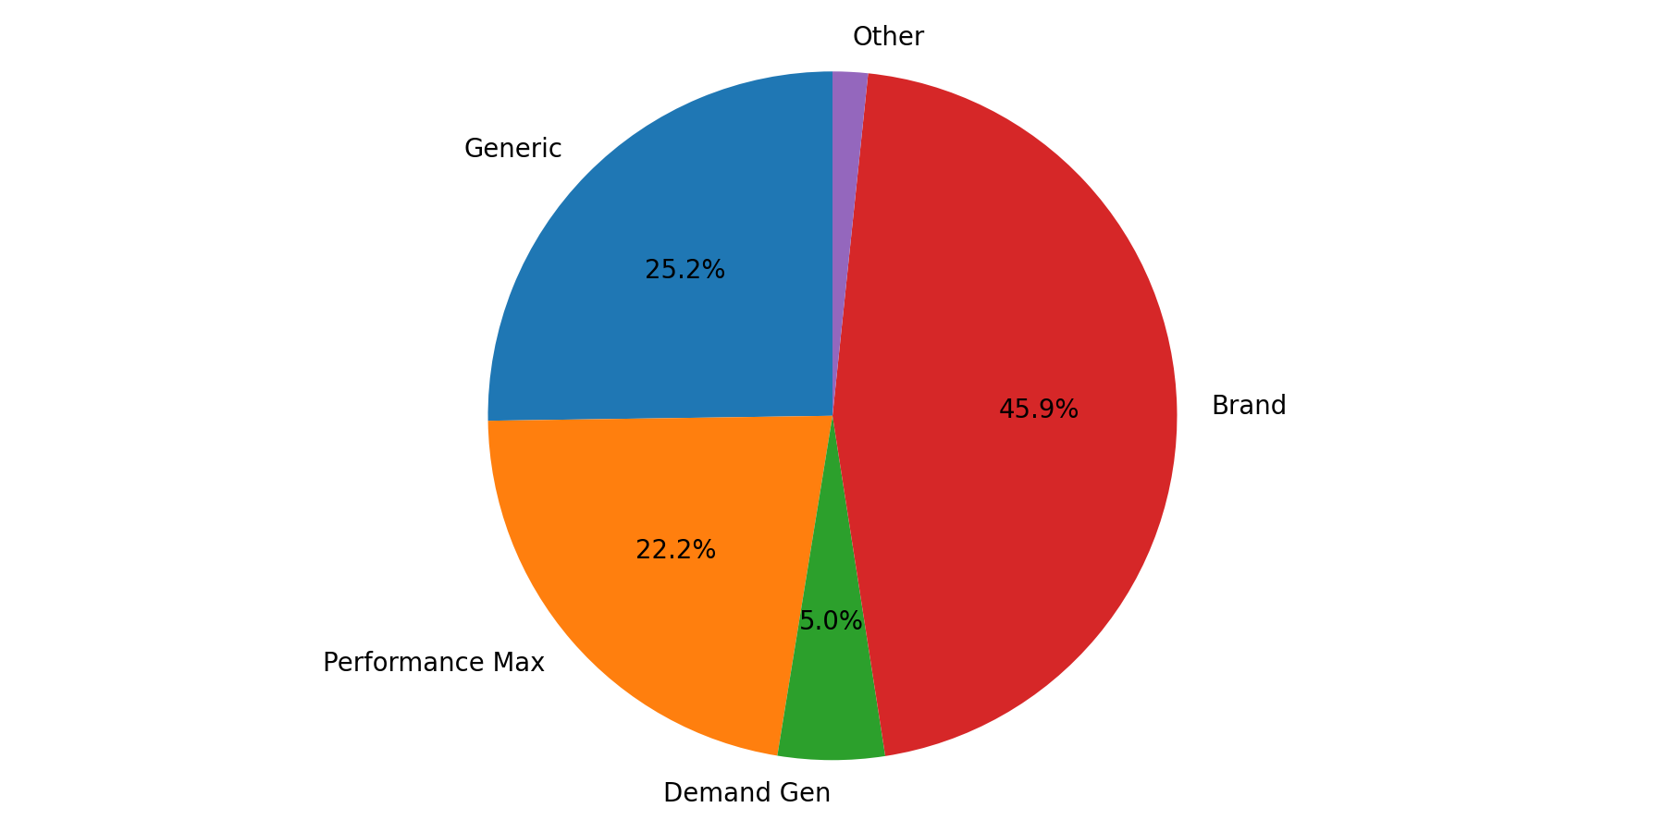
Campaign Type Mix
Q4 2025 (Oct - Dec 2025)
Generic represented the largest share of spend (60.5%).
Brand delivered the largest share of leads (45.9%).
Spend and lead mix are concentrated in different campaign types, indicating different efficiency profiles.

Slide 6
Brand Summary
Q4 2025 (Oct - Dec 2025)
Month | Impressions | Clicks | CTR | CPC | Cost | Sales Leads | CPL | CVR
Oct | 14,338 | 7,651 | 53.36% | £0.58 | £4,457.11 | 604 | £7.38 | 7.89%
Nov | 13,767 | 7,839 | 56.94% | £0.58 | £4,522.25 | 556 | £8.13 | 7.09%
Dec | 13,332 | 7,562 | 56.72% | £0.63 | £4,733.50 | 481 | £9.84 | 6.36%
Total | 41,437 | 23,052 | 55.63% | £0.59 | £13,712.86 | 1,641 | £8.36 | 7.12%
Brand generated 1,641 leads from £13,712.86 with a quarter CPL of £8.36.
Best efficiency was in Oct (£7.38 CPL), while Dec was highest at £9.84.
YoY vs same quarter last year: leads +84.18%, spend +42.32%.

Slide 7
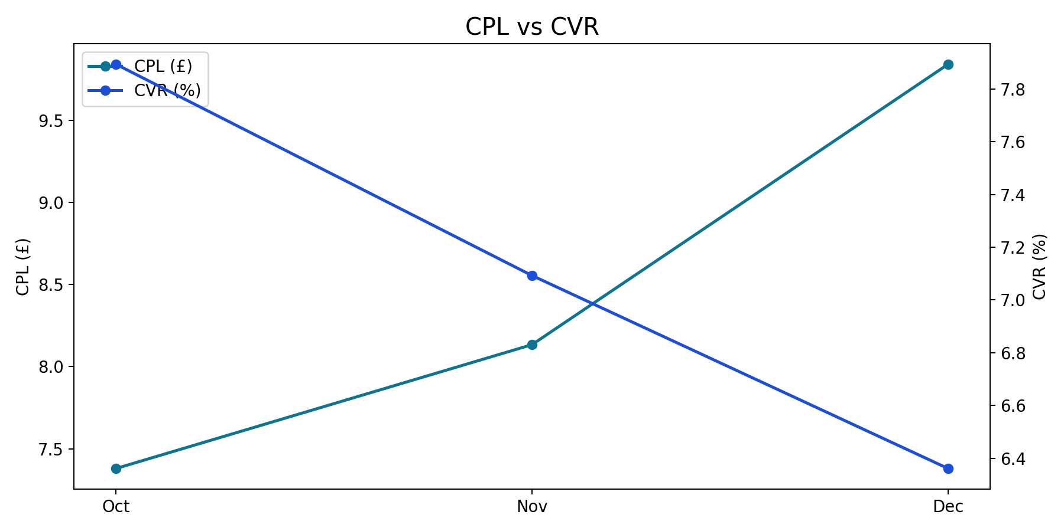
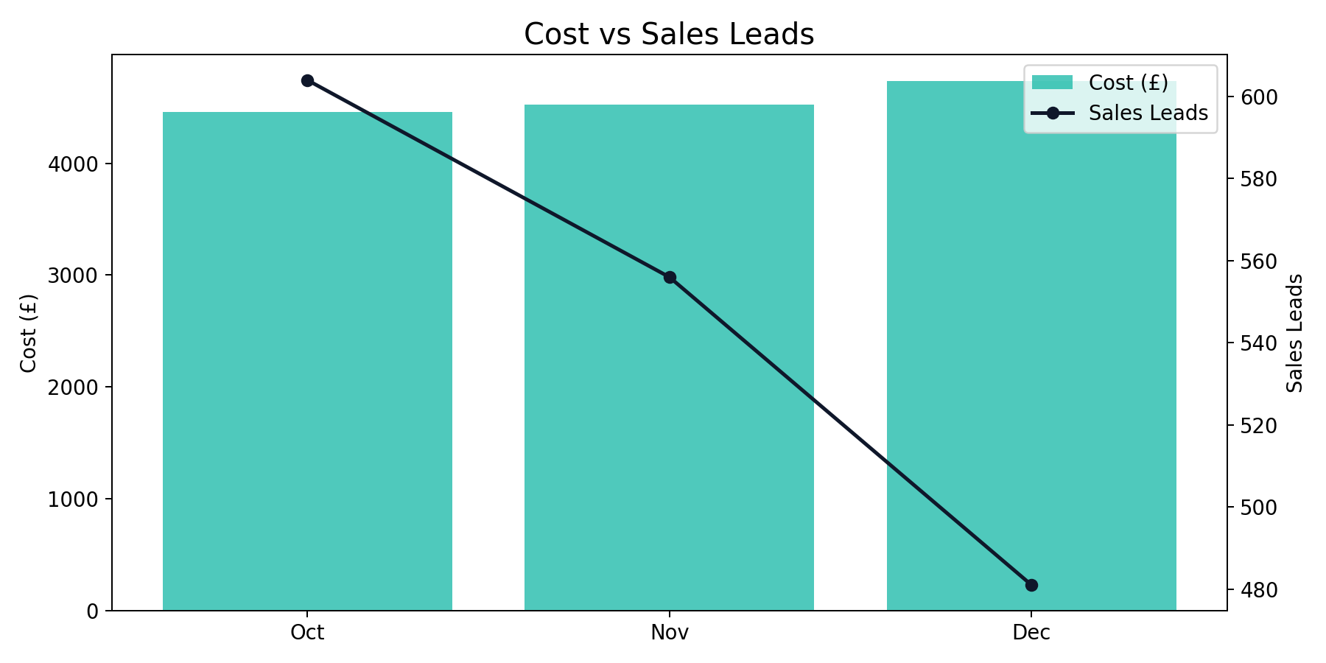
Brand Monthly Trend
Q4 2025 (Oct - Dec 2025)
Brand generated 1,641 leads from £13,712.86 with a quarter CPL of £8.36.
Best efficiency was in Oct (£7.38 CPL), while Dec was highest at £9.84.
YoY vs same quarter last year: leads +84.18%, spend +42.32%.

Slide 8
Generic Summary
Q4 2025 (Oct - Dec 2025)
Month | Impressions | Clicks | CTR | CPC | Cost | Sales Leads | CPL | CVR
Oct | 245,738 | 15,294 | 6.22% | £1.92 | £29,438.53 | 418 | £70.43 | 2.73%
Nov | 187,620 | 10,313 | 5.50% | £1.89 | £19,513.55 | 271 | £72.01 | 2.63%
Dec | 214,428 | 12,086 | 5.64% | £1.96 | £23,715.61 | 213 | £111.34 | 1.76%
Total | 647,786 | 37,693 | 5.82% | £1.93 | £72,667.69 | 902 | £80.56 | 2.39%
Generic generated 902 leads from £72,667.69 with a quarter CPL of £80.56.
Best efficiency was in Oct (£70.43 CPL), while Dec was highest at £111.34.
YoY vs same quarter last year: leads +34.43%, spend -12.71%.

Slide 9
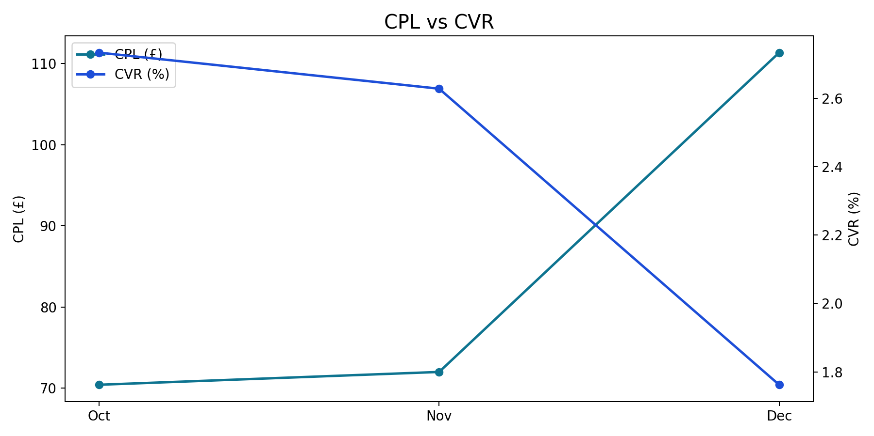
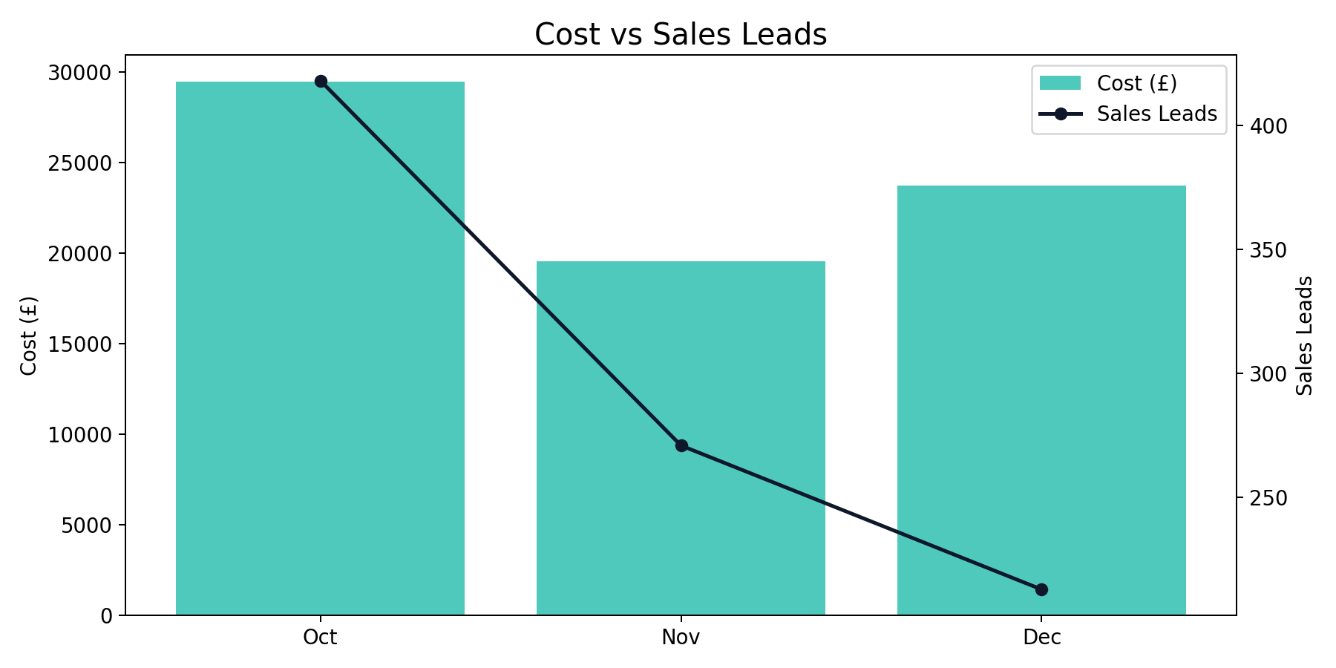
Generic Monthly Trend
Q4 2025 (Oct - Dec 2025)
Generic generated 902 leads from £72,667.69 with a quarter CPL of £80.56.
Best efficiency was in Oct (£70.43 CPL), while Dec was highest at £111.34.
YoY vs same quarter last year: leads +34.43%, spend -12.71%.

Slide 10
Performance Max Summary
Q4 2025 (Oct - Dec 2025)
Month | Impressions | Clicks | CTR | CPC | Cost | Sales Leads | CPL | CVR
Oct | 171,951 | 6,335 | 3.68% | £1.15 | £7,292.58 | 383 | £19.04 | 6.05%
Nov | 203,245 | 4,998 | 2.46% | £1.02 | £5,080.28 | 277 | £18.34 | 5.54%
Dec | 342,860 | 6,414 | 1.87% | £0.85 | £5,466.06 | 134 | £40.79 | 2.09%
Total | 718,056 | 17,747 | 2.47% | £1.01 | £17,838.92 | 794 | £22.47 | 4.47%
Performance Max generated 794 leads from £17,838.92 with a quarter CPL of £22.47.
Best efficiency was in Nov (£18.34 CPL), while Dec was highest at £40.79.
YoY vs same quarter last year: leads +1.02%, spend +88.08%.

Slide 11
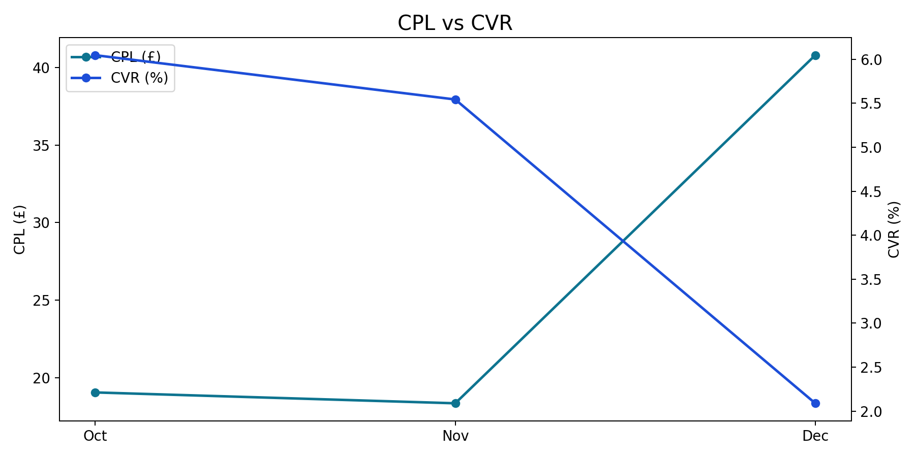
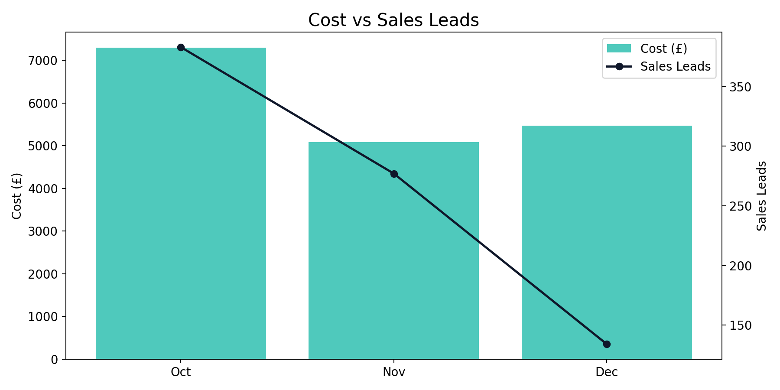
Performance Max Monthly Trend
Q4 2025 (Oct - Dec 2025)
Performance Max generated 794 leads from £17,838.92 with a quarter CPL of £22.47.
Best efficiency was in Nov (£18.34 CPL), while Dec was highest at £40.79.
YoY vs same quarter last year: leads +1.02%, spend +88.08%.

Slide 12
Demand Gen Summary
Q4 2025 (Oct - Dec 2025)
Month | Impressions | Clicks | CTR | CPC | Cost | Sales Leads | CPL | CVR
Oct | 793,535 | 7,214 | 0.91% | £0.72 | £5,206.57 | 82 | £63.49 | 1.14%
Nov | 815,137 | 6,083 | 0.75% | £0.69 | £4,202.76 | 51 | £82.41 | 0.84%
Dec | 886,456 | 9,372 | 1.06% | £0.68 | £6,418.20 | 46 | £139.53 | 0.49%
Total | 2,495,128 | 22,669 | 0.91% | £0.70 | £15,827.53 | 179 | £88.42 | 0.79%
Demand Gen generated 179 leads from £15,827.53 with a quarter CPL of £88.42.
Best efficiency was in Oct (£63.49 CPL), while Dec was highest at £139.53.
YoY comparison is unavailable due to missing or zero baseline in prior year data.

Slide 13
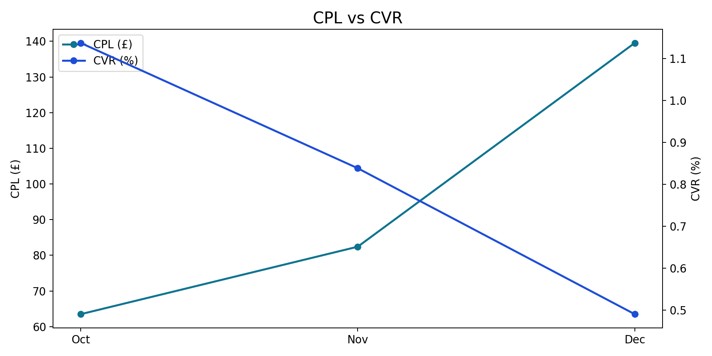
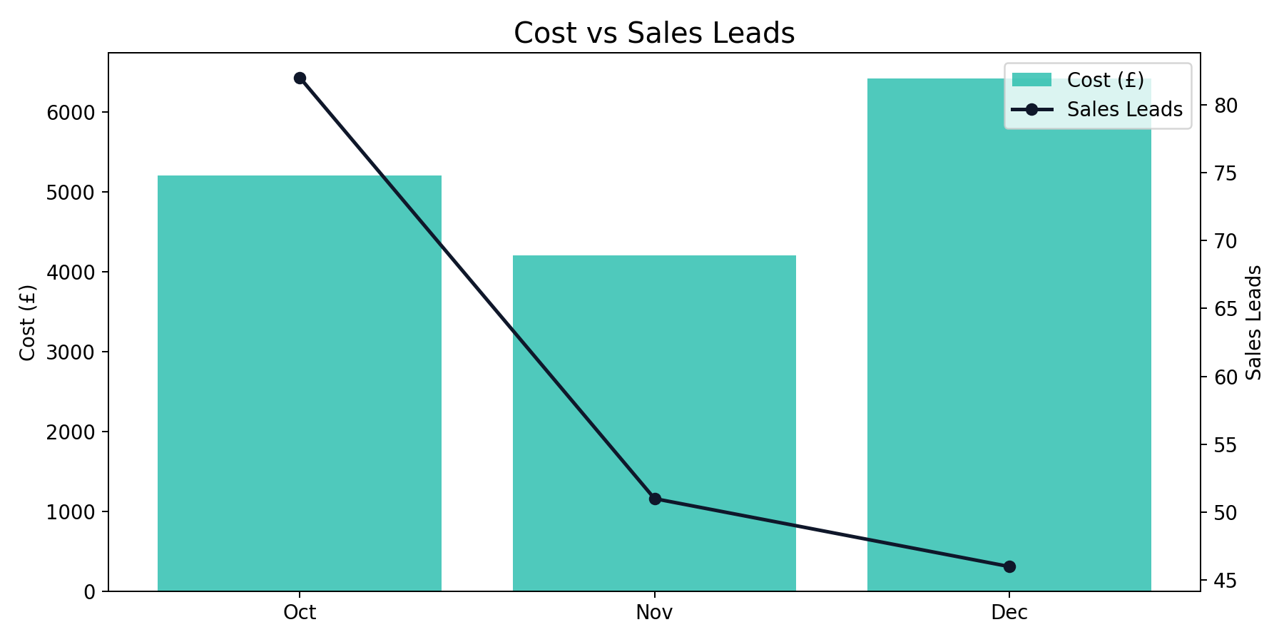
Demand Gen Monthly Trend
Q4 2025 (Oct - Dec 2025)
Demand Gen generated 179 leads from £15,827.53 with a quarter CPL of £88.42.
Best efficiency was in Oct (£63.49 CPL), while Dec was highest at £139.53.
YoY comparison is unavailable due to missing or zero baseline in prior year data.

Slide 14
China Summary + YoY
Q4 2025 (Oct - Dec 2025)
Month | Impressions | Clicks | CTR | CPC | Cost | Sales Leads | CPL | CVR
Oct | 463,037 | 7,125 | 1.54% | £1.50 | £10,702.74 | 186 | £57.54 | 2.61%
Nov | 489,968 | 7,037 | 1.44% | £1.13 | £7,942.00 | 158 | £50.27 | 2.25%
Dec | 376,503 | 7,390 | 1.96% | £1.41 | £10,404.60 | 112 | £92.90 | 1.52%
Total | 1,329,508 | 21,552 | 1.62% | £1.35 | £29,049.33 | 456 | £63.70 | 2.12%
China generated 456 leads from £29,049.33 with a quarter CPL of £63.70.
Best efficiency was in Nov (£50.27 CPL), while Dec was highest at £92.90.
YoY vs same quarter last year: leads +92.41%, spend +82.05%.

Slide 15
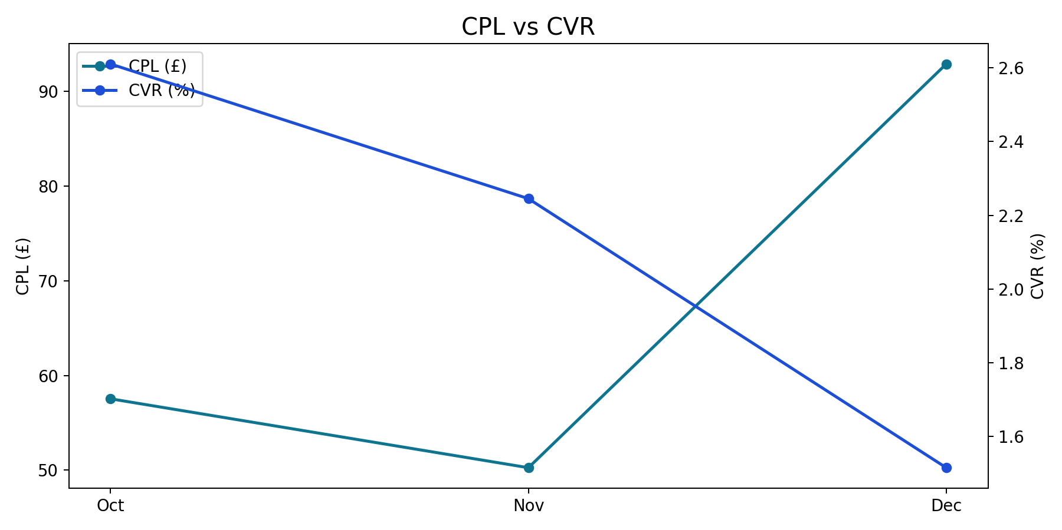
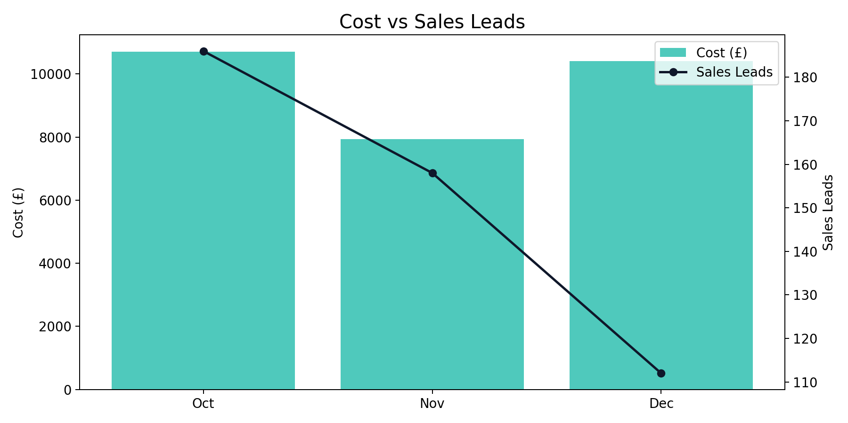
China Monthly Trend
Q4 2025 (Oct - Dec 2025)
China generated 456 leads from £29,049.33 with a quarter CPL of £63.70.
Best efficiency was in Nov (£50.27 CPL), while Dec was highest at £92.90.
YoY vs same quarter last year: leads +92.41%, spend +82.05%.

Slide 16
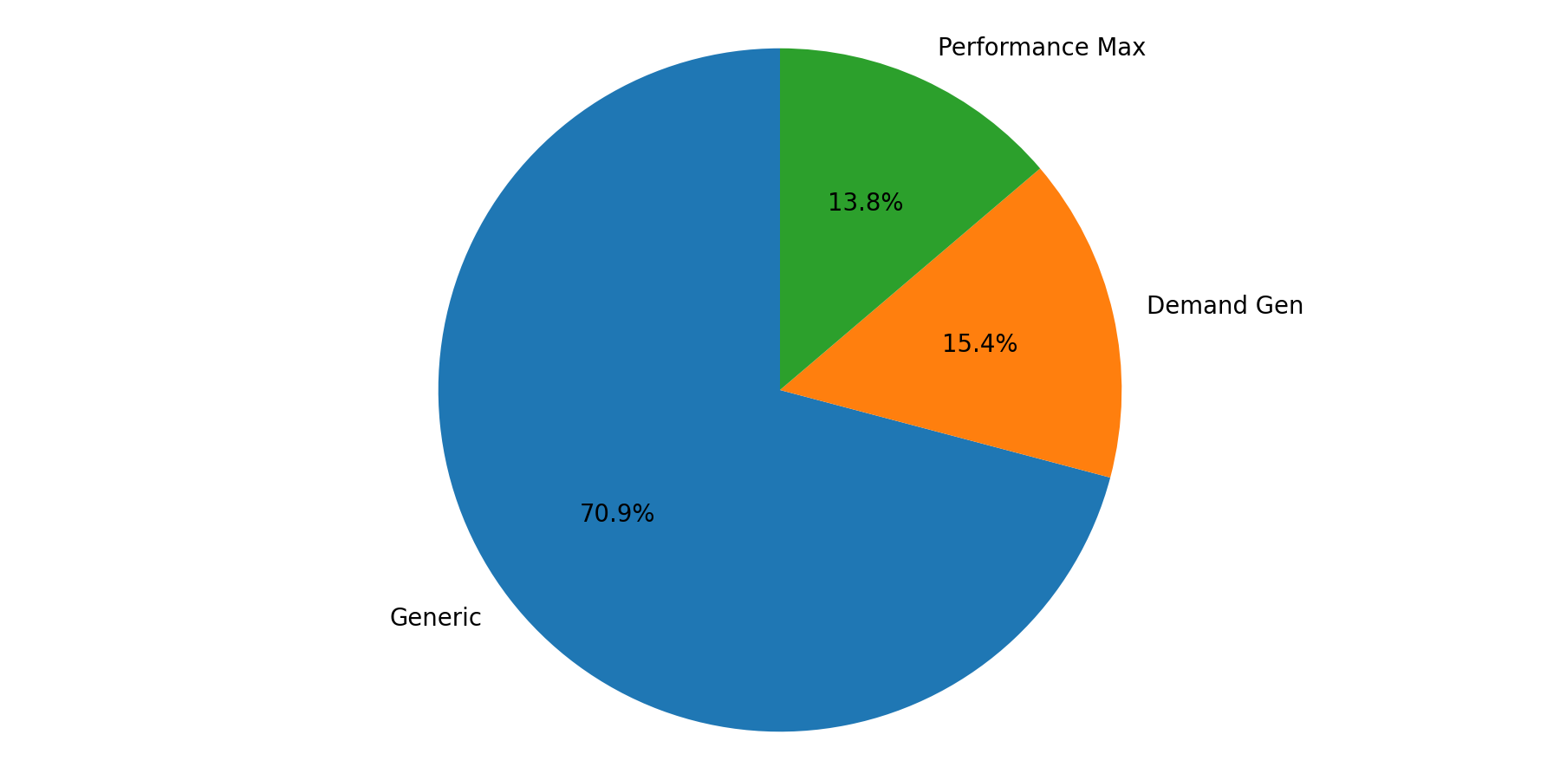
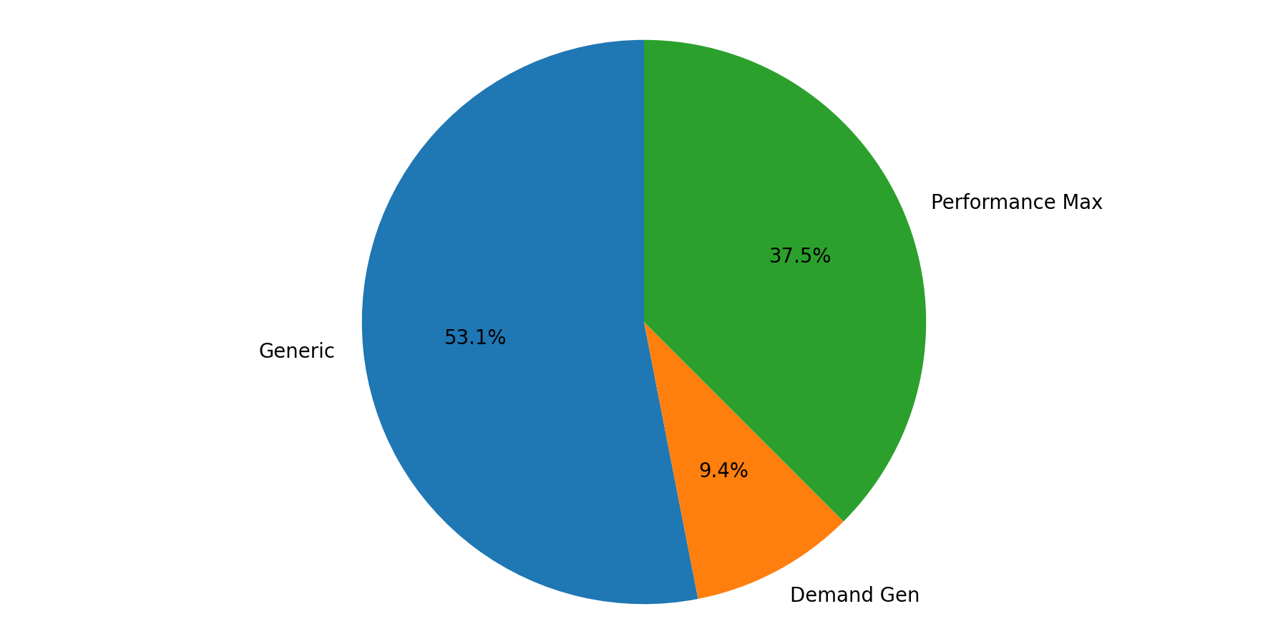
China Campaign Mix
Q4 2025 (Oct - Dec 2025)
Generic represented the largest share of spend (70.9%).
Generic delivered the largest share of leads (53.1%).

Slide 17
Japan Summary + YoY
Q4 2025 (Oct - Dec 2025)
Month | Impressions | Clicks | CTR | CPC | Cost | Sales Leads | CPL | CVR
Oct | 384,790 | 9,533 | 2.48% | £1.53 | £14,576.69 | 315 | £46.28 | 3.30%
Nov | 448,446 | 5,852 | 1.30% | £1.49 | £8,744.31 | 162 | £53.98 | 2.77%
Dec | 462,064 | 9,289 | 2.01% | £1.38 | £12,826.00 | 95 | £135.01 | 1.02%
Total | 1,295,300 | 24,674 | 1.90% | £1.46 | £36,147.00 | 572 | £63.19 | 2.32%
Japan generated 572 leads from £36,147.00 with a quarter CPL of £63.19.
Best efficiency was in Oct (£46.28 CPL), while Dec was highest at £135.01.
YoY vs same quarter last year: leads +0.88%, spend +9.12%.

Slide 18
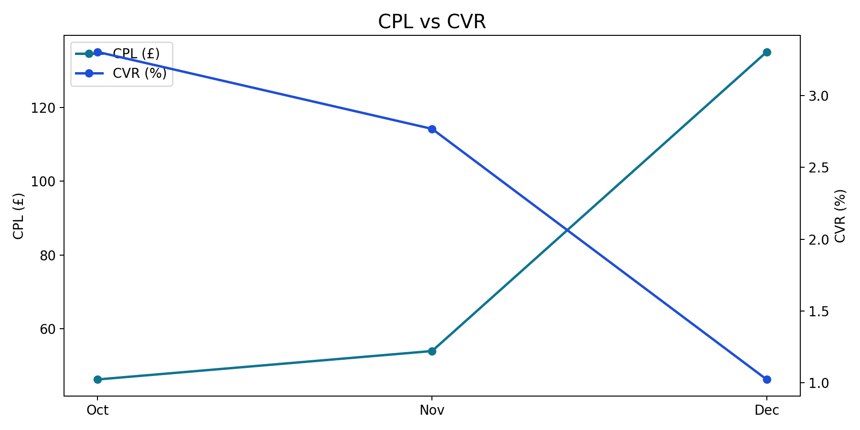
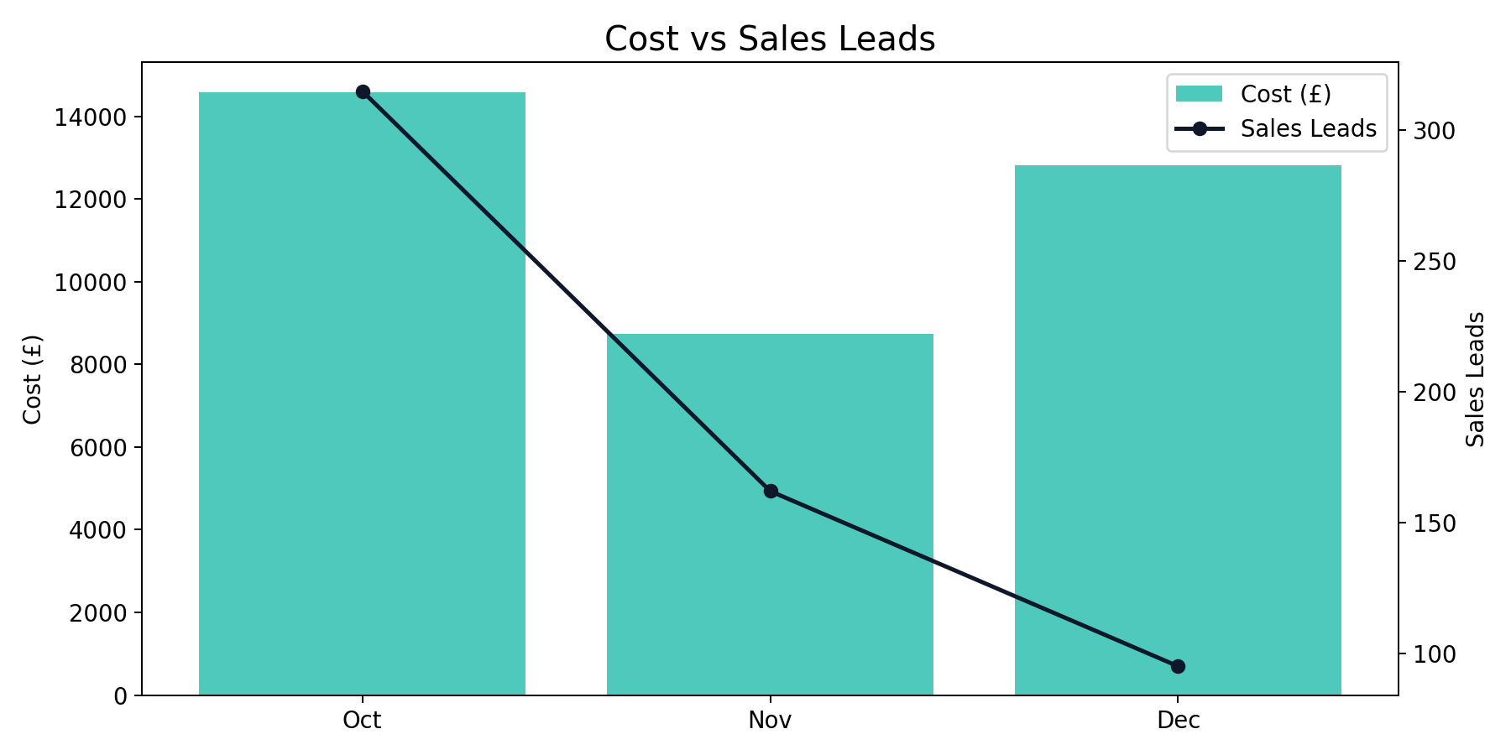
Japan Monthly Trend
Q4 2025 (Oct - Dec 2025)
Japan generated 572 leads from £36,147.00 with a quarter CPL of £63.19.
Best efficiency was in Oct (£46.28 CPL), while Dec was highest at £135.01.
YoY vs same quarter last year: leads +0.88%, spend +9.12%.

Slide 19
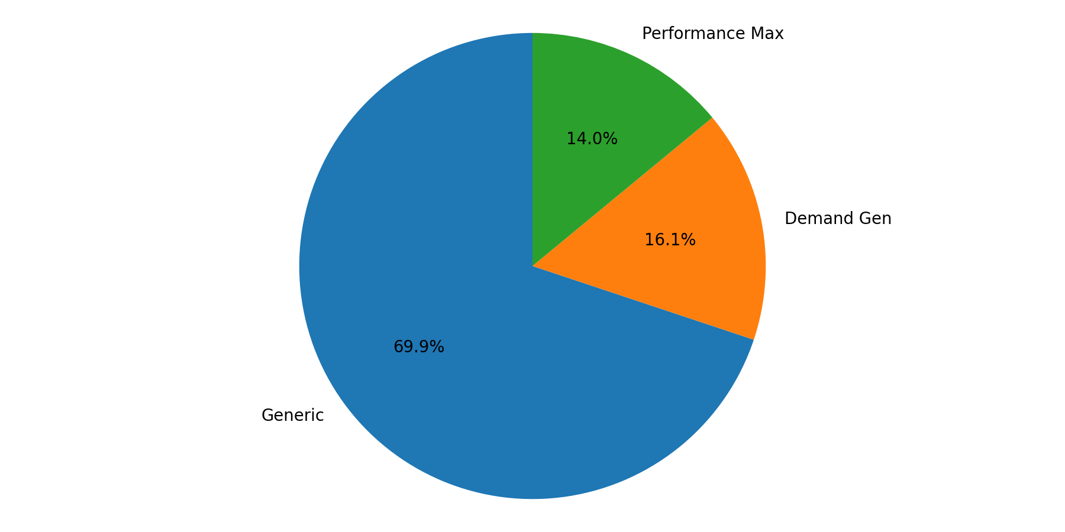
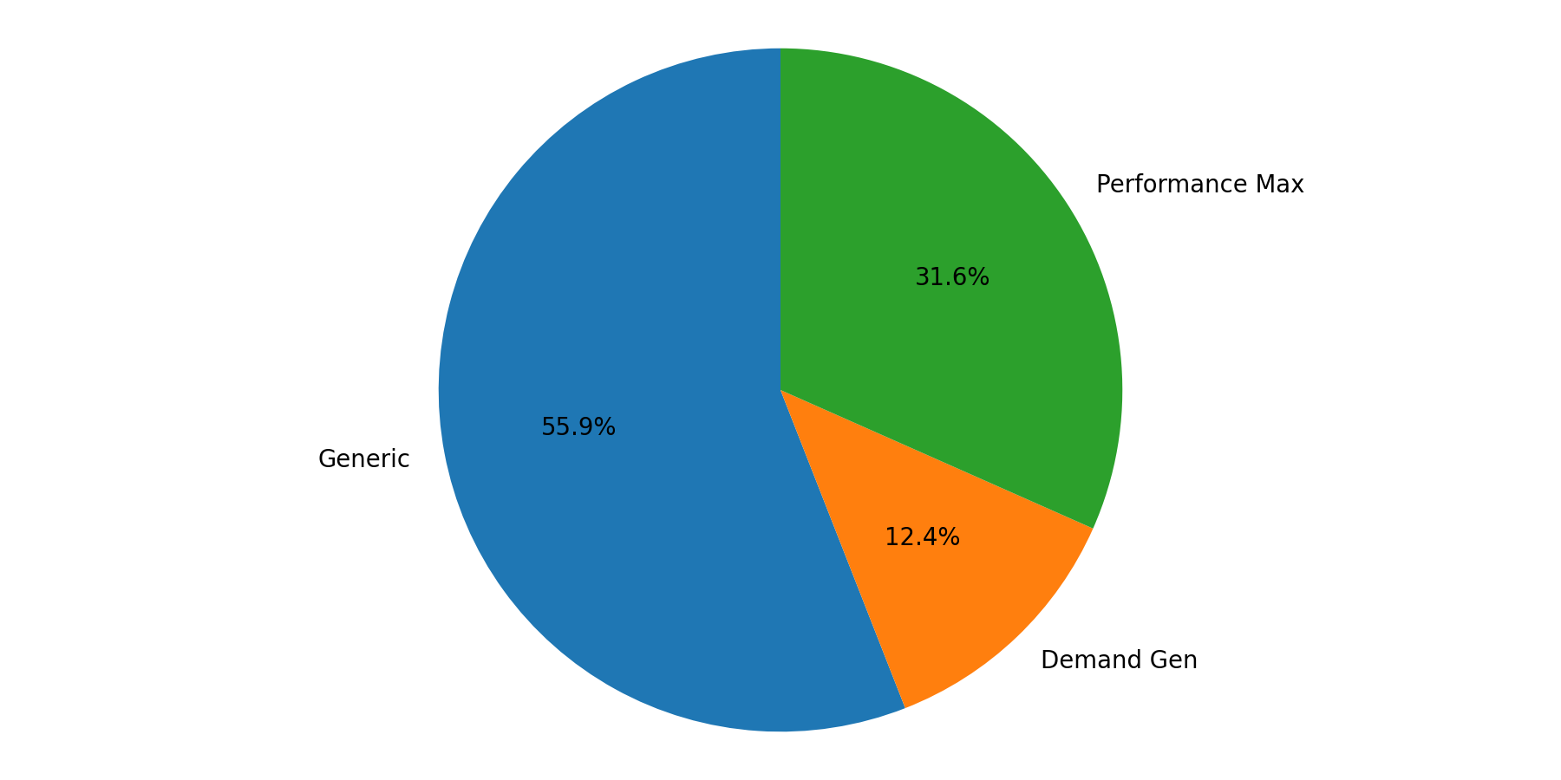
Japan Campaign Mix
Q4 2025 (Oct - Dec 2025)
Generic represented the largest share of spend (69.9%).
Generic delivered the largest share of leads (55.9%).

Slide 20
SE Asia Summary + YoY
Q4 2025 (Oct - Dec 2025)
Month | Impressions | Clicks | CTR | CPC | Cost | Sales Leads | CPL | CVR
Oct | 156,797 | 4,980 | 3.18% | £1.41 | £7,030.78 | 193 | £36.43 | 3.88%
Nov | 124,193 | 3,386 | 2.73% | £1.26 | £4,272.55 | 142 | £30.09 | 4.19%
Dec | 348,109 | 5,216 | 1.50% | £1.01 | £5,256.18 | 84 | £62.57 | 1.61%
Total | 629,099 | 13,582 | 2.16% | £1.22 | £16,559.51 | 419 | £39.52 | 3.08%
SE Asia generated 419 leads from £16,559.51 with a quarter CPL of £39.52.
Best efficiency was in Nov (£30.09 CPL), while Dec was highest at £62.57.
YoY vs same quarter last year: leads +35.60%, spend -2.69%.

Slide 21
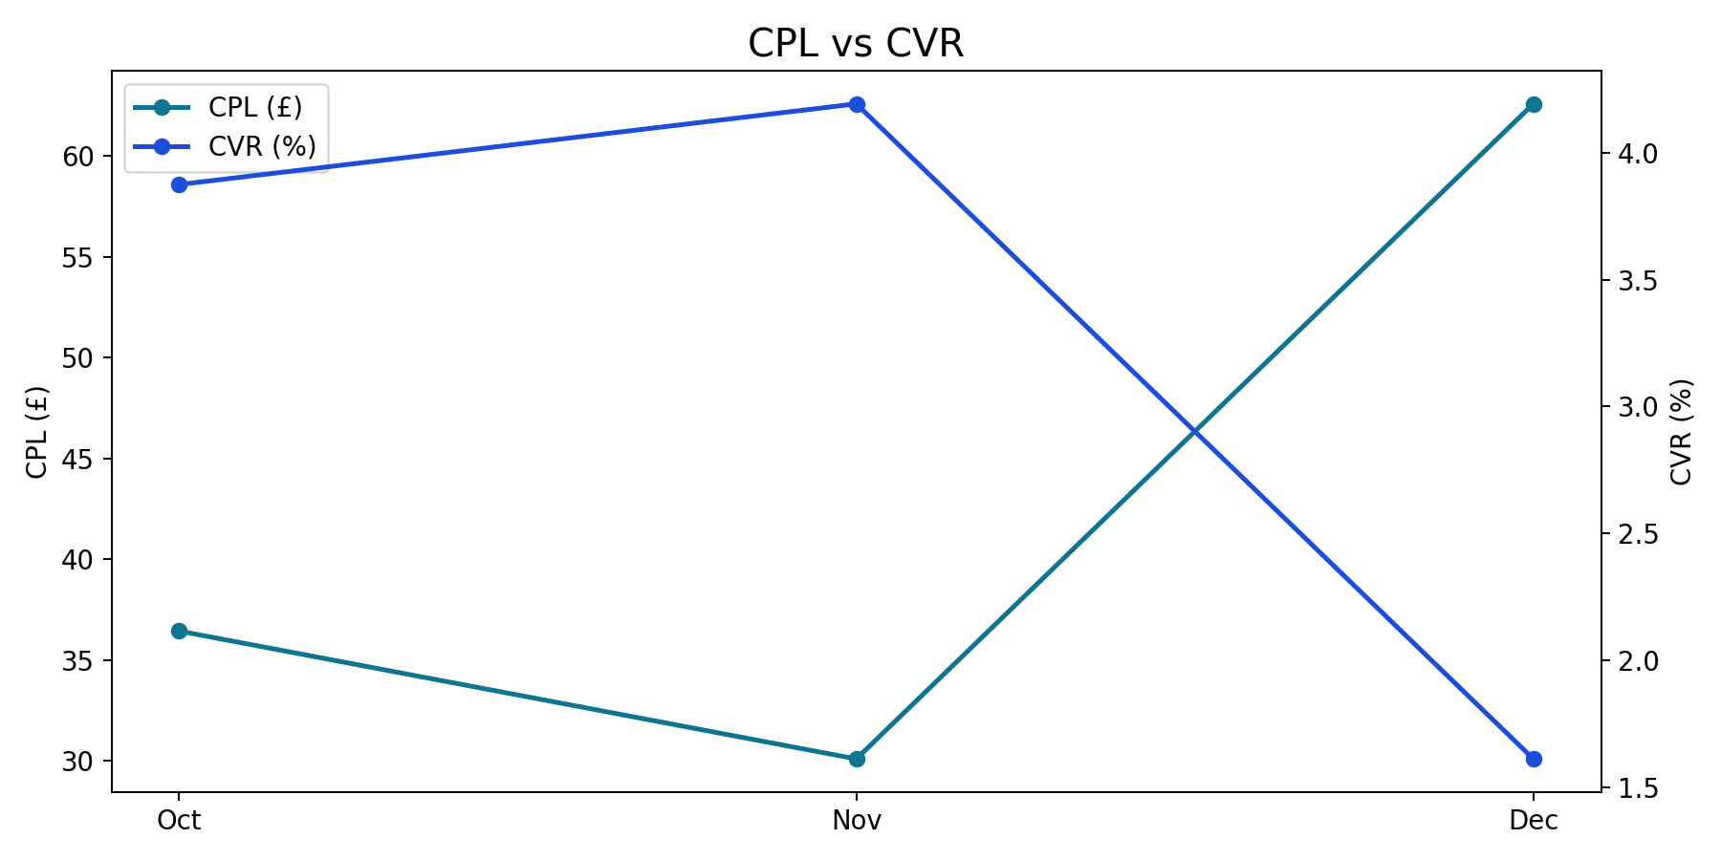
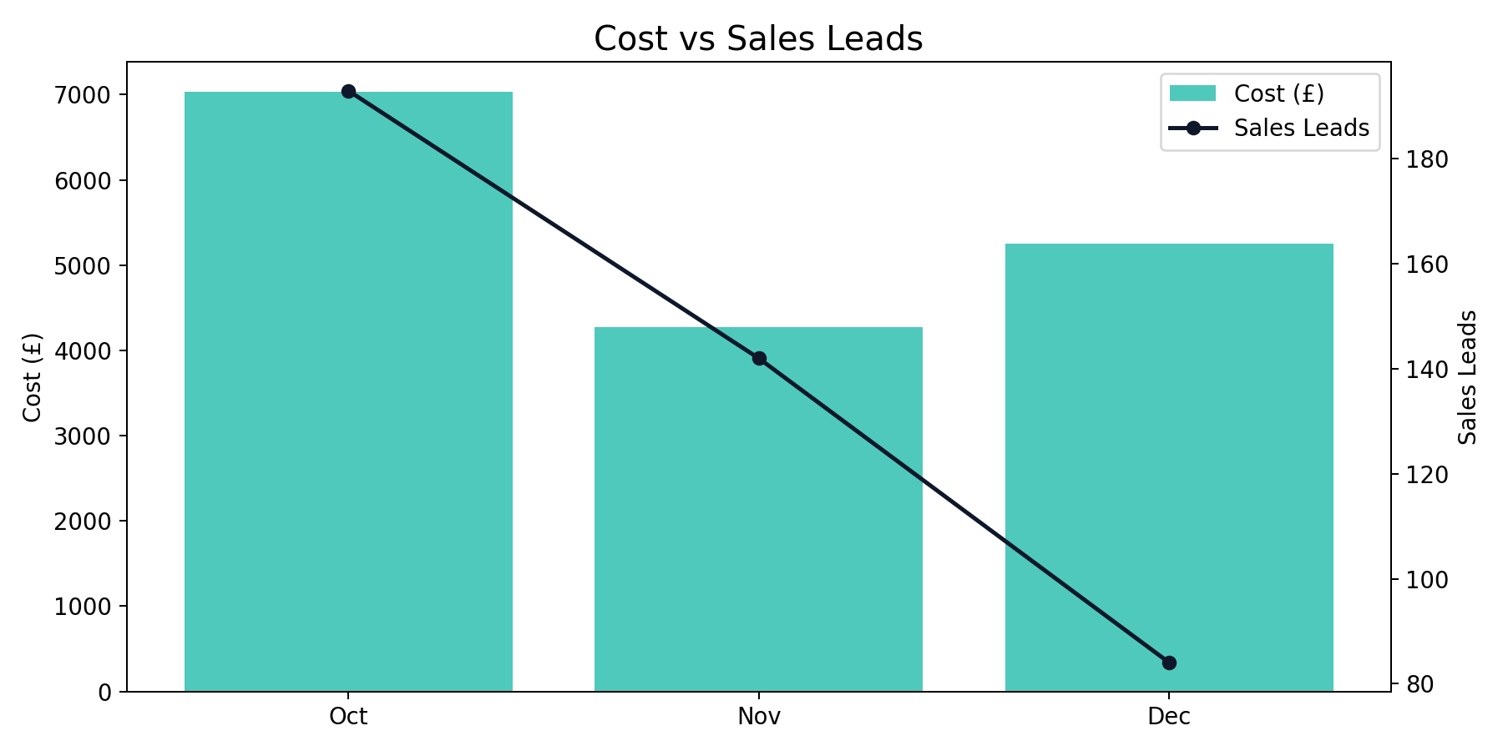
SE Asia Monthly Trend
Q4 2025 (Oct - Dec 2025)
SE Asia generated 419 leads from £16,559.51 with a quarter CPL of £39.52.
Best efficiency was in Nov (£30.09 CPL), while Dec was highest at £62.57.
YoY vs same quarter last year: leads +35.60%, spend -2.69%.

Slide 22
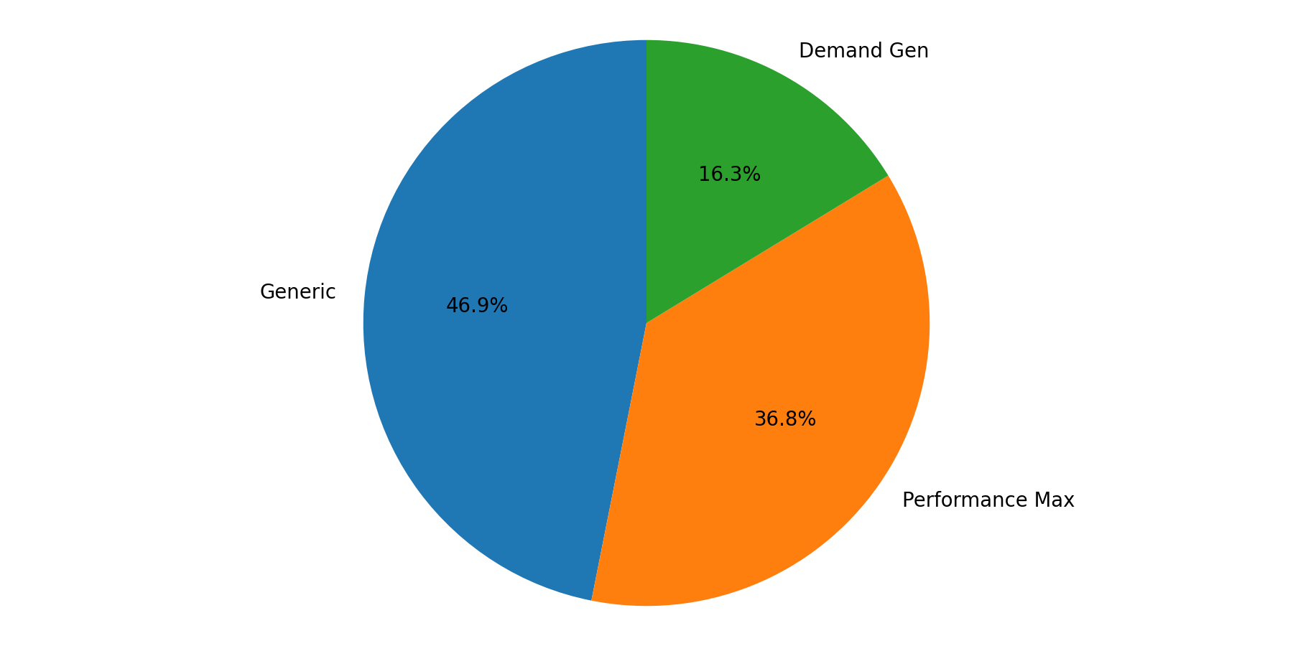
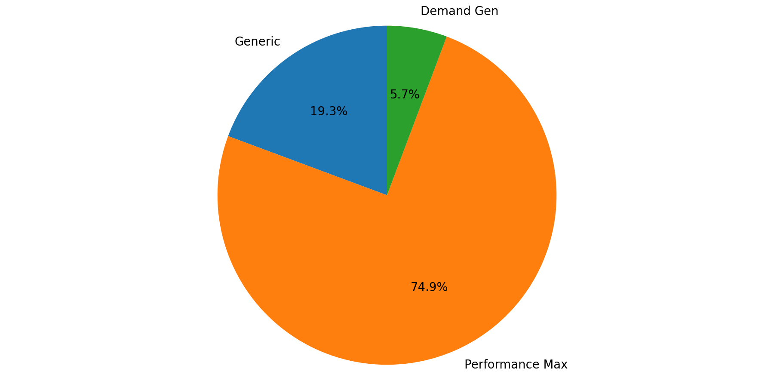
SE Asia Campaign Mix
Q4 2025 (Oct - Dec 2025)
Generic represented the largest share of spend (46.9%).
Performance Max delivered the largest share of leads (74.9%).
Spend and lead mix are concentrated in different campaign types, indicating different efficiency profiles.

Slide 23
India Summary + YoY
Q4 2025 (Oct - Dec 2025)
Month | Impressions | Clicks | CTR | CPC | Cost | Sales Leads | CPL | CVR
Oct | 136,304 | 3,230 | 2.37% | £1.29 | £4,162.33 | 121 | £34.40 | 3.75%
Nov | 82,528 | 1,958 | 2.37% | £1.54 | £3,023.14 | 87 | £34.75 | 4.44%
Dec | 204,416 | 2,831 | 1.38% | £1.14 | £3,222.79 | 45 | £71.62 | 1.59%
Total | 423,248 | 8,019 | 1.89% | £1.30 | £10,408.25 | 253 | £41.14 | 3.16%
India generated 253 leads from £10,408.25 with a quarter CPL of £41.14.
Best efficiency was in Oct (£34.40 CPL), while Dec was highest at £71.62.
YoY vs same quarter last year: leads +57.14%, spend +29.38%.

Slide 24
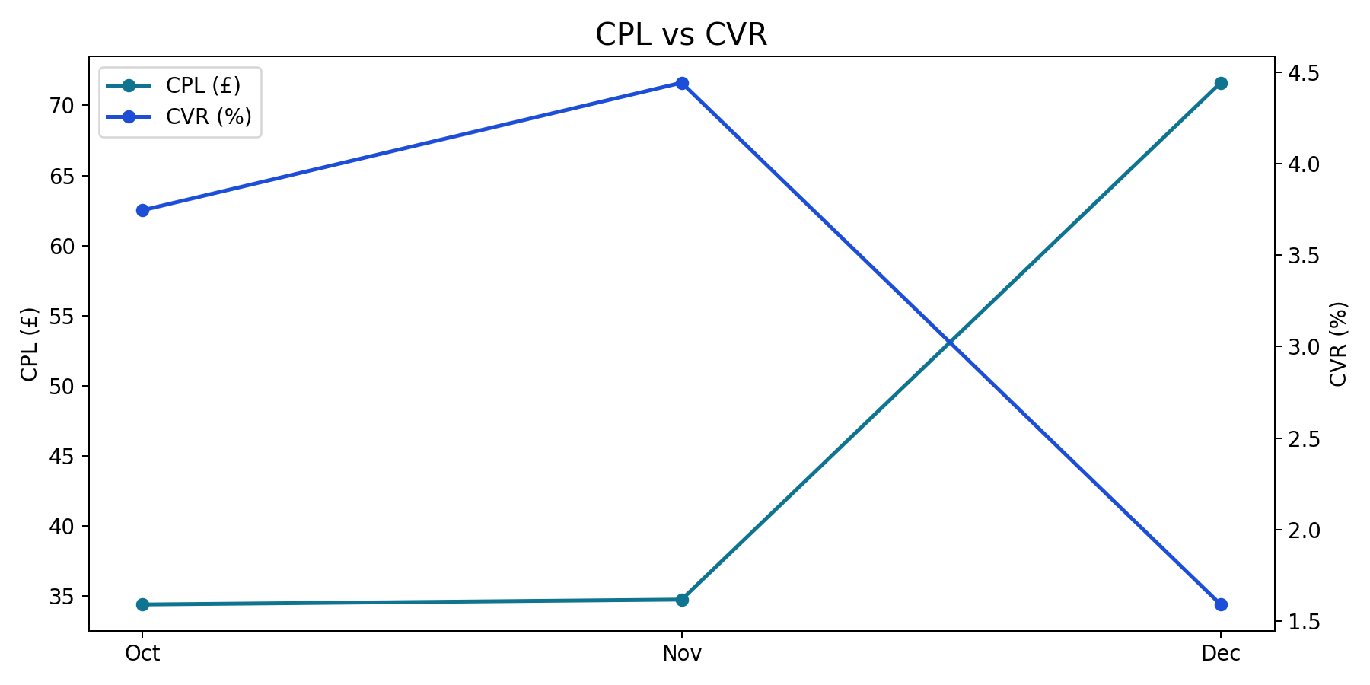
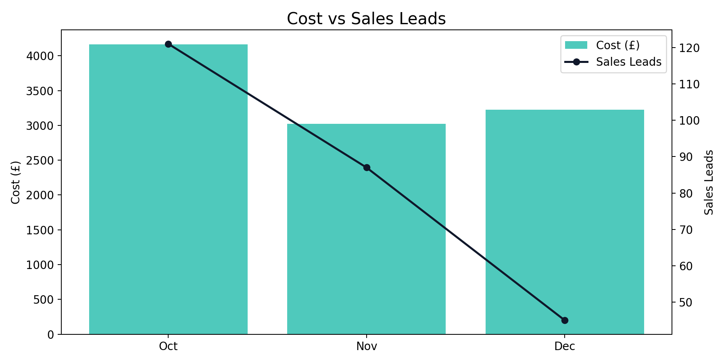
India Monthly Trend
Q4 2025 (Oct - Dec 2025)
India generated 253 leads from £10,408.25 with a quarter CPL of £41.14.
Best efficiency was in Oct (£34.40 CPL), while Dec was highest at £71.62.
YoY vs same quarter last year: leads +57.14%, spend +29.38%.

Slide 25
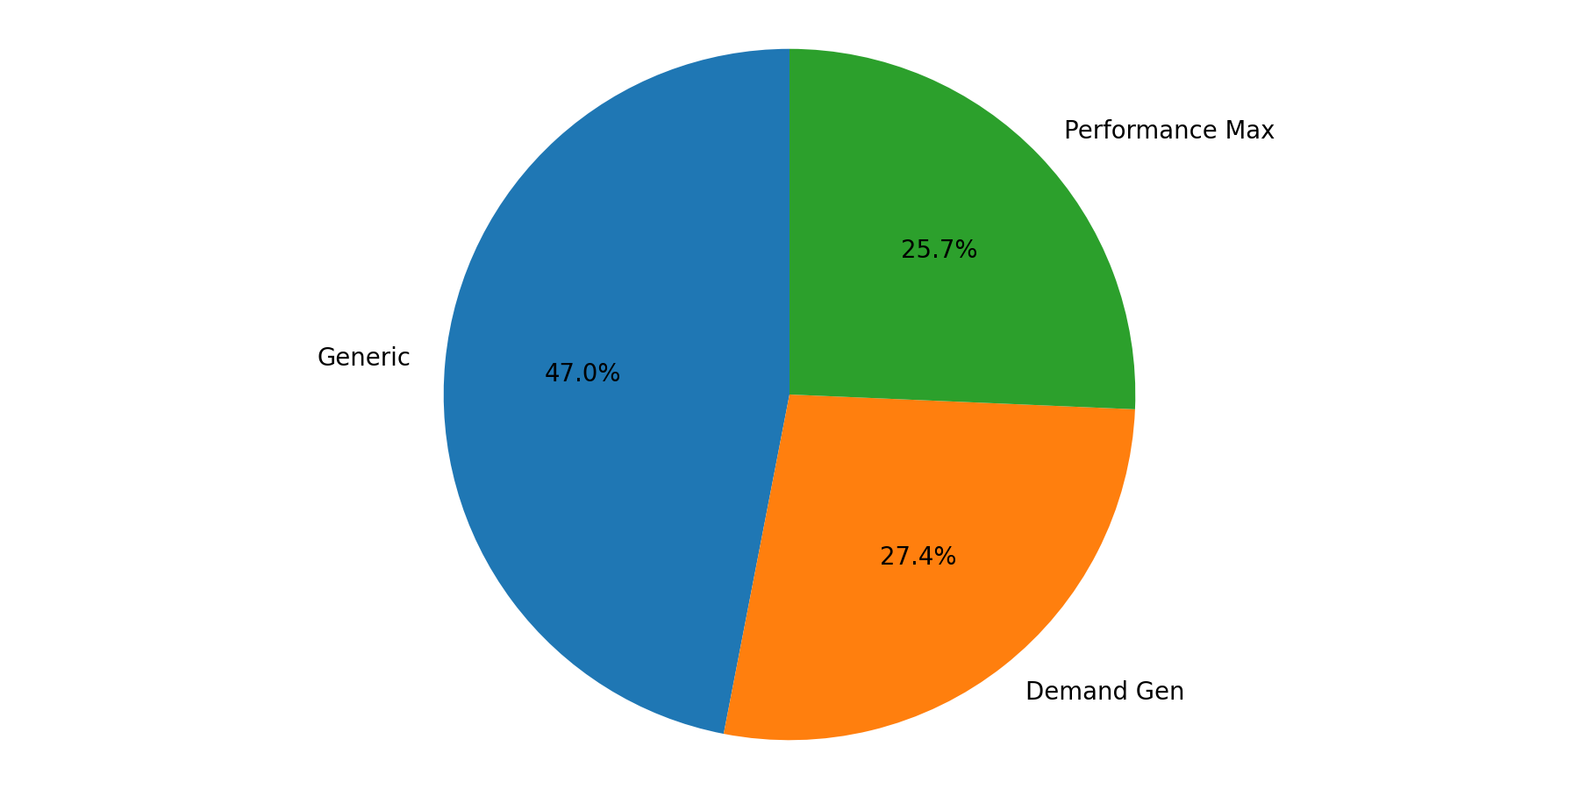
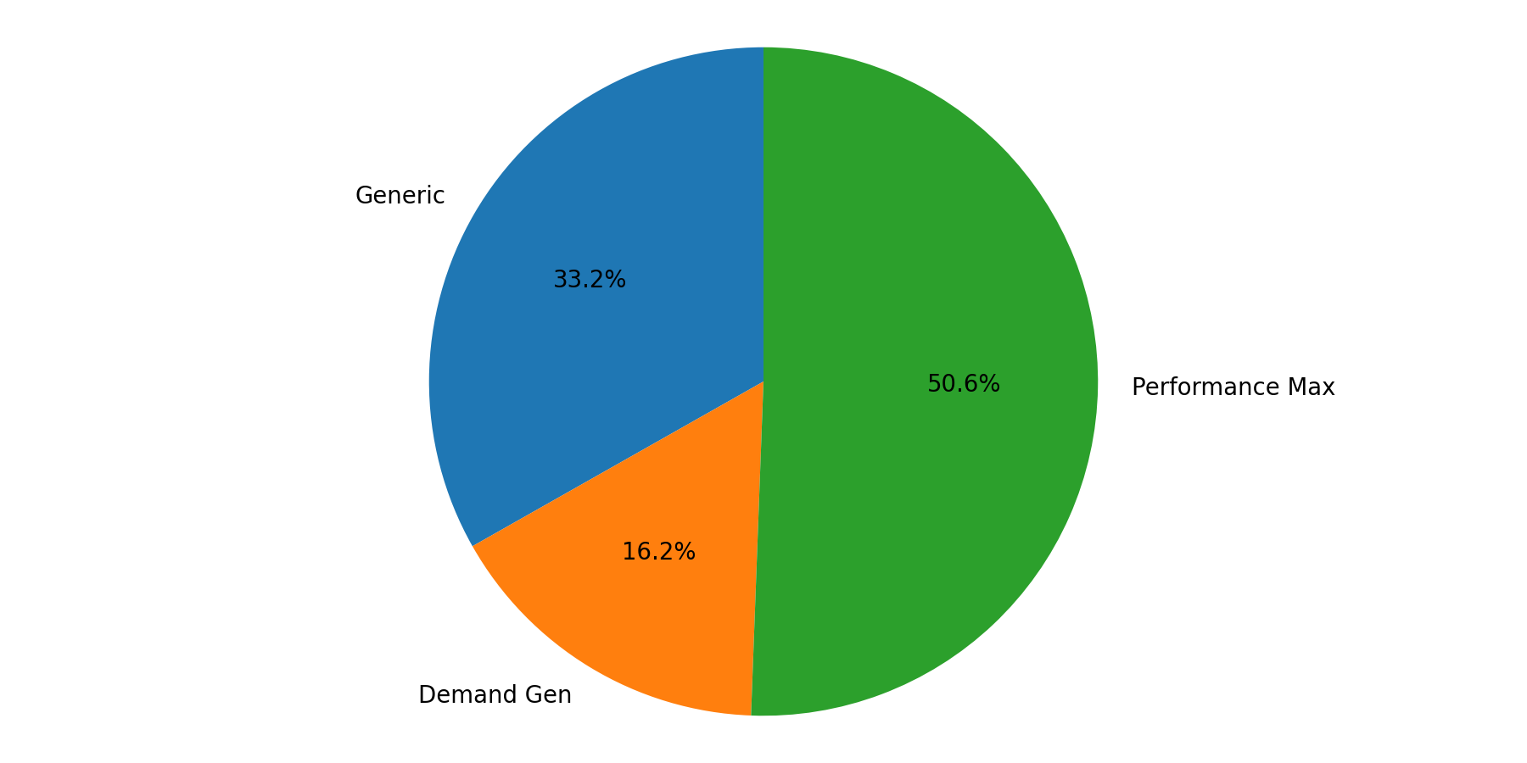
India Campaign Mix
Q4 2025 (Oct - Dec 2025)
Generic represented the largest share of spend (47.0%).
Performance Max delivered the largest share of leads (50.6%).
Spend and lead mix are concentrated in different campaign types, indicating different efficiency profiles.

