Slide 1
Wendy Wu Tours | Quarterly PPC Performance Report
Q4 2025 (Oct - Dec 2025) | Summon Digital

Slide 2
Performance

Slide 3
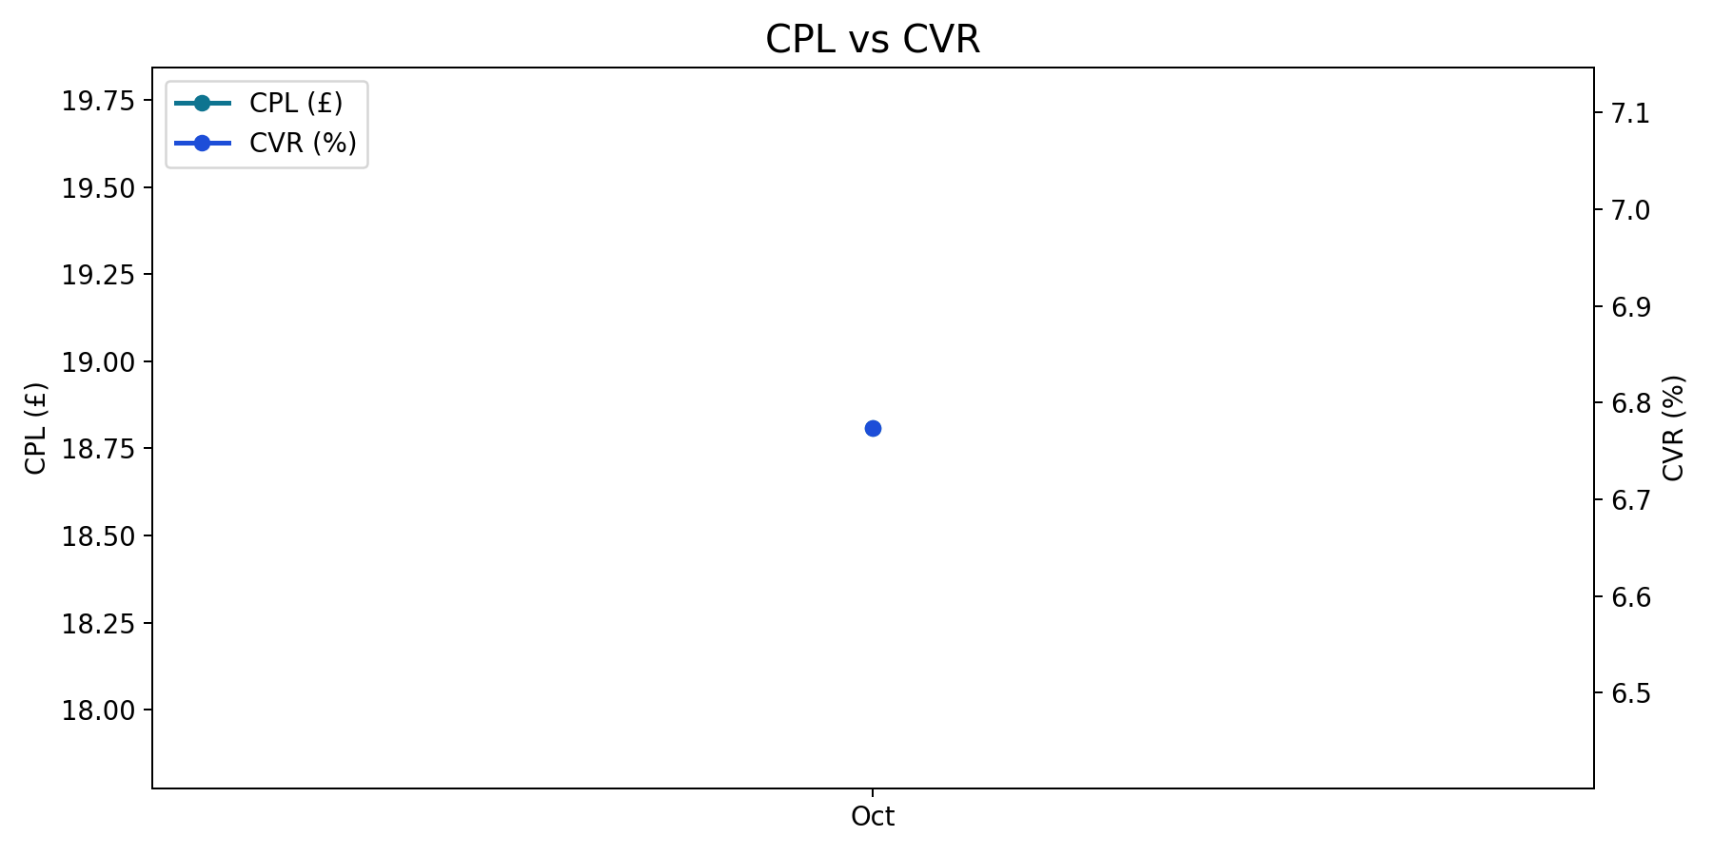
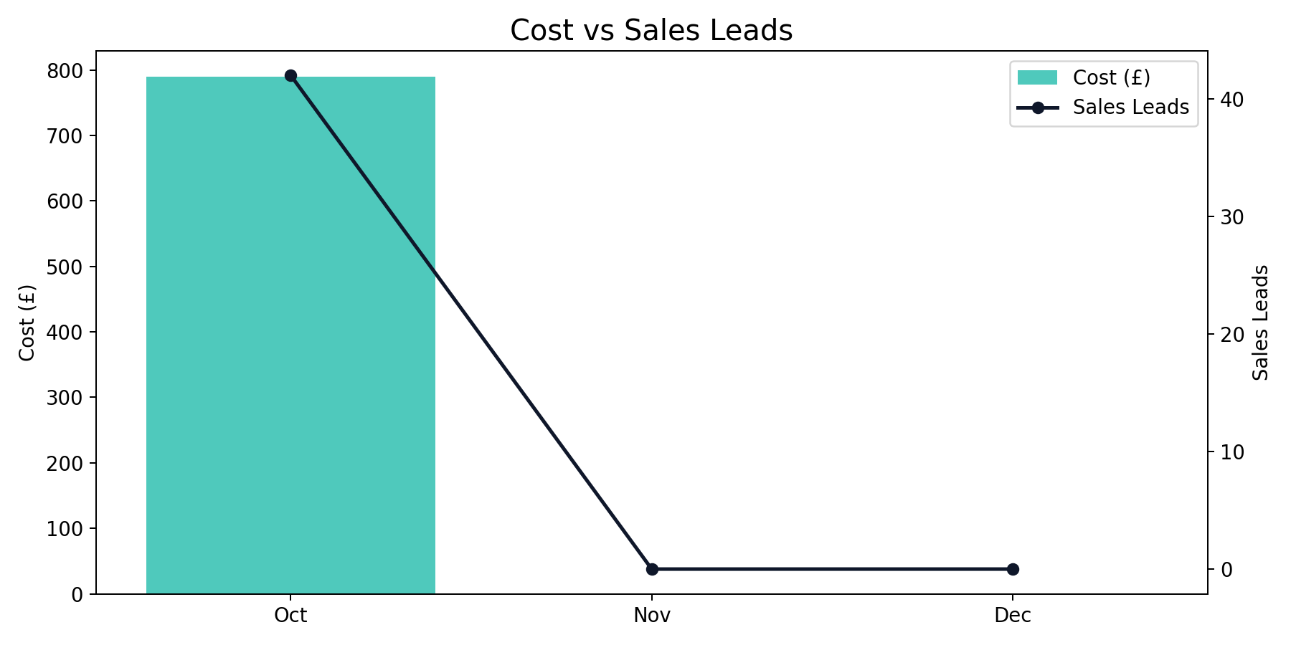
Overall Performance Trend
Q4 2025 (Oct - Dec 2025)
Oct delivered the lowest CPL of the quarter (£18.81), while Oct had the highest CVR (6.77%).
Quarter total: 42 leads from £790.00 spend at a blended CPL of £18.81.
Performance Max generated the highest share of leads (42.9%).

Slide 4
Overall Quarter Summary
Q4 2025 (Oct - Dec 2025)
Month | Impressions | Clicks | CTR | CPC | Cost | Sales Leads | CPL | CVR | Revenue
Oct | 11,700 | 620 | 5.30% | £1.27 | £790.00 | 42 | £18.81 | 6.77% | £8,500.00
Nov | 0 | 0 | n/a | n/a | £0.00 | 0 | n/a | n/a | £0.00
Dec | 0 | 0 | n/a | n/a | £0.00 | 0 | n/a | n/a | £0.00
Total | 11,700 | 620 | 5.30% | £1.27 | £790.00 | 42 | £18.81 | 6.77% | £8,500.00
Overall generated 42 leads from £790.00 with a quarter CPL of £18.81.
Best efficiency was in Oct (£18.81 CPL), while Oct was highest at £18.81.
YoY comparison is unavailable due to missing or zero baseline in prior year data.

Slide 5
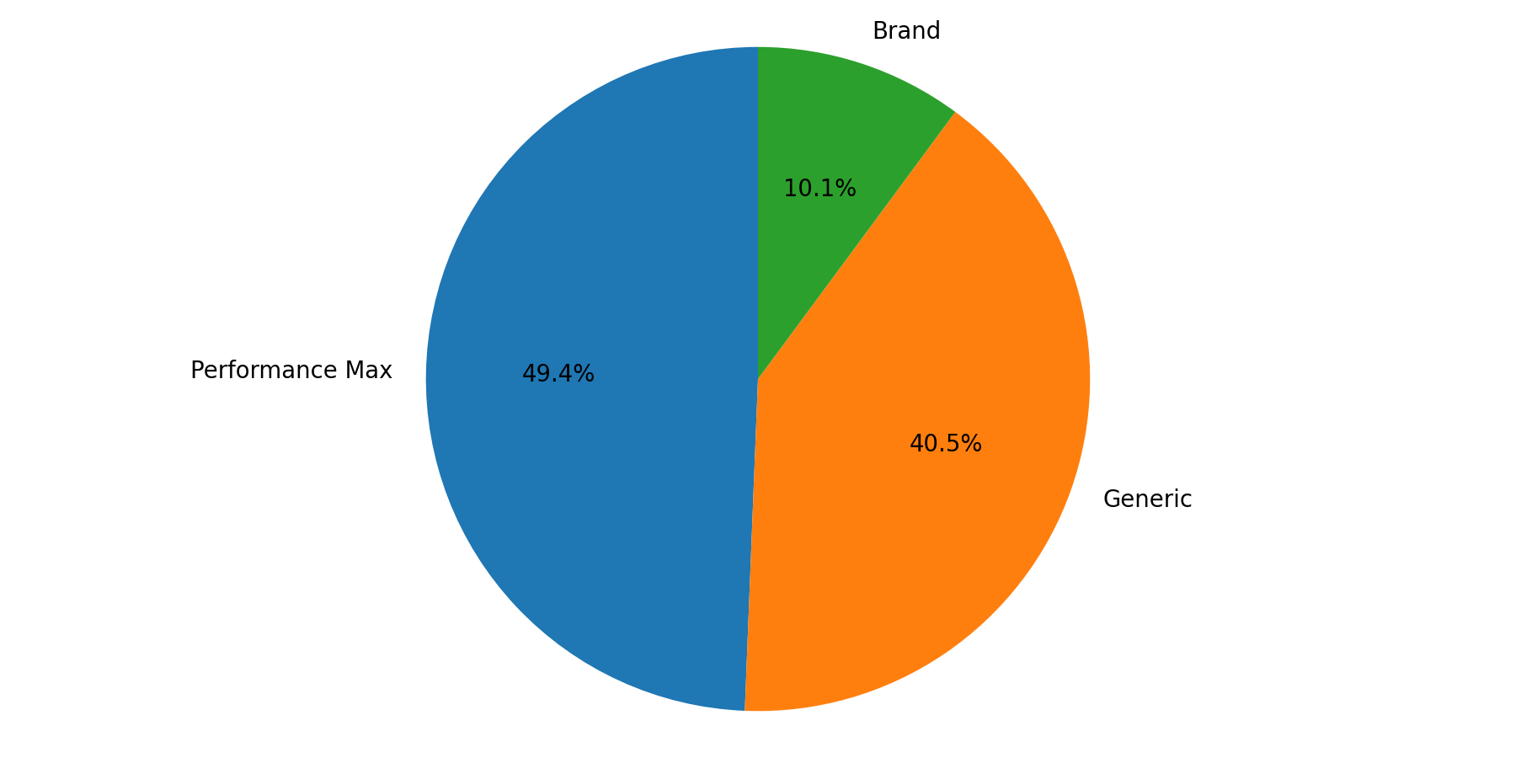
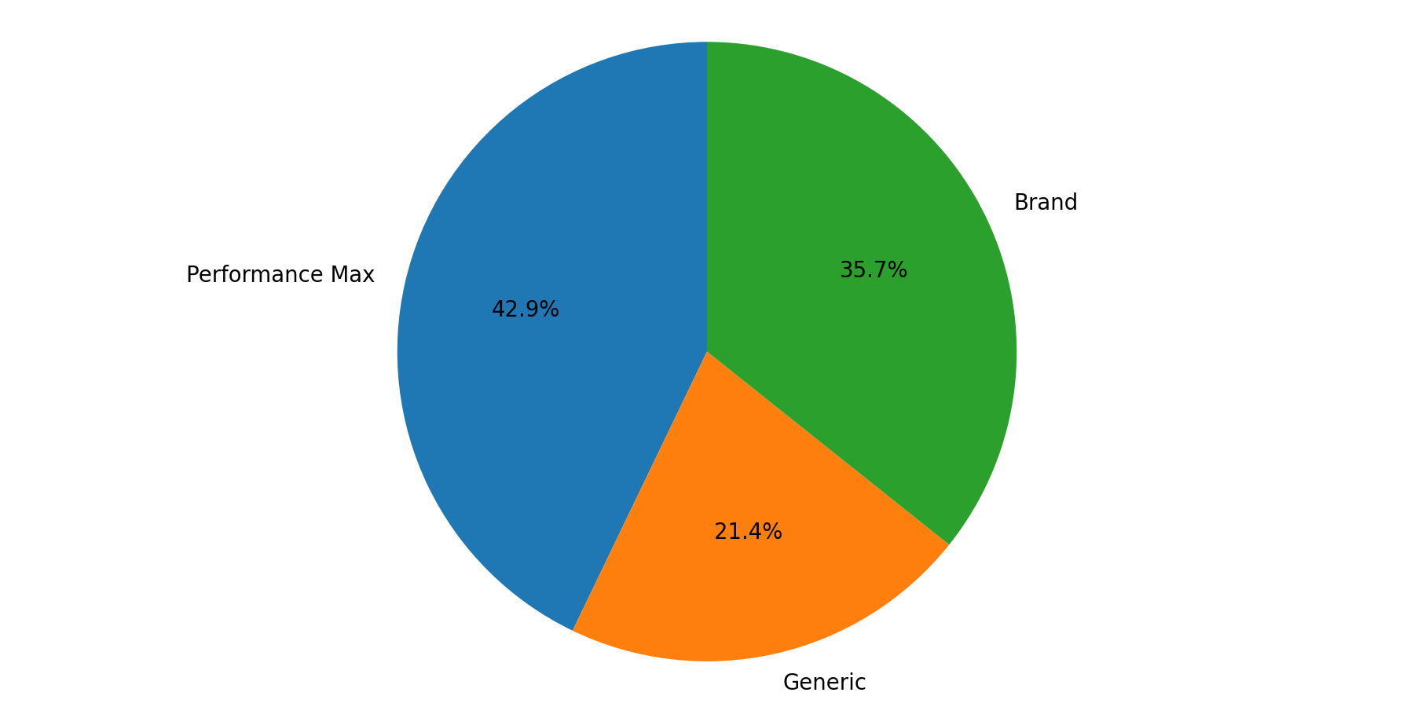
Campaign Type Mix
Q4 2025 (Oct - Dec 2025)
Performance Max represented the largest share of spend (49.4%).
Performance Max delivered the largest share of leads (42.9%).

Slide 6
Brand Summary
Q4 2025 (Oct - Dec 2025)
Month | Impressions | Clicks | CTR | CPC | Cost | Sales Leads | CPL | CVR | Revenue
Oct | 1,000 | 120 | 12.00% | £0.67 | £80.00 | 15 | £5.33 | 12.50% | £2,500.00
Nov | 0 | 0 | n/a | n/a | £0.00 | 0 | n/a | n/a | £0.00
Dec | 0 | 0 | n/a | n/a | £0.00 | 0 | n/a | n/a | £0.00
Total | 1,000 | 120 | 12.00% | £0.67 | £80.00 | 15 | £5.33 | 12.50% | £2,500.00
Brand generated 15 leads from £80.00 with a quarter CPL of £5.33.
Best efficiency was in Oct (£5.33 CPL), while Oct was highest at £5.33.
YoY comparison is unavailable due to missing or zero baseline in prior year data.

Slide 7
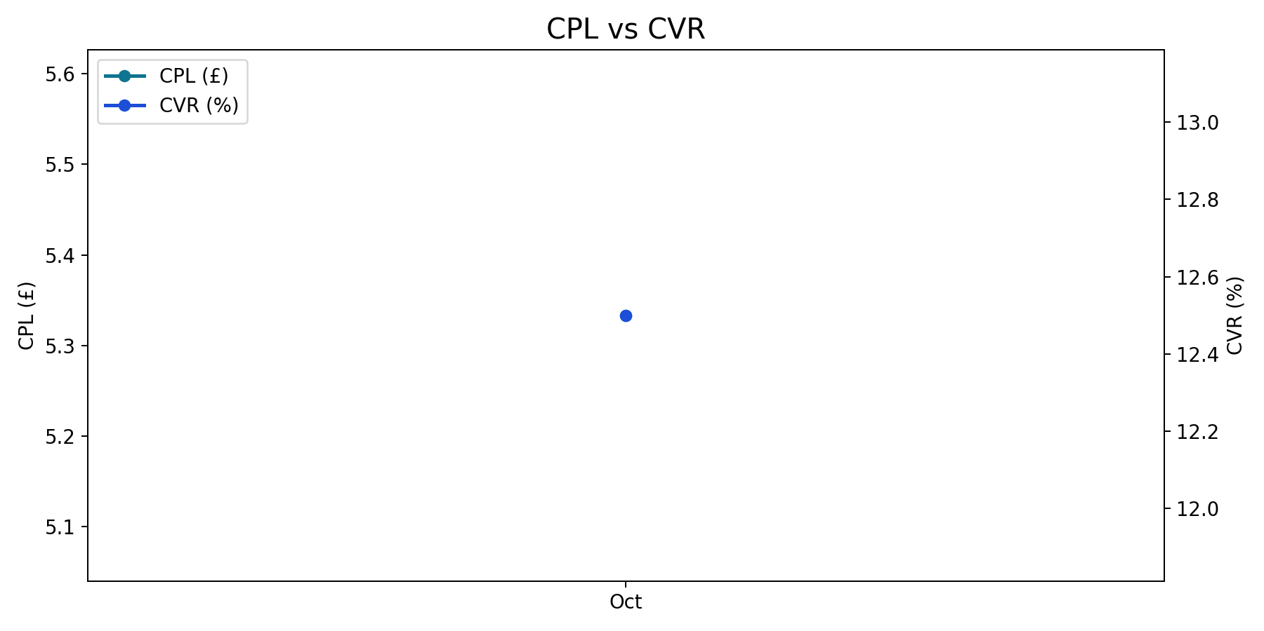
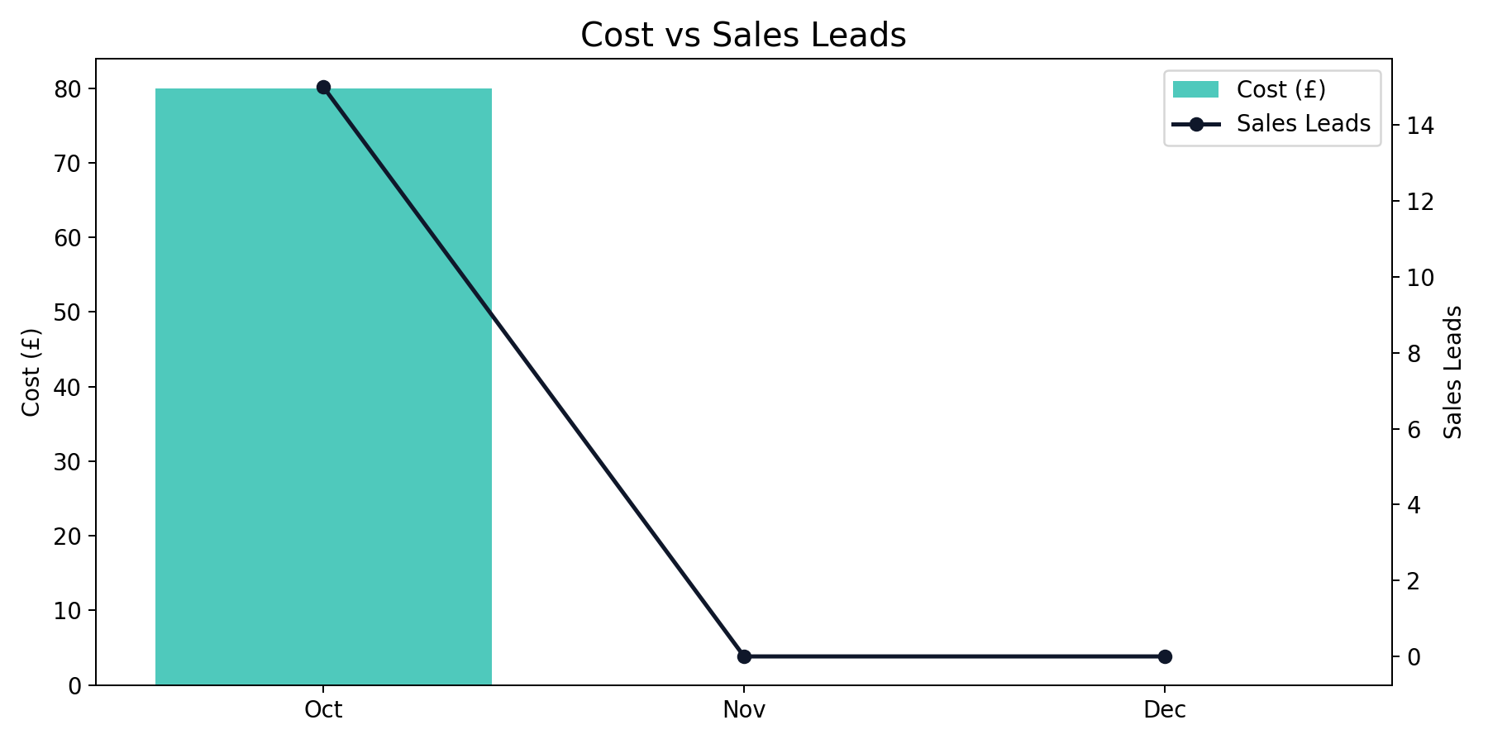
Brand Monthly Trend
Q4 2025 (Oct - Dec 2025)
Brand generated 15 leads from £80.00 with a quarter CPL of £5.33.
Best efficiency was in Oct (£5.33 CPL), while Oct was highest at £5.33.
YoY comparison is unavailable due to missing or zero baseline in prior year data.

Slide 8
Generic Summary
Q4 2025 (Oct - Dec 2025)
Month | Impressions | Clicks | CTR | CPC | Cost | Sales Leads | CPL | CVR | Revenue
Oct | 3,500 | 200 | 5.71% | £1.60 | £320.00 | 9 | £35.56 | 4.50% | £1,800.00
Nov | 0 | 0 | n/a | n/a | £0.00 | 0 | n/a | n/a | £0.00
Dec | 0 | 0 | n/a | n/a | £0.00 | 0 | n/a | n/a | £0.00
Total | 3,500 | 200 | 5.71% | £1.60 | £320.00 | 9 | £35.56 | 4.50% | £1,800.00
Generic generated 9 leads from £320.00 with a quarter CPL of £35.56.
Best efficiency was in Oct (£35.56 CPL), while Oct was highest at £35.56.
YoY comparison is unavailable due to missing or zero baseline in prior year data.

Slide 9
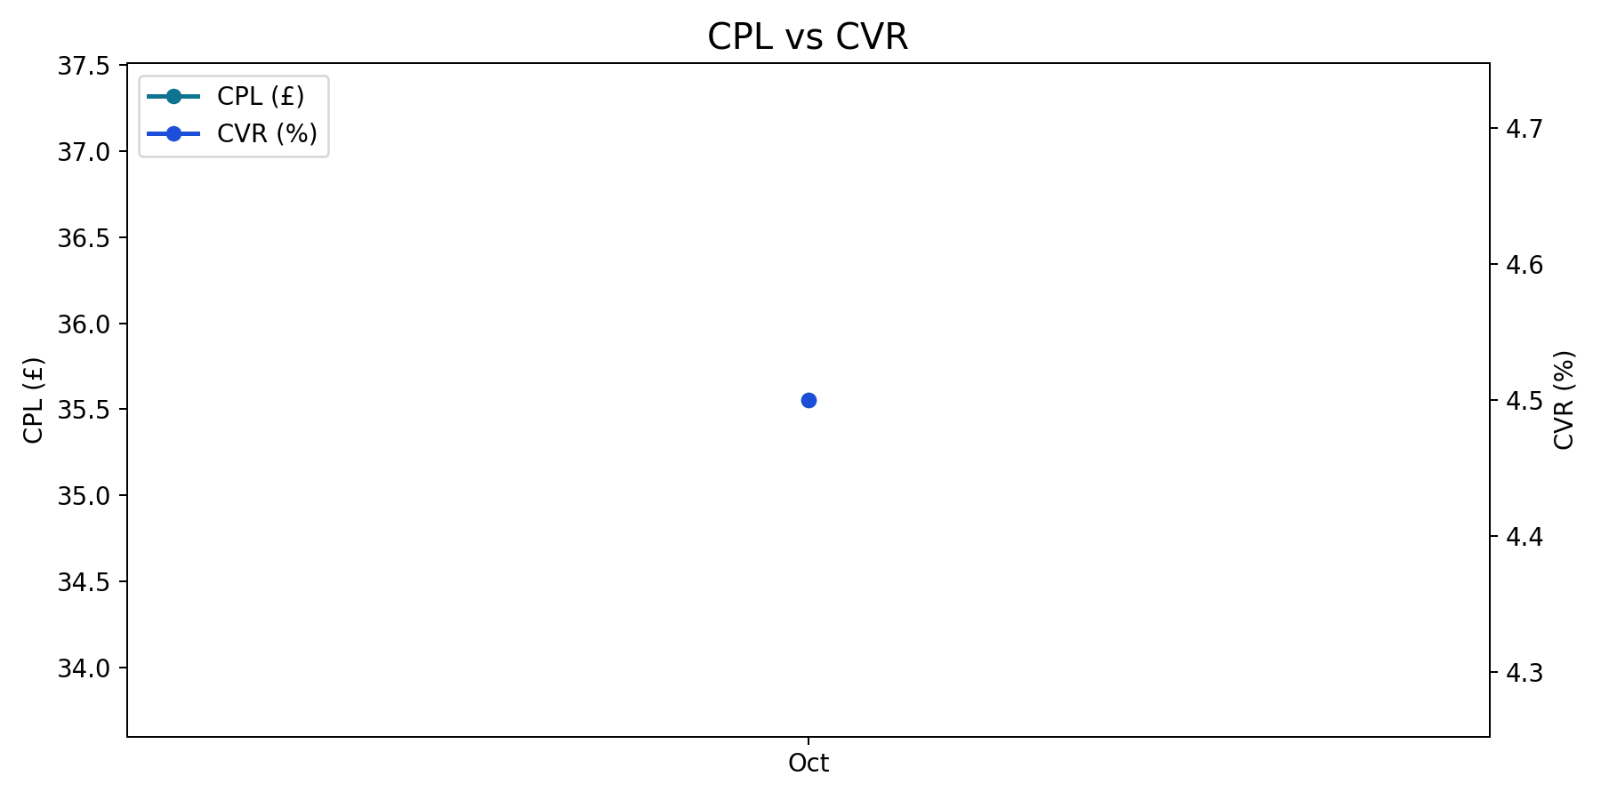

Generic Monthly Trend
Q4 2025 (Oct - Dec 2025)
Generic generated 9 leads from £320.00 with a quarter CPL of £35.56.
Best efficiency was in Oct (£35.56 CPL), while Oct was highest at £35.56.
YoY comparison is unavailable due to missing or zero baseline in prior year data.

Slide 10
Performance Max Summary
Q4 2025 (Oct - Dec 2025)
Month | Impressions | Clicks | CTR | CPC | Cost | Sales Leads | CPL | CVR | Revenue
Oct | 7,200 | 300 | 4.17% | £1.30 | £390.00 | 18 | £21.67 | 6.00% | £4,200.00
Nov | 0 | 0 | n/a | n/a | £0.00 | 0 | n/a | n/a | £0.00
Dec | 0 | 0 | n/a | n/a | £0.00 | 0 | n/a | n/a | £0.00
Total | 7,200 | 300 | 4.17% | £1.30 | £390.00 | 18 | £21.67 | 6.00% | £4,200.00
Performance Max generated 18 leads from £390.00 with a quarter CPL of £21.67.
Best efficiency was in Oct (£21.67 CPL), while Oct was highest at £21.67.
YoY comparison is unavailable due to missing or zero baseline in prior year data.

Slide 11
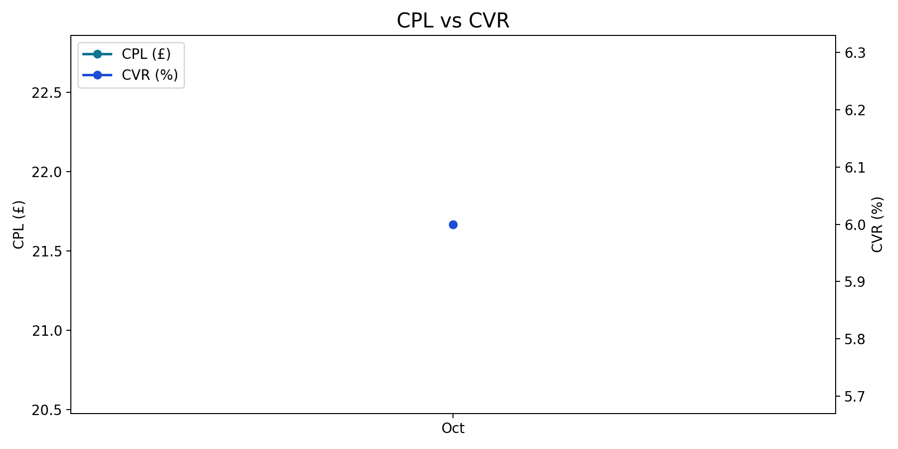
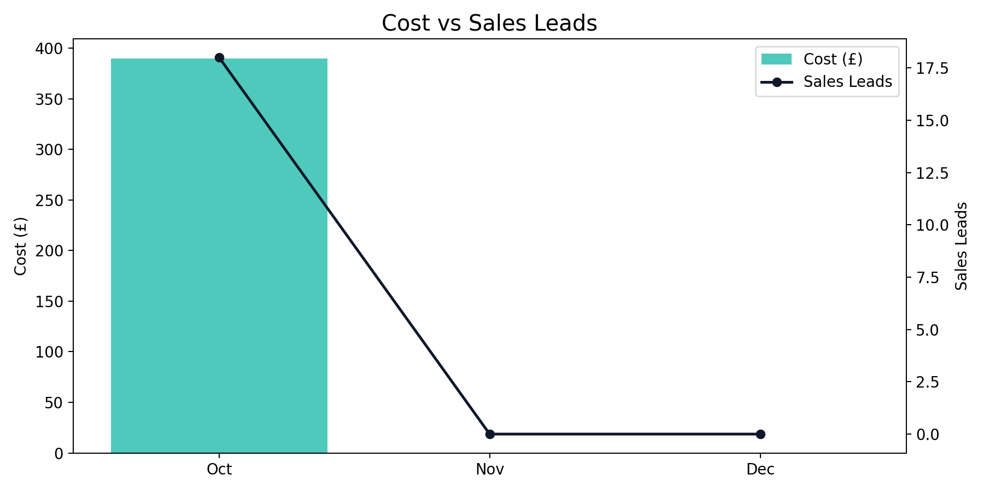
Performance Max Monthly Trend
Q4 2025 (Oct - Dec 2025)
Performance Max generated 18 leads from £390.00 with a quarter CPL of £21.67.
Best efficiency was in Oct (£21.67 CPL), while Oct was highest at £21.67.
YoY comparison is unavailable due to missing or zero baseline in prior year data.

Slide 12
China Summary + YoY
Q4 2025 (Oct - Dec 2025)
Month | Impressions | Clicks | CTR | CPC | Cost | Sales Leads | CPL | CVR | Revenue
Oct | 1,000 | 120 | 12.00% | £0.67 | £80.00 | 15 | £5.33 | 12.50% | £2,500.00
Nov | 0 | 0 | n/a | n/a | £0.00 | 0 | n/a | n/a | £0.00
Dec | 0 | 0 | n/a | n/a | £0.00 | 0 | n/a | n/a | £0.00
Total | 1,000 | 120 | 12.00% | £0.67 | £80.00 | 15 | £5.33 | 12.50% | £2,500.00
China generated 15 leads from £80.00 with a quarter CPL of £5.33.
Best efficiency was in Oct (£5.33 CPL), while Oct was highest at £5.33.
YoY comparison is unavailable due to missing or zero baseline in prior year data.

Slide 13
China Monthly Trend
Q4 2025 (Oct - Dec 2025)
China generated 15 leads from £80.00 with a quarter CPL of £5.33.
Best efficiency was in Oct (£5.33 CPL), while Oct was highest at £5.33.
YoY comparison is unavailable due to missing or zero baseline in prior year data.

Slide 14
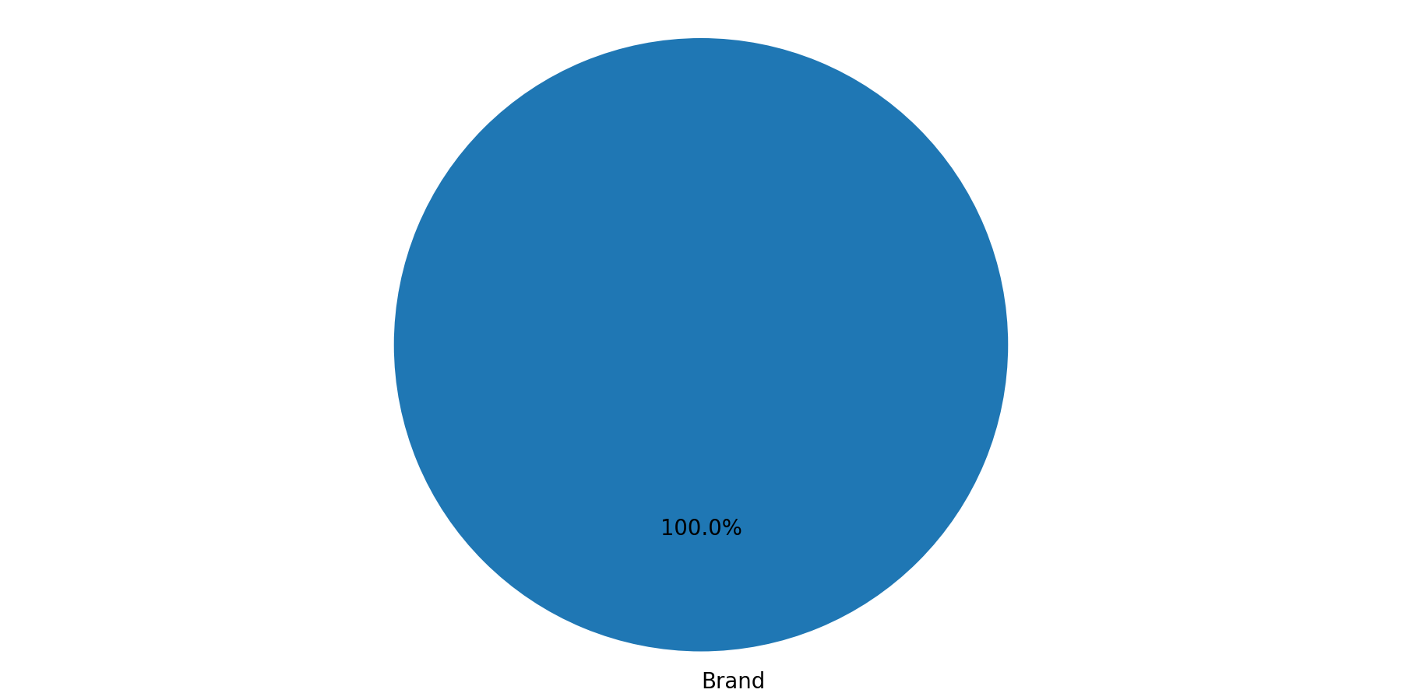
China Campaign Mix
Q4 2025 (Oct - Dec 2025)
Brand represented the largest share of spend (100.0%).
Brand delivered the largest share of leads (100.0%).

Slide 15
Japan Summary + YoY
Q4 2025 (Oct - Dec 2025)
Month | Impressions | Clicks | CTR | CPC | Cost | Sales Leads | CPL | CVR | Revenue
Oct | 3,500 | 200 | 5.71% | £1.60 | £320.00 | 9 | £35.56 | 4.50% | £1,800.00
Nov | 0 | 0 | n/a | n/a | £0.00 | 0 | n/a | n/a | £0.00
Dec | 0 | 0 | n/a | n/a | £0.00 | 0 | n/a | n/a | £0.00
Total | 3,500 | 200 | 5.71% | £1.60 | £320.00 | 9 | £35.56 | 4.50% | £1,800.00
Japan generated 9 leads from £320.00 with a quarter CPL of £35.56.
Best efficiency was in Oct (£35.56 CPL), while Oct was highest at £35.56.
YoY comparison is unavailable due to missing or zero baseline in prior year data.

Slide 16
Japan Monthly Trend
Q4 2025 (Oct - Dec 2025)
Japan generated 9 leads from £320.00 with a quarter CPL of £35.56.
Best efficiency was in Oct (£35.56 CPL), while Oct was highest at £35.56.
YoY comparison is unavailable due to missing or zero baseline in prior year data.

Slide 17

Japan Campaign Mix
Q4 2025 (Oct - Dec 2025)
Generic represented the largest share of spend (100.0%).
Generic delivered the largest share of leads (100.0%).

Slide 18
SE Asia Summary + YoY
Q4 2025 (Oct - Dec 2025)
Month | Impressions | Clicks | CTR | CPC | Cost | Sales Leads | CPL | CVR | Revenue
Oct | 7,200 | 300 | 4.17% | £1.30 | £390.00 | 18 | £21.67 | 6.00% | £4,200.00
Nov | 0 | 0 | n/a | n/a | £0.00 | 0 | n/a | n/a | £0.00
Dec | 0 | 0 | n/a | n/a | £0.00 | 0 | n/a | n/a | £0.00
Total | 7,200 | 300 | 4.17% | £1.30 | £390.00 | 18 | £21.67 | 6.00% | £4,200.00
SE Asia generated 18 leads from £390.00 with a quarter CPL of £21.67.
Best efficiency was in Oct (£21.67 CPL), while Oct was highest at £21.67.
YoY comparison is unavailable due to missing or zero baseline in prior year data.

Slide 19
SE Asia Monthly Trend
Q4 2025 (Oct - Dec 2025)
SE Asia generated 18 leads from £390.00 with a quarter CPL of £21.67.
Best efficiency was in Oct (£21.67 CPL), while Oct was highest at £21.67.
YoY comparison is unavailable due to missing or zero baseline in prior year data.

Slide 20

SE Asia Campaign Mix
Q4 2025 (Oct - Dec 2025)
Performance Max represented the largest share of spend (100.0%).
Performance Max delivered the largest share of leads (100.0%).

Slide 21
Recommendations

Slide 22
Recommendations / Next Steps
Q4 2025 (Oct - Dec 2025)
Budget allocation: Protect investment in Performance Max for scale while testing incremental budget into Brand where efficiency is strongest.

