Slide 1
Wendy Wu Tours | Quarterly PPC Performance Report
Q1 2025 (Jan - Mar 2025) | Summon Digital

Slide 2
Performance

Slide 3
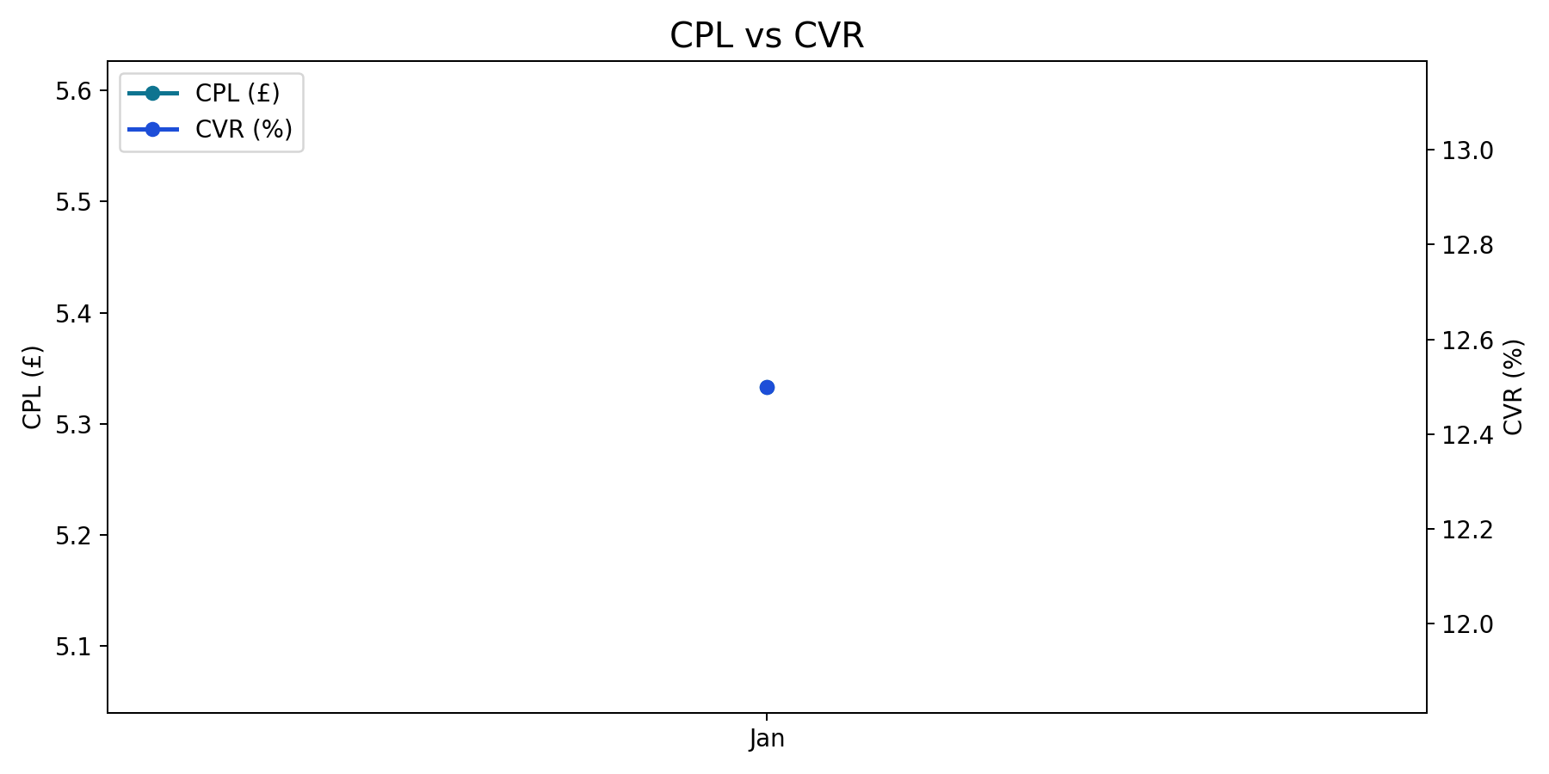
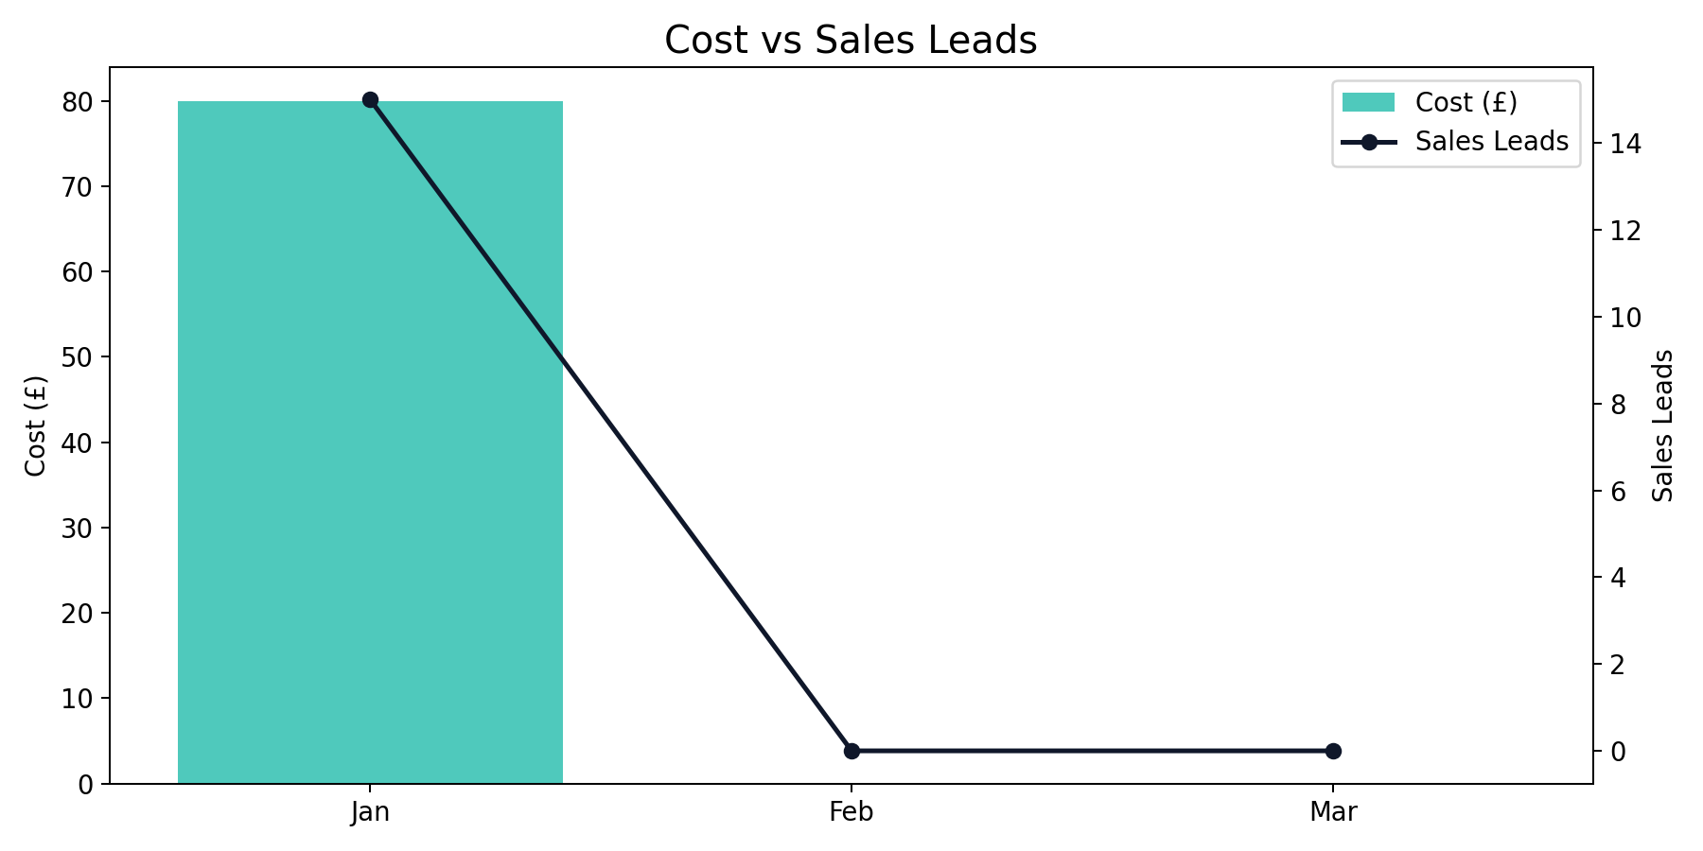
Overall Performance Trend
Q1 2025 (Jan - Mar 2025)
Jan delivered the lowest CPL of the quarter (£5.33), while Jan had the highest CVR (12.50%).
Quarter total: 15 leads from £80.00 spend at a blended CPL of £5.33.
Brand generated the highest share of leads (100.0%).

Slide 4
Overall Quarter Summary
Q1 2025 (Jan - Mar 2025)
Month | Impressions | Clicks | CTR | CPC | Cost | Sales Leads | CPL | CVR | Revenue
Jan | 1,000 | 120 | 12.00% | £0.67 | £80.00 | 15 | £5.33 | 12.50% | £2,500.00
Feb | 0 | 0 | n/a | n/a | £0.00 | 0 | n/a | n/a | £0.00
Mar | 0 | 0 | n/a | n/a | £0.00 | 0 | n/a | n/a | £0.00
Total | 1,000 | 120 | 12.00% | £0.67 | £80.00 | 15 | £5.33 | 12.50% | £2,500.00
Overall generated 15 leads from £80.00 with a quarter CPL of £5.33.
Best efficiency was in Jan (£5.33 CPL), while Jan was highest at £5.33.
YoY comparison is unavailable due to missing or zero baseline in prior year data.

Slide 5
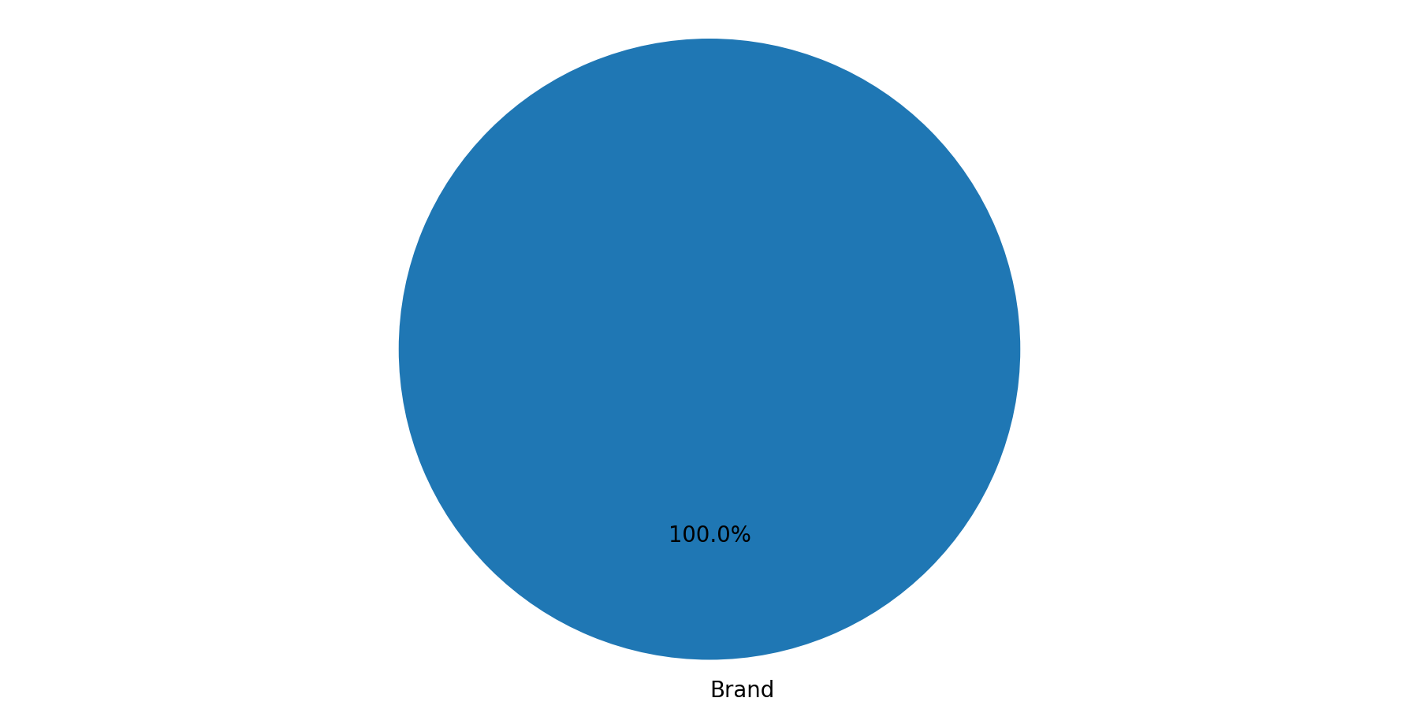
Campaign Type Mix
Q1 2025 (Jan - Mar 2025)
Brand represented the largest share of spend (100.0%).
Brand delivered the largest share of leads (100.0%).

Slide 6
Brand Summary
Q1 2025 (Jan - Mar 2025)
Month | Impressions | Clicks | CTR | CPC | Cost | Sales Leads | CPL | CVR | Revenue
Jan | 1,000 | 120 | 12.00% | £0.67 | £80.00 | 15 | £5.33 | 12.50% | £2,500.00
Feb | 0 | 0 | n/a | n/a | £0.00 | 0 | n/a | n/a | £0.00
Mar | 0 | 0 | n/a | n/a | £0.00 | 0 | n/a | n/a | £0.00
Total | 1,000 | 120 | 12.00% | £0.67 | £80.00 | 15 | £5.33 | 12.50% | £2,500.00
Brand generated 15 leads from £80.00 with a quarter CPL of £5.33.
Best efficiency was in Jan (£5.33 CPL), while Jan was highest at £5.33.
YoY comparison is unavailable due to missing or zero baseline in prior year data.

Slide 7
Brand Monthly Trend
Q1 2025 (Jan - Mar 2025)
Brand generated 15 leads from £80.00 with a quarter CPL of £5.33.
Best efficiency was in Jan (£5.33 CPL), while Jan was highest at £5.33.
YoY comparison is unavailable due to missing or zero baseline in prior year data.

Slide 8
China Summary + YoY
Q1 2025 (Jan - Mar 2025)
Month | Impressions | Clicks | CTR | CPC | Cost | Sales Leads | CPL | CVR | Revenue
Jan | 1,000 | 120 | 12.00% | £0.67 | £80.00 | 15 | £5.33 | 12.50% | £2,500.00
Feb | 0 | 0 | n/a | n/a | £0.00 | 0 | n/a | n/a | £0.00
Mar | 0 | 0 | n/a | n/a | £0.00 | 0 | n/a | n/a | £0.00
Total | 1,000 | 120 | 12.00% | £0.67 | £80.00 | 15 | £5.33 | 12.50% | £2,500.00
China generated 15 leads from £80.00 with a quarter CPL of £5.33.
Best efficiency was in Jan (£5.33 CPL), while Jan was highest at £5.33.
YoY comparison is unavailable due to missing or zero baseline in prior year data.

Slide 9
China Monthly Trend
Q1 2025 (Jan - Mar 2025)
China generated 15 leads from £80.00 with a quarter CPL of £5.33.
Best efficiency was in Jan (£5.33 CPL), while Jan was highest at £5.33.
YoY comparison is unavailable due to missing or zero baseline in prior year data.

Slide 10
China Campaign Mix
Q1 2025 (Jan - Mar 2025)
Brand represented the largest share of spend (100.0%).
Brand delivered the largest share of leads (100.0%).

Slide 11
Auction Insights

Slide 12
Brand coverage is very strong
Q1 2025 (Jan - Mar 2025)
Domain | Impression Share | Overlap Rate | Position Above Rate | Top of Page Rate | Absolute Top Rate | Outranking Share
distantjourneys.co.uk | 9.4% | 29.0% | 18.0% | 58.0% | 16.0% | 6.0%
wendywu.co.uk | 72.4% | 0.0% | 0.0% | 88.0% | 71.0% | 0.0%
travelclubelite.com | 18.6% | 42.0% | 31.0% | 67.0% | 25.0% | 12.0%
riviera.co.uk | 14.1% | 35.0% | 24.0% | 61.0% | 21.0% | 10.0%
travelclubelite.com, riviera.co.uk and distantjourneys.co.uk are the closest competitors based on overlap rate.
Our impression share is 72.40% in the latest Auction Insights export.
travelclubelite.com, riviera.co.uk and distantjourneys.co.uk are strongest on impression share among competitors in the file.
Source: Google Ads Auction Insights

Slide 13
Recommendations

Slide 14
Recommendations / Next Steps
Q1 2025 (Jan - Mar 2025)
Competitive defence: Monitor overlap from travelclubelite.com, riviera.co.uk and protect impression share on the most valuable queries.

