Slide 1
155,485
Total Purchases
Wightlink
£259,615
Financial Year Review
Total Spend
FY 2025/26 (Apr 2025 – Mar 2026)
53.31
Prepared by Summon
Full-Year ROAS
£13,839,790
Total Revenue
Wightlink | FY 2025/26 | Confidential

Slide 2

What We'll Cover Today
FY 2025/26 (Apr 2025 - Mar 2026)
1
2
Trends
Auction Insights
3
4
Testing
Performance
5
6
Next Steps
Other Updates
FY 2025/26 | Wightlink | Confidential

Slide 3
Testing
Trends
Wightlink | FY 2025/26 | Summon
Wightlink | FY 2025/26 | Summon

Slide 4
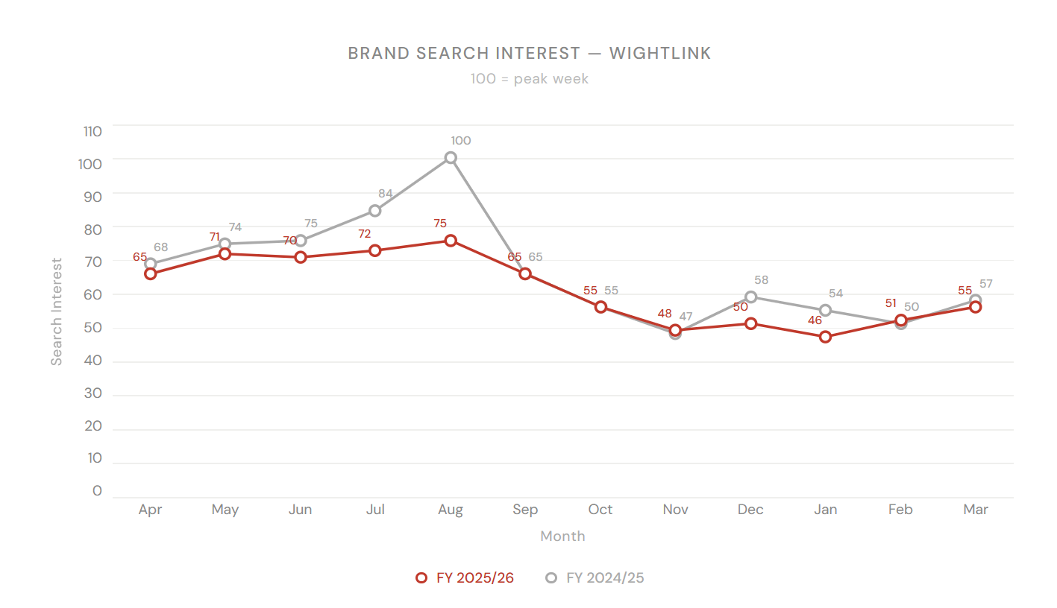
Google Trends – Isle Of Wight Ferry
Google Trends – Wightlink
FY 2025/26 (Apr 2025 - Mar 2026)
FY 2025/26 vs FY 2024/25 | Source: Google Trends (GB)
Brand search interest has followed approximately the same pattern as the previous year, with peaks in August
Search volume in early 2024 was higher than 2025, but they have become more similar as the year progressed.
Source: Google Trends
FY 2025/26 | Wightlink | Confidential
FY 2025/26 | Wightlink | Confidential

Slide 5
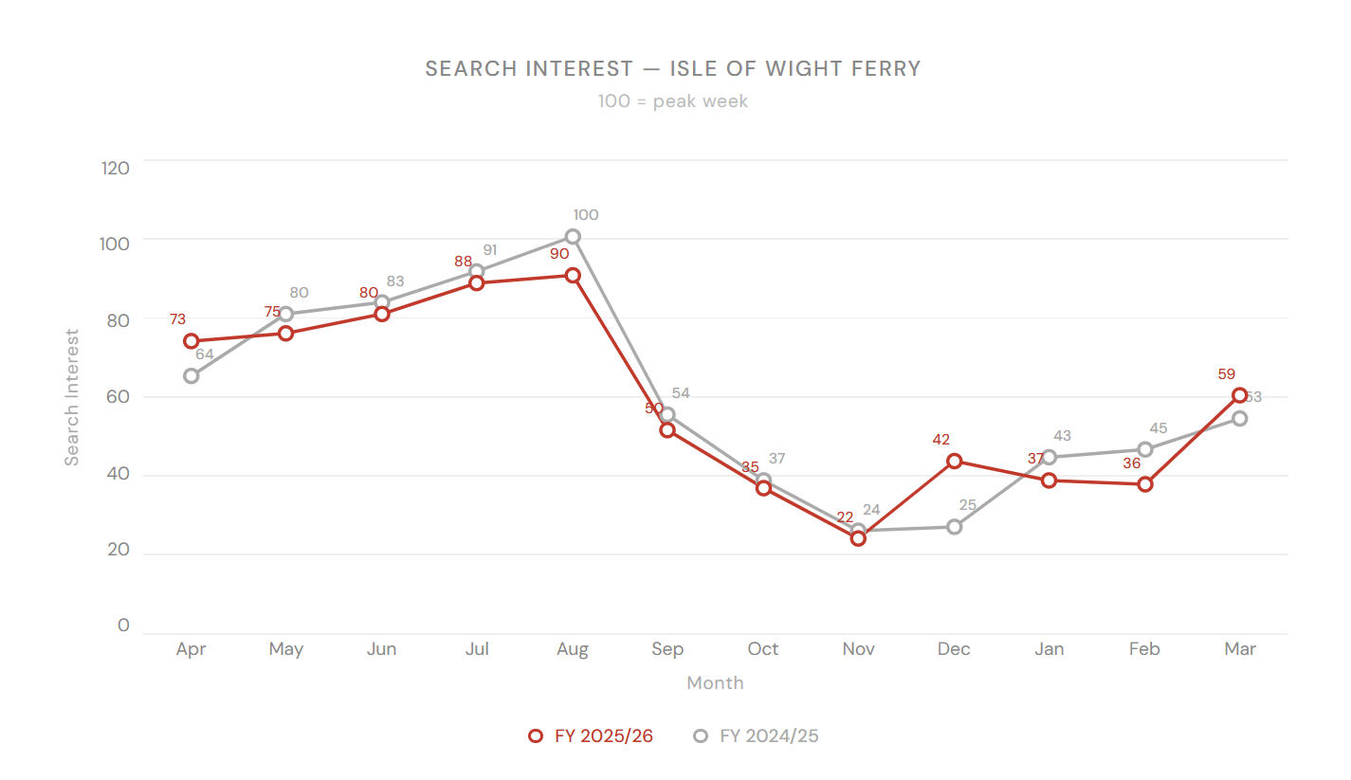
Google Trends – Isle Of Wight Ferry
Google Trends – Wightlink
Google Trends – Isle of Wight Ferry
FY 2025/26 (Apr 2025 - Mar 2026)
FY 2025/26 vs FY 2024/25 | Source: Google Trends (GB)
FY 2025/26 vs FY 2024/25 | Source: Google Trends (GB)
The same can be seen for ‘isle of wight ferry’ searches with volume the previous year being very slightly higher than early 2025, but following the same pattern throughout the year
Source: Google Trends
FY 2025/26 | Wightlink | Confidential
FY 2025/26 | Wightlink | Confidential

Slide 6
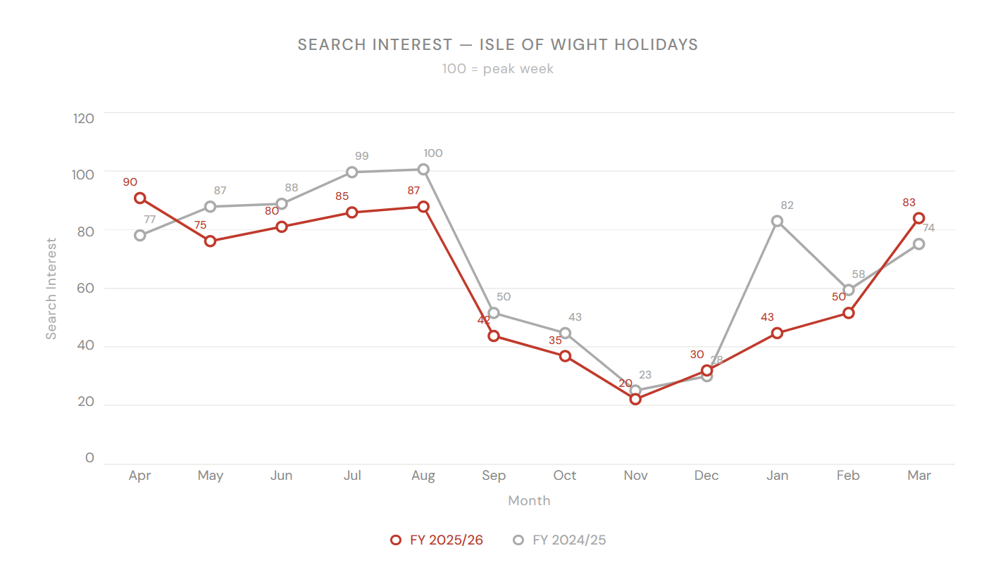
Google Trends – Isle Of Wight Ferry
Google Trends – Wightlink
Google Trends – Isle of Wight Holidays
FY 2025/26 (Apr 2025 - Mar 2026)
FY 2025/26 vs FY 2024/25 | Source: Google Trends (GB)
FY 2025/26 vs FY 2024/25 | Source: Google Trends (GB)
Considering the potential uplift in UK based holidays this year it is also interesting to look at ‘isle of wight holidays’ as a more generic term.
We can see a peak in April 2025 and then a general trend of more search volume the previous year for the majority of the other months
This switches in March 2026 when we can see search volume start to increase compared to the previous year
Source: Google Trends

Slide 7
Testing
Auction Insights
Wightlink | FY 2025/26 | Summon
Wightlink | FY 2025/26 | Summon

Slide 8
Auction Insights – Generic
FY 2025/26 (Apr 2025 - Mar 2026)
Domain | Imp. Share | Overlap | Pos. Above | Top of Page | Abs. Top | Outranking
Wightlink (You) | 38.05% | -- | -- | 89.84% | 50.62% | --
directferries.co.uk | 29.44% | 49.44% | 44.79% | 86.40% | 31.29% | 29.62%
redfunnel.co.uk | 26.48% | 44.85% | 46.40% | 87.63% | 36.68% | 30.13%
openferry.com | 14.74% | 28.60% | 34.94% | 73.94% | 21.38% | 34.24%
awayresorts.co.uk | < 10% | 14.67% | 22.40% | 56.88% | 16.36% | 36.80%
booking.com | < 10% | 2.45% | 59.40% | 74.84% | 29.64% | 37.49%
parkdeanresorts.co.uk | < 10% | 4.78% | 42.45% | 71.43% | 40.40% | 37.27%
Wightlink leads on impression share at 38.05%. Our 89.84% top-of-page rate and 50.62% abs. top-of-page rate are strong across all campaign types.
directferries.co.uk and redfunnel.co.uk each appear in around 45–49% of our auctions. Despite this, our position above rate is competitive
openferry.com has established a foothold at 14.74% impression share with 28.6% overlap, they are emerging as a third direct ferry competitor worth tracking into FY 2026/27.
booking.com, awayresorts.co.uk, and parkdeanresorts.co.uk all remain below 10% impression share, they are present but represent limited competitive pressure at a campaign-wide level.
FY 2025/26 | Wightlink | Confidential

Slide 9
Competitive Landscape – Red Funnel YoY
FY 2024/25 vs FY 2025/26
Red Funnel's overlap increased +12.8pp to 44.85% in FY 2025/26 - they are entering far more of our generic auctions, though quality metrics are weakening.
Metric | FY 2024/25 | FY 2025/26 | Change | What it means
Impression Share | 24.25% | 26.48% | +2.2pp | Modest increase
Overlap Rate | 32.04% | 44.85% | +12.8pp | Present in nearly 45% of our generic auctions
Position Above Rate | 49.30% | 46.40% | -2.9pp | We beat them on position slightly more often
Top of Page Rate | 90.02% | 87.63% | -2.4pp | Appearing at top slightly less
Abs. Top of Page Rate | 40.48% | 36.68% | -3.8pp | Fewer absolute #1 positions on generic terms
Outranking Share | 38.34% | 30.13% | -8.2pp | We outrank them significantly more than a year ago
Wightlink (Generic):
Imp. share FY25: 45.53% → FY26: 38.05% (-7.5pp) | Top of page: 93.27% → 89.84% | Abs. top: 56.80% → 50.62%
Red Funnel's generic overlap increased +12.8pp suggesting increased investment. Despite the growing overlap, their quality metrics are falling: Abs. Top Rate -3.8pp, and our outranking share improved -8.2pp. Higher spend is not translating into better positions.
Importantly our outranking share increased YoY
FY 2025/26 | Wightlink | Confidential

Slide 10



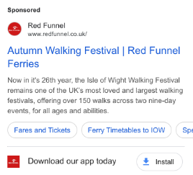


Competitive Landscape – Red Funnel Ad Creatives
Recent ad creatives from RF appear to be focussing on camping offers, things to do and promoting events and attractions on the island.
This TOF / MOF focus does not directly compete with our approach - it also seems like an inefficient use of budget considering they are not maximising their IS on more high intent searches.
FY 2025/26 | Wightlink | Confidential

Slide 11
Testing
Performance
Wightlink | FY 2025/26 | Summon
Wightlink | FY 2025/26 | Summon
Wightlink | FY 2025/26 | Confidential

Slide 12
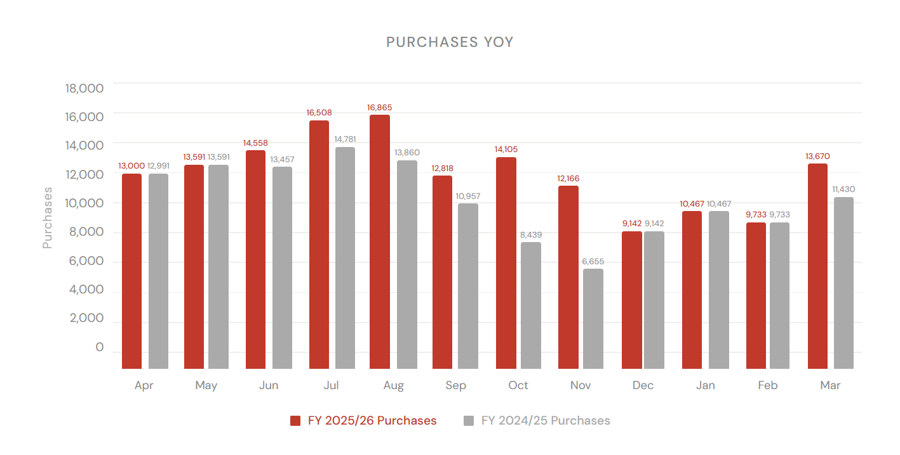
All Performance
FY 2025/26 (Apr 2025 - Mar 2026)
Cost
Purchases
Purchase Revenue
CPA
ROAS
AOV
£259,615
155,485
£13,839,790
£1.67
53.31
£89.01
YoY: +10.7%
YoY: +8.7%
YoY: +12.0%
YoY: +1.8%
YoY: +1.2%
YoY: +3.0%
Plan: -4.4%
Plan: +20.4%
Plan: +4.4%
Plan: -20.6%
Plan: +9.2%
Plan: -13.3%
Purchases and purchase revenue have both increased YoY when compared to previous year and when compared to our 2025/26 plan.
CPA has seen slight increase, but is under our planned prediction. This is a real success considering the increase in spend.
Cost has increased YoY, but has come in slightly under the plan and the increase in revenue has outpaced the increase in spend
Increases in AOV, combined with a shifting budget allocation strategy, have contributed to overall improvements in ROAS YoY. The biggest change of strategy contributing to these results has been putting more emphasis on our Generic campaigns, with brand investment and bids lowered.
FY 2025/26 | Wightlink | Confidential

Slide 13
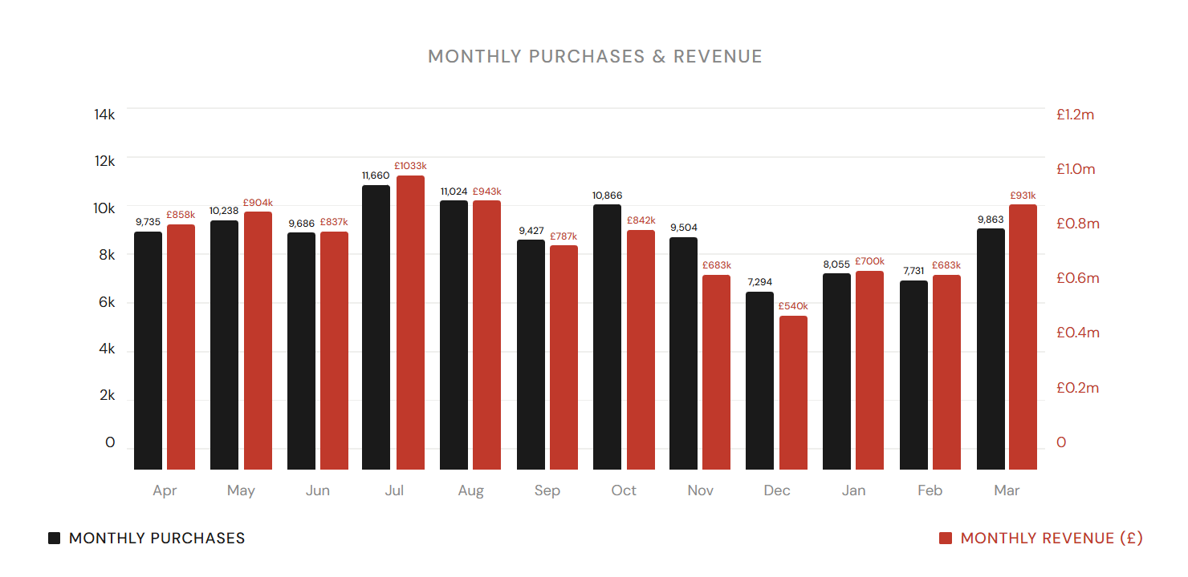
Brand Performance
FY 2025/26 (Apr 2025 - Mar 2026)
Cost
Purchases
Purchase Revenue
CPA
ROAS
AOV
£86,943
115,084
£9,743,002
£0.76
112.06
£84.66
YoY: -23.2%
YoY: +2.8%
YoY: +7.9%
YoY: -25.2%
YoY: +40.4%
YoY: +5.0%
Brand performance has seen really positive improvements in efficiency over the last year.
Our strategy changed significantly here - more emphasis has been placed on our Generic campaigns, with brand investment and bids lowered.
Brand spend has decreased as a result of this strategy, but we have still seen increases in purchases and revenue and of 25% lower CPAs.
FY 2025/26 | Wightlink | Confidential

Slide 14
Brand Monthly Breakdown
FY 2025/26 (Apr 2025 - Mar 2026)
Month | Cost | Purchases | CPA | Purchase Revenue | ROAS | CVR
April | £15,756.08 | 9,735 | £1.62 | £858,258.30 | 54.47 | 13.60%
May | £10,947.90 | 10,238 | £1.07 | £903,987.83 | 82.57 | 14.08%
June | £9,505.12 | 9,686 | £0.98 | £837,312.70 | 88.09 | 13.93%
July | £9,830.32 | 11,660 | £0.84 | £1,033,139.33 | 105.10 | 14.86%
August | £12,505.26 | 11,024 | £1.13 | £943,248.49 | 75.43 | 13.14%
September | £7,693.35 | 9,427 | £0.82 | £787,495.03 | 102.36 | 15.18%
October | £3,263.64 | 10,866 | £0.30 | £841,873.15 | 257.96 | 19.63%
November | £2,890.67 | 9,504 | £0.30 | £683,114.75 | 236.32 | 22.45%
December | £2,403.56 | 7,294 | £0.33 | £540,493.08 | 224.87 | 16.07%
January | £2,774.47 | 8,055 | £0.34 | £700,297.56 | 252.41 | 16.38%
February | £2,712.20 | 7,731 | £0.35 | £682,664.14 | 251.70 | 15.93%
March | £6,660.07 | 9,863 | £0.68 | £931,117.64 | 139.81 | 14.54%
Total | £86,942.64 | 115,084 | £0.76 | £9,743,001.99 | 112.06 | 15.41%
July was the strongest month for purchase volume. | October was the most efficient month on CPA. | November recorded the strongest CVR.
FY 2025/26 | Wightlink | Confidential

Slide 15
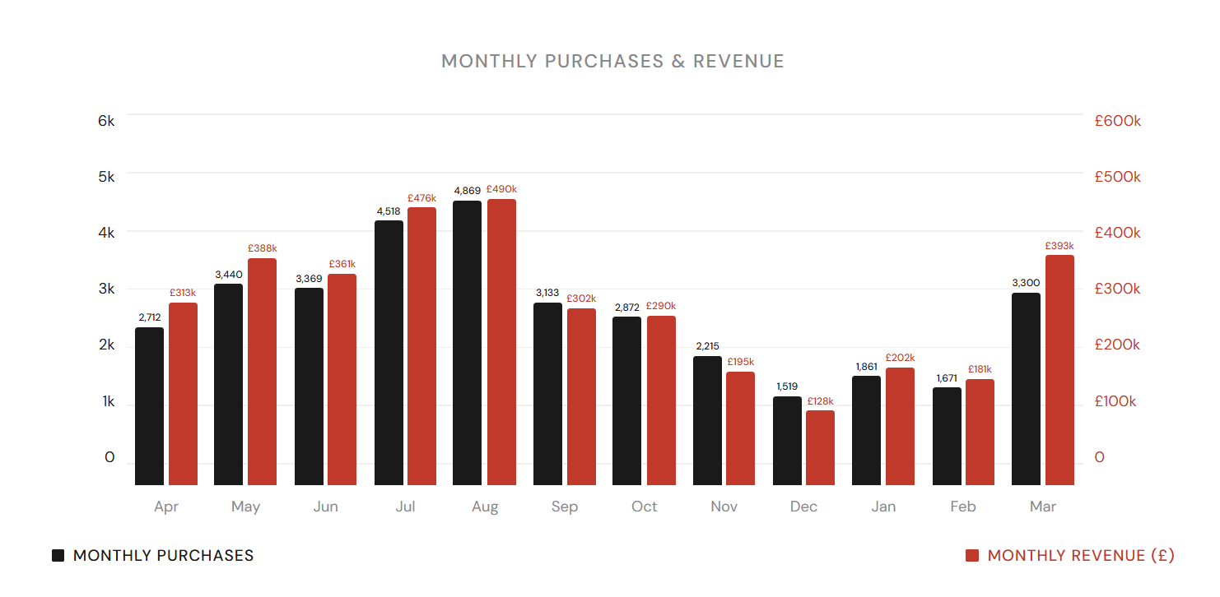
Generics Performance
FY 2025/26 (Apr 2025 - Mar 2026)
Cost
Purchases
Purchase Revenue
CPA
ROAS
AOV
£149,847
35,479
£3,716,979
£4.22
24.81
£104.77
YoY: +35.8%
YoY: +28.6%
YoY: +21.9%
YoY: +5.6%
YoY: -10.2%
YoY: -5.2%
Revenue has increased 22% - in absolute terms this is a £668k increase YoY
Generic campaigns have had more investment over the last year with 35% more spend.
This has resulted in the corresponding higher purchase and revenue figures above
Despite increased spend, CPA has held fairly steady with only a small increase YoY.
Gains in Generic revenue have been achieved while also Brand revenue growth.
FY 2025/26 | Wightlink | Confidential

Slide 16
Generics Monthly Breakdown
FY 2025/26 (Apr 2025 - Mar 2026)
Month | Cost | Purchases | CPA | Purchase Revenue | ROAS | CVR
April | £11,028.65 | 2,712 | £4.07 | £312,625.89 | 28.35 | 6.83%
May | £15,633.19 | 3,440 | £4.54 | £387,710.49 | 24.80 | 6.73%
June | £13,941.47 | 3,369 | £4.14 | £361,330.30 | 25.92 | 6.17%
July | £24,865.13 | 4,518 | £5.50 | £475,715.19 | 19.13 | 6.13%
August | £22,469.99 | 4,869 | £4.62 | £489,608.14 | 21.79 | 6.00%
September | £13,355.29 | 3,133 | £4.26 | £302,310.26 | 22.64 | 6.61%
October | £8,071.01 | 2,872 | £2.81 | £289,732.87 | 35.90 | 8.21%
November | £5,997.04 | 2,215 | £2.71 | £194,988.93 | 32.51 | 9.63%
December | £5,146.62 | 1,519 | £3.39 | £127,850.58 | 24.84 | 7.81%
January | £6,866.11 | 1,861 | £3.69 | £201,575.37 | 29.36 | 6.46%
February | £6,806.00 | 1,671 | £4.07 | £180,929.17 | 26.58 | 6.52%
March | £15,666.11 | 3,300 | £4.75 | £392,601.89 | 25.06 | 5.95%
Total | £149,846.59 | 35,479 | £4.22 | £3,716,979.08 | 24.81 | 6.63%
August was the strongest month for purchase volume. | November was the most efficient month on CPA. | November recorded the strongest CVR.
FY 2025/26 | Wightlink | Confidential

Slide 17
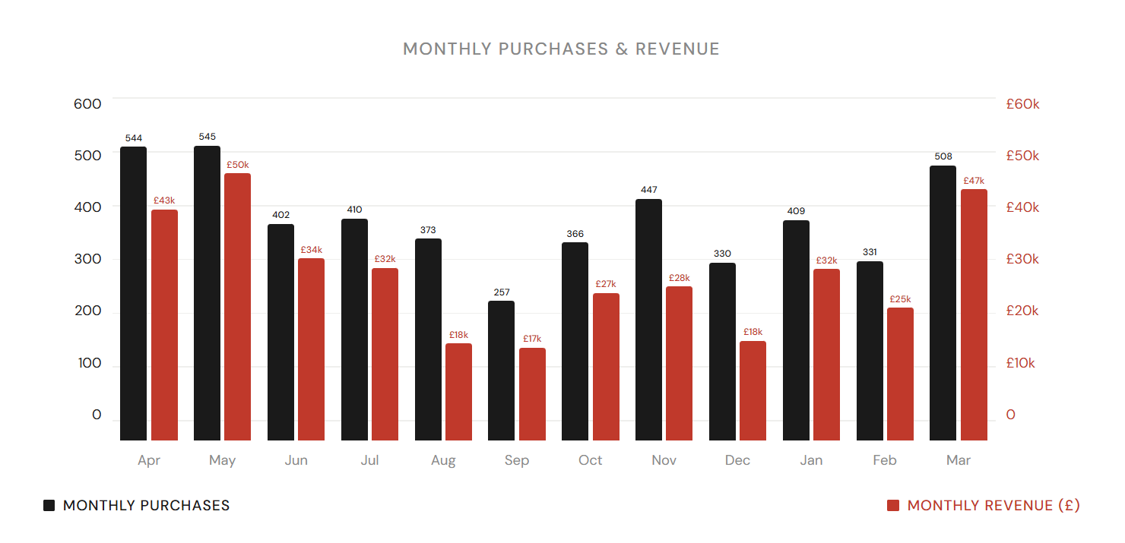
PMax Performance
FY 2025/26 (Apr 2025 - Mar 2026)
Cost
Purchases
Purchase Revenue
CPA
ROAS
AOV
£22,825
4,922
£379,808
£4.64
16.64
£77.17
YoY: +106.3%
YoY: +40.9%
YoY: +34.4%
YoY: +46.4%
YoY: -34.9%
YoY: -4.7%
Performance Max investment has increased in the last year.
The CPA and ROAS increases are a result of changes in PMax strategy and how it is being used.
We now use PMax as a discovery engine with our highest intent searches are being funneled through our Genric search campaigns.
This strategy, combined with the fact that PMax also covers display, means that CPAs are always likely to be higher than generics.
FY 2025/26 | Wightlink | Confidential

Slide 18
PMax Performance Summary
FY 2025/26 (Apr 2025 - Mar 2026)
Month | Cost | Purchases | CPA | Purchase Revenue | ROAS | CVR
April | £2,176.50 | 544 | £4.00 | £42,681.55 | 19.61 | 5.12%
May | £3,199.89 | 545 | £5.88 | £49,500.99 | 15.47 | 4.26%
June | £1,608.59 | 402 | £4.00 | £33,599.85 | 20.89 | 4.12%
July | £1,836.34 | 410 | £4.48 | £31,891.22 | 17.37 | 3.71%
August | £2,359.42 | 373 | £6.33 | £27,188.78 | 11.52 | 2.88%
September | £1,474.44 | 257 | £5.74 | £17,866.61 | 12.12 | 3.61%
October | £1,068.22 | 366 | £2.92 | £27,325.14 | 25.58 | 6.54%
November | £1,658.25 | 447 | £3.71 | £28,412.98 | 17.13 | 9.20%
December | £1,821.85 | 330 | £5.53 | £18,443.36 | 10.12 | 6.19%
January | £1,671.00 | 409 | £4.08 | £31,769.23 | 19.01 | 7.42%
February | £1,523.82 | 331 | £4.60 | £24,628.29 | 16.16 | 5.94%
March | £2,427.09 | 508 | £4.77 | £46,500.45 | 19.16 | 6.57%
Total | £22,825.41 | 4,922 | £4.64 | £379,808.46 | 16.64 | 4.98%
May was the strongest month for purchase volume. | October was the most efficient month on CPA. | November recorded the strongest CVR.
FY 2025/26 | Wightlink | Confidential

Slide 19
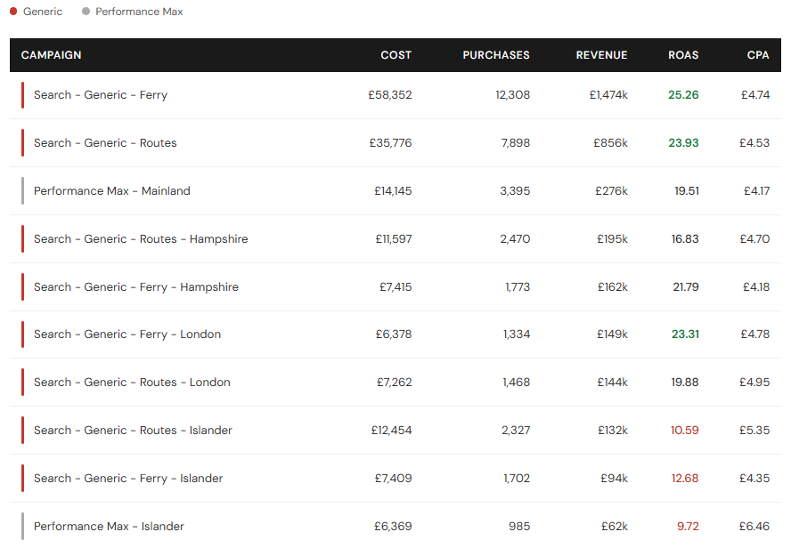
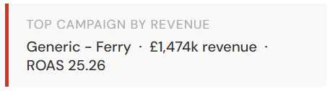
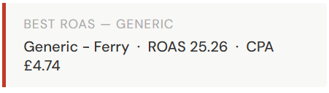
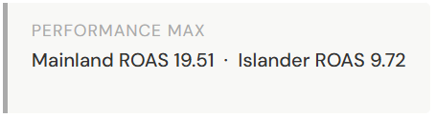
Top Performing Campaigns excl. Brand
FY 2025/26 (Apr 2025 – Mar 2026) | Ranked by Purchase Revenue
Ferry & Routes location campaigns have now been consolidated.
PMax Islander is our lowest performer in terms of ROAS & CPA - this could be a consideration to decreasing budgets or reallocate spend to more efficient campaigns
FY 2025/26 | Wightlink | Confidential

Slide 20
Testing
Testing
Wightlink | FY 2025/26 | Summon
Wightlink | FY 2025/26 | Summon
Wightlink | FY 2025/26 | Confidential

Slide 21
Homepage A/B Test Results
26 March – 28 April 2026 (33 days)
Variant A - no price
Variant B - price led
✓ VARIANT B WINS
wightlink.co.uk/?variant=a
wightlink.co.uk/?variant=b
Statistically significant at 99% confidence
Metric
Variant A
Variant B
B vs A
Note
Clicks
16,790
9,540
-43.2%
Smaller share of budget
Impressions
60,169
39,310
-34.7%
Proportional to spend
CTR
27.90%
24.27%
-13.0%
Ad identical - landing page effect
Cost
£4,050
£2,423
-40.2%
B received less budget
CVR
9.17%
11.11%
+21.2%
Significant at 99%
Conversions
1,539
1,060
-31.1%
Lower due to budget split
Revenue
£205,341
£134,949
-34.3%
Normalised by ROAS below
ROAS
50.70
55.70
+9.9%
B delivers more per £ spent
CPA
£2.63
£2.29
-12.9%
B is cheaper to convert
Recommendation:
Implement Variant B as the permanent homepage. CVR improvement of +21.2% is statistically significant at 99% confidence. At equivalent spend levels, B would deliver an estimated +9.9% improvement in ROAS over the control.
FY 2025/26 | Wightlink | Confidential

Slide 22
Microsoft Ads – Performance Max Test
Mid-February 2026 – 28 April 2026 | New Channel Test | No prior year comparison
NEW CHANNEL TEST
2 Performance Max campaigns launched on Microsoft Ads mid-February 2026. 2.5 months of data.
Total Spend
Conversions
Revenue
ROAS
CPA
Avg. CPC
£489
439
£42,820
87.63
£1.11
£0.33
+ 415 view-through
Strong early signal
vs £4.64 Google PMax
Campaign | Status | Clicks | Impressions | Conv. | View-through | Revenue | ROAS | CPA
Performance Max - Mainland | Active | 1,346 | 41,924 | 387 | 215 | £39,276 | 90.81 | £1.12
Performance Max - Islander | Active | 149 | 7,875 | 52 | 200 | £3,544 | 63.17 | £1.08
Total | — | 1,495 | 49,799 | 439 | 415 | £42,820 | 87.63 | £1.11
Early results are highly encouraging - ROAS of 87.63 significantly outperforms Google PMax (16.64) and Generic Search (24.81) over the same period.
View-through conversions (415) are almost equal to direct conversions (439), suggesting strong brand visibility and assisted attribution not captured in the direct conversion figure alone.
Next steps here are to fully analyse search terms coming through PMax and align negative keyword strategy with Google Ads. We have £500 spend to go before 20th May to reach our threshold to get £1000 promotional credit, so increasing investment here for the next few week would be recommended.
FY 2025/26 | Wightlink | Confidential

Slide 23
Next Steps
Testing
Next Steps
Wightlink | FY 2025/26 | Summon
Wightlink | FY 2025/26 | Summon
Wightlink | FY 2025/26 | Summon
Wightlink | FY 2025/26 | Confidential

Slide 24
Next Steps
Ad copy testing
GTM audit and tracking
Ad copy testing will be carried out across campaigns. New ad copy will incorporate messaging from other marketing channels including the TV ads to ensure consistent brand tone of voice across channels. Unpinning headline tests will be continued
Initial changes to GTM and tracking have had positive results. After conversations with Google reps there are some more things to work on such as ensuring enhanced conversion are set up properly in both Google Ads and GA4
Events / Festivals
Target ROAS testing
Create a new campaign that can be used to promote ferry travel to specific events on the Island - especially IOW Festival, Walk The Wight and Cowes week and any other events you suggest promoting.
There is potential to test target ROAS bidding once we are confident that all tracking and measurement is as accurate as it can be. Target CPA bidding has worked very well for this account, so this would be a limited test to see if any bidding efficiencies could be made.
FY 2025/26 | Wightlink | Confidential

Slide 25
Next Steps
Testing
Other Updates
Wightlink | FY 2025/26 | Summon
Wightlink | FY 2025/26 | Summon
Wightlink | FY 2025/26 | Summon
Wightlink | FY 2025/26 | Confidential

Slide 26
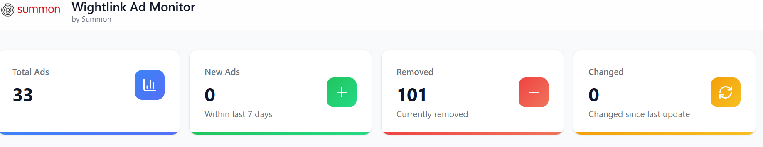
China AI Max 80% Test
Ad Monitor Now Live
Tracking competitor changes in real time
In a fast moving competitor landscape, we wanted to provide an easy solution to monitor competitor offers
So we created the Ad Monitor tool
The platform can include separate views for:
Live prices / offers
Marketing offers
Notification
This is used by us internally. but we hope it will also prove a useful resources for the business too https://ad-transparency-hub.vercel.app/
Q1 2026 | Summon Digital | Confidential

Slide 27
Next Steps
Testing
Thank you!
Wightlink | FY 2025/26 | Summon
Wightlink | FY 2025/26 | Summon
Wightlink | FY 2025/26 | Summon
Wightlink | FY 2025/26 | Confidential

