Slide 1
Wightlink QBR
Q1 2026 (Jan - Mar 2026)
Wightlink

Slide 2
What We'll Cover Today
Q1 2026 (Jan - Mar 2026)
Trends
Auction Insights
Performance
Audience Insights
Competitor Analysis
Opportunities
SEO

Slide 3
Trends

Slide 4
Google Trends - Isle Of Wight Ferry
Q1 2026 (Jan - Mar 2026)
No Google Trends CSV was supplied for this report.
Upload one or more Google Trends exports to populate the trend chart and narrative.

Slide 5
Auction Insights - Generic
Q1 2026 (Jan - Mar 2026)
Display URL domain | Impression share | Overlap rate | Position above rate | Top of page rate | Abs. Top of page rate | Outranking share
ferrysavers.co.uk | 12.99% | 24.22% | 29.01% | 88.84% | 11.94% | 34.58%
booking.com | 10.00% | 1.71% | 62.28% | 85.08% | 35.00% | 36.80%
parkdeanresorts.co.uk | 10.00% | 3.49% | 56.19% | 88.00% | 41.86% | 36.47%
You | 37.20% | -- | -- | 94.72% | 40.11% | --
redfunnel.co.uk | 24.49% | 45.34% | 66.58% | 95.64% | 43.09% | 25.97%
directferries.co.uk | 24.77% | 40.55% | 45.61% | 94.97% | 28.69% | 30.32%
We saw 5 competitors in the supplied auction data.
redfunnel.co.uk was one of the strongest overlapping competitors at 45%, with abs. top-of-page pressure at 43%.
directferries.co.uk was one of the strongest overlapping competitors at 41%, with abs. top-of-page pressure at 29%.
Average top-of-page pressure across competitors was 91% in the supplied file.
Source: Google Ads Auction Insights

Slide 6
Auction Insights - Brand
Q1 2026 (Jan - Mar 2026)
Display URL domain | Impression share | Overlap rate | Position above rate | Top of page rate | Abs. Top of page rate | Outranking share
You | 80.06% | -- | -- | 91.08% | 74.04% | --
redfunnel.co.uk | 35.74% | 42.52% | 26.97% | 84.11% | 25.42% | 70.88%
awayresorts.co.uk | 12.68% | 15.36% | 13.38% | 62.10% | 12.60% | 78.41%
adamvacations.com | < 10% | 11.67% | 11.55% | 42.10% | 9.31% | 78.98%
directferries.co.uk | < 10% | 11.56% | 15.59% | 72.42% | 13.05% | 78.61%
Throughout the quarter we saw 4 main competitors in the market.
Red Funnel were overlapping us 43% of the time, claiming the top spot 25% of the time.
Comparing YoY, Red Funnel had an increased presence versus the reference period.
Source: Google Ads Auction Insights

Slide 7
Performance

Slide 8
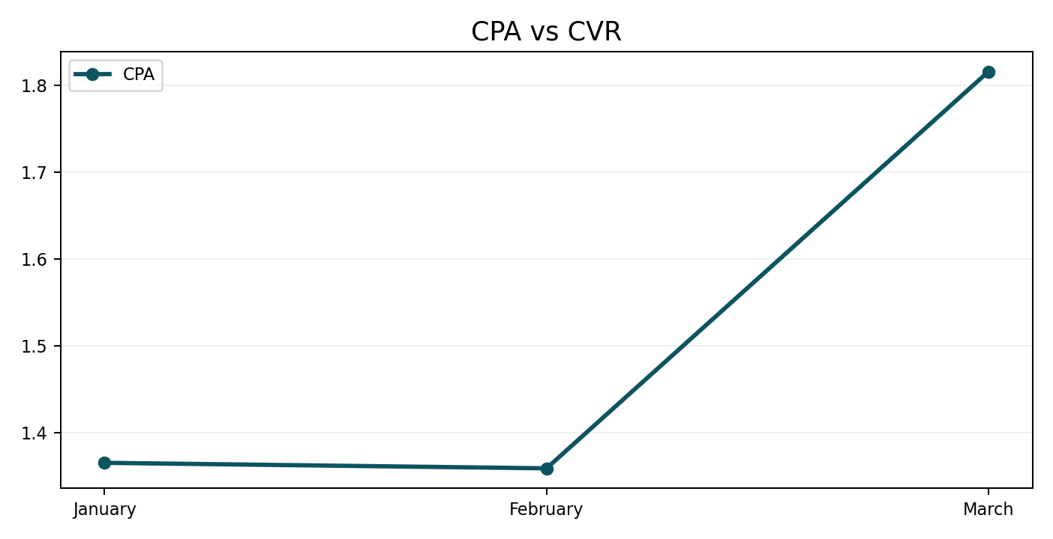
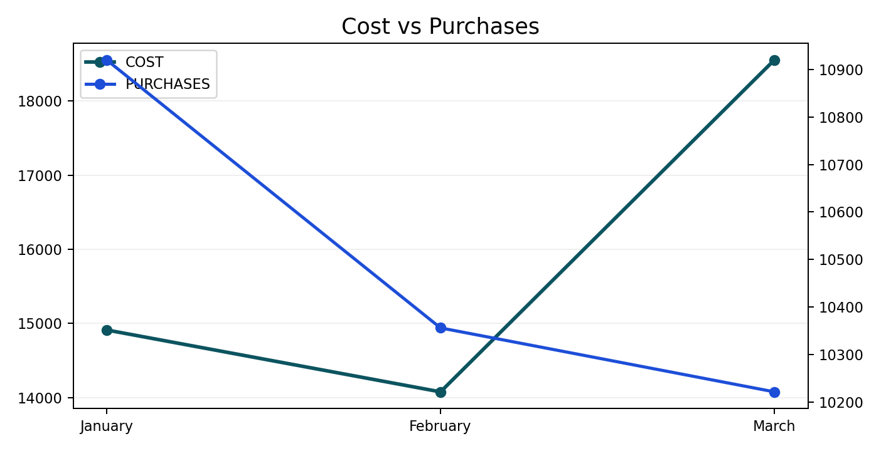
All Performance
Q1 2026 (Jan - Mar 2026)
January was the strongest month for purchase volume.
February was the most efficient month on CPA.
CVR could not be calculated from the uploaded CSV because click data was not supplied.
Quarter ROAS closed at 60.61 on £47,544 spend.
Source: Uploaded performance CSV

Slide 9
All Performance YoY
Q1 2026 (Jan - Mar 2026)
Metric | Current | Prior year | YoY change
Purchases | 31,498 | 25,506 | +23.5%
Revenue | £2,881,519.98 | £2,207,172.42 | +30.6%
Cost | £47,544.04 | £42,141.92 | +12.8%
CPA | £1.51 | £1.65 | -8.6%
ROAS | 60.61 | 52.37 | +15.7%
CVR | -- | -- | --
Purchases were up 23% versus the same quarter last year.
Revenue was up 31% versus the same quarter last year.
Cost was up 13% versus the same quarter last year.
CPA was down 9% versus the same quarter last year.

Slide 10
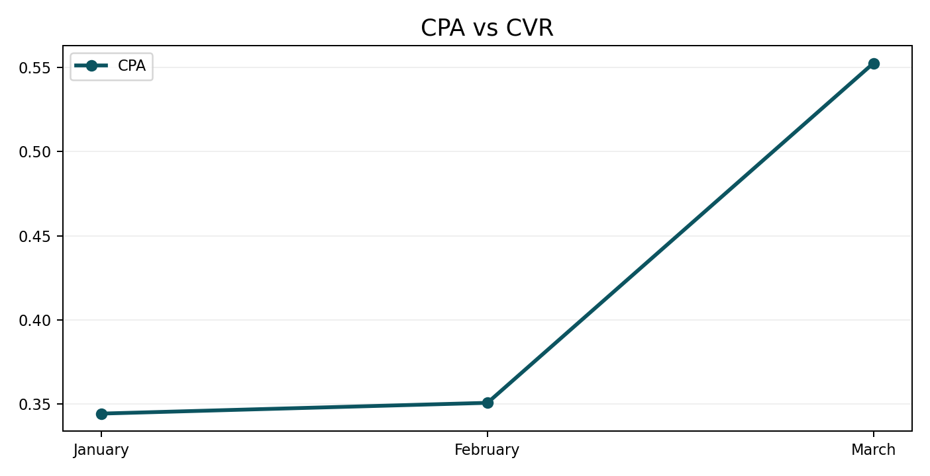
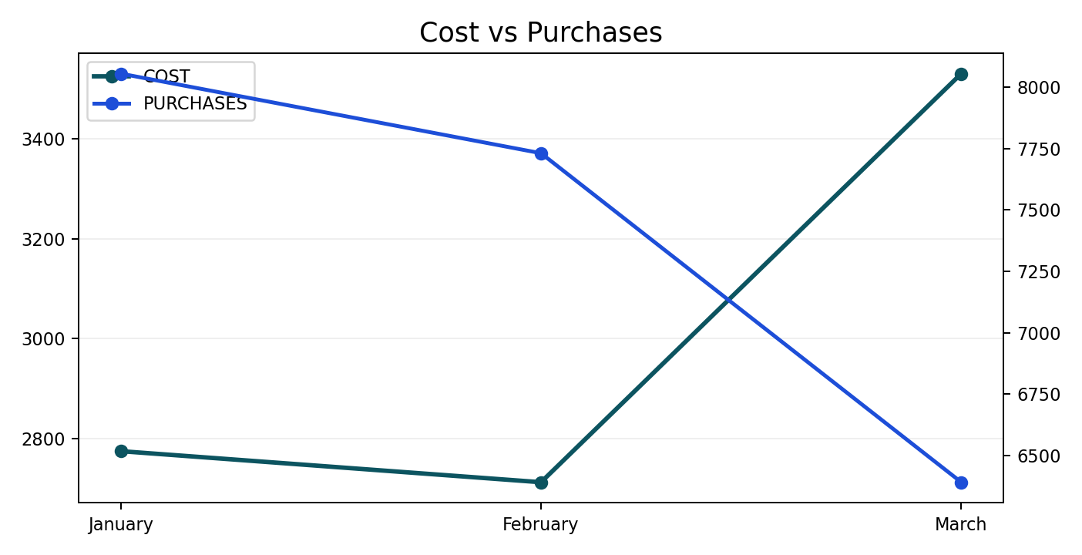
Brand Performance
Q1 2026 (Jan - Mar 2026)
January was the strongest month for purchase volume.
January was the most efficient month on CPA.
CVR could not be calculated from the uploaded CSV because click data was not supplied.
Quarter ROAS closed at 220.03 on £9,018 spend.
Quarter CPA was 65% lower than the same quarter last year.

Slide 11
Brand Performance Summary
Q1 2026 (Jan - Mar 2026)
Month | Impressions | Clicks | CTR | CPC | Cost | Purchases | CPA | Purchase Revenue | ROAS | CVR
January | -- | -- | -- | -- | £2,774.47 | 8,055 | £0.34 | £700,297.56 | 252.41 | --
February | -- | -- | -- | -- | £2,712.20 | 7,731 | £0.35 | £682,664.14 | 251.70 | --
March | -- | -- | -- | -- | £3,531.06 | 6,391 | £0.55 | £601,186.41 | 170.26 | --
Total | -- | -- | -- | -- | £9,017.73 | 22,177 | £0.41 | £1,984,148.11 | 220.03 | --
January was the strongest month for purchase volume.
January was the most efficient month on CPA.
CVR could not be calculated from the uploaded CSV because click data was not supplied.
Quarter ROAS closed at 220.03 on £9,018 spend.
Quarter CPA was 65% lower than the same quarter last year.

Slide 12
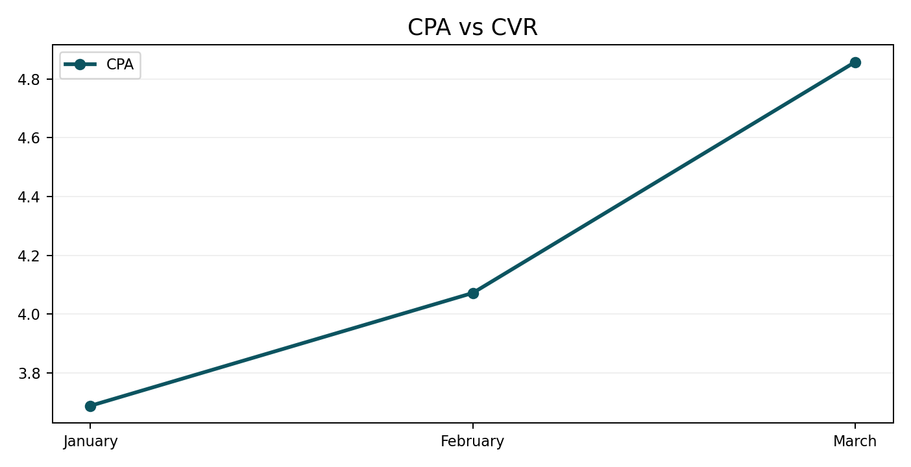
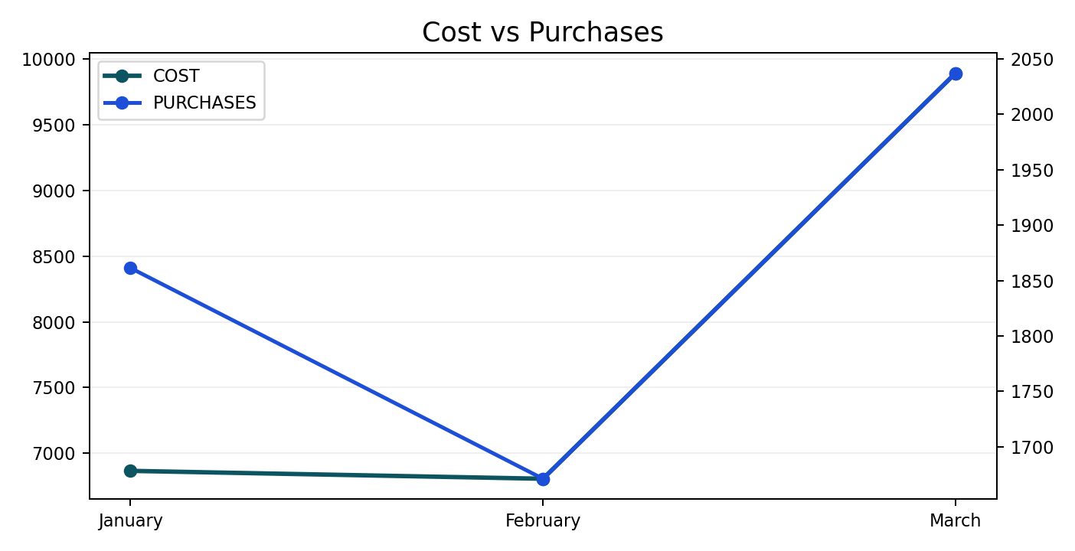
Generics Performance
Q1 2026 (Jan - Mar 2026)
March was the strongest month for purchase volume.
January was the most efficient month on CPA.
CVR could not be calculated from the uploaded CSV because click data was not supplied.
Quarter ROAS closed at 26.42 on £23,567 spend.
Quarter CPA was 18% lower than the same quarter last year.

Slide 13
Generics Performance Summary
Q1 2026 (Jan - Mar 2026)
Month | Impressions | Clicks | CTR | CPC | Cost | Purchases | CPA | Purchase Revenue | ROAS | CVR
January | -- | -- | -- | -- | £6,866.11 | 1,861 | £3.69 | £201,575.37 | 29.36 | --
February | -- | -- | -- | -- | £6,806.00 | 1,671 | £4.07 | £180,929.17 | 26.58 | --
March | -- | -- | -- | -- | £9,894.71 | 2,037 | £4.86 | £240,207.82 | 24.28 | --
Total | -- | -- | -- | -- | £23,566.81 | 5,570 | £4.23 | £622,712.36 | 26.42 | --
March was the strongest month for purchase volume.
January was the most efficient month on CPA.
CVR could not be calculated from the uploaded CSV because click data was not supplied.
Quarter ROAS closed at 26.42 on £23,567 spend.
Quarter CPA was 18% lower than the same quarter last year.

Slide 14
Tests

Slide 15
PMax Performance
Q1 2026 (Jan - Mar 2026)
Month | Impressions | Clicks | CTR | CPC | Cost | Purchases | CPA | Purchase Revenue | ROAS | CVR
January | -- | -- | -- | -- | £1,671.00 | 409 | £4.08 | £31,769.23 | 19.01 | --
February | -- | -- | -- | -- | £1,523.82 | 331 | £4.60 | £24,628.29 | 16.16 | --
March | -- | -- | -- | -- | £1,845.35 | 328 | £5.62 | £29,499.14 | 15.99 | --
Total | -- | -- | -- | -- | £5,040.16 | 1,069 | £4.72 | £85,896.66 | 17.04 | --
January was the strongest month for purchase volume.
January was the most efficient month on CPA.
CVR could not be calculated from the uploaded CSV because click data was not supplied.
Quarter ROAS closed at 17.04 on £5,040 spend.
Performance Max should be read alongside generic activity because the source CSV is aggregated at campaign type level.

Slide 16
Audience Insights - Generics Location Targeting (Q3 2025 Google only)
Q1 2026 (Jan - Mar 2026)
County (Matched) | Impr. | Clicks | CTR | CPC | Cost | Conversions | CPA | CVR
Hampshire | 183,102 | 42,382 | 23.15% | £0.28 | £11,815.56 | 6,109 | £1.93 | 14.41%
Greater London | 197,766 | 34,271 | 17.33% | £0.31 | £10,716.38 | 4,806 | £2.23 | 14.02%
Isle of Wight | 79,349 | 16,790 | 21.16% | £0.45 | £7,512.68 | 3,082 | £2.44 | 18.35%
West Sussex | 38,257 | 10,519 | 27.50% | £0.27 | £2,868.07 | 1,462 | £1.96 | 13.90%
Surrey | 32,705 | 7,543 | 23.06% | £0.31 | £2,306.64 | 1,105 | £2.09 | 14.64%
As you would expect the majority of our traffic comes from the South of England, and our investment mirrors that.
The Isle of Wight has the highest CVR, which is consistent with the reference deck.
Source: Reference deck / manual input

Slide 17
Audience Insights - Generics Device Performance (Q3 2025 Google only)
Q1 2026 (Jan - Mar 2026)
Device | Impr. | Clicks | CTR | Avg. CPC | Cost | Conversions | CPA | CVR | Search impr. share
Mobile phones | 731,128 | 150,483 | 20.58% | £0.25 | £38,142.36 | 18,404 | £2.07 | 12.23% | 58.55%
Computers | 182,096 | 31,697 | 17.41% | £0.50 | £15,828.35 | 7,720 | £2.05 | 24.36% | 56.23%
Tablets | 26,557 | 5,437 | 20.47% | £0.28 | £1,518.94 | 641 | £2.37 | 11.79% | 51.92%
The majority of impressions and clicks are from mobile, and investment continues to follow that demand.
Desktop had the strongest CVR and a similar CPA to the other devices, so it remained an efficient source of conversion volume.
Source: Reference deck / manual input

Slide 18
Audience Insights - Brand Location Targeting (Q3 2025 Google only)
Q1 2026 (Jan - Mar 2026)
County (Matched) | Impr. | Clicks | CTR | CPC | Cost | Conversions | CPA | CVR
Isle of Wight | 98,611 | 53,797 | 54.55% | £0.12 | £6,367.53 | 13,790 | £0.46 | 25.63%
Hampshire | 59,499 | 31,968 | 53.73% | £0.11 | £3,385.37 | 5,906 | £0.57 | 18.47%
Greater London | 55,381 | 28,361 | 51.21% | £0.11 | £3,012.38 | 5,743 | £0.52 | 20.25%
West Sussex | 12,537 | 7,144 | 56.98% | £0.10 | £728.09 | 1,311 | £0.56 | 18.34%
Surrey | 10,609 | 6,015 | 56.70% | £0.11 | £661.48 | 1,259 | £0.53 | 20.93%
Brand location splits broadly mirror the generics footprint.
The Isle of Wight remained the strongest conversion area within the reference deck.
Source: Reference deck / manual input

Slide 19
Audience Insights - Brand Device Performance (Q3 2025 Google only)
Q1 2026 (Jan - Mar 2026)
Device | Impr. | Clicks | CTR | Avg. CPC | Cost | Conversions | CPA | CVR | Search impr. share
Mobile phones | 255,202 | 136,063 | 53.32% | £0.11 | £15,067.60 | 21,464 | £0.70 | 15.78% | 80.02%
Computers | 79,642 | 42,721 | 53.64% | £0.12 | £5,148.75 | 16,466 | £0.31 | 38.54% | 81.58%
Tablets | 10,856 | 5,424 | 49.96% | £0.13 | £716.63 | 1,126 | £0.64 | 20.75% | 72.06%
Mobile still drove most brand impressions and clicks.
Desktop conversion strength was materially higher and accounted for a large share of brand conversions in the reference deck.
Source: Reference deck / manual input

Slide 20
Brand tCPA Test
Q1 2026 (Jan - Mar 2026)
Arm | Impr | Clicks | CTR | CPC | Cost | Conversions | Cost/Conversion | Conversion Value | Conversion Value/Cost | CVR
Control | 34,522 | 15,926 | 46.13% | £0.17 | £2,644.09 | 2,244 | £1.18 | £208,138.19 | 78.72 | 14.09%
Treatment | 29,996 | 14,074 | 46.92% | £0.25 | £3,473.78 | 2,333 | £1.49 | £226,417.79 | 65.18 | 16.58%
Difference (%) | -13% | -12% | 2% | 49% | 31% | 4% | 26% | 9% | -17% | 18%
Control was the stronger arm on overall efficiency in the supplied test summary.
From an efficiency standpoint, this test was not successful.
The treatment arm improved conversion rate but at a materially higher CPC and cost per conversion.
Several of the efficiency movements were statistically significant in the reference analysis.
Source: Reference deck / manual input

Slide 21
Target ROAS Test
Q1 2026 (Jan - Mar 2026)
Arm | Impr | Clicks | CTR | CPC | Cost | Conversions | Cost/Conversion | Conversion Value | Conversion Value/Cost | CVR
Control | 6,482 | 1,589 | 24.51% | £0.32 | £502.79 | 205 | £2.45 | £20,367.47 | 40.51 | 12.91%
Treatment | 5,119 | 1,307 | 25.53% | £0.39 | £509.29 | 130 | £3.91 | £12,118.54 | 23.79 | 9.96%
Difference (%) | -21% | -18% | 4% | 22% | 1% | -37% | 60% | -41% | -41% | -23%
Control was the stronger arm on overall efficiency in the supplied test summary.
The control arm performed significantly better, so the test was ended.
Treatment drove fewer conversions and lower conversion value at a higher CPC.
Cost per conversion was significantly higher in the treatment arm.
Source: Reference deck / manual input

Slide 22
SEO

Slide 23
Organic Keywords (Non Brand)
Q1 2026 (Jan - Mar 2026)
Image / screenshot placeholder
From the 25,933 keywords, 20,262 are non-branded terms.
The reference deck notes a slight reduction in non-brand keyword count, largely in secondary terms.

Slide 24
YOY Clicks reduced, but impact small
Q1 2026 (Jan - Mar 2026)
From the 25,933 keywords, 20,262 are non-branded terms.
The reference deck notes a slight reduction in non-brand keyword count, largely in secondary terms.
Impressions were up 31%, suggesting broader visibility across more non-brand terms.
Clicks were down 20% YoY in the reference deck, with weaker CTR consistent with visibility at lower positions.
AI and LLM behaviour should only be referenced when it is explicitly provided in the manual content, which it is here.

Slide 25
Opportunities/Tests

Slide 26
Live and upcoming tests/builds
Q1 2026 (Jan - Mar 2026)
Search Term Analyser - Running successfully on the account
Ad copy testing using AI - Currently running (not significant yet)
AI Max - Currently testing
Ad customisers - price insertion (on hold)
Predictive budget allocation
Competitor Ad Analysis

Slide 27
Competitors

Slide 28
Competitor Analysis - Red Funnel
Q1 2026 (Jan - Mar 2026)
Image / screenshot placeholder
Mix of formats can be seen across Search, Video and Images.
Creative examples are heavily price-led, including single, return and percentage-off messaging.
The reference deck suggests Performance Max activity promoting Isle of Wight activities.
DSA appears to have been stopped.
Ad extension usage appears limited, mainly image extensions.
Ad Transparency Tool HERE

Slide 29
Any Questions?

