Slide 1
Executive Summary
Olympic Holidays | Q1 2026
Q1 2026 delivered £372,830 revenue from 209.2 purchases on £72,456 spend.
Quarter efficiency closed at £346 CPA, £31 cost per ATC, and £1,782 AOV.
Jan 2026 was the strongest revenue month, while Jan 2026 recorded the most efficient CPA.
Versus Q1 2025, revenue moved -47.3%, cost moved -12.5%, and purchases moved -43.4%.

Slide 2
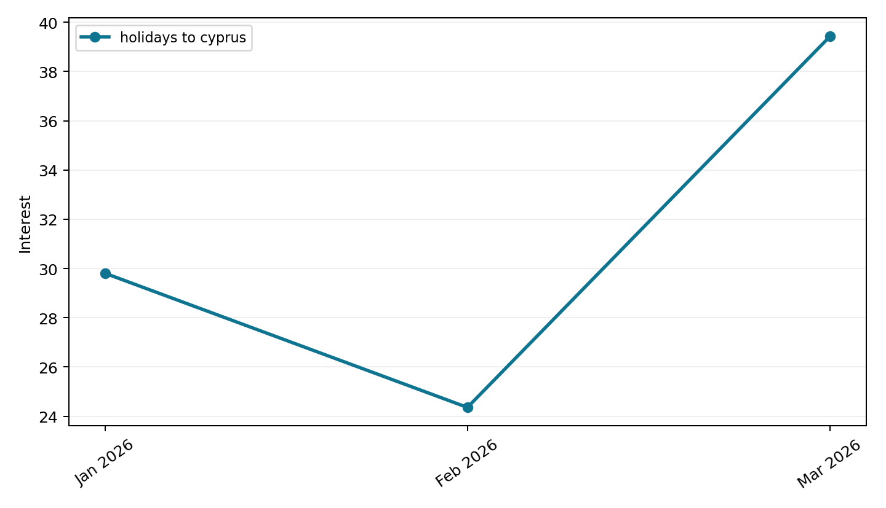
Cyprus Trends
Google Trends
Peak interest occurred in Mar 2026 with an indexed value of 39.4.
Latest month interest rose from 24.4 to 39.4.

Slide 3
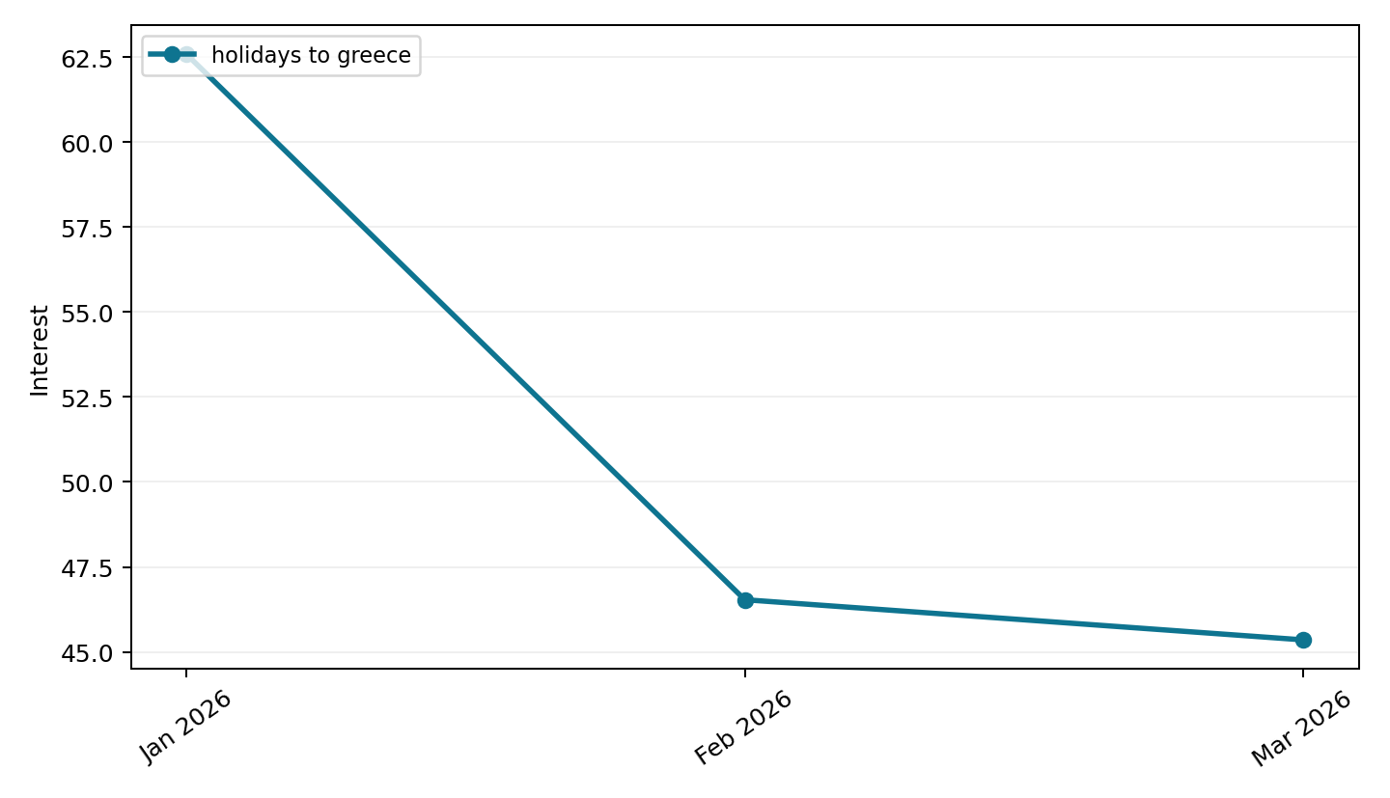
Greece Trends
Google Trends
Peak interest occurred in Jan 2026 with an indexed value of 62.6.
Latest month interest fell from 46.5 to 45.4.

Slide 4
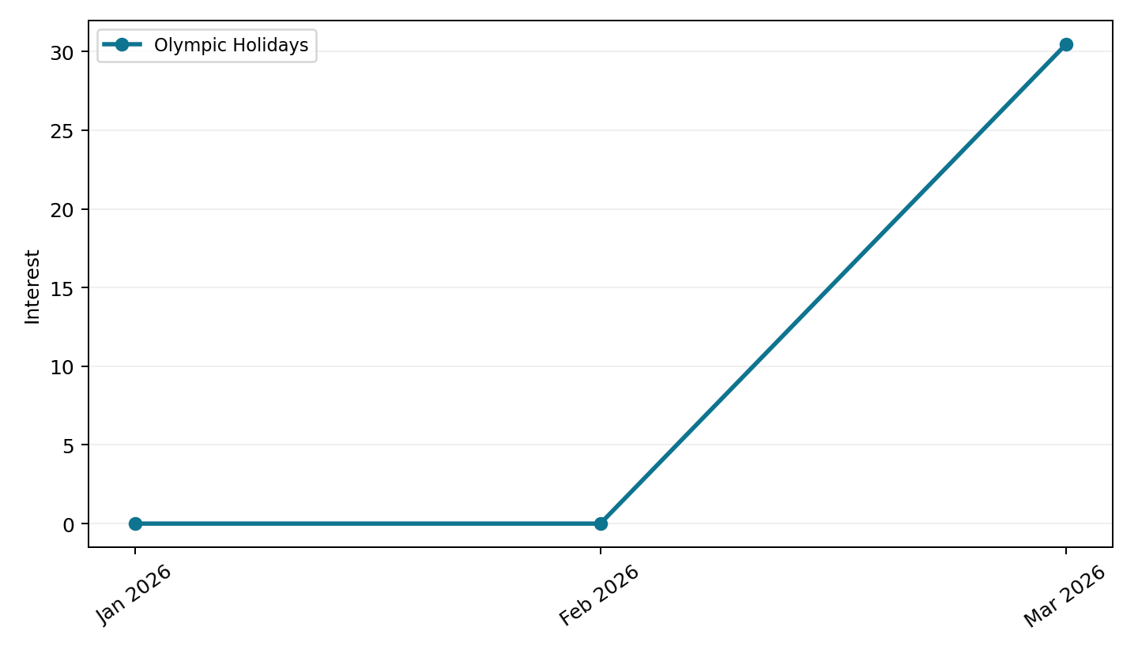
OH Trends
Google Trends
Peak interest occurred in Mar 2026 with an indexed value of 30.5.
Latest month interest rose from 0.0 to 30.5.

Slide 5
Auction Insights
Uploaded auction report
Domain | Impression Share | Overlap Rate | Position Above Rate | Top of Page Rate | Absolute Top Rate | Outranking Share
jet2holidays.com | 57.3% | 35.5% | 83.6% | 90.8% | 52.1% | 6.7%
loveholidays.com | 48.8% | 27.3% | 71.0% | 85.5% | 25.1% | 7.7%
tui.co.uk | 45.7% | 28.9% | 78.4% | 89.1% | 25.5% | 7.3%
easyjet.com | 30.0% | 18.3% | 69.8% | 83.5% | 20.3% | 8.3%
onthebeach.co.uk | 16.9% | 10.3% | 47.7% | 75.2% | 8.4% | 9.0%
booking.com | 16.5% | 11.9% | 60.0% | 82.6% | 19.0% | 8.8%
firstchoice.co.uk | n/a | 6.6% | 44.3% | 52.0% | 6.0% | 9.2%
you | n/a | n/a | n/a | 78.3% | 22.1% | n/a
thomascook.com | n/a | 5.7% | 43.9% | 56.6% | 4.9% | 9.3%
travelsupermarket.com | n/a | 5.4% | 40.2% | 36.3% | 3.0% | 9.3%
icelolly.com | n/a | 4.1% | 40.6% | 31.4% | 3.6% | 9.3%
britishairways.com | n/a | 4.0% | 56.8% | 69.4% | 16.3% | 9.3%
The uploaded auction report included 12 competitor row(s).
Our own row was present without a usable impression-share value, so competitor pressure is read from the surrounding auction metrics.
jet2holidays.com had the highest impression share at 57.3%.
jet2holidays.com had the highest overlap rate at 35.5%.
jet2holidays.com had the highest position-above rate at 83.6%.
jet2holidays.com had the highest absolute top-of-page rate at 52.1%.
Average top-of-page pressure across competitors was 69.2%.

Slide 6
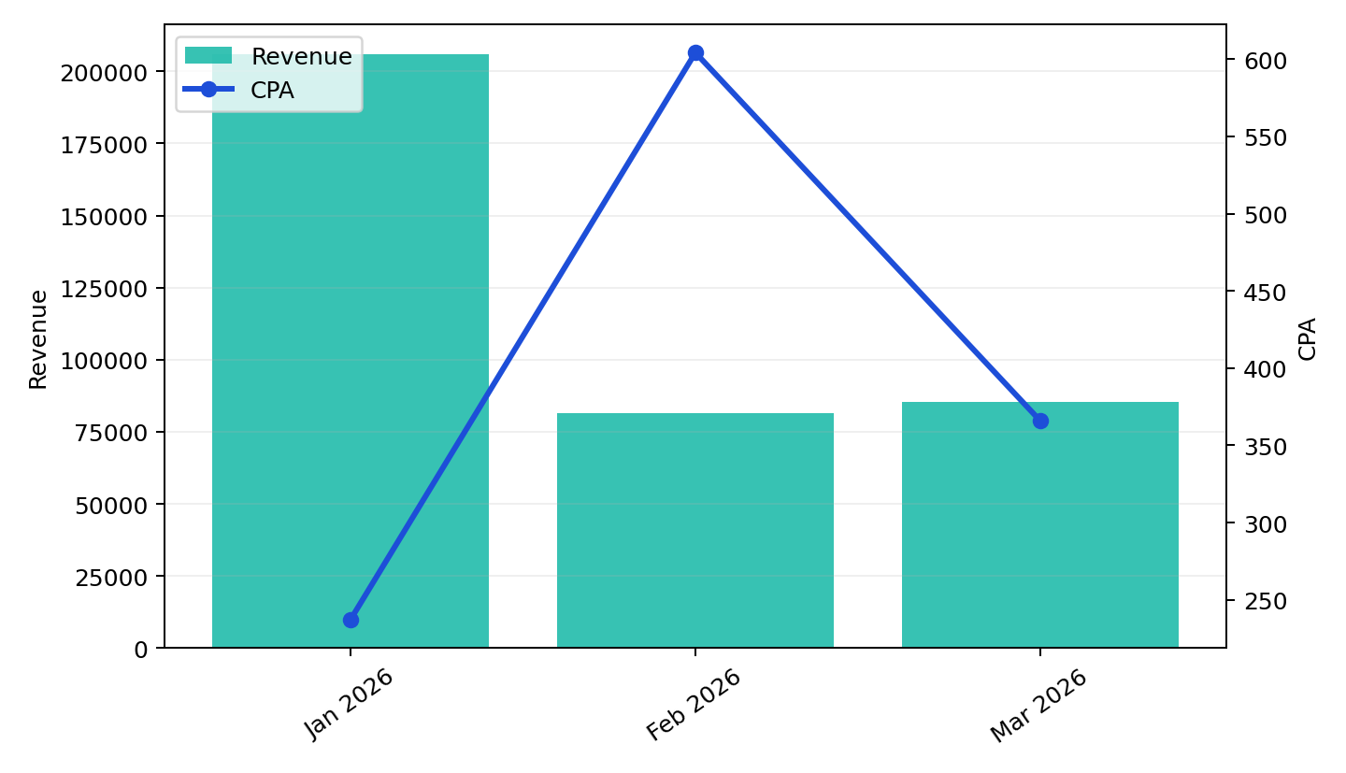
Overall Performance
Olympic Holidays | Q1 2026
Revenue moved -58.6% from Jan 2026 to Mar 2026.
Spend moved -35.0% over the same period, while purchases moved -57.9%.
CPA moved +54.3%, and AOV closed the quarter at £1,782.
Add-to-cart volume reached 2331.2, with quarter cost per ATC at £31.

Slide 7
YoY Matched-Month Comparison
Matched months versus prior-year quarter (2 of 3 months matched)
Metric | Q1 2025 | Q1 2026 | Change
Revenue | £316,901 | £166,853 | -47.3%
Cost | £51,548 | £45,109 | -12.5%
Purchases | 165.6 | 93.8 | -43.4%
Add to Cart | 2567.7 | 1155.1 | -55.0%
CPA | £311 | £481 | +54.5%
Cost per ATC | £20 | £39 | +94.5%
AOV | £1,913 | £1,778 | -7.0%
The comparison covers 2 of 3 month(s) in the quarter.
Revenue was -47.3% versus Q1 2025.
Spend was -12.5% and purchases were -43.4% on matched months.
CPA moved +54.5%, cost per ATC moved +94.5%, and AOV moved -7.0%.

Slide 8
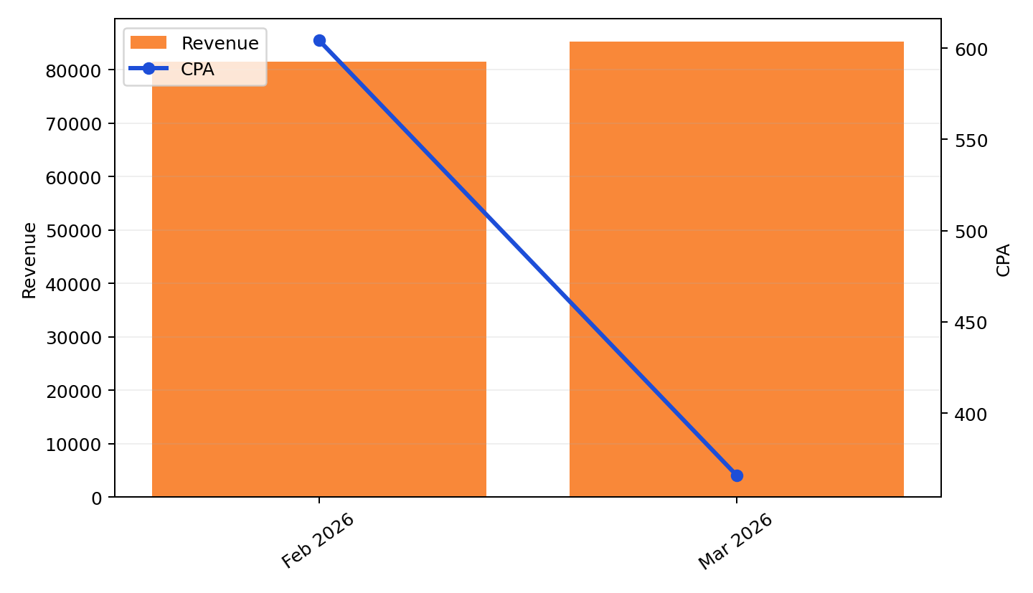
End of Period
Latest months
Mar 2026 revenue was £85,318 versus £81,535 in Feb 2026.
Spend moved from £27,342 to £17,767, while purchases moved from 45.3 to 48.6.
CPA improved from £604 to £366.
Cost per ATC moved from £41 to £37.

Slide 9
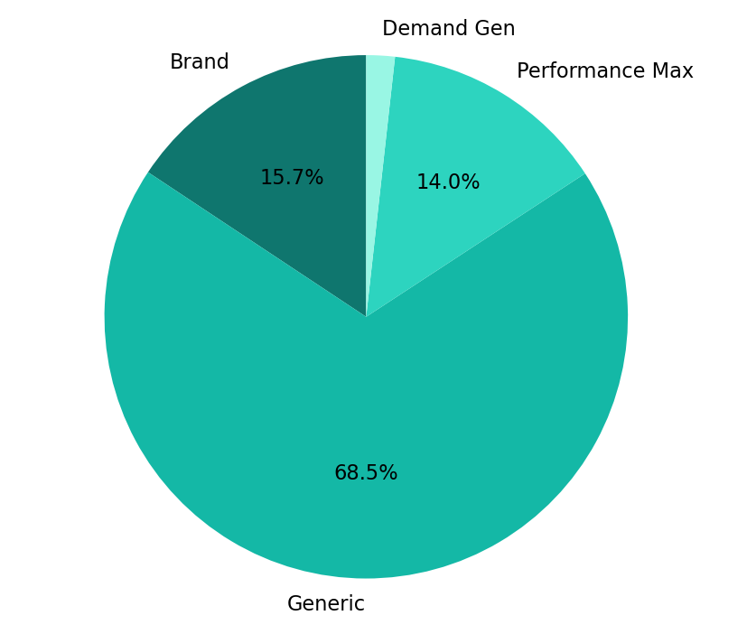
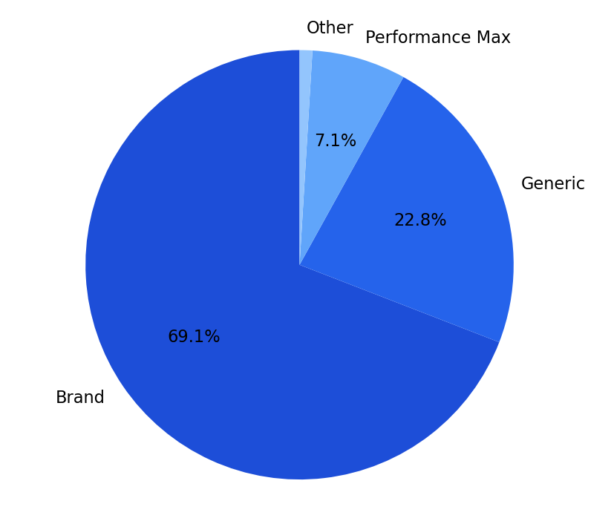
Channel Performance
Cost and revenue share
Brand drove the largest revenue share at 69.1% with £79 CPA.
Generic carried the highest cost share at 68.5% of spend.
Generic was the least efficient campaign type on quarter CPA at £1,036.
Brand delivered 69.1% of revenue, while Generic accounted for 68.5% of spend.

Slide 10
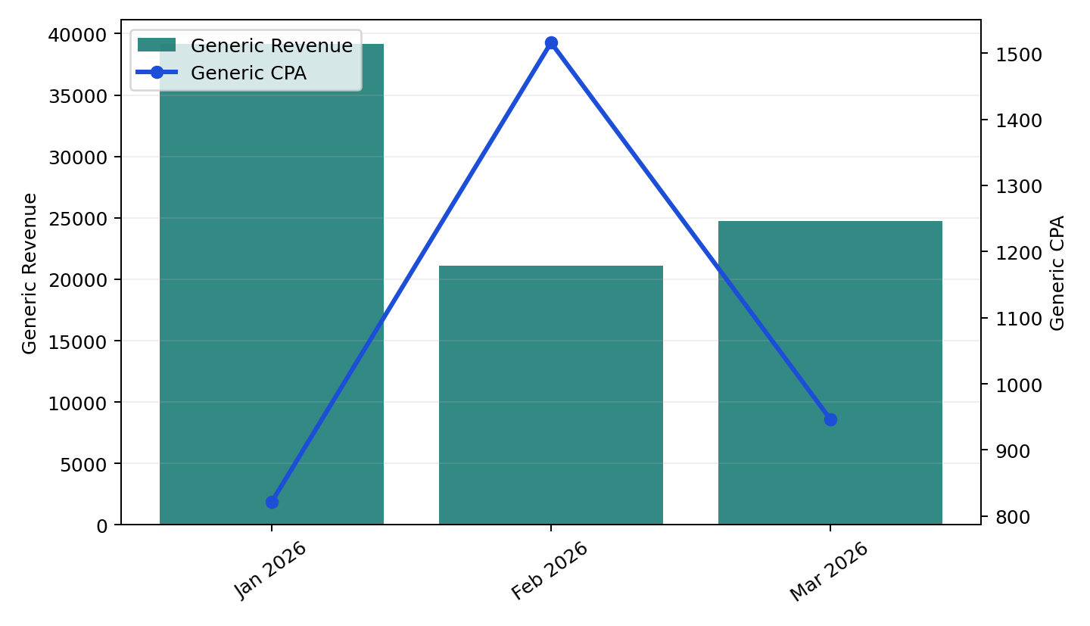
Generic Performance
Olympic Holidays | Q1 2026
Generic delivered £85,032 revenue from £49,665 spend at £1,036 CPA.
Jan 2026 was the strongest generic revenue month in the quarter.
From Jan 2026 to Mar 2026, generic revenue moved -36.8% and CPA moved +15.2%.
Generic add-to-cart volume totalled 746.5, with £67 cost per ATC and £1,773 AOV.

Slide 11
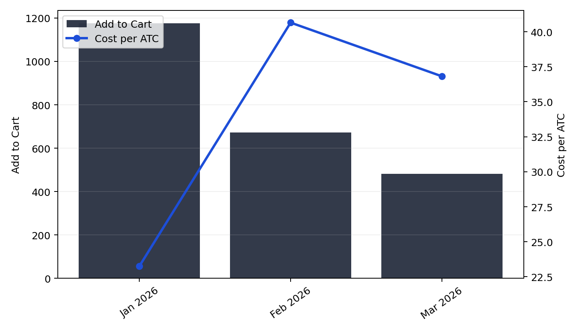
ATC Analysis
Add to cart and cost per ATC
Add-to-cart volume moved -59.0% from Jan 2026 to Mar 2026.
Cost per ATC moved +58.3% across the same period.
The quarter delivered 2331.2 total add-to-cart actions from £72,456 spend.
Purchases totalled 209.2, providing the downstream conversion context for ATC performance.

