Slide 1
Wightlink QBR
Q1 2026 (Jan - Mar 2026)
Wightlink

Slide 2
What We'll Cover Today
Q1 2026 (Jan - Mar 2026)
Trends
Auction Insights
Performance
Plan vs Actual

Slide 3
Trends

Slide 4
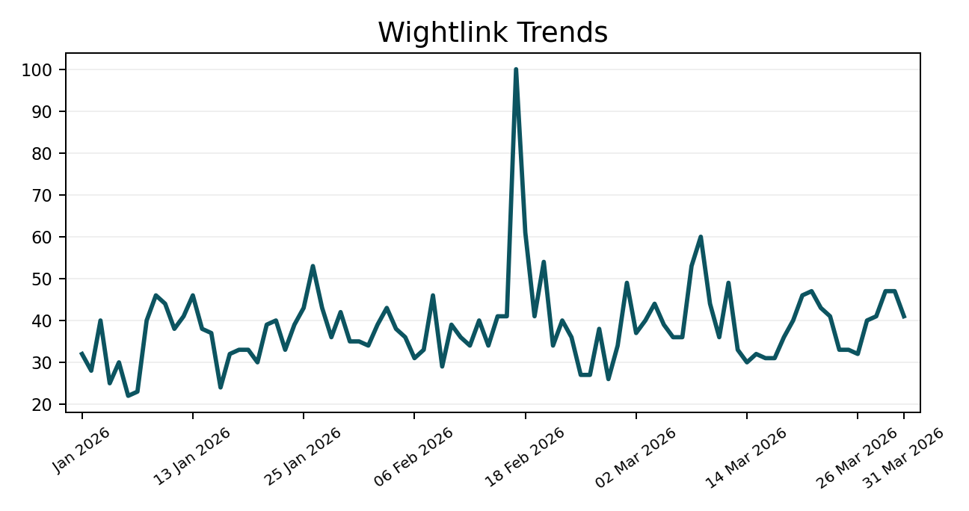
Google Trends - Isle Of Wight Ferry
Q1 2026 (Jan - Mar 2026)
Peak search interest landed in 17 Feb 2026.
Source: Google Trends

Slide 5
Auction Insights - Generic
Q1 2026 (Jan - Mar 2026)
Display URL domain | Impression share | Overlap rate | Position above rate | Top of page rate | Abs. Top of page rate | Outranking share
ferrysavers.co.uk | 12.96% | 24.15% | 29.04% | 88.89% | 11.95% | 34.58%
parkdeanresorts.co.uk | 10.00% | 3.50% | 56.09% | 87.96% | 41.83% | 36.46%
You | 37.19% | -- | -- | 94.72% | 40.20% | --
directferries.co.uk | 24.78% | 40.59% | 45.57% | 94.94% | 28.67% | 30.31%
redfunnel.co.uk | 24.48% | 45.32% | 66.46% | 95.62% | 43.09% | 25.99%
booking.com | 10.00% | 1.72% | 62.20% | 85.06% | 35.00% | 36.80%
We saw 5 competitors in the supplied auction data.
redfunnel.co.uk was one of the strongest overlapping competitors at 45%, with abs. top-of-page pressure at 43%.
directferries.co.uk was one of the strongest overlapping competitors at 41%, with abs. top-of-page pressure at 29%.
Average top-of-page pressure across competitors was 90% in the supplied file.
Source: Google Ads Auction Insights

Slide 6
Auction Insights - Brand
Q1 2026 (Jan - Mar 2026)
Display URL domain | Impression share | Overlap rate | Position above rate | Top of page rate | Abs. Top of page rate | Outranking share
You | 80.06% | -- | -- | 91.08% | 74.04% | --
redfunnel.co.uk | 35.74% | 42.52% | 26.97% | 84.11% | 25.42% | 70.88%
awayresorts.co.uk | 12.68% | 15.36% | 13.38% | 62.10% | 12.60% | 78.41%
adamvacations.com | < 10% | 11.67% | 11.55% | 42.10% | 9.31% | 78.98%
directferries.co.uk | < 10% | 11.56% | 15.59% | 72.42% | 13.05% | 78.61%
Throughout the quarter we saw 4 main competitors in the market.
Red Funnel were overlapping us 43% of the time, claiming the top spot 25% of the time.
Comparing YoY, Red Funnel had an increased presence versus the reference period.
Source: Google Ads Auction Insights

Slide 7
Performance

Slide 8
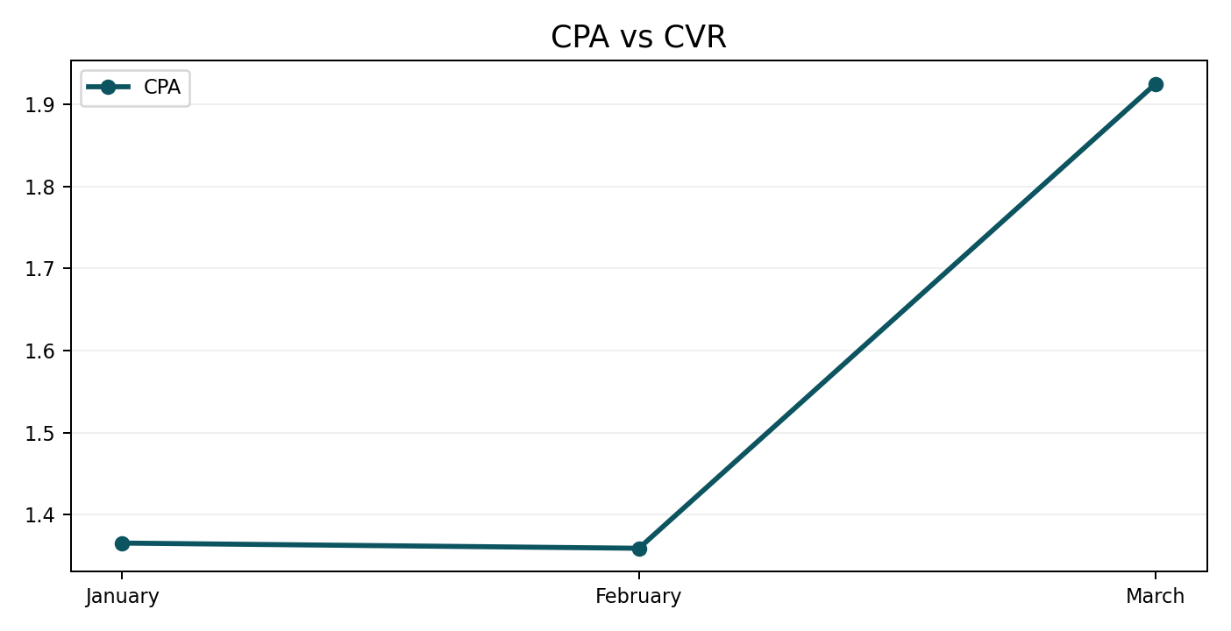
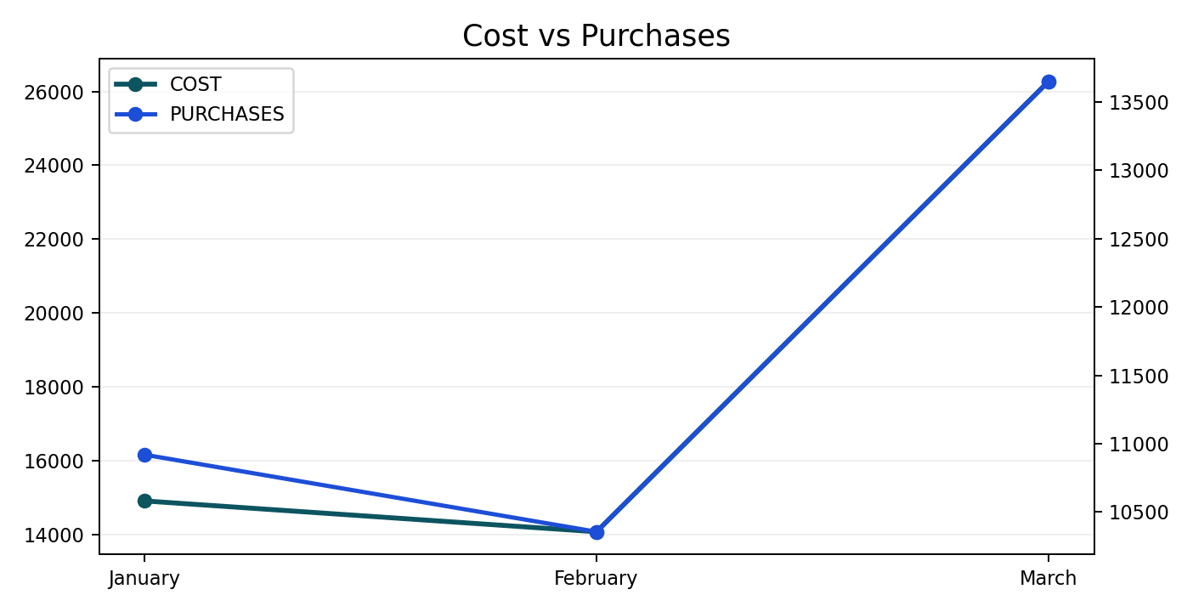
All Performance
Q1 2026 (Jan - Mar 2026)
March was the strongest month for purchase volume.
February was the most efficient month on CPA.
CVR could not be calculated from the uploaded CSV because click data was not supplied.
Quarter ROAS closed at 58.44 on £55,265 spend.
Quarter spend landed 0.2% below plan.
Quarter revenue finished 27% above plan.
Source: Uploaded performance CSV

Slide 9
All Performance YoY
Q1 2026 (Jan - Mar 2026)
Metric | Current | Prior year | YoY change
Purchases | 34,929 | 25,506 | +36.9%
Revenue | £3,229,632.90 | £2,207,172.42 | +46.3%
Cost | £55,265.24 | £42,141.92 | +31.1%
CPA | £1.58 | £1.65 | -4.2%
ROAS | 58.44 | 52.37 | +11.6%
CVR | -- | -- | --
Purchases were up 37% versus the same quarter last year.
Revenue was up 46% versus the same quarter last year.
Cost was up 31% versus the same quarter last year.
CPA was down 4% versus the same quarter last year.
Quarter spend landed 0.2% below plan.

Slide 10
Plan vs Actual Overview
Q1 2026 (Jan - Mar 2026)
Metric | Planned | Actual | Variance | Variance %
Spend | £54,333.46 | £54,207.46 | £-126.00 | -0.2%
Revenue | £2,551,009.48 | £3,229,632.90 | £678,623.42 | +26.6%
Quarter spend closed 0.2% below plan at £54,207 versus £54,333.
Quarter revenue finished 27% above plan at £3,229,633 versus £2,551,009.
January delivered the strongest revenue overdelivery versus plan.
Source: Wightlink planning workbook and uploaded performance CSV

Slide 11
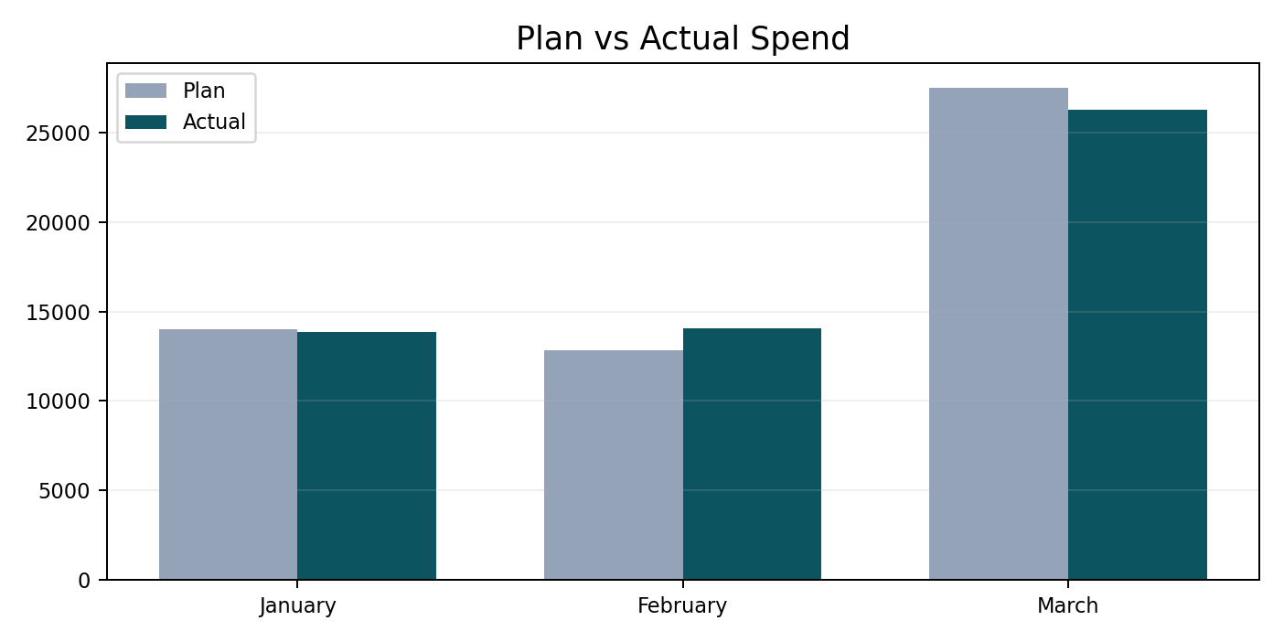
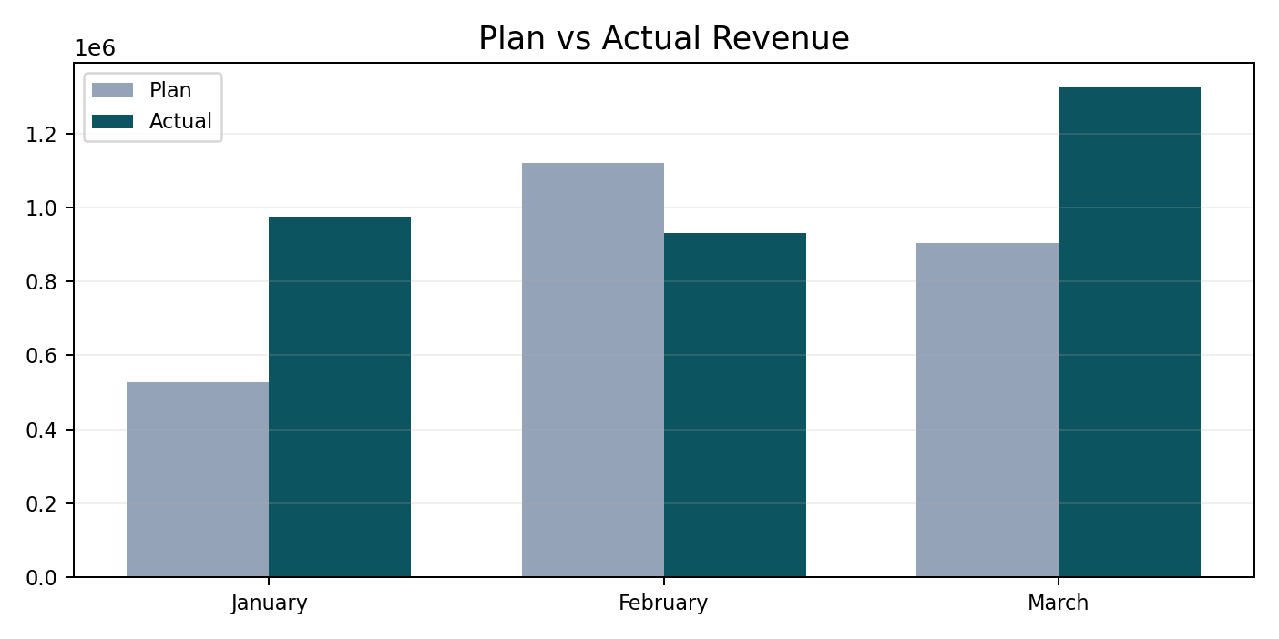
Plan vs Actual Monthly Trend
Q1 2026 (Jan - Mar 2026)
Month | Planned Spend | Actual Spend | Spend Var. | Planned Revenue | Actual Revenue | Revenue Var.
January | £13,987.14 | £13,853.48 | £-133.66 | £527,425.87 | £974,620.29 | £447,194.42
February | £12,842.32 | £14,075.46 | £1,233.14 | £1,120,626.43 | £930,191.88 | £-190,434.55
March | £27,504.00 | £26,278.52 | £-1,225.48 | £902,957.18 | £1,324,820.74 | £421,863.55
Total | £54,333.46 | £54,207.46 | £-126.00 | £2,551,009.48 | £3,229,632.90 | £678,623.42
February showed the largest spend movement versus plan, finishing over plan.
February recorded the largest revenue shortfall versus plan.
January was the strongest month for revenue delivery against plan.
Source: Wightlink planning workbook and uploaded performance CSV

Slide 12
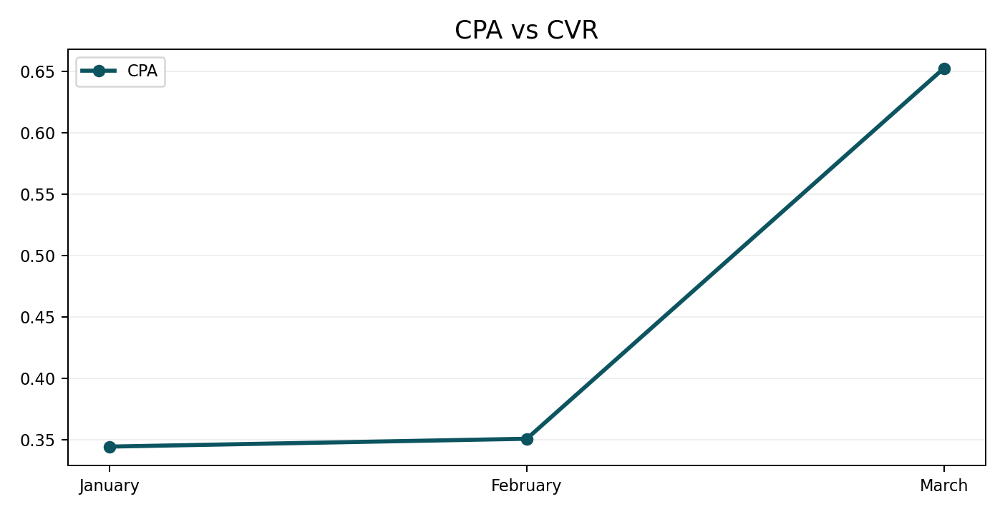
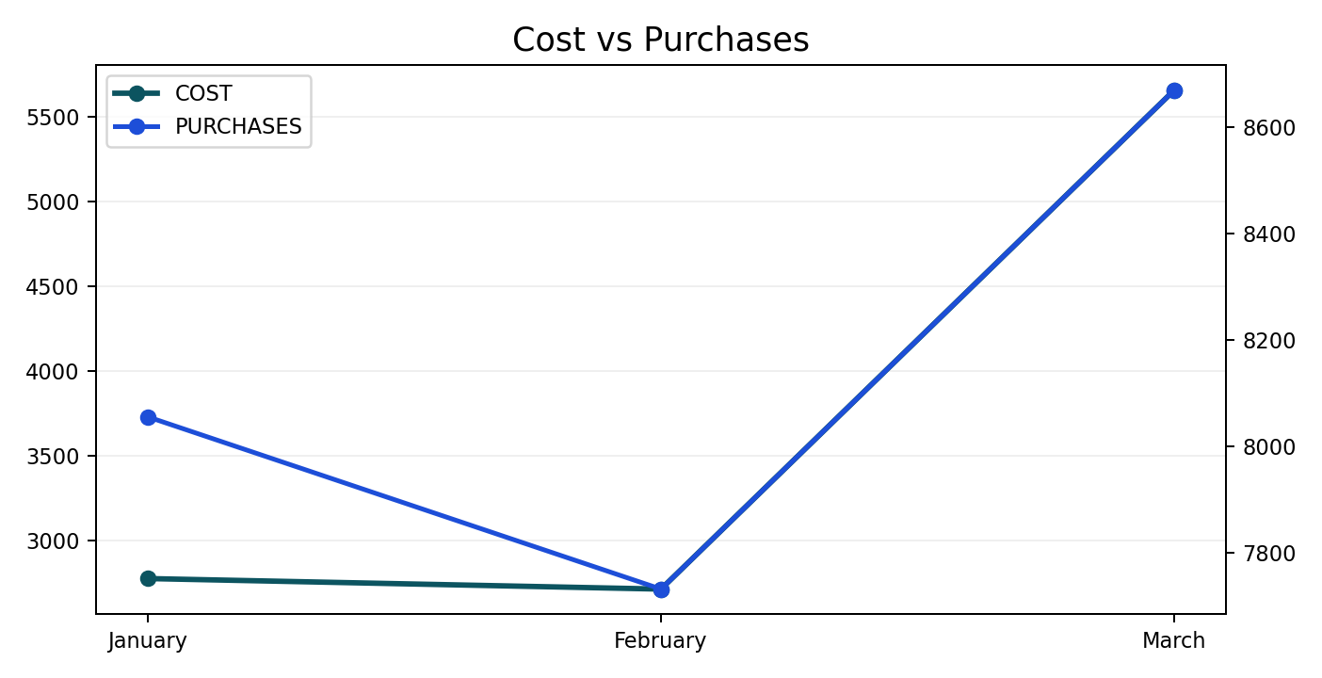
Brand Performance
Q1 2026 (Jan - Mar 2026)
March was the strongest month for purchase volume.
January was the most efficient month on CPA.
CVR could not be calculated from the uploaded CSV because click data was not supplied.
Quarter ROAS closed at 197.77 on £11,144 spend.
Quarter CPA was 61% lower than the same quarter last year.

Slide 13
Brand Performance Summary
Q1 2026 (Jan - Mar 2026)
Month | Impressions | Clicks | CTR | CPC | Cost | Purchases | CPA | Purchase Revenue | ROAS | CVR
January | -- | -- | -- | -- | £2,774.47 | 8,055 | £0.34 | £700,297.56 | 252.41 | --
February | -- | -- | -- | -- | £2,712.20 | 7,731 | £0.35 | £682,664.14 | 251.70 | --
March | -- | -- | -- | -- | £5,657.55 | 8,670 | £0.65 | £821,032.32 | 145.12 | --
Total | -- | -- | -- | -- | £11,144.22 | 24,457 | £0.46 | £2,203,994.03 | 197.77 | --
March was the strongest month for purchase volume.
January was the most efficient month on CPA.
CVR could not be calculated from the uploaded CSV because click data was not supplied.
Quarter ROAS closed at 197.77 on £11,144 spend.
Quarter CPA was 61% lower than the same quarter last year.

Slide 14
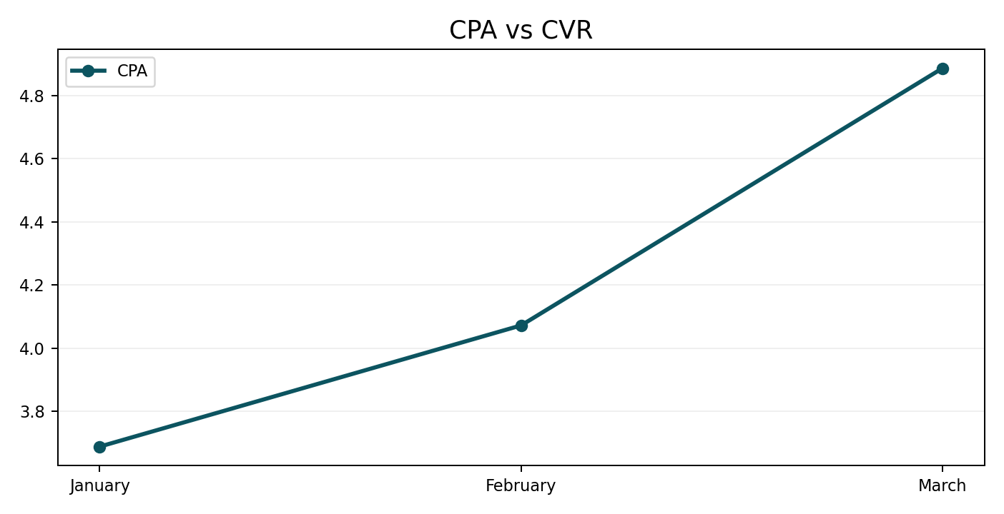
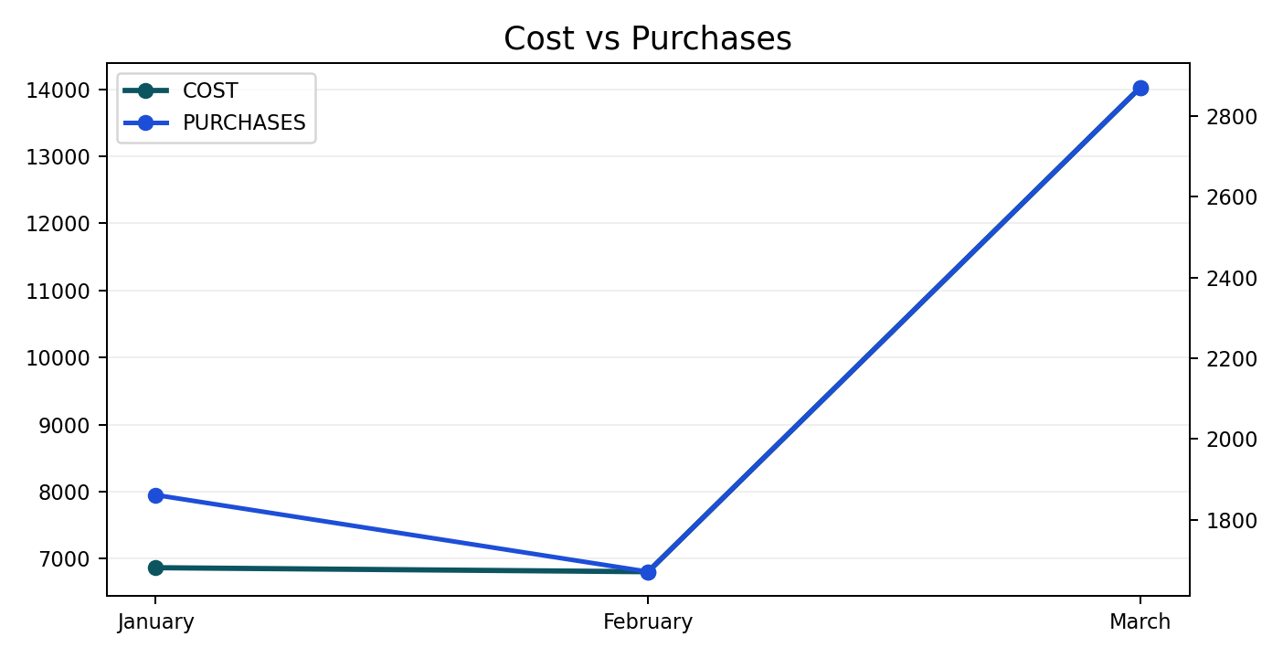
Generics Performance
Q1 2026 (Jan - Mar 2026)
March was the strongest month for purchase volume.
January was the most efficient month on CPA.
CVR could not be calculated from the uploaded CSV because click data was not supplied.
Quarter ROAS closed at 26.18 on £27,700 spend.
Quarter CPA was 16% lower than the same quarter last year.

Slide 15
Generics Performance Summary
Q1 2026 (Jan - Mar 2026)
Month | Impressions | Clicks | CTR | CPC | Cost | Purchases | CPA | Purchase Revenue | ROAS | CVR
January | -- | -- | -- | -- | £6,866.11 | 1,861 | £3.69 | £201,575.37 | 29.36 | --
February | -- | -- | -- | -- | £6,806.00 | 1,671 | £4.07 | £180,929.17 | 26.58 | --
March | -- | -- | -- | -- | £14,027.71 | 2,871 | £4.89 | £342,810.28 | 24.44 | --
Total | -- | -- | -- | -- | £27,699.82 | 6,403 | £4.33 | £725,314.83 | 26.18 | --
March was the strongest month for purchase volume.
January was the most efficient month on CPA.
CVR could not be calculated from the uploaded CSV because click data was not supplied.
Quarter ROAS closed at 26.18 on £27,700 spend.
Quarter CPA was 16% lower than the same quarter last year.

Slide 16
PMax Performance
Q1 2026 (Jan - Mar 2026)
Month | Impressions | Clicks | CTR | CPC | Cost | Purchases | CPA | Purchase Revenue | ROAS | CVR
January | -- | -- | -- | -- | £1,671.00 | 409 | £4.08 | £31,769.23 | 19.01 | --
February | -- | -- | -- | -- | £1,523.82 | 331 | £4.60 | £24,628.29 | 16.16 | --
March | -- | -- | -- | -- | £2,258.27 | 441 | £5.13 | £39,601.87 | 17.54 | --
Total | -- | -- | -- | -- | £5,453.08 | 1,181 | £4.62 | £95,999.39 | 17.60 | --
March was the strongest month for purchase volume.
January was the most efficient month on CPA.
CVR could not be calculated from the uploaded CSV because click data was not supplied.
Quarter ROAS closed at 17.60 on £5,453 spend.
Performance Max should be read alongside generic activity because the source CSV is aggregated at campaign type level.

Slide 17
Any Questions?

