Slide 1
Executive Summary
Olympic Holidays | Q1 2026
Revenue declined across the review period, while efficiency weakened as CPA moved 71.4% from the starting month.
Best revenue month was Jan 2026 at £205,977.
YoY revenue for matched months is down 65.4% versus 2025.
End-period efficiency did not materially deteriorate versus the previous month.

Slide 2
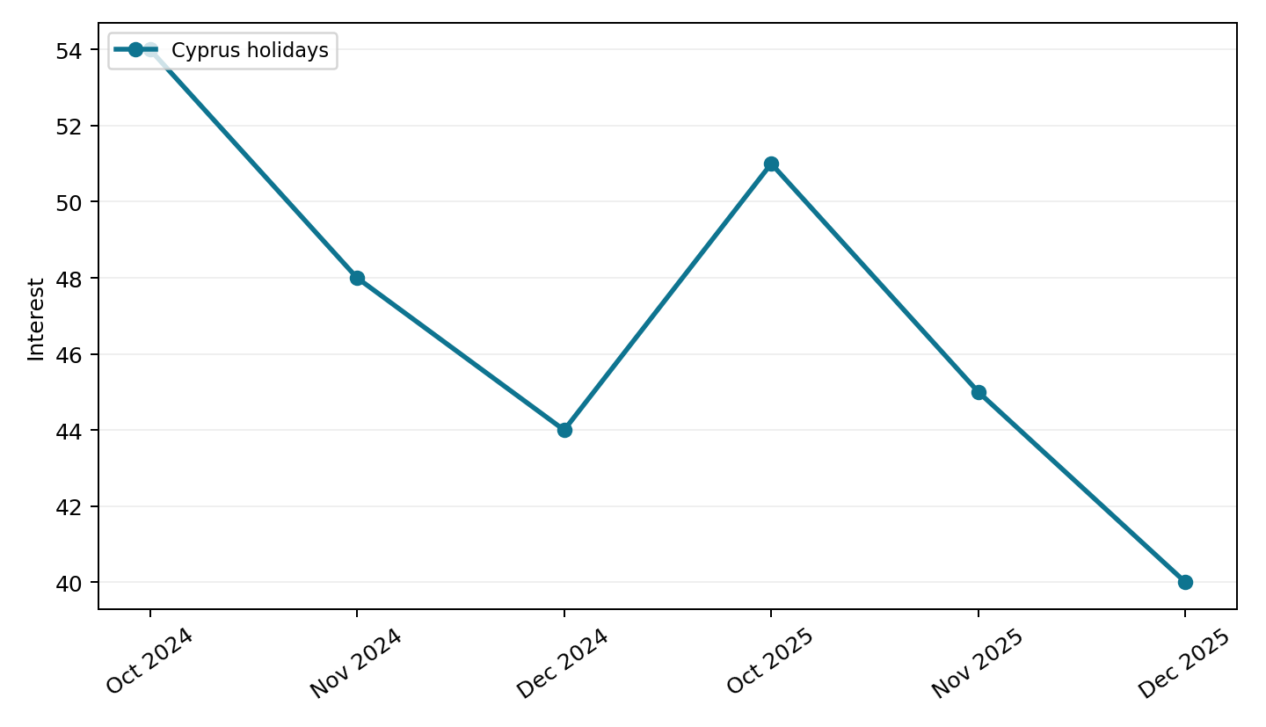
Cyprus
Google Trends
Search interest across this upload changed -6.8% YoY across matched months.
Peak interest occurred in Oct 2024 with an indexed value of 54.0.
Latest month interest fell from 45.0 to 40.0.

Slide 3
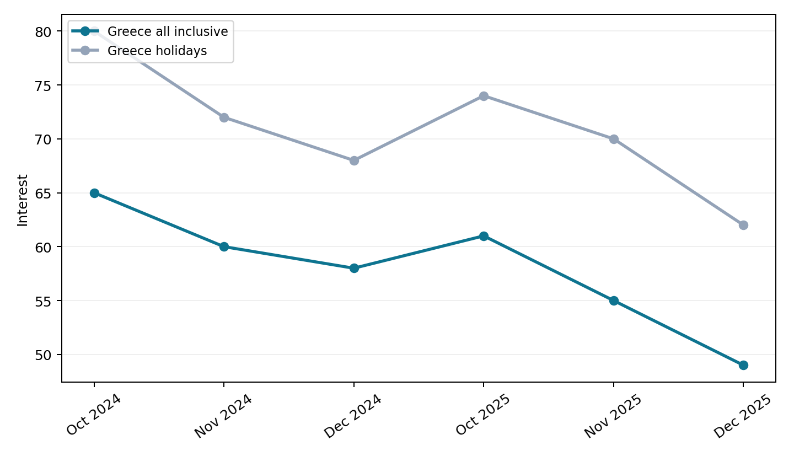
Greece
Google Trends
Search interest across this upload changed -7.9% YoY across matched months.
Peak interest occurred in Oct 2024 with an indexed value of 145.0.
Latest month interest fell from 125.0 to 111.0.

Slide 4
Auction Insights
Uploaded auction report
Domain | Impression Share | Overlap Rate | Position Above Rate | Top of Page Rate | Absolute Top Rate | Outranking Share
airbnb.co.uk | n/a | 6.1% | 50.1% | 80.2% | 15.5% | 5.4%
thomascook.com | n/a | 6.9% | 48.4% | 65.6% | 5.1% | 5.4%
firstchoice.co.uk | n/a | 6.9% | 53.5% | 59.0% | 2.9% | 5.4%
britishairways.com | n/a | 4.2% | 54.0% | 77.5% | 12.7% | 5.4%
you | n/a | n/a | n/a | 77.1% | 16.2% | n/a
jet2holidays.com | 64.1% | 56.5% | 82.8% | 90.5% | 50.1% | 3.0%
tui.co.uk | 52.0% | 50.3% | 77.1% | 89.7% | 25.5% | 3.4%
loveholidays.com | 45.0% | 29.9% | 64.0% | 85.0% | 16.9% | 4.5%
jet2holidays.com had the highest impression share at 64.1%.
jet2holidays.com had the highest overlap rate at 56.5%.
The average top of page rate across competitors was 80.4%.

Slide 5
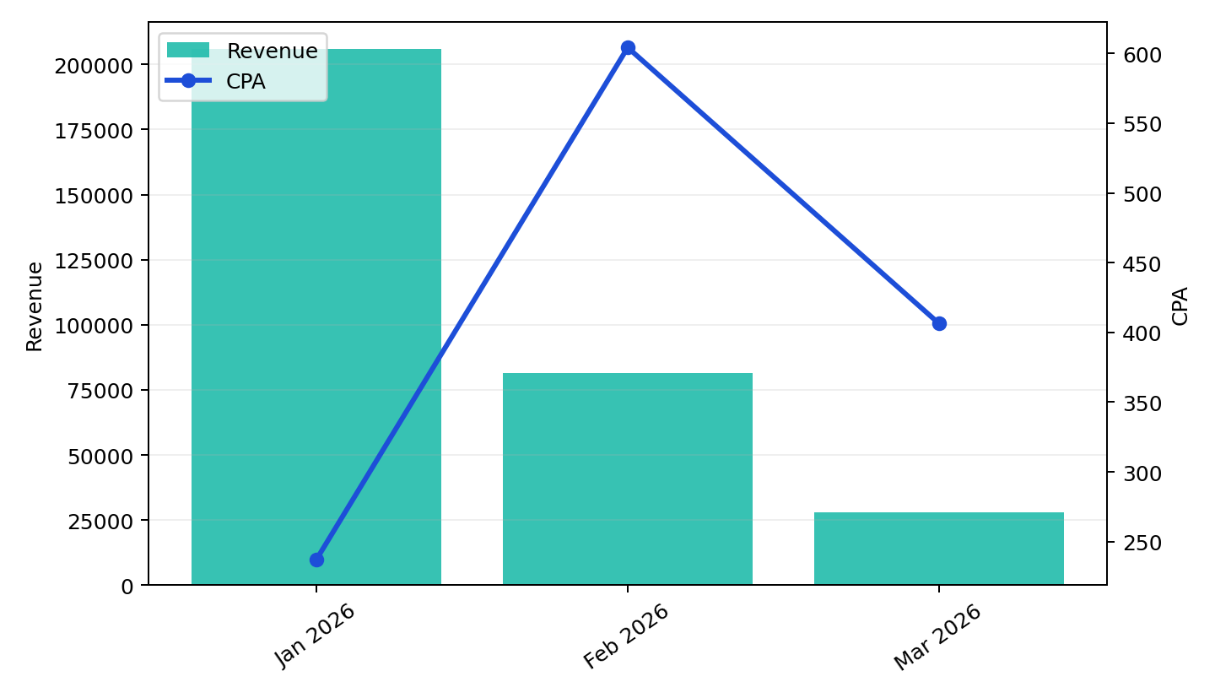
Overall Performance
Olympic Holidays | Q1 2026
Revenue fell 86.3% from Jan 2026 to Mar 2026.
CPA worsened 71.4% over the same period, linking spend to lower output efficiency.
Spend decreased 72.4%, helping explain the gap between investment and returned revenue.
YoY matched-month revenue moved -65.4% while CPA moved 75.6%.

Slide 6
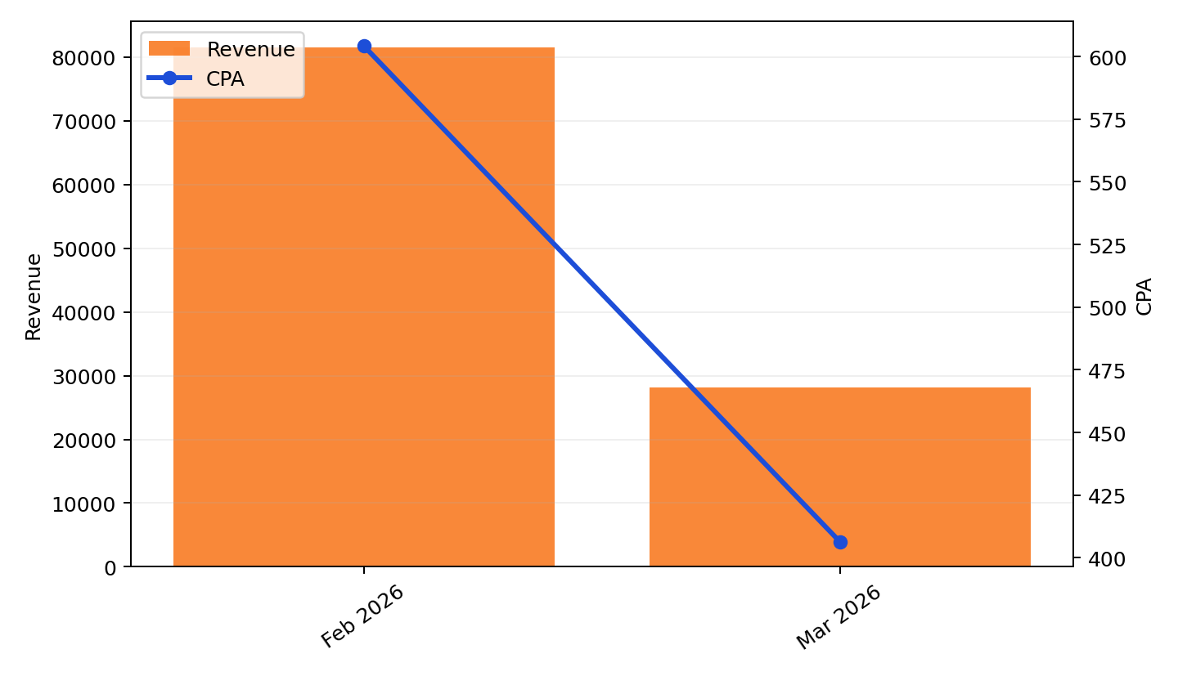
End of Period
Latest months
Mar 2026 revenue was £28,148, versus £81,535 in Feb 2026.
CPA fell from £604 to £406 across the closing months.
Purchases moved from 45.3 to 18.6 over the same period.

Slide 7
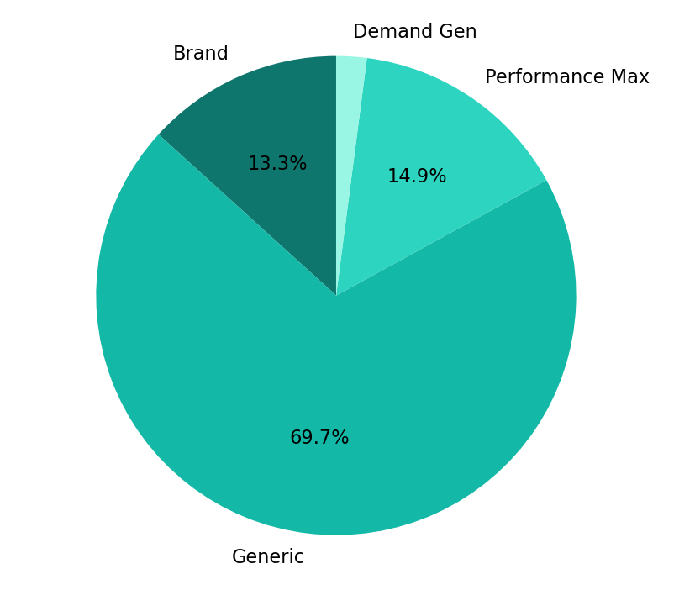
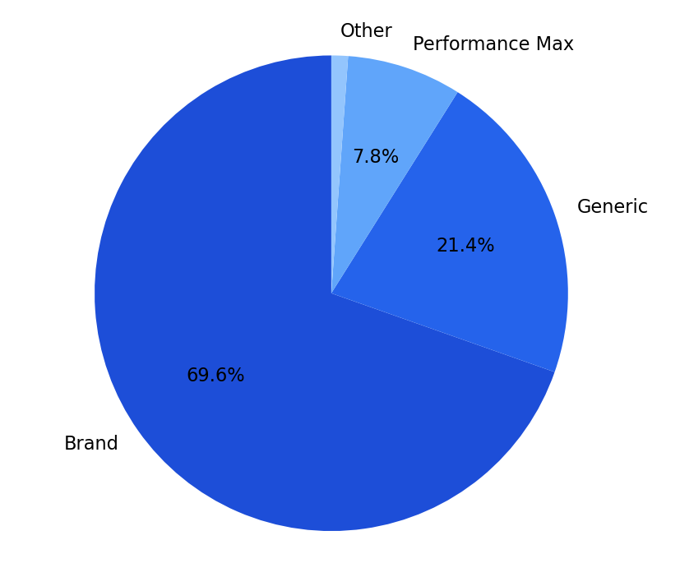
Channel Performance
Cost and revenue share
Brand is the strongest channel, delivering 69.6% of revenue at £68 CPA.
Generic is the weakest budget allocation, taking 69.7% of cost while running at £1,076 CPA.
Generic carries the largest cost share at 69.7%, so budget discipline there has the biggest account impact.
Budget efficiency is strongest where revenue share materially exceeds cost share, and weakest where cost concentration is not matched by returns.

Slide 8
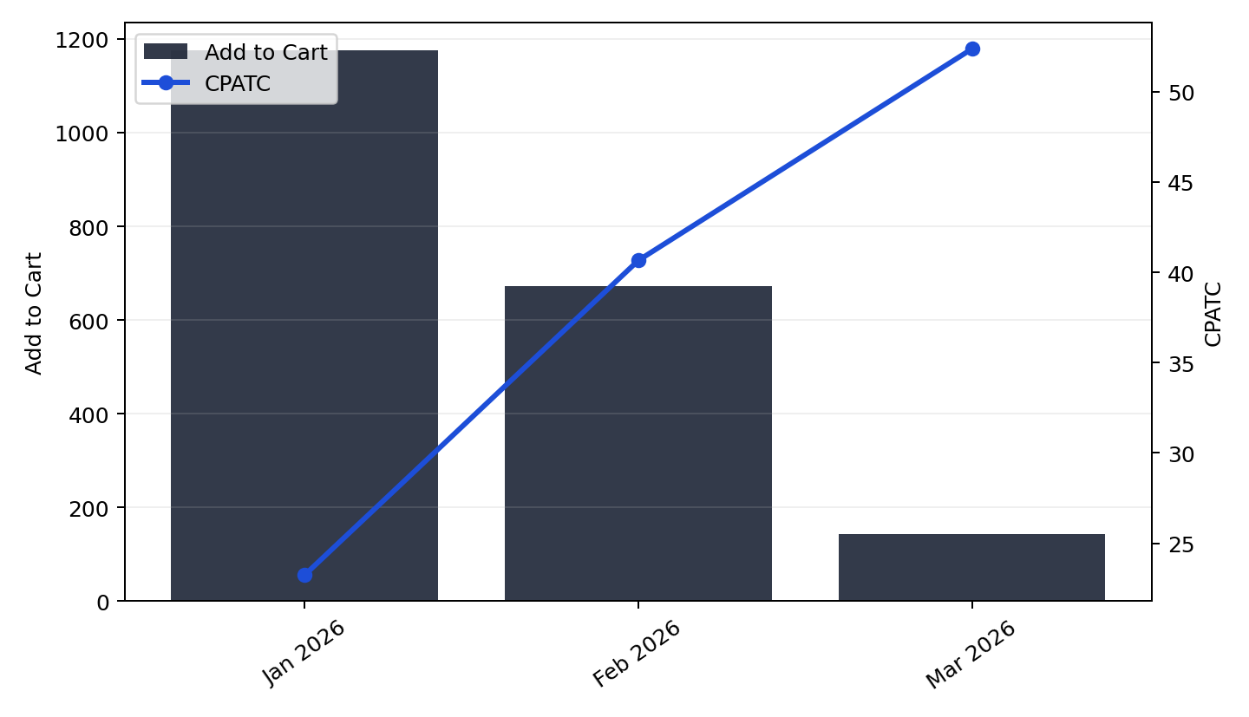
ATC Analysis
Add to cart and CPATC
Add-to-cart volume declined 87.8% from Jan 2026 to Mar 2026.
CPATC rose 125.2% across the same period.
Both add-to-cart volume and revenue decreased in the latest period.
Purchases totalled 179.2 across the period covered by the add-to-cart view.

Slide 9
Actions
Manual input
Review final-month efficiency by channel.
Carry forward budget toward highest revenue-share themes.

