Slide 1
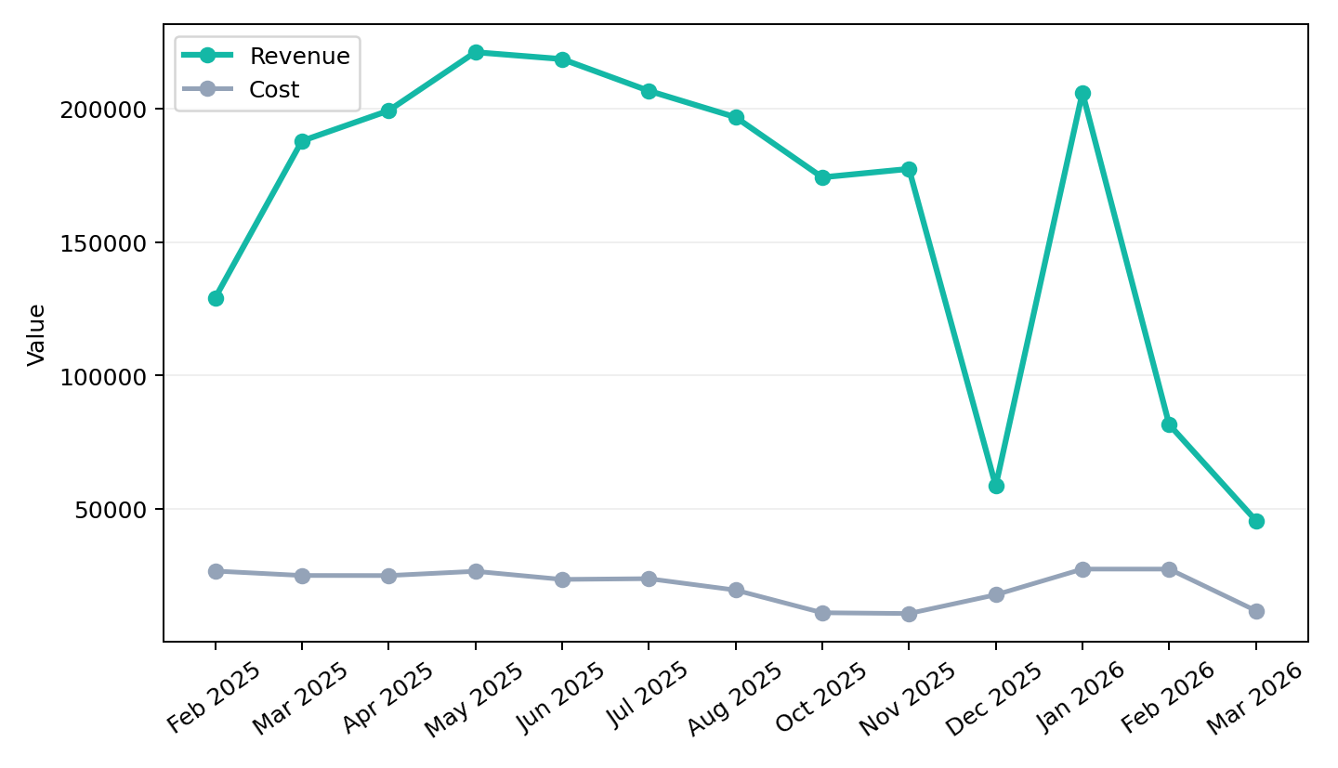
Executive Summary
Olympic Holidays | Feb 2025 to Mar 2026
Revenue declined across the review period, while efficiency weakened as CPA moved 12.9% from the starting month.
Best revenue month was May 2025 at £221,159.
YoY revenue for matched months is down 59.9% versus 2025.
End-period efficiency did not materially deteriorate versus the previous month.

Slide 2
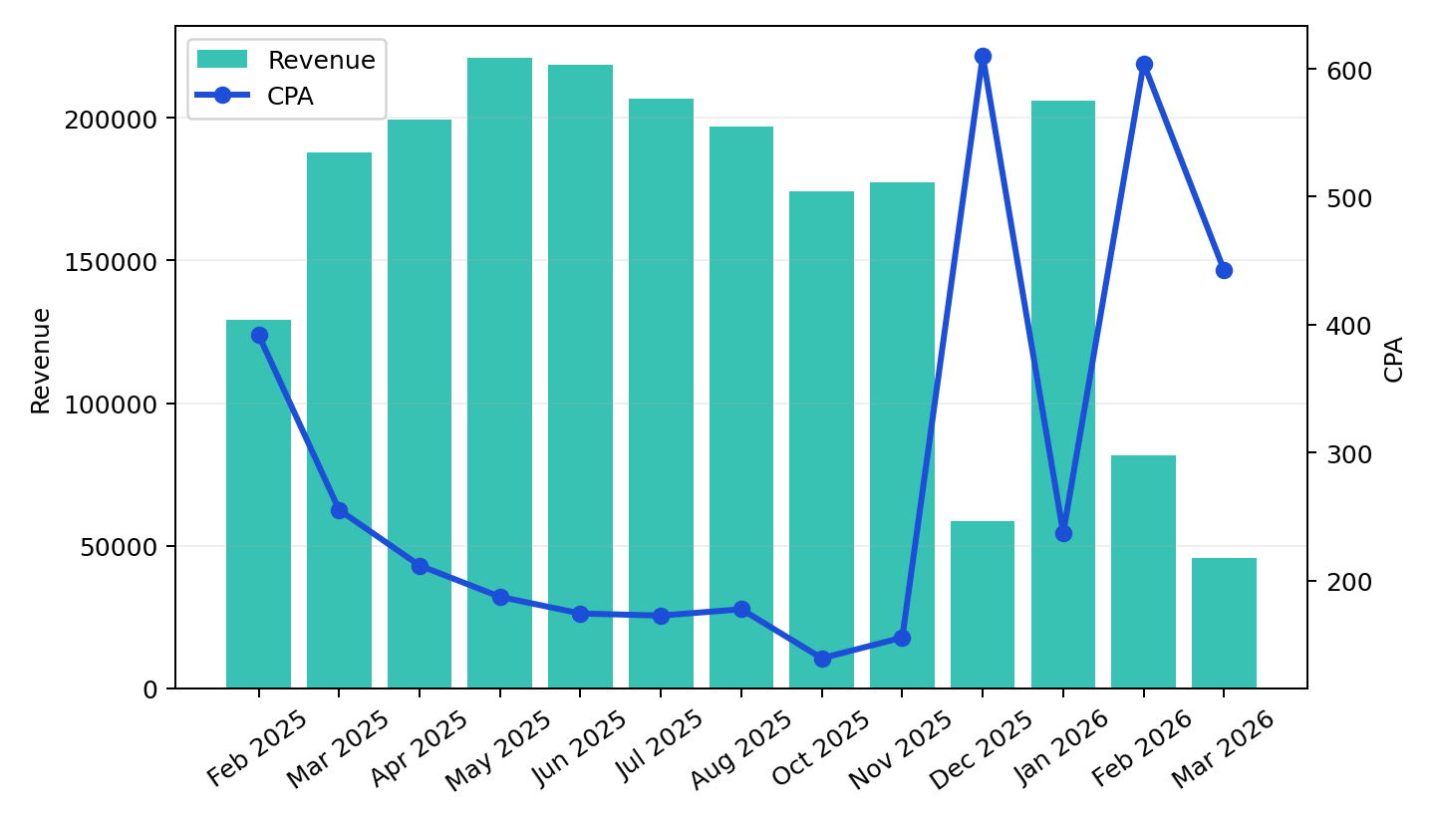
Overall Performance
Olympic Holidays | Feb 2025 to Mar 2026
Revenue fell 64.7% from Feb 2025 to Mar 2026.
CPA worsened 12.9% over the same period, linking spend to lower output efficiency.
Spend decreased 55.9%, helping explain the gap between investment and returned revenue.
YoY matched-month revenue moved -59.9% while CPA moved 74.9%.

Slide 3
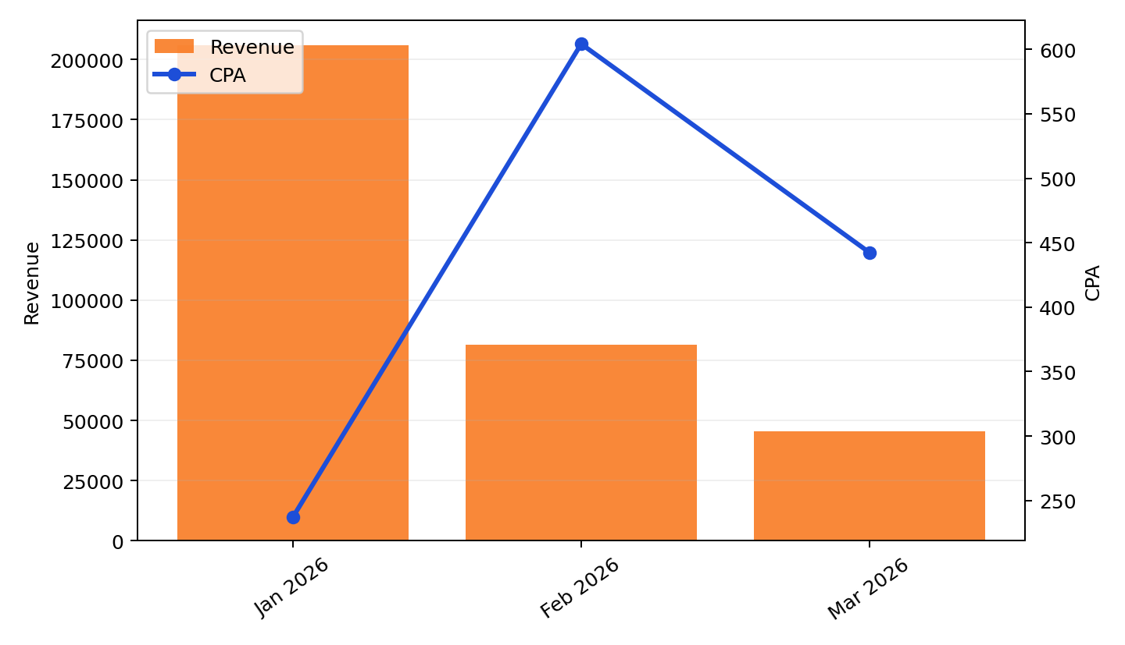
End of Period Analysis
Latest months focus
Mar 2026 revenue was £45,555, versus £81,535 in Feb 2026.
CPA fell from £604 to £442 across the closing months.
Purchases moved from 45.3 to 26.6 over the same period.

Slide 4
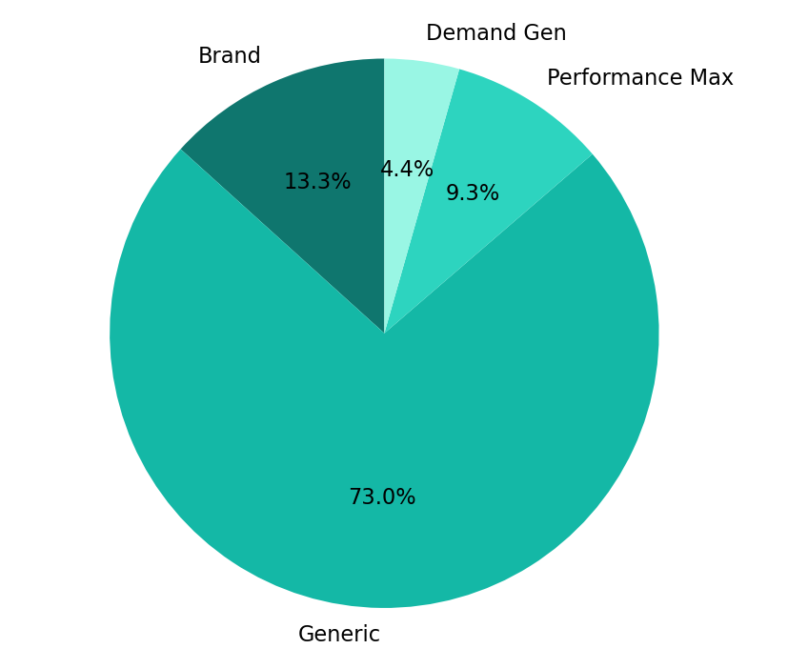
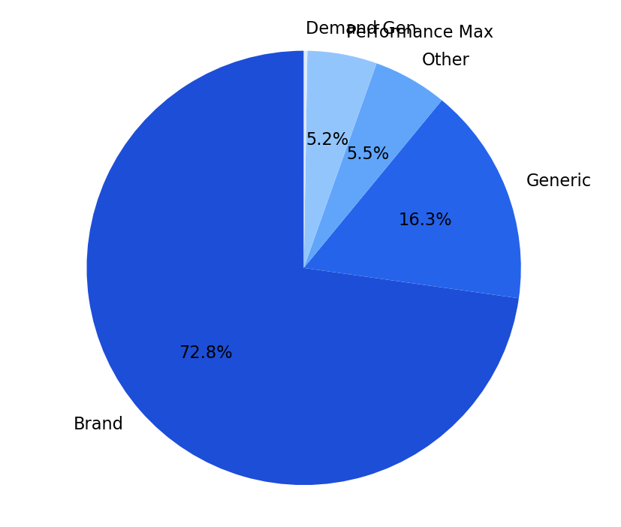
Channel Performance
Cost share, revenue share and efficiency
Brand is the strongest channel, delivering 72.8% of revenue at £43 CPA.
Demand Gen is the weakest budget allocation, taking 4.4% of cost while running at £4,777 CPA.
Generic carries the largest cost share at 73.0%, so budget discipline there has the biggest account impact.
Budget efficiency is strongest where revenue share materially exceeds cost share, and weakest where cost concentration is not matched by returns.

Slide 5
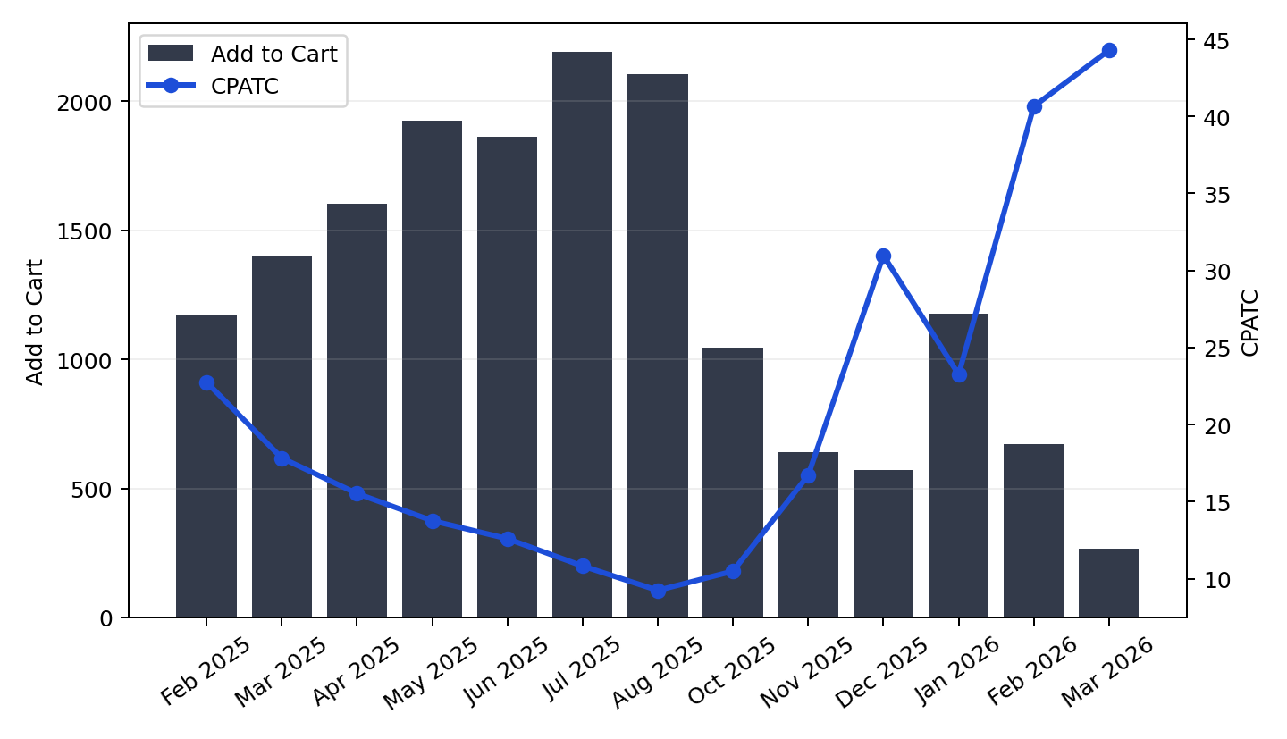
Add to Cart Analysis
Intent generation and CPATC trend
Add-to-cart volume declined 77.3% from Feb 2025 to Mar 2026.
CPATC rose 94.7% across the same period.
Both add-to-cart volume and revenue decreased in the latest period.
Purchases totalled 1171.1 across the period covered by the add-to-cart view.

Slide 6
Trends
Manual input
Q4 search interest remained soft despite stable visibility.
Conversion pressure was concentrated in the final weeks of the period.

Slide 7
Actions
Manual input
Review final-month traffic quality by channel and query intent.
Hold budget on the weakest CPA segments until efficiency improves.

