Slide 1

JAFFLE SHOP ANALYTICS PIPELINE
Building a Production style dbt Pipeline in Snowflake
dbt Deep Dive project • dbt Core + Snowflake
Serhiy Dranko • 21.08.2026

Slide 2

01 - The problem / dataset
Raw e-commerce data. Main questions.
1
Who are our customers?
Clean, deduplicated customer records analysts can trust.
2
What are they ordering and how order goes?
Orders linked to payments, with a reliable total per order
3
How has pricing changed?
Full price history per product. It’s not just the current price.
Source: dbt-labs jaffle-shop-classic · Imported at 17.08.2026 09:50:00

Slide 3
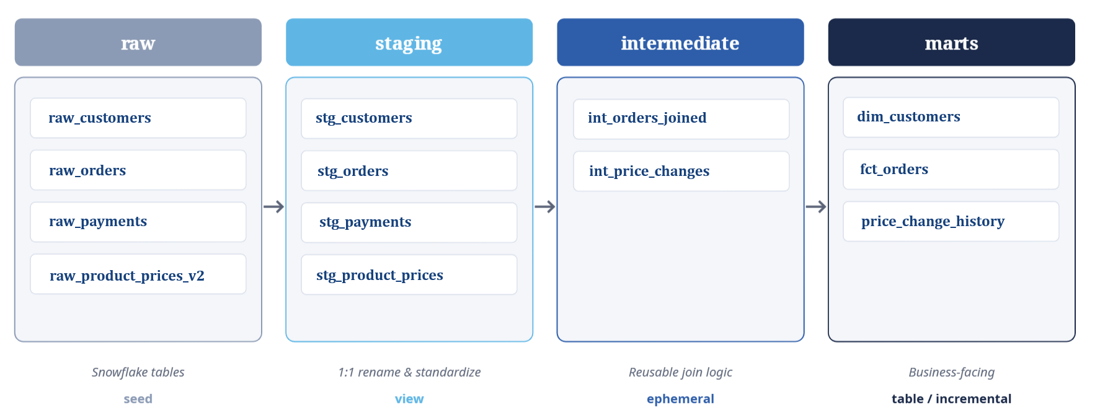
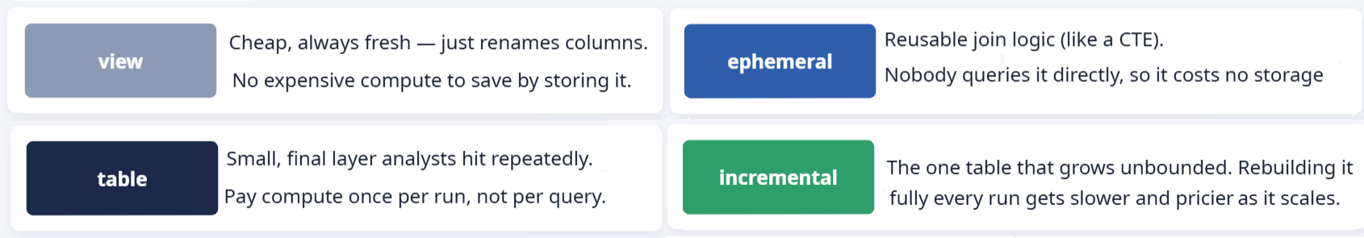
02 - The Pipeline
Four layers, one dependency graph
Source: dbt-labs jaffle-shop-classic · Imported at 17.08.2026 09:50:00

Slide 4
03 - Data quality
38 data tests a quality story.
1:1
unique
The test query selects for duplicates. Useful to avoid duplicates by id’s.
R
relationships
An order with no matching customer means a broken join.
∅
not_null
The test query selects for null values. Useful to avoid nulls in data during join.
true
expression is true
A negative total is a business logic bug upstream. It's caught before it reaches a dashboard.
✓
accepted values
A typo'd or new status silently breaks every downstream filter that expects a known set of values.
Source: dbt-labs jaffle-shop-classic · Imported at 17.08.2026 09:50:00

Slide 5
04 - Snapshot + incremental model
fct_orders: incremental for one exact purpose
The reason: it's the one table that grows unbounded. Full rebuilds get slower and costs more and more as it scales.
First run
is_incremental() = false → full table builds (101 rows)
{{ config( materialized='incremental',
unique_key='order_id' ) }}
select ... from {{ ref('int_orders_joined') }}
{% if is_incremental() %}
where order_date > (select max(order_date) from {{ this }})
{% endif %}
Every run after
Add only rows newer than max(order_date) get merged.
that means adding 2 test rows produced "SUCCESS 2," not a full rebuild.
Source: dbt-labs jaffle-shop-classic · Imported at 17.08.2026 09:50:00

Slide 6
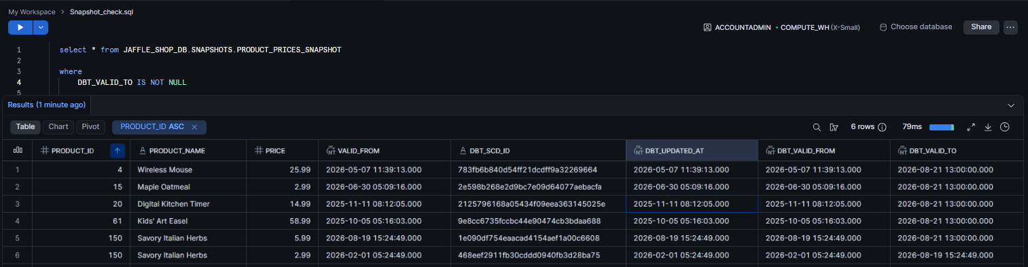
04 - Snapshot + incremental model
Snapshots: SCD Type 2 in one dbt command
product_prices_snapshot compares source data to the last snapshot on every run.
What do dbt_valid_from & dbt_valid_to mean?
The time window this row was the "current truth." NULL to = still current.
Nothing changed in source. What happens on dbt snapshot?
Nothing new is inserted. The existing valid row just stays valid after update.
Source: dbt-labs jaffle-shop-classic · Imported at 17.08.2026 09:50:00

Slide 7
05 - What's next
If I had another week...
More incremental models
Apply the same pattern to price_change_history as history grows past a trivial size.
More sources
Bring in a real second system (e.g. an inventory data) to test joins across genuinely different data shapes
More visualisation
Create connection to the Power BI. Build one simple report and maybe one dashboard for price changes.
More macros
Apply more macros in data filtering. To cover more bussines goals in our database.
Source: dbt-labs jaffle-shop-classic · Imported at 17.08.2026 09:50:00

Slide 8
Thank you for your attention!
I will be happy to answer your questions.
Source: dbt-labs jaffle-shop-classic · Imported at 17.08.2026 09:50:00

