Slide 1
Big Mountain Resort
Summary and Findings

Slide 2
Problem Statement
Big Mountain Resort, a ski resort located in Montana, recently installed a new chairlift, which increased their operating costs by $1,540,000. The strategy of offsetting these additional costs, charging a premium above the average price of resorts in the same market segment, has aroused suspicion that Big Mountain is not capitalizing on its facilities as much as it could.

Slide 3
Recommendation and Key Findings
Upon carefully examining multiple factors impacting operating costs, and making comparisons to resorts nationwide, it is recommended that Big Mountain close up to 10 of its least used runs.
Closing up to 10 runs will not have a significant impact on ticket price and revenue.
Closing up to 10 runs will alleviate funds currently used for maintenance, staff, and snow production of those runs.
Adding or expanding a run(s) will create the need for another new chair lift, as well as more snow production, which will result in a ticket price increase of $1.99, and higher overall operating costs.
Big Mountain is priced higher than other resorts in Montana.

Slide 4
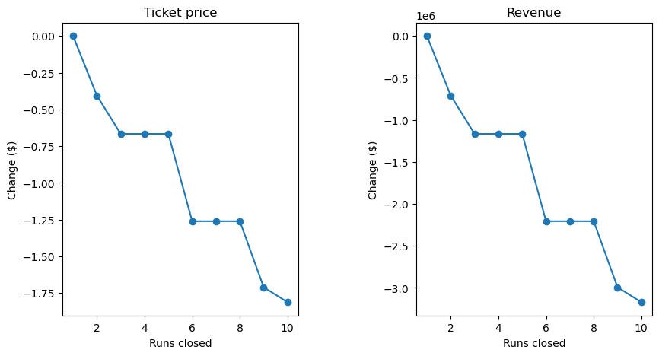
The figures above demonstrate the effects of closing runs on ticket price and revenue.

Slide 5
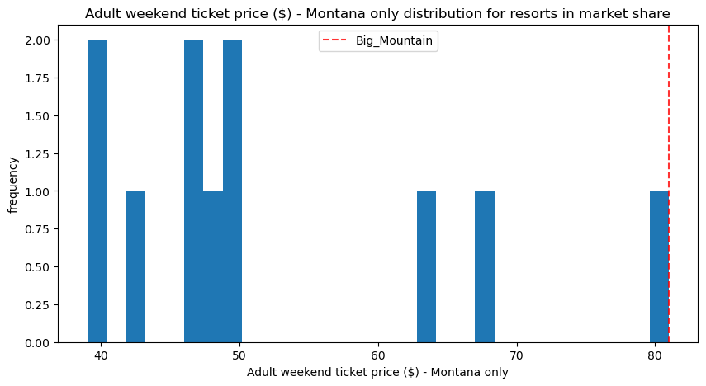
The figure above demonstrates the market share distribution for Montana. Big Mountain is priced higher in comparison to other resorts in Montana, allowing for a slight decrease.

Slide 6
Conclusion
Big Mountain should close up to 10 of its least used runs.
This will cut maintenance costs.
Big Mountain should also consider examining other areas of operating costs (other amenities, utilities, etc.)

