Slide 1

THE STATE UNIVERSITY OF ZANZIBAR
SCHOOL OF COMPUTING COMMUNICATION AND MEDIA STUDIES
DEPARTMENT OF COMPUTER SCIENCE AND INFORMATION TECHNOLOGY
INNOVATION WEEK TANZANIA 2025
(IWTZ2025)
PROJECT PRESENTATION
Project Title: AI MEDICAL LAB
Project Author: ISACK SWALEHE ADAM

Slide 2
Project Definition
Disease Prediction from Medical Imaging is a web-based application that uses artificial intelligence (AI), particularly machine learning models, to automatically detect and predict the presence of diseases from medical images such as X-rays, MRIs, or CT scans.
The system is built using the MERN stack (MongoDB, Express.js, React.js, Node.js) for the web platform and integrates a trained machine learning model developed in Python to analyze and interpret uploaded medical images.

Slide 3
Significance of the Project
✅ Reduces Human Error in diagnosis️
✅ Enables Timely Medical Intervention
✅ Improves Accessibility to expert-level care
✅ Learns and Improves from Data
✅ Offers Personalized Healthcare experiences
✅ Enhances Efficiency in medical workflows

Slide 4
Problem Statement
Slow and Error-Prone Process
Interpreting medical images takes time and often depends on the experience of specialists, making it prone to mistakes.
Shortage of Experts
In many areas, especially low-resource regions, there aren’t enough trained radiologists, causing delayed or missed diagnoses.
Need for Intelligent Support
There’s a strong demand for an AI-powered solution that can help detect diseases accurately and quickly—improving access and patient outcomes.

Slide 5
Functional Requirements
What the system MUST do:
User Registration and login
Disease Prediction
Accept patient inputs (symptoms, test results)
Return predictions for:
Breast cancer, Diabetes, Heart disease, Lung cancer etc.
Report Generation
Generate PDF reports with predictions
Upload and view medical images (X-rays, MRIs, etc.)
AI-based disease detection and prediction

Slide 6
Non Functional Requirements
Quality Attributes
Performance: Quick image processing and response time
Scalable: Able to handle many users and large datasets
Security: Data encryption, secured login
Usability: Simple, intuitive, accessible and very friendly UI

Slide 7
Business Impact
🎯 Target Users:
Hospitals & Clinics, Radiologists & Medical Experts, Patients, HealthTech Startups & NGOs
✅ Key Benefits:
Faster Diagnosis, Cost Reduction, Scalability
💰 Monetization Strategy:
Subscription Plans (Monthly/Annual), Tiered Pricing (Basic to Premium)

Slide 8
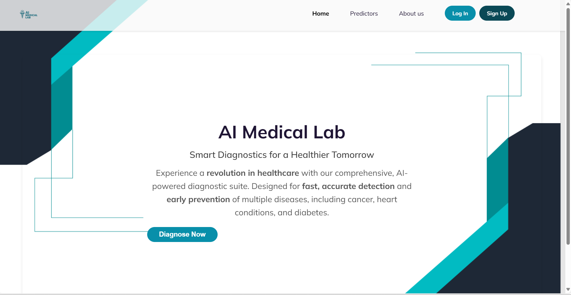
Welcome Page
Implementation

Slide 9
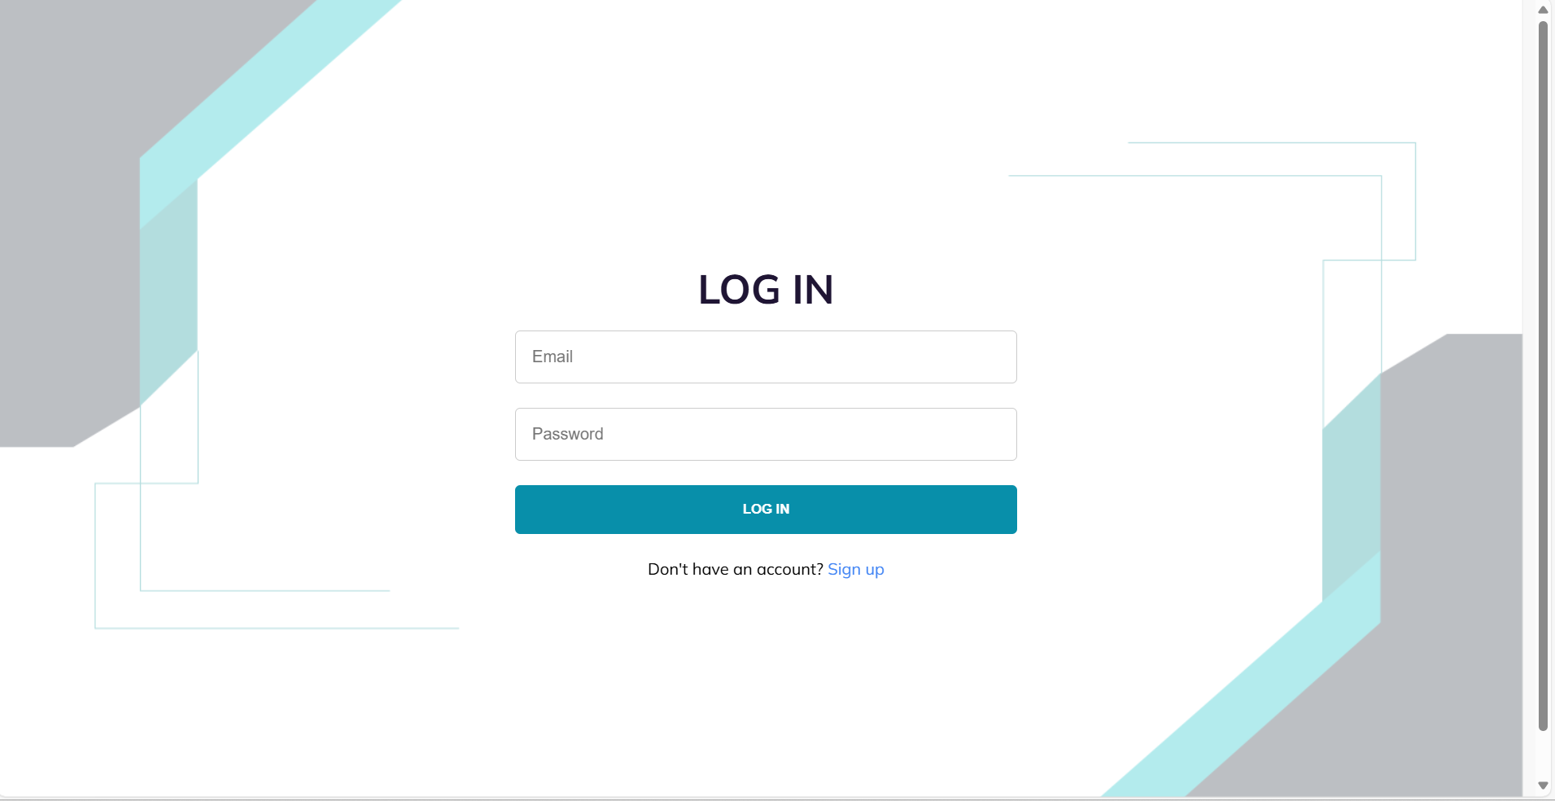
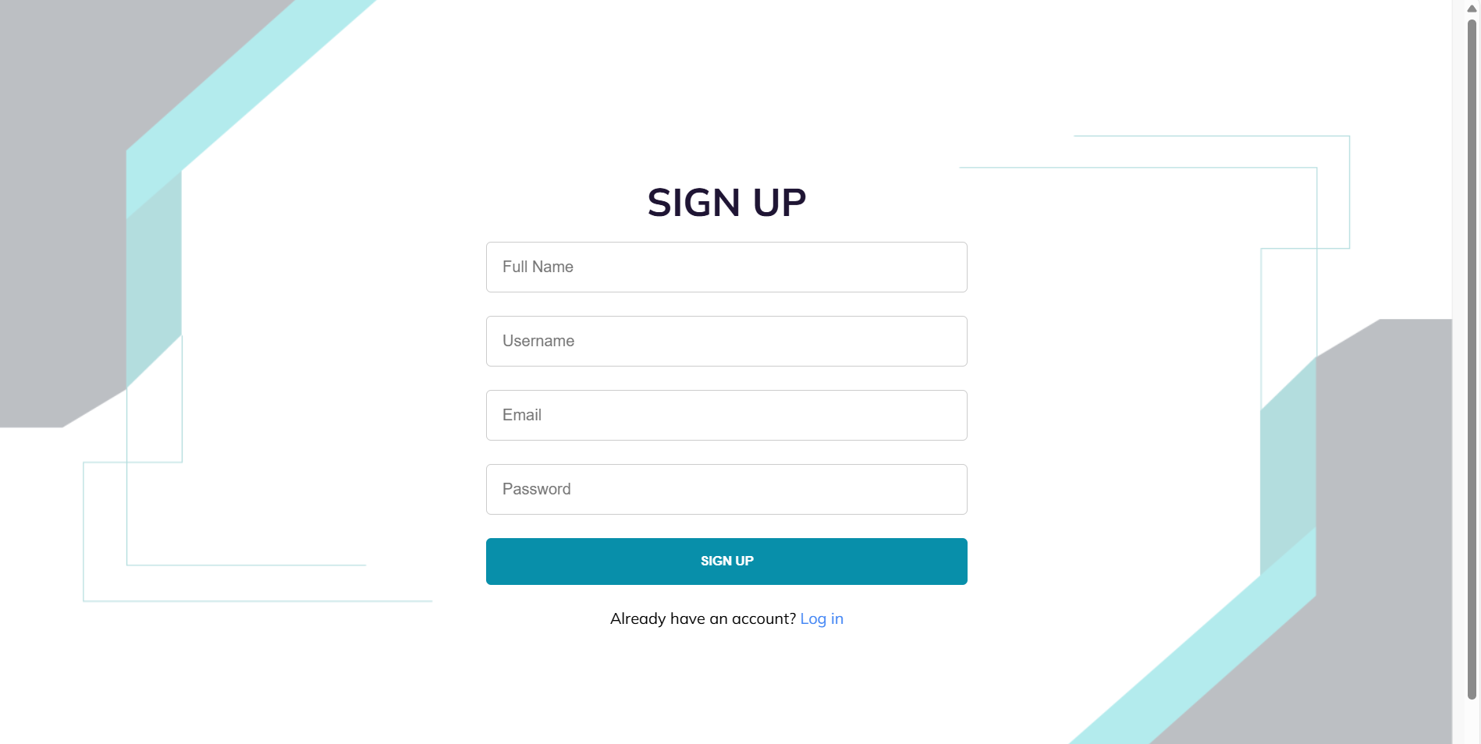
Authentication
Implementation

Slide 10
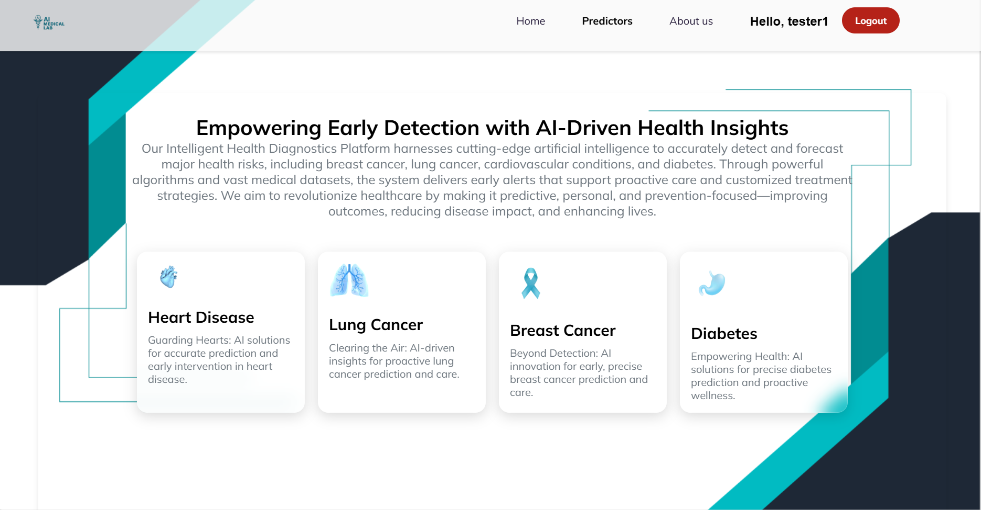
Prediction
Implementation

Slide 11
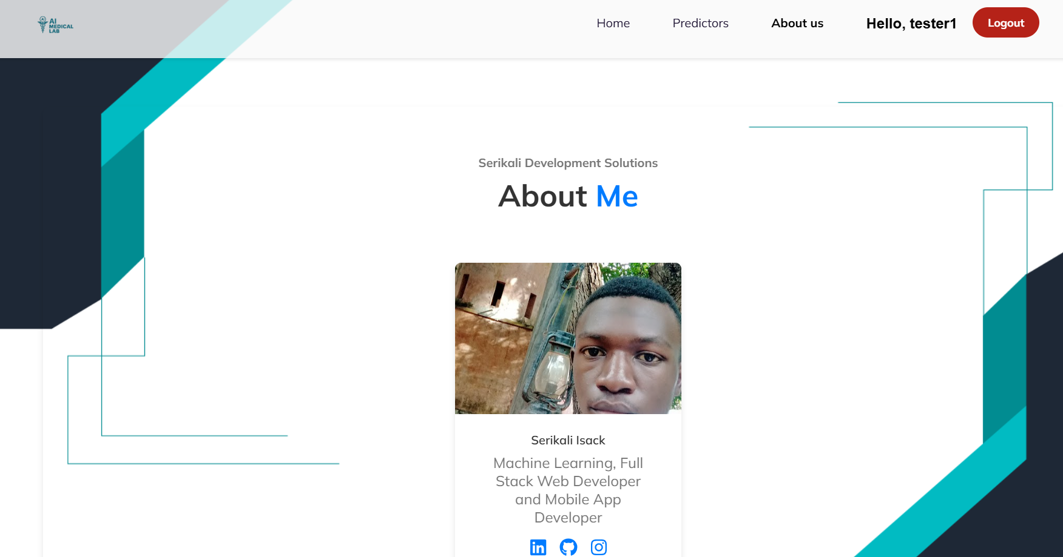
About Me
Implementation

Slide 12
THANKS !!!

