Slide 1
Article review
3D Printed Organs: The Future of Regenerative Medicine
Serikov Vasily B03-102

Slide 2
CONTENTS
A few words about the journal the paper comes from
The key terms
The article review

Slide 3



About journal of Clinical and Diagnostic Research
H
H-index
Quartile
66
Q1
Peer-review type
Author guidelines
Collaborative
Open peer review
Papers number
Format of Articles

Slide 4
Key terms
01
02
03
04
Bioprinting
[baI.oʊˈprint.Iŋ]
Bioinks
[baɪ.oʊ.ɪnks]
Vascularization
[væs.kyə.ləˈreɪ.ʃən]
Regenerative
[rɪˈdʒɛn.ər.ə.tɪv]

Slide 5
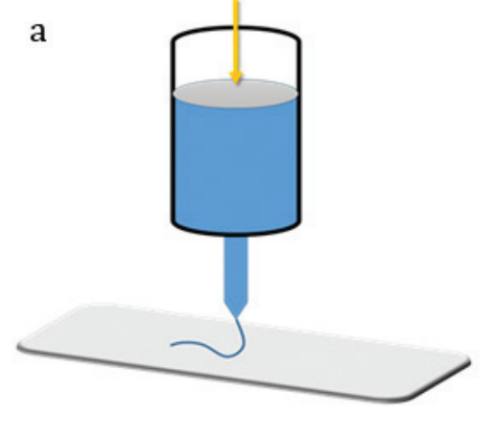
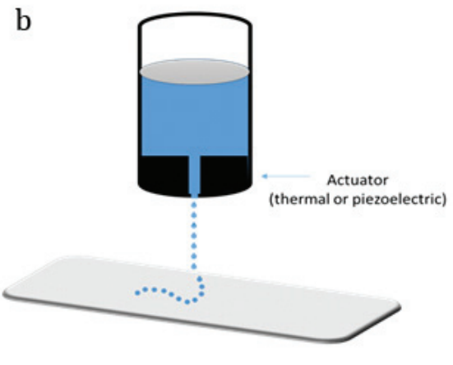
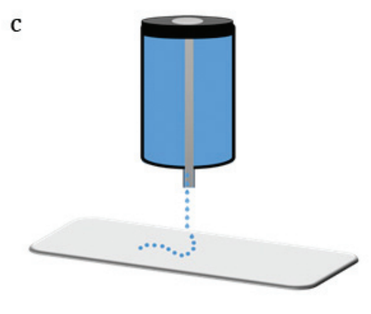
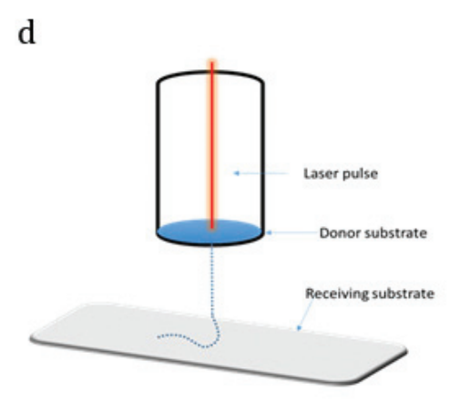
Extrusion based printing
Methods
Inkjet printing
Microwave based printing
Laser-assisted bioprinting

Slide 6




Bioprinting of functional tissues
Results
Development of new bioinks and bioprinting techniques
Progress in vascularizing bioprinted tissues
Integration of bioprinting with other technologies

Slide 7
Thanks !

