Slide 1
article review
Surges in volcanic activity on the Moon
about two billion years ago
Serikov Vasily B03-102

Slide 2
Contents
01
A few words about the journal the paper comes from
02
The key terms
03
The article review

Slide 3



About Nature journal
H
H-index
Peer-review type
1331
Collaborative
Open peer review
Quartile
Author guidelines
Q1
Papers number
Format of Articles

Slide 4
Key terms
01
02
03
04
Eruptions
[ɪˈrʌpʃn]
Olivine
[ˈɒlɪviːn]
Clinopyroxene
[klaɪnə(ʊ)paɪˈrɒksiːn]
Magma
[ˈmægmə]

Slide 5


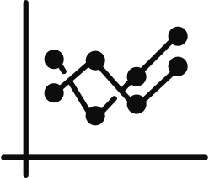
Electron microscope
Methods
Mineral orientations
Diffusion modeling

Slide 6


Enhanced magmatic flux ~2 billion years ago
Results
Revising models of lunar thermal evolution

Slide 7
Thanks !

