Slide 1

Stack Overflow Developer Survey Analysis
Learner Name Lalitha Devi Seri

Slide 2



OUTLINE
Executive Summary
Introduction
Methodology
Results
Visualization – Charts
Dashboard
Discussion
Findings & Implications
Conclusion
Appendix

Slide 3

EXECUTIVE SUMMARY
Executive Summary
This capstone project analyzes technology, programming language, database, job market, and demographic trends using survey and job-posting datasets.
The analysis combines API data, web-scraped data, survey exploration, data cleaning, visualizations, and dashboarding.
Python, SQL, JavaScript and similar technologies appear prominently in current demand, while future trend analysis highlights continued demand for modern development tools and databases.
Dashboard analysis helps compare current technology usage, future preferences, and respondent demographics.
Overall, the project provides practical insights for students, aspiring data analysts, recruiters, and organizations to understand changing technology and job-market patterns.

Slide 4

INTRODUCTION
Purpose of the report
To analyze real-world developer and job-market data using data analytics techniques.
To identify trends in programming languages, databases, salaries, jobs, and demographics.
To present findings using charts and dashboards for easier interpretation.
Target audience
Students and aspiring data professionals
Recruiters and hiring managers
Training institutions and educators
Business stakeholders interested in technology trends
Value of the analysis
Helps understand current and future technology demand
Supports better career and skill decisions
Converts raw data into actionable insights through dashboards and visualizations

Slide 5

METHODOLOGY
Data sources
Job posting data collected using API
Popular language data collected through web scraping
Stack Overflow Developer Survey dataset used for technology and demographic analysis
Dashboard insights created from cleaned survey data
Data collection and wrangling
Imported datasets into Python using pandas
Cleaned missing values and duplicate rows
Standardized columns where required
Filtered relevant variables for programming languages, web frameworks, remote work, employment, education, organization size, and developer demographics.
Created summary tables and visualizations for analysis
Tools used : Python, Pandas , NumPy, Matplotlib, Jupyter Notebook, Power BI

Slide 6
Results
Programming Languages
JavaScript is the most widely used programming language.
SQL ranks second.
HTML/CSS and TypeScript remain highly popular.
Python is among the top five languages.

Slide 7
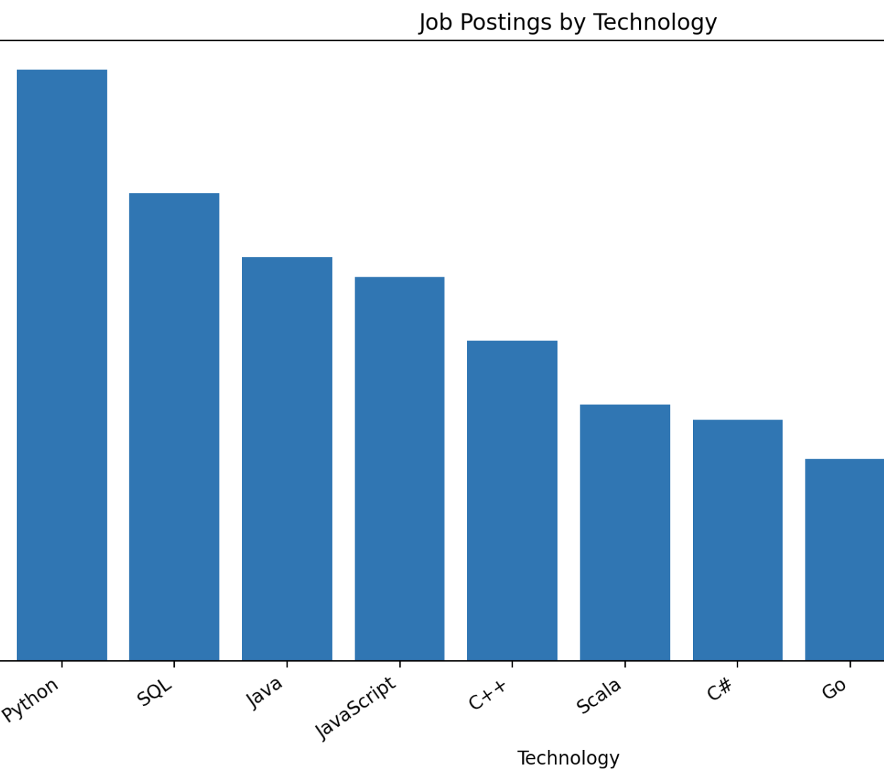
JOB POSTINGS
Insights
Python and SQL-related roles show strong demand in job postings.
Data-focused and software-related technologies appear frequently across listings.
The job market indicates sustained demand for technical and analytical skills.

Slide 8
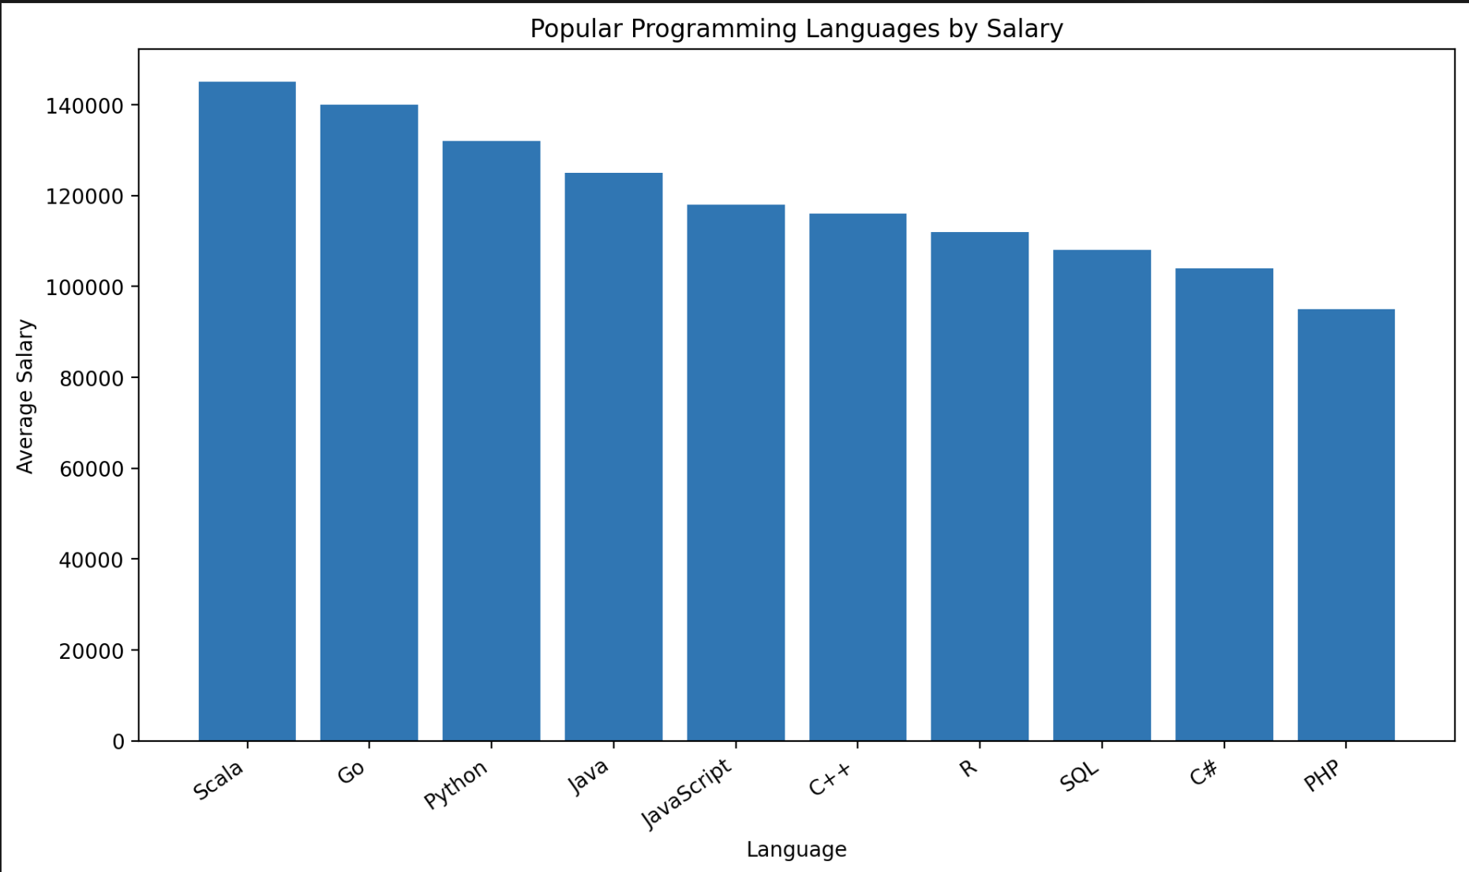
POPULAR LANGUAGES
Insights
Some programming languages command significantly higher salaries than others.
Popularity and salary do not always move together; niche or enterprise technologies may pay more.
Salary comparison helps identify languages with stronger earning potential.

Slide 9
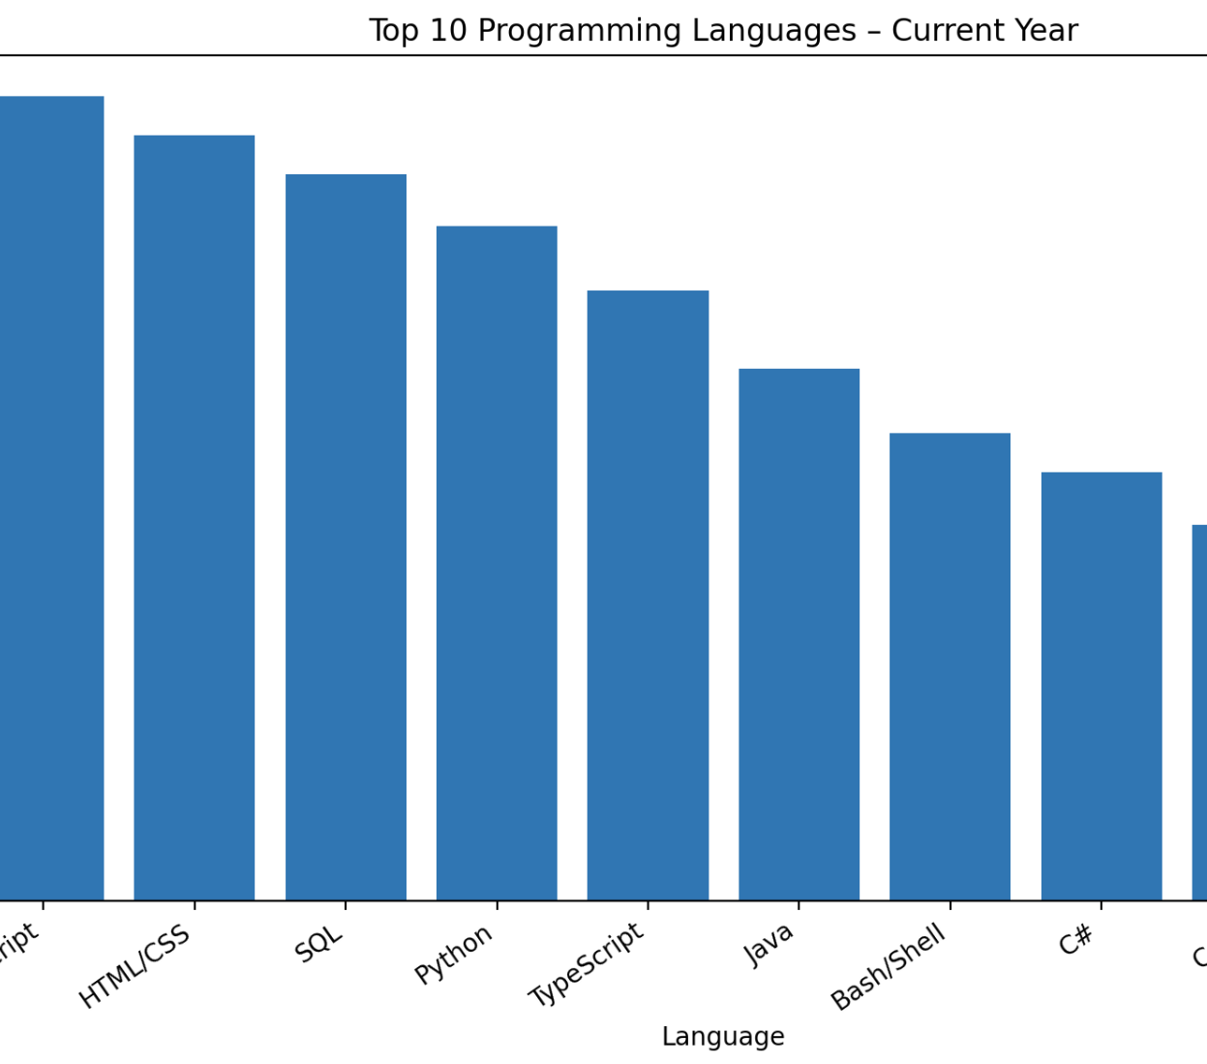
PROGRAMMING LANGUAGE TRENDS
Key Trends
A few core languages remain highly popular in both current and future usage trends.
Languages used for data, web development, and automation continue to dominate.
The next-year trend suggests that developers are likely to continue investing in modern, versatile programming languages.

Slide 10
PROGRAMMING LANGUAGE TRENDS - FINDINGS & IMPLICATIONS
Findings
Programming language demand is concentrated around a small group of widely used languages.
Languages associated with data analysis, backend development, and web development show continued relevance.
Future preference trends are broadly aligned with current usage, suggesting stability in core technologies.
Implications
Learners should prioritize high-demand, widely adopted languages.
Employers can focus hiring and training efforts around technologies with long-term relevance.
Institutions can align curriculum with languages showing both current and future demand.

Slide 11
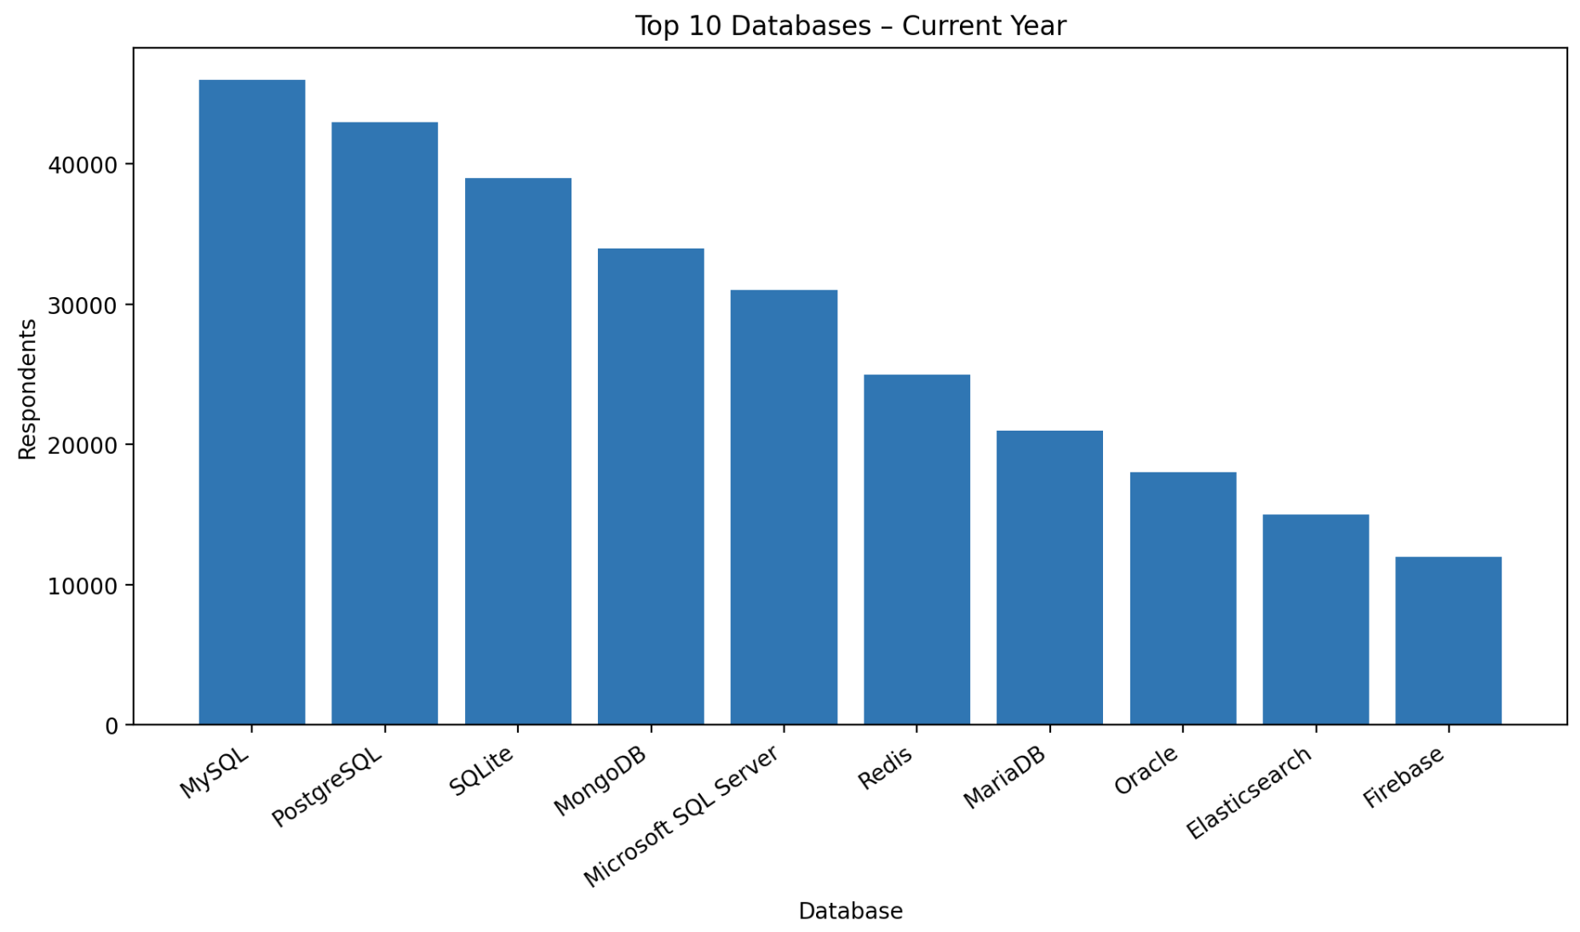
DATABASE TRENDS
Key Trends
Relational databases continue to play a major role in current usage.
Future trends indicate continued interest in both traditional SQL databases and modern scalable database tools.
Database demand reflects the need for both structured analytics and application development.

Slide 12
DATABASE TRENDS - FINDINGS & IMPLICATIONS
Findings
SQL-based databases remain central to developer and analytics workflows.
A few major database systems dominate both current use and future interest.
Database preferences indicate a mix of enterprise stability and interest in modern platforms.
Implications
Database skills remain highly valuable for analytics and development careers.
Learners should build strong SQL fundamentals while staying aware of emerging database tools.
Organizations should continue investing in database technologies that balance reliability, scalability, and developer demand.

Slide 13
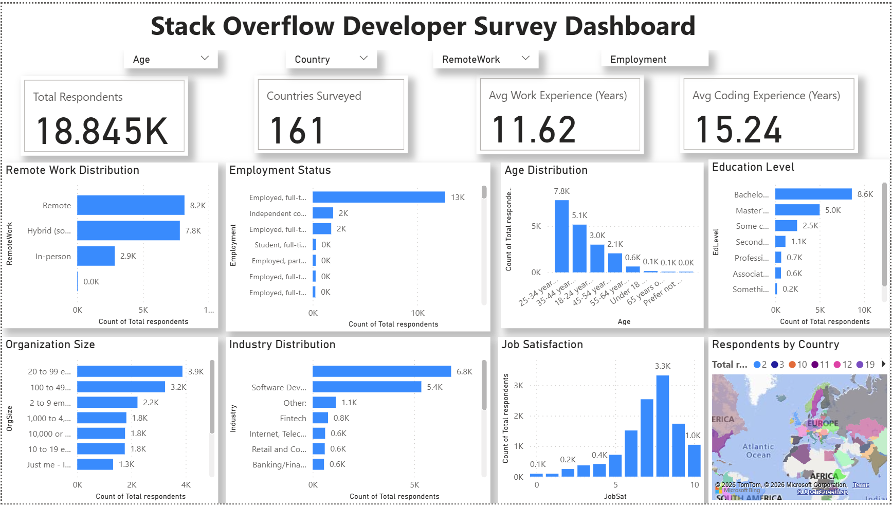
DASHBOARD
Dashboard Overview
The dashboard was created to summarize the capstone analysis across three key areas:
Current Technology Usage
Future Technology Trends
Demographics
It allows users to visually explore technology adoption, future preferences, and respondent characteristics.

Slide 14
DASHBOARD TAB 1: Current Technology Usage
Dashboard Insight
This dashboard tab highlights the technologies currently used by respondents.
It helps identify the most common programming languages, databases, and platforms in present-day use.
The results show where current developer demand and familiarity are concentrated.

Slide 15
DASHBOARD TAB 2: Future Technology Trends
Dashboard Insight
This tab focuses on technologies respondents want to work with in the future.
It helps compare current usage with future interest to identify upcoming trends.
The analysis shows which tools and technologies may gain continued relevance over time.

Slide 16
DASHBOARD TAB 3: Demographics
Dashboard Insight
This tab summarizes respondent demographics such as age, work experience, work arrangement, and related characteristics.
It provides context for understanding who the respondents are and how demographic patterns relate to technology preferences.
Demographic analysis improves interpretation of the broader findings.

Slide 17

DISCUSSION
Discussion
The dashboard and chart analysis together provide a broader picture of technology usage, future preferences, and workforce characteristics.
Current technology trends highlight established tools that remain important in the market.
Future trends suggest that developers continue to value adaptable, in-demand technologies. Power BI dashboards improved data exploration by allowing interactive filtering and visualization of developer survey responses.
Demographic analysis adds context by showing how respondent background and work characteristics shape the dataset.
Overall, the capstone demonstrates how multiple data sources can be combined to generate practical business and career insights.

Slide 18
OVERALL FINDINGS & IMPLICATIONS
Findings
Technology demand is concentrated around a set of core programming languages and databases.
Job posting and salary analyses show that technical skills continue to be strongly valued in the labor market.
Dashboard insights reveal a connection between current technology use, future interest, and respondent demographics
Implications
Students and job seekers should focus on high-demand technical skills with strong market relevance.
Employers and recruiters can use these insights to understand skill demand and workforce preferences.
Training institutions can use trend analysis to improve curriculum alignment with industry needs.

Slide 19

CONCLUSION
Conclusion
tThe capstone project successfully combined data collection, cleaning, analysis, visualization, and dashboard creation.
The findings highlight important trends in programming languages, databases, job demand, and developer demographics.
Visualizations and the interactive Power BI dashboard made it easier to interpret complex data and communicate results clearly.
The use of Python and Power BI enabled effective analysis and visualization of the Stack Overflow Developer Survey dataset.
Overall, the project demonstrates the practical value of data analysis in supporting technology and career decision-making.
he use of Python and Power BI enabled effective analysis and visualization of the Stack Overflow Developer Survey dataset.

Slide 20
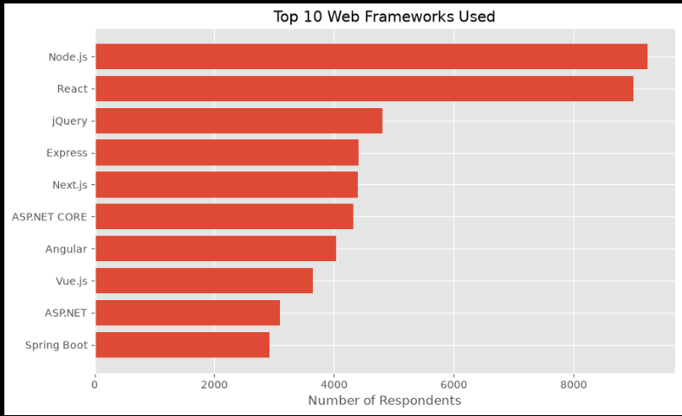
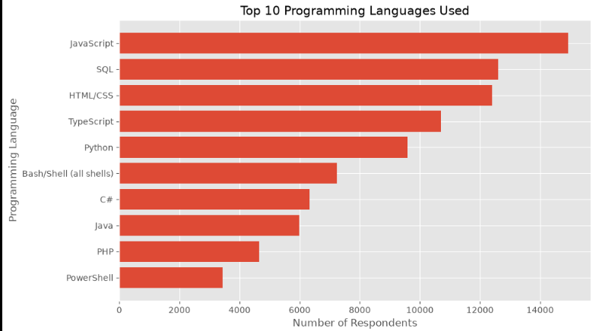
APPENDIX
extra job chart
extra language chart
extra database chart
any additional dashboard screenshots
notes if needed

