Slide 1

Python Data Analysis Exploratory Data Analysis of Netflix Movies & TV Shows
Prepared by Seri Lalitha Devi
Python • Pandas • NumPy • Matplotlib

Slide 2
Project Overview
Netflix is one of the world's leading streaming platforms, offering a diverse collection of movies and TV shows across multiple countries and genres. Analyzing its content library provides valuable insights into content distribution, production trends, and audience preferences.
This project performs Exploratory Data Analysis (EDA) on the Netflix Movies & TV Shows dataset using Python. The analysis includes data cleaning, visualization, and insight generation to identify trends in content type, release patterns, ratings, genres, and geographic distribution.
Project Scope
Analyze content distribution
Examine release trends
Identify top countries & genres
Explore content ratings
Generate business insights
Tools Used
Python
Pandas
NumPy
Matplotlib
Jupyter Notebook

Slide 3
Business Objective
This project aims to analyze Netflix's content library and answer key business questions using data analysis and visualization techniques.
Objectives
Identify the distribution of Movies and TV Shows.
Analyze content growth over time.
Discover the top content-producing countries.
Examine ratings and audience classifications.
Identify the most common genres.
Generate actionable business insights from the data.
Expected Outcome The analysis helps understand Netflix's content strategy, audience targeting, and content trends, enabling data-driven business decisions.

Slide 4
Dataset Overview
The analysis is based on the Netflix Movies & TV Shows dataset, which contains detailed information about movies and TV shows available on Netflix. The dataset provides metadata that helps analyze content distribution, release patterns, genres, ratings, and geographic trends.
Metric | Value
Total Records | 8,807
Total Features | 12
File Format | CSV
Data Source | Kaggle
Dataset Information
Source: Kaggle – Netflix Movies & TV Shows Dataset
Records: 8,807
Features: 12
Format: CSV
Key Attributes
Show ID, Title, Type, Director, Cast, Country, Date Added, Release Year, Rating, Duration, Genre & Description.

Slide 5
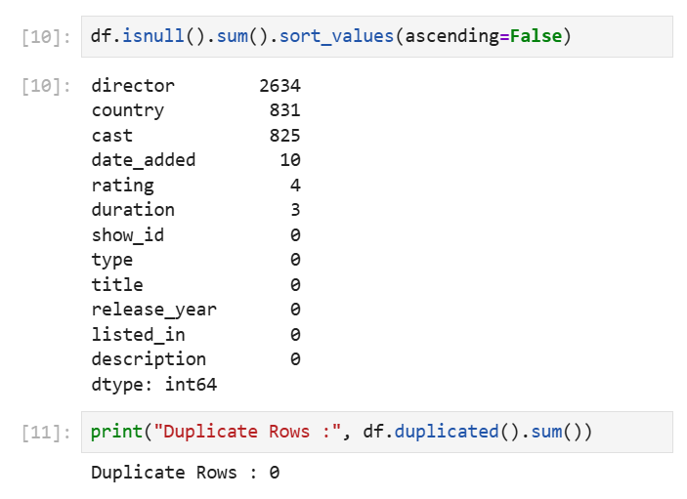
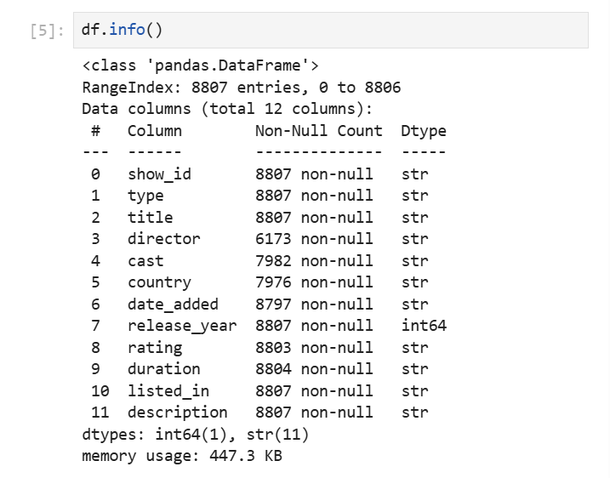
Data Cleaning
Data cleaning was performed to improve the quality and reliability of the dataset before analysis.
Data Cleaning Process
Checked dataset structure and data types.
Identified missing values across columns.
Removed duplicate records.
Converted the Date Added column to datetime format.
Verified data consistency for analysis.
Outcome
Clean and structured dataset.
Accurate date formatting for time-based analysis.
Improved data quality for visualization and business insights.
Dataset prepared for Exploratory Data Analysis (EDA).

Slide 6
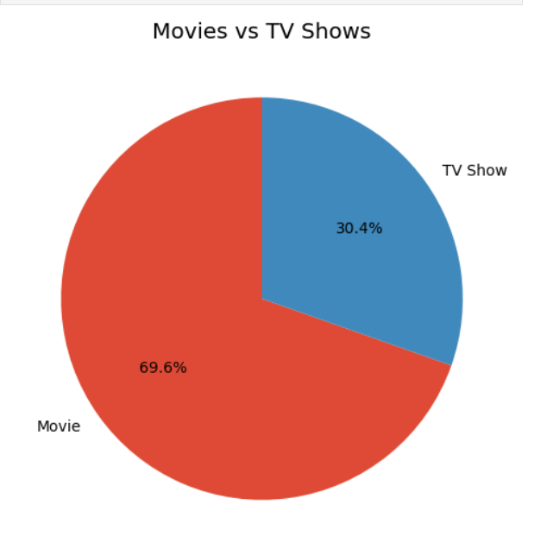
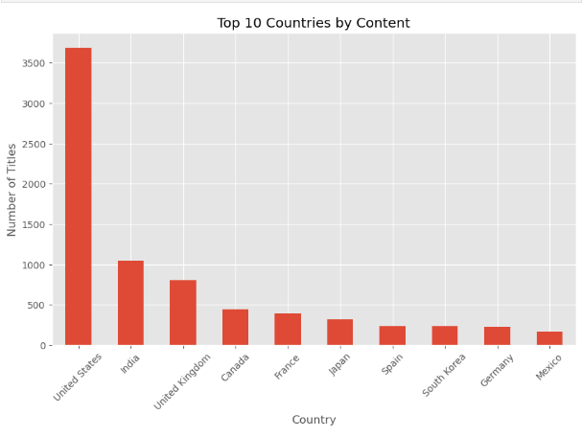
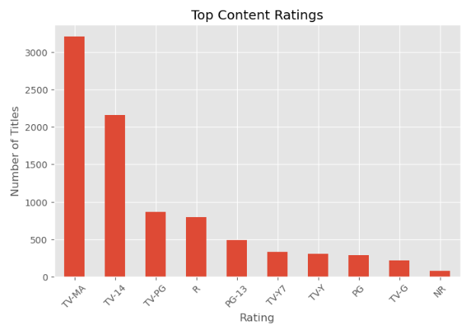
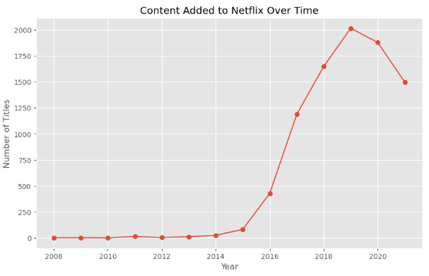
Exploratory Data Analysis (EDA)
EDA was conducted to identify trends, patterns, and relationships within Netflix's content library through data visualization.
Visualizations Performed
Content Distribution (Movies vs TV Shows)
Top 10 Content-Producing Countries
Content Ratings Distribution
Content Added Over Time
Release Year Trend
Top 10 Genres
Top 10 Directors
Movie Duration Distribution
Top Release Years
Content Type Distribution
Key Focus Areas
Content Type • Countries • Ratings • Release Trends • Genres • Directors

Slide 7
Key Insights
Based on the exploratory data analysis, the following insights were identified:
Movies make up the majority of Netflix's content library.
The United States contributes the highest number of titles.
TV-MA is the most common content rating.
Netflix's content library experienced significant growth after 2015.
International Movies and Dramas are among the most popular genres.
Most movies have a duration between 80–120 minutes.

Slide 8
Recommendations
Based on the analysis, the following recommendations can help strengthen Netflix's content strategy:
Expand investment in international content to reach a broader audience.
Increase production in high-performing genres such as Drama and International Movies.
Maintain a balanced mix of Movies and TV Shows to cater to diverse viewer preferences.
Focus on data-driven content acquisition by analyzing audience demand and viewing trends.
Continuously monitor content ratings and release trends to optimize future content planning.

Slide 9
Conclusion
This project successfully analyzed the Netflix Movies & TV Shows dataset using Python to uncover meaningful trends in content distribution, genres, ratings, release patterns, and geographic presence.
The analysis demonstrated the complete data analysis workflow, including data cleaning, exploratory data analysis (EDA), visualization, and business insight generation. The findings highlight how Python can be used to transform raw data into actionable insights that support data-driven decision-making.

Slide 10
Thank You
Thank you for your time and attention.
I appreciate the opportunity to present this project and demonstrate my Python data analysis skills. I look forward to applying these analytical techniques to solve real-world business problems.
Prepared by
Lalitha Devi Seri
BBA (Marketing) Aspiring Marketing & Data Analyst
📧 Email: serilalithadevi@gmail.com
💼 LinkedIn: linkedin.com/in/lalitha-devi-seri
🐙 GitHub: github.com/serilalithadevi

