Slide 1

Minor Project Final Viva –Voce MSc Computer Science III Semester – 2022
School of Computer Science and Applications

Slide 2
A PROJECT REPORT ON Simple Web Search Engine
Submitted Final Viva-Voce Project report completion of MSc –Computer Science degree
Presented by:
Mr. Seriman Doumbia and Tshibangu Georges
SRN: R20SCS26 and R20SCS23
Internal Guide : Prof. Krishnamurthy R

Slide 3
Agenda
Existing System
Proposed System
Advantages of Proposed System
Methodology Used
Architecture Diagram
Class Diagram
Testing Strategy
Implementation
Result
Future Enhancement

Slide 4
Existing System
Existing search engine provides the following feature:
Relevant result to every query no matter the way the query has been returned
Fast response to the query
Autocompletion
Typo-tolerance
Managing synonyms
…..

Slide 5
Proposed System
After completion of this project work, our search engine should be able to provide the following feature:
Relevant result to every query no matter the way the query has been returned
Fast response to the query dependent to connection speed
Autocompletion
Typo-tolerance

Slide 6
Advantages of Proposed System
The proposed system have the following advantages:
Time Savings. A search engine saves you time in two ways:
by eliminating the need to find information manually,
and by performing searches at high speeds.
Relevance. When a search engine scans a website, it scores the content for relevance to particular search words.
Free Access.
Comprehensive.
Advanced Search.

Slide 7
Methodology Used
In this minor project we follow the waterfall methodology development which is composed of the following phases:
Problem statement definition or project requirement
Design
Implementation
Verification
Maintenance

Slide 8
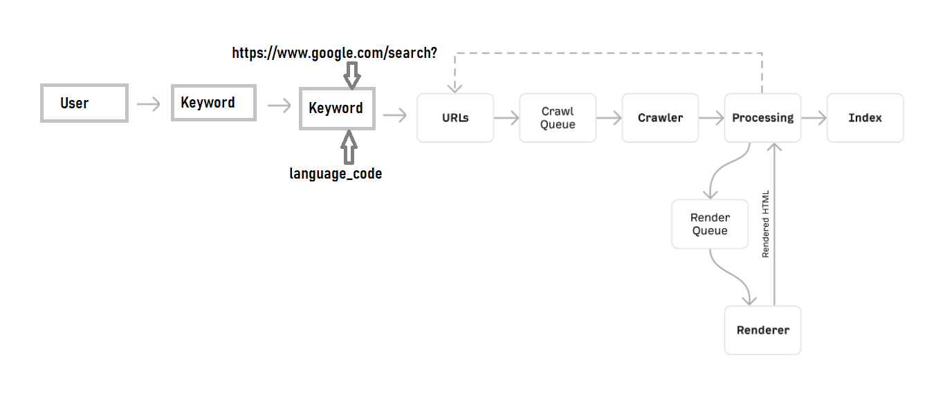
Architecture Diagram
--

Slide 9
Architecture Diagram
Let’s break down the above architecture, step by step:
URLs
Crawling
Processing & rendering
Indexing

Slide 10
Architecture Diagram
Step 1. URLs
Everything begins with a known list of URLs. Google discovers these through various processes, but the three most common ones are:
From backlinks
From sitemaps
From URL submissions

Slide 11
Architecture Diagram
Step 2. Crawling
Crawling is where a computer bot called a spider (e.g., Googlebot) visits and downloads the discovered pages.
Step 3. Processing
Processing is where Google works to understand and extract key information from crawled pages. Nobody outside of Google knows every detail about this process, but the important parts for our understanding are extracting links and storing content for indexing.

Slide 12
Architecture Diagram
Step 4. Indexing
Indexing is where processed information from crawled pages is added to a big database called the search index. This is essentially a digital library of trillions of webpages where Google’s search results come from.
That’s an important point. When you type a query into a search engine, you’re not directly searching the internet for matching results. You’re searching a search engine’s index of web pages. If a web page isn’t in the search index, search engine users won’t find it. That’s why getting your website indexed in major search engines like Google and Bing is so important.

Slide 13
Class Diagram
This project is a simple general search engine which means the collection of web site so every web site has it own class representation.
The class diagram of this project will be the combination of so many class diagram depending to the number of web site. So in order to tackle those problem we will set an overview class diagram.

Slide 14
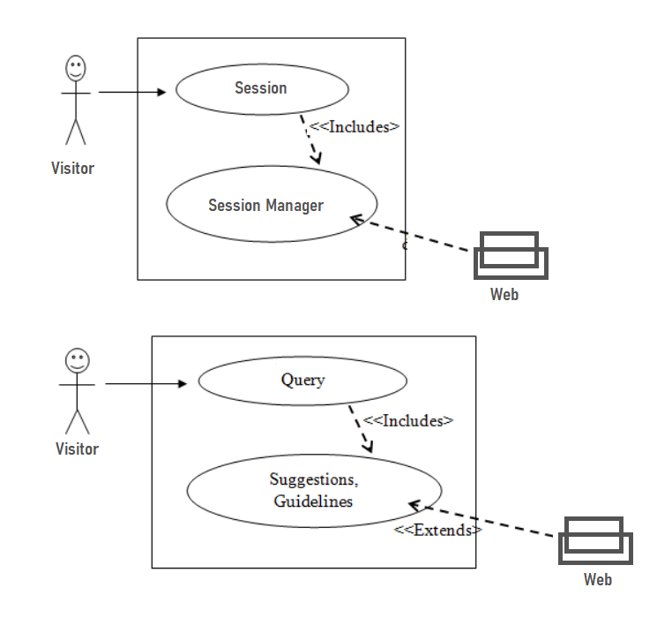
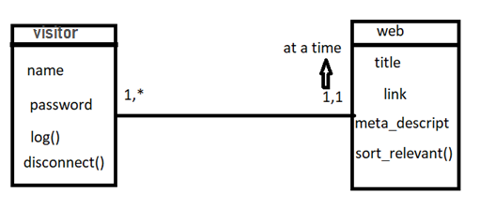
Class Diagram
.

Slide 15
Testing Strategy
Regarding to testing strategy we have used the three basic testing strategy which are:
Static testing: testing without running the developing product ,detect bugs and issues present in the code
Structural testing: called white-box testing, accessed the product’s structure and data flows, to track any changes in the system’s behavior by comparing the tests’ outcomes with the results of previous iterations.
Behavioral testing: consist to run numerous tests to see the product from user’s point of view known as black-box testing

Slide 16
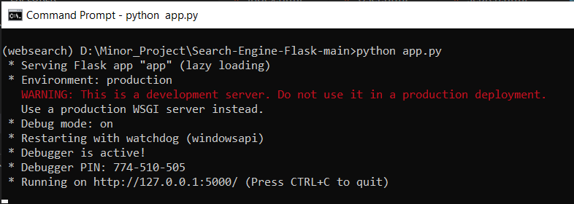
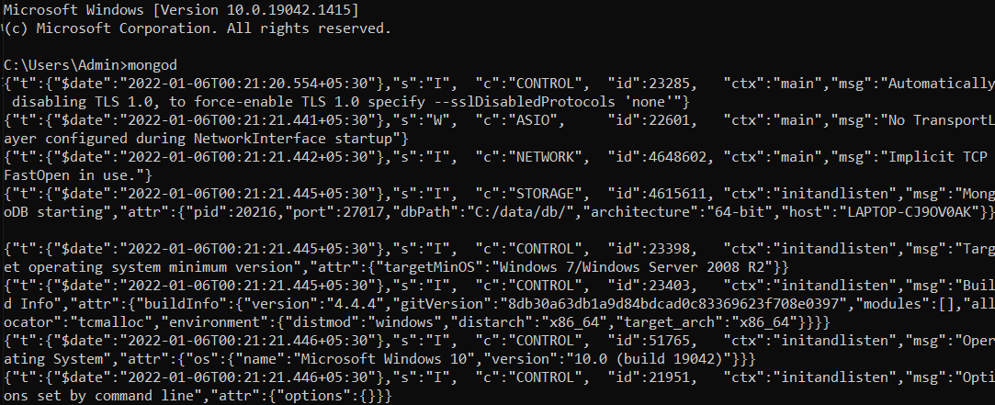
Testing Strategy
Launching project:

Slide 17
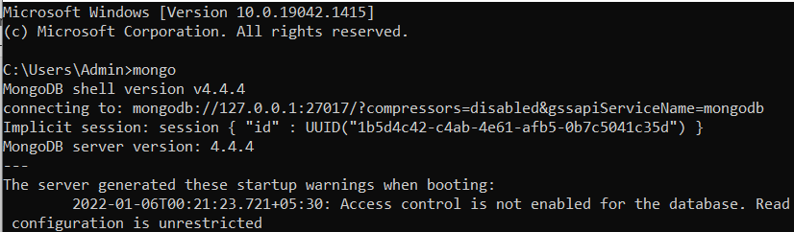
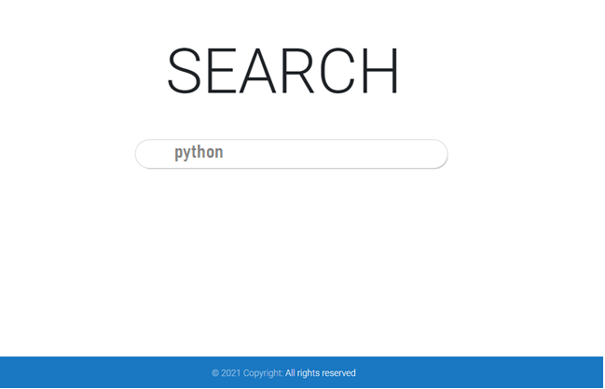
Testing Strategy
Home page

Slide 18
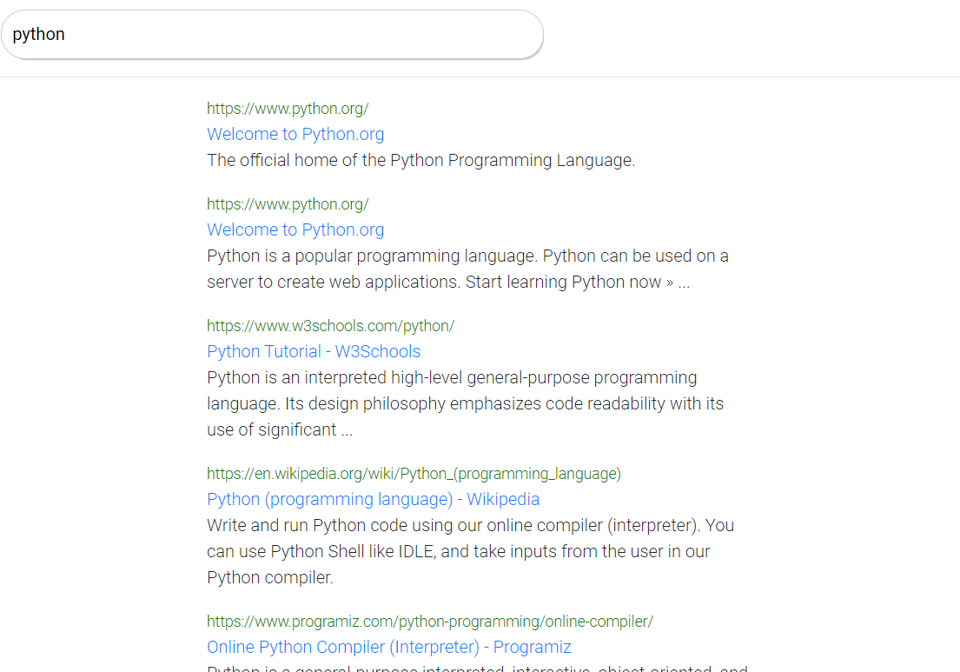
Testing Strategy
Output page

Slide 19
Implementation
This project has been implemented on:
Python
Framework Flask
Storage MongoDB
And we have two models and three views in all.

Slide 20
Result
Home page:

Slide 21
Result
Response page:

Slide 22
Future Enhancement
Possible search by image
Possible search by audio

Slide 23
summary
As conclusion a search engine is an information retrieval system that has various website data stored in it.
It shows user appropriate results on search.
It also consists of website data.
The search engine records number of times the URL was clicked on, its goes to the web URL to fetch its meta data and gives points according to page errors.
An SEO suggester used with it allows user to enter a live URL.
Our system goes and scans the webpages extracts its meta features and provides SEO suggestions.

Slide 24
summary
The search engine is first fed with URLs of various website and stores this data in its database.
After that the search engine allows user to search for data.
The user can enter the data or text lines (query) to be searched.
The system then uses this text and matches it with the content provided in the URLs fed in the database.
The user query is matched with these contents and finally it generates a list of related URLs.
The user can then click on the URLs thus generated and it will take them directly to the website.

Slide 25
summary
The search is based on user’s demand.
Once user clicks on the links he sees the web page and all the data on it.
It also calculates and displays the web page rank based on website meta score and number of visits.
The system has an advance feature that suggests website’s owner for suitable keywords, meta descriptions for their website’s SEO.
This project’s realization allowed us to implement our theorical knowledge in relation with this project.

Slide 26
Thank You

Slide 27







Icons
Architecture
Commerce
Legal Studies
Arts & Humanities
Performing Arts
Management Studies
Science & Tech
Engineering

