Slide 1
Plans and future directions
Create contingency tables for 8 important residue positions
Cross-reference whether any hypotheses could be tested with mutant library (I, V, L, M, F, Y)
Write up methods and results from this summer
Plan some wet lab experiments for the fall
Build an OleA sequence similarity network
Just TARA OleA sequences
TARA sequences + PFAM sequences (UniProt50 for PF08545)

Slide 2
Sequence Similarity Networking
July 28, 2020

Slide 3
What is an SSN?
Sequence similarity network (SSN) allows for visualization of relationships among protein sequences.
In SSNs, the most related proteins are grouped together in clusters
Two steps to generate:
1) A set of sequences to analyze is chosen, and an all-by-all BLAST is performed to determine sequence similarity for each pair of sequences in the dataset.
2) Filter the sequences into clusters, based on a similarity threshold that is user defined.

Slide 4
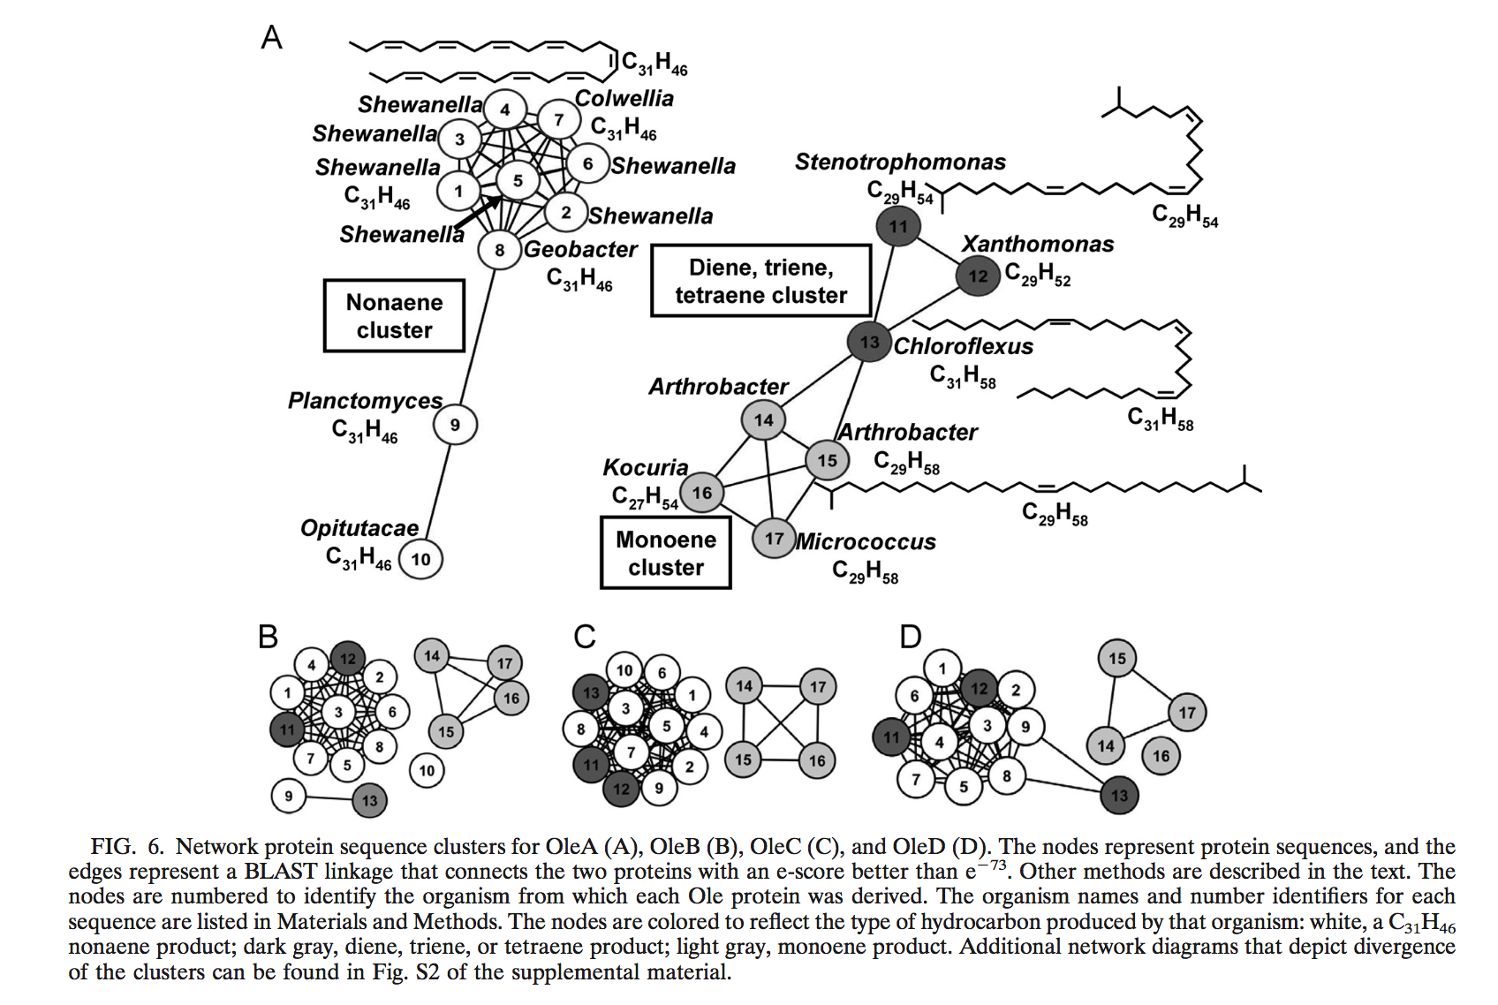
Last OleA SSN built

Slide 5
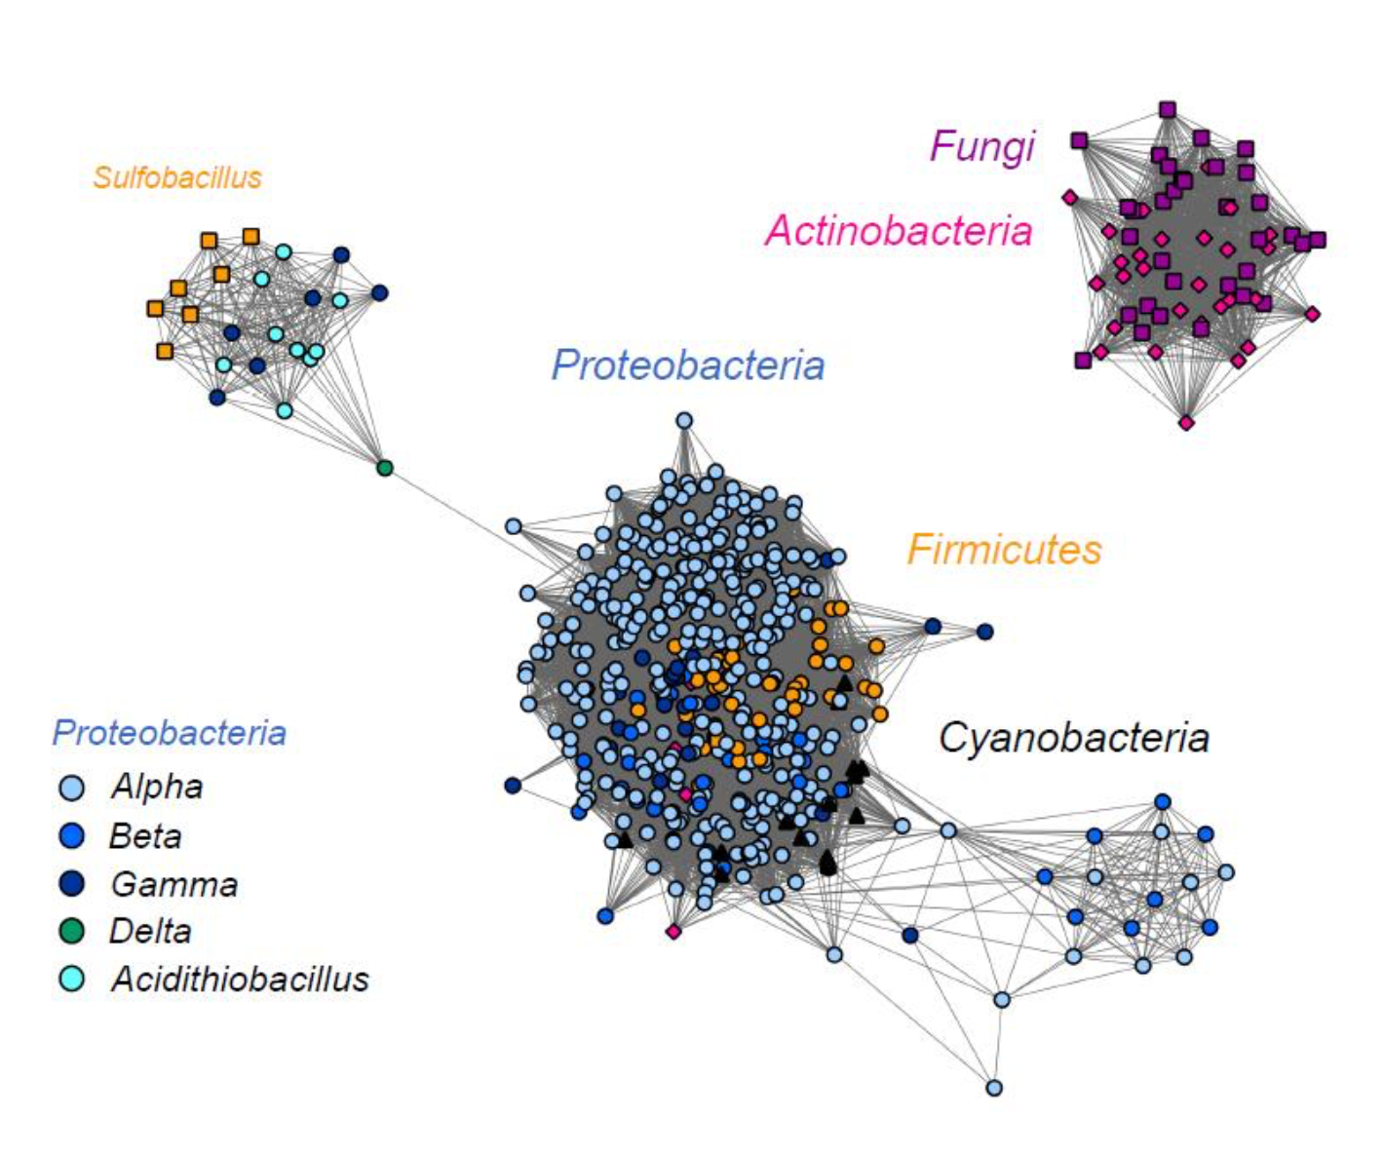
Kelly’s most recent SSN
Aukema et al. (2019) AEM

Slide 6
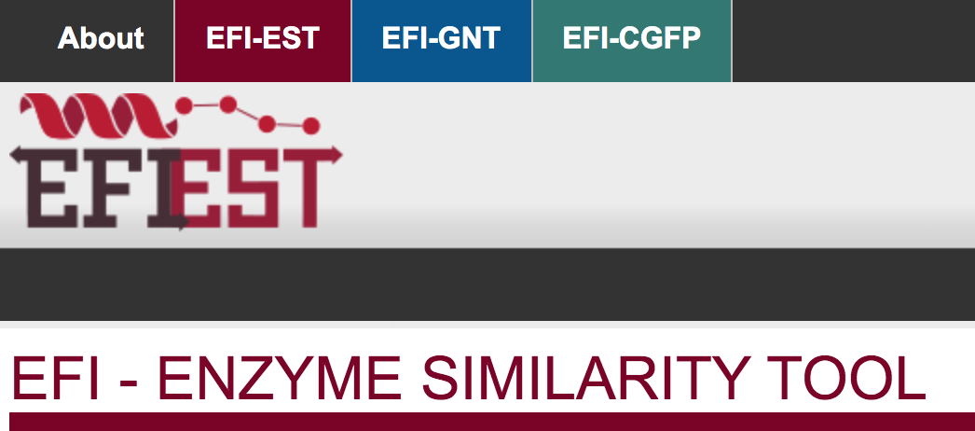
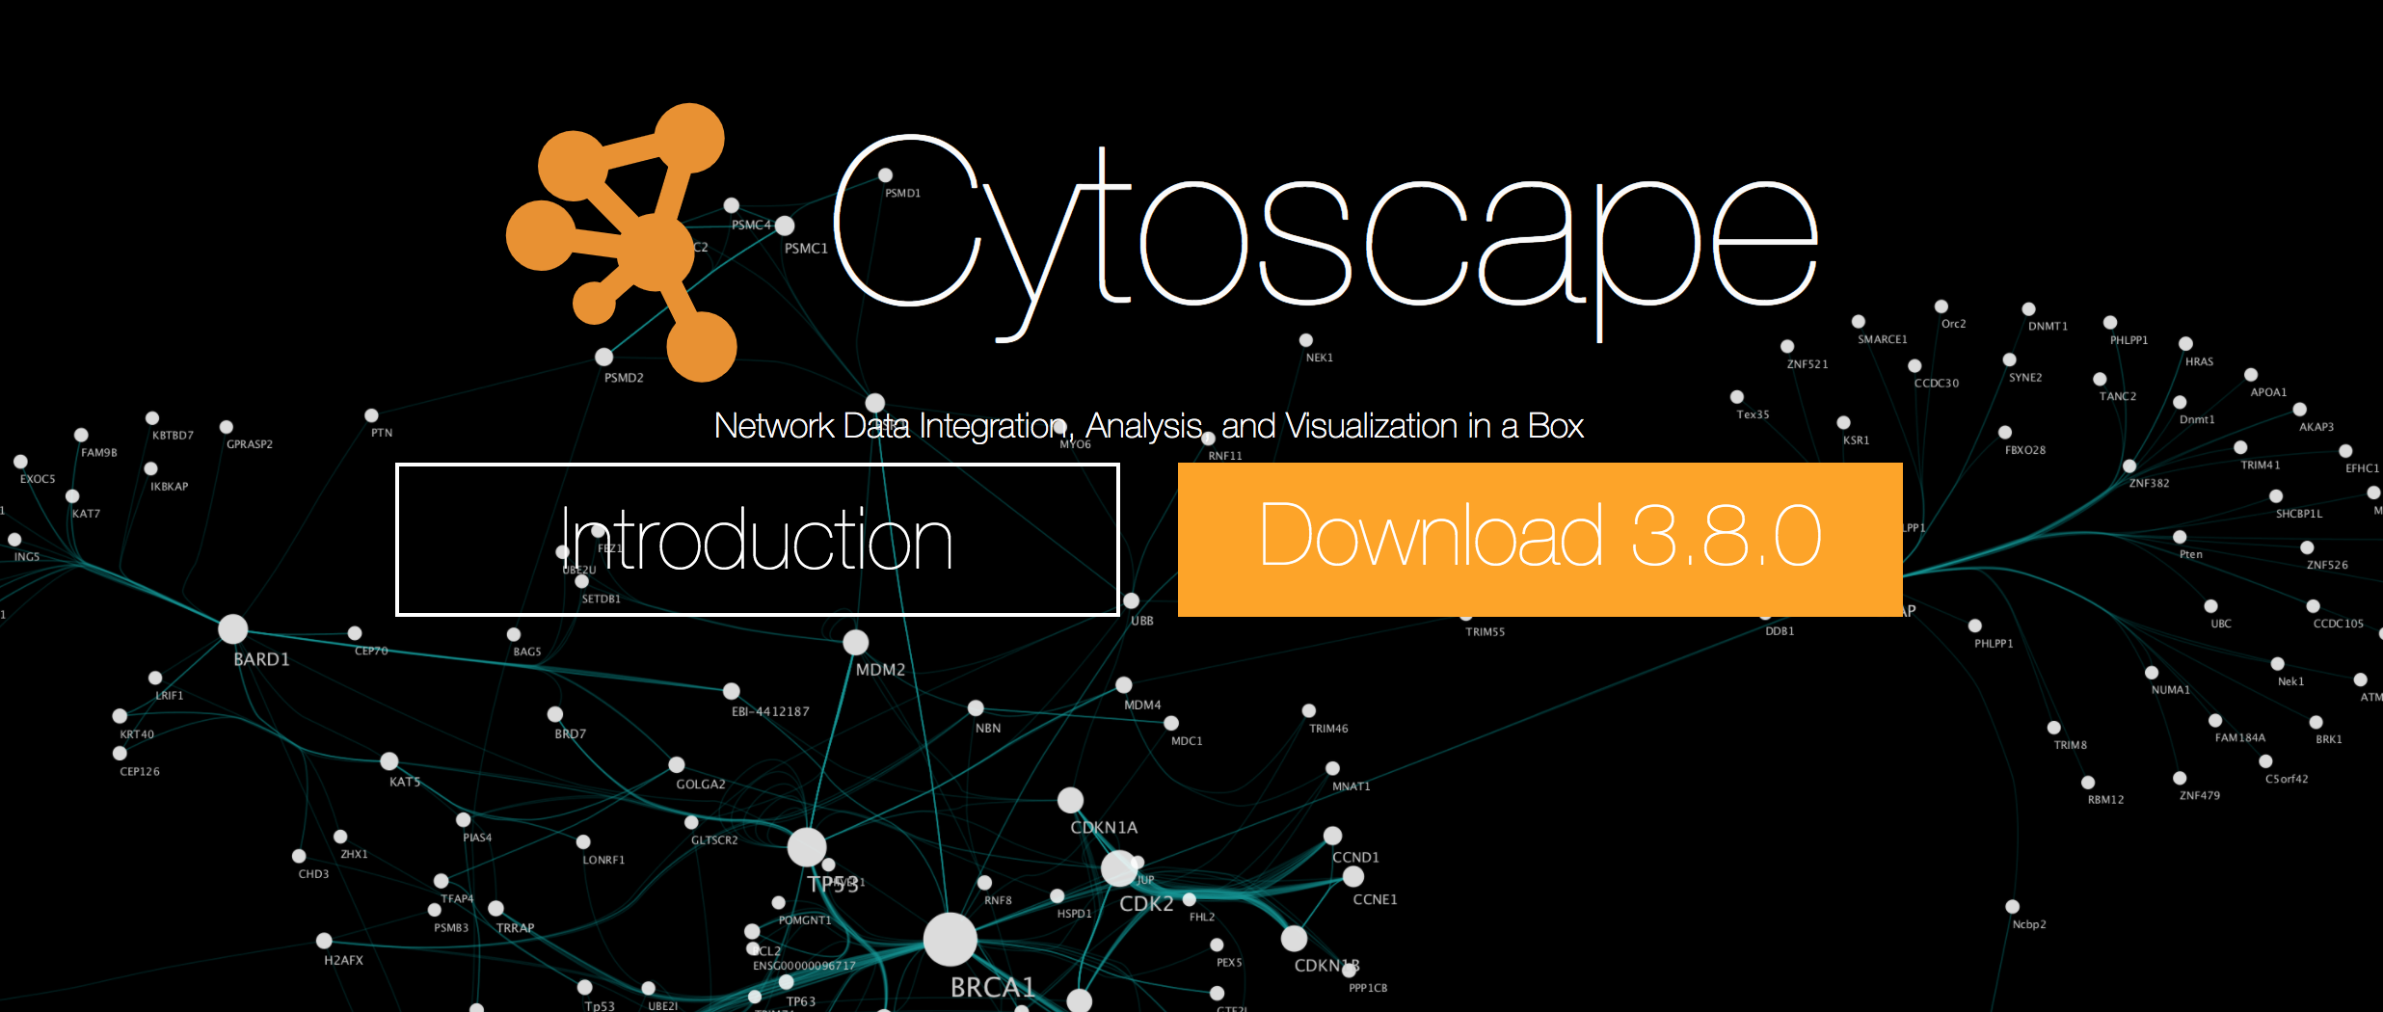
Tools to generate SSNs

Slide 7
SSN Workflow
Challenge is to decide what set of OleA sequences to use
To start we can use the (30 TARA + 20 psych/therm + 73 OleAs)
Could try a second, expanded one with more OleA BLAST hits
EFI-EST tutorial:
https://efi.igb.illinois.edu/efi-est/tutorial.php
Cytoscape tutorial:
https://efi.igb.illinois.edu/efi-est/tutorial_cytoscape.php

Slide 8
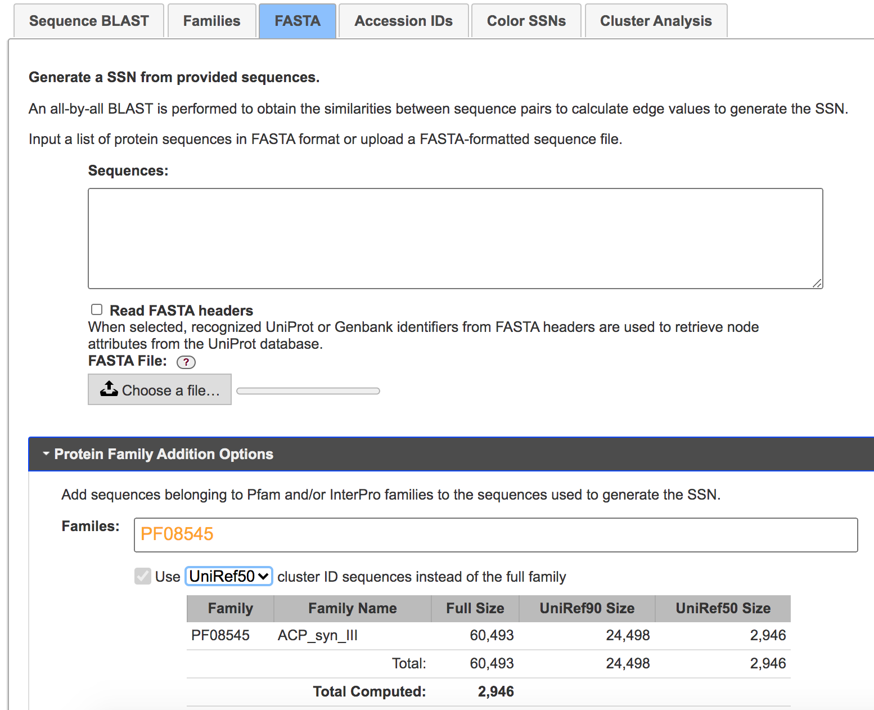
Protein Family:
ACP_syn_III
(PF08545)
https://pfam.xfam.org/family/ACP_syn_III

Slide 9
Challenges expected
Coloring the SSN? Kelly will hopefully have some help here
Idea would be to color by optimal growth/isolation temperature (if known)
Else if not known, then gray?
Could also color by taxonomy...

