Slide 1
Introduction to machine learning
Friday, July 10, 2020

Slide 2
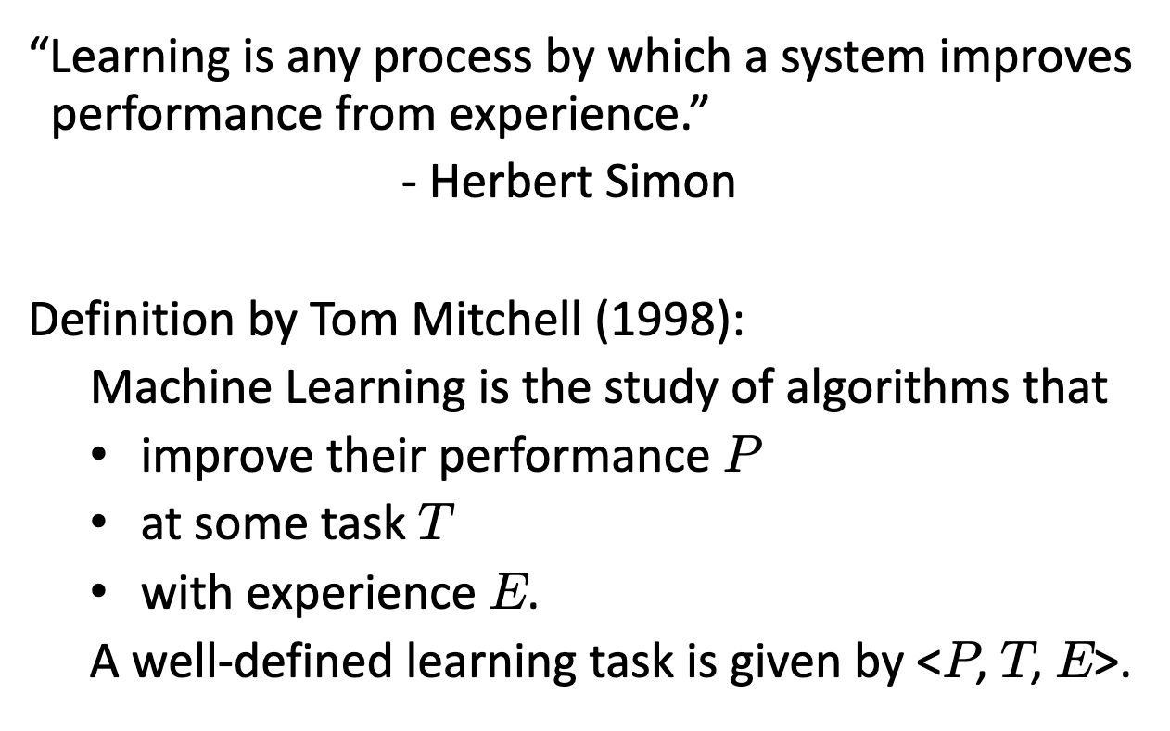
What is machine learning?

Slide 3
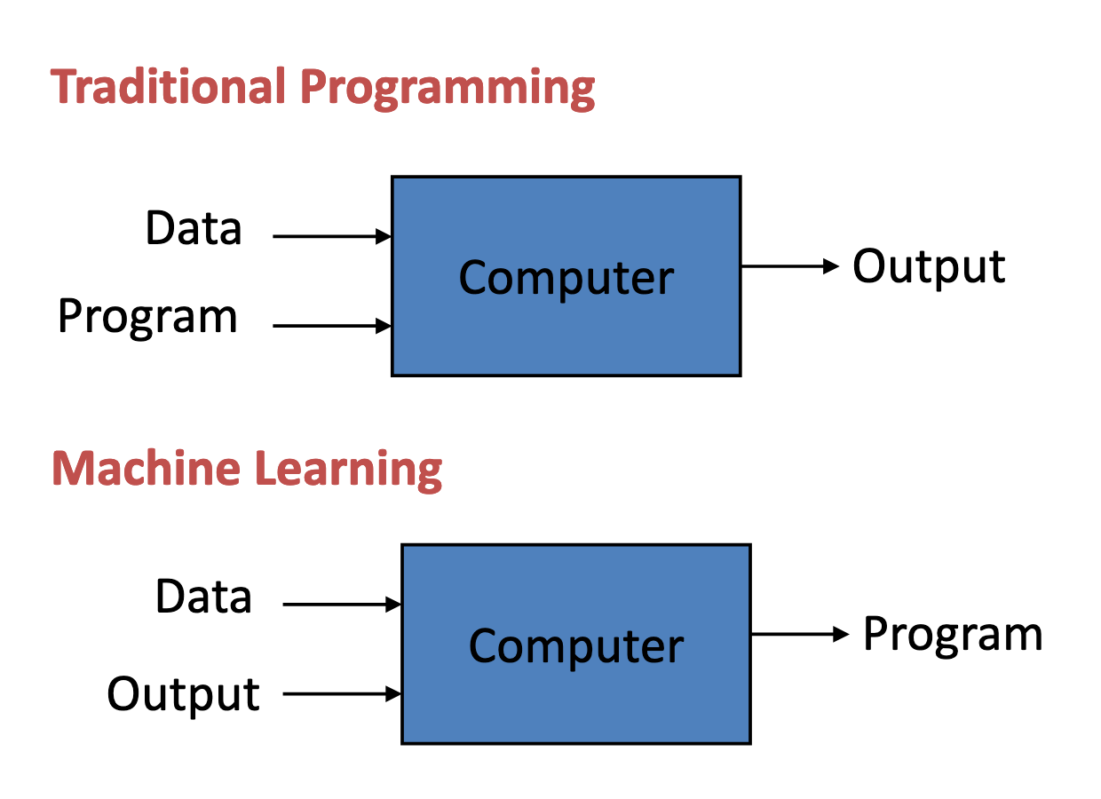

Slide 4
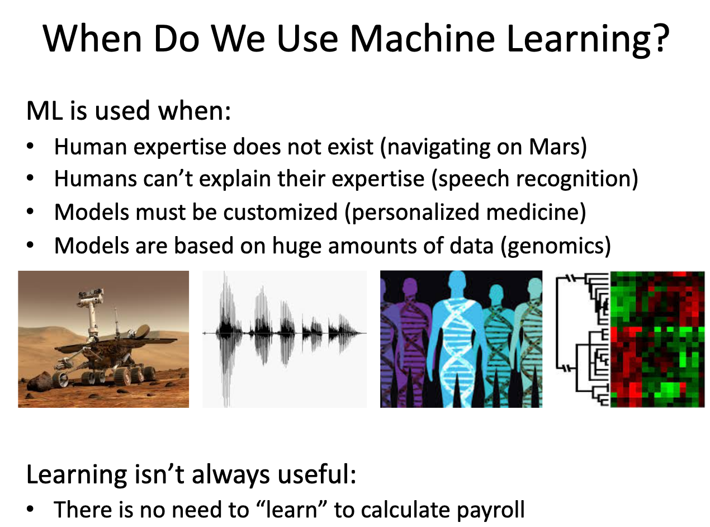

Slide 5
Types of Learning
Supervised (inductive) learning
Given: training data + desired outputs (labels)
Unsupervised learning
Given: training data (without desired outputs)
Semi-supervised learning
Given: training data + a few desired outputs
Reinforcement learning
Rewards from sequence of actions

Slide 6
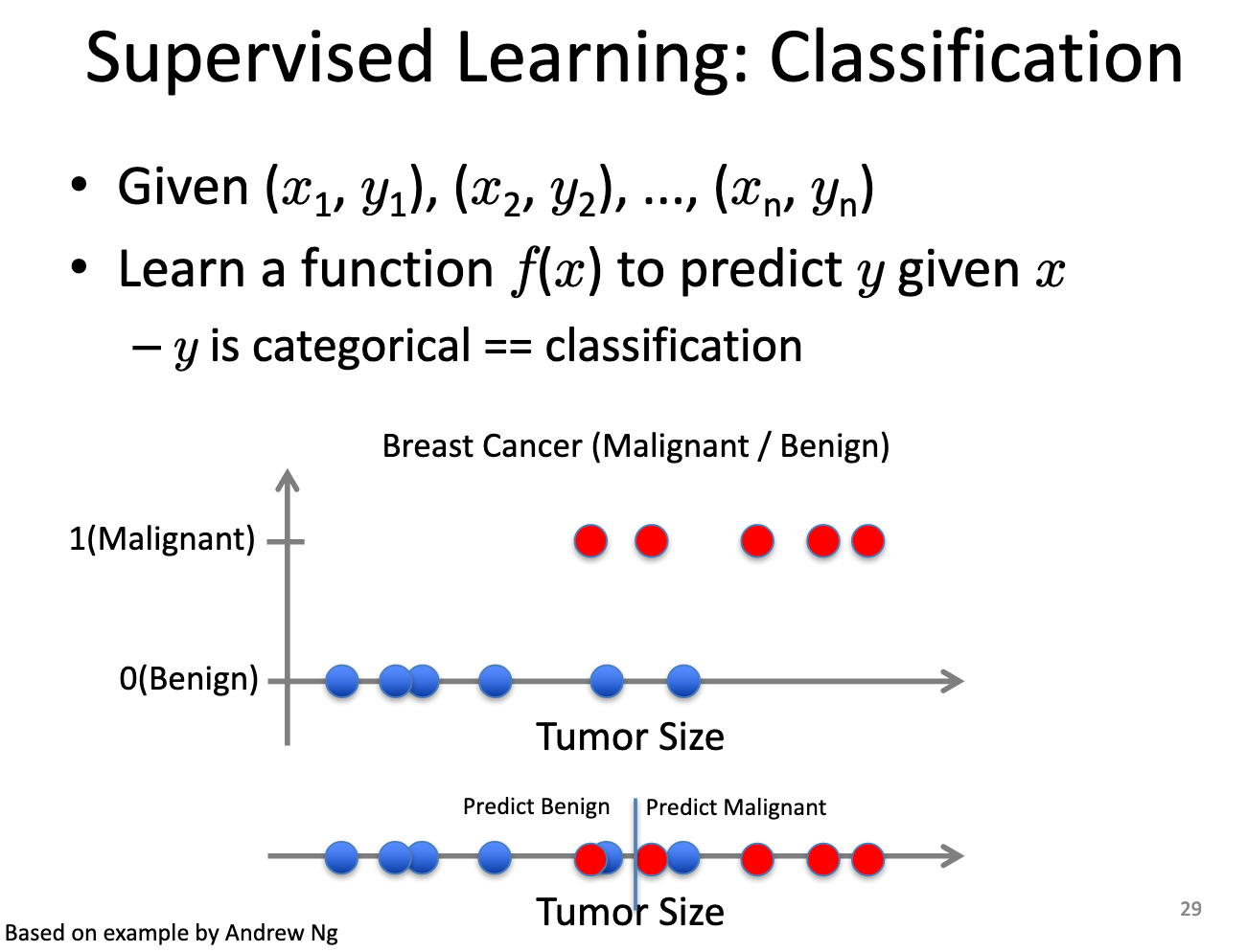

Slide 7
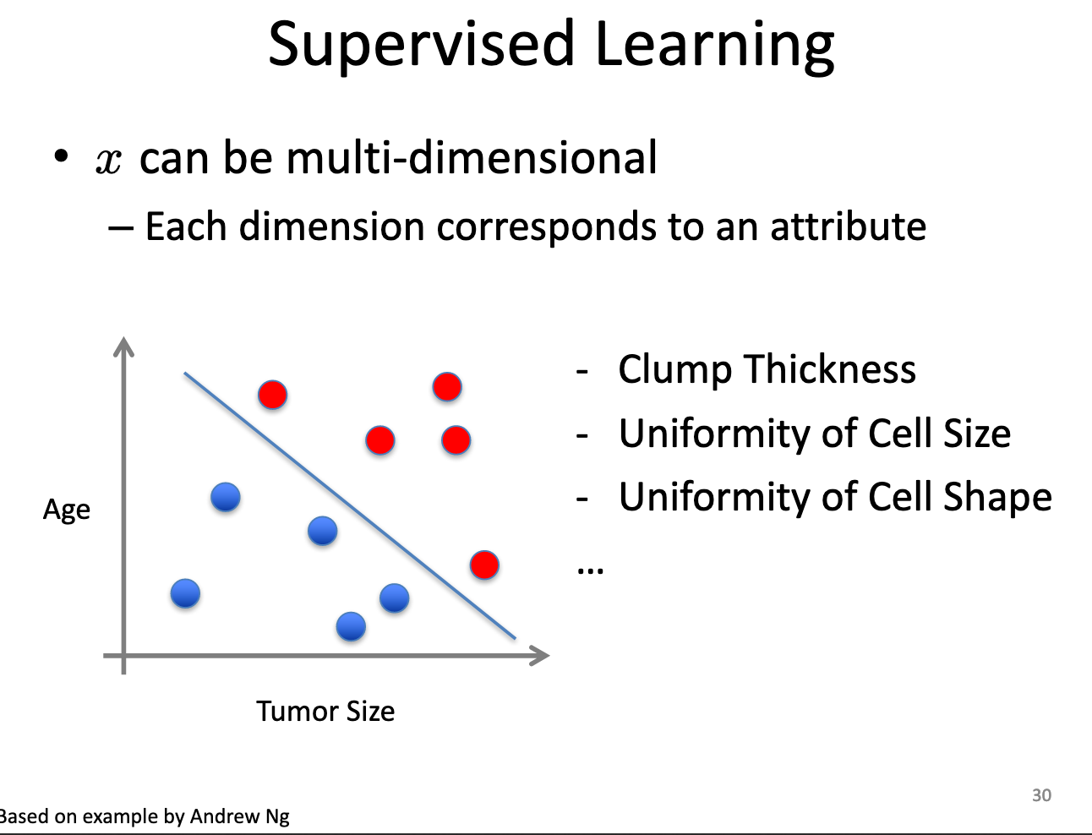

Slide 8
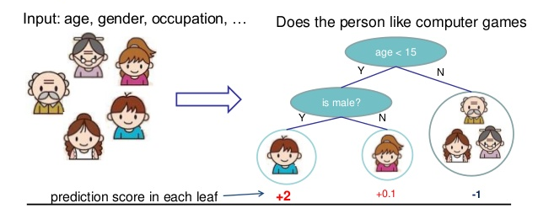
Supervised learning: Classification Trees
Binary recursive partitioning
Algorithm identifies best candidate split (parent node) that minimizes the mean impurity of child nodes
Nodes represent a set of rules that can be used to make a prediction
Notes:
When no improvement can be made, the terminal node is identified

Slide 9
Classification Trees
Advantages
Detects weak signal in noisy, high-dimensional data
Able to handle mixed variable types simultaneously (categorical, ordinal, continuous)
Incorporates and identifies complex variable interactions
Nonparametric
Disadvantages
Risk of “overfitting” training data
“Greedy” approach suggests the final tree may not be the optimal solution
High variance because small changes in data may result in different splits

Slide 10
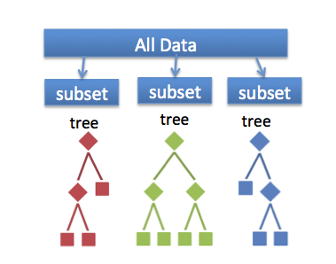
Random Forest
Random subset
samples
predictors
Grow a “forest”
Weak learners
Trees vote to classify
Majority rules
Working together,
many weak learners
become strong! ☺
Notes:
Advantages:
Trees are decorrelated
Permute through each node to find the best split by using the Gini entropy index t o asses information content and purity. Grow each tree to full extent with no pruning
Use withheld data (OOB, out-of-bag) to validate each random tree

Slide 11
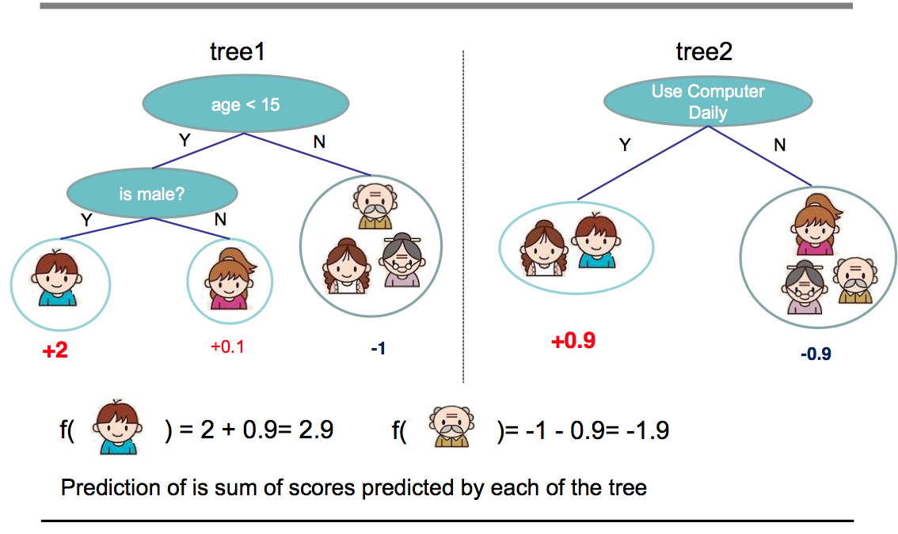
Random forest mini-example

Slide 12
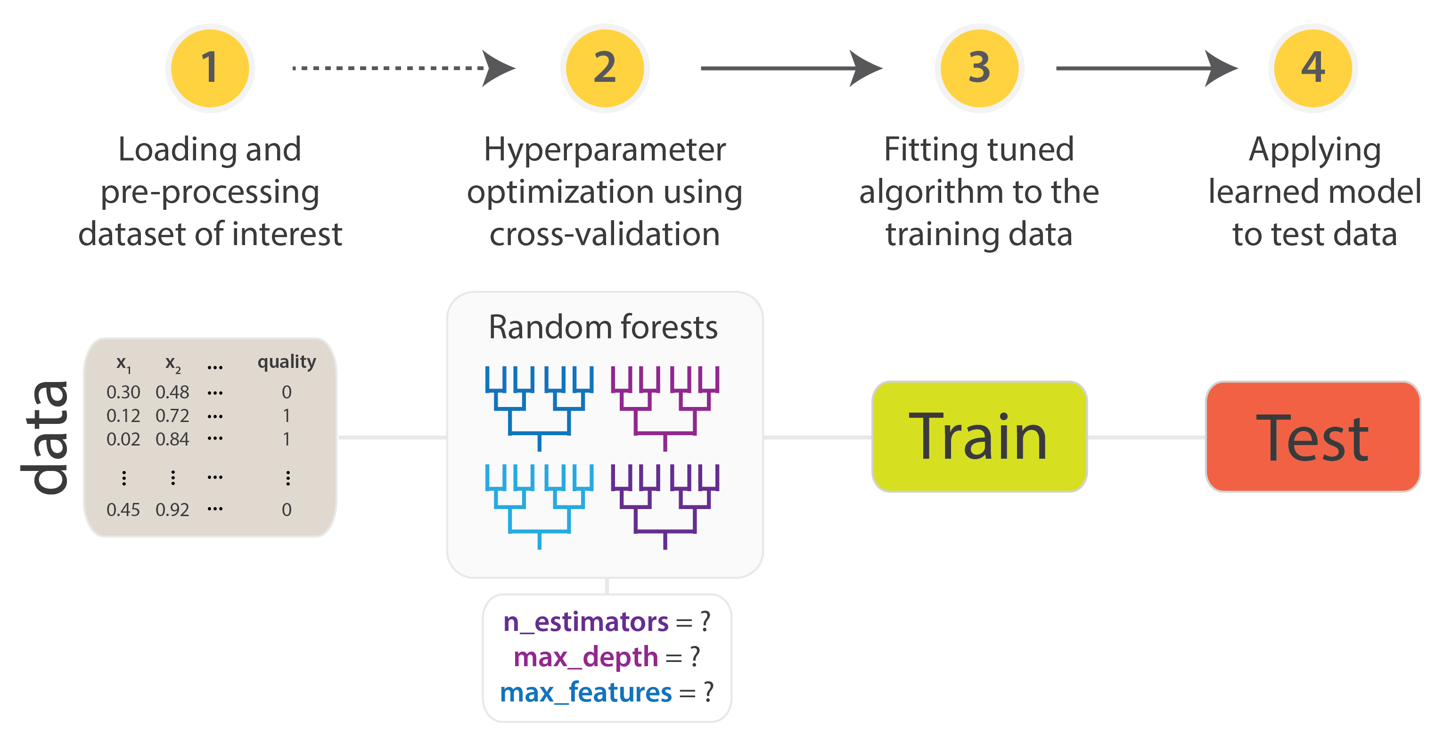
Machine learning workflow

Slide 13
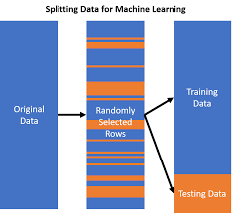
Splitting data for machine learning
Split by stratification:
Ensure that the train and test sets have approximately the same percentage of samples of each target class as the complete set.

Slide 14

Cross-validation and avoiding ‘data leakage’
Data leakage is when information from outside the training dataset is used to create the model such as during the model tuning process.

Slide 15
Measuring classification accuracy
Classification accuracy is the ratio of number of correct predictions to the total number of input samples. It works well only if there are equal number of samples belonging to each class.
However, it suffers when there is a class imbalance; suppose 95% of the data have a specific class. 95% accuracy can be achieved by predicting samples to be the majority class.
There are measures that correct for the natural event rate, such as Cohen’s Kappa.

Slide 16
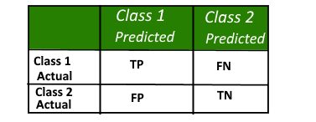
Confusion matrices
A confusion matrix is a table that is often used to describe the performance of a classification model (or "classifier") on a set of test data for which the true values are known

Slide 17
Sensitivity and Specificity
Another way to evaluate performance is to consider false negatives and false positives.
The sensitivity is the true positive rate (out of all of the actual positives, how many did you get right?).
The specificity is the rate of correctly predicted negatives, or 1 - false positive rate (out of all the actual negatives, how many did you get right?).
Sensitivity and specificity can be computed from sens() and spec(), respectively.

Slide 18
Varying the event threshold
One thing to consider: what happens if our threshold to call a sample an event is not optimal?
For two classes, the 50% cutoff is customary; if the probability of class #1 is >= 50%, they would be labelled as Class 1.
What happens when you change the cutoff?
Increasing it makes it harder to be called Class1 ⇒⇒ fewer predicted events, specificity ↑↑, sensitivity ↓↓
Decreasing the cutoff makes it easier to be called Class1 ⇒⇒ more predicted events, specificity ↓↓, sensitivity ↑

Slide 19
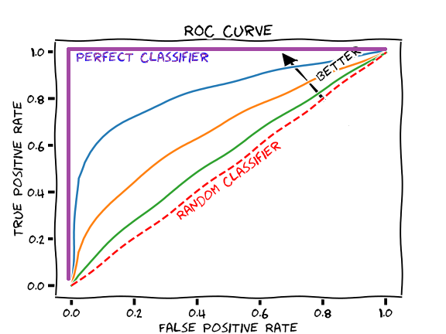
Receiver operating characteristic (ROC) curves
With two classes, the Receiver Operating Characteristic (ROC) curve can be used to estimate performance using a combination of sensitivity and specificity.
To create the curve, many alternative cutoffs are evaluated.
For each cutoff, we calculate the sensitivity and specificity.
The ROC curve plots the sensitivity (eg. true positive rate) versus 1 - specificity (eg. the false positive rate).
The area under the ROC curve is a common metric of performance.

Slide 20
Advantages of ROC curves
The ROC curve has some major advantages:
It can allow models to be optimized for performance before a definitive cutoff is determined.
It is robust to class imbalances; no matter the event rate, it does a good job at characterizing model performance.
The ROC curve can be used to pick an optimal cutoff based on the trade-offs between the types of errors that can occur.
When there are two classes, it is advisable to focus on the area under the ROC curve instead of sensitivity and specificity.

Slide 22
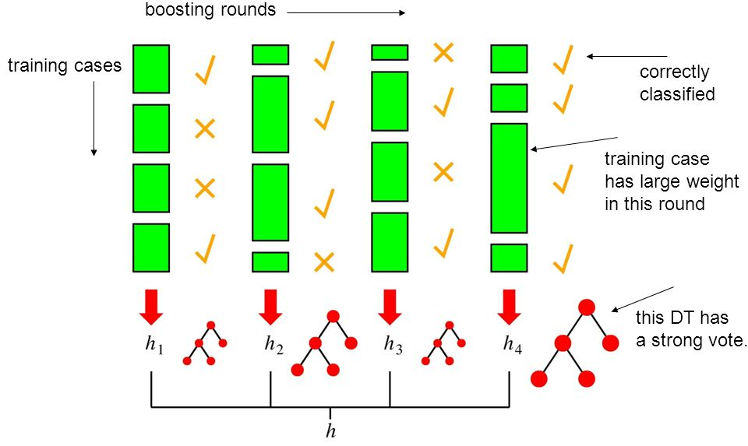
Boosted Regression Trees
Trees are grown sequentially using information from previously grown trees (weighted samples instead of bootstrapped samples)

Slide 23
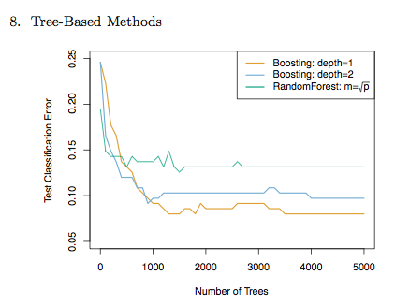
RF vs. BRT Comparison
James , G. et al., An Introduction to Statistical Learning, 2015

