Slide 1
Intro to phylogenetics
Thurs, June 18, 2020

Slide 2
Phylogenetic tree of OleAs
No
PUFA
genes
Has PUFA
genes

Slide 3
Phylogenetic trees illustrate the evolutionary relationships among groups of organisms, or among a family of related nucleic acid or protein sequences
Different software available to estimate phylogeny:
MEGA[X] is great for smaller phylogenies (< 50 sequences)
RaxML and PhyML are good for larger phylogenies but take a long time
For >1,000 sequences FastTree approximate maximum likelihood estimation is a good alternative
Other software you might see mentioned: PHYLIP, PAUP, BEAST, Mr. Bayes

Slide 4
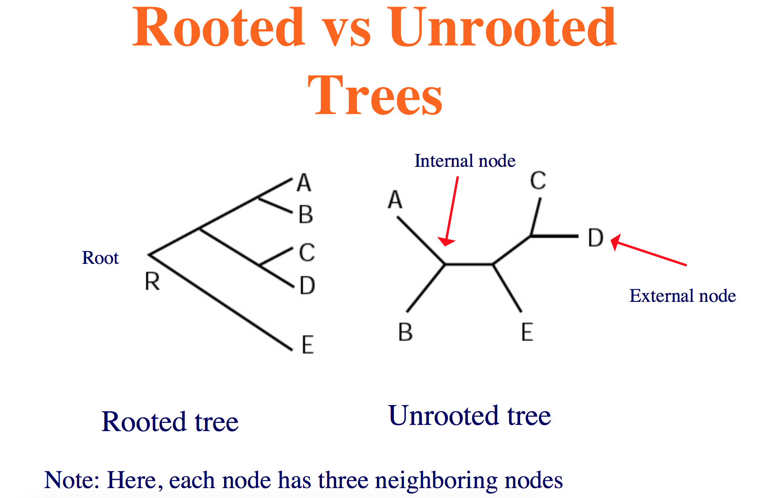

Slide 5
How to reconstruct trees:
• Distance methods like UPGMA and neighbor-joining:
evolutionary distances are computed for all proteins and a tree is built where the distance between proteins “matches” these distances
Maximum parsimony (MP):
choose tree that minimizes number of changes required to explain data
Maximum likelihood (ML):
under a model of sequence evolution, find the tree which gives the highest likelihood of the observed data
Also Bayesian, minimum-evolution, many more approaches

Slide 6
Distance methods
UPGMA (Unweighted group method with arithmetic mean)
UPGMA assumes that the rates of evolution are the same among different lineages
In general, should not use this method for phylogenetic tree reconstruction (unless believe assumption)
Neighbor-joining is an improvement on UPGMA because it takes into account averaged distances to other leaves as well
Produces an unrooted tree

Slide 7
Maximum Likelihood
Given a probabilistic model for nucleotide (or protein) substitution pick the tree that has highest probability of generating observed data
Given data D and model M, find tree T such that Pr(D|T, M) is maximized
Makes 2 independence assumptions
– Different sites evolve independently
– Diverged sequences (or species) evolve independently after diverging
ML methods are now fairly widely considered to be the best but also the most time-consuming

Slide 8
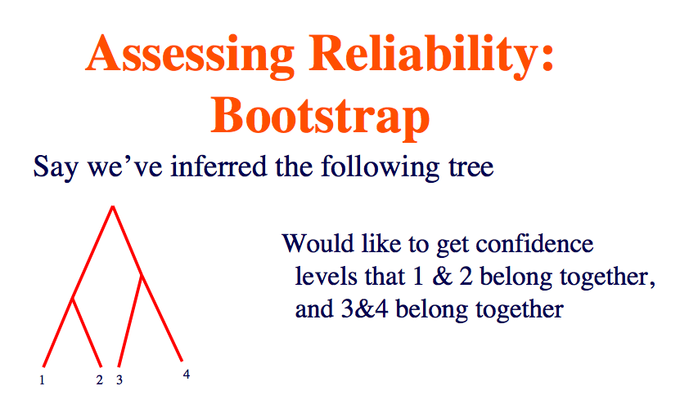
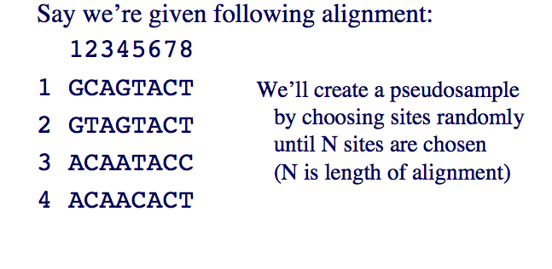

Slide 9
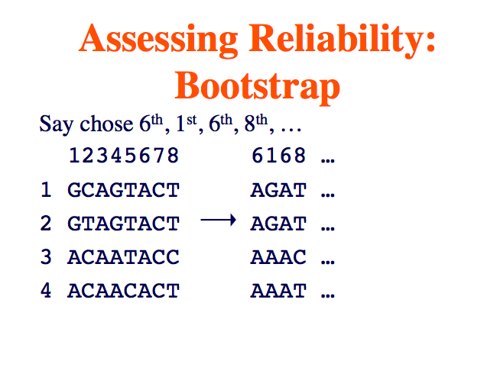
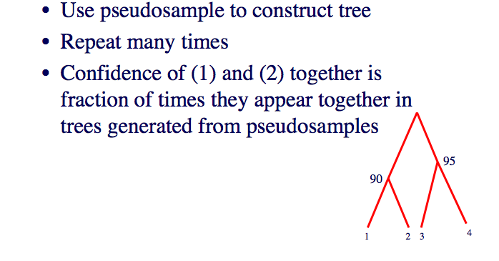

Slide 11
