Slide 1
LSSURP long-term summer planning
June 11, 2020

Slide 2
Looking ahead
June 14 – 19: PUFA week!
June 21 – 26: Homology modeling, protein dynamics, sequence signatures
June 28 – July 3: I am taking mandatory vacation ☺ we can start thinking about some independent coding projects so you can keep busy! July 3 is a mandatory holiday though hehe.
July 7 – on: hopefully start some lab experiments? Also continued coding and writing

Slide 3

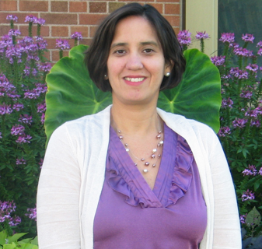
Any interest in a “side project”?
Advancing industry, conserving our environment will enhance opportunities for Minnesota industries, including those in agriculture, aquaculture, and mining, through the use of science and technology to solve environmental challenges and efficiently use water and other precious resources. The overall goal of this initiative is to support and stimulate research and development on environmental remediation by using microorganisms, plants, enzymes, or chemicals, either by themselves or in combination, to remove pollutants from the environment.
Prof. Betsy Martinez-Vaz
Hamline University

Slide 4
Fate and biodegradation of N-rich compounds

Slide 5
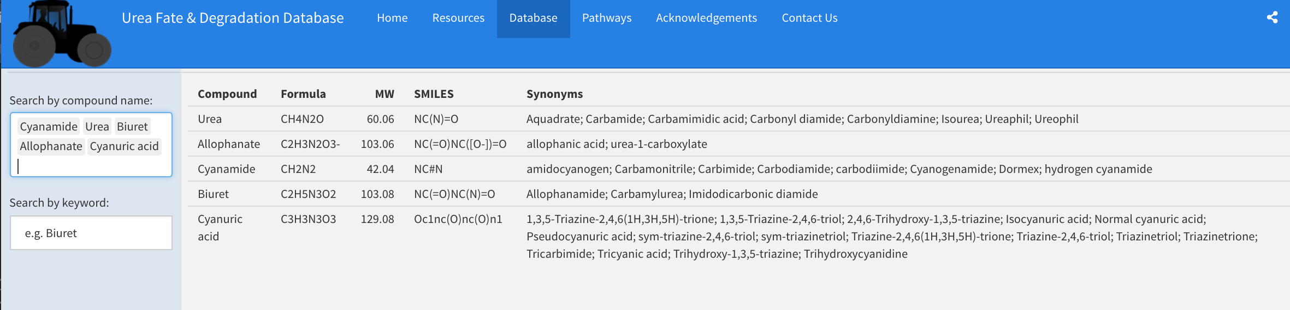
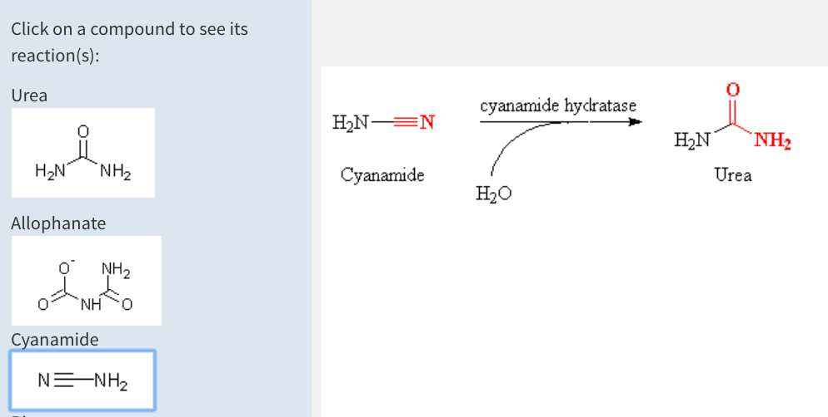
UreaDB: z.umn.edu/ureadb
Pathway & compound databases

Slide 6
Interest in helping with the web app development?
Goals:
Add more compounds and pathways (Betsy’s students are compiling them and doing the literature searches)
Improve user interface and experience. Option for interactive plotting of variables like compound C:N ratio, price, molecular weight?
Plans to improve the resources section

Slide 7
Other bioinformatics skills you would like to learn or focus on?
Optional:
Phylogenetics
Machine learning
Python
Linux/command line & working with HPC resources
Substrate docking & molecular dynamics
Covering:
Building simple web applications
Mapping
Genome analysis
Protein structure analysis

Slide 8
Timeline
Goal to finish new database version by end of July
Initial meeting with Betsy and group week of June 22?
Primary work on project could be done June 27 –> on (especially week of June 27 – July 6)
Check-in meeting with Betsy on July 9

