Slide 1
Intro to phylogenetics
Thurs, June 18, 2020

Slide 2
Phylogenetic tree of OleAs
No
PUFA
genes
Has PUFA
genes

Slide 3
Phylogenetic trees illustrate the evolutionary relationships among groups of organisms, or among a family of related nucleic acid or protein sequences
Different software available to estimate phylogeny:
MEGA[X] is great for smaller phylogenies (< 50 sequences)
RaxML and PhyML are good for larger phylogenies but take a long time
For >1,000 sequences FastTree approximate maximum likelihood estimation is a good alternative
Other software you might see mentioned: PHYLIP, PAUP, BEAST, Mr. Bayes

Slide 4
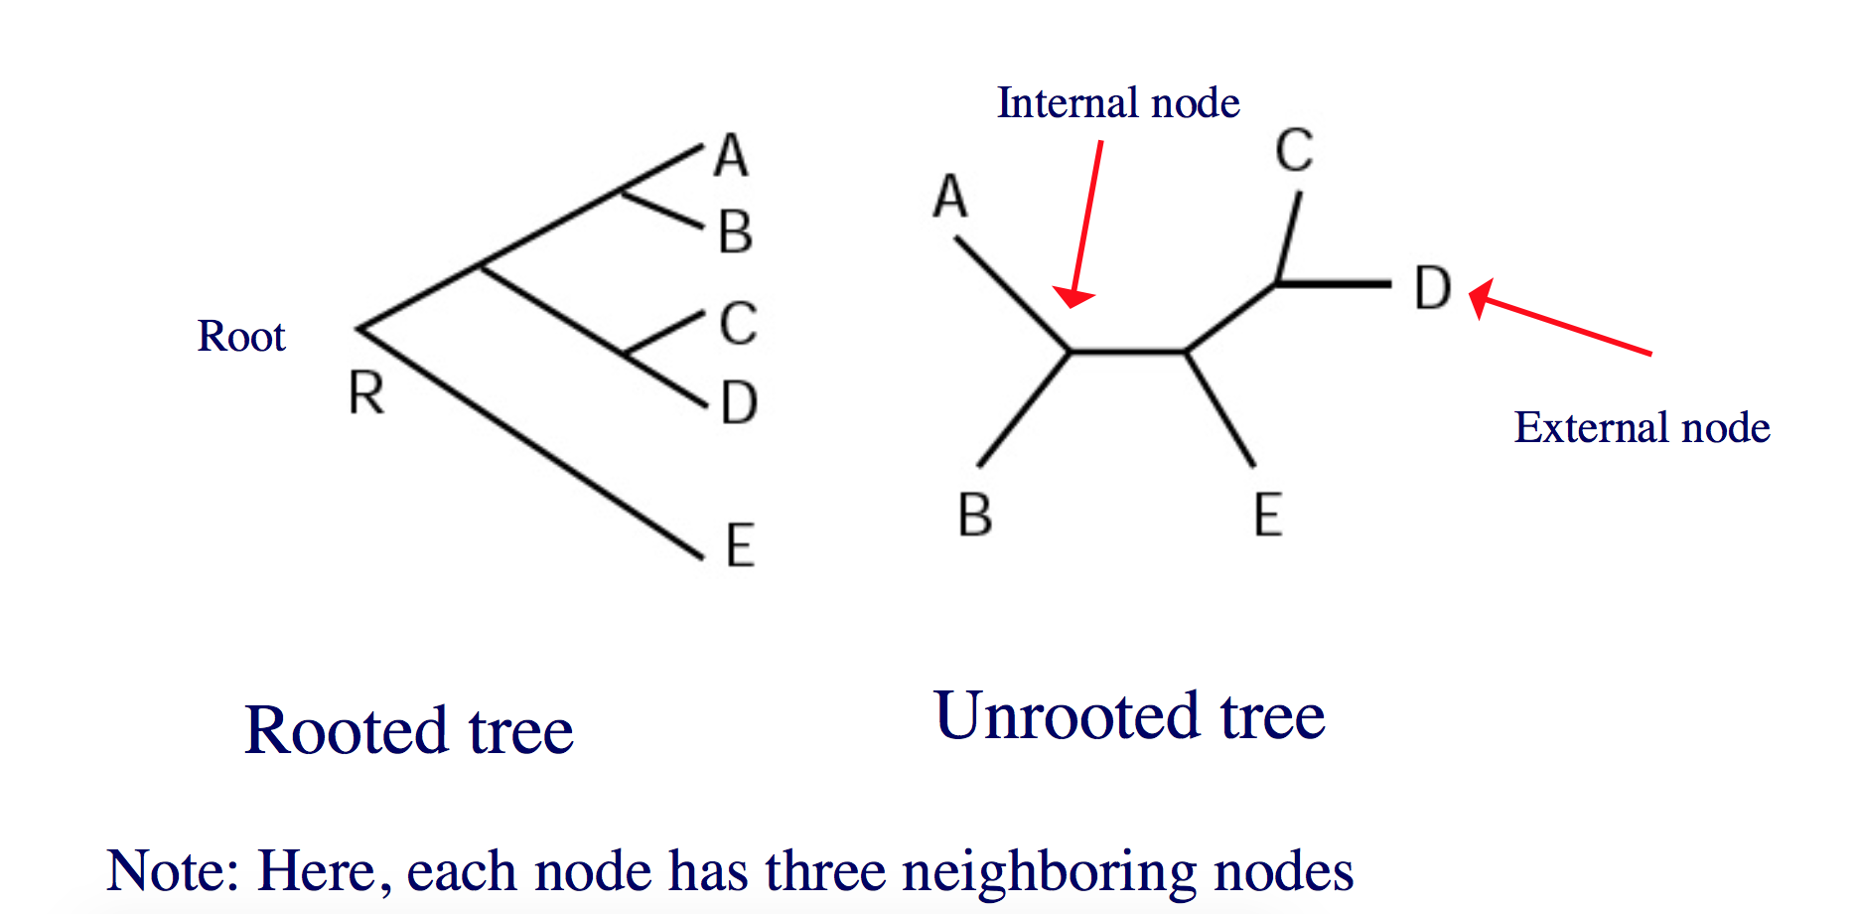
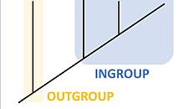
Rooted vs. unrooted trees
Adding an outgroup (ideally distantly related) allows the phylogenetic tree to be rooted
Figures courtesy of Mona Singh, Princeton University

Slide 5
Methods for tree estimation
Distance-based e.g., ‘neighbor joining’ produces unrooted tree
Maximum parsimony (MP): choose tree that minimizes number of changes required to explain data, good for closely-related sequences
Maximum likelihood (ML): under a model of sequence evolution, find the tree which gives the highest likelihood of the observed data -> best default choice for rooted tree
Also Bayesian, minimum-evolution, many more approaches…

Slide 6
Software to build trees
Graphical user interface
MEGA software is great for smaller phylogenies (< 50 sequences)
Open source, relatively easy to use
Command line
IQ-TREE and RaxML are good for larger phylogenies but take a long time
For >1,000 sequences FastTree is a good estimation (takes seconds)
Other software you might see mentioned: PHYLIP, BEAST, Mr. Bayes…

Slide 7
Distance methods
UPGMA (Unweighted group method with arithmetic mean)
UPGMA assumes that the rates of evolution are the same among different lineages
In general, should not use this method for phylogenetic tree reconstruction (unless believe assumption)
Neighbor-joining is an improvement on UPGMA because it takes into account averaged distances to other leaves as well
Produces an unrooted tree

Slide 8
Maximum Likelihood
Given a probabilistic model for nucleotide (or protein) substitution pick the tree that has highest probability of generating observed data
Given data D and model M, find tree T such that Pr(D|T, M) is maximized
Makes 2 independence assumptions
– Different sites evolve independently
– Diverged sequences (or species) evolve independently after diverging
ML methods are now fairly widely considered to be the best but also the most time-consuming

Slide 9
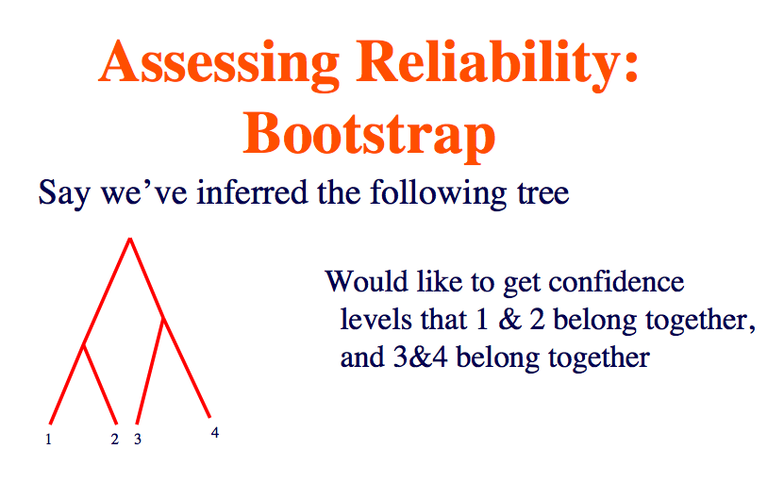
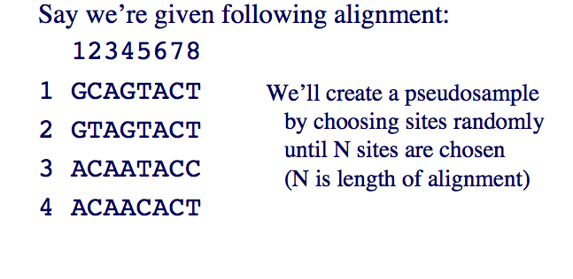
Slides courtesy of Mona Singh, Princeton University

Slide 10
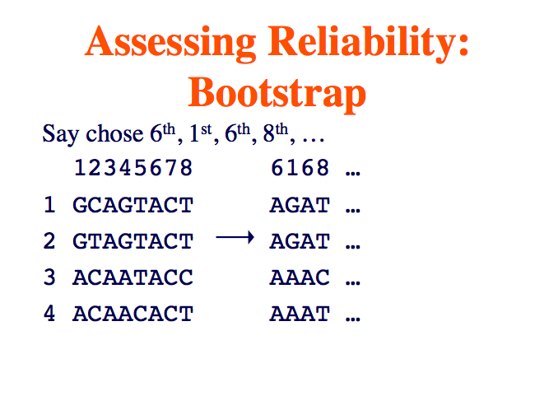
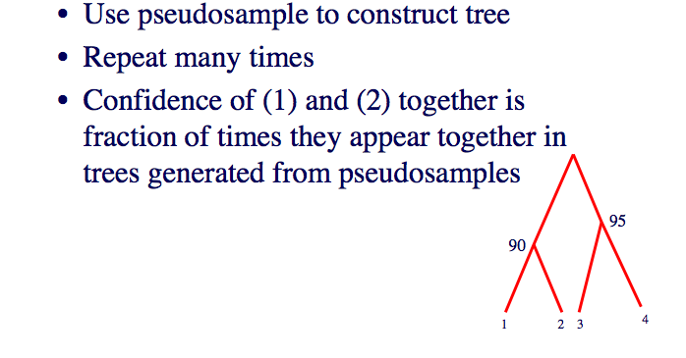
Slides courtesy of Mona Singh, Princeton University

Slide 11
Scale bar represents 0.5 changes per amino acid position

Slide 12
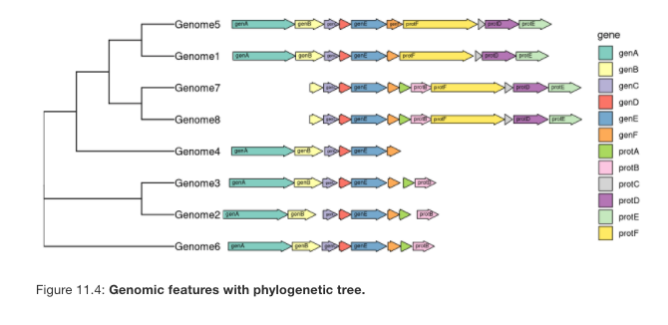
Fancy trees

