Slide 1
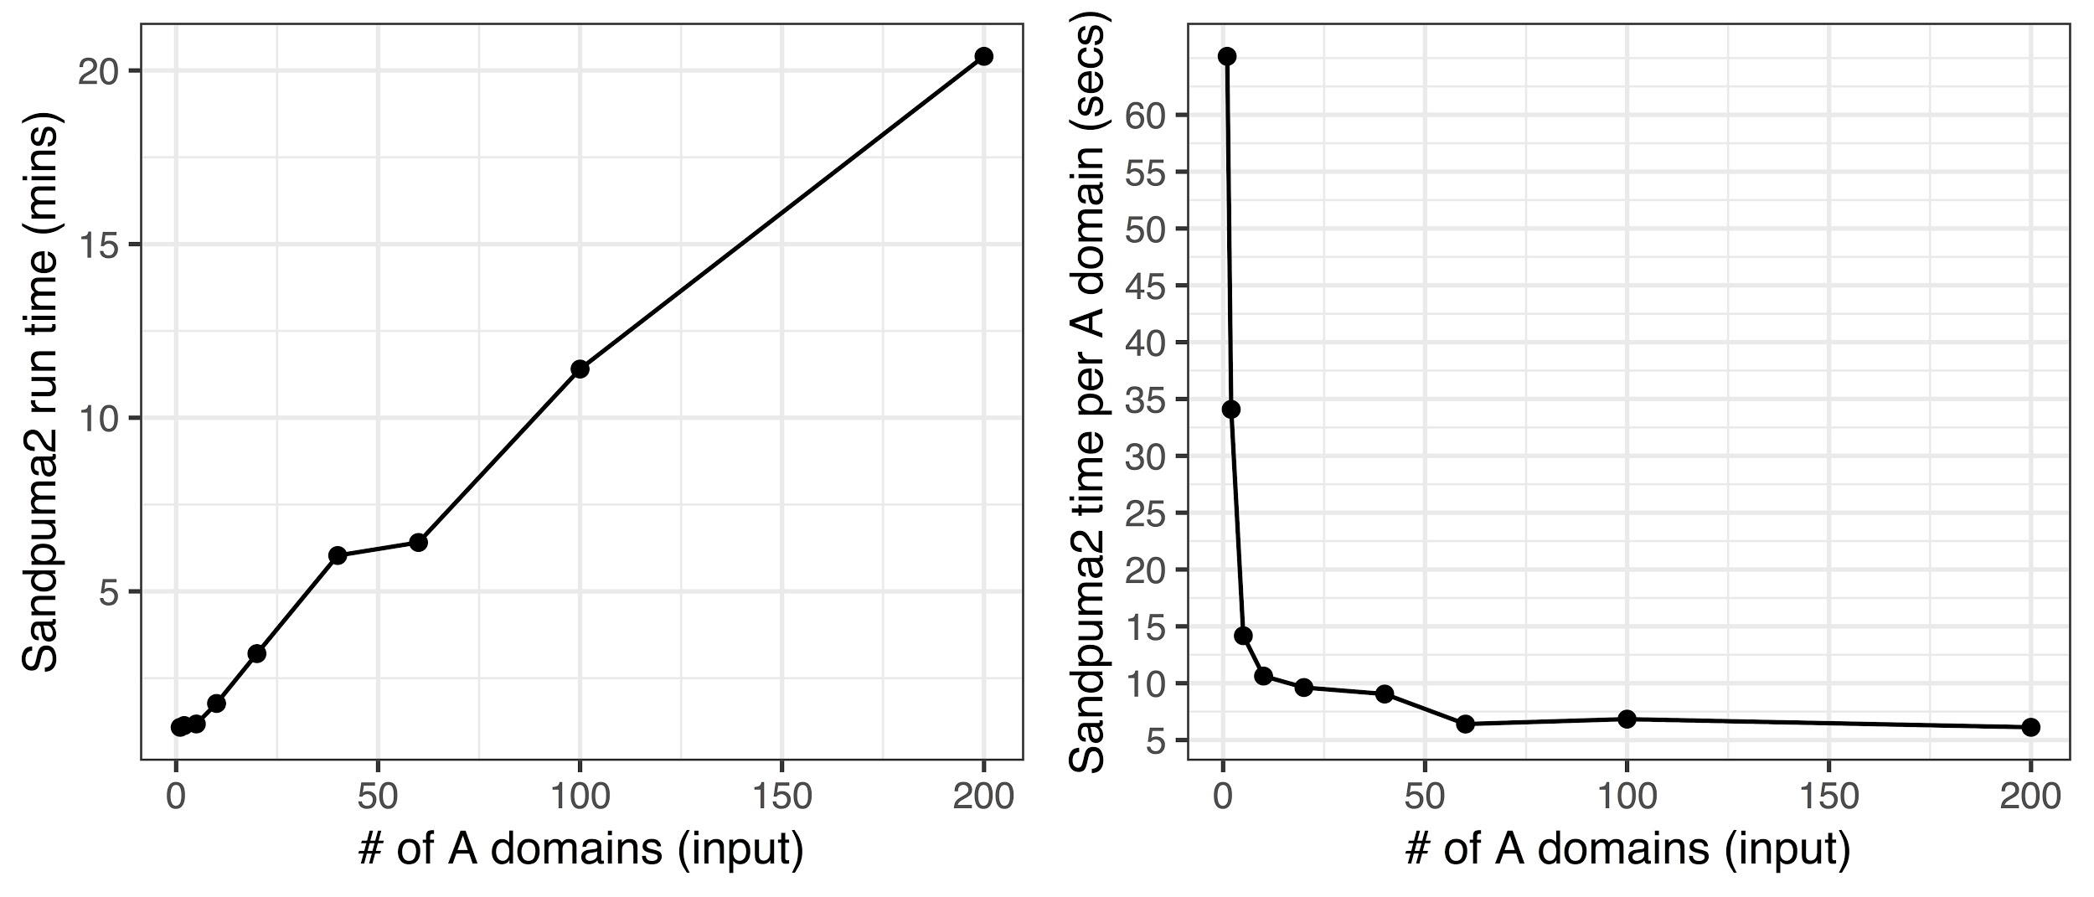
Runtime evaluation
NRPSPredictor2 currently takes ~0.75 s per A-domain
Sandpuma2 could take ~75 times longer in the worst case and ~6 times longer in the best case (at least on our machines).
Since modules only analyse a record at a time, that worst case will be relatively common in antiSMASH inputs with many records/contigs (e.g. metagenomic and draft genome inputs).
Note: this analysis is definitely machine specific. Still significantly faster than Sandpuma1!

Slide 2
Overall goals
Remove Java dependency of antiSMASH5 by re-implementing NRPSPredictor2 (or comparable classifier) in Python and retraining on newest NRPS A-domain data
Allow for multilevel, hierarchical predictions for amino acids from broad specificity group to individual monomers
Write code with 100% test coverage
Speed
Relatively high accuracy, but will take a slight hit for faster prediction ​

Slide 3
Changes/work in progress
Training separate models for fungal A-domains (based on phylogenetic analysis and previous work, fungal ASMs are fundamentally different)
Duplicate handling (when 34 aa signature is extracted, there are 250 duplicated data points out of 1,093. Need to be removed to report prediction accuracy)
Predicting “broad” amino acid specificity when there is no confident prediction for individual monomers (construct NRPSPredictor2-like hierarchy)
Tuning all model parameters not just training/test split

Slide 4
Unsupervised learning for selection of broad AA groups
Amino acid class | Class size | Members
polar.and.charged | 189 | ser, oh-asn, o-iv, noh-val, noh-ala, glu, gln, arg, arg|leu, dab, oh-orn, hser, cysa, asp|bme-asp, asp, asn|gln, asn, arg|lys, oh-asp, orn, oh-orn|orn
small.hydrophobic | 170 | val, norcma, nme-gly, ile|val, ile, goh-val, ala|val, aile|ile, abu, 3oh-leu, hiv, valol, ncp-ala, leu, akic, ala|leu|val
bulky.mainly.phenyl.derivatives | 176 | tyr, trp, phe|trp, phe, htyr, his, gln|tyr, lys, glyco-cya, nme-asp, fo-oh-orn, dhh-tyr, asp|nme-asp, aad, boh-tyr|tyr, boh|tyr, bme-phe, bhceala, 6cl-trp|trp, 3oh-gln, 33p-ala, met, homm-tyr, 3me-tyr, kyn, boh-tyr, phe|tyr, phgly, hpg, hcn, dhpg, cl2-hpg|hpg, 2cl-hpg|hpg
small.hydrophilic | 125 | thr, piz, me-dpr, di-oh-bz, di-oh-bz|sal, dhdab, dhabu|dhtyr|thr, dhabu, dh-thr, bmt, athr|thr, athr, alaol, ala, akiv, hse
cyclic.aliphatic | 65 | pro, pip, gac, ac-phe, 6cl-hic, 4pe-pro, 4p-pro, 4oh-pro, 4me-pro|pro, 3me-pro, 4me-pro
tiny | 59 | gly, gca, d-ala
cysteine | 38 | cys
reject (not enough training data) | 21 | d-lea, bala, blys, ahnpb, btrp, athr|ser, aeo, ame-ser, ser|thr, pac, ddh-arg|3me-tyr, me-bala

Slide 5
Filtering step to remove duplicate data points
A
1093 x
646 (individual aas)
840 (broad aa groups)
A
A
Duplicates
A
Different specificities, same sequence
aa sequence
specificity

Slide 6
A-domain active site sequence
(34 AA)
AA specificity
broad AA specificity
Encode as tuples of 15 physicochemical properties per active site residue
 | PRECISION | STD DEV
BROAD AA SPECIFICITY | 0.857 | 0.007
AA MONOMER SPECIFICITY | 0.821 | 0.012

Slide 7
Preliminary comparison of classification algorithms
Broad AA Specificity
Model | 10-fold CV accuracy | Test set accuracy
Random Forest | 0.84 ± 0.04 | 0.83 ± 0.06
Neural Network | 0.81 ± 0.04 | 0.80 ± 0.06
Naïve Bayes | 0.78 ± 0.05 | 0.75 ± 0.06
AA Monomer specificity
Model | 10-fold CV accuracy | Test set accuracy
Random Forest | 0.82 ± 0.06 | 0.80 ± 0.07
Neural Network | 0.75 ± 0.07 | 0.70 ± 0.08
Naïve Bayes | 0.74 ± 0.05 | 0.72 ± 0.07

Slide 8
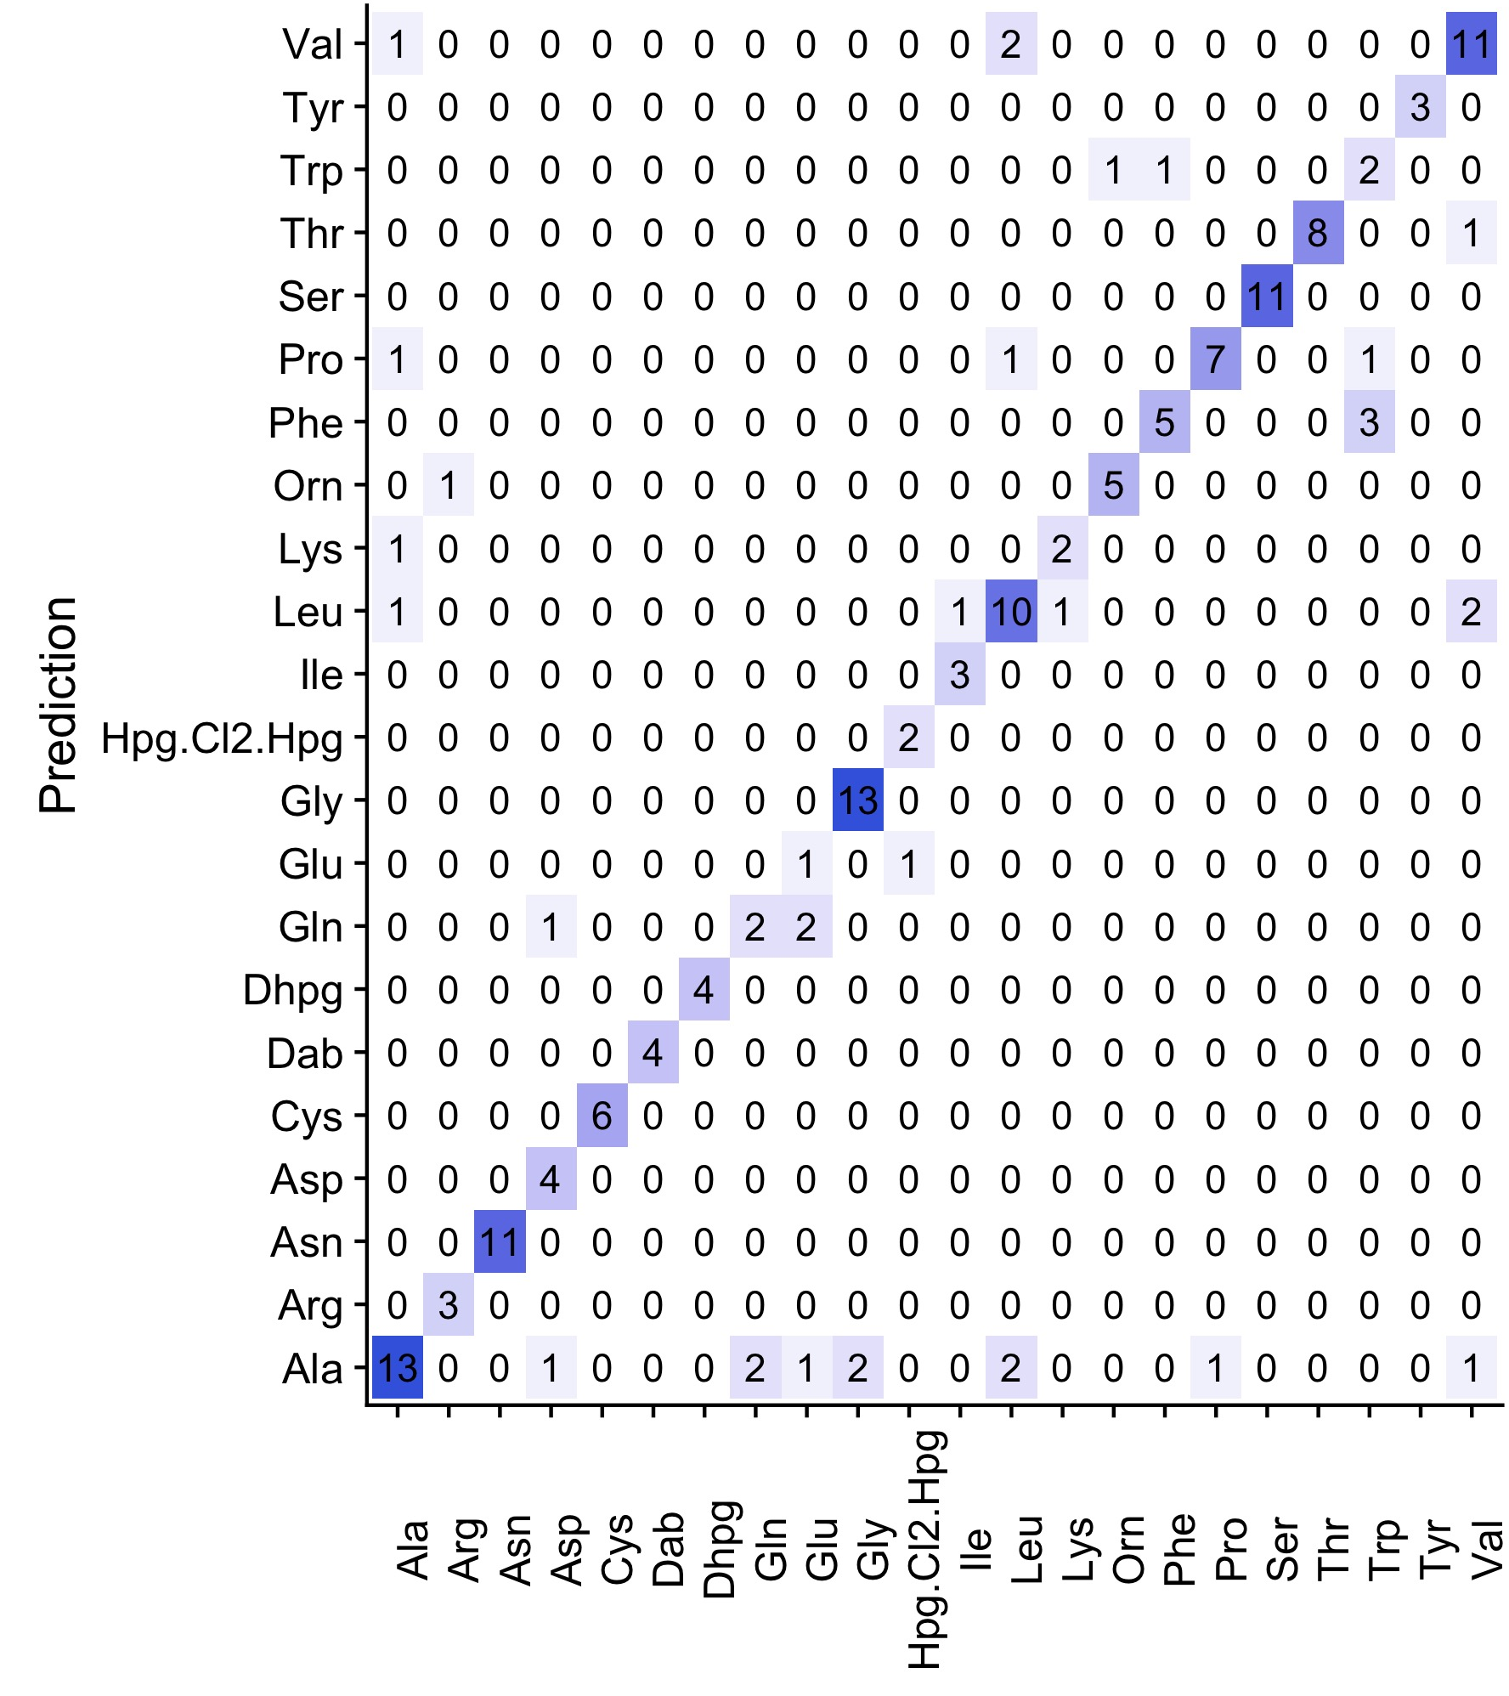
Random Forest Confusion Matrices*
*only showing AA monomers with class support >10

Slide 9
Future changes
Runtime evaluation of different methods
Use HMMalign instead of MUSCLE to align sequences. This reduces the number of gapped 34-aa sequences used from 353 to 11 in the NRPS training set. This should also get rid of some false duplicates.
Revisit dataset and change the specificity of tailored residues to untailored residues if there is evidence for tailoring elsewhere in the cluster. This will increase the number of A-domains for each amino acid group, which makes a larger proportion of the data usable.
Evaluation of transductive SVMs and ensemble methods to find optimal method that will provide reasonable accuracy without runtime penalty

