Slide 1
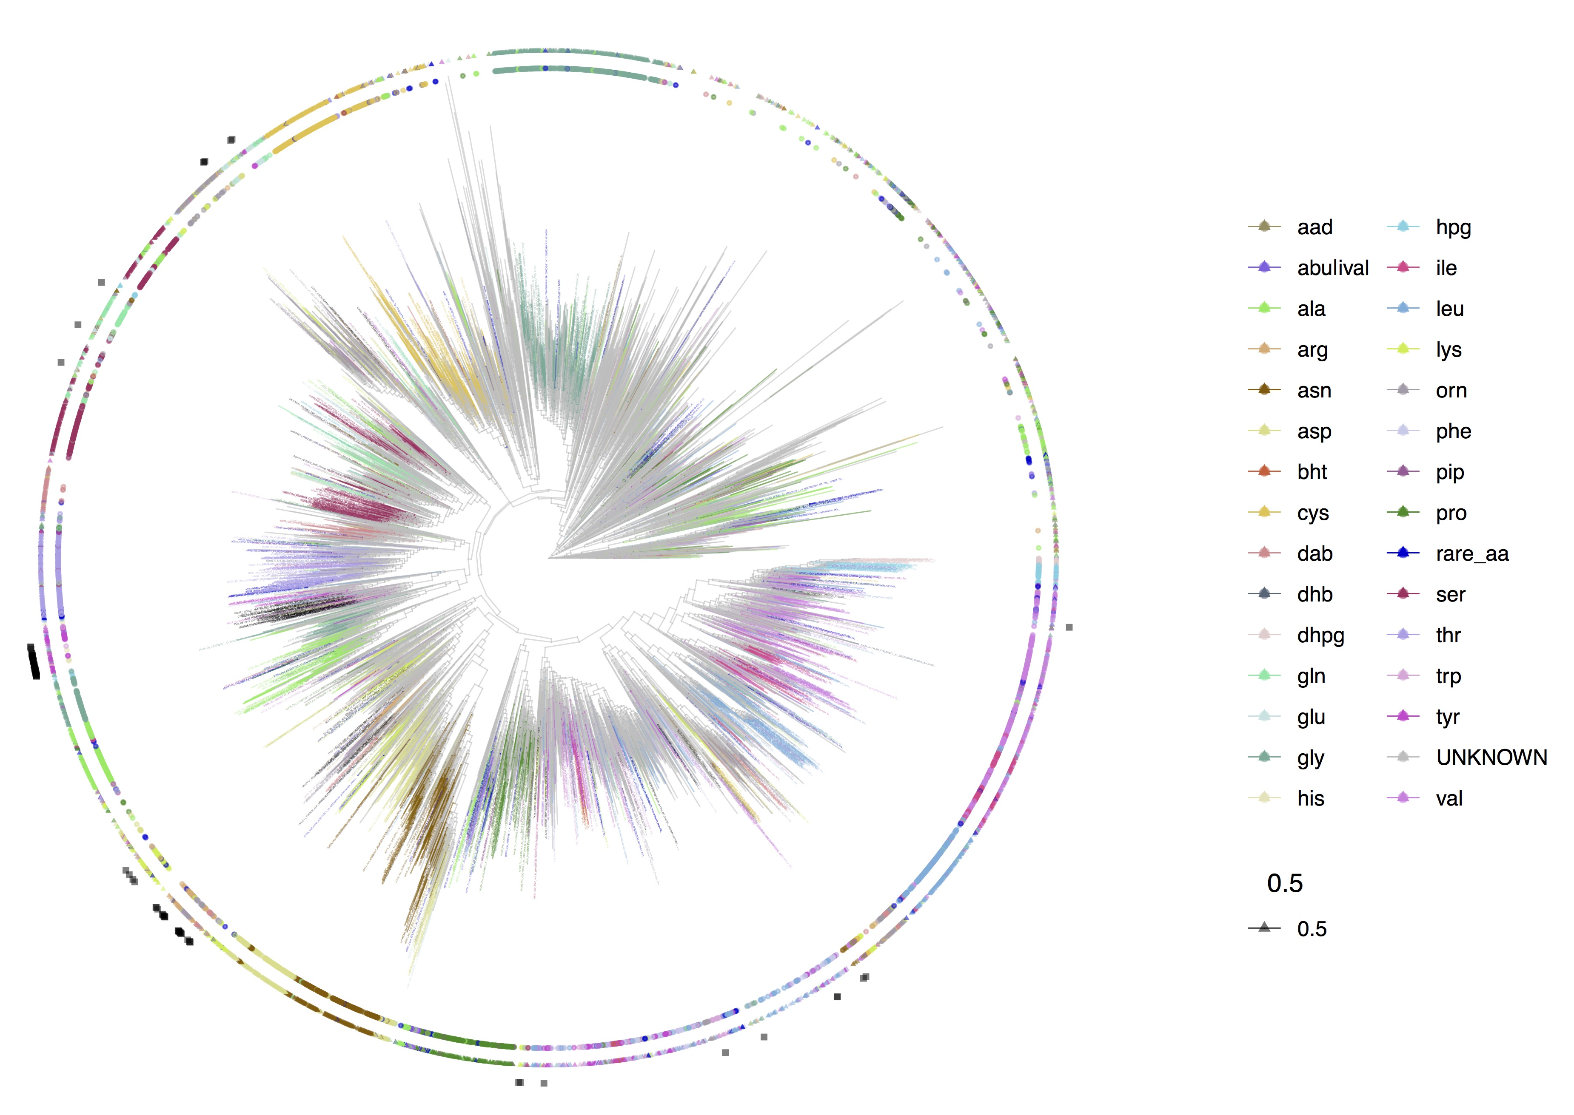
Group #1
130°
Group #2
150°
160°
Group #11
350°
190°
220°
230°
310°
300°
270°
290°

