Slide 1
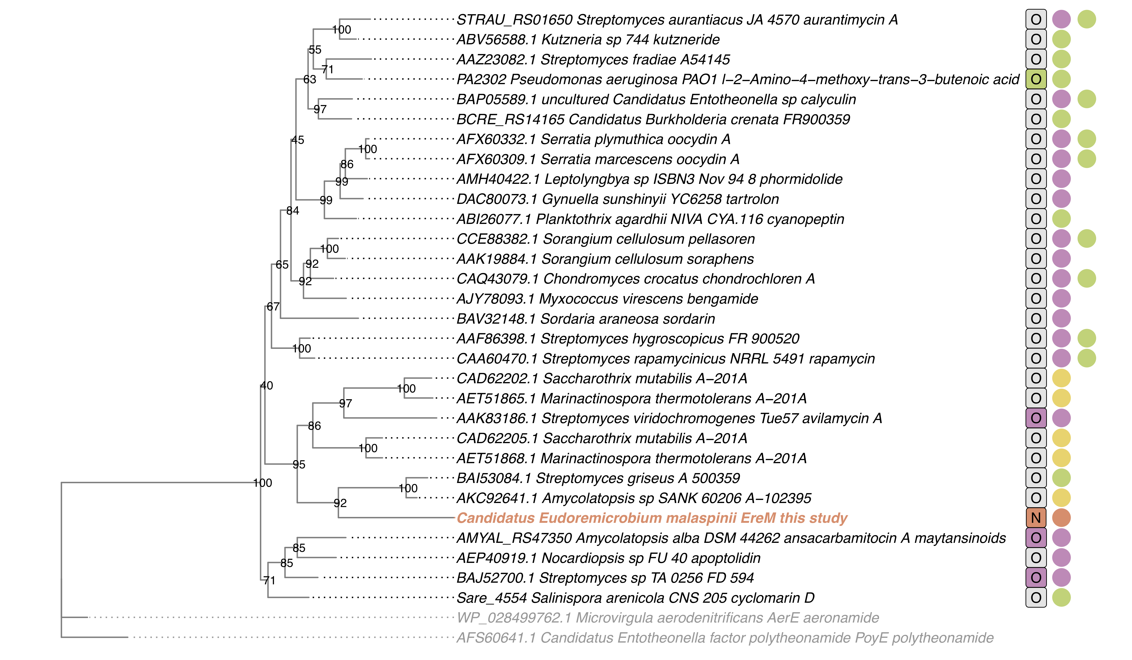
FkbM-like methyltransferase
family
Methyltransf_21
(PF05050)
-MT type
BGC type 1
BGC type 2
Figure SX. Maximum-likelihood tree of FkbM-family methyltransferase (PF05050) HMM hits within BGCs for natural products in the MIBiG 2.0 database (Table SX). Outgroups involved in proteusin biosynthesis from a different methyltransferase protein family (PF05175) are shown in gray text. Branch support values are estimated using the 5,000 ultrafast bootstrap approximation (Hoang et al. 2018) in IQ-TREE 2 (Minh et al. 2020). Letter in ‘MT-type’ column indicates documented N- or O-methyltransferase activity from publications based on genetic knockout or heterologous expression studies (colored) or bioinformatic evidence, biosynthetic logic, and final natural product structure (gray). To date, EreM characterized from this study is the only FkbM-family enzyme with reported N-methyltransferase activity in a characterized biosynthetic pathway. Colored points in BGC type columns indicate the the majority of FkbM-family enzymes are contained with PKS, NRPS, or Other (e.g. nucleoside antibiotic) biosynthetic pathways. To date, EreM is also the only FkbM-family MT characterized in a RiPP cluster.

