Slide 1
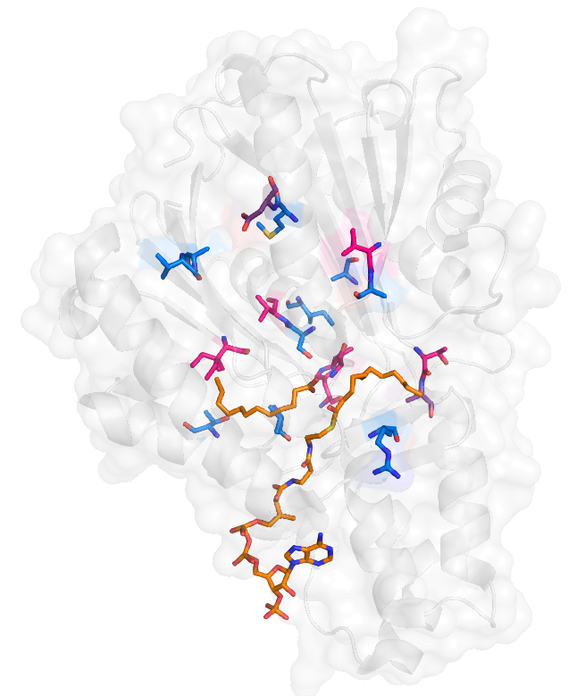
D151
A354
M150
V139
V228
V321
A140
I284
I316
T172
A channel
B channel
T292
A173
V287
R240
P channel

Slide 2
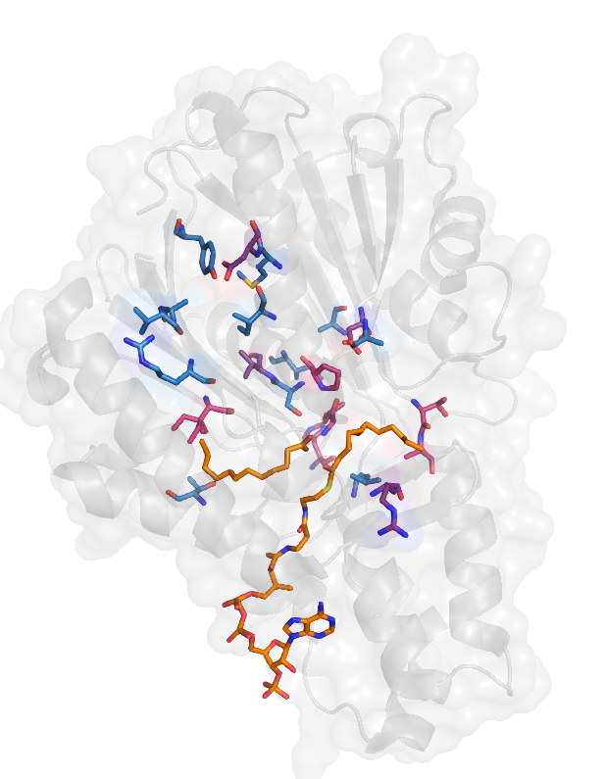
D151
M150
R230
D169
V231
I316
T172
I284
B channel
A channel
A173
P channel
T292
L203
R240

Slide 3
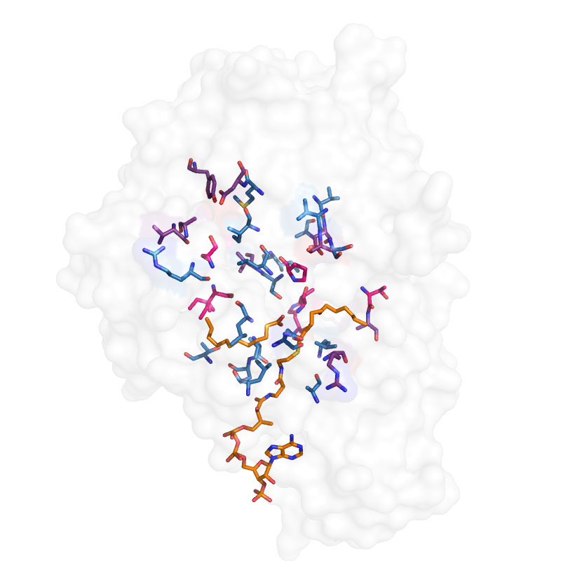
ALL IMPORTANT RESIDUES
D151
M150
R230
I316
T172
I284
B channel
A channel
P channel
T292
A173*
L203

Slide 4
32 MOST IMPORTANT RESIDUES
D151
M150
R230
D169
V231
I316
T172
I284
B channel
A channel
A173
P channel
T292
L203
R240

