Slide 1
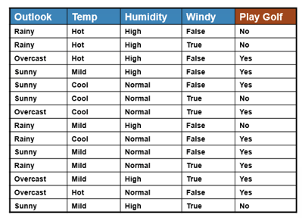
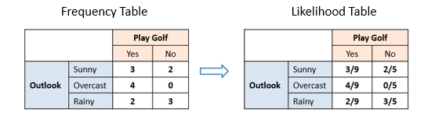
Training
http://www.saedsayad.com/naive_bayesian.htm

