Slide 1
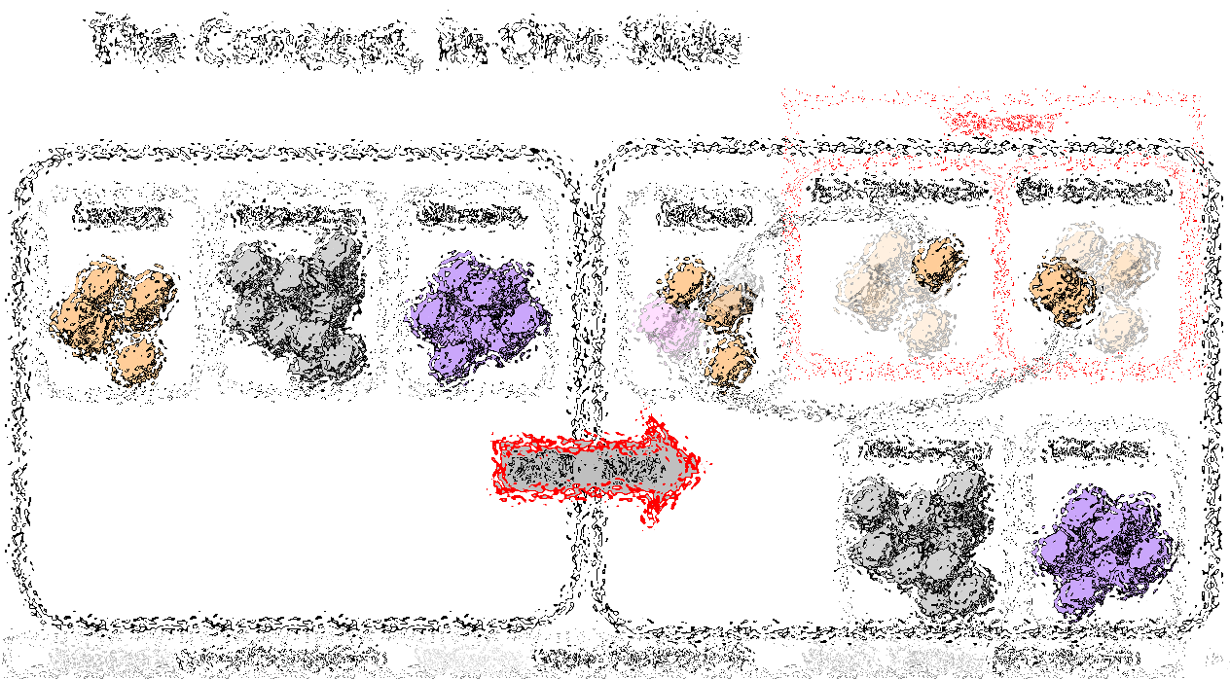
Bip300: Getting to 100% Bitcoin Dominance and Collecting Every Transaction Fee on Earth
Paul Sztorc
Anduro Maker Space
7.25.2024
Notes:
TRANSCRIPT OF SPEECH, 11/5/2021: Okay, hello. I’ve been invited to speak about Bip300 ... which is one of my ideas for taking Bitcoin to the next level. ...

Slide 2
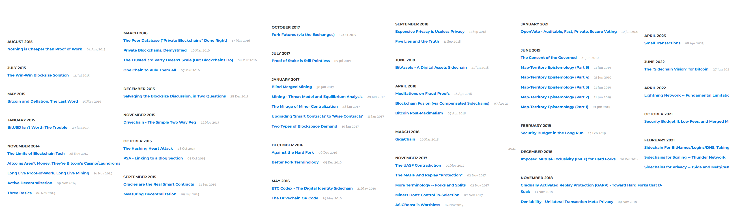
My 1000+ Pages About Bitcoin
2012-2014 | Statistician, Yale Econ → Bitcoin Researcher
Notes:
Before I was a CEO, I described myself as a Bitcoin Researcher.

Slide 3
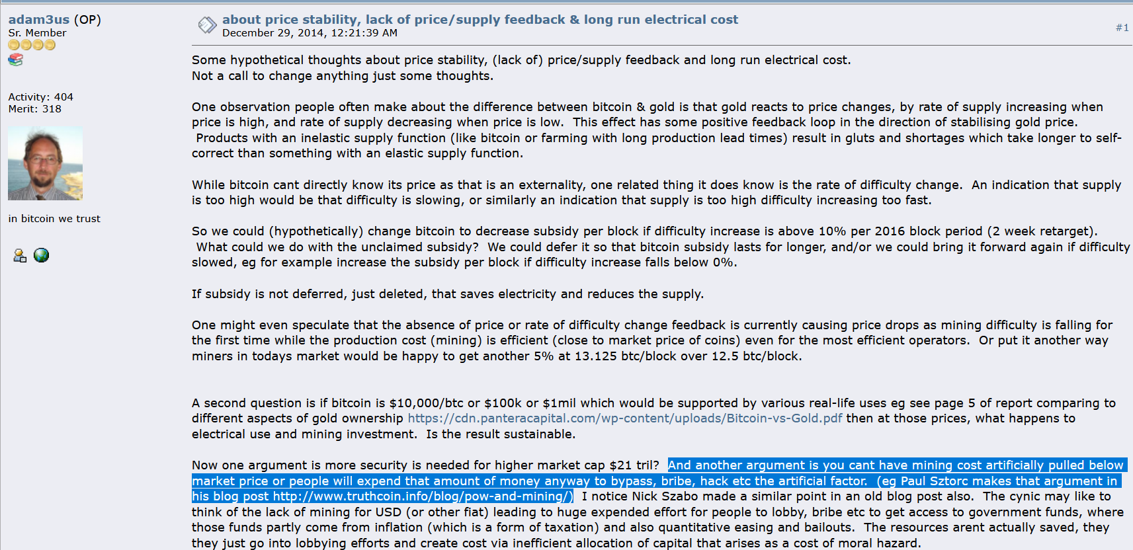
My Big Break
Dec 2014 – Adam Back links to my blog

Slide 4
What You Should Do (I think)
Try the testnet software yourself – to figure out what is going on.
LayerTwoLabs.com/download
Consume some drivechain.info content
Including a huge YouTube playlist with 35+ hours of content
Read the FAQ
Read the misinformation section
Read about CUSF, as well -- Bip300cusf.com
If you agree –
get 51% of hashrate to run the Activator client.
Plan out which sidechain to adopt first (zCash clone)

Slide 5
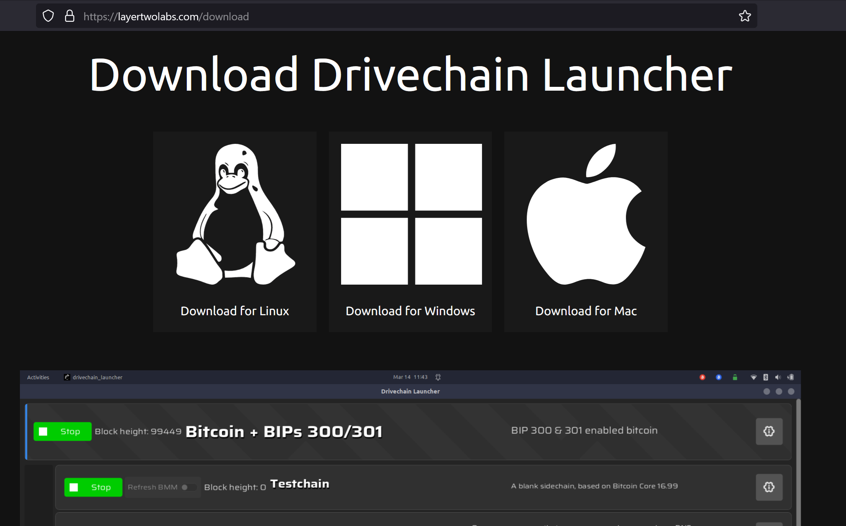

Slide 6
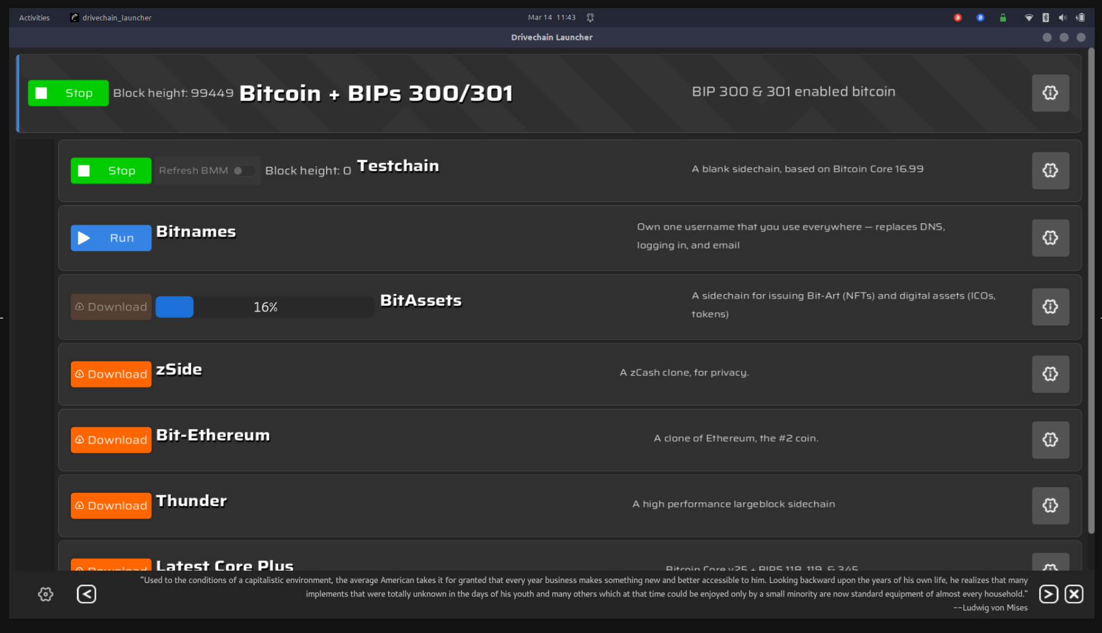

Slide 7
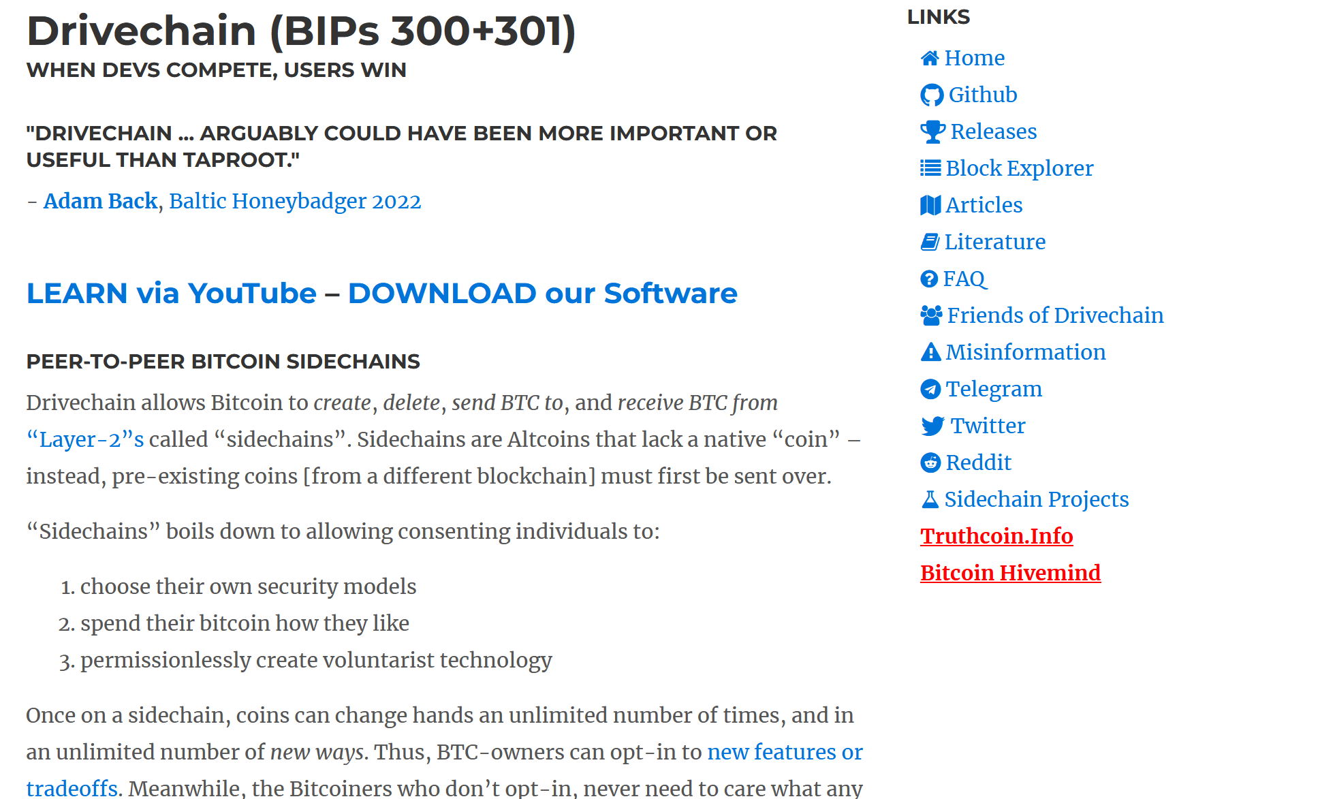

Slide 8
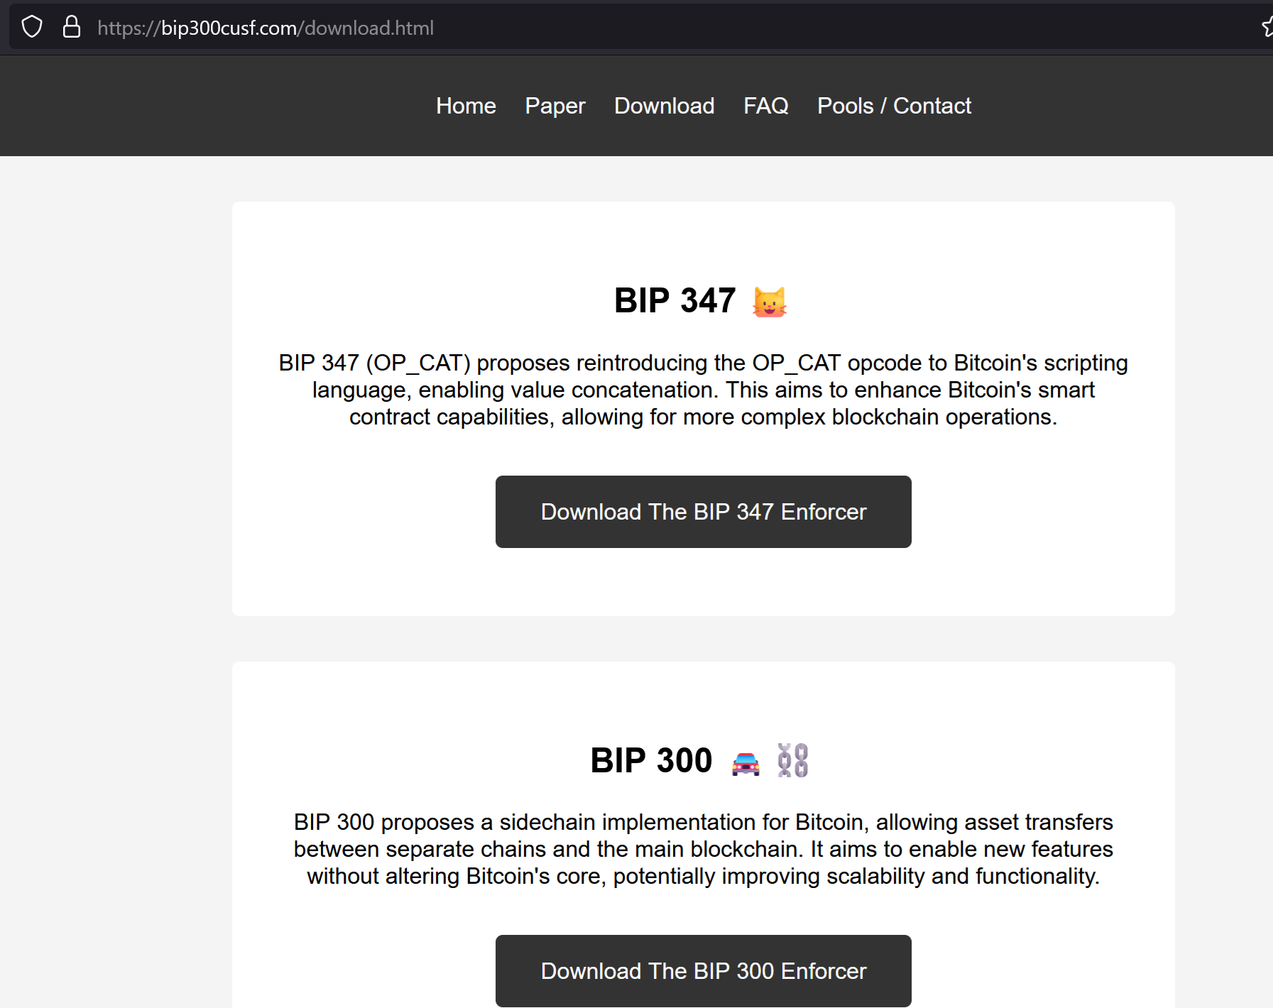

Slide 9
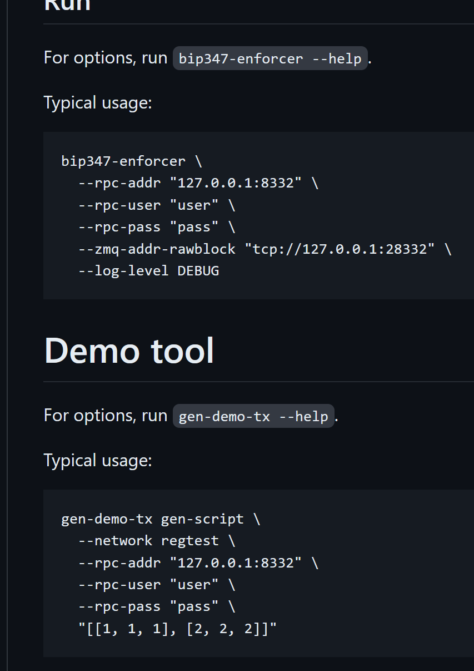
This is how easy it is to activate soft forks (no modification to Bitcoin Core) 51% hashrate needed also: reversible

Slide 10
My Three Favorite Endorsements
"Drivechains…are pretty cool…and arguably could have been more important or useful than let’s say Taproot.“ - Adam Back, Baltic Honeybadger 2022, Live on stage in front of everyone
“We need Drivechain or all the work of thousands in the last 13 years will be in vain.” ... “Drivechain is our only hope”. - fiatjaf, (creator of nostr), on twitter
“We need your project, of course, for the obvious reasons...” - Rene Pickhardt ( Author of Mastering Lightning , #1 stackoverflow (?) contributor for LN questions ), MIT Bitcoin Expo, 2023
Visit www.LayerTwoLabs.com/friends for 49 more!
Notes:
These people all *Lead* a different project. Adam Back leads Blockstream and thus indirectly Liquid. Fiatjaf leads nostr. Rene is one of the leaders of LN.
Yet they all found some nice things to say about my project.
What can I say, kids – real respects real.

Slide 11
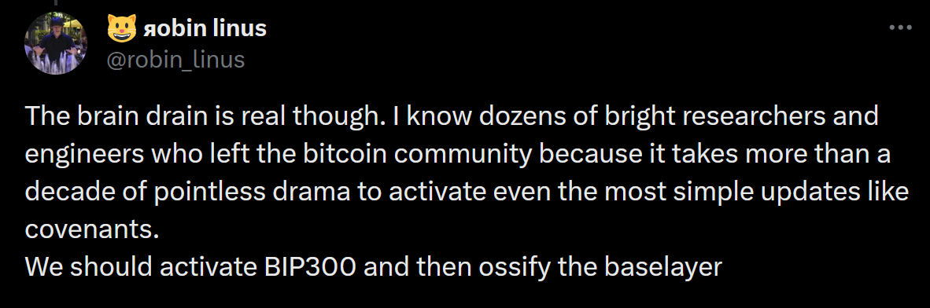
My Three Favorite Endorsements
"Drivechains…are pretty cool…and arguably could have been more important or useful than let’s say Taproot.“ - Adam Back, Baltic Honeybadger 2022, Live on stage in front of everyone
“We need Drivechain or all the work of thousands in the last 13 years will be in vain.” ... “Drivechain is our only hope”. - fiatjaf, (creator of nostr), on twitter
“We need your project, of course, for the obvious reasons...” - Rene Pickhardt ( Author of Mastering Lightning , #1 stackoverflow (?) contributor for LN questions ), MIT Bitcoin Expo, 2023
-Robin Linus, Founder of ZeroSync, Creator of BitVM / BitStream
Visit www.LayerTwoLabs.com/friends for 49 more!
Notes:
These people all *Lead* a different project. Adam Back leads Blockstream and thus indirectly Liquid. Fiatjaf leads nostr. Rene is one of the leaders of LN.
Yet they all found some nice things to say about my project.
What can I say, kids – real respects real.

Slide 12

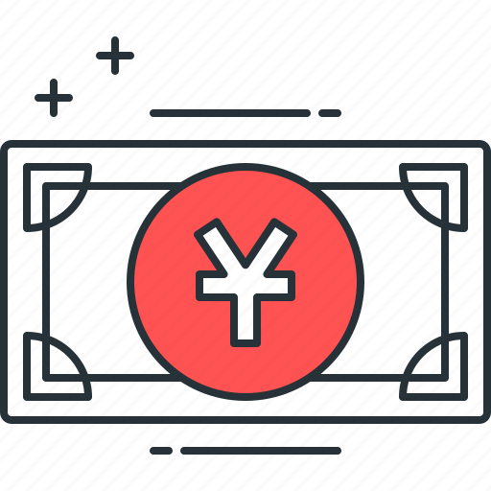

BIP300: Everything on Top of Bitcoin
zCash
FileCoin
ETH
VISA
WeChat Pay
ETH
zCash
FileCoin
BTC Today
WeChat Pay
VISA
BTC + Drivechain
Today ☹
Tomorrow ☺
Notes:
Bip300 proposes these new layer2s, that some call “sidechains”. Sidechains are a response to the threat of Altcoins, but they’re also a response to the desire of Bitcoiners for creativity, and innovation – -- you know: the desire to try new things without asking for anyone’s permission. How can we let everyone try the ideas that they like? And how do I keep other people’s bad ideas away from me? So here you see we have the world of Altcoins on the left, but then, the revenge of Bip300 on the right. We have copied Ethereum and Monero into our own projects that respect the 21M coin limit of BTC. No inflation.

Slide 13
BIP300: Everything on Top of Bitcoin
zCash
FileCoin
ETH
VISA
WeChat Pay
ETH
zCash
FileCoin
BTC Today
WeChat Pay
VISA
BTC + Drivechain
Today ☹
Tomorrow ☺
Notes:
6

Slide 14
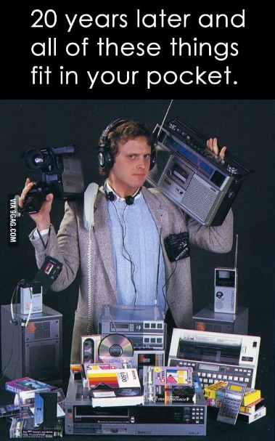


The Coming Death of Bitcoin’s Competitors
WeChat Pay
VISA
ETH
BTC Today
zCash
BTC + Drivechain
* Network effects of Money * Universality of Computation
* Tech/Culture Kick People Out
FileCoin

Slide 15
Drivechain = Altcoin Tech, BTC Coin Only
“Drivechains”
n
n
Bit-Ethereum
Bit-Monero
Bitcoin
Ethereum
Monero
Bitcoin
Bip300
Bip300
BIP 300
Ethereum
Monero
Notes:
Bip300 proposes these new layer2s, that some call “sidechains”. Sidechains are a response to the threat of Altcoins, but they’re also a response to the desire of Bitcoiners for creativity, and innovation – -- you know: the desire to try new things without asking for anyone’s permission. How can we let everyone try the ideas that they like? And how do I keep other people’s bad ideas away from me? So here you see we have the world of Altcoins on the left, but then, the revenge of Bip300 on the right. We have copied Ethereum and Monero into our own projects that respect the 21M coin limit of BTC. No inflation.

Slide 16

The Goal
Smart Contracts DeFi Turing Completeness Ring Signatures zk-Snarks Large Blocksizes
NFTs Oracles
Mimblewimble
…(etc)
Bitcoin does seem great… but can it do _______ ?
Actually we DON’T want Bitcoin to do ______ in the first place because it is actually a bad due to _______, as you can read ______. But if by ______ you really mean ______, then yes Bitcoin can do that! Eventually we are working on _____ which should be able to do ______ even better than ______ anyway but it is actually a good thing that the protocol is so difficult to upgrade beca …
Yes. See BIP 300.
Noob
Bitcoiner
Notes:
Ideally, with Bip300, if some annoying person asks “Sure Bitcoin seems great, but can it do .... smart_contracts, DeFI, zk-snarks, blah blah, you just say “Yes, Bitcoin can do that – see Bip300”.

Slide 17
Fringe Ideas
I can improve Bitcoin! It only needs my new idea: _______ !! When can you merge my code ??
You can’t just merge something into Bitcoin -- It affects everyone else’s nodes!! Besides, ______ has been proposed before and you need to read ______ so that you can learn why everyone hates it, especially our infallible _______ who would have done it by now if it were a good idea. ________ is a SCAM and you are trying to ATTACK BITCOIN!! Even if your idea was good it would probably take years to get consensus and get merged into …
Noob (and/or Fringe Genius)
Use BIP 300.
Good luck!!
Bitcoiner
Notes:
Similarly, if some innovator dreams up a crazy idea, “Hey I can improve Bitcoin, it only needs my new idea ... larger blocksizes, Turing Completeness, KYC-miner-coins?” Then: similarly, they now can do that without anyone’s permission. They just don’t do it on Bitcoin base layer, they do it on a Bip300 sidechain.
So: that’s the goal – FREEDOM. Developers can write whatever code they want, users can use that code if they like. Everyone gets what they want. But how is it accomplished?

Slide 18
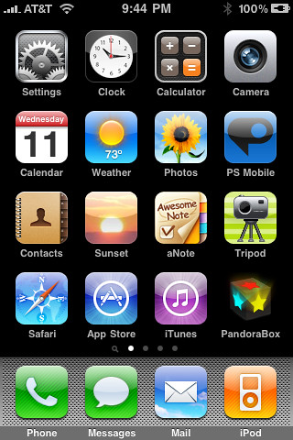
(#1) Full Autonomy
Bip300 Sidechains
zCash (Altcoin)
Bit-zCash
Bit-Monero
Lightning Apps
Strike
Zap
Metaphor
Bitcoin Core
Notes:
Each new Bip300 sidechain is its own ‘app’ and you can change the sidechain software however you like. It’s just like making a new iPhone app: each “app” has its own development team, the software they write can have any validation rules, (!) or no validation rules. But, for example, they could add: zk-snarks, higher Blocksize, turing complete scripts, Taproot, mimblewimble, Monero ring-signatures, whatever you like. Any idea –good or bad— can be done and no one can stop them. It’s just like releasing a new iPhone app. Each project starts with zero Bit-coins on them. No coins.

Slide 19
(#1) Full Autonomy
Bip300 Sidechains
zCash (Altcoin)
Bit-zCash
Bit-Monero
Lightning Apps
Strike
Zap
Metaphor
Bitcoin Core
Notes:
Coins travel from layer1, to these other networks. Users have to voluntarily choose to send their BTC over. To your software. Just like a lighting App. (So it’s a good comparison). Those purple coins are Altcoins ... we don’t like those. But next to it is a sidechain that does the exact same thing. So....

Slide 20
(#1) Full Autonomy
Bip300 Sidechains
zCash (Altcoin)
Bit-zCash
Bit-Monero
Lightning Apps
Strike
Zap
Metaphor
Bitcoin Core
Notes:
here you see the coins move over. Two coins to Zap, in the lightning world; and one coin to Bit-ZCash, in the Bip300 world. Still 21 million coins total.

Slide 21
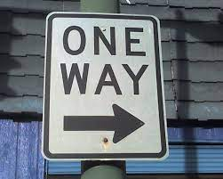
(#2) Base Layer safely ignores L2s
Bip300 Sidechains
Bit-zCash
Bit-Monero
Drama
Centralization
Reorgs
Bad Design
Base Layer
Bitcoin Core
Notes:
Ok, aspect two – the base layer ( ie, Bitcoin Core, ie the mainchain, ie “layer1”) that – your Bitcoin node -- is unaffected by problems on the sidechain. Even under very extreme adversarial conditions where the sidechain experiencing all sorts of chaos, Layer1 is just going to solider on, and ignore all of that. The drama can only go one way. So, let me try to explain this.

Slide 22
(#2) Base Layer safely ignores L2s
= Block Header
= List of transactions
December 2020
January 2021
February 2021
March 2021
April 2021
Base Layer (Bitcoin Core)
Notes:
Here is a representation of Bitcoin’s blockchain. The squares are block headers, and the trailing rectangles are the list of transactions in each block. (Because blocks aren’t always the same size, of course.) And time is flowing from left to right. You can see across the top I’m going from Dec to April. Normally, of course, there would be tens of thousands of blocks (from Dec to April), that wouldn’t have FIT on the slides so there’s only seventeen. Now, what if there was a sidechain, activated, this whole time? Like a clone of Monero, or something. Well, we’ll put it up...

Slide 23
(#2) Base Layer is Safe
= Block Header
= List of transactions
December 2020
January 2021
February 2021
March 2021
April 2021
Layer 2 (Bit-Monero)
Base Layer (Bitcoin Core)
Notes:
Here it is. It has its own blocks, and its own block headers, and its own block chain, from December (on the left) to April (on the right). Now, the idea is ... that ...

Slide 24
(#2) Base Layer is Safe
= Block Header
= List of transactions
December 2020
January 2021
February 2021
March 2021
April 2021
Layer 2 (Bit-Monero)
e320
81cd
3 Months = One 32-byte Hash
3 Months = One 32-byte Hash
e320b6c2fffc8d750423db8b1eb942ae710e951ed797f7affc8892b0f1fc122b
81cd02ab7e569e8bcd9317e2fe99f2de44d49ab2b8851ba4a308000000000000
Base Layer (Bitcoin Core)
e320 ... Pays Out
Notes:
... Three months of sidechain activity are compressed into one little 64-character string here. And that string is the only thing inserted into Layer1. Ever. So, no matter what Bit-Monero over here is doing, this is all that layer1 will see.. ready ?

Slide 25
Your Layer 1 Node Sees…
(#2) Base Layer is Safe
Base Layer (Bitcoin Core)
e320b6c2fffc8d750423db8b1eb942ae710e951ed797f7affc8892b0f1fc122b
e320 ... Pays Out
81cd02ab7e569e8bcd9317e2fe99f2de44d49ab2b8851ba4a308000000000000
Notes:
This. Therefore, full nodes (on Layer1, down here in blue); they do not check anything that is happening on the sidechain (where there can be, theoretically, unlimited complexity). The sidechain doesn’t need to be a blockchain, it doesn’t need to be written in c++, it can make all kinds of mistakes. Etc. Bip300 operates entirely off of this one little string (here in green). (!) It does a lot of logic to that 4 little string, and assumptions and engineering, game theory economics, etc. I don’t have time to explain all of it. But the point is that Layer1 can’t be harmed by Layer2 because it really is ignoring Layer2. I feel compelled to drive this point even further, so...

Slide 26
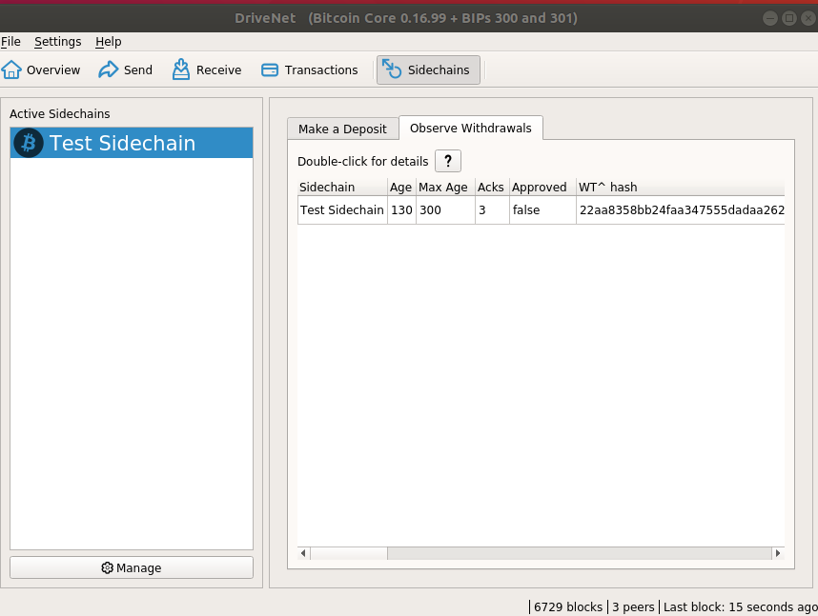
Your Layer 1 Node Sees…
(#2) Base Layer is Safe
Base Layer (Bitcoin Core)
e320b6c2fffc8d750423db8b1eb942ae710e951ed797f7affc8892b0f1fc122b
e320 ... Pays Out
81cd02ab7e569e8bcd9317e2fe99f2de44d49ab2b8851ba4a308000000000000
Notes:
Here is our software. –Just two more slides to finish this point, with a real-world example-- We are looking all the Bip300 withdrawals, there’s only one right now. Which is this little row here.

Slide 27
Your Layer 1 Node Sees…
(#2) Base Layer is Safe
Software will look for a sidechain node, on your computer, (to ask it questions). But if it can’t find one it will report back nothing.
Hash we mentioned before
Base Layer (Bitcoin Core)
e320b6c2fffc8d750423db8b1eb942ae710e951ed797f7affc8892b0f1fc122b
e320 ... Pays Out
81cd02ab7e569e8bcd9317e2fe99f2de44d49ab2b8851ba4a308000000000000
Notes:
Now, the software says “double-click for details”, up here. But for the purposes of this talk, that is misleading. Because what the “double-click” does, is try to find a sidechain node on your computer, with rpc-access, so that it can ask questions about the withdrawal. But if you don’t have a sidechain full node (on this computer), then if you “double-click” it will just tell you that it knows absolutely nothing whatsoever. So, this little row here, is the entire Bip300 idea.

Slide 28


Collect Every Transaction Fee
Every transaction, in the world, is a Bitcoin txn, and each contributes to miner-revenues.
There are many different Bitcoin Networks, to accommodate different people /usecases.
Competition among networks/devs, ie – they all hate each other.
Layer 2
Layer 1
All the world’s txns are already on some network or another. They all pay some kind of fee to someone. (VISA, Venmo)
Notes:
That’s right, I’m pro-hate. Because I’m pro-competition. The more they hate each other, the harder they will work for the user.
More users → more transaction fees, and a higher price of Bitcoin.

Slide 29
Collect Every Transaction Fee
Every transaction, in the world, is a Bitcoin txn, and each contributes to miner-revenues.
There are many different Bitcoin Networks, to accommodate different people /usecases.
Competition among networks/devs, ie – they all hate each other.
BIP 300
BIP 301
Layer 2
Layer 1
All the world’s txns are already on some network or another. They all pay some kind of fee to someone. (VISA, Venmo)
Notes:
That’s right, I’m pro-hate. Because I’m pro-competition. The more they hate each other, the harder they will work for the user.
More users → more transaction fees, and a higher price of Bitcoin.

Slide 30
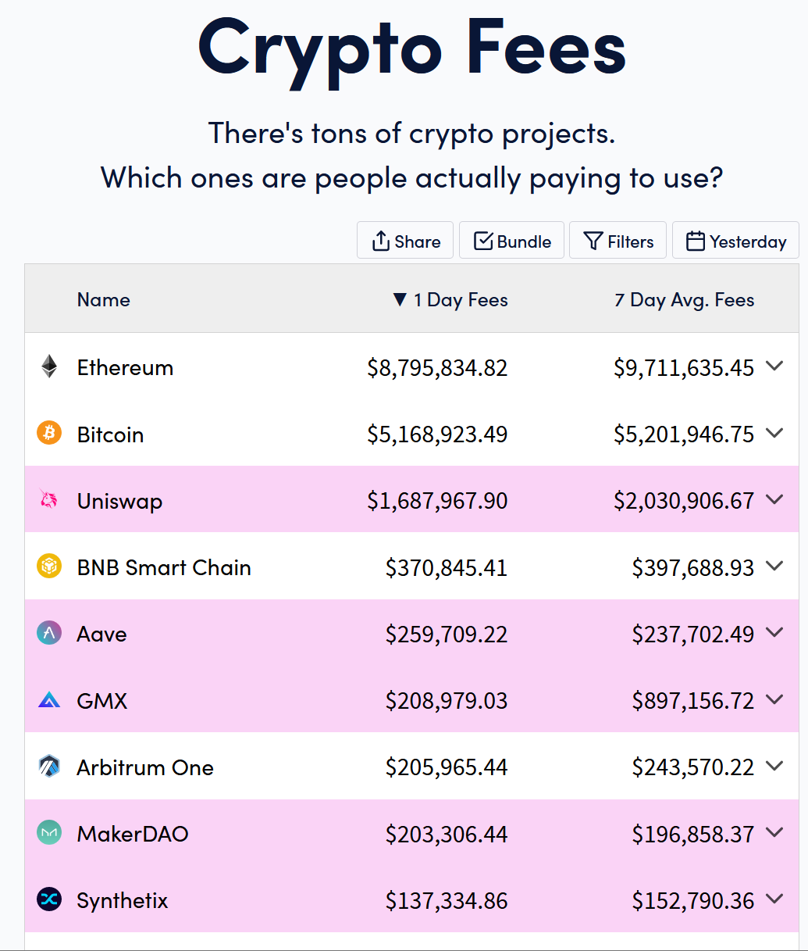
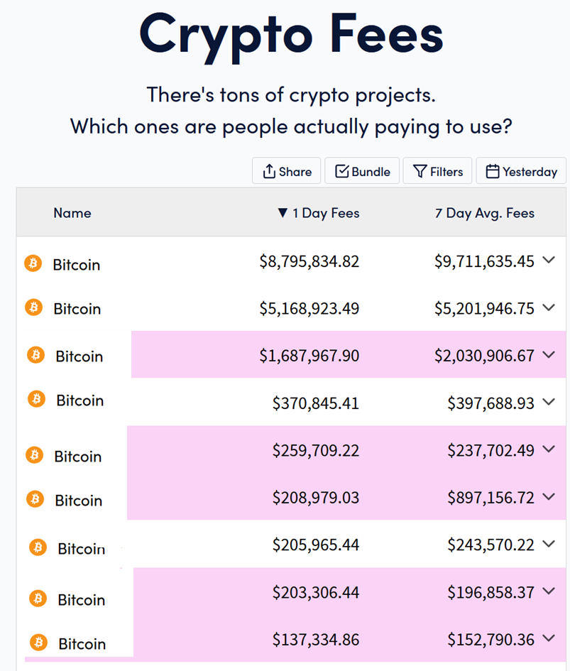
The Goal
$17,000,000
Notes:
Ok – I have an image for you.

Slide 31
The Goal
300
Bit-Ethereum
301
$17,000,000
Bit-Uniswap Bit-BNC Bit-Aave Bit-GMX Bit-Arbitrum Bit-MakerDAO Bit-Synthetix
L2 → L1
300
Alt → BTC
Notes:
Ok – I have an image for you.

Slide 32
Not limited to Existing Altcoins
Can include other networks, including centralized ones.
Or new blockchain networks we build from scratch.
Earth’s 1.1 trillion txns
At $0.10 = $100B per year in revenue. From payments alone.
Doubles roughly every ~ 5 years.
Chase revenues, instead of cutting costs.
More users = more Bitcoin adoption = higher price.
Notes:
As you will see, it doesn’t matter that it’s napkin math because the numbers are favorable to say the least.

Slide 33
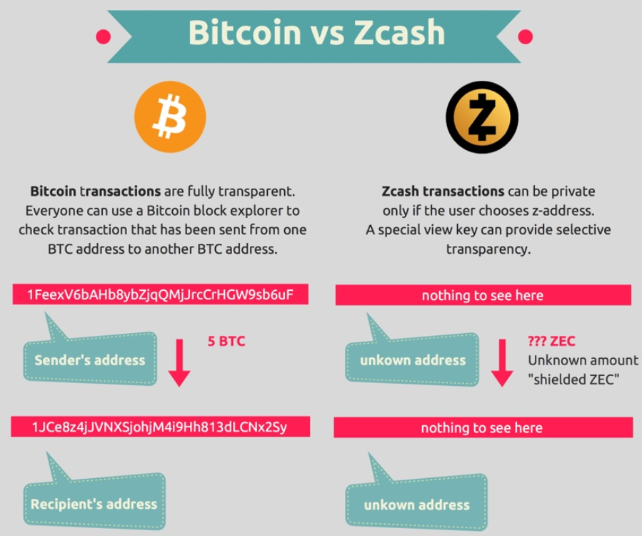
Altcoins we should copy (?): zCash
Image from blockchainhub.net : https://blockchainhub.net/blog/infographics/zcash-explained/
Notes:
Obviously, zCash I mentioned at the beginning. ZCash has transactions where the sender, receiver, and the amount are all private. So then we Bitcoiners have to put up with comparisons like this. Where someone puts something up and says “Bitcoin vs Zcash”. If we had Bip300, this infographic wouldn’t make any sense at all. In fact all debates about one coin vs another coin would make no sense at all. Which brings me to my related point...

Slide 34
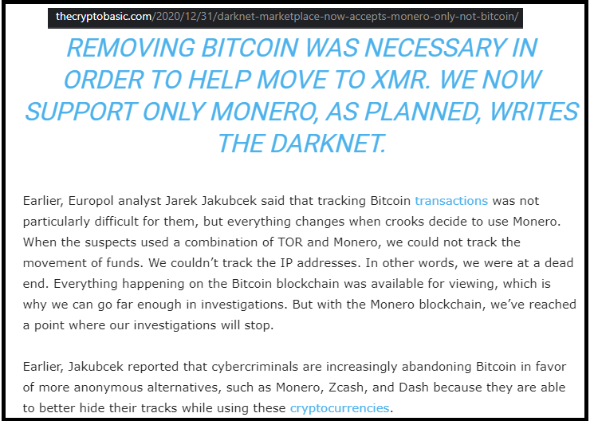
Losing Customers to Monero (?)
Lame!
“White House Market” Retired (not exit scam) on Oct 4, 2021 [last month]
Notes:
...there is a darknet market that, in Dec of last year, decided to only accept Monero. So that’s kind of a slap to the face. If we had Bip300, then there would be no reason for them to accept Monero at all, let alone exclusively.

Slide 35
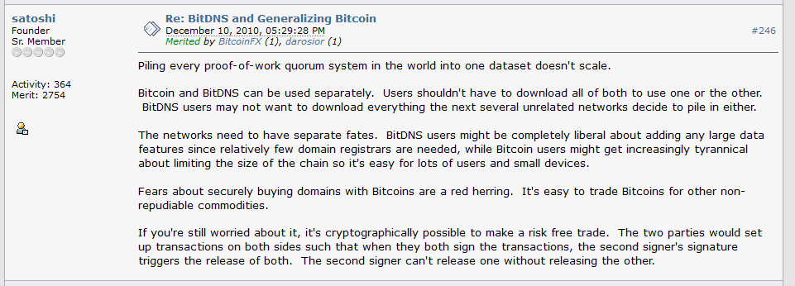
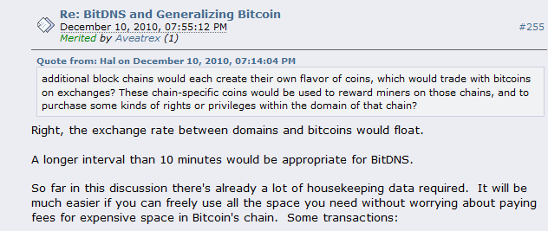
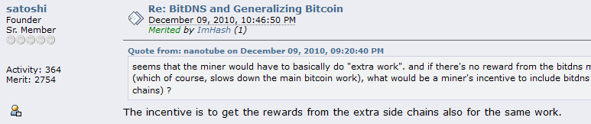
Altcoins we should copy (?): NameCoin
Fun facts -- in this thread, Satoshi: * Invents what is now known as Merged Mining. * Assumes that there will be many separate blockchains that pay different fees (as if this were non-controversial!).
* The term “side chain” is used numerous times!
Notes:
BitDNS was an idea proposed on bitcointalk, which later became the Altcoin Namecoin. This thread -where it’s proposed- is something that absolutely everyone should look up and read, if they have the time. Lots of cool history here. ... Satoshi invents Merged Mining, he coins the term “side chain”, he writes about how there will be lots of different chains, all back in 2010. It’s really cool. Anyway, this concept, “BitDNS” is a weird idea, but I think it has tremendous potential. Again, I don’t have enough time to talk about it. But I did write a big article…

Slide 36
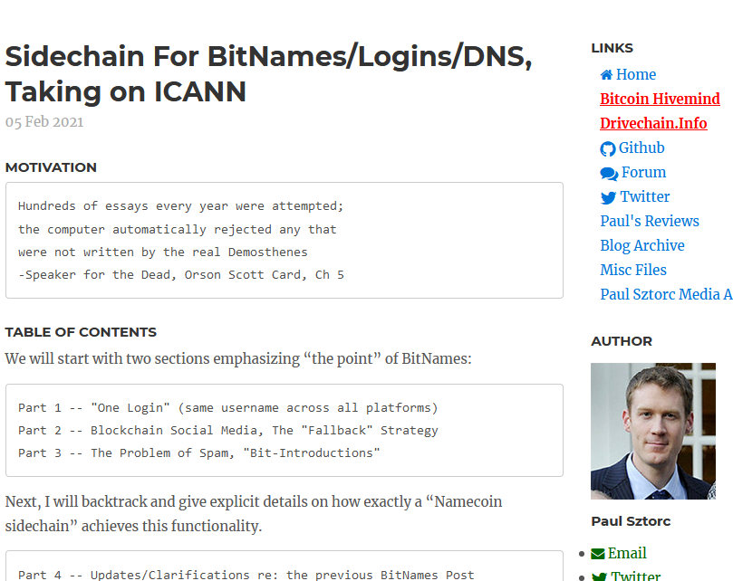
Altcoins we should copy (?): NameCoin
Screenshot #0 from www.truthcoin.info/blog/bitnames/
Notes:
…in Feburary –“BitNames, there’s the url”, and I will now give you a FEW of the images from that article. And you can read the article if you are interested.

Slide 37
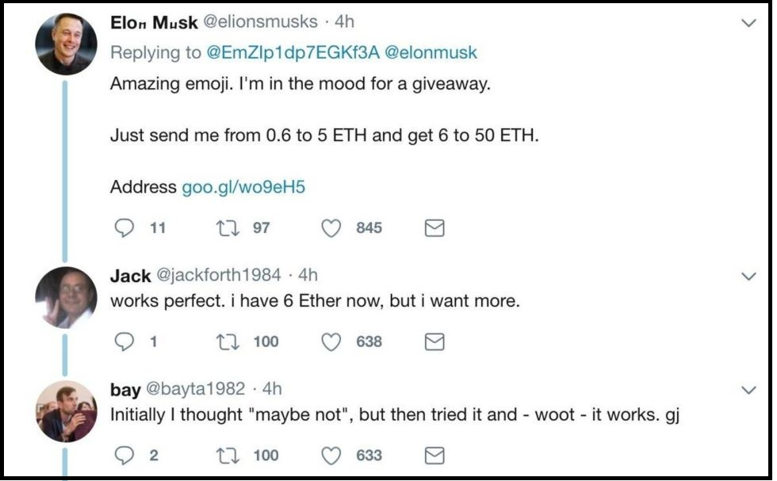
Screenshot #1 from www.truthcoin.info/blog/bitnames/
Altcoins we should copy (?): NameCoin
Notes:
…this is someone pretending to be Elon Musk, on Twitter…

Slide 38
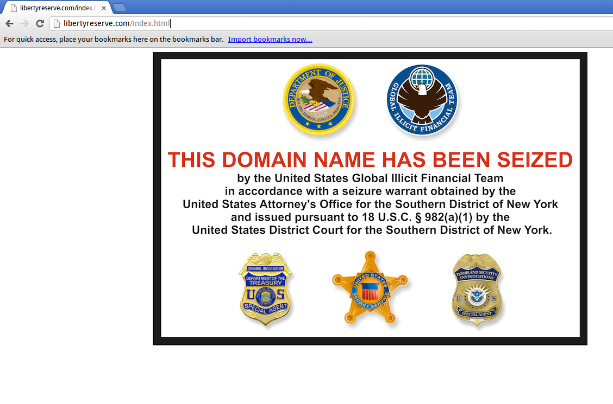
Screenshot #2 from www.truthcoin.info/blog/bitnames/
Altcoins we should copy (?): NameCoin
Notes:
…this is the Liberty Reserve website domain_name being seized…

Slide 39
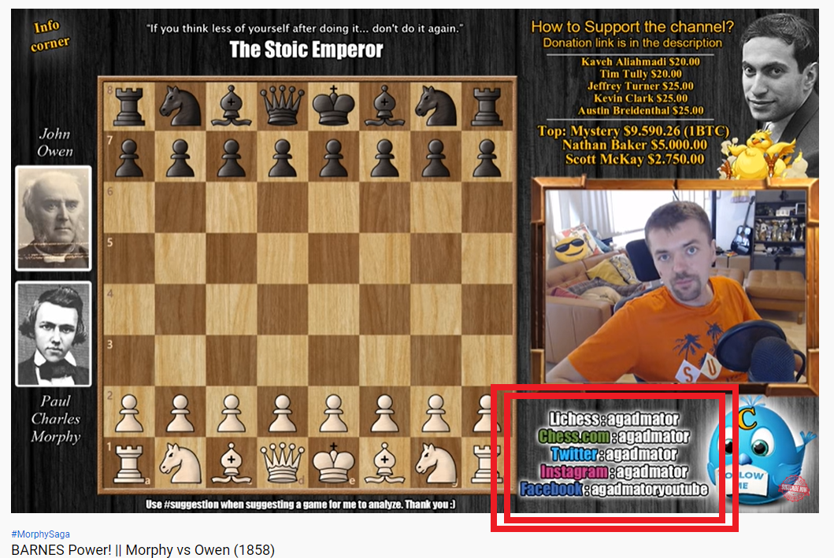
Screenshot #3 from www.truthcoin.info/blog/bitnames/
Altcoins we should copy (?): NameCoin
Notes:
…this is a guy on YouTube who, in the bottom-right, has to list out all of his screennames ... and they aren’t all identical, his Facebook name is different. With BitDNS everyone would just have one login, for every service. No one could seize your account, anywhere. And people would always be able to find you.

Slide 40
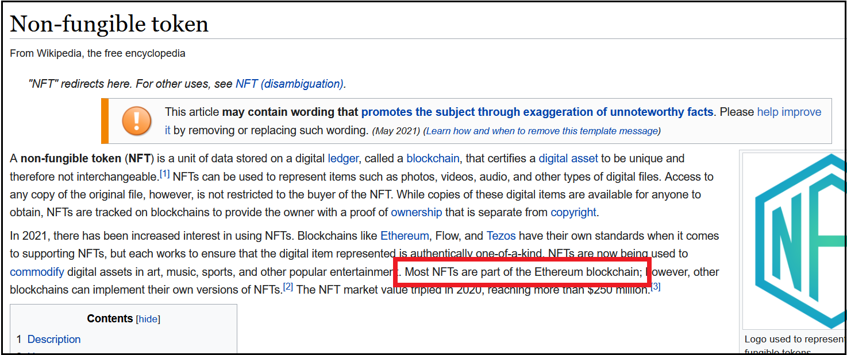
Altcoins we should copy (?): XCP / BitAssets / ERC20
Screenshots NFT craze, Cap table, Outstanding Bonds
So lame!!
Notes:
Ok lets talk about digital assets, now. Erc20/NFTs. They’re basically digital baseball cards. Except they are unforgeable and indestructible, and unseizable. Anyways, a lot of people have fun collecting things. Most NFTs are on Ethereum, which is really lame. Because we Bitcoiners started all that, with counterparty and colored coins, etc. If we had Bip300, we could have a whole, special ERC20 chain or something. That would domesticate all of this energy in Bitcoin. Instead of having it compete against Bitcoin.

Slide 41
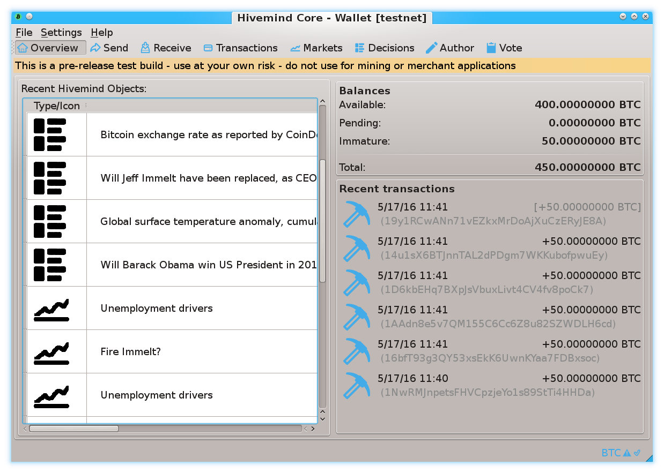
Prediction Markets
Screenshots from my own BTC sidechain project
www.BitcoinHivemind.com
Notes:
This is one of my other projects, BitcoinHivemind.com, check it out. I designed it to be a sidechain from the very beginning. Here are some screenshots…

Slide 42
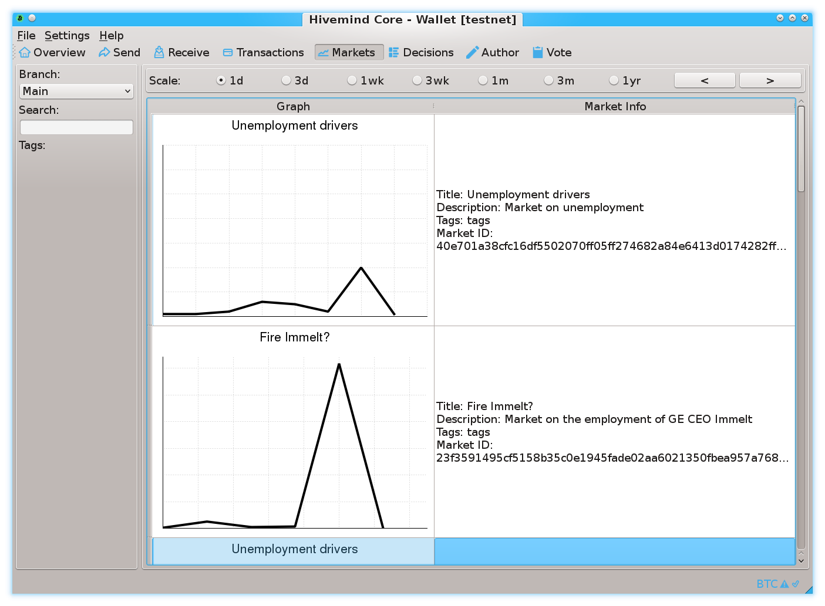
Prediction Markets
Screenshots from my own BTC sidechain project
www.BitcoinHivemind.com
Notes:
…

Slide 43
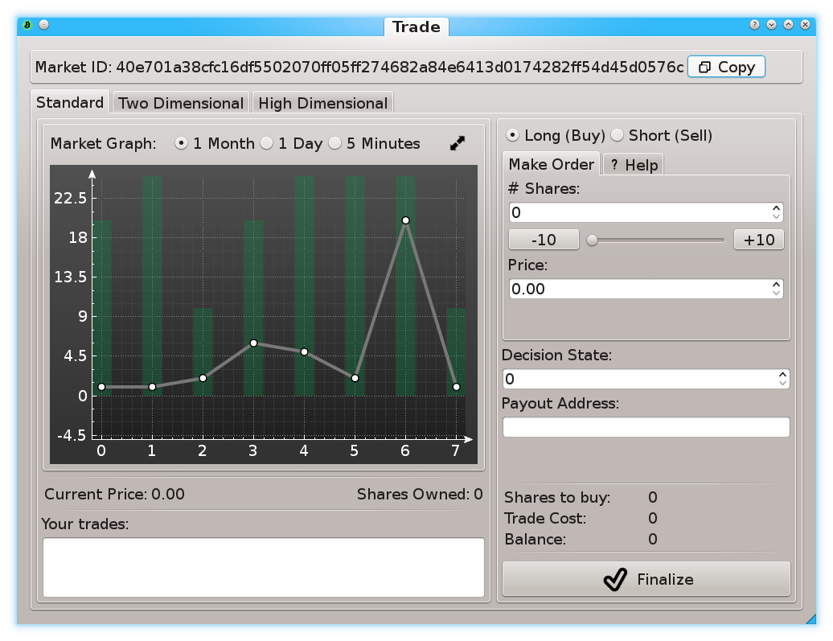
Prediction Markets
Screenshots from my own BTC sidechain project
www.BitcoinHivemind.com
Notes:
… This software can do a lot of things…

Slide 44
Prediction Markets
Screenshots from my own BTC sidechain project
www.BitcoinHivemind.com
Key Idea: “Futarchy” -- futures markets for how well certain leaders would perform, if they were in charge.
Notes:
…but the crowd favorite is ‘Futarchy’ – where there are futures markets for how well certain leaders would perform, if they were in charge. ... This idea is very distressing to bad leaders, [laugh] , because WE can learn about exactly how bad they are going to be, before we cast a vote for anyone. I think that this is one of the most important ideas in the whole world.

Slide 45

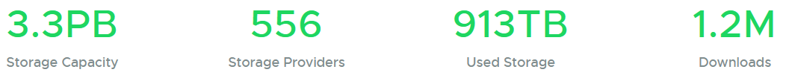
Altcoins we should copy (?): Sia
P2P Cloud Storage – Managed via Blockchain
Running for 5 years
No files ever lost?
$1-2 per TB/month (vs $23 on Amazon S3)
https://sia.tech
June 4
Notes:
This is Sia, which is David Vorick’s project (who some of you may know). (Decentralized P2P cloud storage, managed and enforced by the blockchain). So, you have a hard drive at home, a lot of that space you aren’t using. And you also have a bandwith connection at home, most of that bandwith you also aren’t using. With this you rent it out. Sia has been running for 5 years, it’s very decentralized – it would keep running if the dev team quit. He’s got the costs down an order of magnitude below Amazon. Using his Altcoin software – you can walk across a border, buy a new a blank computer, type in your 12 word seed phrase, and it will automatically download your entire filesystem (to that computer). It’s really kind of cool. Again, I gave this talk in June, 5 months ago. But I looked up the new numbers, yesterday…

Slide 46
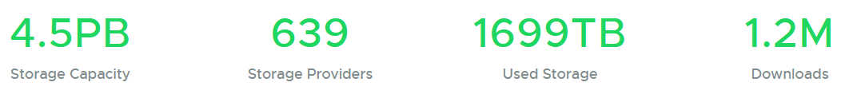
Altcoins we should copy (?): Sia
P2P Cloud Storage – Managed via Blockchain
Running for 5 years
No files ever lost?
$1-2 per TB/month (vs $23 on Amazon S3)
https://sia.tech
June 4
Nov 4 (Yesterday)
+36%
+15%
+86%
+0%
Notes:
…and here they are. They’re up a lot. Unfortunately, you don’t often hear about projects like this, because 99+% of Altcoins are scams, and it drowns out the useful projects. Which is sad. Yet another thing solved by Bip300, since no scammer would make a Bip300 sidechain.

Slide 47
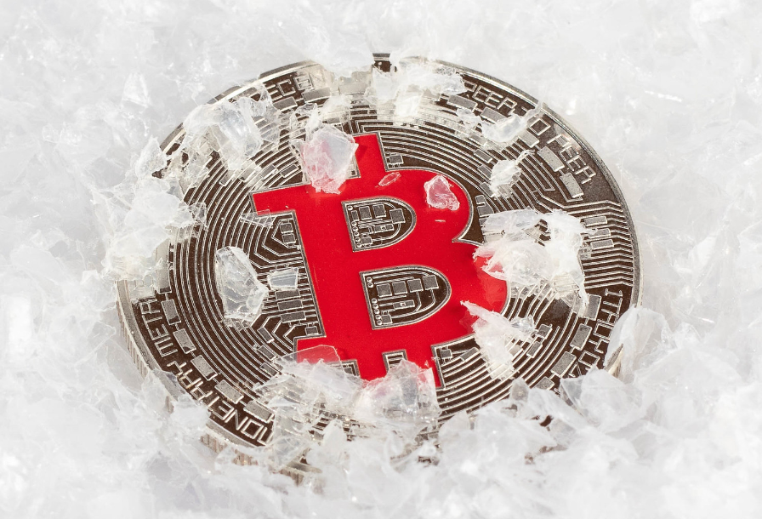
Finally: How Bip300 Improves Layer1
Never Change Layer 1 Again – “Protocol Ossification”
No “drama”.
No “mob rule”.
Shrink Layer1 Blocksize.
Improves Decentralization.
Protects your node.
“Frozen Bitcoin” - Marco Verch , Creative Commons License
Notes:
I will mention that, as an added bonus, if miners upgraded to activate Bips 300+301, then ---theoretically--- that might be the very last time anyone ever needs to upgrade their Bitcoin software again, ever. Which is more convenient, but also more secure as well. ( If you’re worrying about protecting Layer 1. ) Furthermore, in my opinion, Bip300 is the only practical way of eventually forking the Layer1 Blocksize down to 350k, which I know at least some of claim to want. Because this would improve decentralization (as recommended by some experts, including Luke Dashjr). …

Slide 48
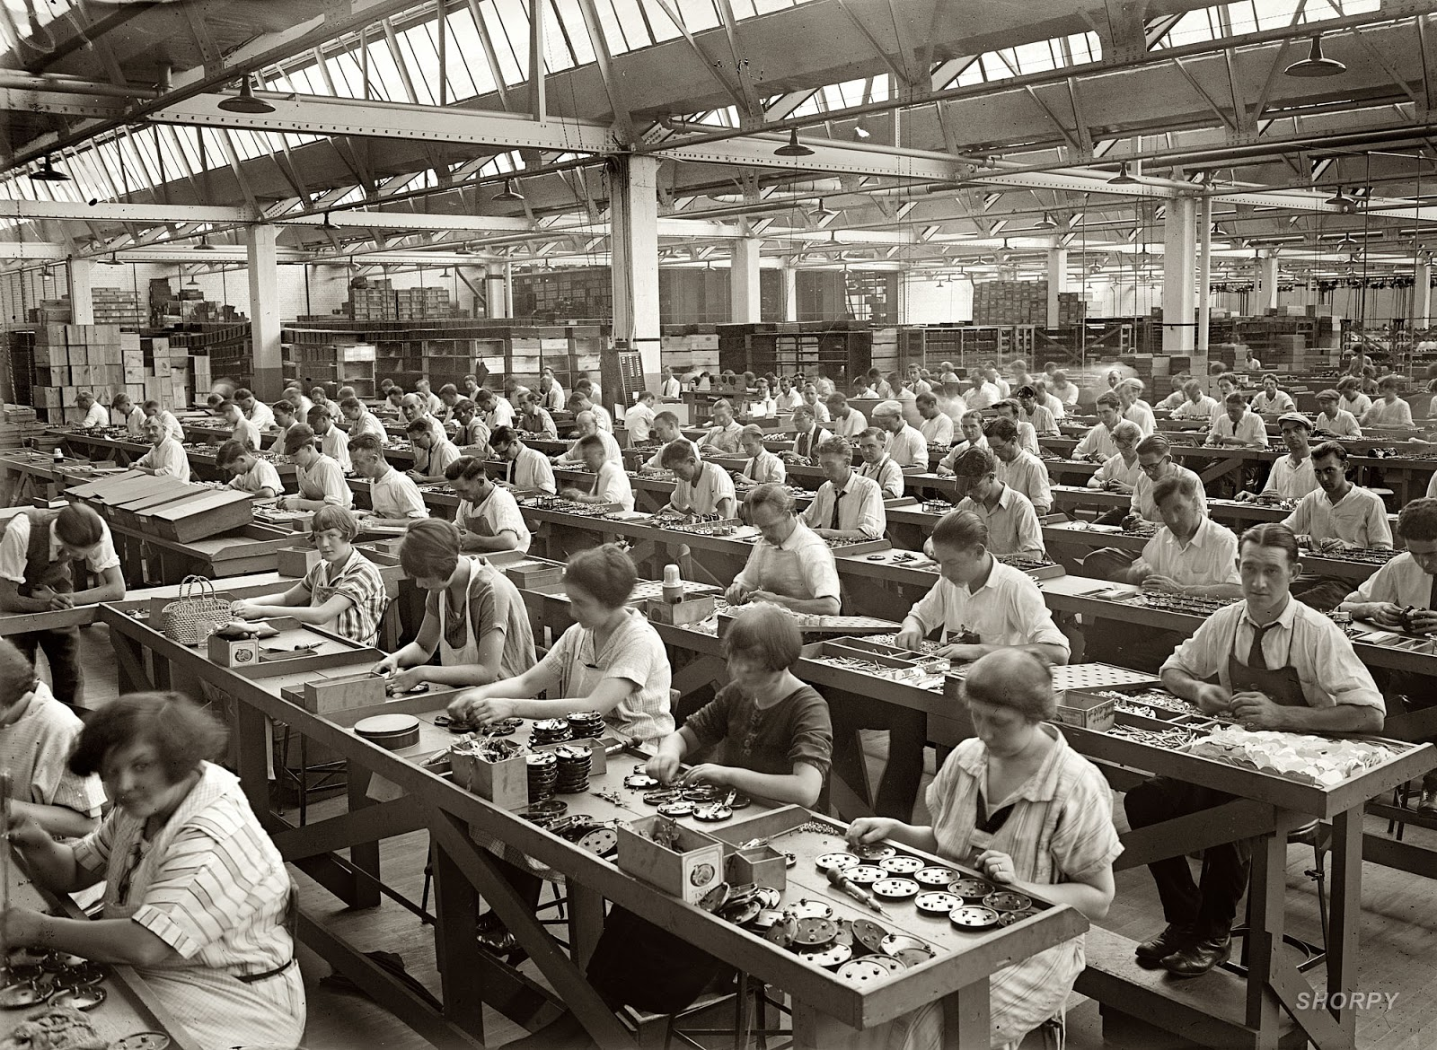

Miners
Optimizing: kWh /$ / ASIC Efficiency / Cooling / Labor / Demand Management Programs / Drying Fruit / Getting NatGas Credits / Outcompeting All Rivals
Full Node
Validating L1
+ counting to 13,150
+ add/remove/validate Sidechains

Slide 49
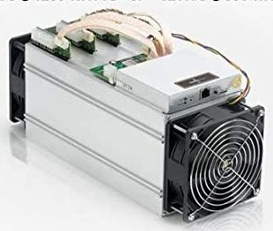
Two Supposed Drawbacks
(#1) Miners-Can-Steal from Bip300 Scripts (and this is bad)
Hashrate
fixed
cost
0%
100%
(#2) Merged-Mining is a Side-Hustle (and those are bad)
eb942ae710e951ed797e320b6c2fffc8d750423db8b1f2b0f1fc122b7affc889
eb94 ... Pays Out
e320b6c2fffc8d750423db8b1eb942ae710e951ed797f7affc8892b0f1fc122b
Notes:
… Ok now for those *drawbacks*. Here they are. The first supposed drawback of Bip300, is that miners can ---with a little bit of setup and technical knowledge and effort on their part, and certainly patience--- miners can remove all the coins from a Bip300 sidechain, and pay those coins, to themselves. Hence it is called the “miners- can-steal” problem. Here you see an evil miner, replacing that one hash I mentioned before with a different hash, and then it eventually pays out (to the miner). The second, supposed drawback of Bip300, *sigh* is: if some miners ever have a profitable side- hustle, then maybe some other miners might not be able to have that side hustle. And then they might go out of business; and wouldn’t be able to buy as many Xmas presents for their children.

Slide 50
(#1) Miners-Can-Steal from Bip300 Scripts (and this is bad) | (#2) Merged-Mining is a Side-Hustle (and those are always bad)
The free market allows entrepreneurs to go bankrupt – this is an essential part of creativity. True: not every SC will succeed. But those few that do, will pay fees to miners and boost BTC’s appeal (since BTC can now easily do everything). The failures will serve as a warning to lazy or incompetent developers. | The fixed cost in question… …is zero under BMM. …was already microscopic, vs other miner fixed costs. …must always be small enough for non-mining nodes to exist (since their revenue is the smallest of all, $0.)
Bip300 has multiple safeguards in place to make “stealing” difficult. Stealing requires 3-6 months of openly dishonest mining activity. Humans can audit theft, by checking just 32 bytes. | Mining is a complex task involving many “sub-tasks” (getting cheap power / sourcing good ASICs / etc). Each has its own incentives, innovation, and fixed costs. No stopping those.
Miners “can” steal from Lightning Network (by broadcasting old state + censoring Justice Txns), but this criterion is never held against LN. | Bizarre implications: if BitFury sold t-shirts on the side, for profit, then t-shirts = bad for BTC. If Saylor altruistically paid miners $0.10 per year, then MS = bad for Bitcoin.
The user is sovereign. Users are allowed to sell their BTC for USD; or use BTC to buy “bad” products (ie “drugs”). Or invest in Alts / scams. Bip300 allows users to spend BTC to a script. | MM is the opposite of bad – it is good and necessary. MM alone can boost BTC’s fee revenues by 10,000x or more. Without MM, long run hashrate may be too low.
This supposed “flaw” is actually a pro, as it gives miners motive and opportunity to destroy “parasite sidechains” (SC which antagonize other SCs). I am not aware of any other way of efficiently accomplishing this. And I believe it is prerequisite for high-quality smart contracts. | What is probably happening is that people are confusing node costs with mining costs. Node costs *must* be low, for decentralization. But mining costs have no such requirement. In fact, if we wanted mining costs to be low we could remove the upward difficulty adjustments.
The whole point of SCs is that Layer1 nodes ignore them. With federations, you trust a fixed committee of law-abiding people. With BIp300 you trust a decentralized P2P process. | MM is already unblockable. Satoshi invented MM in 2010, and envisioned many independent MM chains. We have been MM since 2011, with no end in sight.
Notes:
Both of these are so, false, that its hard to know where to begin.

Slide 51
(#1) Miners-Can-Steal from Bip300 Scripts (and this is bad) | (#2) Merged-Mining is a Side-Hustle (and those are always bad)
The free market allows entrepreneurs to go bankrupt – this is an essential part of creativity. True: not every SC will succeed. But those few that do, will pay fees to miners and boost BTC’s appeal (since BTC can now easily do everything). The failures will serve as a warning to lazy or incompetent developers. | The fixed cost in question… …is zero under BMM. …was already microscopic, vs other miner fixed costs. …must always be small enough for non-mining nodes to exist (since their revenue is the smallest of all, $0.)
Bip300 has multiple safeguards in place to make “stealing” difficult. Stealing requires 3-6 months of openly dishonest mining activity. Humans can audit theft, by checking just 32 bytes. | Mining is a complex task involving many “sub-tasks” (getting cheap power / sourcing good ASICs / etc). Each has its own incentives, innovation, and fixed costs. No stopping those.
Miners “can” steal from Lightning Network (by broadcasting old state + censoring Justice Txns), but this criterion is never held against LN. | Bizarre implications: if BitFury sold t-shirts on the side, for profit, then t-shirts = bad for BTC. If Saylor altruistically paid miners $0.10 per year, then MS = bad for Bitcoin.
The user is sovereign. Users are allowed to sell their BTC for USD; or use BTC to buy “bad” products (ie “drugs”). Or invest in Alts / scams. Bip300 allows users to spend BTC to a script. | MM is the opposite of bad – it is good and necessary. MM alone can boost BTC’s fee revenues by 10,000x or more. Without MM, long run hashrate may be too low.
This supposed “flaw” is actually a pro, as it gives miners motive and opportunity to destroy “parasite sidechains” (SC which antagonize other SCs). I am not aware of any other way of efficiently accomplishing this. And I believe it is prerequisite for high-quality smart contracts. | What is probably happening is that people are confusing node costs with mining costs. Node costs *must* be low, for decentralization. But mining costs have no such requirement. In fact, if we wanted mining costs to be low we could remove the upward difficulty adjustments.
The whole point of SCs is that Layer1 nodes ignore them. With federations, you trust a fixed committee of law-abiding people. With BIp300 you trust a decentralized P2P process. | MM is already unblockable. Satoshi invented MM in 2010, and envisioned many independent MM chains. We have been MM since 2011, with no end in sight.
c
Notes:
So, Bip300 is designed, to prevent miners from stealing from sidechains. But, it is nonetheless possible. Similarly, – miners “can” (can in quotes **) steal from the LN. In fact its much easier for miners to steal from the LN, since Bip300 has this 6 month timeout period. So, were you worried about miners stealing from the lightning network a moment ago? If so, just cross off this entire left half of the page. I have to stress: this comparison isn’t to knock the LN, I’m saying that the criterion is stupid. 51% hashrate can do a lot of horrible things, but that doesn’t stop us from allowing users to opt-in to certain tradeoffs. After all, its Bitcoin not Prison.

Slide 52
(#1) Miners-Can-Steal from Bip300 Scripts (and this is bad) | (#2) Merged-Mining is a Side-Hustle (and those are always bad)
The free market allows entrepreneurs to go bankrupt – this is an essential part of creativity. True: not every SC will succeed. But those few that do, will pay fees to miners and boost BTC’s appeal (since BTC can now easily do everything). The failures will serve as a warning to lazy or incompetent developers. | The fixed cost in question… …is zero under BMM. …was already microscopic, vs other miner fixed costs. …must always be small enough for non-mining nodes to exist (since their revenue is the smallest of all, $0.)
Bip300 has multiple safeguards in place to make “stealing” difficult. Stealing requires 3-6 months of openly dishonest mining activity. Humans can audit theft, by checking just 32 bytes. | Mining is a complex task involving many “sub-tasks” (getting cheap power / sourcing good ASICs / etc). Each has its own incentives, innovation, and fixed costs. No stopping those.
Miners “can” steal from Lightning Network (by broadcasting old state + censoring Justice Txns), but this criterion is never held against LN. | Bizarre implications: if BitFury sold t-shirts on the side, for profit, then t-shirts = bad for BTC. If Saylor altruistically paid miners $0.10 per year, then MS = bad for Bitcoin.
The user is sovereign. Users are allowed to sell their BTC for USD; or use BTC to buy “bad” products (ie “drugs”). Or invest in Alts / scams. Bip300 allows users to spend BTC to a script. | MM is the opposite of bad – it is good and necessary. MM alone can boost BTC’s fee revenues by 10,000x or more. Without MM, long run hashrate may be too low.
This supposed “flaw” is actually a pro, as it gives miners motive and opportunity to destroy “parasite sidechains” (SC which antagonize other SCs). I am not aware of any other way of efficiently accomplishing this. And I believe it is prerequisite for high-quality smart contracts. | What is probably happening is that people are confusing node costs with mining costs. Node costs *must* be low, for decentralization. But mining costs have no such requirement. In fact, if we wanted mining costs to be low we could remove the upward difficulty adjustments.
The whole point of SCs is that Layer1 nodes ignore them. With federations, you trust a fixed committee of law-abiding people. With BIp300 you trust a decentralized P2P process. | MM is already unblockable. Satoshi invented MM in 2010, and envisioned many independent MM chains. We have been MM since 2011, with no end in sight.
Notes:
The second one is even sillier. I think what I would like to highlight is that the implications are ridiculous. So, if BitFury sold t-shirts on the side, for profit, then t-shirts = bad for BTC. They would be as bad for Bitcoin as Bip300 is, anyway. If Michal Saylor altruistically paid miners $0.10 per year, then MS = bad for 9 Bitcoin. Blah blah blah... I think what’s really happening here, is that people are confusing nodes with miners. Miners run nodes, but not the other way around. We want nodes to be as cheap as possible. That is absolutely important; but we don’t want mining to be as cheap as possible. If we wanted that, we could just get rid of all of the upward difficulty adjustments. So I have total contempt for these two supposed drawbacks. In fact both of them are not drawbacks at all…

Slide 53
(#1) Miners-Can-Steal from Bip300 Scripts (and this is bad) | (#2) Merged-Mining is a Side-Hustle (and those are always bad)
The free market allows entrepreneurs to go bankrupt – this is an essential part of creativity. True: not every SC will succeed. But those few that do, will pay fees to miners and boost BTC’s appeal (since BTC can now easily do everything). The failures will serve as a warning to lazy or incompetent developers. | The fixed cost in question… …is zero under BMM. …was already microscopic, vs other miner fixed costs. …must always be small enough for non-mining nodes to exist (since their revenue is the smallest of all, $0.)
Bip300 has multiple safeguards in place to make “stealing” difficult. Stealing requires 3-6 months of openly dishonest mining activity. Humans can audit theft, by checking just 32 bytes. | Mining is a complex task involving many “sub-tasks” (getting cheap power / sourcing good ASICs / etc). Each has its own incentives, innovation, and fixed costs. No stopping those.
Miners “can” steal from Lightning Network (by broadcasting old state + censoring Justice Txns), but this criterion is never held against LN. | Bizarre implications: if BitFury sold t-shirts on the side, for profit, then t-shirts = bad for BTC. If Saylor altruistically paid miners $0.10 per year, then MS = bad for Bitcoin.
The user is sovereign. Users are allowed to sell their BTC for USD; or use BTC to buy “bad” products (ie “drugs”). Or invest in Alts / scams. Bip300 allows users to spend BTC to a script. | MM is the opposite of bad – it is good and necessary. MM alone can boost BTC’s fee revenues by 10,000x or more. Without MM, long run hashrate may be too low.
This supposed “flaw” is actually a pro, as it gives miners motive and opportunity to destroy “parasite sidechains” (SC which antagonize other SCs). I am not aware of any other way of efficiently accomplishing this. And I believe it is prerequisite for high-quality smart contracts. | What is probably happening is that people are confusing node costs with mining costs. Node costs *must* be low, for decentralization. But mining costs have no such requirement. In fact, if we wanted mining costs to be low we could remove the upward difficulty adjustments.
The whole point of SCs is that Layer1 nodes ignore them. With federations, you trust a fixed committee of law-abiding people. With BIp300 you trust a decentralized P2P process. | MM is already unblockable. Satoshi invented MM in 2010, and envisioned many independent MM chains. We have been MM since 2011, with no end in sight.
Notes:
… the left one allows for super-reliable oracle and high-quality smart contracts, and the right one is the only thing that is going to keep hashrate security up, in the future. So, they’re not drawbacks at all, in fact they’re both pretty cool; features.

Slide 54
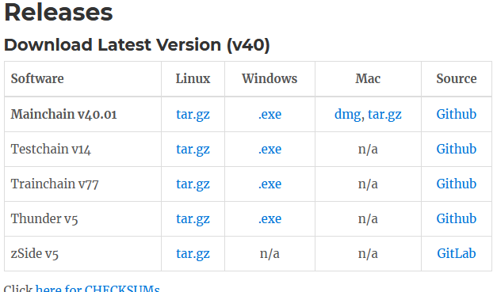
Future of Bip300 – Depends on You!
Learn !
Download the software
Read drivechain.info
Talk
Soft forks need consensus
Invite on podcasts/whatever
View Altcoins Differently
drivechain.info/releases/
Drivechain = Bip 300+301
Talk
Learn
Notes:
Ok, what should you do? Here is what I suggest: The most important thing is, to learn. The best way to learn, is to actually download the software and use it. Don’t listen to what people say on Twitter. Run the testnet software yourself ... otherwise you know ... nothing. Second: the Bitcoin community prides itself on consensus – we don’t make a change, until lots of people agree that they want it. So: help spread the word. So, talk to your friends or whatever. Finally, maybe (?) this might help – Change the way you view Altcoins. They aren’t rivals, that are inherently evil; they’re a place where technology is previewed, before it is copied into BTC.

Slide 55
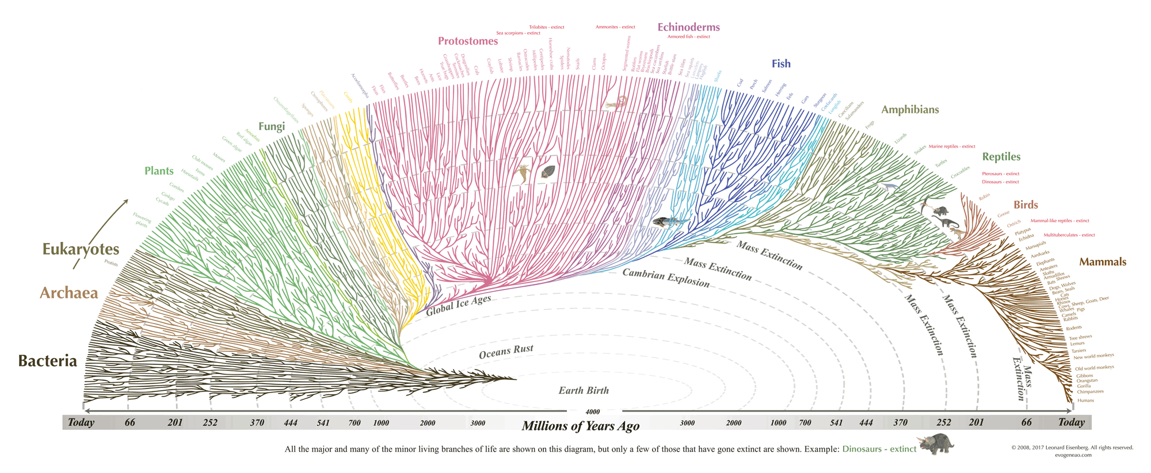
Thank You for Your Attention! (Find me and talk to me!)
Notes:
Ok that’s the talk, thank you! : )

